Slide 1
FARMezy
101803186
101803187
101803189
101853038
Kulpreet Singh
Sajjal Tiwari
Arshnoor Batra
Vishrut Agrawal

Slide 2
PROJECT OVERVIEW
FARMezy is a Smart Farming based system that will provide the farmers with all the necessary tools required for good production. From monitoring the pollution levels, preventing Crop Vandalism to sensing the amount of irrigation required, it will provide all the details at one location.
The project will also include the concept of Blockchain Technology to ensure that the farmers are paid fairly. The amount of supply of the produce from the farmers along with the details including the price at which it was sold as well as the MSP at that particular time will be stored in a hashnode in a blockchain. This will ensure the financial stability of the farmers.

Slide 3
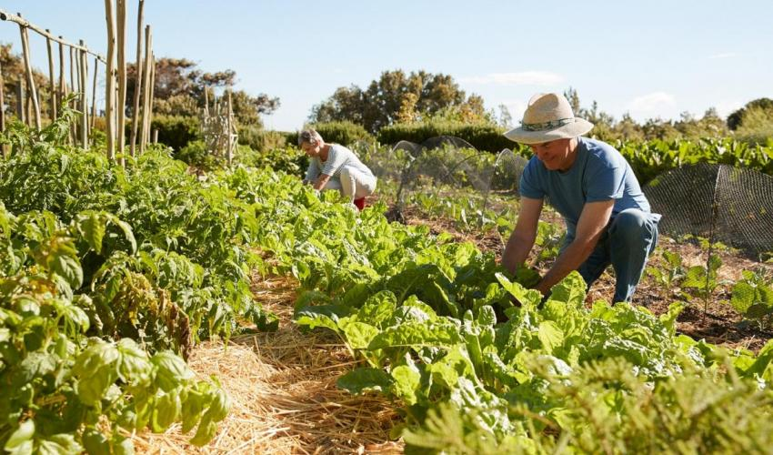
NEED Analysis
Smart Farming has completely revolutionized the agricultural industry and led us all into the phenomenon being recognized as the Third Green Revolution.
It has made agriculture more profitable for the farmer. Decreased resource inputs will save the farmer money and labor, and increased reliability of spatially explicit data will reduce risks related to yield.
In India most of the farmers are still using traditional methods for farming, they mostly are small scale farmers who lack the capital to invest in these technologies. A cost effective solution is required which can cater for their small needs without requiring much capital investment

Slide 4
Literature Survey
One Water – Smart Irrigation
Intellia IoT solution
It is a smart water delivery system ensuring minimal wastage of water.
It uses soil, moisture and temperature sensor to automatically execute drip irrigation.
They are using NPK, light, temperature sensor to monitor crops and send data to their crops.
Provide climate monitoring and forecasting along with soil monitoring
SMARTFARM
AGRIAPP
Gives real-time satellite and weather based advise to farmers to make farm operations exceedingly efficient.
Recommends a customized package of practices for each crop to increase their produce by giving valuable information about that particular crop.
Provides an online marketplace for farmers, to sell their crops.
It provides diversified videos of agricultural work and also an option to chat with other and with experts in the field of agriculture

Slide 5
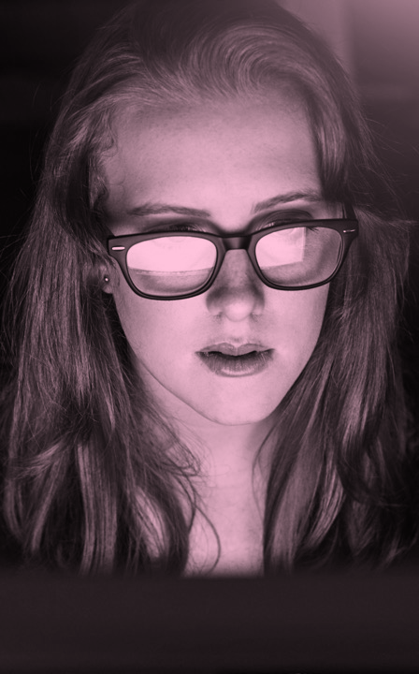
Problem statement and objectives
To assemble various sensors and camera and link them with Raspberry Pi and to send the data from Raspberry Pi to centralized database.
To fetch the data from the database, run ML prediction models on the data, display the relevant information and trends to the user via a mobile app as a user interface.
To run object detection models to detect crop vandalism by stray animals and send alert to the farmer.
To build a blockchain based solution to store the transaction information between farmers and the buying agency.

Slide 6
ASSumptions and constraints
Assumptions
There will be Wi-Fi (or maybe some other network) connectivity available in the fields.
There will be continuous power supply available in the fields for our product to operate.
Camera would be placed in a secured position such that no animal can harm it.
The farmer who wants to use our product is already an android or IOS smartphone user (to use our mobile app).
Constraints
The NPK nutrient sensor is quite expensive (above Rs 10,000) making it infeasible to be included in the product for now as budget is a constraint.
We do not have the skill set to develop a mobile app for other mobile OS (other than android or IOS) like Kai OS (used in jio phones).

Slide 7
PROJECT Execution PLAN
Our initial intention was to use NPK sensor to determine the precise amounts of nutrients to be added to soil, but its costly (above Rs 10,000) hence inefficient. So, we have a workaround of using a dataset for the analysis work. An extensive study of various datasets is done through use of relevant sources like Kaggle, etc. Soil moisture sensor is used to determine the precise amount of water irrigation required by the crops in a given season and at any particular time. Temperature and Humidity Sensor is used to determine the humidity and temperature in the surrounding environment. Air Quality sensor is used to determine the amounts of pollutants like PM2.5 in the surrounding environment. Camera is used to detect crop vandalism by stray animals. | All the data from various sensors and the camera is sent to the Raspberry Pi microcontroller, which sends all this data to the centralized database through a Wi-Fi module. Machine Learning Models are used to predict the yield/produce trends from the data received from the sensors. Computer Vision and Deep Learning Algorithms are used to detect the crop vandalism by stray animals from the data received by the camera. The final output is shown to the User through a Mobile App Interface (Android and IOS) which fetch all the important presentable data from the centralized database and display to the User. The transaction information including the amount of supply of the produce from the farmers along with the details including the price at which it was sold as well as the MSP at that particular time is all stored in a hash-node in a blockchain which is immutable and accessible at all times through the mobile app.

Slide 8
PROJECT REQUIREMENTS
Flutter, vs code
Kaggle (Dataset for soil Nutrients)
Soil moisture and PH sensor
Air Quality(pm2.5), temperature and humidity sensor
Camera
Raspberry pi (with wi-fi)
Tensorflow, pytorch, scikit-learn

Slide 9
Project outcome
The main outcome of the project is a complete farming aid digital solution which can be accessible to the common farmer with a smartphone and network connection in distant villages.
The product will comprise of a hardware unit of microcontroller and sensors and camera, along with a mobile application (supported on Android and IOS) that can be installed on smartphone and will act as an interactive user interface for the farmer.
On the backend, the product is supported by ML models for trend prediction, and Computer Vision with Neural Networks for object detection, lastly the blockchain technology with immutable hashnodes storing MSP of crops, for ensuring economic safety of farmer in selling to buyers.

Slide 10
workplan
STAGE 01
Designing Model, Sensor Testing and Hardware Interfacing
Making ML model and Mobile App. Integrating the ML model with app
STAGE 03
STAGE 02
STAGE 04
STAGE 05
Learning Blockchain and implementing it. Adding ecommerce facility to the app.
Final Testing and Debugging and performing modifications is necessary
Implementing Object Detection using Neural Networks.
Integrating it with the app

Slide 11
Role of team members
NAME | ROLE PLAYED
Kulpreet Singh | Implementation of project Assembly of hardware unit Predicting trends using ML Implementing Blockchain for supply chain management Project Report
Sajjal Tiwari | Implementation of project Design and Development of mobile application Object Detection using Neural Networks Project Report
Arshnoor Batra | Implementation of project Assembly of hardware unit Predicting trends using ML Implementing Blockchain for supply chain management Project Report
Vishrut Agrawal | Implementation of project Design and Development of mobile application Object Detection using Neural Networks Project Report

Slide 12
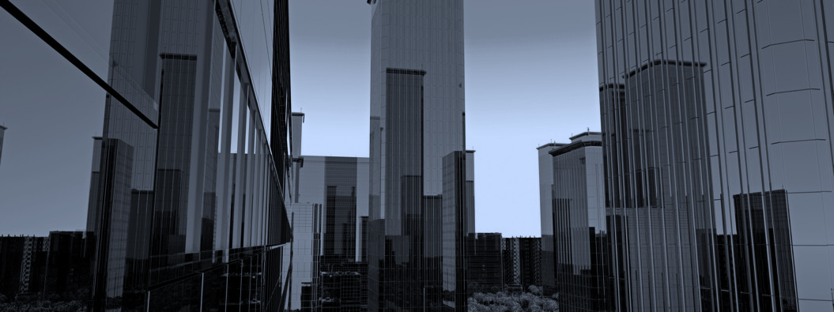
QUESTIONS

