Slide 1
ALU, Sign Extend & Adder
Tyler Hall
Trevor Yager
The ‘Pooters

Slide 2
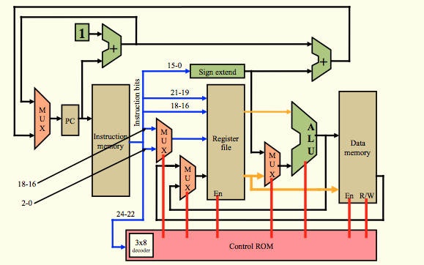
Overview

Slide 3
ALU
Function
Test Equality
Add
Nand

Slide 4
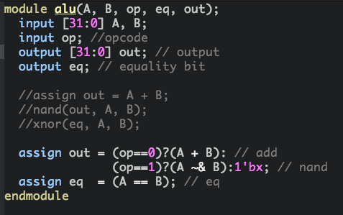

Slide 5
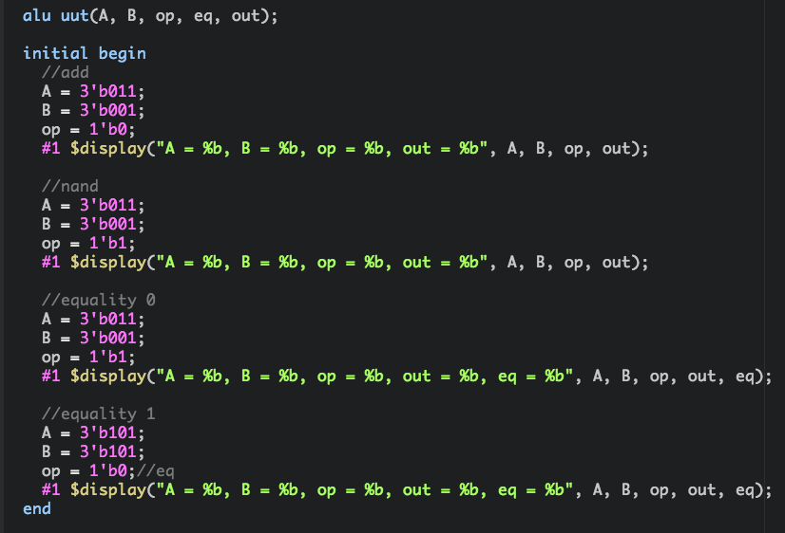

Slide 6
Sign Extend
Function
Extend 16 bit inputs to 32 bits
Extends MSB

Slide 7
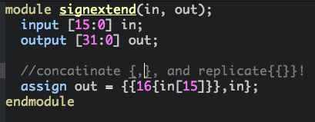
Sign Extend

Slide 8
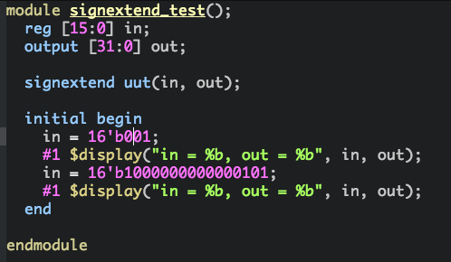

Slide 9
Full Bit Adder
Function
Add 32 bit inputs
Ripple Carry

Slide 10
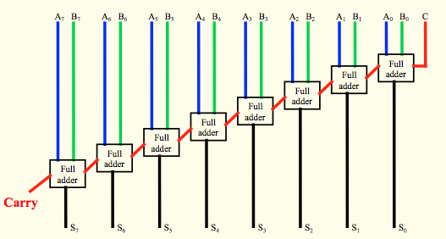
Ripple Carry

Slide 11
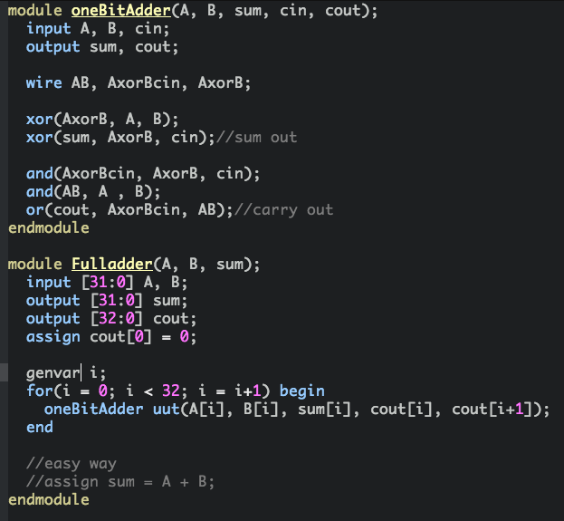

Slide 12
