Slide 1
ALU, Sign Extend & Adder
Tyler Hall
Trevor Yager

Slide 2
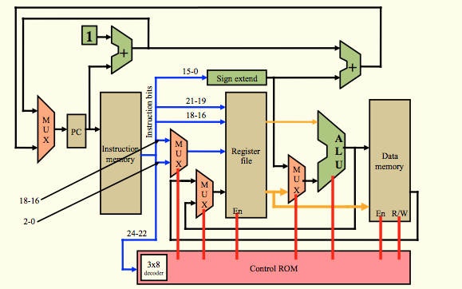
Overview

Slide 3
ALU
Function
Test Equality
Add
Nand

Slide 4
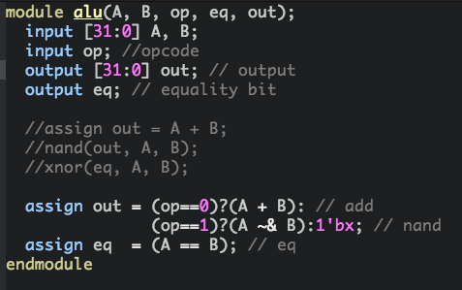

Slide 5
Sign Extend
Function
Extend 16 bit inputs to 32 bits
Extends MSB

Slide 6
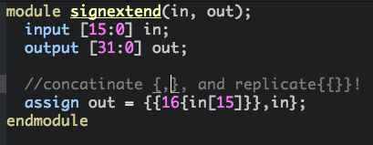
Sign Extend

Slide 7
Full Bit Adder
Function
Add 32 bit inputs
Ripple Carry

Slide 8
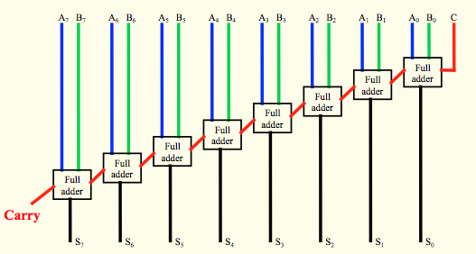
Ripple Carry

Slide 9
