Slide 1
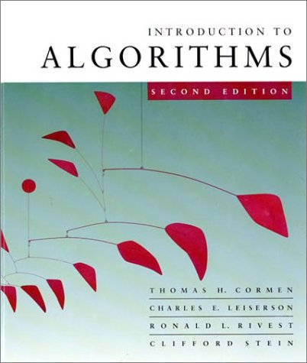
Introduction to Algorithms
6.046J/18.401J/SMA5503
Lecture 4
Based on slides by Prof. Charles E. Leiserson

Slide 2
Symbol-table problem
Symbol table T holding n records:
record
x
Operations on T:
INSERT(T, x)
DELETE(T, x)
SEARCH(T, k)
key[x]
Other fields containing satellite data
How should the data structure T be organized?
Introduction to Algorithms
October 1, 2001 L7.<number>
Notes:
Introduction to Algorithms, Lecture 5
September 24, 2001
© 2001 by Charles E. Leiserson

Slide 3
Direct-access table
IDEA: Suppose that the set of keys is K ⊆ {0, 1, …, m–1}, and keys are distinct. Set up an array T[0 . . m–1]:
x if x ∈ K and key[x] = k,
NIL otherwise.
T[k] =
Then, operations take Θ(1) time.
Problem: The range of keys can be large:
64-bit numbers (which represent 18,446,744,073,709,551,616 different keys),
character strings (even larger!).
Introduction to Algorithms
October 1, 2001 L7.<number>

Slide 4
Hash functions
Solution: Use a hash function h to map the universe U of all keys into
{0, 1, …, m–1}:
T
0
k₁
h(k₁)
h(k₄)
K
k₅
k₄
h(k₂)
= h(k₅)
k₂
k₃
h(k₃)
U
m–1
When a record to be inserted maps to an already occupied slot in T, a collision occurs.
As each key is inserted, h maps it to a slot of T.
Introduction to Algorithms
October 1, 2001 L7.<number>

Slide 5
Resolving collisions by chaining
Records in the same slot are linked into a list.
T
i
49
86
52
h(49) = h(86) = h(52) = i
Introduction to Algorithms
October 1, 2001 L7.<number>

Slide 6
Analysis of chaining
We make the assumption of simple uniform hashing:
Each key k ∈ K of keys is equally likely to be hashed to any slot of table T, independent of where other keys are hashed.
Let n be the number of keys in the table, and let m be the number of slots.
Define the load factor of T to be
  α = n/m
= average number of keys per slot.
Introduction to Algorithms
October 1, 2001 L7.<number>

Slide 7
Search cost
Expected time to search for a record with a given key = Θ(1 + α).
apply hash function and access slot
search the list
Expected search time = Θ(1) if α = O(1), or equivalently, if n = O(m).
Introduction to Algorithms
October 1, 2001 L7.<number>

Slide 8
Choosing a hash function
The assumption of simple uniform hashing is hard to guarantee, but several common techniques tend to work well in practice as long as their deficiencies can be avoided.
Desirata:
A good hash function should distribute the keys uniformly into the slots of the table.
Regularity in the key distribution should not affect this uniformity.
Introduction to Algorithms
October 1, 2001 L7.<number>

Slide 9
Division method
Assume all keys are integers, and define
  h(k) = k mod m.
Deficiency: Don’t pick an m that has a small divisor d. A preponderance of keys that are congruent modulo d can adversely affect uniformity.
Extreme deficiency: If m = 2^{r}, then the hash doesn’t even depend on all the bits of k:
If k = 1011000111011010₂ and r = 6, then h(k) = 011010₂ .
h(k)
Introduction to Algorithms
October 1, 2001 L7.<number>

Slide 10
Division method (continued)
h(k) = k mod m.
Pick m to be a prime not too close to a power of 2 or 10 and not otherwise used prominently in the computing environment.
Annoyance:
Sometimes, making the table size a prime is inconvenient.
But, this method is popular, although the next method we’ll see is usually superior.
Introduction to Algorithms
October 1, 2001 L7.<number>

Slide 11
Multiplication method
Assume that all keys are integers, m = 2^{p}, and our computer has w-bit words. Define
  h(k) = (A·k mod 2^{w}) rsh (w – p),
where rsh is the “bit-wise right-shift” operator and A is an odd integer in the range 2^{w–1} < A < 2^{w}.
Don’t pick A too close to 2^{w}.
Multiplication modulo 2^{w} is fast.
The rsh operator is fast.
Introduction to Algorithms
October 1, 2001 L7.<number>

Slide 12
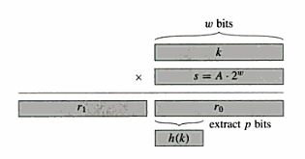
Multiplication method
Assume that all keys are integers, m = 2^{p}, and our computer has w-bit words. Define
  h(k) = (A·k mod 2^{w}) rsh (w – p),
where rsh is the “bit-wise right-shift” operator and A is an odd integer in the range 2^{w–1} < A < 2^{w}.
Don’t pick A too close to 2^{w}.
Multiplication modulo 2^{w} is fast.
The rsh operator is fast.
Introduction to Algorithms
October 1, 2001 L7.<number>

Slide 13
Multiplication method example
h(k) = (A·k mod 2^{w}) rsh (w – p)
Suppose that m = 8 = 2³ and that our computer has w = 7-bit words:
1 0 1 1 0 0 1
  1 1 0 1 0 1 1
1 0 0 1 0 1 0 0 1 1 0 0 1 1
= A
= k
h(k)
Introduction to Algorithms
October 1, 2001 L7.<number>

Slide 14
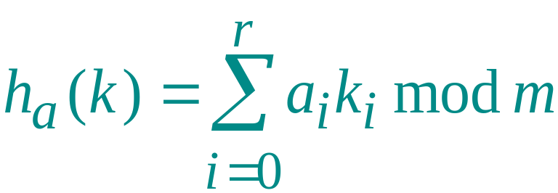
Dot-product method
Randomized strategy:
Let m be prime. Decompose key k into r + 1 digits, each with value in the set {0, 1, …, m–1}. That is, let k = ⟨k₀, k₁, …, k_{r}⟩, where 0 ≤ k_{i} < m.
Pick a = ⟨a₀, a₁, …, a_{r}⟩ where each a_{i} is chosen randomly from {0, 1, …, m–1}.
Define
.
Excellent in practice, but expensive to compute.
Introduction to Algorithms
October 1, 2001 L7.<number>

Slide 15
Resolving collisions by open addressing
No storage is used outside of the hash table itself.
Insertion systematically probes the table until an empty slot is found.
The hash function depends on both the key and probe number:
  h : U × {0, 1, …, m–1} → {0, 1, …, m–1}.
The probe sequence ⟨h(k,0), h(k,1), …, h(k,m–1)⟩ should be a permutation of {0, 1, …, m–1}.
The table may fill up, and deletion is difficult (but not impossible).
Introduction to Algorithms
October 1, 2001 L7.<number>

Slide 16
Example of open addressing
Insert key k = 496:
T
0
0. Probe h(496,0)
586
133
204
collision
204
481
m–1
Introduction to Algorithms
October 1, 2001 L7.<number>

Slide 17
Example of open addressing
Insert key k = 496:
T
0
0. Probe h(496,0)
1. Probe h(496,1)
collision
586
586
133
204
481
m–1
Introduction to Algorithms
October 1, 2001 L7.<number>

Slide 18
Example of open addressing
Insert key k = 496:
T
0
0. Probe h(496,0)
1. Probe h(496,1)
586
2. Probe h(496,2)
133
204
insertion
496
481
m–1
Introduction to Algorithms
October 1, 2001 L7.<number>

Slide 19
Example of open addressing
Search for key k = 496:
T
0
0. Probe h(496,0)
1. Probe h(496,1)
586
2. Probe h(496,2)
133
204
496
Search uses the same probe
sequence, terminating suc-
cessfully if it finds the key
and unsuccessfully if it encounters an empty slot.
481
m–1
Introduction to Algorithms
October 1, 2001 L7.<number>

Slide 20
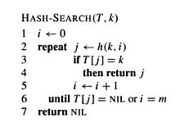
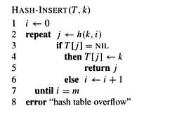
Resolving collisions by open addressing
Introduction to Algorithms
October 1, 2001 L7.<number>

Slide 21
Probing strategies
Linear probing:
Given an ordinary hash function h′(k), linear probing uses the hash function
  h(k,i) = (h′(k) + i) mod m.
This method, though simple, suffers from primary clustering, where long runs of occupied slots build up, increasing the average search time. Moreover, the long runs of occupied slots tend to get longer.
Introduction to Algorithms
October 1, 2001 L7.<number>

Slide 22
Probing strategies
Quadratic probing:
Given an ordinary hash function h′(k), quadratic probing uses the hash function
  h(k,i) = (h′(k) + c₁i+c₂i²) mod m.
This method, though simple, suffers from secondary clustering. Again, the initial probe determines the entire sequence.
Introduction to Algorithms
October 1, 2001 L7.<number>

Slide 23
Probing strategies
Double hashing
Given two ordinary hash functions h₁(k) and h₂(k), double hashing uses the hash function
  h(k,i) = (h₁(k) + i⋅h₂(k)) mod m.
This method generally produces excellent results, but h₂(k) must be relatively prime to m. One way is to make m a power of 2 and design h₂(k) to produce only odd numbers.
Introduction to Algorithms
October 1, 2001 L7.<number>

Slide 24
Analysis of open addressing
We make the assumption of uniform hashing:
Each key is equally likely to have any one of the m! permutations as its probe sequence.
Theorem. Given an open-addressed hash table with load factor α = n/m < 1, the expected number of probes in an unsuccessful search is at most 1/(1–α).
Introduction to Algorithms
October 1, 2001 L7.<number>

Slide 25
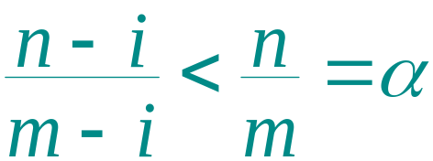
Proof of the theorem
Proof.
At least one probe is always necessary.
With probability n/m, the first probe hits an occupied slot, and a second probe is necessary.
With probability (n–1)/(m–1), the second probe hits an occupied slot, and a third probe is necessary.
With probability (n–2)/(m–2), the third probe hits an occupied slot, etc.
Observe that
for i = 1, 2, …, n.
Introduction to Algorithms
October 1, 2001 L7.<number>

Slide 26
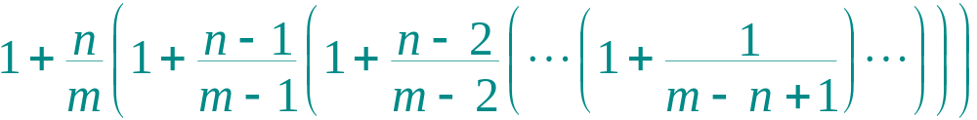
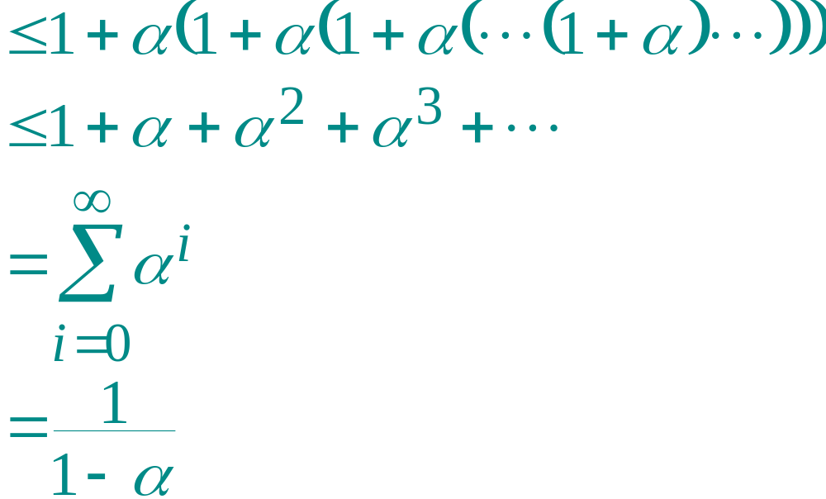
Proof (continued)
Therefore, the expected number of probes is
The textbook has a more rigorous proof.
.
Introduction to Algorithms
October 1, 2001 L7.<number>

Slide 27
Implications of the theorem
If α is constant, then accessing an open-addressed hash table takes constant time.
If the table is half full, then the expected number of probes is 1/(1–0.5) = 2.
If the table is 90% full, then the expected number of probes is 1/(1–0.9) = 10.
Introduction to Algorithms
October 1, 2001 L7.<number>

