Slide 1
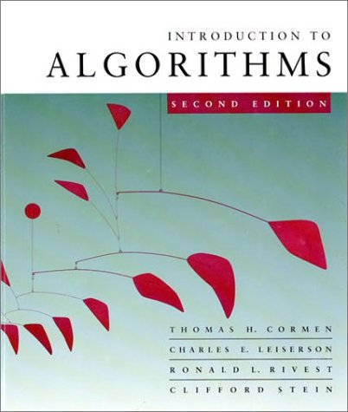
Introduction to Algorithms
6.046J/18.401J/SMA5503
Lecture 5
Based on slides by Prof. Charles E. Leiserson
Notes:
Introduction to Algorithms, Lecture 5
September 24, 2001
© 2001 by Charles E. Leiserson

Slide 2
A weakness of hashing
Problem: For any hash function h, a set of keys exists that can cause the average access time of a hash table to skyrocket.
An adversary can pick all keys from {k ∈ U : h(k) = i} for some slot i.
IDEA: Choose the hash function at random, independently of the keys.
Even if an adversary can see your code, he or she cannot find a bad set of keys, since he or she doesn’t know exactly which hash function will be chosen.
Introduction to Algorithms
October 3, 2001 L8.<number>
Notes:
Introduction to Algorithms, Lecture 5
September 24, 2001
© 2001 by Charles E. Leiserson
Introduction to Algorithms, Lecture 5
September 24, 2001
© 2001 by Charles E. Leiserson

Slide 3
Universal hashing
Definition. Let U be a universe of keys, and let H be a finite collection of hash functions, each mapping U to {0, 1, …, m–1}. We say H is universal if for all x, y ∈ U, where x ≠ y, we have |{h ∈ H : h(x) = h(y)}| ≤ |H| / m.
That is, the chance of a collision between x and y is 1/m if we choose h randomly from H.
{h : h(x) = h(y)}
H
|H|
m
Introduction to Algorithms
October 3, 2001 L8.<number>
Notes:
Introduction to Algorithms, Lecture 5
September 24, 2001
© 2001 by Charles E. Leiserson

Slide 4
Universality is good
Theorem. Let h be a hash function chosen (uniformly) at random from a universal set H of hash functions. Suppose h is used to hash n arbitrary keys into the m slots of a table T. Then, for a given key x, we have
E[#collisions with x] < n/m.
Introduction to Algorithms
October 3, 2001 L8.<number>
Notes:
Introduction to Algorithms, Lecture 5
September 24, 2001
© 2001 by Charles E. Leiserson

Slide 5
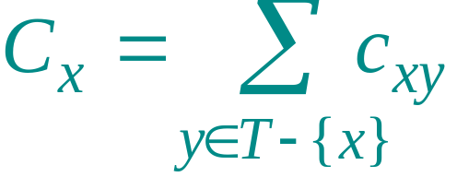
Proof of theorem
Proof. Let C_{x} be the random variable denoting the total number of collisions of keys in T with x, and let
1 if h(x) = h(y),
0 otherwise.
c_{xy} =
Note: E[c_{xy}] ≤ 1/m and
.
Introduction to Algorithms
October 3, 2001 L8.<number>
Notes:
Introduction to Algorithms, Lecture 5
September 24, 2001
© 2001 by Charles E. Leiserson

Slide 6
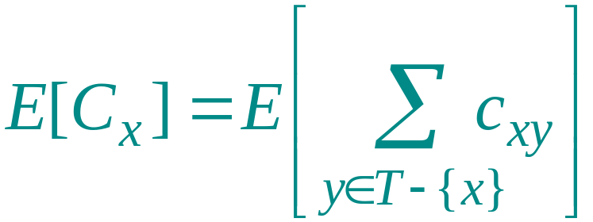
Proof (continued)
Take expectation of both sides.
Introduction to Algorithms
October 3, 2001 L8.<number>
Notes:
Introduction to Algorithms, Lecture 5
September 24, 2001
© 2001 by Charles E. Leiserson

Slide 7
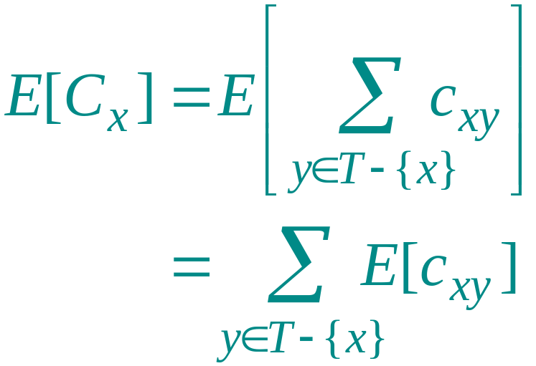
Proof (continued)
Take expectation of both sides.
Linearity of expectation.
Introduction to Algorithms
October 3, 2001 L8.<number>
Notes:
Introduction to Algorithms, Lecture 5
September 24, 2001
© 2001 by Charles E. Leiserson

Slide 8
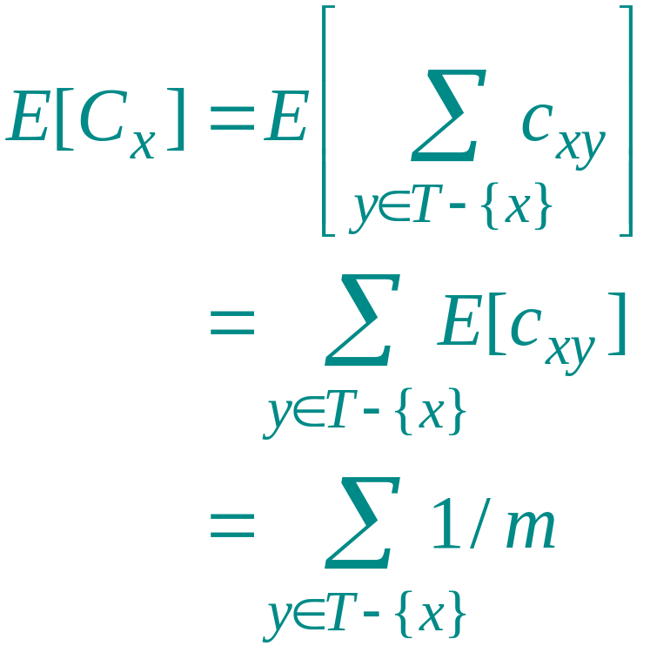
Proof (continued)
Take expectation of both sides.
Linearity of expectation.
≤
E[c_{xy}] ≤ 1/m.
Introduction to Algorithms
October 3, 2001 L8.<number>
Notes:
Introduction to Algorithms, Lecture 5
September 24, 2001
© 2001 by Charles E. Leiserson

Slide 9
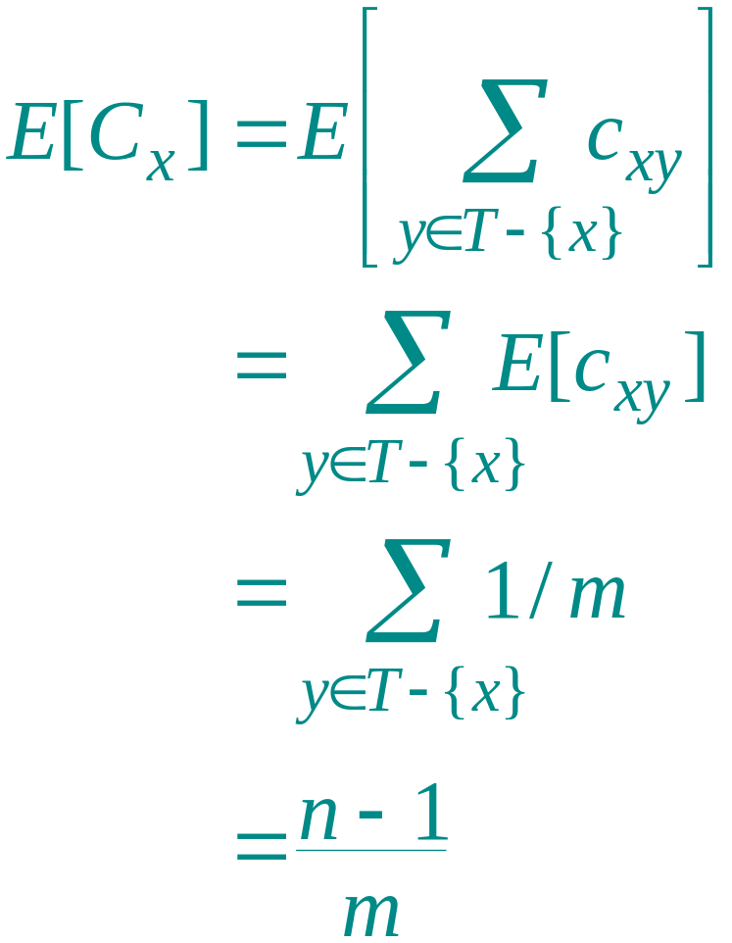
Proof (continued)
Take expectation of both sides.
Linearity of expectation.
E[c_{xy}] ≤ 1/m.
.
Algebra.
Introduction to Algorithms
October 3, 2001 L8.<number>
Notes:
Introduction to Algorithms, Lecture 5
September 24, 2001
© 2001 by Charles E. Leiserson

Slide 10
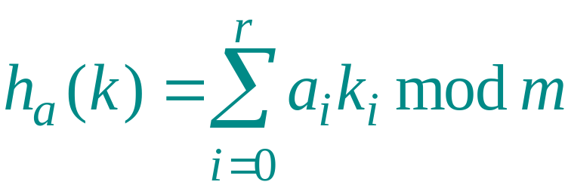
Constructing a set of universal hash functions
Let m be prime. Decompose key k into r + 1 digits, each with value in the set {0, 1, …, m–1}. That is, let k = ⟨k₀, k₁, …, k_{r}⟩, where 0 ≤ k_{i} < m.
Randomized strategy:
Pick a = ⟨a₀, a₁, …, a_{r}⟩ where each a_{i} is chosen randomly from {0, 1, …, m–1}.
Dot product, modulo m
Define
.
How big is H = {h_{a}}?
|H| = m^{r + 1}.
REMEMBER
THIS!
Introduction to Algorithms
October 3, 2001 L8.<number>
Notes:
Introduction to Algorithms, Lecture 5
September 24, 2001
© 2001 by Charles E. Leiserson

Slide 11
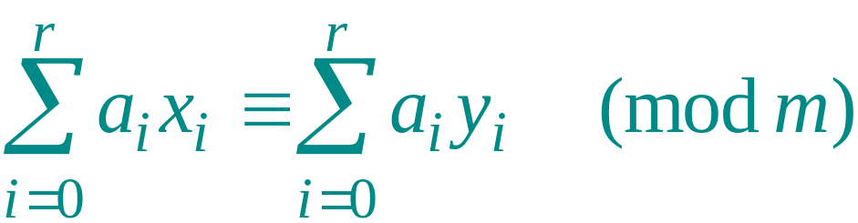
Universality of dot-product hash functions
Theorem. The set H = {h_{a}} is universal.
Proof. Suppose that x = ⟨x₀, x₁, …, x_{r}⟩ and y = ⟨y₀, y₁, …, y_{r}⟩ be distinct keys. Thus, they differ in at least one digit position, wlog position 0. For how many h_{a} ∈ H do x and y collide?
We must have h_{a}(x) = h_{a}(y), which implies that
.
Introduction to Algorithms
October 3, 2001 L8.<number>
Notes:
Introduction to Algorithms, Lecture 5
September 24, 2001
© 2001 by Charles E. Leiserson

Slide 12
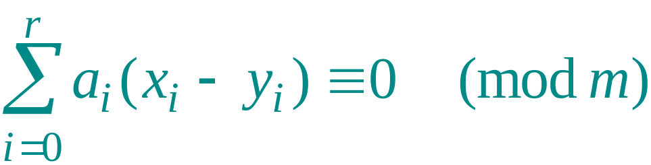
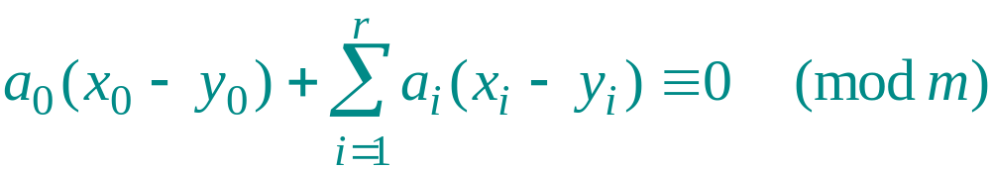
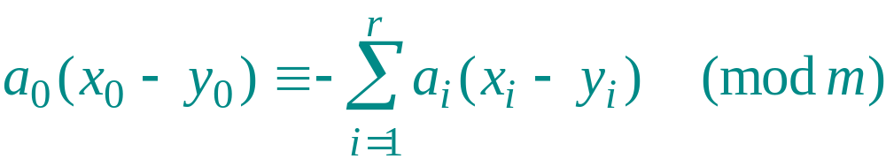
Proof (continued)
Equivalently, we have
or
,
which implies that
.
Introduction to Algorithms
October 3, 2001 L8.<number>
Notes:
Introduction to Algorithms, Lecture 5
September 24, 2001
© 2001 by Charles E. Leiserson

Slide 13
Fact from number theory
Theorem. Let m be prime. For any z ∈ Z_{m} such that z ≠ 0, there exists a unique z^{–1} ∈ Z_{m} such that
z · z^{–1} ≡ 1 (mod m).
Example: m = 7.
z
1 2 3 4 5 6
z^{–1}
1 4 5 2 3 6
Introduction to Algorithms
October 3, 2001 L8.<number>
Notes:
Introduction to Algorithms, Lecture 5
September 24, 2001
© 2001 by Charles E. Leiserson

Slide 14
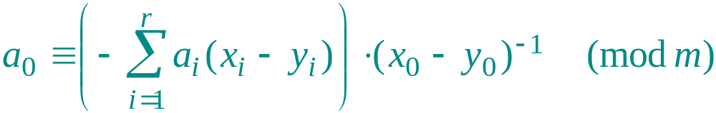
Back to the proof
We have
,
and since x₀ ≠ y₀ , an inverse (x₀ – y₀ )^{–1} must exist, which implies that
.
Thus, for any choices of a₁, a₂, …, a_{r}, exactly one choice of a₀ causes x and y to collide.
Introduction to Algorithms
October 3, 2001 L8.<number>
Notes:
Introduction to Algorithms, Lecture 5
September 24, 2001
© 2001 by Charles E. Leiserson

Slide 15

Proof (completed)
Q. How many h_{a}’s cause x and y to collide?
A. There are m choices for each of a₁, a₂, …, a_{r} , but once these are chosen, exactly one choice for a₀ causes x and y to collide, namely
.
Thus, the number of h_{a}’s that cause x and y to collide is m^{r} · 1 = m^{r} = |H|/m.
Introduction to Algorithms
October 3, 2001 L8.<number>
Notes:
Introduction to Algorithms, Lecture 5
September 24, 2001
© 2001 by Charles E. Leiserson

Slide 16
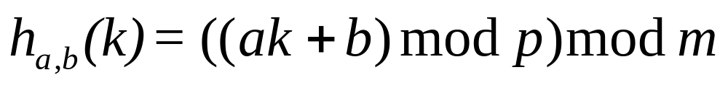
Another universal class of hash functions
Let p be prime such that all keys lie in {0,1…, p-1} and m be arbitrary.
Randomized strategy:
Pick a∈{1,…, p-1}, b∈{0,1,…, p-1} randomly.
REMEMBER
THIS!
Define
How big is H = {h_{a,b}}?
|H| = p(p−1).
Theorem: the number of h_{a,b}’s that cause x ≠ y to collide is at most p(p−1)/m = |H|/m.
Introduction to Algorithms
October 3, 2001 L8.<number>
Notes:
Introduction to Algorithms, Lecture 5
September 24, 2001
© 2001 by Charles E. Leiserson

Slide 17
Perfect hashing
Given a set of n keys, construct a static hash table of size m = O(n) such that SEARCH takes Θ(1) time in the worst case.
h_{3,1} (k)= ((3k+1)mod p)mod 4)
T
p=97
S₁
IDEA: Two-level scheme with universal hashing at both levels.
0
1
4
3,1
12
27
2
h (12) = h (27) = 1
3
S₄
4
1
0,0
26
S₆
No collisions at level 2!
5
6
9
8,6
5
34
40
m
a,b
0
1
2
3
4
5
6
7
8
Introduction to Algorithms
October 3, 2001 L8.<number>
Notes:
Introduction to Algorithms, Lecture 5
September 24, 2001
© 2001 by Charles E. Leiserson

Slide 18

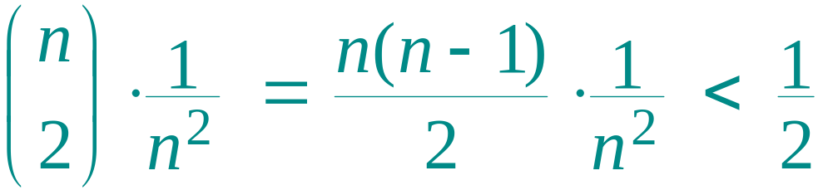
Collisions at level 2
Theorem. Let H be a class of universal hash functions for a table of size m = n². Then, if we use a random h ∈ H to hash n keys into the table, the expected number of collisions is at most 1/2.
Proof. By the definition of universality, the probability that 2 given keys in the table collide under h is 1/m = 1/n². Since there are pairs of keys that can possibly collide, the expected number of collisions is
.
Introduction to Algorithms
October 3, 2001 L8.<number>
Notes:
Introduction to Algorithms, Lecture 5
September 24, 2001
© 2001 by Charles E. Leiserson

Slide 19
No collisions at level 2
Corollary. The probability of no collisions is at least 1/2.
Proof. Markov’s inequality says that for any nonnegative random variable X, we have
Pr{X ≥ t} ≤ E[X]/t.
Applying this inequality with t = 1, we find that the probability of 1 or more collisions is at most 1/2.
Thus, just by testing random hash functions in H, we’ll quickly find one that works.
Introduction to Algorithms
October 3, 2001 L8.<number>
Notes:
Introduction to Algorithms, Lecture 5
September 24, 2001
© 2001 by Charles E. Leiserson

Slide 20
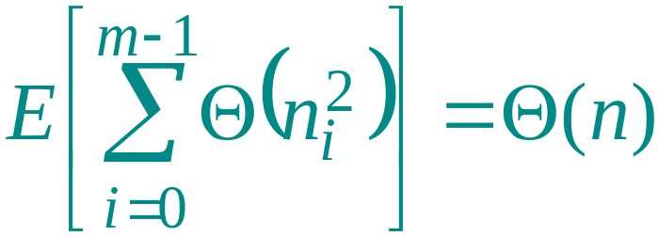
Analysis of storage
For the level-1 hash table T, choose m = n, and
let n_{i} be random variable for the number of keys that hash to slot i in T. By using n_{i}² slots for the level-2 hash table S_{i}, the expected total storage required for the two-level scheme is therefore
,
since the analysis is identical to the analysis from recitation of the expected running time of bucket sort. (For a probability bound, apply Markov.)
Introduction to Algorithms
October 3, 2001 L8.<number>
Notes:
Introduction to Algorithms, Lecture 5
September 24, 2001
© 2001 by Charles E. Leiserson

