Slide 1
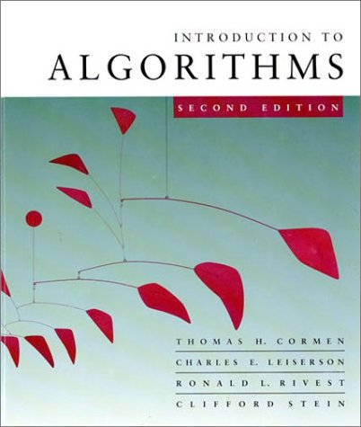
Introduction to Algorithms
6.046J/18.401J/SMA5503
Lecture 0
Based on slides by Prof. Erik Demaine

Slide 2
Solving recurrences
The analysis of merge sort from Lecture 1 required us to solve a recurrence.
Recurrences are like solving integrals, differential equations, etc.
  Learn a few tricks.
Lecture 3: Applications of recurrences.
September 10, 2001
Introduction to Algorithms
L2.<number>

Slide 3
Asymptotic notation (Θ)
Math:
Θ(g(n)) = { f (n): there exist positive
constants c₁, c₂, and n₀
such that 0 ≤c₁g(n) ≤f (n) ≤c₂g(n)
for all n≥n₀}
Engineering:
•Drop low-order terms; ignore leading constants.
•Example: 3n³ + 90n²–5n+ 6046 = Θ(n³)
Copyright © 2001-5 Erik D. Demaine and Charles E. Leiserson
Introduction to Algorithms
September 7, 2005
L1.22

Slide 4
Asymptotic notation (O)
Math:
O(g(n)) = { f (n): there exist positive
constants c, and n₀
such that 0 ≤f (n) ≤c g(n)
for all n≥n₀}
Engineering:
•An upper bound.
•Example: 3n³ + 90n²–5n+ 6046 = O(n^{3.1})
Copyright © 2001-5 Erik D. Demaine and Charles E. Leiserson
Introduction to Algorithms
September 7, 2005
L1.22

Slide 5
Asymptotic notation (O)
Math:
O(g(n)) = { f (n): there exist positive
constants c, and n₀
such that 0 ≤f (n) ≤c g(n)
for all n≥n₀}
Engineering:
•An upper bound.
•Example: 3n³ + 90n²–5n+ 6046 = O(n³)
Copyright © 2001-5 Erik D. Demaine and Charles E. Leiserson
Introduction to Algorithms
September 7, 2005
L1.22

Slide 6
Asymptotic notation (o)
Math:
o(g(n)) = { f (n): for any
constant c>0, there exists a constant n₀>0
such that 0 ≤f (n) < c g(n)
for all n≥n₀}
Engineering:
•A strict upper bound.
•Example: 3n³ + 90n²–5n+ 6046 = o(n^{3.1})
Copyright © 2001-5 Erik D. Demaine and Charles E. Leiserson
Introduction to Algorithms
September 7, 2005
L1.22

Slide 7
Asymptotic notation (o)
Math:
o(g(n)) = { f (n): for any
constant c>0, there exists a constant n₀>0
such that 0 ≤f (n) < c g(n)
for all n≥n₀}
Engineering:
•A strict upper bound.
•But: 3n³ + 90n²–5n+ 6046 ≠ o(n³)
Copyright © 2001-5 Erik D. Demaine and Charles E. Leiserson
Introduction to Algorithms
September 7, 2005
L1.22

Slide 8
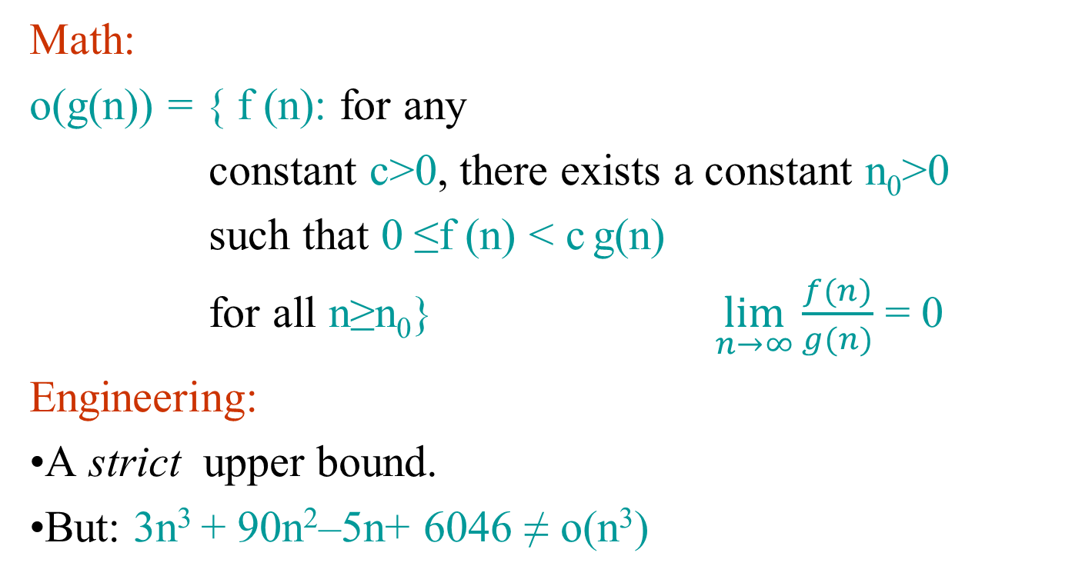
Asymptotic notation (o)
Copyright © 2001-5 Erik D. Demaine and Charles E. Leiserson
Introduction to Algorithms
September 7, 2005
L1.22

Slide 9
Asymptotic notation (Ω)
Math:
Ω (g(n)) = { f (n): there exist positive
constants c, and n₀
such that 0 ≤c g (n) ≤ f(n)
for all n≥n₀}
Engineering:
•A lower bound.
•Example: 3n³ + 90n²–5n+ 6046 = Ω(n^{2.5})
Copyright © 2001-5 Erik D. Demaine and Charles E. Leiserson
Introduction to Algorithms
September 7, 2005
L1.22

Slide 10
Asymptotic notation (Ω)
Math:
Ω (g(n)) = { f (n): there exist positive
constants c, and n₀
such that 0 ≤c g (n) ≤ f(n)
for all n≥n₀}
Engineering:
•A lower bound.
•Example: 3n³ + 90n²–5n+ 6046 = Ω(n³)
Copyright © 2001-5 Erik D. Demaine and Charles E. Leiserson
Introduction to Algorithms
September 7, 2005
L1.22

Slide 11
Asymptotic notation (ω)
Math:
ω(g(n)) = { f (n): for any
constant c>0, there exists a constant n₀>0
such that 0 ≤c g (n) < f(n)
for all n≥n₀}
Engineering:
•A strict lower bound.
•Example: 3n³ + 90n²–5n+ 6046 = ω(n^{2.5})
Copyright © 2001-5 Erik D. Demaine and Charles E. Leiserson
Introduction to Algorithms
September 7, 2005
L1.22

Slide 12
Asymptotic notation (ω)
Math:
ω(g(n)) = { f (n): for any
constant c>0, there exists a constant n₀>0
such that 0 ≤c g (n) < f(n)
for all n≥n₀}
Engineering:
•A strict lower bound.
•But: 3n³ + 90n²–5n+ 6046 ≠ ω(n³)
Copyright © 2001-5 Erik D. Demaine and Charles E. Leiserson
Introduction to Algorithms
September 7, 2005
L1.22

Slide 13
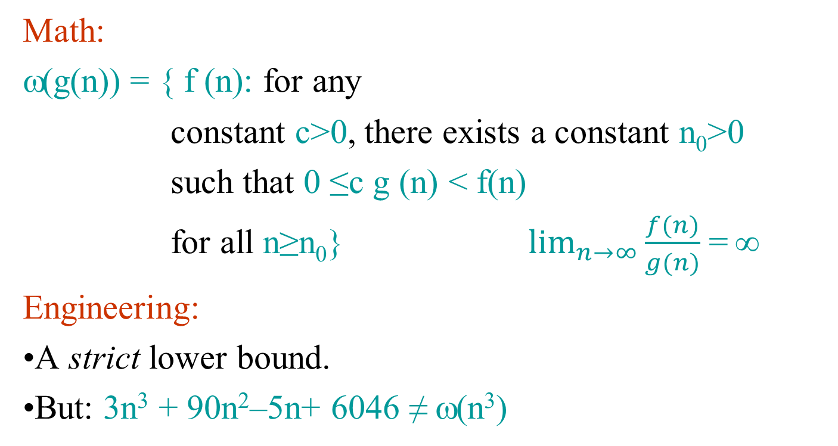
Asymptotic notation (ω)
Copyright © 2001-5 Erik D. Demaine and Charles E. Leiserson
Introduction to Algorithms
September 7, 2005
L1.22

Slide 14
Substitution method
The most general method:
Guess the form of the solution.
Verify by induction.
Solve for constants.
Example: T(n) = 4T(n/2) + n
[Assume that T(1) = Θ(1).]
Guess O(n³) . (Prove O and Ω separately.)
Assume that T(k) ≤ ck³ for k < n .
Prove T(n) ≤ cn³ by induction.
September 10, 2001
Introduction to Algorithms
L2.<number>

Slide 15
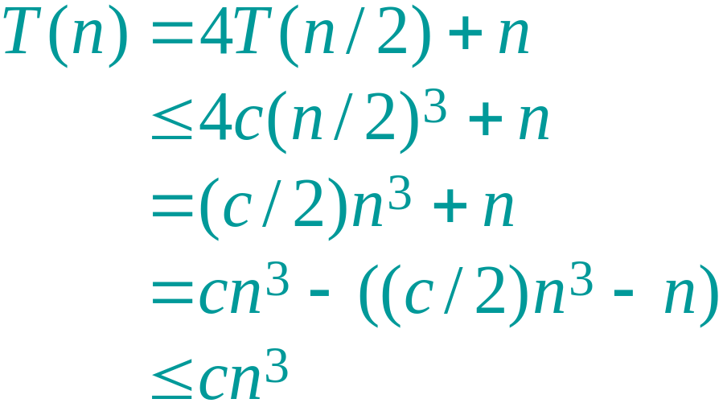
Example of substitution
desired – residual
desired
whenever (c/2)n³ – n ≥ 0, for example, if c ≥ 2 and n ≥ 1.
residual
September 10, 2001
Introduction to Algorithms
L2.<number>

Slide 16
Example (continued)
We must also handle the initial conditions, that is, ground the induction with base cases.
Base: T(n) = Θ(1) for all n < n₀, where n₀ is a suitable constant.
For 1 ≤ n < n₀, we have “Θ(1)” ≤ cn³, if we pick c big enough.
This bound is not tight!
September 10, 2001
Introduction to Algorithms
L2.<number>

Slide 17
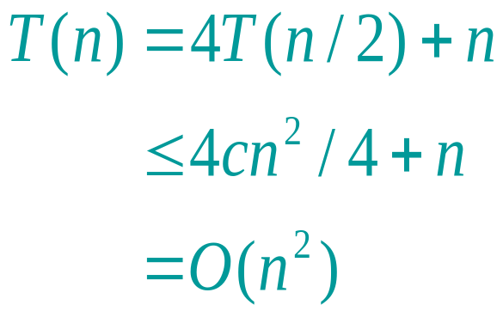
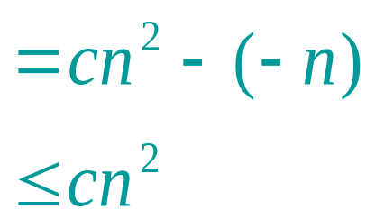
A tighter upper bound?
We shall prove that T(n) = O(n²).
Assume that T(k) ≤ ck² for k < n:
Wrong! We must prove the I.H.
[ desired – residual ]
for no choice of c > 0. Lose!
September 10, 2001
Introduction to Algorithms
L2.<number>

Slide 18
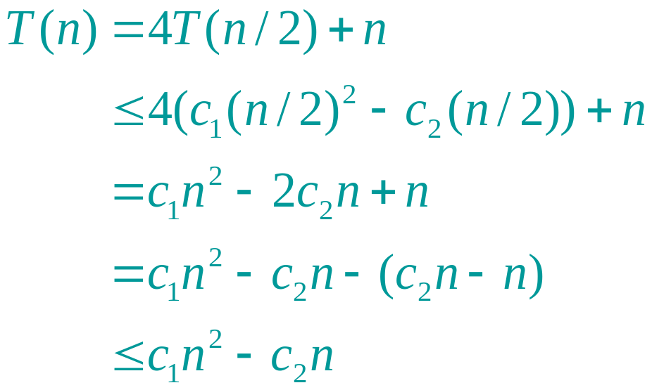
A tighter upper bound!
IDEA: Strengthen the inductive hypothesis.
Subtract a low-order term.
Inductive hypothesis: T(k) ≤ c₁k² – c₂k for k < n.
if c₂ > 1.
Pick c₁ big enough to handle the initial conditions.
September 10, 2001
Introduction to Algorithms
L2.<number>

Slide 19
Recursion-tree method
A recursion tree models the costs (time) of a recursive execution of an algorithm.
The recursion tree method is good for generating guesses for the substitution method.
The recursion-tree method can be unreliable.
The recursion-tree method promotes intuition, however.
September 10, 2001
Introduction to Algorithms
L2.<number>

Slide 20
Example of recursion tree
Solve T(n) = T(n/4) + T(n/2) + n²:
September 10, 2001
Introduction to Algorithms
L2.<number>

Slide 21
Example of recursion tree
Solve T(n) = T(n/4) + T(n/2) + n²:
T(n)
September 10, 2001
Introduction to Algorithms
L2.<number>

Slide 22
Example of recursion tree
Solve T(n) = T(n/4) + T(n/2) + n²:
n²
T(n/4)
T(n/2)
September 10, 2001
Introduction to Algorithms
L2.<number>

Slide 23
Example of recursion tree
Solve T(n) = T(n/4) + T(n/2) + n²:
n²
(n/4)²
(n/2)²
T(n/16)
T(n/8)
T(n/8)
T(n/4)
September 10, 2001
Introduction to Algorithms
L2.<number>

Slide 24
Example of recursion tree
Solve T(n) = T(n/4) + T(n/2) + n²:
n²
(n/4)²
(n/2)²
(n/16)²
(n/8)²
(n/8)²
(n/4)²
…
Θ(1)
September 10, 2001
Introduction to Algorithms
L2.<number>

Slide 25

Example of recursion tree
Solve T(n) = T(n/4) + T(n/2) + n²:
n²
(n/4)²
(n/2)²
(n/16)²
(n/8)²
(n/8)²
(n/4)²
…
Θ(1)
September 10, 2001
Introduction to Algorithms
L2.<number>

Slide 26
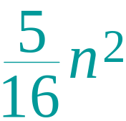
Example of recursion tree
Solve T(n) = T(n/4) + T(n/2) + n²:
n²
(n/4)²
(n/2)²
(n/16)²
(n/8)²
(n/8)²
(n/4)²
…
Θ(1)
September 10, 2001
Introduction to Algorithms
L2.<number>

Slide 27
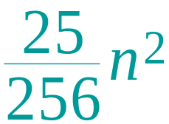
Example of recursion tree
Solve T(n) = T(n/4) + T(n/2) + n²:
n²
(n/4)²
(n/2)²
(n/16)²
(n/8)²
(n/8)²
(n/4)²
…
…
Θ(1)
September 10, 2001
Introduction to Algorithms
L2.<number>

Slide 28
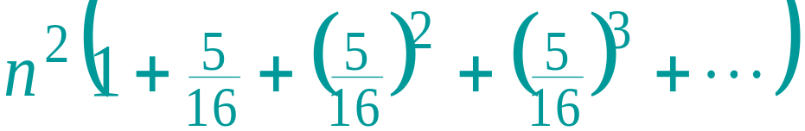
Example of recursion tree
Solve T(n) = T(n/4) + T(n/2) + n²:
n²
(n/4)²
(n/2)²
(n/16)²
(n/8)²
(n/8)²
(n/4)²
…
…
Θ(1)
Total =
= Θ(n²)
geometric series
September 10, 2001
Introduction to Algorithms
L2.<number>

Slide 29
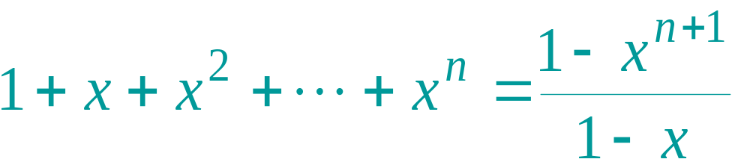
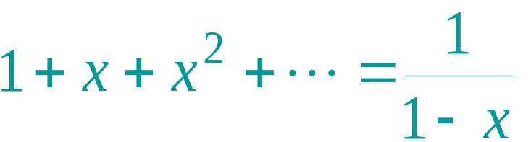
Appendix: geometric series
for x ≠ 1
for |x| < 1
Return to last slide viewed.
September 10, 2001
Introduction to Algorithms
L2.<number>

Slide 30
The master method
The master method applies to recurrences of the form
T(n) = a T(n/b) + f (n) ,
where a ≥ 1, b > 1, and f is asymptotically positive.
September 10, 2001
Introduction to Algorithms
L2.<number>

Slide 31
Three common cases
Compare f (n) with n^{logba}:
f (n) = O(n^{logba – ε}) for some constant ε > 0.
  f (n) grows polynomially slower than n^{logba} (by an n^{ε} factor).
Solution: T(n) = Θ(n^{logba}) .
f (n) = Θ(n^{logba} lg^{k}n) for some constant k ≥ 0.
  f (n) and n^{logba} grow at similar rates.
  Solution: T(n) = Θ(n^{logba} lg^{k+1}n) .
September 10, 2001
Introduction to Algorithms
L2.<number>

Slide 32
Three common cases (cont.)
Compare f (n) with n^{logba}:
f (n) = Ω(n^{logba + ε}) for some constant ε > 0.
  f (n) grows polynomially faster than n^{logba} (by an n^{ε} factor),
and f (n) satisfies the regularity condition that a f (n/b) ≤ c f (n) for some constant c < 1.
Solution: T(n) = Θ( f (n) ) .
September 10, 2001
Introduction to Algorithms
L2.<number>

Slide 33
Examples
Ex. T(n) = 4T(n/2) + n
a = 4, b = 2 ⇒ n^{logba} = n²; f (n) = n.
CASE 1: f (n) = O(n^{2 – ε}) for ε = 1.
∴ T(n) = Θ(n²).
Ex. T(n) = 4T(n/2) + n²
a = 4, b = 2 ⇒ n^{logba} = n²; f (n) = n².
CASE 2: f (n) = Θ(n²lg⁰n), that is, k = 0.
∴ T(n) = Θ(n²lg n).
September 10, 2001
Introduction to Algorithms
L2.<number>

Slide 34
Examples
Ex. T(n) = 4T(n/2) + n³
a = 4, b = 2 ⇒ n^{logba} = n²; f (n) = n³.
CASE 3: f (n) = Ω(n^{2 + ε}) for ε = 1
and 4(n/2)³ ≤ cn³ (reg. cond.) for c = 1/2.
∴ T(n) = Θ(n³).
Ex. T(n) = 4T(n/2) + n²/lg n
a = 4, b = 2 ⇒ n^{logba} = n²; f (n) = n²/lg n.
Master method does not apply. In particular, for every constant ε > 0, we cannot write n^{ε} = Θ (lg n).
September 10, 2001
Introduction to Algorithms
L2.<number>

Slide 35
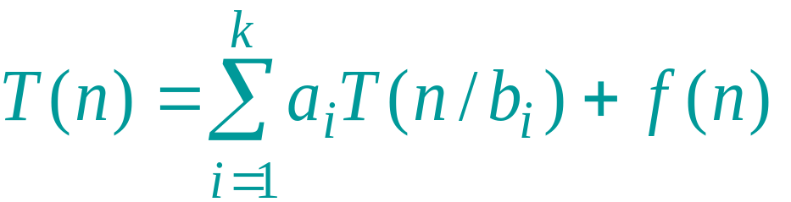
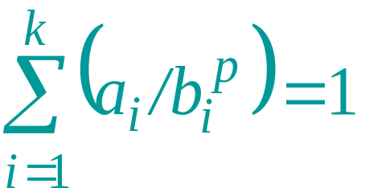
General method (Akra-Bazzi)
Let p be the unique solution to
.
Then, the answers are the same as for the master method, but with n^{p} instead of n^{logba}. (Akra and Bazzi also prove an even more general result.)
September 10, 2001
Introduction to Algorithms
L2.<number>

Slide 36
Idea of master theorem
Recursion tree:
f (n)
f (n)
a
f (n/b)
f (n/b)
…
f (n/b)
a f (n/b)
a
h = log_{b}n
f (n/b²)
f (n/b²)
…
f (n/b²)
a² f (n/b²)
…
…
#leaves = a^{h}
= a^{logbn}
= n^{logba}
n^{logba}Τ (1)
Τ (1)
September 10, 2001
Introduction to Algorithms
L2.<number>

Slide 37
Idea of master theorem
Recursion tree:
f (n)
f (n)
a
f (n/b)
f (n/b)
…
f (n/b)
a f (n/b)
a
h = log_{b}n
f (n/b²)
f (n/b²)
…
f (n/b²)
a² f (n/b²)
…
…
CASE 1: The weight increases geometrically from the root to the leaves. The leaves hold a constant fraction of the total weight.
n^{logba}Τ (1)
Τ (1)
Θ(n^{logba})
September 10, 2001
Introduction to Algorithms
L2.<number>

Slide 38
Idea of master theorem
Recursion tree:
f (n)
f (n)
a
f (n/b)
f (n/b)
…
f (n/b)
a f (n/b)
a
h = log_{b}n
f (n/b²)
f (n/b²)
…
f (n/b²)
a² f (n/b²)
…
…
CASE 2: (k = 0) The weight is approximately the same on each of the log_{b}n levels.
n^{logba}Τ (1)
Τ (1)
Θ(n^{logba}lg n)
September 10, 2001
Introduction to Algorithms
L2.<number>

Slide 39
Idea of master theorem
Recursion tree:
f (n)
f (n)
a
f (n/b)
f (n/b)
…
f (n/b)
a f (n/b)
a
h = log_{b}n
f (n/b²)
f (n/b²)
…
f (n/b²)
a² f (n/b²)
…
…
CASE 3: The weight decreases geometrically from the root to the leaves. The root holds a constant fraction of the total weight.
n^{logba}Τ (1)
Τ (1)
Θ( f (n))
September 10, 2001
Introduction to Algorithms
L2.<number>

Slide 40
Conclusion
Next time: applying the master method.
For proof of master theorem, see CLRS.
September 10, 2001
Introduction to Algorithms
L2.<number>

