Slide 1
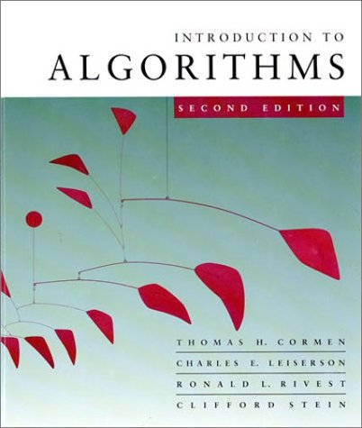
Introduction to Algorithms
6.046J/18.401J/SMA5503
Lecture 1
Based on slides by Prof. Charles E. Leiserson

Slide 2
Quicksort
Proposed by C.A.R. Hoare in 1962.
Divide-and-conquer algorithm.
Sorts “in place” (like insertion sort, but not like merge sort).
Very practical (with tuning).
September 19, 2001
Introduction to Algorithms
L4.<number>

Slide 3
Quicksort
Proposed by C.A.R. Hoare in 1962.
Divide-and-conquer algorithm.
Sorts “in place” (like insertion sort, but not like merge sort).
Very practical (with tuning).
Recommended reading:
Sections 5.1, 5.2, 5.3
Appendix C.2, C.3
September 19, 2001
Introduction to Algorithms
L4.<number>

Slide 4
Divide and conquer
Quicksort an n-element array:
Divide: Partition the array into two subarrays around a pivot x such that elements in lower subarray ≤ x ≤ elements in upper subarray.
Conquer: Recursively sort the two subarrays.
Combine: Trivial.
≤ x
x
≥ x
Key: Linear-time partitioning subroutine.
September 19, 2001
Introduction to Algorithms
L4.<number>

Slide 5
Partitioning subroutine
PARTITION(A, p, q) ⊳ A[ p . . q]
  x ← A[ p] ⊳ pivot = A[ p]
  i ← p
  for j ← p + 1 to q
    do if A[ j] ≤ x
        then i ← i + 1
        exchange A[i] ↔ A[ j]
  exchange A[ p] ↔ A[i]
  return i
Running time = O(n) for n elements.
Invariant:
x
≤ x
≥ x
?
p
i
j
q
September 19, 2001
Introduction to Algorithms
L4.<number>

Slide 6
Example of partitioning
6
10
13
5
8
3
2
11
i
j
September 19, 2001
Introduction to Algorithms
L4.<number>

Slide 7
Example of partitioning
6
10
13
5
8
3
2
11
i
j
September 19, 2001
Introduction to Algorithms
L4.<number>

Slide 8
Example of partitioning
6
10
13
5
8
3
2
11
i
j
September 19, 2001
Introduction to Algorithms
L4.<number>

Slide 9
Example of partitioning
6
10
13
5
8
3
2
11
6
5
13
10
8
3
2
11
i
j
September 19, 2001
Introduction to Algorithms
L4.<number>

Slide 10
Example of partitioning
6
10
13
5
8
3
2
11
6
5
13
10
8
3
2
11
i
j
September 19, 2001
Introduction to Algorithms
L4.<number>

Slide 11
Example of partitioning
6
10
13
5
8
3
2
11
6
5
13
10
8
3
2
11
i
j
September 19, 2001
Introduction to Algorithms
L4.<number>

Slide 12
Example of partitioning
6
10
13
5
8
3
2
11
6
5
13
10
8
3
2
11
6
5
3
10
8
13
2
11
i
j
September 19, 2001
Introduction to Algorithms
L4.<number>

Slide 13
Example of partitioning
6
10
13
5
8
3
2
11
6
5
13
10
8
3
2
11
6
5
3
10
8
13
2
11
i
j
September 19, 2001
Introduction to Algorithms
L4.<number>

Slide 14
Example of partitioning
6
10
13
5
8
3
2
11
6
5
13
10
8
3
2
11
6
5
3
10
8
13
2
11
6
5
3
2
8
13
10
11
i
j
September 19, 2001
Introduction to Algorithms
L4.<number>

Slide 15
Example of partitioning
6
10
13
5
8
3
2
11
6
5
13
10
8
3
2
11
6
5
3
10
8
13
2
11
6
5
3
2
8
13
10
11
i
j
September 19, 2001
Introduction to Algorithms
L4.<number>

Slide 16
Example of partitioning
6
10
13
5
8
3
2
11
6
5
13
10
8
3
2
11
6
5
3
10
8
13
2
11
6
5
3
2
8
13
10
11
i
j
September 19, 2001
Introduction to Algorithms
L4.<number>

Slide 17
Example of partitioning
6
10
13
5
8
3
2
11
6
5
13
10
8
3
2
11
6
5
3
10
8
13
2
11
6
5
3
2
8
13
10
11
2
5
3
6
8
13
10
11
i
September 19, 2001
Introduction to Algorithms
L4.<number>

Slide 18
Pseudocode for quicksort
QUICKSORT(A, p, r)
  if p < r
    then q ← PARTITION(A, p, r) QUICKSORT(A, p, q–1)
      QUICKSORT(A, q+1, r)
Initial call: QUICKSORT(A, 1, n)
September 19, 2001
Introduction to Algorithms
L4.<number>

Slide 19
Analysis of quicksort
Assume all input elements are distinct.
Let T(n) = worst-case running time on an array of n elements.
September 19, 2001
Introduction to Algorithms
L4.<number>

Slide 20
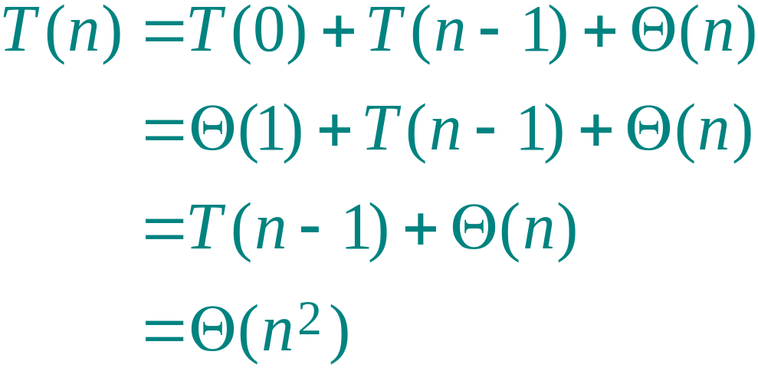
Worst-case of quicksort
Input sorted or reverse sorted.
Partition around min or max element.
One side of partition always has no elements.
(arithmetic series)
September 19, 2001
Introduction to Algorithms
L4.<number>

Slide 21
Worst-case recursion tree
T(n) = T(0) + T(n–1) + cn
September 19, 2001
Introduction to Algorithms
L4.<number>

Slide 22
Worst-case recursion tree
T(n) = T(0) + T(n–1) + cn
T(n)
September 19, 2001
Introduction to Algorithms
L4.<number>

Slide 23
Worst-case recursion tree
T(n) = T(0) + T(n–1) + cn
cn
T(0)
T(n–1)
September 19, 2001
Introduction to Algorithms
L4.<number>

Slide 24
Worst-case recursion tree
T(n) = T(0) + T(n–1) + cn
cn
T(0)
c(n–1)
T(0)
T(n–2)
September 19, 2001
Introduction to Algorithms
L4.<number>

Slide 25

Worst-case recursion tree
T(n) = T(0) + T(n–1) + cn
cn
T(0)
c(n–1)
T(0)
c(n–2)
T(0)
Θ(1)
September 19, 2001
Introduction to Algorithms
L4.<number>

Slide 26
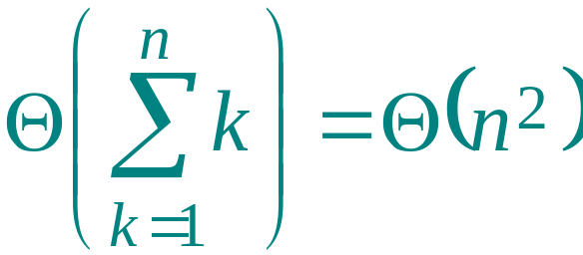
Worst-case recursion tree
T(n) = T(0) + T(n–1) + cn
cn
T(0)
c(n–1)
T(0)
c(n–2)
T(0)
Θ(1)
September 19, 2001
Introduction to Algorithms
L4.<number>

Slide 27
Worst-case recursion tree
T(n) = T(0) + T(n–1) + cn
cn
Θ(1)
c(n–1)
Θ(1)
c(n–2)
h = n
T(n) = Θ(n) + Θ(n²)
= Θ(n²)
Θ(1)
Θ(1)
September 19, 2001
Introduction to Algorithms
L4.<number>

Slide 28
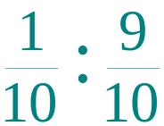
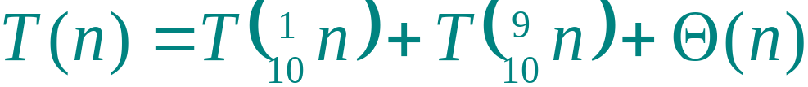
Best-case analysis
(For intuition only!)
If we’re lucky, PARTITION splits the array evenly:
T(n) = 2T(n/2) + Θ(n)
= Θ(n lg n)
(same as merge sort)
What if the split is always
?
What is the solution to this recurrence?
September 19, 2001
Introduction to Algorithms
L4.<number>

Slide 29

Analysis of “almost-best” case
September 19, 2001
Introduction to Algorithms
L4.<number>

Slide 30



Analysis of “almost-best” case
September 19, 2001
Introduction to Algorithms
L4.<number>

Slide 31
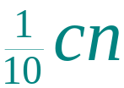
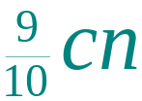



Analysis of “almost-best” case
September 19, 2001
Introduction to Algorithms
L4.<number>

Slide 32
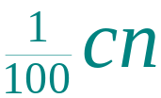
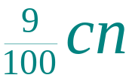
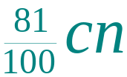
Analysis of “almost-best” case
log_{10/9}n
…
…
O(n) leaves
…
Θ(1)
Θ(1)
September 19, 2001
Introduction to Algorithms
L4.<number>

Slide 33
Analysis of “almost-best” case
log₁₀n
log_{10/9}n
…
…
O(n) leaves
…
Θ(1)
Θ(n lg n)
Lucky!
Θ(1)
cn log₁₀n ≤
T(n) ≤ cn log_{10/9}n + Ο(n)
September 19, 2001
Introduction to Algorithms
L4.<number>

Slide 34
More intuition
Suppose we alternate lucky, unlucky, lucky, unlucky, lucky, ….
  L(n) = 2U(n/2) + Θ(n) lucky
  U(n) = L(n – 1) + Θ(n) unlucky
Solving:
  L(n) = 2(L(n/2 – 1) + Θ(n/2)) + Θ(n)
  = 2L(n/2 – 1) + Θ(n)
  = Θ(n lg n)
Lucky!
How can we make sure we are usually lucky?
September 19, 2001
Introduction to Algorithms
L4.<number>

Slide 35
Randomized quicksort
IDEA: Partition around a random element.
Running time is independent of the input order.
No assumptions need to be made about the input distribution.
No specific input elicits the worst-case behavior.
The worst case is determined only by the output of a random-number generator.
September 19, 2001
Introduction to Algorithms
L4.<number>

Slide 36
Randomized quicksort analysis
Let T(n) = the random variable for the running time of randomized quicksort on an input of size n, assuming random numbers are independent.
For k = 0, 1, …, n–1, define the indicator random variable
1 if PARTITION generates a k : n–k–1 split,
0 otherwise.
X_{k} =
E[X_{k}] = Pr{X_{k} = 1} = 1/n, since all splits are equally likely, assuming elements are distinct.
September 19, 2001
Introduction to Algorithms
L4.<number>

Slide 37
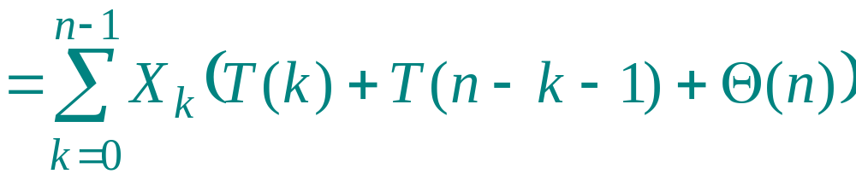
Analysis (continued)
T(0) + T(n–1) + Θ(n) if 0 : n–1 split,
T(1) + T(n–2) + Θ(n) if 1 : n–2 split,

T(n–1) + T(0) + Θ(n) if n–1 : 0 split,
T(n) =
.
September 19, 2001
Introduction to Algorithms
L4.<number>

Slide 38
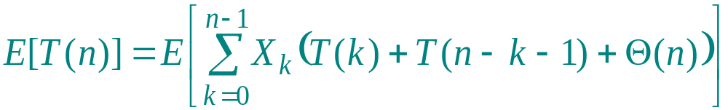
Calculating expectation
Take expectations of both sides.
September 19, 2001
Introduction to Algorithms
L4.<number>

Slide 39
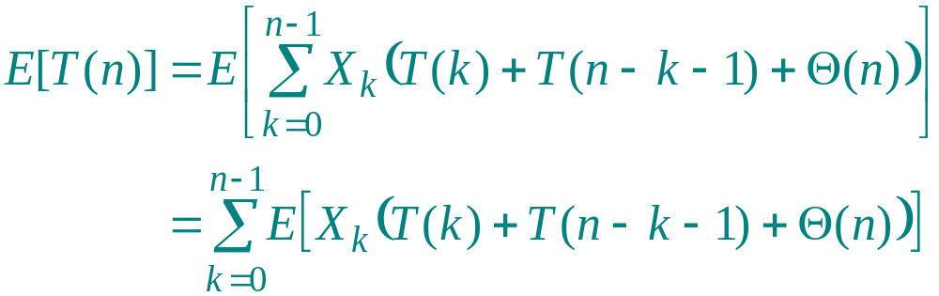
Calculating expectation
Linearity of expectation.
September 19, 2001
Introduction to Algorithms
L4.<number>

Slide 40
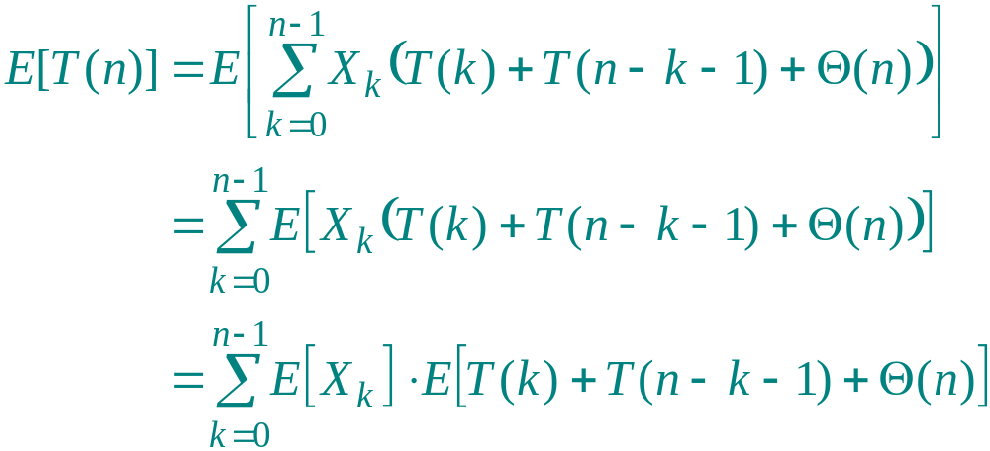
Calculating expectation
Independence of X_{k} from other random choices.
September 19, 2001
Introduction to Algorithms
L4.<number>

Slide 41
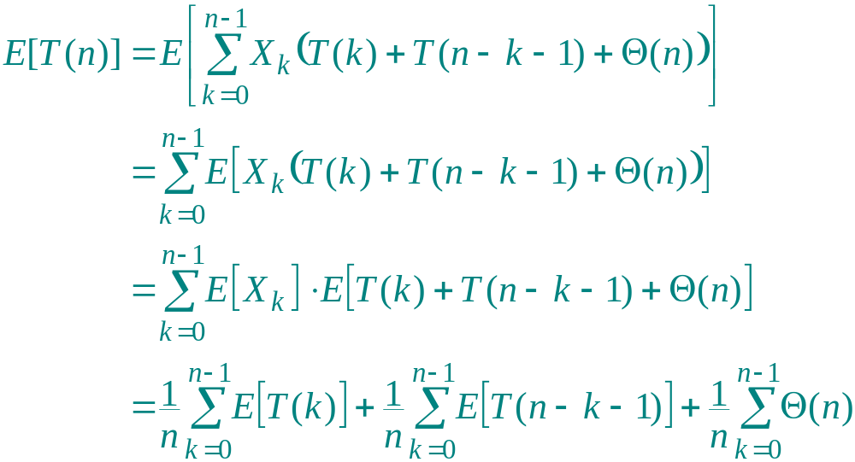
Calculating expectation
Linearity of expectation; E[X_{k}] = 1/n .
September 19, 2001
Introduction to Algorithms
L4.<number>

Slide 42
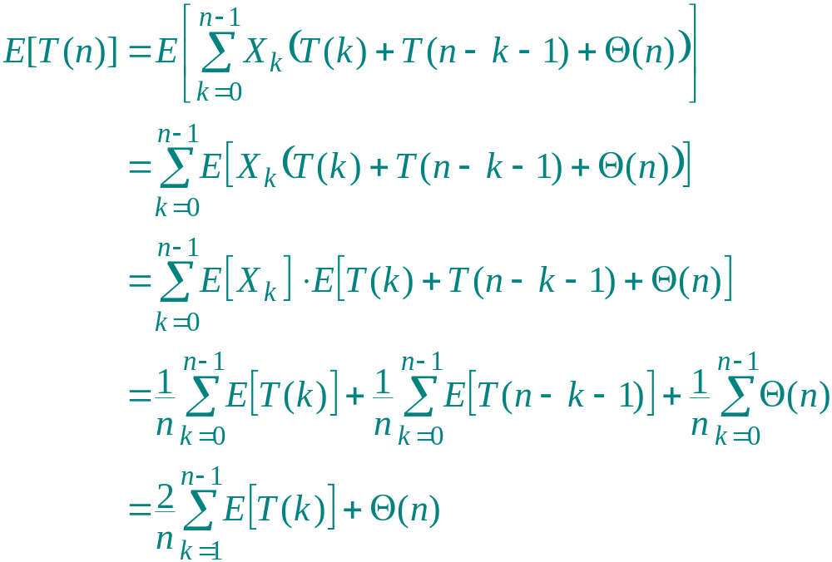
Calculating expectation
Summations have identical terms.
September 19, 2001
Introduction to Algorithms
L4.<number>

Slide 43
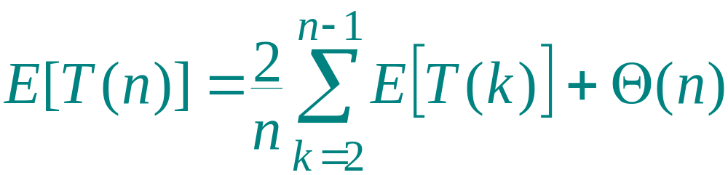
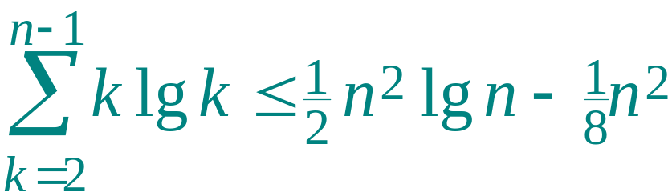
Hairy recurrence
(The k = 0, 1 terms can be absorbed in the Θ(n).)
Prove: E[T(n)] ≤ a n lg n for constant a > 0 .
Choose a large enough so that a n lg n dominates E[T(n)] for sufficiently small n ≥ 2.
Use fact:
(exercise).
September 19, 2001
Introduction to Algorithms
L4.<number>

Slide 44
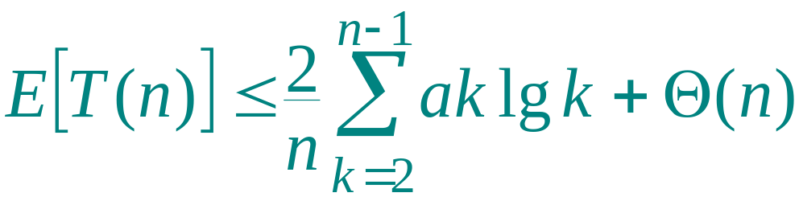
Substitution method
Substitute inductive hypothesis.
September 19, 2001
Introduction to Algorithms
L4.<number>

Slide 45
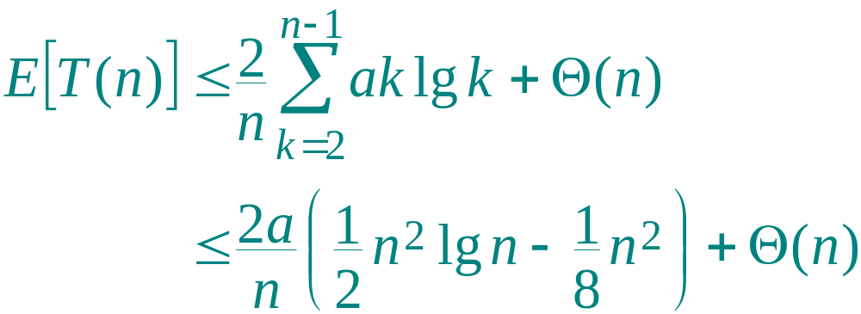
Substitution method
Use fact.
September 19, 2001
Introduction to Algorithms
L4.<number>

Slide 46
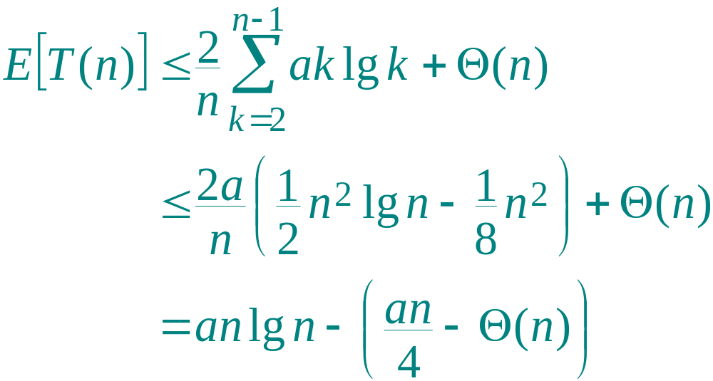
Substitution method
Express as desired – residual.
September 19, 2001
Introduction to Algorithms
L4.<number>

Slide 47
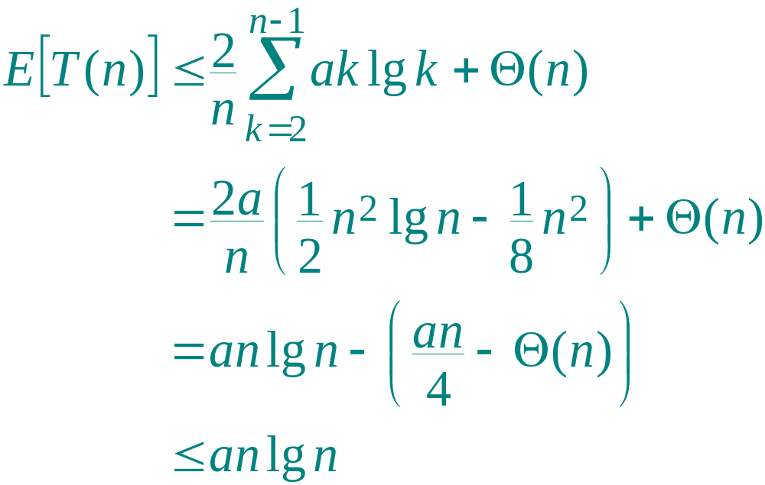
Substitution method
,
if a is chosen large enough so that an/4 dominates the Θ(n).
September 19, 2001
Introduction to Algorithms
L4.<number>

Slide 48
Quicksort in practice
Quicksort is a great general-purpose sorting algorithm.
Quicksort is typically over twice as fast as merge sort.
Quicksort can benefit substantially from code tuning.
Quicksort behaves well even with caching and virtual memory.
September 19, 2001
Introduction to Algorithms
L4.<number>

