Slide 1
Introduction to Algorithms
6.046J/18.401J
LECTURE 3
Order Statistics
• Randomized divide and conquer
• Analysis of expected time
• Worse-case linear-time order statistics
• Analysis
Based on slides by Prof. Erik Demaine
September 28, 2005
Copyright©2001-5 Erik D. Demaine and Charles E. Leiserson
L6.<number>

Slide 2

Order statistics
Select the ith smallest of nelements (the element with rank i).
•i = 1: minimum;
•i = n: maximum;
•i= median.
Naive algorithm: Sort and index ith element.
Worst-case running time = Θ(nlg n) + Θ(1)
= Θ(nlg n),
using merge sort or heapsort (not quicksort).
L6.<number>

Slide 3
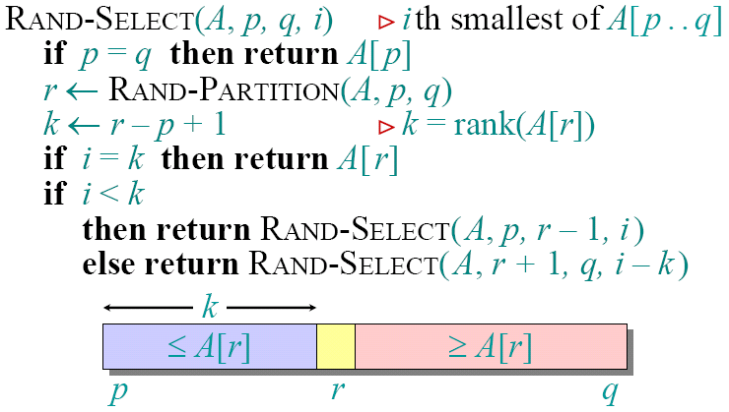
Randomized divide-and-conquer algorithm
RAND-SELECT
th smallest of
th smallest of
if
then return
RAND-PARTITION
if
then return
if
then return
RAND-SELECT
else return
RAND-SELECT
L6.<number>

Slide 4
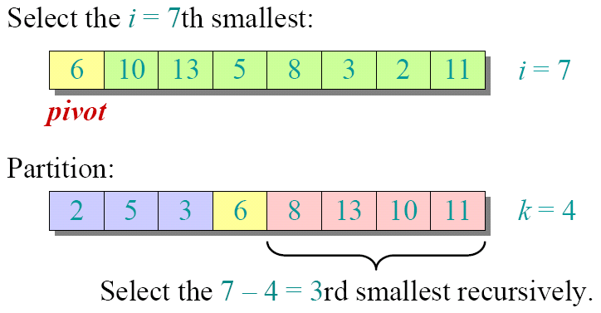
Example
Select the
th smallest:
Partition:
Select the
rd smallest recursively.
L6.<number>

Slide 5
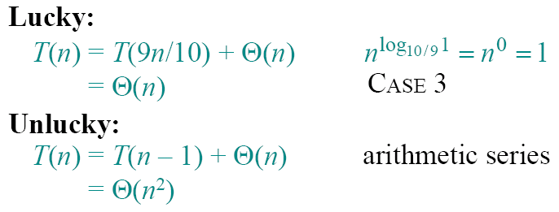
Intuition for analysis
(All our analyses today assume that all elements are distinct.)
Lucky:
CASE 3
Unlucky:
arithmetic series
L6.<number>

Slide 6

Analysis of expected time
The analysis follows that of randomized quicksort, but it’s a little different.
Let T(n) =the random variable for the running time of RAND-SELECTon an input of size n, assuming random numbers are independent.
For k= 0, 1, …, n–1, define the indicator random variable
if PARTITION generates a
split,
otherwise
L6.<number>

Slide 7
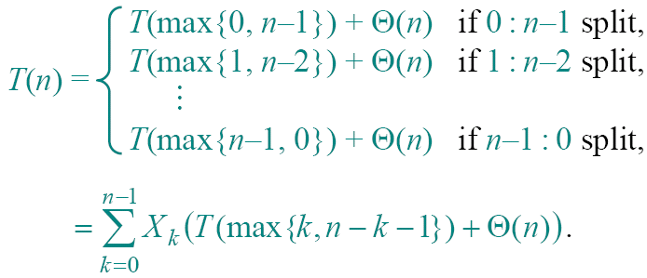
Analysis (continued)
To obtain an upper bound, assume that the ith element always falls in the larger side of the partition:
if
split,
if
split,
if
split,
L6.<number>

Slide 8


Calculating expectation
Take expectations of both sides.
L6.<number>

Slide 9

Calculating expectation
Linearity of expectation.
L6.<number>

Slide 10

Calculating expectation
Independence of X_{k} from other random choices
L6.<number>

Slide 11


Calculating expectation
Linearity of expectation;
L6.<number>

Slide 12
Calculating expectation
This part is Θ(n)
L6.<number>

Slide 13

Calculating expectation
Upper terms appear twice.
E.g. k = 1 vs. k = n - 2
max(1, n-2) = max(n-2, 1)
L6.<number>

Slide 14
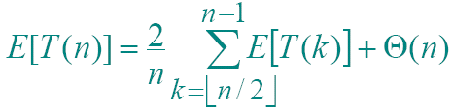
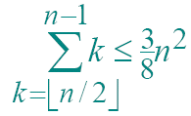
Hairy recurrence
(But not quite as hairy as the quicksort one.)
Prove: E[T(n)] ≤ cn for constant c > 0.
• The constant c can be chosen large enough so that E[T(n)]≤ cn for the base cases.
Use fact:
(exercise).
L6.<number>

Slide 15
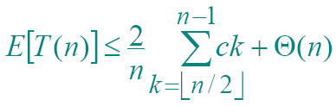
Substitution method
Substitute inductive hypothesis.
L6.<number>

Slide 16

Substitution method
Use fact.
L6.<number>

Slide 17

Substitution method
Express as desired–residual.
L6.<number>

Slide 18

Substitution method
if c is chosen large enough so that cn/4 dominates the Θ(n).
L6.<number>

Slide 19
Summary of randomized order-statistic selection
• Works fast: linear expected time.
• Excellent algorithm in practice.
• But, the worst case is very bad: Θ(n²).
Q. Is there an algorithm that runs in linear time in the worst case?
A. Yes, due to Blum, Floyd, Pratt, Rivest, and Tarjan [1973].
IDEA : Generate a good pivot recursively.
L6.<number>

Slide 20


Worst-case linear-time order statistics
SELECT(i, n)
1. Divide the n elements into groups of 5. Find the median of each 5-element group by rote.
2. Recursively SELECT the median x of the n/5 group medians to be the pivot.
3. Partition around the pivot x. Let k= rank(x).
4. If i = k then return x
else if i < k
then recursively SELECT the i th
smallest element in the lower part
else recursively SELECT the (i-k) th
smallest element in the upper part
Same as RAND-SELECT
L6.<number>

Slide 21
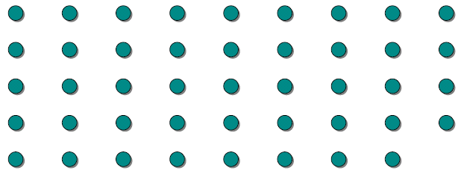
Choosing the pivot
L6.<number>

Slide 22
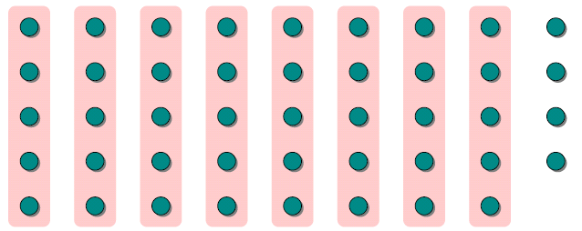
Choosing the pivot
1. Divide the n elements into groups of 5.
L6.<number>

Slide 23
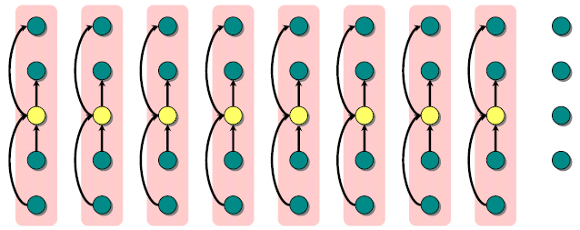

Choosing the pivot
lesser
1. Divide the n elements into groups of 5. Find the median of each 5-element group by rote.
greater
L6.<number>

Slide 24
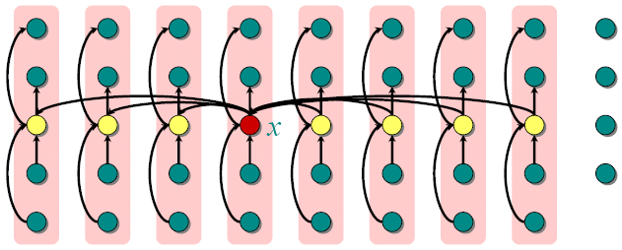
Choosing the pivot
lesser
1. Divide the n elements into groups of 5. Find the median of each 5-element group by rote.
2. Recursively SELECT the median x of the n/5 group medians to be the pivot.
greater
L6.<number>

Slide 25
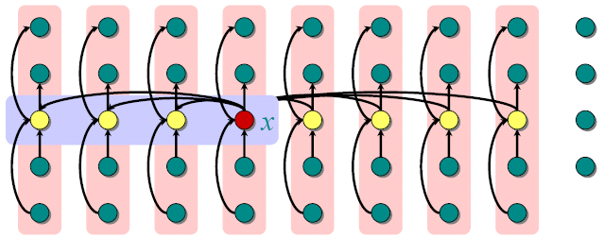

Analysis
At least half the group medians are ≤ x , which is at least n/5/2= n/10 group medians.
lesser
greater
L6.<number>

Slide 26
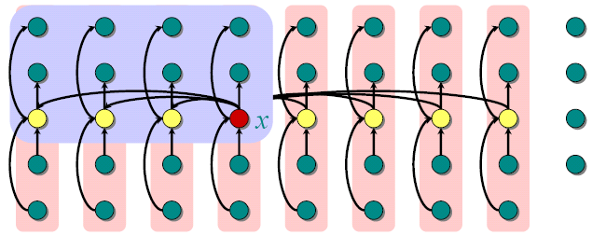

Analysis
(Assume all elements are distinct.)
At least half the group medians are ≤ x , which is at least n/5/2= n/10 group medians.
• Therefore, at least 3n/10 elements are ≤ x.
lesser
greater
L6.<number>

Slide 27
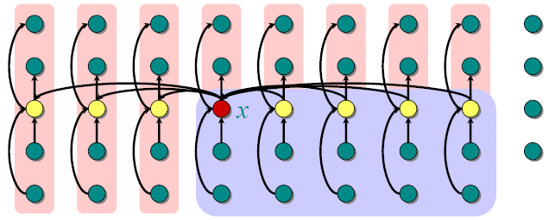
Analysis
(Assume all elements are distinct.)
At least half the group medians are ≤ x , which is at least n/5/2= n/10 group medians.
• Therefore, at least 3n/10 elements are ≤ x.
• Similarly, at least 3n/10 elements are ≥ x.
lesser
greater
L6.<number>

Slide 28
Minor simplification
• For n ≥ 50, we have 3n/10 ≥ n/4.
• Therefore, for n ≥ 50 the recursive call to SELECT in Step 4 is executed recursively on ≤ 3n/4 elements.
• Thus, the recurrence for running time can assume that Step 4 takes time T(3n/4) in the worst case.
• For n< 50, we know that the worst-case time is T(n) = Θ(1).
L6.<number>

Slide 29
Developing the recurrence
T(n)
Θ(n)
T(n/5)
Θ(n)
T(3n/4)
SELECT(i, n)
1. Divide the n elements into groups of 5. Find the median of each 5-element group by rote.
2. Recursively SELECT the median x of the n/5 group medians to be the pivot.
3. Partition around the pivot x. Let k= rank(x).
4. If i = k then return x
else if i < k
then recursively SELECT the i th
smallest element in the lower part
else recursively SELECT the (i-k) th
smallest element in the upper part
L6.<number>

Slide 30

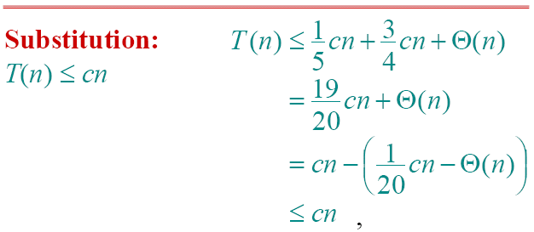
Solving the recurrence
Substitution:
if c is chosen large enough to handle both the Θ(n) and the initial conditions.
L6.<number>

Slide 31
Conclusions
• Since the work at each level of recursion is a constant fraction (19/20) smaller, the work per level is a geometric series dominated by the linear work at the root.
• In practice, this algorithm runs slowly, because the constant in front of n is large.
• The randomized algorithm is far more practical.
Exercise: Why not divide into groups of 3?
L6.<number>

