Slide 1
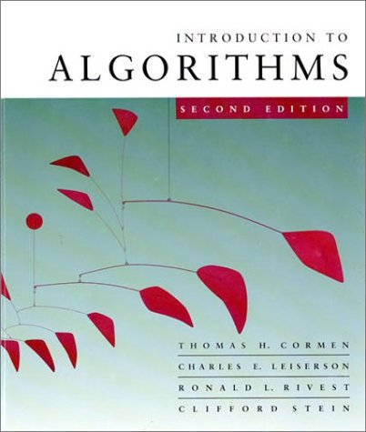
Introduction to Algorithms
6.046J/18.401J/SMA5503
Lecture 6
Based on slides by Prof. Charles E. Leiserson
Notes:
Introduction to Algorithms, Lecture 5
September 24, 2001
© 2001 by Charles E. Leiserson

Slide 2
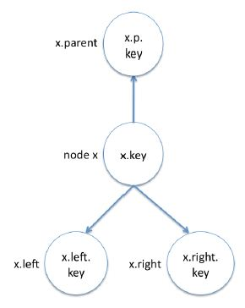
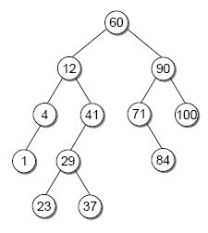
Binary-search-tree
Example:
root
h
≤
≤
Introduction to Algorithms
October 15, 2001 L9.<number>
Notes:
Introduction to Algorithms, Lecture 5
September 24, 2001
© 2001 by Charles E. Leiserson

Slide 3
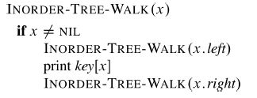
BST-walk
Example:
O(n)
Introduction to Algorithms
October 15, 2001 L9.<number>
Notes:
Introduction to Algorithms, Lecture 5
September 24, 2001
© 2001 by Charles E. Leiserson

Slide 4
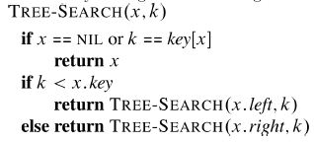
BST-search
Example:
O(h)
Introduction to Algorithms
October 15, 2001 L9.<number>
Notes:
Introduction to Algorithms, Lecture 5
September 24, 2001
© 2001 by Charles E. Leiserson

Slide 5
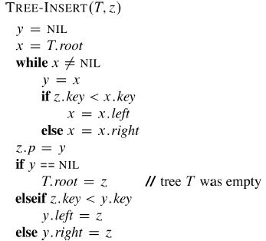
BST-insert
Example:
O(h)
Introduction to Algorithms
October 15, 2001 L9.<number>
Notes:
Introduction to Algorithms, Lecture 5
September 24, 2001
© 2001 by Charles E. Leiserson

Slide 6
Binary-search-tree sort
T ← ∅ ⊳ Create an empty BST
for i = 1 to n
  do TREE-INSERT(T, A[i])
Perform an inorder tree walk of T.
Example:
A = [3 1 8 2 6 7 5]
3
1
8
Tree-walk time = O(n), but how long does it take to build the BST?
2
6
5
7
Introduction to Algorithms
October 15, 2001 L9.<number>
Notes:
Introduction to Algorithms, Lecture 5
September 24, 2001
© 2001 by Charles E. Leiserson

Slide 7
Analysis of BST sort
BST sort performs the same comparisons as quicksort, but in a different order!
3 1 8 2 6 7 5
1 2
8 6 7 5
2
6 7 5
5
7
The expected time to build the tree is asymptot-ically the same as the running time of quicksort.
Introduction to Algorithms
October 15, 2001 L9.<number>
Notes:
Introduction to Algorithms, Lecture 5
September 24, 2001
© 2001 by Charles E. Leiserson

Slide 8
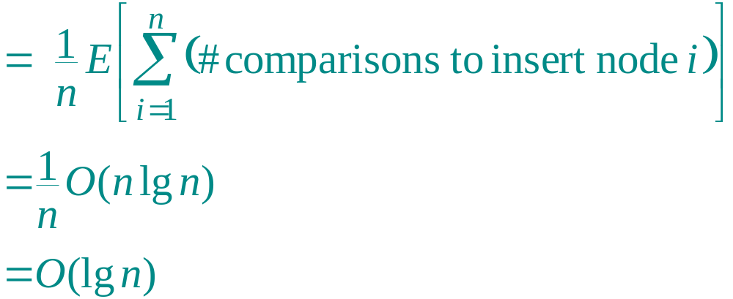
Node depth
The depth of a node = the number of comparisons made during TREE-INSERT. Assuming all input permutations are equally likely, we have
Average node depth
(quicksort analysis)
.
Introduction to Algorithms
October 15, 2001 L9.<number>
Notes:
Introduction to Algorithms, Lecture 5
September 24, 2001
© 2001 by Charles E. Leiserson

Slide 9
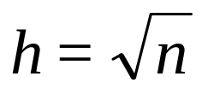
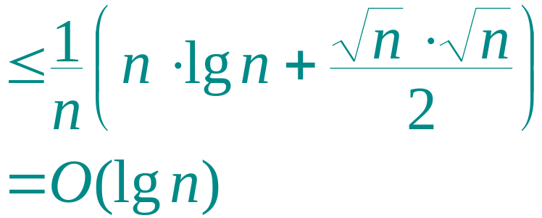
Expected tree height
But, average node depth of a randomly built BST = O(lg n) does not necessarily mean that its expected height is also O(lg n) (although it is).
Example.
≤ lg n
Ave. depth
Introduction to Algorithms
October 15, 2001 L9.<number>
Notes:
Introduction to Algorithms, Lecture 5
September 24, 2001
© 2001 by Charles E. Leiserson

Slide 10
Height of a randomly built binary search tree
Outline of the analysis:
Prove Jensen’s inequality, which says that f(E[X]) ≤ E[f(X)] for any convex function f and random variable X.
Analyze the exponential height of a randomly built BST on n nodes, which is the random variable Y_{n} = 2^{Xn}, where X_{n} is the random variable denoting the height of the BST.
Prove that 2^{E[Xn]} ≤ E[2^{Xn} ] = E[Y_{n}] = O(n³), and hence that E[X_{n}] = O(lg n).
Introduction to Algorithms
October 15, 2001 L9.<number>
Notes:
Introduction to Algorithms, Lecture 5
September 24, 2001
© 2001 by Charles E. Leiserson

Slide 11
Convex functions
A function f : R → R is convex if for all α,β ≥ 0 such that α + β = 1, we have
f(αx + βy) ≤ αf(x) + βf(y)
for all x,y ∈ R.
f
f(y)
αf(x) + βf(y)
f(x)
f(αx + βy)
x
αx + βy
y
Introduction to Algorithms
October 15, 2001 L9.<number>
Notes:
Introduction to Algorithms, Lecture 5
September 24, 2001
© 2001 by Charles E. Leiserson

Slide 12
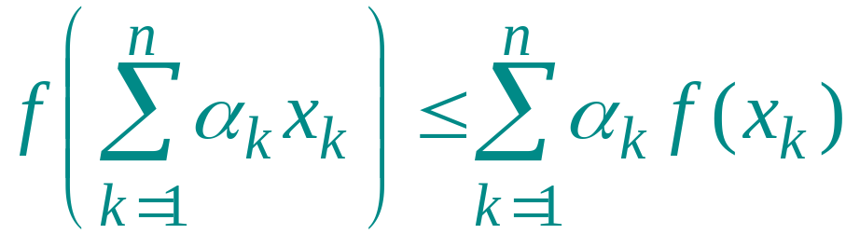
Convexity lemma
Lemma. Let f : R → R be a convex function, and let {α₁, α₂ , …, α_{n}} be a set of nonnegative constants such that ∑_{k} α_{k} = 1. Then, for any set {x₁, x₂, …, x_{n}} of real numbers, we have
.
Proof. By induction on n. For n = 1, we have α₁ = 1, and hence f(α₁x₁) ≤ α₁f(x₁) trivially.
Introduction to Algorithms
October 15, 2001 L9.<number>
Notes:
Introduction to Algorithms, Lecture 5
September 24, 2001
© 2001 by Charles E. Leiserson

Slide 13
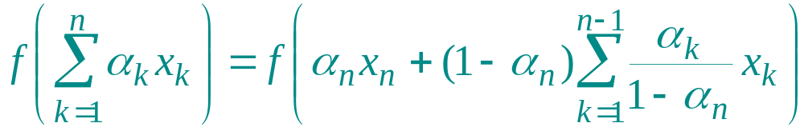
Proof (continued)
Inductive step:
Algebra.
Introduction to Algorithms
October 15, 2001 L9.<number>
Notes:
Introduction to Algorithms, Lecture 5
September 24, 2001
© 2001 by Charles E. Leiserson

Slide 14
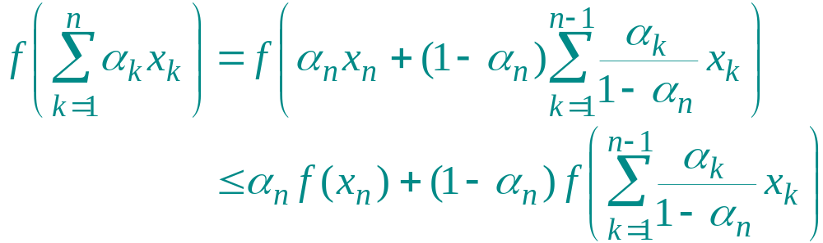
Proof (continued)
Inductive step:
Convexity.
Introduction to Algorithms
October 15, 2001 L9.<number>
Notes:
Introduction to Algorithms, Lecture 5
September 24, 2001
© 2001 by Charles E. Leiserson

Slide 15
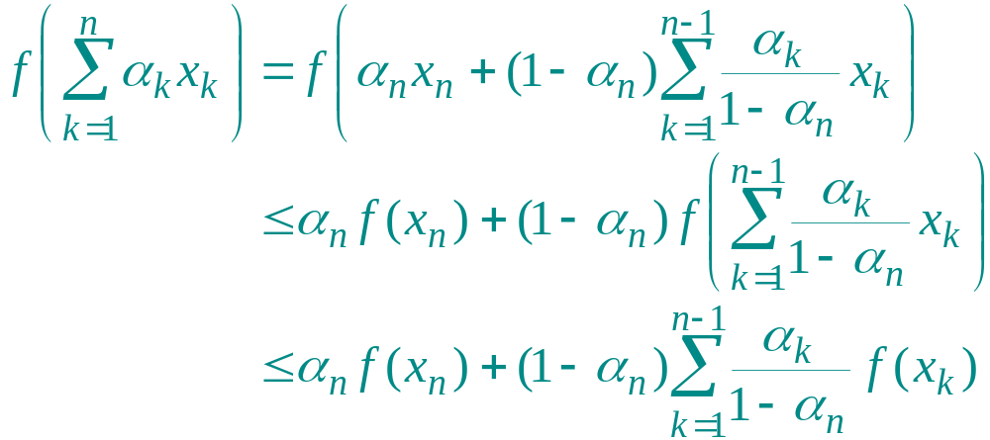
Proof (continued)
Inductive step:
Induction.
Introduction to Algorithms
October 15, 2001 L9.<number>
Notes:
Introduction to Algorithms, Lecture 5
September 24, 2001
© 2001 by Charles E. Leiserson

Slide 16
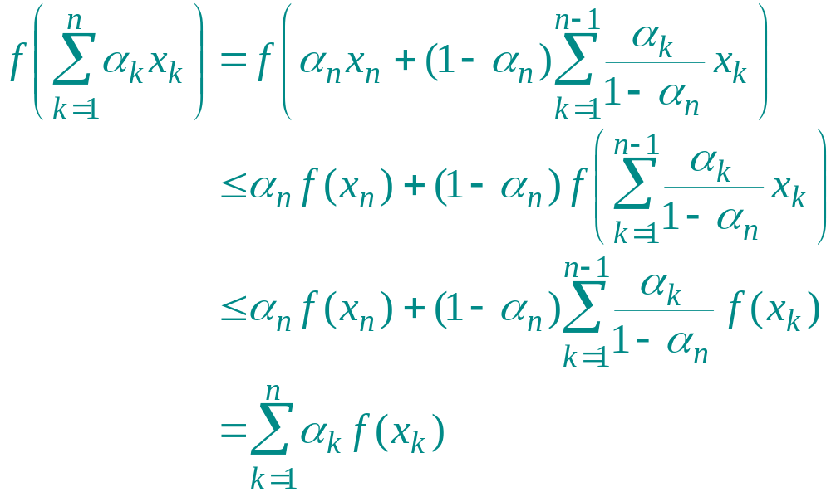
Proof (continued)
Inductive step:
.
Algebra.
Introduction to Algorithms
October 15, 2001 L9.<number>
Notes:
Introduction to Algorithms, Lecture 5
September 24, 2001
© 2001 by Charles E. Leiserson

Slide 17
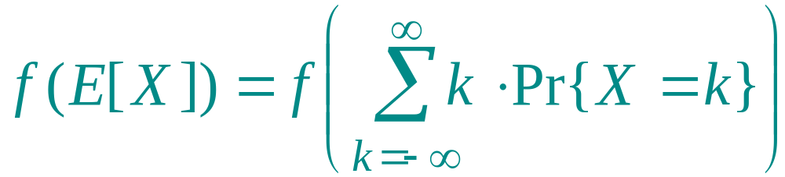
Jensen’s inequality
Lemma. Let f be a convex function, and let X be a random variable. Then, f (E[X]) ≤ E[ f (X)].
Proof.
Definition of expectation.
Introduction to Algorithms
October 15, 2001 L9.<number>
Notes:
Introduction to Algorithms, Lecture 5
September 24, 2001
© 2001 by Charles E. Leiserson

Slide 18
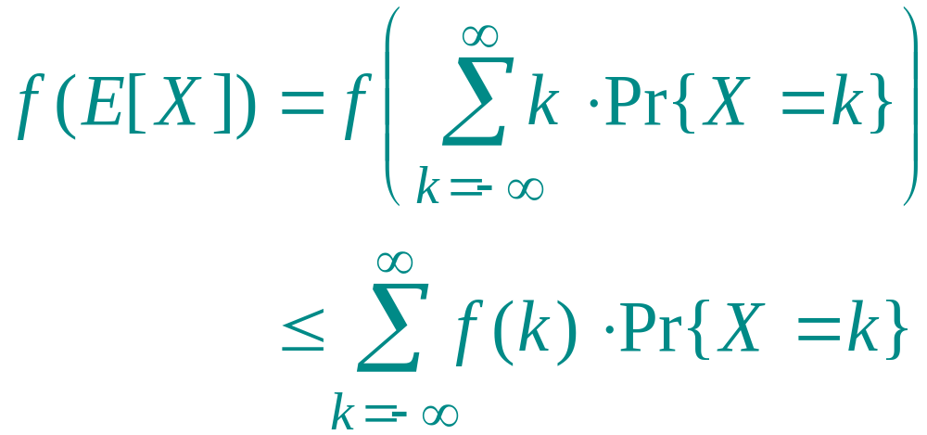
Jensen’s inequality
Lemma. Let f be a convex function, and let X be a random variable. Then, f (E[X]) ≤ E[ f (X)].
Proof.
Convexity lemma (generalized).
Introduction to Algorithms
October 15, 2001 L9.<number>
Notes:
Introduction to Algorithms, Lecture 5
September 24, 2001
© 2001 by Charles E. Leiserson

Slide 19
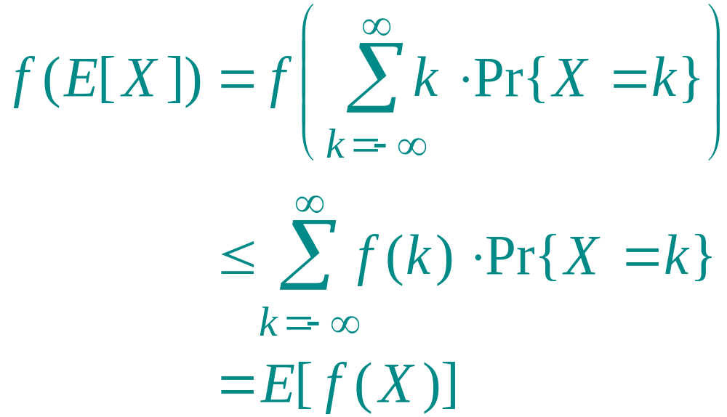
Jensen’s inequality
Lemma. Let f be a convex function, and let X be a random variable. Then, f (E[X]) ≤ E[ f (X)].
Proof.
.
Tricky step, but true—think about it.
Introduction to Algorithms
October 15, 2001 L9.<number>
Notes:
Introduction to Algorithms, Lecture 5
September 24, 2001
© 2001 by Charles E. Leiserson

Slide 20
Analysis of BST height
Let X_{n} be the random variable denoting the height of a randomly built binary search tree on n nodes, and let Y_{n} = 2^{Xn} be its exponential height.
If the root of the tree has rank k, then
X_{n} = 1 + max{X_{k–1}, X_{n–k}} ,
since each of the left and right subtrees of the root are randomly built. Hence, we have
Y_{n} = 2· max{Y_{k–1}, Y_{n–k}} .
Introduction to Algorithms
October 15, 2001 L9.<number>
Notes:
Introduction to Algorithms, Lecture 5
September 24, 2001
© 2001 by Charles E. Leiserson

Slide 21
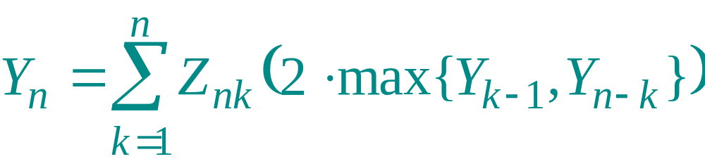
Analysis (continued)
Define the indicator random variable Z_{nk} as
1 if the root has rank k,
0 otherwise.
Z_{nk} =
Thus, Pr{Z_{nk} = 1} = E[Z_{nk}] = 1/n, and
.
Introduction to Algorithms
October 15, 2001 L9.<number>
Notes:
Introduction to Algorithms, Lecture 5
September 24, 2001
© 2001 by Charles E. Leiserson

Slide 22
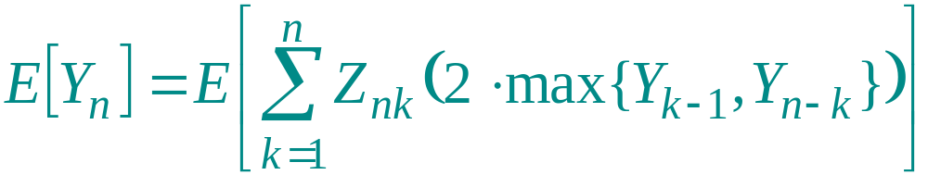
Exponential height recurrence
Take expectation of both sides.
Introduction to Algorithms
October 15, 2001 L9.<number>
Notes:
Introduction to Algorithms, Lecture 5
September 24, 2001
© 2001 by Charles E. Leiserson

Slide 23
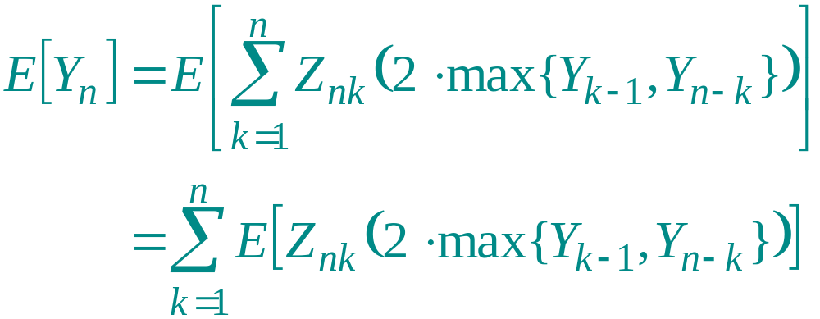
Exponential height recurrence
Linearity of expectation.
Introduction to Algorithms
October 15, 2001 L9.<number>
Notes:
Introduction to Algorithms, Lecture 5
September 24, 2001
© 2001 by Charles E. Leiserson

Slide 24
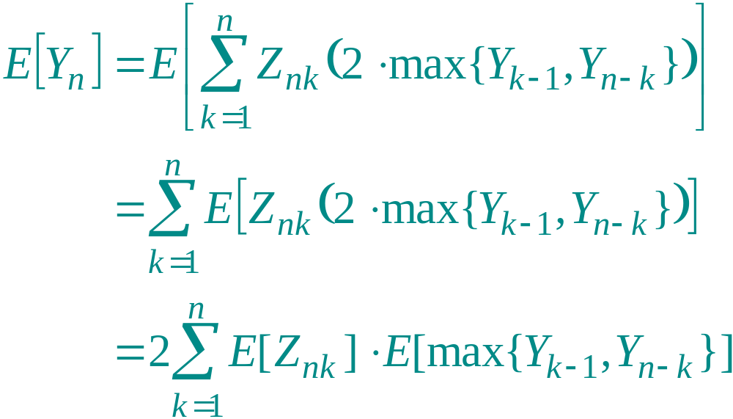
Exponential height recurrence
Independence of the rank of the root from the ranks of subtree roots.
Introduction to Algorithms
October 15, 2001 L9.<number>
Notes:
Introduction to Algorithms, Lecture 5
September 24, 2001
© 2001 by Charles E. Leiserson

Slide 25
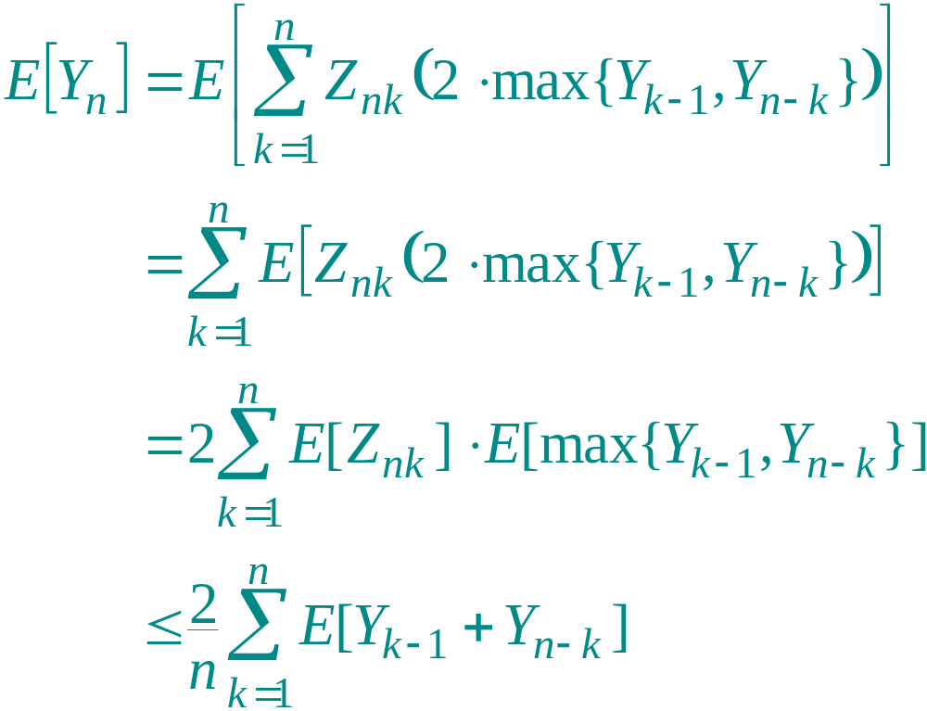
Exponential height recurrence
The max of two nonnegative numbers is at most their sum, and E[Z_{nk}] = 1/n.
Introduction to Algorithms
October 15, 2001 L9.<number>
Notes:
Introduction to Algorithms, Lecture 5
September 24, 2001
© 2001 by Charles E. Leiserson

Slide 26
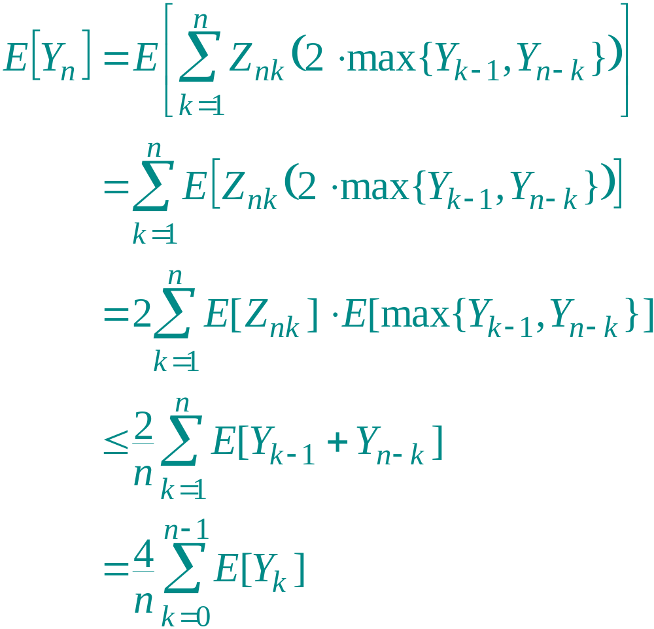
Exponential height recurrence
Each term appears twice, and reindex.
Introduction to Algorithms
October 15, 2001 L9.<number>
Notes:
Introduction to Algorithms, Lecture 5
September 24, 2001
© 2001 by Charles E. Leiserson

Slide 27
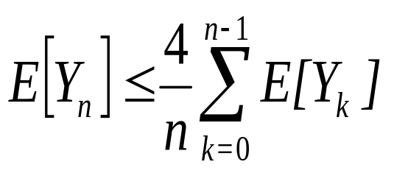
Solving the recurrence
Use substitution to show that E[Y_{n}] ≤ cn³ for some positive constant c, which we can pick sufficiently large to handle the initial conditions.
Introduction to Algorithms
October 15, 2001 L9.<number>
Notes:
Introduction to Algorithms, Lecture 5
September 24, 2001
© 2001 by Charles E. Leiserson

Slide 28
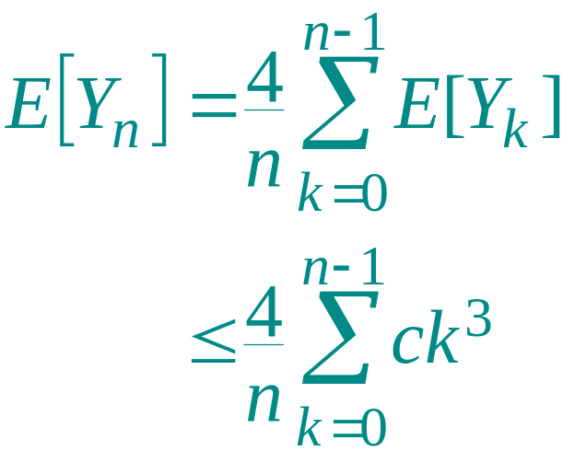
Solving the recurrence
Use substitution to show that E[Y_{n}] ≤ cn³ for some positive constant c, which we can pick sufficiently large to handle the initial conditions.
Substitution.
Introduction to Algorithms
October 15, 2001 L9.<number>
Notes:
Introduction to Algorithms, Lecture 5
September 24, 2001
© 2001 by Charles E. Leiserson

Slide 29
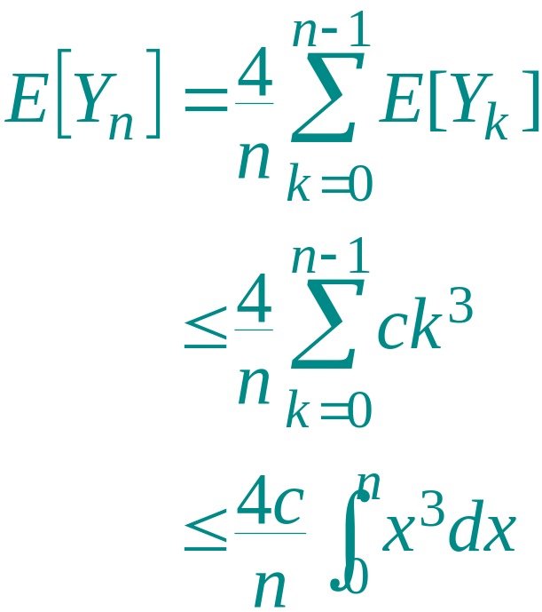
Solving the recurrence
Use substitution to show that E[Y_{n}] ≤ cn³ for some positive constant c, which we can pick sufficiently large to handle the initial conditions.
Integral method.
Introduction to Algorithms
October 15, 2001 L9.<number>
Notes:
Introduction to Algorithms, Lecture 5
September 24, 2001
© 2001 by Charles E. Leiserson

Slide 30
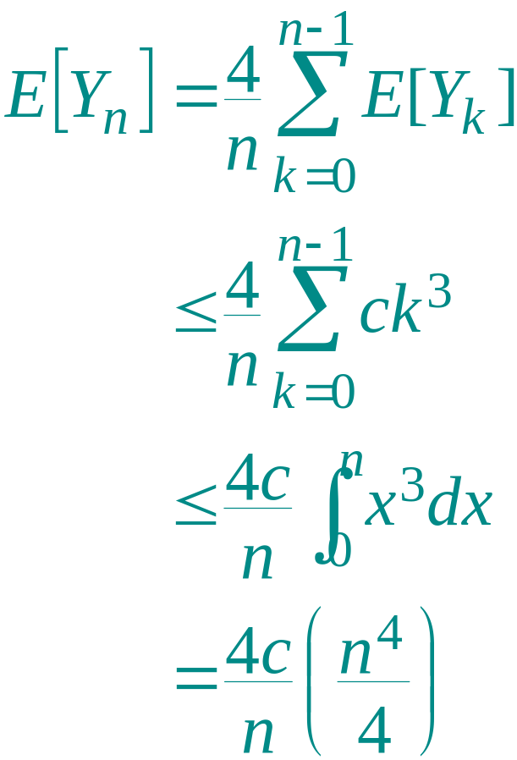
Solving the recurrence
Use substitution to show that E[Y_{n}] ≤ cn³ for some positive constant c, which we can pick sufficiently large to handle the initial conditions.
Solve the integral.
Introduction to Algorithms
October 15, 2001 L9.<number>
Notes:
Introduction to Algorithms, Lecture 5
September 24, 2001
© 2001 by Charles E. Leiserson

Slide 31
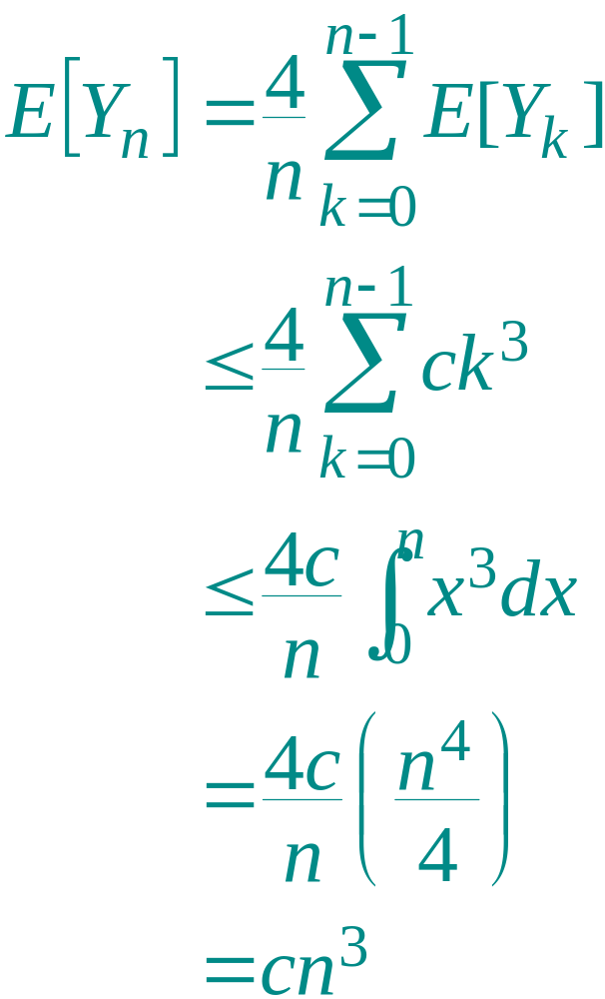
Solving the recurrence
Use substitution to show that E[Y_{n}] ≤ cn³ for some positive constant c, which we can pick sufficiently large to handle the initial conditions.
. Algebra.
Introduction to Algorithms
October 15, 2001 L9.<number>
Notes:
Introduction to Algorithms, Lecture 5
September 24, 2001
© 2001 by Charles E. Leiserson

Slide 32
The grand finale
Putting it all together, we have
2^{E[Xn]} ≤ E[2^{Xn} ]
Jensen’s inequality, since f(x) = 2^{x} is convex.
Introduction to Algorithms
October 15, 2001 L9.<number>
Notes:
Introduction to Algorithms, Lecture 5
September 24, 2001
© 2001 by Charles E. Leiserson

Slide 33
The grand finale
Putting it all together, we have
2^{E[Xn]} ≤ E[2^{Xn} ]
= E[Y_{n}]
Definition.
Introduction to Algorithms
October 15, 2001 L9.<number>
Notes:
Introduction to Algorithms, Lecture 5
September 24, 2001
© 2001 by Charles E. Leiserson

Slide 34
The grand finale
Putting it all together, we have
2^{E[Xn]} ≤ E[2^{Xn} ]
= E[Y_{n}]
≤ cn³ .
What we just showed.
Introduction to Algorithms
October 15, 2001 L9.<number>
Notes:
Introduction to Algorithms, Lecture 5
September 24, 2001
© 2001 by Charles E. Leiserson

Slide 35
The grand finale
Putting it all together, we have
2^{E[Xn]} ≤ E[2^{Xn} ]
= E[Y_{n}]
≤ cn³ .
Taking the lg of both sides yields
E[X_{n}] ≤ 3 lg n +O(1) .
Introduction to Algorithms
October 15, 2001 L9.<number>
Notes:
Introduction to Algorithms, Lecture 5
September 24, 2001
© 2001 by Charles E. Leiserson

Slide 36
Thought exercises
See what happens when you try to do the analysis on X_{n} directly.
Try to understand better why the proof uses an exponential. Will a quadratic do?
Introduction to Algorithms
October 15, 2001 L9.<number>
Notes:
Introduction to Algorithms, Lecture 5
September 24, 2001
© 2001 by Charles E. Leiserson

