Slide 1
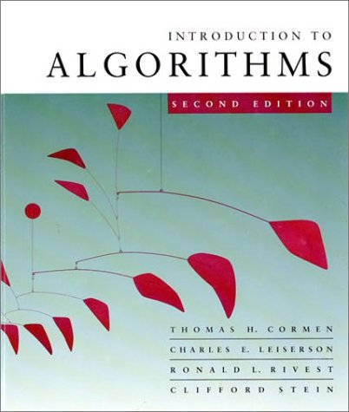
Introduction to Algorithms
6.046J/18.401J/SMA5503
    LECTURE 8
    Amortized Analysis
    • Dynamic tables
    • Aggregate method
    • Accounting method
    • Potential method
    Chapter17 in Text book
Based on slides by Prof. Charles E. Leiserson
Notes:
Introduction to Algorithms, Lecture 14
October 31, 2001
© 2001 by Charles E. Leiserson

Slide 2
How large should a hash table be?
Goal: Make the table as small as possible, but large enough so that it won’t overflow (or otherwise become inefficient).
Problem: What if we don’t know the proper size in advance?
Solution: Dynamic tables.
IDEA: Whenever the table overflows, “grow” it by allocating (via malloc or new) a new, larger table. Move all items from the old table into the new one, and free the storage for the old table.
Introduction to Algorithms
October 31, 2001 L14.<number>

Slide 3
Example of a dynamic table
INSERT
1
INSERT
overflow
Introduction to Algorithms
October 31, 2001 L14.<number>

Slide 4
Example of a dynamic table
INSERT
1
INSERT
overflow
Introduction to Algorithms
October 31, 2001 L14.<number>

Slide 5
Example of a dynamic table
INSERT
1
INSERT
2
Introduction to Algorithms
October 31, 2001 L14.<number>

Slide 6
Example of a dynamic table
INSERT
1
INSERT
2
INSERT
overflow
Introduction to Algorithms
October 31, 2001 L14.<number>

Slide 7
Example of a dynamic table
INSERT
1
INSERT
2
INSERT
overflow
Introduction to Algorithms
October 31, 2001 L14.<number>

Slide 8
Example of a dynamic table
INSERT
1
INSERT
2
INSERT
Introduction to Algorithms
October 31, 2001 L14.<number>

Slide 9
Example of a dynamic table
INSERT
1
INSERT
2
INSERT
3
INSERT
4
Introduction to Algorithms
October 31, 2001 L14.<number>
Notes:
Introduction to Algorithms, Lecture 14
October 31, 2001
© 2001 by Charles E. Leiserson

Slide 10
Example of a dynamic table
INSERT
1
INSERT
2
INSERT
3
INSERT
4
INSERT
overflow
Introduction to Algorithms
October 31, 2001 L14.<number>

Slide 11
Example of a dynamic table
INSERT
1
INSERT
2
INSERT
3
INSERT
4
INSERT
overflow
Introduction to Algorithms
October 31, 2001 L14.<number>

Slide 12
Example of a dynamic table
INSERT
1
INSERT
2
INSERT
3
INSERT
4
INSERT
Introduction to Algorithms
October 31, 2001 L14.<number>

Slide 13
Example of a dynamic table
INSERT
1
INSERT
2
INSERT
3
INSERT
4
INSERT
5
INSERT
6
INSERT
7
Introduction to Algorithms
October 31, 2001 L14.<number>

Slide 14
Worst-case analysis
Consider a sequence of n insertions. The worst-case time to execute one insertion is Θ(n). Therefore, the worst-case time for n insertions is n · Θ(n) = Θ(n²).
WRONG! In fact, the worst-case cost for n insertions is only Θ(n) ≪ Θ(n²).
Let’s see why.
Introduction to Algorithms
October 31, 2001 L14.<number>

Slide 15
Tighter analysis
Let c_{i} = the cost of the i th insertion
i if i – 1 is an exact power of 2,
1 otherwise.
=
i 1 2 3 4 5 6 7 8 9 10
size_{i} 1 2 4 4 8 8 8 8 16 16
c_{i} 1 2 3 1 5 1 1 1 9 1
Introduction to Algorithms
October 31, 2001 L14.<number>

Slide 16
Tighter analysis
Let c_{i} = the cost of the i th insertion
i if i – 1 is an exact power of 2,
1 otherwise.
=
i 1 2 3 4 5 6 7 8 9 10
size_{i} 1 2 4 4 8 8 8 8 16 16
1 1 1 1 1 1 1 1 1 1
1 2 4 8
c_{i}
Introduction to Algorithms
October 31, 2001 L14.<number>

Slide 17
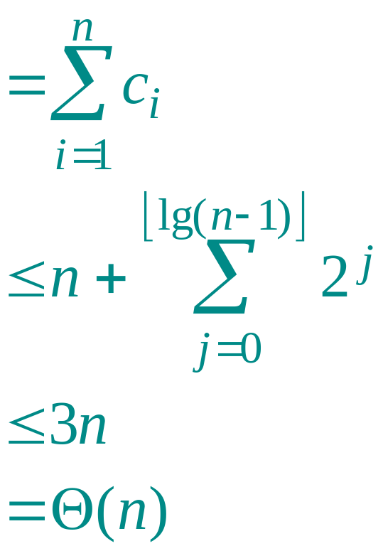
Tighter analysis (continued)
Cost of n insertions
.
Thus, the average cost of each dynamic-table operation is Θ(n)/n = Θ(1).
Introduction to Algorithms
October 31, 2001 L14.<number>

Slide 18
Amortized analysis
An amortized analysis is any strategy for analyzing a sequence of operations to show that the average cost per operation is small, even though a single operation within the sequence might be expensive.
Even though we’re taking averages, however, probability is not involved!
An amortized analysis guarantees the average performance of each operation in the worst case.
Introduction to Algorithms
October 31, 2001 L14.<number>

Slide 19
Types of amortized analyses
Three common amortization arguments:
the aggregate method,
the accounting method,
the potential method.
We’ve just seen an aggregate analysis.
The aggregate method, though simple, lacks the precision of the other two methods. In particular, the accounting and potential methods allow a specific amortized cost to be allocated to each operation.
Introduction to Algorithms
October 31, 2001 L14.<number>

Slide 20
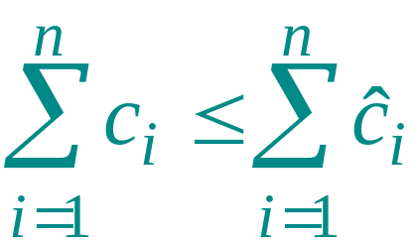
Accounting method
Charge i th operation a fictitious amortized cost ĉ_{i}, where $1 pays for 1 unit of work (i.e., time).
This fee is consumed to perform the operation.
Any amount not immediately consumed is stored in the bank for use by subsequent operations.
The bank balance must not go negative! We must ensure that
for all n.
Thus, the total amortized costs provide an upper bound on the total true costs.
Introduction to Algorithms
October 31, 2001 L14.<number>

Slide 21
Accounting analysis of dynamic tables
Charge an amortized cost of ĉ_{i} = $3 for the i th insertion.
$1 pays for the immediate insertion.
$2 is stored for later table doubling.
When the table doubles, $1 pays to move a recent item, and $1 pays to move an old item.
Example:
$0
$0
$0
$0
$2
$2
$2
$2
overflow
Introduction to Algorithms
October 31, 2001 L14.<number>

Slide 22
Accounting analysis of dynamic tables
Charge an amortized cost of ĉ_{i} = $3 for the i th insertion.
$1 pays for the immediate insertion.
$2 is stored for later table doubling.
When the table doubles, $1 pays to move a recent item, and $1 pays to move an old item.
Example:
overflow
$0
$0
$0
$0
$0
$0
$0
$0
Introduction to Algorithms
October 31, 2001 L14.<number>

Slide 23
Accounting analysis of dynamic tables
Charge an amortized cost of ĉ_{i} = $3 for the i th insertion.
$1 pays for the immediate insertion.
$2 is stored for later table doubling.
When the table doubles, $1 pays to move a recent item, and $1 pays to move an old item.
Example:
$0
$0
$0
$0
$0
$0
$0
$0
$2
$2
$2
Introduction to Algorithms
October 31, 2001 L14.<number>

Slide 24
Accounting analysis (continued)
Key invariant: Bank balance never drops below 0. Thus, the sum of the amortized costs provides an upper bound on the sum of the true costs.
i 1 2 3 4 5 6 7 8 9 10
size_{i} 1 2 4 4 8 8 8 8 16 16
c_{i} 1 2 3 1 5 1 1 1 9 1
ĉ_{i} 2 3 3 3 3 3 3 3 3 3
bank_{i} 1 2 2 4 2 4 6 8 2 4
*
*The first operation costs only $2, not $3.
Introduction to Algorithms
October 31, 2001 L14.<number>

Slide 25
Potential method
IDEA: View the bank account as the potential energy (à la physics) of the dynamic set.
Framework:
Start with an initial data structure D₀.
Operation i transforms D_{i–1} to D_{i}.
The cost of operation i is c_{i}.
Define a potential function Φ : {D_{i}} → R,
such that Φ(D₀ ) = 0 and Φ(D_{i} ) ≥ 0 for all i.
The amortized cost ĉ_{i} with respect to Φ is defined to be ĉ_{i} = c_{i} + Φ(D_{i}) – Φ(D_{i–1}).
Introduction to Algorithms
October 31, 2001 L14.<number>

Slide 26
Understanding potentials
ĉ_{i} = c_{i} + Φ(D_{i}) – Φ(D_{i–1})
potential difference ΔΦ_{i}
If ΔΦ_{i} > 0, then ĉ_{i} > c_{i}. Operation i stores work in the data structure for later use.
If ΔΦ_{i} < 0, then ĉ_{i} < c_{i}. The data structure delivers up stored work to help pay for operation i.
Introduction to Algorithms
October 31, 2001 L14.<number>

Slide 27
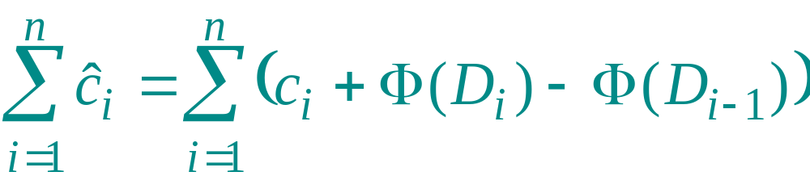
The amortized costs bound the true costs
The total amortized cost of n operations is
Summing both sides.
Introduction to Algorithms
October 31, 2001 L14.<number>

Slide 28
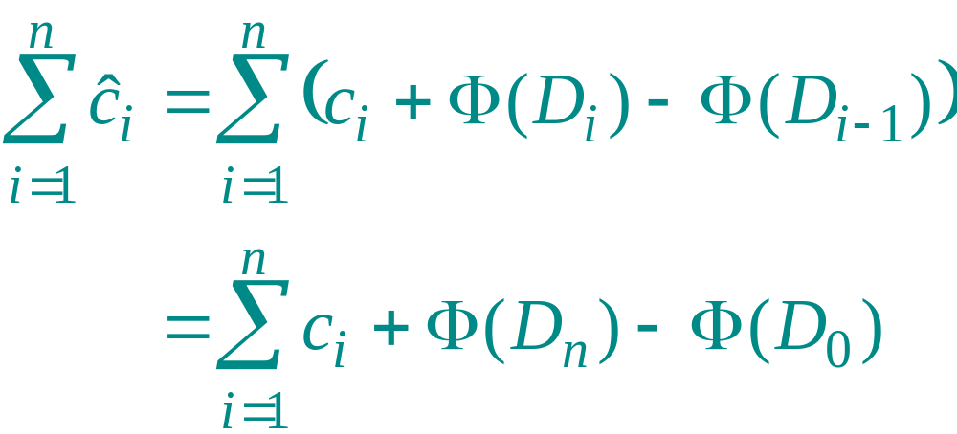
The amortized costs bound the true costs
The total amortized cost of n operations is
The series telescopes (each term
added and subtracted once,
except first and last terms)
Introduction to Algorithms
October 31, 2001 L14.<number>

Slide 29
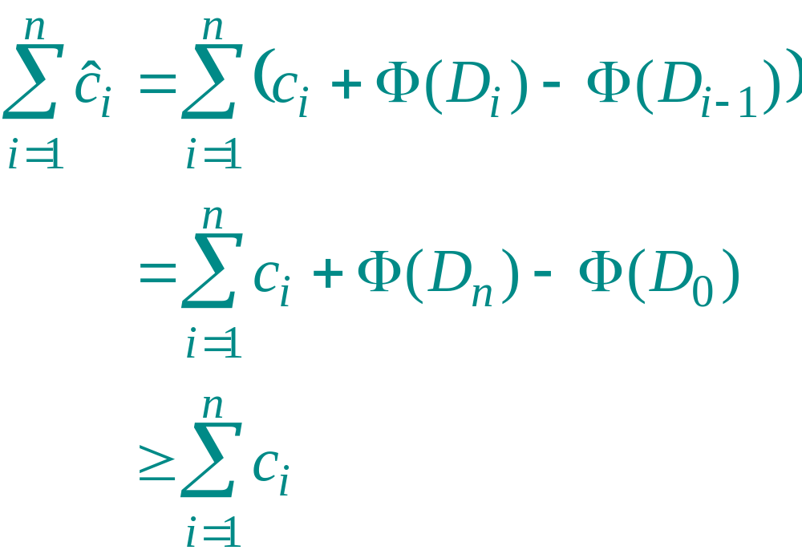
The amortized costs bound the true costs
The total amortized cost of n operations is
since Φ(D_{n}) ≥ 0 and
Φ(D₀ ) = 0.
Introduction to Algorithms
October 31, 2001 L14.<number>

Slide 30
Potential analysis of table doubling
Define the potential of the table after the ith insertion by Φ(D_{i}) = 2i – 2^{⎡lg i⎤}.
(Assume that 2^{⎡lg 0⎤} = 0.)
The second term
is just the current
table size!
Note:
Φ(D₀ ) = 0,
Φ(D_{i}) ≥ 0 for all i.
Example:
•
•
•
•
•
•
Φ = 2·6 – 2³ = 4
(
accounting method)
$0
$0
$0
$0
$2
$2
Introduction to Algorithms
October 31, 2001 L14.<number>

Slide 31
Calculation of amortized costs
The amortized cost of the i th insertion is
ĉ_{i} = c_{i} + Φ(D_{i}) – Φ(D_{i–1})
i + (2i – 2^{⎡lg i⎤}) – (2(i –1) – 2^{⎡lg (i–1)⎤})
  if i – 1 is an exact power of 2,
1 + (2i – 2^{⎡lg i⎤}) – (2(i –1) – 2^{⎡lg (i–1)⎤})
  otherwise.
=
Introduction to Algorithms
October 31, 2001 L14.<number>

Slide 32
Calculation (Case 1)
Case 1: i – 1 is an exact power of 2.
ĉ_{i} = i + (2i – 2^{⎡lg i⎤}) – (2(i –1) – 2^{⎡lg (i–1)⎤})
= i + 2 – (2^{⎡lg i⎤} – 2^{⎡lg (i–1)⎤})
= i + 2 – (2(i – 1) – (i – 1))
= i + 2 – 2i + 2 + i – 1
= 3
If (i-1) is exact power of 2, lg(i-1) is integer, therefore:
2^{⎡lg (i–1)⎤} = 2^{lg (i–1)} = (i-1)
If lg(i–1) is integer, then
⎡lg i⎤ is the next integer up, hence 2^{⎡lg i⎤} = 2 . 2^{⎡lg (i–1)⎤}
Introduction to Algorithms
October 31, 2001 L14.<number>

Slide 33
Calculation (Case 2)
Case 2: i – 1 is not an exact power of 2.
ĉ_{i} = 1 + (2i – 2^{⎡lg i⎤}) – (2(i –1) – 2^{⎡lg (i–1)⎤})
= 1 + 2 – (2^{⎡lg i⎤} – 2^{⎡lg (i–1)⎤})
= 3
If (i-1) is not exact power of 2,, then
2^{⎡lg i⎤} = 2^{⎡lg (i–1)⎤}
Therefore, n insertions cost Θ(n) in the worst case.
Exercise: Fix the bug in this analysis to show that the amortized cost of the first insertion is only 2.
Introduction to Algorithms
October 31, 2001 L14.<number>

Slide 34
Deletion
Suppose we allow deletions.
IDEA: Whenever the table becomes less than half-full, shrink it to half its current size by allocating (via malloc or new) a new, smaller table. Move all items from the old table into the new one, and free the storage for the old table.
Does this work?
Bad example:
As sequence of n/2 insertions
insert, delete, delete, insert, insert, delete, delete, insert, insert,....
Θ(n²)
Introduction to Algorithms
October 31, 2001 L14.<number>

Slide 35
Deletion
Suppose we allow deletions.
Solution: allow for some operations to be done before rebuilding the table; this way we will have done enough work to pay for the cost of rebuilding.
Method that works:
If the load factor α becomes 1, double the table size
If the load factor α drops below 1/4 shrink the table to half its current size
Introduction to Algorithms
October 31, 2001 L14.<number>

Slide 36
Potential analysis of table doubling/shrinking
Recall: We defined the potential of the table after the ith insertion by
Φ(D_{i}) = 2i – 2^{⎡lg i⎤} = 2*num(D_{i})−size(D_{i}).
New potential function: We define the potential of the table after the ith operation by
Φ(D_{i}) = 2*num(D_{i})−size(D_{i}) if α(D_{i}) ≥1/2
Φ(D_{i}) = size(D_{i})/2−num(D_{i}) if α(D_{i}) <1/2.
Introduction to Algorithms
October 31, 2001 L14.<number>

Slide 37
Potential analysis of table doubling/shrinking
Case analysis: ith operation is
INSERT
DELETE
α(D_{i}) ≥1/2, α(D_{i−1}) ≥ 1/2
α(D_{i−1}) =1/4
α(D_{i}) <1/2, α(D_{i−1}) < 1/2
1/4 < α(D_{i−1}) < 1/2
α(D_{i}) ≥1/2, α(D_{i−1}) < 1/2
α(D_{i−1}) ≥ 1/2
Introduction to Algorithms
October 31, 2001 L14.<number>

Slide 38
Case:
INSERT, α(D_{i}) <1/2, α(D_{i−1}) < 1/2
Φ(D_{i}) = size(D_{i})/2−num(D_{i}) no expansion
Φ(D_{i−1}) = size(D_{i−1})/2−num(D_{i−1})
size(D_{i−1})=size(D_{i})
num(D_{i−1})=num(D_{i})−1, c_{i}=1
ĉ_{i} =1+ Φ(D_{i}) − Φ(D_{i−1})
=1+(size(D_{i})/2−num(D_{i}))−(size(D_{i−1})/2−num(D_{i−1}))
=0.
Introduction to Algorithms
October 31, 2001 L14.<number>

Slide 39
Potential analysis of table doubling/shrinking
Case analysis: ith operation is
INSERT
DELETE
α(D_{i}) ≥1/2, α(D_{i−1}) ≥ 1/2
α(D_{i−1}) = 1/4
α(D_{i}) <1/2, α(D_{i−1}) < 1/2
1/4 < α(D_{i−1}) < 1/2
α(D_{i}) ≥1/2, α(D_{i−1}) < 1/2
α(D_{i−1}) ≥ 1/2
Introduction to Algorithms
October 31, 2001 L14.<number>

Slide 40
Case:
INSERT, α(D_{i}) ≥1/2, α(D_{i−1}) < 1/2
no expansion
Φ(D_{i}) = 2*num(D_{i})− size(D_{i})
Φ(D_{i−1}) = size(D_{i−1})/2−num(D_{i−1})
size(D_{i−1})=size(D_{i})
num(D_{i−1})=num(D_{i})−1, c_{i}=1
ĉ_{i} =1+ Φ(D_{i}) − Φ(D_{i−1})
=1+(2*num(D_{i}) −size(D_{i}))−(size(D_{i−1})/2−num(D_{i−1}))
=1+(2*(num(D_{i−1}) +1) − size(D_{i}))
−(size(D_{i−1})/2−num(D_{i−1}))
=3+ 3*num(D_{i−1}) − 3 size(D_{i})/2
Introduction to Algorithms
October 31, 2001 L14.<number>

Slide 41
Case:
INSERT, α(D_{i}) ≥1/2, α(D_{i−1}) < 1/2
ĉ_{i} =1+ Φ(D_{i}) − Φ(D_{i−1})
=1+(2*num(D_{i}) −size(D_{i}))−(size(D_{i−1})/2−num(D_{i−1}))
=1+(2*(num(D_{i−1}) +1) − size(D_{i}))
−(size(D_{i−1})/2−num(D_{i−1}))
=3+ 3*num(D_{i−1}) − 3 size(D_{i−1})/2
=3+3 α(D_{i−1}) size(D_{i−1}) − 3 size(D_{i−1})/2
<3+ size(D_{i−1})/2− 3 size(D_{i−1})/2
(since α(D_{i−1}) < 1/2)
=3.
Introduction to Algorithms
October 31, 2001 L14.<number>

Slide 42
Potential analysis of table doubling/shrinking
Case analysis: ith operation is
INSERT
DELETE
α(D_{i}) ≥1/2, α(D_{i−1}) ≥ 1/2
α(D_{i−1}) = 1/4
α(D_{i}) <1/2, α(D_{i−1}) < 1/2
1/4 < α(D_{i−1}) < 1/2
α(D_{i}) ≥1/2, α(D_{i−1}) < 1/2
α(D_{i−1}) ≥ 1/2
Introduction to Algorithms
October 31, 2001 L14.<number>

Slide 43
Case:
DELETE, α(D_{i−1}) = 1/4
Φ(D_{i}) = size(D_{i})/2−num(D_{i}) contract
Φ(D_{i−1}) = size(D_{i−1})/2−num(D_{i−1})
size(D_{i−1})=2*size(D_{i})
num(D_{i−1})=num(D_{i})+1, c_{i}= num(D_{i})+1
ĉ_{i} =(num(D_{i})+1)+ Φ(D_{i}) − Φ(D_{i−1})
=(num(D_{i})+1)+(size(D_{i})/2−num(D_{i}))
−(size(D_{i−1})/2−num(D_{i−1}))
=1+ size(D_{i})/2−size(D_{i−1})/2+size(D_{i−1})/4
=1 + size(D_{i−1})/4−size(D_{i−1})/2+size(D_{i−1})/4 =1.
Introduction to Algorithms
October 31, 2001 L14.<number>

Slide 44
Potential analysis of table doubling/shrinking
Case analysis: ith operation is
INSERT
DELETE
α(D_{i}) ≥1/2, α(D_{i−1}) ≥ 1/2
α(D_{i−1}) = 1/4
α(D_{i}) <1/2, α(D_{i−1}) < 1/2
1/4 < α(D_{i−1}) < 1/2
α(D_{i}) ≥1/2, α(D_{i−1}) < 1/2
α(D_{i−1}) ≥ 1/2
Introduction to Algorithms
October 31, 2001 L14.<number>

Slide 45
Case:
DELETE, 1/4 < α(D_{i−1}) < 1/2
Φ(D_{i}) = size(D_{i})/2−num(D_{i}) no contraction
Φ(D_{i−1}) = size(D_{i−1})/2−num(D_{i−1})
size(D_{i−1})=size(D_{i})
num(D_{i−1})=num(D_{i})+1, c_{i}=1
ĉ_{i} =1+ Φ(D_{i}) − Φ(D_{i−1})
=1+(size(D_{i})/2−num(D_{i}))−(size(D_{i−1})/2−num(D_{i−1}))
=1+ num(D_{i−1})−num(D_{i})
=2.
Introduction to Algorithms
October 31, 2001 L14.<number>

Slide 46
Conclusions
Amortized costs can provide a clean abstraction of data-structure performance.
Any of the analysis methods can be used when an amortized analysis is called for, but each method has some situations where it is arguably the simplest.
Different schemes may work for assigning amortized costs in the accounting method, or potentials in the potential method, sometimes yielding radically different bounds.
Introduction to Algorithms
October 31, 2001 L14.<number>

