Slide 1
Inference in first-order logic
Andreas Henschel
Updated from textbook slides

Slide 2
Outline
Reducing first-order inference to propositional inference
Unification
Generalized Modus Ponens
Forward chaining
Backward chaining
Resolution

Slide 3
Universal instantiation (UI)
Every instantiation of a universally quantified sentence is entailed by it:
∀v α Subst({v/g}, α) for any variable v and ground term g (i.e. term with no variables)
Remember: a term is something that refers to an object
E.g. Subst({x/Omar, y/Ali}, friends(x,y)) = friends(Omar, Ali)
E.g., ∀x King(x) ∧ Greedy(x) ⇒ Evil(x) can yield substitutions:
King(John) ∧ Greedy(John) ⇒ Evil(John)
King(Richard) ∧ Greedy(Richard) ⇒ Evil(Richard)
King(Father(John)) ∧ Greedy(Father(John)) ⇒ Evil(Father(John))

Slide 4
Existential instantiation (EI)
For any sentence α, variable v, and constant symbol k that does not appear elsewhere in the knowledge base:
∃v α
Subst({v/k}, α)
E.g., ∃x Crown(x) ∧ OnHead(x,John) yields:
Crown(C₁) ∧ OnHead(C₁,John)
provided C₁ is a new constant symbol, called a Skolem constant

Slide 5
Reduction to propositional inference
Suppose the KB contains just the following:
∀x King(x) ∧ Greedy(x) ⇒ Evil(x)
King(John)
Greedy(John)
Brother(Richard,John)
Instantiating the universal sentence in all possible ways, we have:
King(John) ∧ Greedy(John) ⇒ Evil(John)
King(Richard) ∧ Greedy(Richard) ⇒ Evil(Richard)
King(John)
Greedy(John)
Brother(Richard,John)
The new KB is propositionalized

Slide 6
Reduction contd.
Every FOL KB can be propositionalized so as to preserve entailment
(A ground sentence is entailed by new KB iff entailed by original KB)
Idea: propositionalize KB and query, apply resolution, return result
Problem: with function symbols, there are infinitely many ground terms,
e.g., Father(Father(Father(John)))

Slide 7
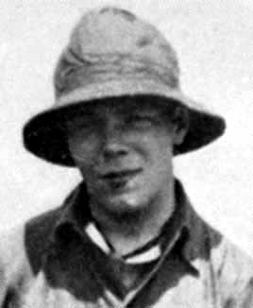
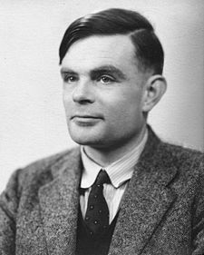
Reduction contd.
Theorem: Herbrand (1930). If a sentence α is entailed by an FOL KB, it is entailed by a finite subset of the propositionalized KB
Idea: For n = 0 to ∞ do
create a propositional KB by instantiating with depth-n terms
see if α is entailed by this KB
Problem: works if α is entailed, loops if α is not entailed
Theorem: Turing (1936), Church (1936) Entailment for FOL is semidecidable (algorithms exist that say yes to every entailed sentence, but no algorithm exists that also says no to every nonentailed sentence.)
Jacques Herbrand
(1908-1931)
Alan Turing
(1912-1954)

Slide 8
Problems with propositionalization
Propositionalization seems to generate lots of irrelevant sentences.
E.g., from:
∀x King(x) ∧ Greedy(x) ⇒ Evil(x)
King(John)
∀y Greedy(y)
Brother(Richard,John)
it seems obvious that Evil(John), but propositionalization produces lots of facts such as Greedy(Richard) that are irrelevant
With p k-ary predicates and n constants, there are p·n^{k} instantiations.

Slide 9
Unification
We can get the inference immediately if we can find a substitution θ such that King(x) and Greedy(x) match King(John) and Greedy(y)
θ = {x/John,y/John} works
Unify(α,β) = θ if αθ = βθ
p q θ
Knows(John,x) Knows(John,Jane)
Knows(John,x) Knows(y,OJ)
Knows(John,x) Knows(y,Mother(y))
Knows(John,x) Knows(x,OJ)
Standardizing apart eliminates overlap of variables, e.g., Knows(z₁₇,OJ)

Slide 10
Unification
We can get the inference immediately if we can find a substitution θ such that King(x) and Greedy(x) match King(John) and Greedy(y)
θ = {x/John,y/John} works
Unify(α,β) = θ if αθ = βθ
p q θ
Knows(John,x) Knows(John,Jane) {x/Jane}}
Knows(John,x) Knows(y,OJ)
Knows(John,x) Knows(y,Mother(y))
Knows(John,x) Knows(x,OJ)
Standardizing apart eliminates overlap of variables, e.g., Knows(z₁₇,OJ)

Slide 11
Unification
We can get the inference immediately if we can find a substitution θ such that King(x) and Greedy(x) match King(John) and Greedy(y)
θ = {x/John,y/John} works
Unify(α,β) = θ if αθ = βθ
p q θ
Knows(John,x) Knows(John,Jane) {x/Jane}}
Knows(John,x) Knows(y,OJ) {x/OJ,y/John}}
Knows(John,x) Knows(y,Mother(y))
Knows(John,x) Knows(x,OJ)
Standardizing apart eliminates overlap of variables, e.g., Knows(z₁₇,OJ)

Slide 12
Unification
We can get the inference immediately if we can find a substitution θ such that King(x) and Greedy(x) match King(John) and Greedy(y)
θ = {x/John,y/John} works
Unify(α,β) = θ if αθ = βθ
p q θ
Knows(John,x) Knows(John,Jane) {x/Jane}}
Knows(John,x) Knows(y,OJ) {x/OJ,y/John}}
Knows(John,x) Knows(y,Mother(y)) {y/John,x/Mother(John)}}
Knows(John,x) Knows(x,OJ)
Standardizing apart eliminates overlap of variables, e.g., Knows(z₁₇,OJ)

Slide 13
Unification
We can get the inference immediately if we can find a substitution θ such that King(x) and Greedy(x) match King(John) and Greedy(y)
θ = {x/John,y/John} works
Unify(α,β) = θ if αθ = βθ
p q θ
Knows(John,x) Knows(John,Jane) {x/Jane}}
Knows(John,x) Knows(y,OJ) {x/OJ,y/John}}
Knows(John,x) Knows(y,Mother(y)) {y/John,x/Mother(John)}}
Knows(John,x) Knows(x,OJ) {fail}
Standardizing apart eliminates use of same variable name in different sentences by renaming variables: Knows(z₁₇,OJ)

Slide 14
Unification
To unify Knows(John,x) and Knows(y,z),
θ = {y/John, x/z } or θ = {y/John, x/John, z/John}
The first unifier is more general than the second.
Places fewer restrictions on the values of variables
There is a single most general unifier (MGU) that is unique up to renaming of variables.
MGU = { y/John, x/z }

Slide 15
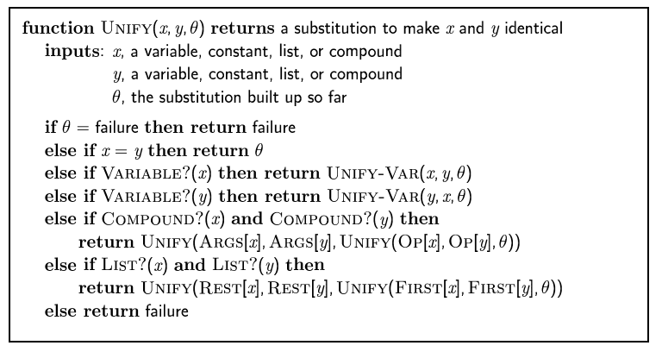
The unification algorithm
Compare the structures of the inputs, element by element. The substitution θ that is the argument to UNIFY is built up along the way and is used to make sure that later comparisons are consistent with the bindings established earlier.

Slide 16
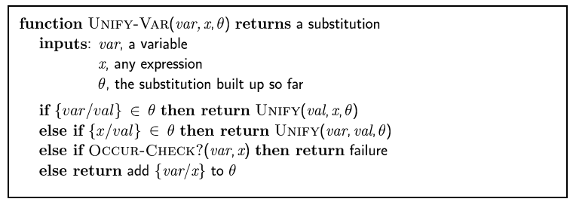
The unification algorithm

Slide 17
Generalized Modus Ponens (GMP)
p₁', p₂', … , p_{n}', ( p₁ ∧ p₂ ∧ … ∧ p_{n} ⇒q)
qθ
p₁' is King(John) p₁ is King(x)
p₂' is Greedy(y) p₂ is Greedy(x)
θ is {x/John,y/John} q is Evil(x)
q θ is Evil(John)
GMP used with KB of definite clauses (exactly one positive literal)
Remember: definite clause q is called a fact
All variables assumed universally quantified
where p_{i}'θ = p_{i} θ for all i

Slide 18
Soundness of GMP
Need to show that
p₁', …, p_{n}', (p₁ ∧ … ∧ p_{n} ⇒ q) ╞ qθ
provided that p_{i}'θ = p_{i}θ for all I
Lemma: For any sentence p, we have p ╞ pθ by Universal Instantiation
(p₁ ∧ … ∧ p_{n} ⇒ q) ╞ (p₁ ∧ … ∧ p_{n} ⇒ q)θ = (p₁θ ∧ … ∧ p_{n}θ ⇒ qθ)
p₁', …, p_{n}' ╞ p₁' ∧ … ∧ p_{n}' ╞ p₁'θ ∧ … ∧ p_{n}'θ
From 1 and 2, qθ follows by ordinary Modus Ponens

Slide 19
Example knowledge base
The law says that it is a crime for an American to sell weapons to hostile nations. The country Nono, an enemy of America, has some missiles, and all of its missiles were sold to it by Colonel West, who is American.
Prove that Col. West is a criminal

Slide 20
Example knowledge base contd.
... it is a crime for an American to sell weapons to hostile nations:
American(x) ∧ Weapon(y) ∧ Sells(x,y,z) ∧ Hostile(z) ⇒ Criminal(x)
Nono … has some missiles, i.e., ∃x Owns(Nono,x) ∧ Missile(x):
Owns(Nono,M₁) and Missile(M₁)
… all of its missiles were sold to it by Colonel West
Missile(x) ∧ Owns(Nono,x) ⇒ Sells(West,x,Nono)
Missiles are weapons:
Missile(x) ⇒ Weapon(x)
An enemy of America counts as "hostile“:
Enemy(x,America) ⇒ Hostile(x)
West, who is American …
American(West)
The country Nono, an enemy of America …
Enemy(Nono,America)

Slide 21
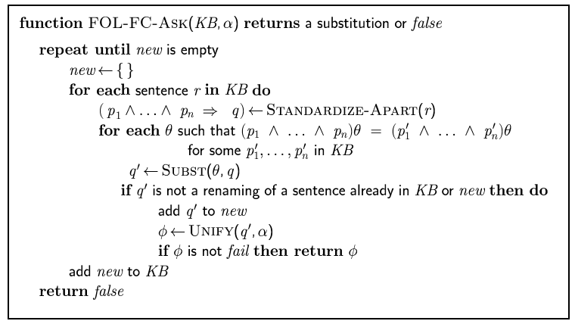
Forward chaining algorithm

Slide 22
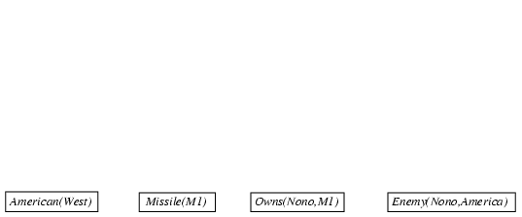
Forward chaining proof

Slide 23
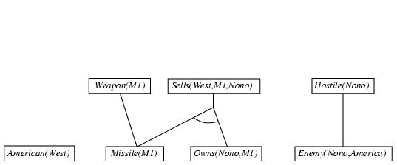
Forward chaining proof

Slide 24
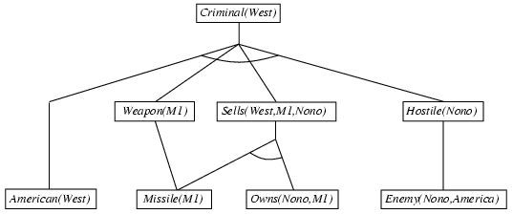
Forward chaining proof

Slide 25
Properties of forward chaining
Sound and complete for first-order definite clauses
Datalog = first-order definite clauses + no functions
FC terminates for Datalog in finite number of iterations
May not terminate in general if α is not entailed
This is unavoidable: entailment with definite clauses is semidecidable

Slide 26
Efficiency of forward chaining
Problems:
Inner loop finds all possible unifiers s.t. the premise of a rule unifies with facts in the KB (called “pattern matching”)
But some are more likely to lead to a solution
Similar to heuristics for CSP variable assignment
Rechecks every rule on every iteration to see if its premises are satisfied, even if very few additions were made to KB
Generates many irrelevant facts

Slide 27
Efficiency of forward chaining
Incremental forward chaining: no need to match a rule on iteration k if a premise wasn't added on iteration k-1
⇒ match each rule whose premise contains a newly added positive literal
Matching itself can be expensive:
Database indexing allows O(1) retrieval of known facts
e.g., query Missile(x) retrieves Missile(M₁)
Forward chaining is widely used in deductive databases

Slide 28
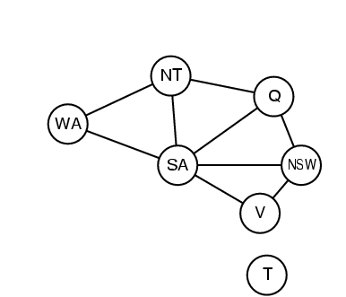
Why Matching is Hard?
Diff(wa,nt) ∧ Diff(wa,sa) ∧ Diff(nt,q) ∧ Diff(nt,sa) ∧ Diff(q,nsw) ∧ Diff(q,sa) ∧ Diff(nsw,v) ∧ Diff(nsw,sa) ∧ Diff(v,sa) ⇒ Colorable()
Diff(Red,Blue) Diff (Red,Green) Diff(Green,Red) Diff(Green,Blue) Diff(Blue,Red) Diff(Blue,Green)
Colorable() is inferred iff the CSP has a solution
CSPs include 3SAT as a special case, hence matching is NP-hard

Slide 29
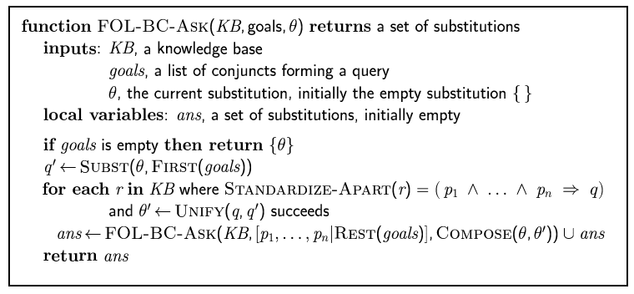
Backward chaining algorithm
SUBST(COMPOSE(θ₁, θ₂), p) = SUBST(θ₂, SUBST(θ₁, p))
Note: 3rd edition book has a different version

Slide 30

Backward chaining example

Slide 31
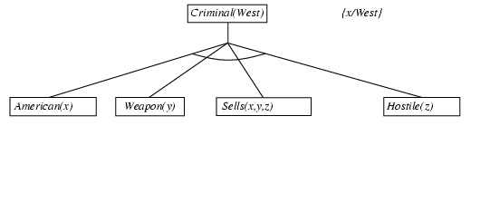
Backward chaining example

Slide 32
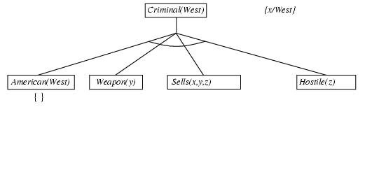
Backward chaining example

Slide 33
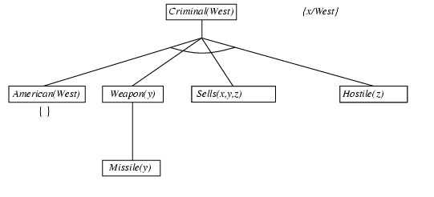
Backward chaining example

Slide 34
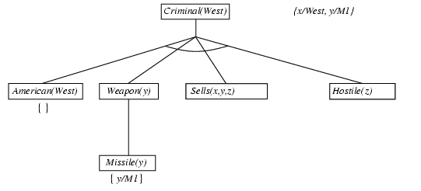
Backward chaining example

Slide 35
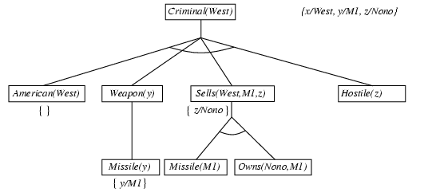
Backward chaining example

Slide 36
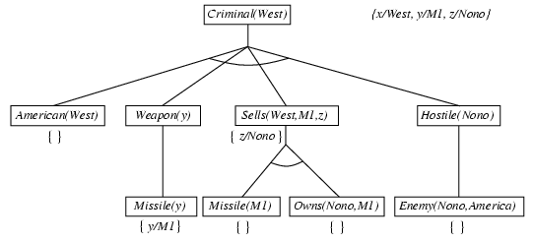
Backward chaining example

Slide 37
Backward chaining example

Slide 38
Properties of backward chaining
Depth-first recursive proof search: space is linear in size of proof
Incomplete due to infinite loops
⇒ fix by checking current goal against every goal on stack
Inefficient due to repeated subgoals (both success and failure)
⇒ fix using caching of previous results (extra space)
Widely used for logic programming

Slide 39
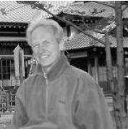
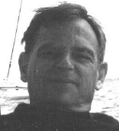
Logic programming: Prolog
Algorithm = Logic + Control
Basis: backward chaining with Horn clauses + bells & whistles
Program = set of clauses = head :- literal₁, … literal_{n}.
criminal(X) :- american(X), weapon(Y), sells(X,Y,Z), hostile(Z).
Depth-first, left-to-right backward chaining
Built-in predicates for arithmetic etc., e.g., X is Y*Z+3
Closed-world assumption ("negation as failure")
e.g., given alive(X) :- not dead(X).
alive(joe) succeeds if dead(joe) fails
Bob Kowalski
(1941-)
Alain Colmerauer
(1941-)

Slide 40
Prolog
Program: Appending two lists to produce a third:
append([],Y,Y).
append([A|X],Y,[A|Z]) :- append(X,Y,Z). [A|X] is a list with head A and tail X
Appending an empty list [] with list Y produces Y
[A|Z] is the result of appending [A|X] onto Y provided that Z is the result of appending X onto Y.
Query: append(X,Y,[1,2]) ?
Answers: X=[] Y=[1,2];
X=[1] Y=[2];
X=[1,2] Y=[]

Slide 41
Resolution: brief summary
Full first-order version:
l₁ ∨ ··· ∨ l_{k}, m₁ ∨ ··· ∨ m_{n}
(l₁ ∨ ··· ∨ l_{i-1} ∨ l_{i+1} ∨ ··· ∨ l_{k} ∨ m₁ ∨ ··· ∨ m_{j-1} ∨ m_{j+1} ∨ ··· ∨ m_{n})θ
where Unify(l_{i}, ¬m_{j}) = θ
The two clauses are assumed to be standardized apart so that they share no variables.
For example,
¬Rich(x) ∨ Unhappy(x)
Rich(Ken)
Unhappy(Ken)
with θ = {x/Ken}
Apply resolution steps to CNF(KB ∧ ¬α); complete for FOL

Slide 42
Conversion to CNF
Everyone who loves all animals is loved by someone:
∀x [∀y Animal(y) ⇒ Loves(x,y)] ⇒ [∃y Loves(y,x)]
1. Eliminate biconditionals and implications
∀x [¬∀y ¬Animal(y) ∨ Loves(x,y)] ∨ [∃y Loves(y,x)]
2. Move ¬ inwards: ¬∀x p ≡ ∃x ¬p, ¬ ∃x p ≡ ∀x ¬p
∀x [∃y ¬(¬Animal(y) ∨ Loves(x,y))] ∨ [∃y Loves(y,x)]
∀x [∃y ¬¬Animal(y) ∧ ¬Loves(x,y)] ∨ [∃y Loves(y,x)]
∀x [∃y Animal(y) ∧ ¬Loves(x,y)] ∨ [∃y Loves(y,x)]

Slide 43
Conversion to CNF contd.
Standardize variables: each quantifier should use a different one
∀x [∃y Animal(y) ∧ ¬Loves(x,y)] ∨ [∃z Loves(z,x)]
Skolemize: a more general form of existential instantiation.
Each existential variable is replaced by a Skolem function of the enclosing universally quantified variables:
∀x [Animal(F(x)) ∧ ¬Loves(x,F(x))] ∨ Loves(G(x),x)
Drop universal quantifiers:
[Animal(F(x)) ∧ ¬Loves(x,F(x))] ∨ Loves(G(x),x)
Distribute ∨ over ∧ :
[Animal(F(x)) ∨ Loves(G(x),x)] ∧ [¬Loves(x,F(x)) ∨ Loves(G(x),x)]

Slide 44
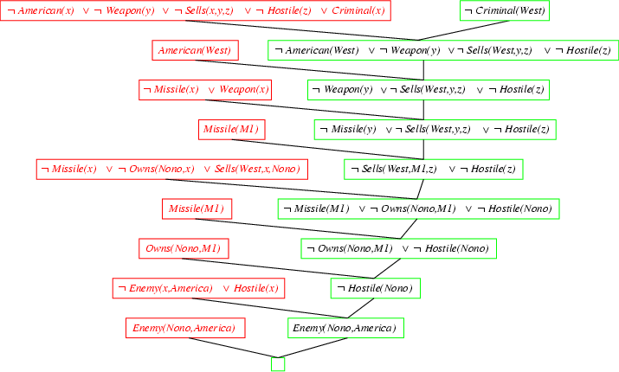
Resolution proof: definite clauses

Slide 45
Required Reading
Stuart Russell and Peter Norvig. Artificial Intelligence: A Modern Approach. Prentice Hall, 3rd Edition, 2010
Chapter 9
Optional parts:
Section 9.2.3
Sections 9.4.3-9.4.6
Sections 9.5.4-9.5.6

