Slide 1
Techniques in
Artificial Intelligence
Beyond Classical Search
Andreas Henschel
Credit: Based on slides from Iyad Rahwan, Dan Klein (Berkeley), and modified by Stuart Russell, Andrew Moore, Teg Grenager, Peter Norvig (Stanford)

Slide 2

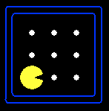





Remember
A search problem consists of:
  A state space
  A successor function
  A start state, goal test, and path cost function
A solution is a sequence of actions (a plan) which transforms the start state to a goal state
N, 1
E, 1

Slide 3
State Space Graphs
State space graph: A mathematical representation of a search problem
  For every search problem, there’s a corresponding state space graph
  The successor function is represented by arcs
a
G
b
c
e
d
f
S
h
p
q
r

Slide 4
Un-informed Search: Summary
 | Complete? | Optimal? | Time | Space
Depth First Search | N (Y if no cycles) | N | O(b^{m}) | O(bm)
Depth-Limited Search | N | N | O(b^{l}) | O(bl)
Breadth First Search | Y | N (Y if identical step costs) | O(b^{s}) | O(b^{s})
Iterative Deepening | Y | N (Y if identical step costs) | O(b^{s}) | O(bs)
Uniform Cost Search (if arc costs available) | Y Costs > 0 | Y | O(b^{C*/ε}) | O(b^{C*/ε})
Bi-directional (if applicable) | Y | Y | O(b^{s/2}) | O(b^{s/2})
n: Number of states
b: Average branching factor
s: Depth of shallowest goal
m: Maximum tree depth
ε : Minimum step cost
C*: Cost of least cost goal
l: Depth limit

Slide 5
Summary: A*
A* uses both backward costs, g(n), and (estimates of) forward costs, h(n)
A* is optimal with admissible heuristics
Heuristic design is key: often use relaxed problems

Slide 6
Local Search

Slide 7
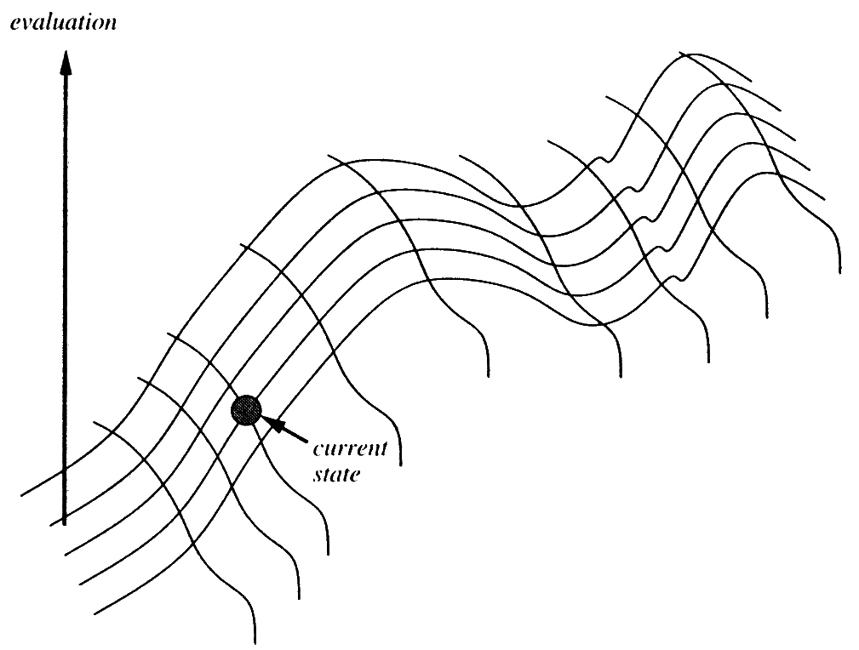
Local Search
Start with a complete configuration and make modifications to improve its quality
Suitable when solutions are states, not paths

Slide 8
Hill Climbing Search
Move up (according to some heuristic)
Stop when you reach a peak
Also called “greedy local search”
function HILL-CLIMBING(problem) returns a solution state
inputs: problem, a problem
static: current, a node
next, a node
current ← MAKE-NODE(INITIAL-STATE[problem])
loop do
next ← a highest-valued successor of current
if VALUE[next] < VALUE[current] then return current
current ← next
end

Slide 9

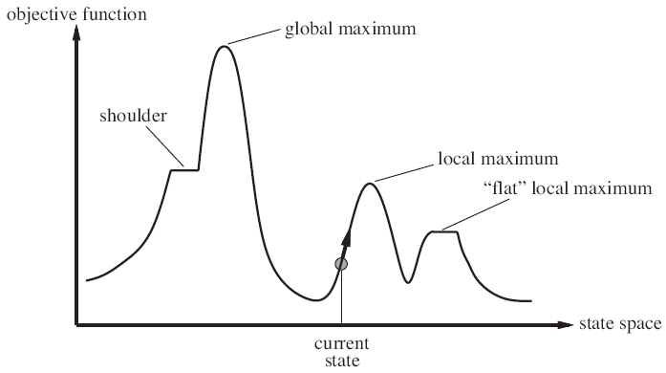
Hill Climbing Can Get Stuck

Slide 10
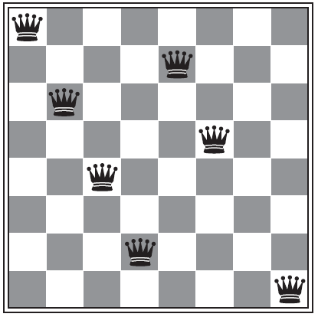
n-Queen Problem
Goal: place n queens on an n x n chess board, with no two attacking each other
Suppose we use heuristic:
  h = # of pairs attacking each other

Slide 11
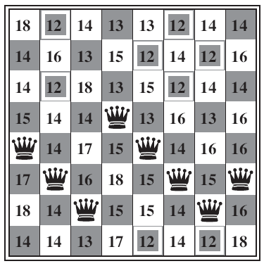
Hill Climbing with 8-Queens
State with h=17
Numbers are values of h for each successor obtained by moving a queen within its column

Slide 12
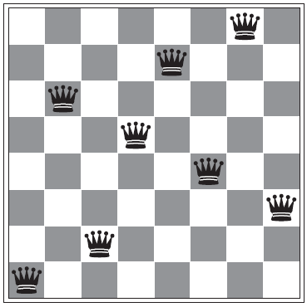
8-Queen in Local Minimum
Here, h=1 (almost there)
But no way to improve in a single step
Random-restart
  Let p = probability of success of each hill climb
  Need 1/p restarts
  Performance depends on state-space surface

Slide 13
Simulated Annealing
Idea:
  Hill-climbing
  Random restart
    If resulting node is better, accept it
    Else, if it is worse, accept with some probability that decreases exponentially with “badness”
  Reduce randomness (jump size) gradually
    Like cooling a metal
    Reduces likelihood of bad moves
Applied widely in VLSI layout design and factory and airline scheduling

Slide 14
Simulated Annealing Algorithm
function SIMULATED-ANNEALING(problem,schedule) returns a solution state
inputs: problem, a problem
schedule, a mapping from time to “temperature”
static: current, a node
next, a node
T, a “temperature” controlling the probability of downward steps
current ← MAKE-NODE(INITIAL-STATE[problem])
for t ← 1 to ∞ do
T ← schedule[t]
if T=0 then return current
next ← a randomly selected successor of current
ΔE ← VALUE[next] – VALUE[current]
if ΔE > 0 then current ← next
else current ← next only with probability e ^{ΔE/T}

Slide 15
Local Beam Search
Keep track of k states rather than just one
Start with k randomly generated states
At each iteration, all the successors of all k states are generated
If any one is a goal state, stop; else select the k best successors from the complete list and repeat.

Slide 16
Genetic Algorithms
Start with k randomly generated states (population)
  A state is represented as a string over a finite alphabet (often a string of 0s and 1s)
A successor state is generated by combining two parent states
Evaluation function (fitness function).
  Higher values for better states.
Produce the next generation of states by selection, crossover, and mutation

Slide 17

Genetic Algorithms
Reproduce according to probabilities derived from fitness
  24/(24+23+20+11) = 31%
  23/(24+23+20+11) = 29% etc
Some may mate multiple times, others never!

Slide 18

Genetic Algorithms for n-Queens
Fitness function: number of non-attacking pairs of queens (min = 0, max = 8 × 7/2 = 28)
Cross over at the line
This corresponds to first 2 parents in previous slides

Slide 19
Search with Non-Deterministic Actions

Slide 20
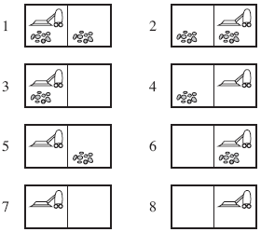
Erratic Vacuum World
Goal states: 7 & 8
Suppose:
  If current square is clean, “suck” sometimes cleans adjacent square too
  If current square is dirty, “suck” sometimes deposits dirt on carpet
First modification needed:
  Transition model must return set of resulting states

Slide 21
Erratic Vacuum World
No single sequence of actions to reach the goal
Second modification needed:
  Solution is not a sequence of actions, but a contingency plan:
  [Suck, if State = 5,
  then [Right, Suck]
  else []]
Can be defined recursively

Slide 22
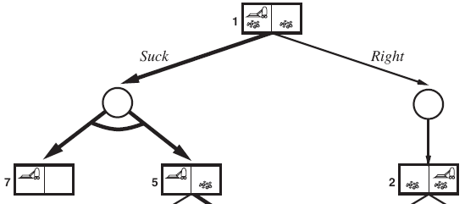
AND-OR Search Tree
OR node: Branches upon agent’s action
  Suck or Right (considers all actions)
AND node: Branches to possible results
  E.g. consider both outcomes of “Suck”
Solution = plan, corresponds to sub-tree (not a path) with:
  Goal in every leaf node
  Choice on each OR node
  Includes every branch
  at each AND node

Slide 23
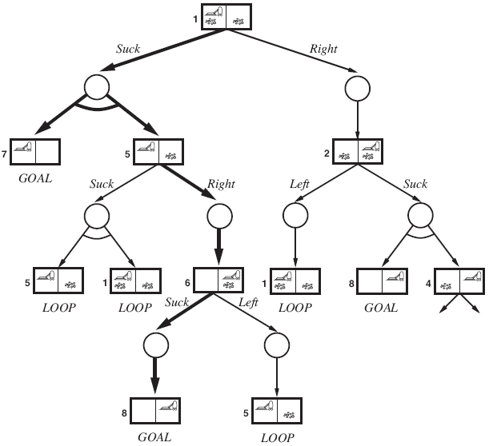
AND-OR Search Tree
Solution sub-tree
shown in bold arrows
Corresponds to plan:
[Suck, if State = 5,
  then [Right, Suck]
  else []]
See book for (depth-first) AND-OR Graph Search algorithm

Slide 24
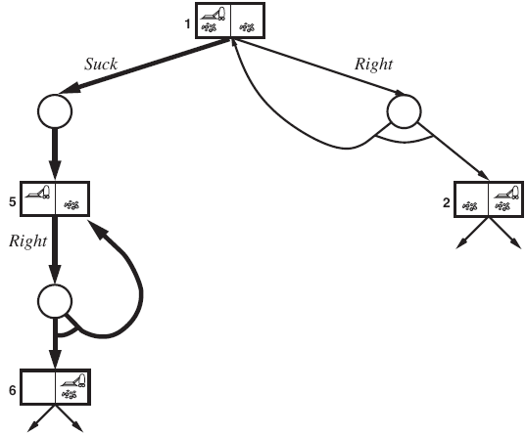
Cyclicity: Slippery Vacuum World
Movement actions may fail
Solution = cyclic plan
Label parts and return to them, e.g.
[Suck, L1: Right, if State = 5
then L1
else Suck]
Needs modifications to AND-OR Graph Search algorithms
Part of cyclic AND-OR search graph

Slide 25
Search with No Observation
(so-called conformant problems)

Slide 26
Belief-State Search Problem
Belief states: All possible sub-sets of states in original problem
  b = {1,2} means I might be in state 1 or 2
Initial state: All states (no idea where I am)
Actions: if b is the current belief state
  ACTIONS(b) = actions possible in any s ∈ b
Transition model: if b is the current belief state
  RESULT(b,a) = set of all states that could result from executing a in any state in b
  If a is non-deterministic: union over all results of a in each s ∈ b
Goal test: Do all states in b satisfy the goal condition?
Path cost: Tricky! We assume identical action costs

Slide 27
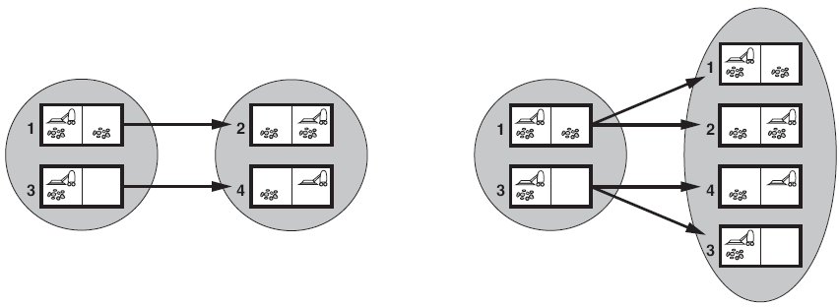
Predicting Next Belief State
Shaded ovals are belief states
Deterministic action
Non-deterministic action
Prediction: PREDICT(b,a)
Process of generating new belief state after action

Slide 28
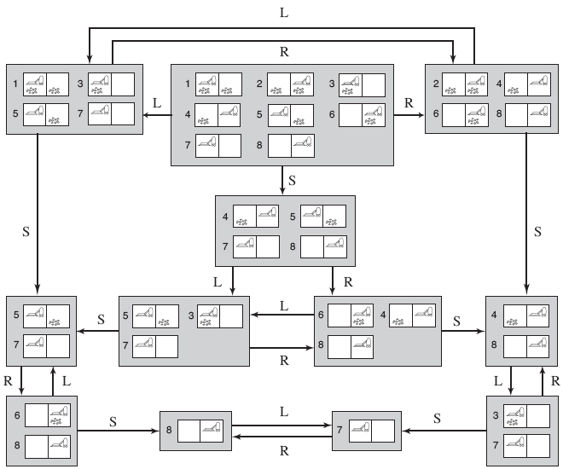
Deterministic Sensorless Vacuum World
Apply normal search algorithm to get to goal state!

Slide 29
Belief-State Search Problem: Issues
Belief state explosion
  Initial belief state in 10 x 10 vacuum world contains 100 x 2¹⁰⁰ ~ 10³² states
Solution?
  Compact descriptions of belief states
  First: Believe(nothing)
  After moving left: Believe(not in right box)
  Etc.
More on this later

Slide 30
Search with (Partial) Observation

Slide 31
Local Sensing
Sensor returns a percept: PERCEPT(s)
  Example: PERCEPT(s) = [A,Dirty]
    Detect current square name and its dirt status
Prediction stage (of next belief state):
  b^ = PREDICT(b,a)
Observation prediction stage:
  POSSIBLE-PERCEPTS(b^) = possible percepts from predicted belief state
Update stage (updated belief state)
  UPDATE(b^,o) = States in predicted belief state b^ that could have produced percept o

Slide 32
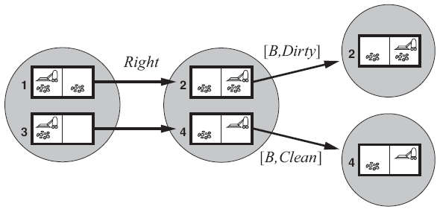
Local-sensing (Deterministic)
Possible belief states resulting from an action:
  RESULTS(b,a) = {b_{o} : b_{o} = UPDATE(PREDICT(b,a),o) and
  o ∈ POSSIBLE-PERCEPTS(PREDICT(b,a)) }
Initial belief state b = {1,3}
Take action Right
Two possible percepts
  [B,Dirty] leads to belief state {2}
  [B,Clean] leads to belief state {4}

Slide 33
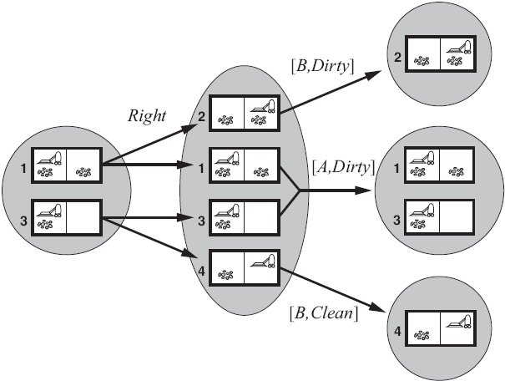
Local-sensing (Non-Deterministic)
Slippery world
Three possible percepts

Slide 34
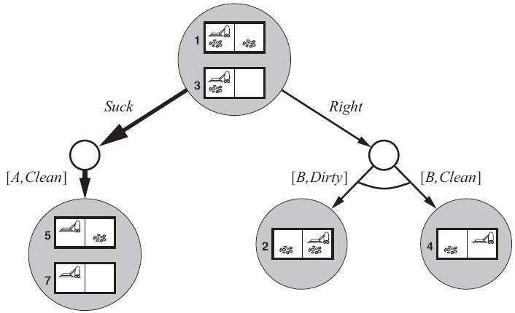
AND-OR Search Algorithm
Use same AND-OR Search Algorithm
  Assuming initial percept [A,Dirty]
  Solution: [Suck, Right, if Bstate={6} then Suck else []]
First level of AND-OR search tree for the local sensing vacuum world

Slide 35
Maintaining Belief State
A.k.a. monitoring, filtering, state estimation
Will look into this more later

Slide 36
Online Search &
Unknown Environments

Slide 37
Offline vs. Online Search
So far, all we saw was offline search
  Compute solution before actual action
Online search:
  Interleave computation and action
A must in unknown environments
  Agent doesn’t know what states there are
  Agent doesn’t know what actions do
Agent needs to explore

Slide 38
Online Search Problem
Suppose the world is deterministic and fully observable (we relax this later on)
Agent knows:
  ACTIONS(s): possible actions in state s
  c(s,a,s’): cost (known only after executing a)
  GOAL-TEST(s)
  May have access to an admissible heuristic h
Agent does not know (a priori):
  RESULT(s,a)

Slide 39
Online Search Problem
Competitive ratio: ratio between
  Actual (executed) path cost
  Cost of path taken if the agent knew the search space in advance
Problem: dead ends:
  States from which no goal is reachable (caused by irreversible actions)
  Impossible to avoid in general
Safely explorable state space:
  Some goal state is always reachable

Slide 40
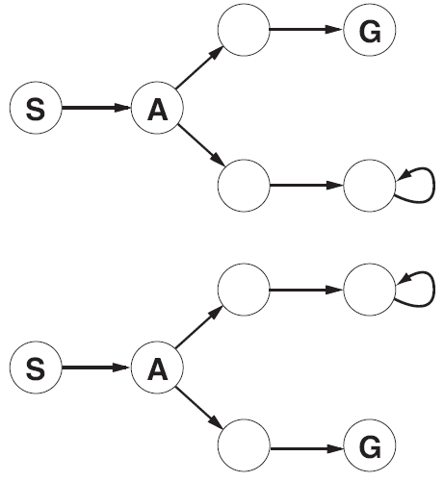
Dead Ends
State Space with Inevitable Dead
Any agent will fail in at least one of these, state spaces look identical after exploring S and A

Slide 41
Required Reading
Stuart Russell and Peter Norvig. Artificial Intelligence: A Modern Approach. Prentice Hall, 3rd Edition, 2010
  Chapter 4
    Skip 4.2
    Just skim 4.5

