Slide 1
Techniques in
Artificial Intelligence
Search: Uninformed
Andreas Henschel
Credit: Based on slides from Iyad Rahwan, and in turn from Dan Klein (Berkeley), and modified by Stuart Russell, Andrew Moore, Teg Grenager, Peter Norvig (Stanford)

Slide 2







Search Problems
A search problem consists of:
  A state space
  A successor function
  A start state, goal test, and path cost function
A solution is a sequence of actions (a plan) which transforms the start state to a goal state
N, 1
E, 1

Slide 3
Two Equivalent Formulations
Successor function
  Successors( ) = {(N, 1, ), (E, 1, )}
Actions and Transition Model
  Actions( ) = {N, E}
  Result( , N) = ; Result( , E) =
  Cost( , N, ) = 1; Cost( , E, ) = 1

Slide 4
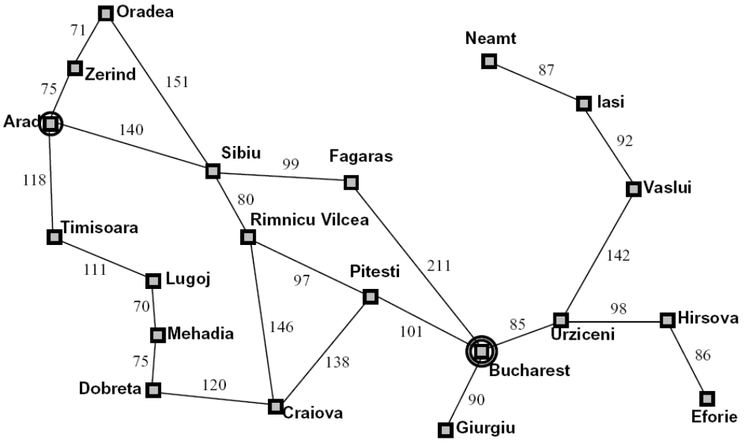
Example: Romania
State space:
  Cities
Successor function:
  Go to adj city with cost = dist
Start state:
  Arad
Goal test:
  Is state == Bucharest?
Solution?

Slide 5
State Space Graphs
State space graph: A mathematical representation of a search problem
  For every search problem, there’s a corresponding state space graph
  The successor function is represented by arcs
This can be large or infinite, so we won’t create it in memory
a
G
b
c
e
d
f
S
h
p
q
r
Ridiculously tiny search graph for a tiny search problem

Slide 6
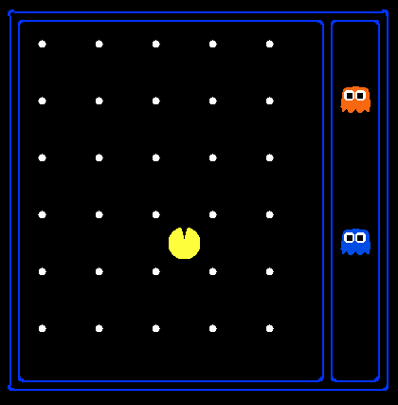
Exponential State Space Sizes
Search Problem:
Eat all of the food
Pacman positions:
10 x 12 = 120
Food count: 30
Ghost positions: 12
Pacman facing:
up, down, left, right
Notes:
90 * (2^30-1) + 30 * 2^29 = 145 billion
2^29 = 536 870 912

Slide 7
Search Trees
N, 1
E, 1
A search tree:
  This is a “what if” tree of plans and outcomes
  Start state at the root node
  Children correspond to successors
  Nodes contain states, correspond to PLANS to those states
  For most problems, we can never actually build the whole tree

Slide 8
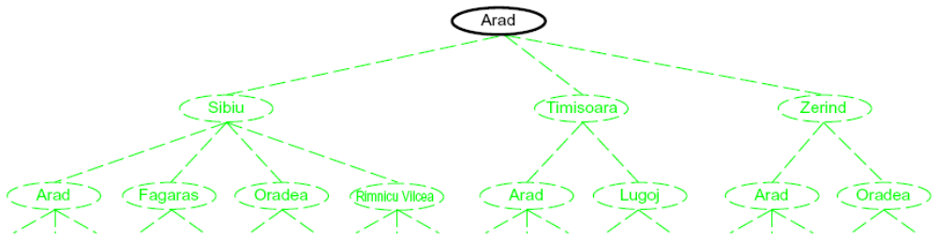
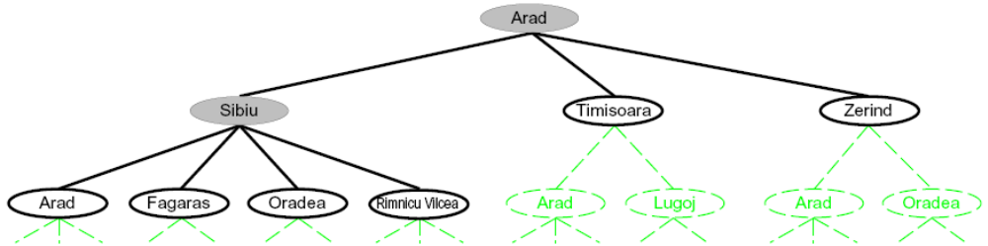
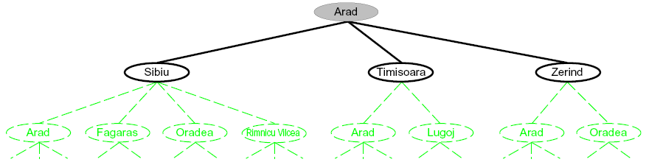
Another Search Tree
Search:
  Expand out possible plans
  Maintain a frontier of unexpanded plans
  Try to expand as few tree nodes as possible

Slide 9
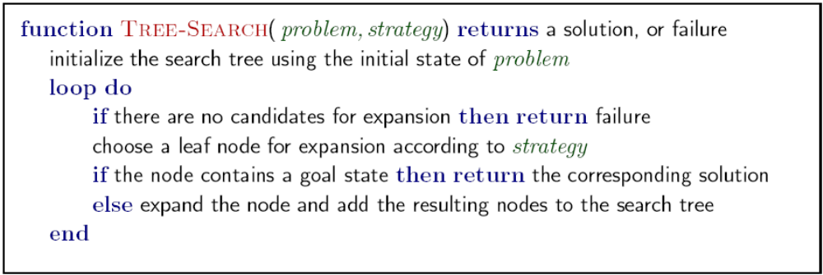
General Tree Search
Important ideas:
  Frontier (aka fringe)
  Expansion
  Exploration strategy
Main question: which frontier nodes to explore?
Detailed pseudocode is in the book!

Slide 10
State Graphs vs. Search Trees
Each NODE in in the search tree is an entire PATH in the problem graph.
a
G
b
c
d
e
f
S
h
p
q
r
S
d
e
p
We construct both on demand – and we construct as little as possible.
b
c
e
h
r
q
a
a
h
r
p
q
f
p
q
f
q
c
G
q
c
G
a
a

Slide 11

States vs. Nodes
Nodes in state space graphs are problem states
  Represent an abstracted state of the world
  Have successors, can be goal / non-goal, have multiple predecessors
Nodes in search trees are plans
  Represent a plan (sequence of actions) which results in the node’s state
  Have a problem state and one parent, a path length, a depth & a cost
  The same problem state may be achieved by multiple search tree nodes
State Space Graph
Search Tree
Parent
Depth 5
Action
Node
Depth 6

Slide 12
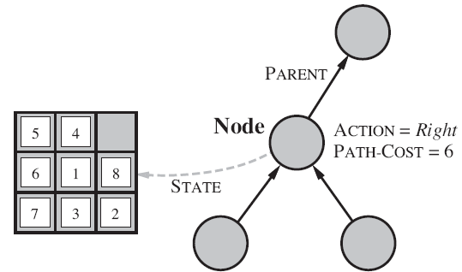
Representing Nodes
Nodes are conceptually paths, but better to represent as a state, cost, previous action, and reference to the parent node; not as a list

Slide 13
Depth First Search
Strategy: expand deepest node first
Implementation: Frontier is a LIFO stack
a
b
a
c
G
b
c
e
d
e
f
d
h
f
S
h
p
r
p
q
r
q
S
d
e
p
b
c
e
h
r
q
a
a
h
r
p
q
f
p
q
f
q
c
G
q
c
G
a
a

Slide 14
Breadth First Search
Strategy: expand shallowest node first
Implementation: Fringe is a FIFO queue
a
G
b
c
d
e
f
S
h
p
q
r
S
d
e
p
Search
Tiers
b
c
e
h
r
q
a
a
h
r
p
q
f
p
q
f
q
c
G
q
c
G
a
a

Slide 15

In-Class Exercise
Remember the vacuum world?
  Actions: Suck, Right, Left
Draw the state space graph
Draw the full search tree
Show Depth First Search progress
Show Breadth First Search progress

Slide 16
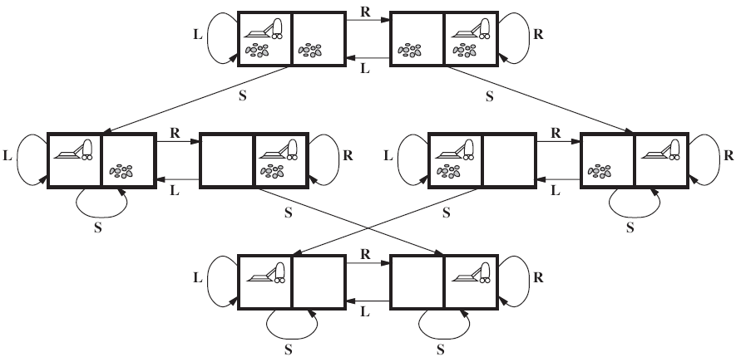
Vacuum World State Space Graph

Slide 17
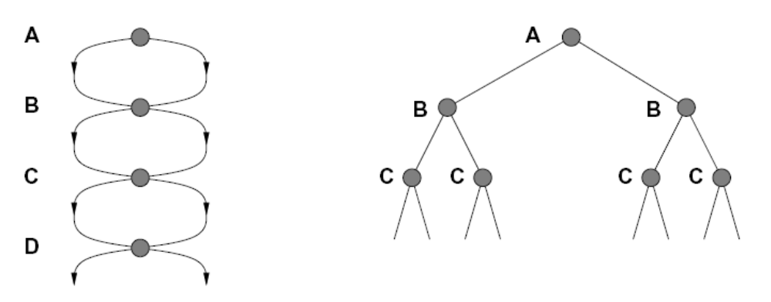
Santayana’s Warning
“Those who cannot remember the past are condemned to repeat it.” – George Santayana
Failure to detect repeated states can cause exponentially more work (why?)

Slide 18
Graph Search
In BFS, for example, we shouldn’t bother expanding the circled nodes (why?)
S
d
e
p
b
c
e
h
r
q
a
a
h
r
p
q
f
a
G
p
q
f
q
c
G
b
c
q
c
G
a
e
d
f
a
S
h
p
q
r

Slide 19
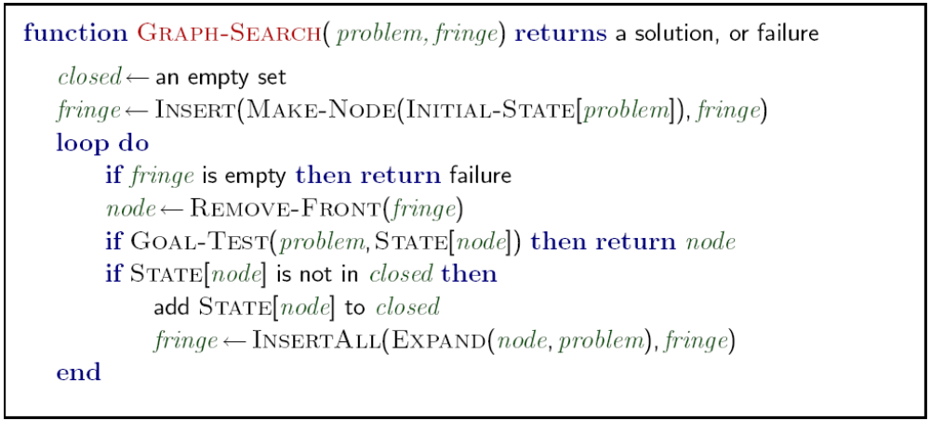
Graph Search
Very simple fix: never expand a state twice
Note:
closed
aka
explored

Slide 20
Graph Search Hints
Note: Graph Search still produces a search tree (not a graph)!
Graph search is almost always better than tree search (when not?)
  Trade-off: Storage of “explored” nodes
Implement closed/explored as a dict or set! (why?)
  Near constant lookup time

Slide 21
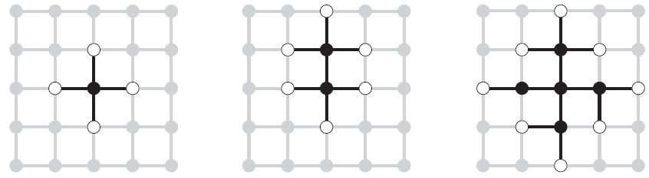
Separation Property of Graph Search
The frontier (white nodes) always separates the explored region of the state space (black nodes) from the unexplored region (gray nodes).

Slide 22

Big ‘O’ Notation
f(n) = O(g(n)) means:
  there are positive constants c and k, such that
  0 ≤ f(n) ≤ cg(n)
  for all n ≥ k
f(n) is asymptotically bounded by g(n)
Example: 2n + 10 is O(n)
  Given c = 3 and k = 10
Example: 3n³ + 20n² + 5 is O(n³)
  Given c = 4 and k = 21

Slide 23
Common Complexity Classes
If n is problem size
Notation | Name
O(1) | Constant.
O(log n) | Logarithmic.
O(n) | Linear.
O(n log n) | Linearithmic, loglinear, quasilinear or supralinear.
O(n²) | Quadratic.
O(n^{c}), c > 1 | Polynomial, sometimes called algebraic. Examples: O(n²), O(n³), O(n⁴).
O(c^{n}) | Exponential, sometimes called geometric. Examples: O(2^{n}), O(3^{n}).
O(n!) | Factorial, sometimes called combinatorial.

Slide 24
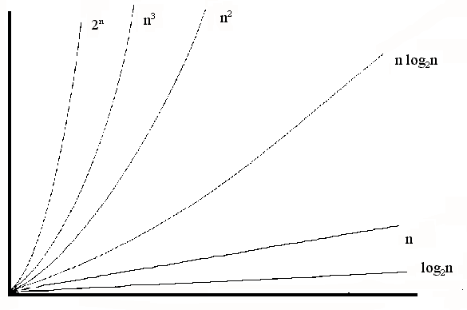
Visually

Slide 25
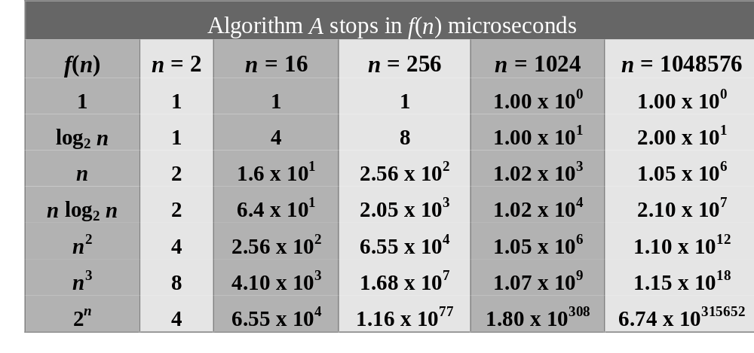
Growth of Operations
Table 1. Running Times for Different Complexity Classes

Slide 26
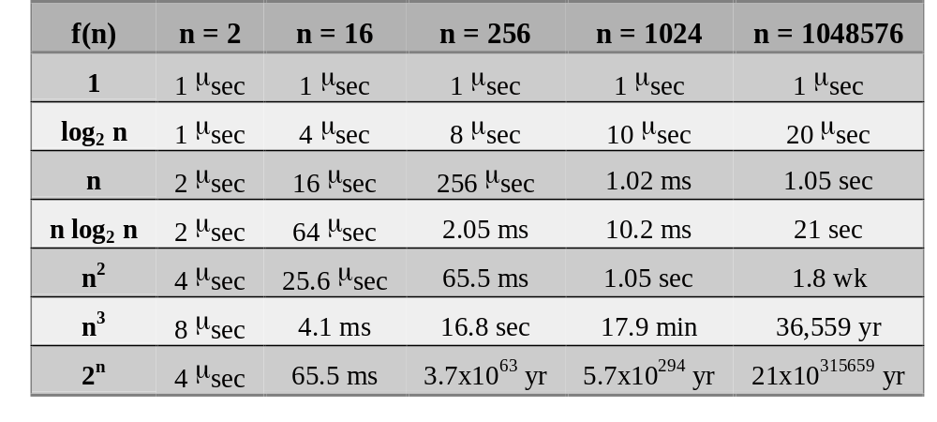
Growth of Running Time
In micro-seconds
Table 2. Running Times for Algorithm A in Different Time Units.

Slide 27
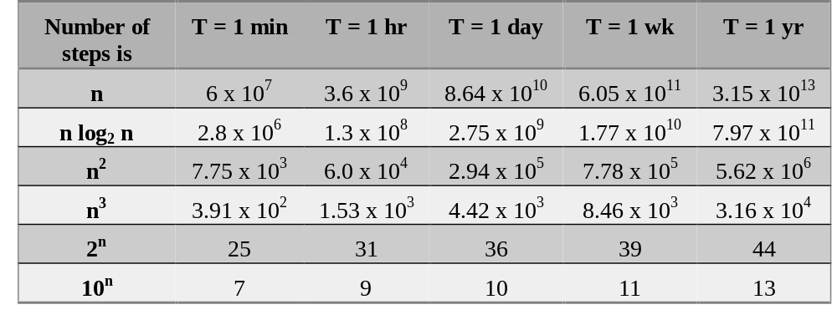
Seen from Another Angle
Table 3. Size of Largest Problem that Algorithm A can solve if solution is computed in time <= T at 1 micro-sec per step.

Slide 28
Search Algorithm Properties
Complete? Guaranteed to find a solution if one exists?
Optimal? Guaranteed to find the least cost path?
Time complexity?
Space complexity?
Variables:
n | Number of states in the problem
b | The average branching factor B (the average number of successors)
C* | Cost of least cost solution
s | Depth of the shallowest solution (d in the book)
m | Max depth of the search tree

Slide 29
Depth First Search (tree search)
Algorithm |  | Complete | Optimal | Time | Space
DFS | Depth First Search | N | N | O(B^{LMAX}) | O(LMAX)
N
N
Infinite
Infinite
b
START
a
GOAL
Infinite paths make DFS incomplete…
How can we fix this?

Slide 30
DFS (graph search)
With cycle checking or graph search, DFS is complete.
When is DFS optimal?
1 node
Space: Once all children have been explored, node can be removed from explored set
Backtracking search: DFS + generate one successor at a time instead of all
→ O(m) space needed
b
…
b nodes
b² nodes
m tiers
b^{m} nodes
Algorithm |  | Complete | Optimal | Time | Space
DFS | w/ Path Checking
Y
N
O(b^{m+1})
O(bm)

Slide 31
Note on Space Complexity
Space complexity above is for the size of frontier stack
DFS graph search needs to store “explored set”, which is O(b^{m})

Slide 32
Depth-Limited Search
To deal with infinite state spaces
DFS + pre-determined depth limit l
Time complexity O(b^{l}) instead of infinity
Incomplete if we choose l < s

Slide 33
Breadth First Search (BFS)
Optimal only when path cost is non-decreasing is node depth
Algorithm |  | Complete | Optimal | Time | Space
DFS | w/ Path Checking
BFS
Y
N
O(b^{m+1})
O(bm)
Y
N*
O(b^{s+1})
O(b^{s})
1 node
b
…
b nodes
At level 1, b nodes
At level 2, b² nodes
…
At level s, b^{s} nodes
s tiers
b² nodes
b^{s} nodes
b^{m} nodes

Slide 34
BFS Performance
Assume b=10; 1 million nodes/second; 1000 bytes/node
Depth | Nodes | Time | Memory
2 | 110 | .11 milliseconds | 107 kilobytes
4 | 11,110 | 11 milliseconds | 10.6 megabytes
6 | 10⁶ | 1.1 seconds | 1 gigabyte
8 | 10⁸ | 2 minutes | 103 gigabytes
10 | 10¹⁰ | 3 hours | 10 terabytes
12 | 10¹² | 13 days | 1 petabytes
14 | 10¹⁴ | 3.5 years | 99 petabytes
16 | 10¹⁶ | 350 years | 10 exabytes

Slide 35
Iterative Deepening Search (IDS)
Combine benefits of DFS and BFS
Uses DFS as a subroutine:
Do a DFS which only searches for paths of length 1 or less.
If “1” failed, do a DFS which only searches paths of length 2 or less.
If “2” failed, do a DFS which only searches paths of length 3 or less.
….and so on.
b
…
Algorithm |  | Complete | Optimal | Time | Space
DFS | w/ Path Checking
BFS
IDS
Y
N
O(b^{m+1})
O(bm)
Y
N*
O(b^{s+1})
O(b^{s})
Y
N*
O(b^{s+1})
O(bs)

Slide 36
Iterative Deepening Search (cont.)
Space Complexity reduction:
  Never store more than O(bs) nodes at a time
Time Complexity: Too much repetition?
    b^{s} nodes at level s (goal level) generated once
    b^{s-1} nodes at level s-1 generated twice
    …
    Total # nodes = (s)b + (s-1)b²+…+(2)b^{s-1}+(1)b^{s}
    This is still in O(b^{s}) time complexity, same as BFS
    E.g. with b=10, s=5 difference is not too big
      With IDS: 50+400+3,000+20,000+100,000 = 123,450
      With BFS: 10+100+1,000+10,000+100,000=111,110

Slide 37
Costs on Actions
2
2
a
GOAL
3
c
2
b
1
8
2
3
e
d
9
8
2
f
START
4
h
1
1
p
4
r
15
q
Notice that BFS finds the shortest path in terms of number of transitions. What if transitions have varying costs?
We will quickly cover an algorithm which does find the least-cost path.

Slide 38
Uniform Cost Search
2
a
8
G
Expand cheapest node first:
Frontier is a priority queue
1
2
c
b
2
3
d
9
e
1
8
f
1
S
h
1
p
r
15
q
S
0
d
3
e
9
p
1
b
4
e
5
h
17
r
11
q
16
c
11
Cost contours
a
6
a
h
13
r
7
p
q
f
p
q
f
8
q
c
G
q
c
a
11
G
10
a

Slide 39
Priority Queue Refresher
A priority queue is a data structure in which you can insert and retrieve (key, value) pairs with the following operations:
pq.push(key, value) | inserts (key, value) into the queue.
pq.pop() | returns the key with the lowest value, and removes it from the queue.
You can decrease a key’s priority by pushing it again
Unlike a regular queue, insertions aren’t constant time, usually O(log n)
We’ll need priority queues for cost-sensitive search methods

Slide 40
Uniform Cost Search
Algorithm |  | Complete | Optimal | Time | Space
DFS | w/ Path Checking
BFS
UCS
Y
N
O(b^{m+1})
O(bm)
Y
N
O(b^{s+1})
O(b^{s})
Y
Y
O(b^{C*/ε})
O(b^{C*/ε})
b
…
Completeness: UCS can fail if actions can get arbitrarily cheap (e.g. zero).
Completeness guaranteed if cost always exceed some small constant ε
C*/ε tiers
Time: b^{C*/ε} can be >> b^{s} if ε is very small (large trees of small steps)
Note: Equal step cost: UCS = BFS

Slide 41
Uniform Cost Issues
Remember: explores increasing cost contours
The good: UCS is complete and optimal!
The bad:
  Explores options in every “direction”
  No information about goal location
c ≤ 1
…
c ≤ 2
c ≤ 3
Start
Goal
Notes:
python pacman.py -l contoursMaze -p SearchAgent -a fn=ucs --frameTime -1
python pacman.py -p SearchAgent -a fn=ucs -l smallMaze --frameTime -1

Slide 42
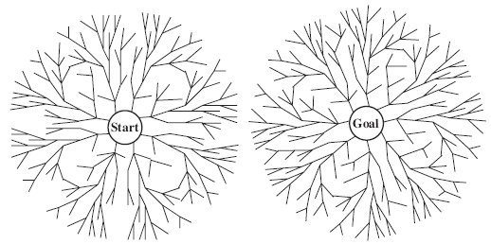
Bi-Directional Search
Why?
  (b^{s/2} +b^{s/2}) is much less than b^{s}
Searching backwards:
  Need to compute “predecessor”
  Not always possible

Slide 43
Un-informed Search: Summary
 | Complete? | Optimal? | Time | Space
Depth First Search | N (Y if no cycles) | N | O(b^{m}) | O(bm)
Depth-Limited Search | N | N | O(b^{l}) | O(bl)
Breadth First Search | Y | N (Y if identical step costs) | O(b^{s}) | O(b^{s})
Iterative Deepening | Y | N (Y if identical step costs) | O(b^{s}) | O(bs)
Uniform Cost Search (if arc costs available) | Y Costs > 0 | Y | O(b^{C*/ε}) | O(b^{C*/ε})
Bi-directional (if applicable) | Y | Y | O(b^{s/2}) | O(b^{s/2})
n: Number of states
b: Average branching factor
s: Depth of shallowest goal
m: Maximum tree depth
ε : Minimum step cost
C*: Cost of least cost goal
l: Depth limit

Slide 44
Required Reading
Stuart Russell and Peter Norvig. Artificial Intelligence: A Modern Approach. Prentice Hall, 3rd Edition, 2010
  Chapter 3, sections 3.1-3.4
  Appendix A.1

