Slide 1
Techniques in
Artificial Intelligence
Adversarial Search
(or Playing Games)
Andreas Henschel
Credit: Based on slides from Iyad Rahwan (Masdar Institute), Dan Klein (Berkeley), and modified by Stuart Russell, Andrew Moore, Teg Grenager, Peter Norvig (Stanford)

Slide 2
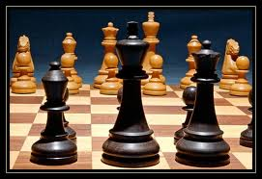
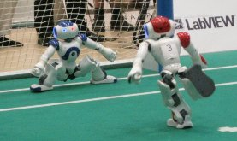
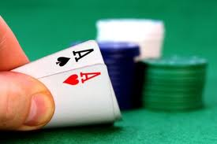
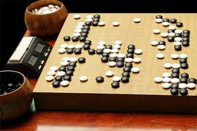
Types of Games
Deterministic (Chess)
Stochastic (Soccer)
Partially Observable (Poker)
Large state space (Go)

Slide 3
Game Playing State-of-the-Art
Chess: Deep Blue defeated human world champion Gary Kasparov in a six-game match in 1997. Deep Blue examined 200 million positions per second, used very sophisticated evaluation and undisclosed methods for extending some lines of search up to 40 ply. Current programs are even better, if less historic.
Checkers: Chinook ended 40-year-reign of human world champion Marion Tinsley in 1994. Used an endgame database defining perfect play for all positions involving 8 or fewer pieces on the board, a total of 443 billion positions. Checkers is now solved!
Othello: Human champions refuse to compete against computers, which are too good.
Go: Human champions are just beginning to be challenged by machines, though the best humans still beat the best machines. In go, b > 300, so most programs use pattern knowledge bases to suggest plausible moves, along with aggressive pruning.

Slide 4
Deterministic, Fully Observable
Many possible formalizations, one is:
  States: S (start at s₀)
  Players: P={1...N} (usually take turns; often N=2)
  Actions: A (may depend on player / state)
  Transition Function: SxA → S or Sx{A_{i}} → S
  Terminal Test: S → {t,f}
  Terminal Utilities: SxP → R
Solution for a player is a policy: S → A

Slide 5
Deterministic Single-Player
Deterministic, single player (solitaire), perfect information:
  Know the rules
  Know what actions do
  Know when you win
  E.g. Rubik’s cube
… it’s just search!
Slight reinterpretation:
  Each node stores a value: the best outcome it can reach
  This is the maximal outcome of its children (the max value)
  Note that we don’t have path sums as before (utilities at end)
lose
win
lose

Slide 6
Deterministic Two-Player
Deterministic, zero-sum games:
  Tic-tac-toe, chess, checkers
  Interpretation:
    One player maximizes result
    The other minimizes result
Minimax search:
  A state-space search tree
    Sort of depth first
  Players alternate turns
  Each node has a minimax value: best achievable utility against a rational adversary
Minimax values:
computed recursively
5
max
2
5
min
8
2
5
6
Terminal values:
part of the game

Slide 7
Computing Minimax Values
Two recursive functions:
  max-value maxes the values of successors
  min-value mins the values of successors
def value(state):
  If the state is a terminal state: return the state’s utility
  If the next agent is MAX: return max-value(state)
  If the next agent is MIN: return min-value(state)
def max-value(state):
  Initialize max = -∞
  For each successor of state:
    v ← value(successor)
    max ← maximum(max, v)
  Return max
Notes:
Pick an order for two reasons: sequential processor and pruning

Slide 8
Computing Minimax Values
Two recursive functions:
  max-value maxes the values of successors
  min-value mins the values of successors
def value(state):
  If the state is a terminal state: return the state’s utility
  If the next agent is MAX: return max-value(state)
  If the next agent is MIN: return min-value(state)
def max-value(state):
Return max([value(successor) for each successor of state])
def min-value(state):
Return min([value(successor) for each successor of state])
Notes:
Pick an order for two reasons: sequential processor and pruning

Slide 9
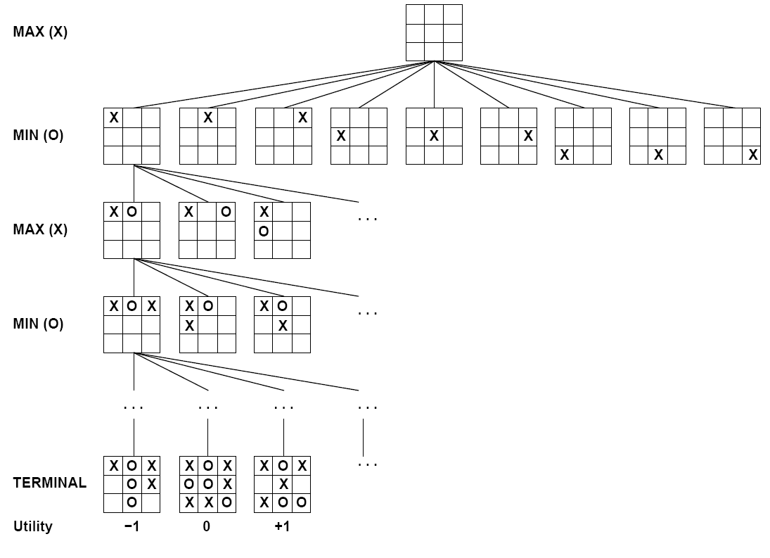
Tic-tac-toe Game Tree

Slide 10
Minimax Example
3
max
3
2
1
3
12
8
2
3
9
14
1
8

Slide 11
Minimax Properties
Optimal against a perfect player.
Against non-perfect player?
Time complexity?
  O(b^{m})
  b=branching factor, m=max path length
Space complexity?
  O(bm) with normal DFS
  generates all successors
  O(m) with backtracking search
  recursively generates one
  successor at a time
For chess, b ≈ 35, m ≈ 100
  Exact solution is completely infeasible
  Grand-master level: m=12 → 3,379,220,508,056,640,625 nodes
max
min
10
10
9
100

Slide 12
Overcoming Computational Limits
Cannot search to leaves in most games
Depth-limited search
  Instead, search a limited depth of tree
  Replace terminal utilities with an evaluation function for non-terminals, which approximate true utilities
Guarantee of optimal play is gone
More plies makes a BIG difference
(as does good evaluation function)
Example: Chess program
  Suppose we have 100 seconds, can explore 10K nodes / sec
  So can check 1M nodes per move
  Minimax won’t finish depth 4: novice
  If we could reach depth 8: decent
  How could we achieve that?
4
max
-2
min
4
min
limit=2
-1
-2
4
9
?
?
?
?

Slide 13
Depth-Limited Search
Still two recursive functions:
  max-value and min-value
def value(state, limit):
  If the state is a terminal state: return the state’s utility
  If limit = 0: return evaluation_function(state)
  If the next agent is MAX: return max-value(state, limit)
  If the next agent is MIN: return min-value(state, limit)
def max-value(state, limit):
  Initialize max = -∞
  For each successor of state:
    V ← value(successor, limit-1)
    max ← maximum(max, v)
  Return max
Notes:
Pick an order for two reasons: sequential processor and pruning

Slide 14
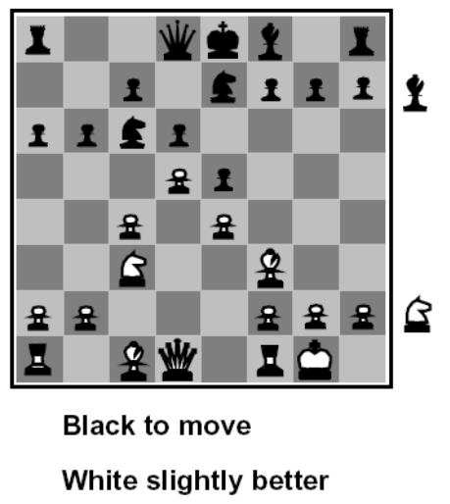
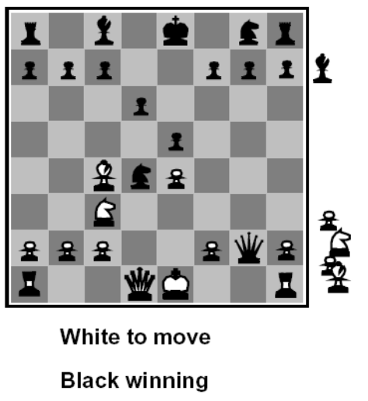
Evaluation Functions
Function which scores non-terminals
Ideal function: returns the utility of the position
In practice: typically weighted linear sum of features:
e.g. f₁(s) = (num white queens – num black queens), etc.

Slide 15
Pruning in Minimax
3
max
3
≤2
≤1
3
12
8
2
14
1

Slide 16
α-β: Pruning in Depth-Limited Search
General configuration
  α is the best value that MAX can get at any choice point along the current path
  If n becomes worse than α, MAX will avoid it, so can stop considering n’s other children
  Define β similarly for MIN
Player
Opponent
α
Player
Opponent
n

Slide 17
Another α-β Pruning Example
3
≤2
≤1
3
3
12
2
14
5
1
≥8
8

Slide 18
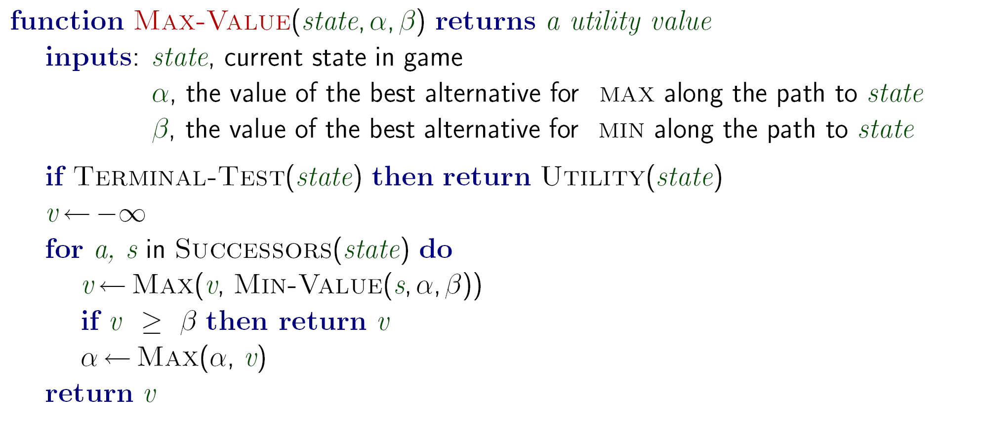
α-β Pruning Algorithm
β
v

Slide 19
α-β Pruning Properties
Pruning has no effect on final action computed
Good move ordering improves effectiveness of pruning
With “perfect ordering”:
  Time complexity drops to O(b^{m/2})
    Why? Exercise!
  Doubles solvable depth
  Chess: from bad to good player, but far from perfect
A simple example of metareasoning, here reasoning about which computations are relevant

Slide 20
Stochastic Single-Player
What if we don’t know what the result of an action will be? E.g.,
  In solitaire, shuffle is unknown
  In minesweeper, mine locations
  In pacman, ghosts!
Can do expectimax search
  Chance nodes, like actions except the environment controls the action chosen
  Calculate utility for each node
  Max nodes as in search
  Chance nodes take average (expectation) of value of children
Later, we’ll learn how to formalize this as a Markov Decision Process
max
average
10
4
5
7
[DEMO: minVsExp]

Slide 21
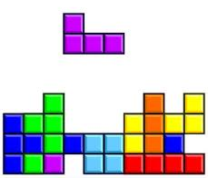

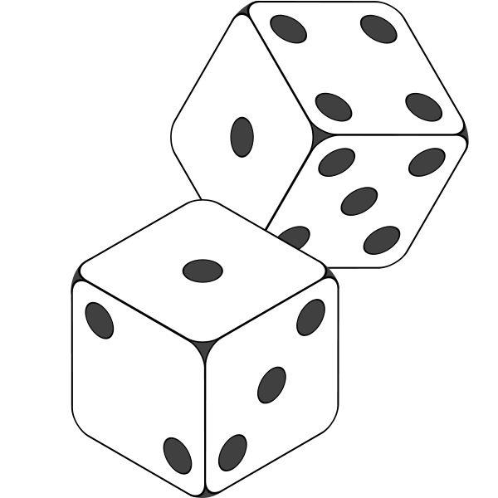

Stochasticity

Slide 22
Expectimax Search Trees
What if we don’t know what the result of an action will be? E.g.,
  In solitaire, next card is unknown
  In backgammon, dice roll
  In minesweeper, mine locations
  In Pacman, random ghost moves
Can do expectimax search
  Max nodes as in minimax search
  Chance nodes are like min nodes, except the outcome is uncertain
  Chance nodes take average (expectation) of value of children
This is a Markov Decision Process
couched in the language of trees
max
chance
10
4
5
7

Slide 23
Reminder: Expectations
We can define function f(X) of a random variable X
The expected value, E[f(X)], is the average value,
weighted by the probability of each value X=x_{i}
Example: How long to get to the airport?
  Length of driving time as a function of traffic, L(T):
  L(none) = 20 min, L(light) = 30 min, L(heavy) = 60 min
  Given P(T) = {none: 0.25, light: 0.5, heavy: 0.25}
  What is my expected driving time, E[ L(T) ]?
  E[ L(T) ] = ∑_{i} L(t_{i}) P(t_{i})
  E[ L(T) ] = L(none) P(none) + L(light) P(light) + L(heavy) P(heavy)
  E[ L(T) ] = (20 * 0.25) + (30 * 0.5) + (60 * 0.25) = 35 min

Slide 24



Expectimax Search
In expectimax search, we have a probabilistic model of how the opponent (or environment) will behave in any state
  Model could be a simple uniform distribution (roll a die)
  Model could be sophisticated and require a great deal of computation
  We have a node for every outcome out of our control: opponent or environment
  The model might say that adversarial actions are likely!
For now, assume for any state we magically have a distribution to assign probabilities to opponent actions / environment outcomes
Having a probabilistic belief about an agent’s action does not mean that agent is flipping any coins!

Slide 25
Expectimax Algorithm
def value(s)
if s is a max node return maxValue(s)
if s is an exp node return expValue(s)
if s is a terminal node return evaluation(s)
def maxValue(s)
values = [value(s’) for s’ in successors(s)]
return max(values)
def expValue(s)
values = [value(s’) for s’ in successors(s)]
weights = [probability(s, s’) for s’ in successors(s)]
return expectation(values, weights)
8
4
5
6

Slide 26
Expectimax for Pacman
Notice that we’ve gotten away from thinking that the ghosts are trying to minimize pacman’s score
Instead, they are now a part of the environment
Pacman has a belief (distribution) over how they will act
Quiz: Can we see minimax as a special case of expectimax?
Quiz: what would pacman’s computation look like if we assumed that the ghosts were doing 1-ply minimax and taking the result 80% of the time, otherwise moving randomly?
If you take this further, you end up calculating belief distributions over your opponents’ belief distributions over your belief distributions, etc…
  Can get unmanageable very quickly!

Slide 27
Expectimax Evaluation
Evaluation functions quickly return an estimate for a node’s true value (which value, expectimax or minimax?)
For minimax, evaluation function scale doesn’t matter
  We just want better states to have higher evaluations (get the ordering right)
For expectimax, we need magnitudes to be meaningful
0
40
20
30
x²
0
1600
400
900

Slide 28
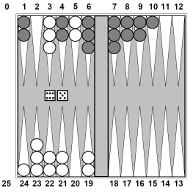
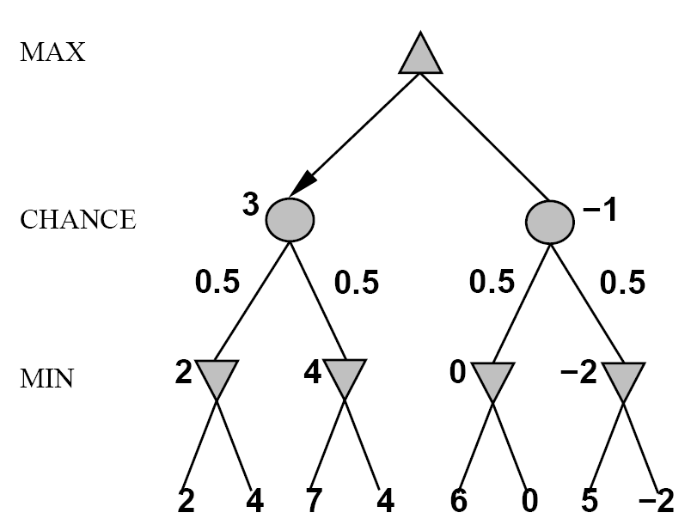
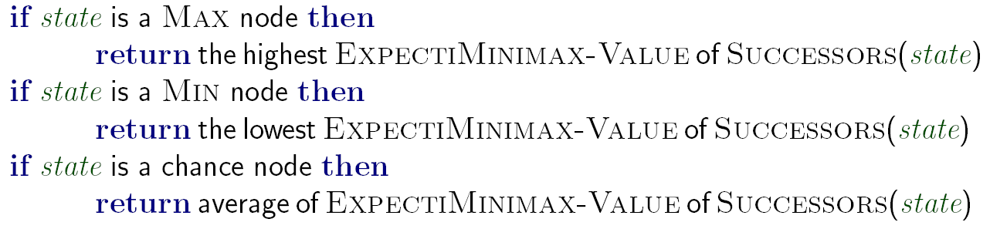
Expectiminimax
E.g. Backgammon
Environment is an extra player that moves after each agent
Combines minimax
and expectimax
ExpectiMinimax-Value(state):
Notes:
If it’s terminal or we reached our depth limit, return utility

Slide 29
Required Reading
Stuart Russell and Peter Norvig. Artificial Intelligence: A Modern Approach. Prentice Hall, 3rd Edition, 2010
  Chapter 5
    Skip 5.4.2, 5.4.3, and 5.4.4
    Skip 5.5.1-5.8 (or read for your own pleasure)

