Slide 1
ElGamal Cryptosystem – Applications, Performance and Comparison with RSA.
Rajat Swarup 885-18-6016
Sumanth Adluru 885-27-6513

Slide 2
ElGamal Review
Choose a large prime p (512-bit)
Take g, a generator for F_{p}*
y ≡ g^{x} (mod p)
Public Key (p,g,y)
Private Key (x)
Message (m) sent as (g^{r}, m*y^{r}) ≡ (g^{r}, m* g^{xr})
Decryption (m* g^{xr})((g^{r})^{x})⁻¹ mod p ≡ m

Slide 3
Applications of ElGamal
Popular for ElGamal Signature Scheme
Also used for ElGamal encryption
Digital Signature Standard (DSS) – a variant of ElGamal – standardized by NIST
Open Source Free Libraries – Crypto++, CryptoLib, Python, Java Cryptix.

Slide 4
ElGamal Signature Scheme
a ≡ g^{k} (mod p); gcd(k, p-1) = 1; else a ≡ 1?
Message M (digraph, trigraph blocks)
Public key (g, p, y ≡ g^{x} (mod p))
M ≡ (xa + kb) mod (p-1)
where x = private key
k = random secret value
Digital Signature (a,b) sent with M

Slide 5
ElGamal Signature Verification
yªa^{b} ≡ g^{M} (mod p)
The Math :
g^{M} ≡ g^{(xa+kb)} mod p
(g^{x})ª (g^{k})^{b} ≡ yªa^{b} (mod p)
If M was modified, congruence would be violated

Slide 6
El Gamal Signature Security
New random value for k required for each signature (why????)
Mallory (a malicious user) could recover private key x if same k was used for two messages. >:-)
Secrecy of k is critical, else x can be unearthed ! >:-)

Slide 7
ElGamal Security
Index-calculus attack - The prime p should be sufficiently large to prevent efficient use of the index-calculus methods .
Pohlig-Hellman attack - p − 1 should be divisible by a prime number q sufficiently large to prevent a Pohlig-Hellman discrete logarithm attack .
Weak generators - Suppose that p ≡ 1 (mod 4) and the generator satisfies the following conditions:
(a) divides (p − 1); and
(b) computing logarithms in the subgroup S of order in Z*p can be efficiently done (for example, if a Pohlig-Hellman attack can be mounted in S).
Possible for an adversary to construct signatures (without knowledge of A’s private key) which will be accepted by the verification algorithm.

Slide 8
ElGamal Performance
(i) Signature generation is relatively fast, requiring one modular exponentiation (a^k mod p), the extended Euclidean algorithm (for computing k^−1 mod (p − 1)), and two modular multiplications. (Modular subtraction is negligible when compared with modular multiplication.) The exponentiation and application of the extended Euclidean algorithm can be done off-line, in which case signature generation (in instances where precomputation is possible) requires only two (on-line) modular multiplications.
(ii) Signature verification is more costly, requiring three exponentiations. Each exponentiation (using naive techniques) requires 3/2 [logp] modular multiplications, on average, for a total cost of 9/2 [log p] multiplications. The computing costs can be reduced by modifying the verification slightly. Compute v1 = a^−h(m) y^r r^s mod p, and accept the signature as valid if and only if v1 = 1. Now, v1 can be computed more efficiently by doing the three exponentiations simultaneously the total cost is now about 15/8[log p] modular multiplications, almost 2:5 times as cost efficient as before.
(iii) Signature verification calculations are all performed modulo p, while signature generation calculations are done modulo p and modulo (p − 1).

Slide 9
Performance of ElGamal
ElGamal Speeds for Different Modulus lengths (i.e. length of p)
160-bit exponent on a SPARC-II
Source : Applied Cryptography, Bruce Schneier, Pg 479
 | 512-bit | 768-bit | 1024-bit
Encrypt | 0.33 sec | 0.8 sec | 1.09 sec
Decrypt | 0.24 sec | 0.58 sec | 0.77 sec
Sign | 0.25 sec | 0.47 sec | 0.63 sec
Verify | 1.37 sec | 5.12 sec | 9.3 sec

Slide 10
RSA Vs EL-GAMAL
RSA
Tests for key generation, encryption and decryption for RSA.
The encryption tests were performed on large key blobs for a symmetric cipher since that is generally what one encrypts with public key cryptography.
Observation : The time required for key generation is very costly compared to the cubic time required for encryption and decryption.
Observation : There is a constant factor difference in performance between encryption and decryption, resulting in a difference of orders of magnitude between the two operations.
So where encryption may take tens of milliseconds, decryption can take seconds, and key generation may even take minutes.

Slide 11
ElGamal
Similar tests on ElGamal as on RSA.
We found the same cubic behavior for encryption and decryption, however the operations are on the same order of magnitude.
The key difference we found is that key generation is much quicker for ElGamal, taking even less time than encryption or decryption.
The caveat is that group parameter generation,done once per PKI (Public Key Infrastructure), is extremely expensive.

Slide 12
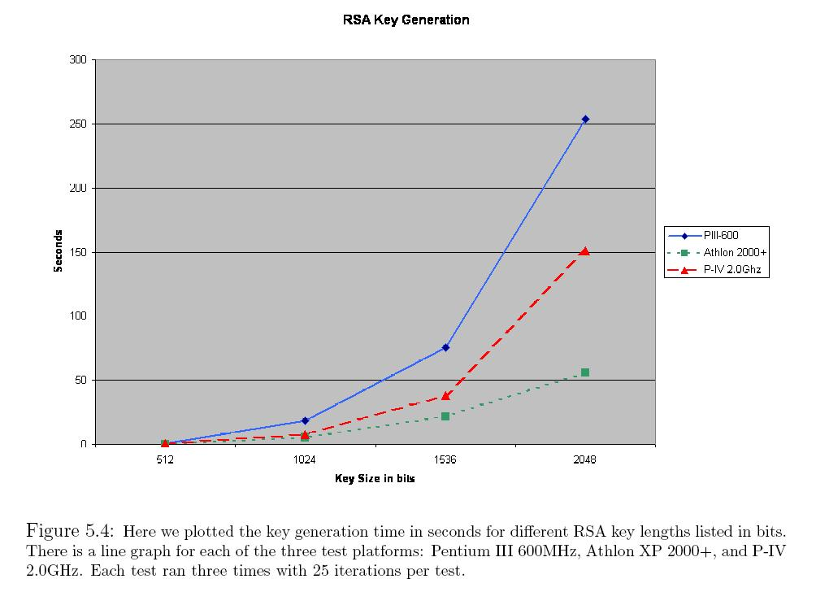
RSA Key Generation

Slide 13
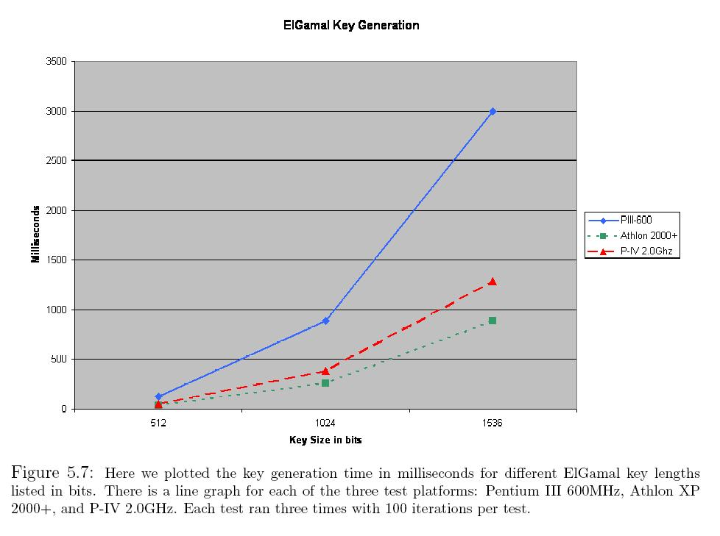
ElGamal Key Generation

Slide 14
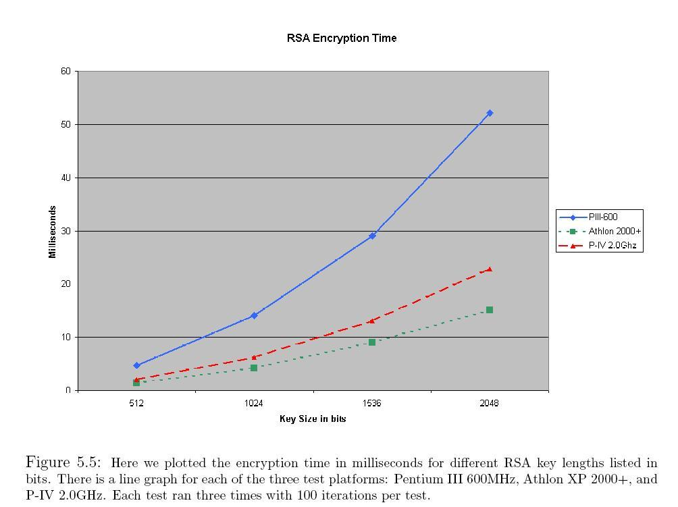
RSA Encryption

Slide 15
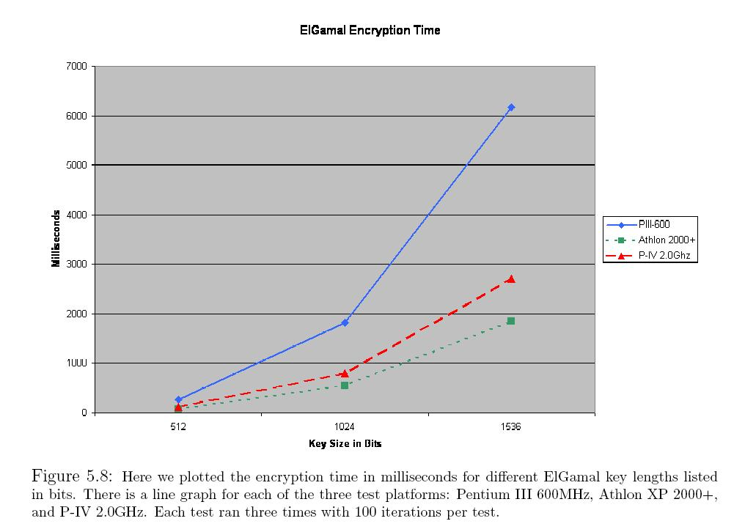
ElGamal Encryption

Slide 16
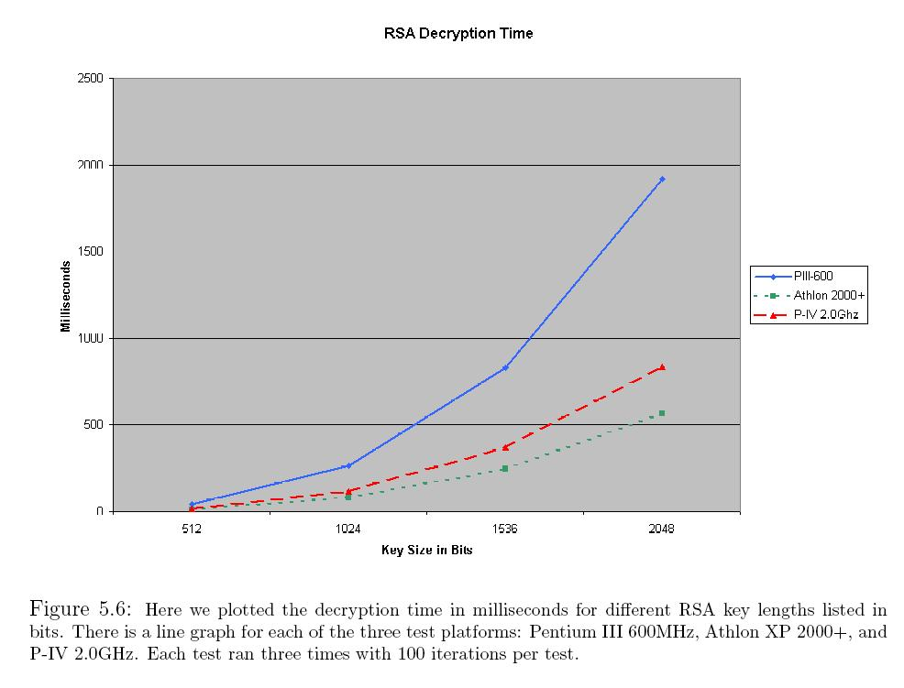
RSA Decryption

Slide 17
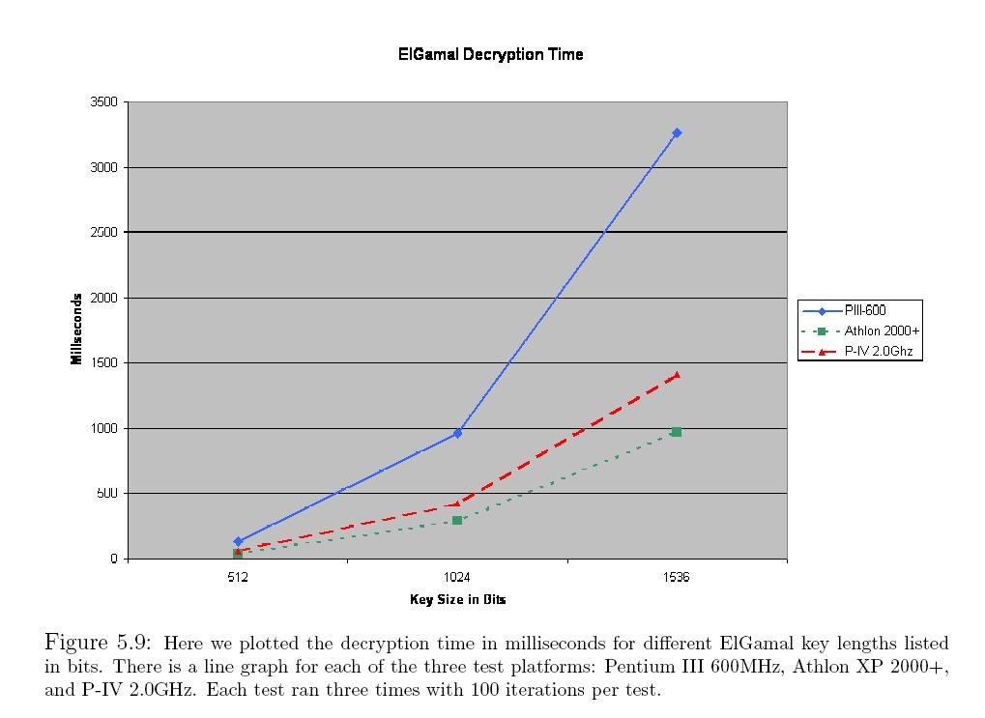
ElGamal Decryption

Slide 18
Comparison
RSA
The key generation tests were fewer because of the inordinate amount of time it takes to generate large keys.
Two large primes each half the size of the final modulus.
Exponentially harder to find larger primes and hence the exponential behavior observed with key generation.
Observation : RSA is very expensive in the cost of time. Encryption is more than three orders of magnitude slower than that of symmetric key cryptography. Key generation is six orders of magnitude slower than that of symmetric key generation.
Cost of time for key generation, encryption and decryption all increase super-linearly with respect to key size.
AMD® Athlon performed better than Pentium IV. certain operations used in RSA that are not as optimized on the Pentium IV architecture.
The decision of a good key size is especially important when the costs grow cubically with key size such as they do with RSA.
512 bits is considered weak. 1024 bits is considered OK. 1536 bit keys are considered to be good. 2048 bit keys are considered very strong.
Most Certificates use 1024 bit encryption and above.

Slide 19
Comparison (contd.)
EL-GAMAL
The ElGamal implementation uses the same package to compute operations on large numbers as our RSA implementation. Also, the mathematical operations are similar in that they both use a lot of modular arithmetic including addition, multiplication and exponentiation modulo a large integer.
Interestingly, all three tests (key generation, encryption and decryption) can be made to look identical to the others by multiplying the results by the appropriate constant.
The slowest test results, i.e. the cubic with the largest constant, is encryption which has the most operations in the source code. The fastest test results are for key generation which has the fewest operations in the source code.
In ElGamal, all that is done is choosing a random integer within given bounds and raising the generator to that power.
Also, the prime in a 1024 bit key, for example, must be 1024 bits. But for RSA, a 1024 bit key only requires two 512 bit primes.
Let r(n) be a function representing the time taken to
generate an n bit RSA key. Then we expect an ElGamal key to take roughly 1/2 (r(2n))^2 time.
On Athlon platform it took 128.75s to generate a 512 bit key, 5.06 hours for a1024 bit key and 45.99 hours for a 1536 bit key

Slide 20
Comparison (contd.)
EL-GAMAL
Firstly, done once for many keys.
Secondly, the discrete log problem for an n bit prime is significantly harder than factorization of a product of two primes of length n/2 bits each.
So security for a 1024 bit ElGamal system is above normal needs, and once the first prime has been generated, key generation is done faster than encryption and decryption operations.
This makes ElGamal a good alternative to RSA.

Slide 21
References
Applied Cryptography by Bruce Schneier
Cryptographic Libraries : A comparison
http://www.kanga.nu/~mirror/mirrors/www.homeport.org/%257Eadam/crypto/
Adam James Slagell - A Simple, Portable & Expandable Cryptographic API, Thesis, http://cairo.cs.uiuc.edu/publications/paper-files/thesis-slagell.pdf

