Slide 1
Appendix

Slide 2
Appendix
Networking basics
Protocol stack, layers, etc.
Math basics
Modular arithmetic
Permutations
Probability
Linear algebra

Slide 3
Networking Basics

Slide 4







Network
Includes
Computers
Servers
Routers
Wireless devices
Etc.
Purpose is to transmit data

Slide 5
Network Edge
Network edge includes
Hosts
Computers
Laptops
Servers
Cell phones
Etc., etc.

Slide 6
Network Core
Network core consists of
Interconnected mesh of routers
Purpose is to move data from host to host

Slide 7
Packet Switched Network
Telephone network is/was circuit switched
For each call, a dedicated circuit established
Dedicated bandwidth
Modern data networks are packet switched
Data is chopped up into discrete packets
Packets are transmitted independently
No dedicated circuit is established
More efficient bandwidth usage
But more complex than circuit switched

Slide 8
Network Protocols
Study of networking focused on protocols
Networking protocols precisely specify “communication rules”
Details are given in RFCs
RFC is essentially an Internet standard
Stateless protocols don’t remember
Stateful protocols do remember
Many security problems related to “state”
E.g., DoS is a problem with stateful protocols

Slide 9
Protocol Stack
Application layer protocols
HTTP, FTP, SMTP, etc.
Transport layer protocols
TCP, UDP
Network layer protocols
IP, routing protocols
Link layer protocols
Ethernet, PPP
Physical layer
user
space
application
transport
network
link
physical
OS
NIC
card

Slide 10
Layering in Action
router
data
application
transport
network
link
physical
application
transport
network
link
physical
data
network
link
physical
host
host
At source, data goes “down” the protocol stack
Each router processes packet “up” to network layer
That’s where routing info lives
Router then passes packet down the protocol stack
Destination processes up to application layer
That’s where the data lives

Slide 11
Encapsulation
data X
X = application data at source
As X goes down protocol stack, each layer adds header information:
Application layer: (H, X)
Transport layer: (H, (H, X))
Network layer: (H, (H, (H, X)))
Link layer: (H, (H, (H, (H, X))))
Header has info required by layer
Note that app data is on the inside
application
transport
network
link
physical
packet
(H,(H,(H,(H,X))))

Slide 12
Application Layer
Applications
Web browsing, email, P2P, etc.
Running on hosts
Hosts want network to be transparent
Application layer protocols
HTTP, SMTP, IMAP, Gnutella, etc.
Protocol is only one part of an application
For example, HTTP only a part of web browsing

Slide 13
Client-Server Model
Client
“speaks first”
Server
tries to respond to request
Hosts are clients and/or servers
Example: Web browsing
You are the client (request web page)
Web server is the server

Slide 14
Peer-to-Peer Model
Hosts act as clients and servers
For example, when sharing music
You are client when requesting a file
You are a server when someone downloads a file from you
In P2P, how does client find server?
Many different P2P models for this

Slide 15
HTTP Example
HTTP request
HTTP response
HTTP --- HyperText Transfer Protocol
Client (you) requests a web page
Server responds to your request

Slide 16
Web Cookies
cookie
initial
session
HTTP request
HTTP response, cookie
Cookie
database
HTTP request, cookie
cookie
HTTP response
later
session
HTTP is stateless ⎯ cookies used to add state
Initially, cookie sent from server to browser
Browser manages cookie, sends it to server
Server looks in cookie database to “remember” you

Slide 17
Web Cookies
Web cookies used for…
Shopping carts
Recommendations, etc., etc.
A very, very weak form of authentication
Privacy concerns
Web site can learn a lot about you
Multiple web sites could learn even more

Slide 18
SMTP
SMTP used to send email from sender to recipient’s mail server
Then use POP3, IMAP or HTTP (Web mail) to get messages from server
As with many application protocols, SMTP commands are human readable
Sender
Recipient
SMTP
SMTP
POP3

Slide 19
Spoofed email with SMTP
User types the red lines:
> telnet eniac.cs.sjsu.edu 25
220 eniac.sjsu.edu
HELO ca.gov
250 Hello ca.gov, pleased to meet you
MAIL FROM: <arnold@ca.gov>
250 arnold@ca.gov... Sender ok
RCPT TO: <stamp@cs.sjsu.edu>
250 stamp@cs.sjsu.edu ... Recipient ok
DATA
354 Enter mail, end with "." on a line by itself
It is my pleasure to inform you that you
are terminated
.
250 Message accepted for delivery
QUIT
221 eniac.sjsu.edu closing connection

Slide 20
Application Layer
DNS --- Domain Name Service
Convert human-friendly names such as www.google.com into 32-bit IP address
A distributed hierarchical database
Only 13 “root” DNS server clusters
Almost a single point of failure for Internet
Attacks on root servers have succeeded
But, attacks have not lasted long enough

Slide 21
Transport Layer
The network layer offers unreliable, “best effort” delivery of packets
Any improved service must be provided by the hosts
Transport layer: two protocols of interest
TCP ⎯ more service, more overhead
UDP ⎯ less service, less overhead
TCP and UDP runs on hosts, not routers

Slide 22
TCP
TCP assures that packets…
Arrive at destination
Are processed in order
Are not sent too fast for receiver: flow control
TCP also provides…
Network-wide congestion control
TCP is connection-oriented
TCP contacts server before sending data
Orderly setup and take down of “connection”
No true connection, only a logical connection

Slide 23
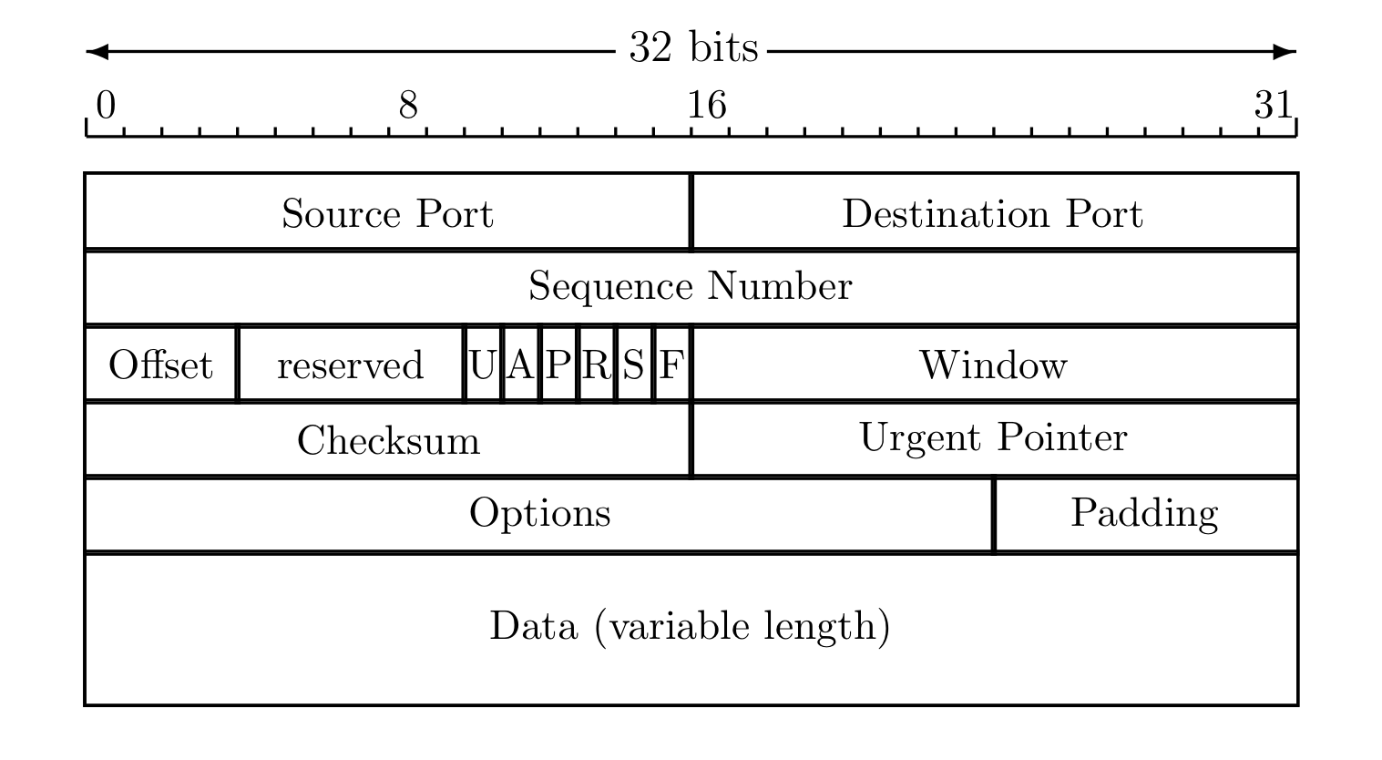
TCP Header
Source and destination port
Sequence number
Flags (ACK, SYN, RST, etc.)
Usually 20 bytes (if no options)

Slide 24
TCP Three-Way Handshake
SYN request
SYN-ACK
ACK (and data)
SYN: synchronization requested
SYN-ACK: acknowledge SYN request
ACK: acknowledge msg 2 and send data
Then TCP “connection” established
Connection terminated by FIN or RST

Slide 25
Denial of Service Attack
The TCP 3-way handshake makes denial of service (DoS) attacks possible
Whenever SYN packet is received, server must remember “half-open” connection
Remembering consumes resources
Too many half-open connections and server’s resources will be exhausted, and then…
…server can’t respond to legitimate connections

Slide 26
UDP
UDP is minimalist, “no frills” service
No assurance that packets arrive
No assurance packets are in order, etc., etc.
Why does UDP exist?
More efficient (smaller header)
No flow control to slow down sender
No congestion control to slow down sender
Packets sent too fast, they will be dropped
Either at intermediate router or at destination
But in some apps this is OK (audio/video)

Slide 27
Network Layer
Core of network/Internet
Interconnected mesh of routers
Purpose of network layer
Route packets through this mesh
Network layer protocol is known as IP
Follows a best effort approach
IP runs in every host and every router
Routers also run routing protocols
Used to determine the path to send packets
Routing protocols: RIP, OSPF, BGP, …

Slide 28
IP Addresses
IP address is 32 bits
Every host has an IP address
Not enough IP addresses!
Lots of tricks used to extend address space
IP addresses given in dotted decimal notation
For example: 195.72.180.27
Each number is between 0 and 255
Usually, host’s IP address can change

Slide 29
Socket
Each host has a 32 bit IP address
But many processes on one host
You can browse web, send email at same time
How to distinguish processes on a host?
Each process has a 16 bit port number
Port numbers < 1024 are “well-known” ports (HTTP is port 80, POP3 is port 110, etc.)
Port numbers above 1024 are dynamic (as needed)
IP address and port number define a socket
Socket uniquely identifies process, Internet-wide

Slide 30
Network Address Translation
Network Address Translation (NAT)
Used to extend IP address space
Use one IP address, different port numbers, for multiple hosts
“Translates” outside packet (based on port number) to IP for inside host

Slide 31
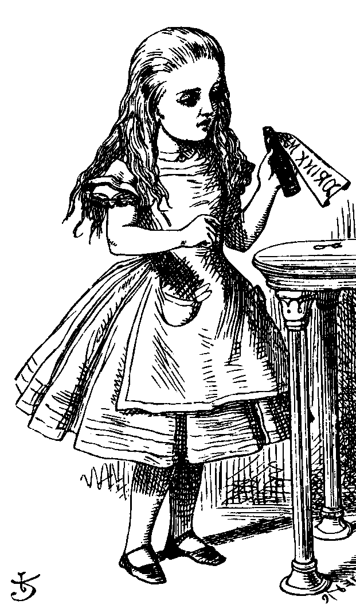
NAT-less Example
source 11.0.0.1:1025
destination 12.0.0.1:80
source 12.0.0.1:80
destination 11.0.0.1:1025
Web
server
Alice
IP: 12.0.0.1
Port: 80
IP: 11.0.0.1
Port: 1025

Slide 32

NAT Example
src 11.0.0.1:4000
dest 12.0.0.1:80
src 10.0.0.1:1025
dest 12.0.0.1:80
src 12.0.0.1:80
dest 11.0.0.1:4000
src 12.0.0.1:80
dest 10.0.0.1:1025
Web
server
Firewall
Alice
IP: 12.0.0.1
IP: 11.0.0.1
IP: 10.0.0.1
NAT Table
4000 10.0.0.1:1025

Slide 33
NAT: The Last Word
Advantage(s)?
Extends IP address space
One (or a few) IP address(es) can be shared by many users
Disadvantage(s)?
Makes end-to-end security difficult
Might make IPSec less effective (IPSec discussed in Chapter 10)

Slide 34
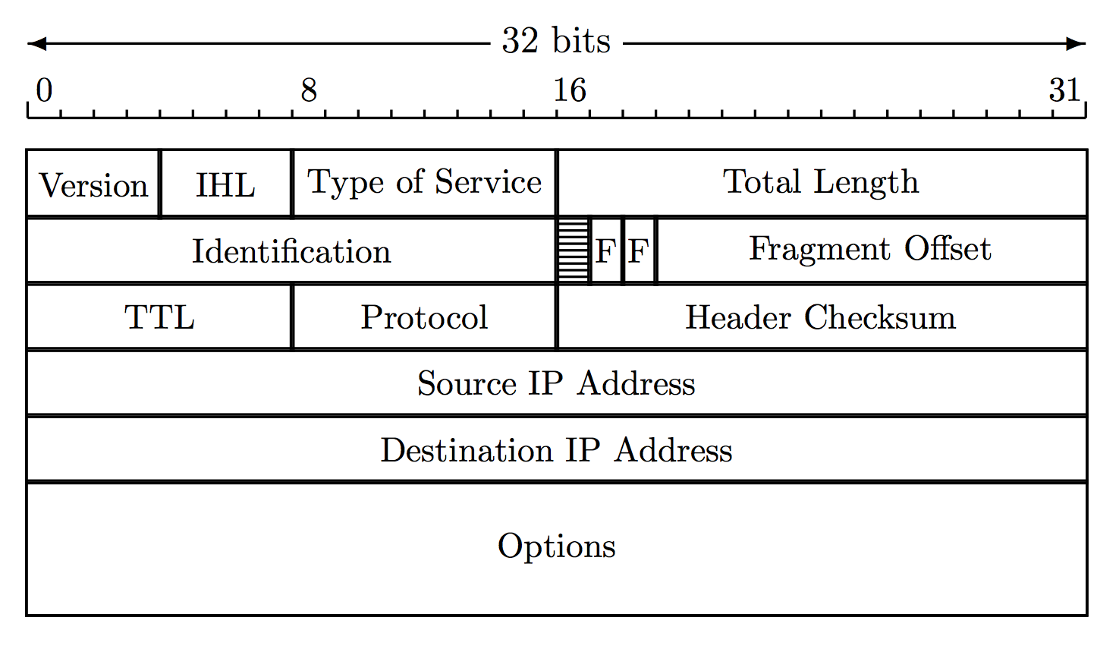
IP Header
IP header used by routers
Note source and destination IP addresses
Time to live (TTL) limits number of “hops”
So packets can’t circulate forever
Fragmentation information (see next slide)

Slide 35
IP Fragmentation
fragmented
re-assembled
Each link limits maximum size of packets
If packet is too big, router fragments it
Re-assembly occurs at destination

Slide 36
IP Fragmentation
One packet becomes multiple packets
Packets reassembled at destination
Prevents multiple fragmentation/re-assemble
Fragmentation is a security issue…
Fragments may obscure real purpose of packet
Fragments can overlap when re-assembled
Must re-assemble packet to fully understand it
Lots of work for firewalls, for example

Slide 37
IPv6
Current version of IP is IPv4
IPv6 is a “new-and-improved” version
IPv6 is “bigger and better” than IPv4
Bigger addresses: 128 bits
Better security: IPSec
How to migrate from IPv4 to IPv6?
Unfortunately, nobody has a good answer…
So IPv6 has not taken hold (yet?)

Slide 38
Link Layer
Link layer sends packet from one node to next
Links can be different
Wired
Wireless
Ethernet
Point-to-point…

Slide 39
Link Layer
On host, implemented in adapter: Network Interface Card (NIC)
Ethernet card, wireless 802.11 card, etc.
NIC is “semi-autonomous” device
NIC is (mostly) out of host’s control
Implements both link and physical layers

Slide 40
Ethernet
Ethernet is a multiple access protocol
Many hosts access a shared media
On a local area network, or LAN
With multiple access, packets can “collide”
Data is corrupted and packets must be resent
How to efficiently deal with collisions in distributed environment?
Many possibilities, but ethernet is most popular
We won’t discuss details here…

Slide 41
Link Layer Addressing
IP addresses live at network layer
Link layer also requires addresses (why?)
MAC address (LAN address, physical address)
MAC address
48 bits, globally unique
Used to forward packets over one link
Analogy…
IP address is like your home address
MAC address is like a social security number

Slide 42
ARP
Address Resolution Protocol (ARP)
Used by link layer ⎯ given IP address, find corresponding MAC address
Each host has ARP table, or ARP cache
Generated automatically
Entries expire after some time (about 20 min)
ARP used to find ARP table entries

Slide 43
ARP
ARP is stateless
ARP sends request and receives ARP reply
Replies used to fill ARP cache
IP: 111.111.111.001
IP: 111.111.111.002
LAN
MAC: AA-AA-AA-AA-AA-AA
MAC: BB-BB-BB-BB-BB-BB
111.111.111.002 | BB-BB-BB-BB-BB-BB
111.111.111.001 | AA-AA-AA-AA-AA-AA
ARP cache
ARP cache

Slide 44

ARP Cache Poisoning
ARP is stateless, so…
Accepts “reply”, even if no request sent
111.111.111.003
CC-CC-CC-CC-CC-CC
ARP “reply”
111.111.111.002
CC-CC-CC-CC-CC-CC
ARP “reply”
111.111.111.001
CC-CC-CC-CC-CC-CC
111.111.111.001
LAN
111.111.111.002
AA-AA-AA-AA-AA-AA
BB-BB-BB-BB-BB-BB
111.111.111.002 CC-CC-CC-CC-CC-CC
111.111.111.002 BB-BB-BB-BB-BB-BB
111.111.111.001 AA-AA-AA-AA-AA-AA
111.111.111.001 CC-CC-CC-CC-CC-CC
ARP cache
ARP cache
Host CC-CC-CC-CC-CC-CC is man-in-the-middle

Slide 45
Math Basics

Slide 46
Modular Arithmetic

Slide 47
Clock Arithmetic
For integers x and n, “x mod n” is the remainder when we compute x ÷ n
We can also say “x modulo n”
0
Examples
7 mod 6 = 1
33 mod 5 = 3
33 mod 6 = 3
51 mod 17 = 0
17 mod 6 = 5
5
1
number “line”
mod 6
2
4
3

Slide 48
Modular Addition
Notation and facts
7 mod 6 = 1
7 = 13 = 1 mod 6
((a mod n) + (b mod n)) mod n = (a + b) mod n
((a mod n)(b mod n)) mod n = ab mod n
Addition Examples
3 + 5 = 2 mod 6
2 + 4 = 0 mod 6
3 + 3 = 0 mod 6
(7 + 12) mod 6 = 19 mod 6 = 1 mod 6
(7 + 12) mod 6 = (1 + 0) mod 6 = 1 mod 6

Slide 49
Modular Multiplication
Multiplication Examples
3 ⋅ 4 = 0 (mod 6)
2 ⋅ 4 = 2 (mod 6)
5 ⋅ 5 = 1 (mod 6)
(7 ⋅ 4) mod 6 = 28 mod 6 = 4 mod 6
(7 ⋅ 4) mod 6 = (1 ⋅ 4) mod 6 = 4 mod 6

Slide 50
Modular Inverses
Additive inverse of x mod n, denoted –x mod n, is the number that must be added to x to get 0 mod n
-2 mod 6 = 4, since 2 + 4 = 0 mod 6
Multiplicative inverse of x mod n, denoted x⁻¹ mod n, is the number that must be multiplied by x to get 1 mod n
3⁻¹ mod 7 = 5, since 3 ⋅ 5 = 1 mod 7

Slide 51
Modular Arithmetic Quiz
Q: What is -3 mod 6?
A: 3
Q: What is -1 mod 6?
A: 5
Q: What is 5⁻¹ mod 6?
A: 5
Q: What is 2⁻¹ mod 6?
A: No number works!
Multiplicative inverse might not exist

Slide 52
Relative Primality
x and y are relatively prime if they have no common factor other than 1
x⁻¹ mod y exists only when x and y are relatively prime
If it exists, x⁻¹ mod y is easy to compute using Euclidean Algorithm
We won’t do the computation here

Slide 53
Totient Function
ϕ(n) is “the number of numbers less than n that are relatively prime to n”
Here, “numbers” are positive integers
Examples
ϕ(4) = 2 since 4 is relatively prime to 3 and 1
ϕ(5) = 4 since 5 is relatively prime to 1,2,3,4
ϕ(12) = 4
ϕ(p) = p-1 if p is prime
ϕ(pq) = (p-1)(q-1) if p and q prime

Slide 54
Permutations

Slide 55
Permutation Definition
Let S be a set
A permutation of S is an ordered list of the elements of S
Each element of S appears exactly once
Suppose S = {0,1,2,…,n-1}
Then the number of perms is…
n(n-1)(n-2) ⋅ ⋅ ⋅ (2)(1) = n!

Slide 56
Permutation Example
Let S = {0,1,2,3}
Then there are 24 perms of S
For example,
(3,1,2,0) is a perm of S
(0,2,3,1) is a perm of S, etc.
Perms are important in cryptography

Slide 57
Probability Basics

Slide 58
Discrete Probability
We only require some elementary facts
Suppose that S={0,1,2,…,N−1} is the set of all possible outcomes
If each outcome is equally likely, then the probability of event E ⊆ S is
P(E) = # elements in E / # elements in S

Slide 59
Probability Example
For example, suppose we flip 2 coins
Then S = {hh,ht,th,tt}
Suppose X = “at least one tail” = {ht,th,tt}
Then P(X) = 3/4
Often, it’s easier to compute
P(X) = 1 − P(complement of X)

Slide 60
Complement
Again, suppose we flip 2 coins
Let S = {hh,ht,th,tt}
Suppose X = “at least one tail” = {ht,th,tt}
Complement of X is “no tails” = {hh}
Then
P(X) = 1 − P(comp. of X) = 1 − 1/4 = 3/4
We make use of this trick often!

Slide 61
Linear Algebra Basics

Slide 62
Vectors and Dot Product
Let ℜ be the set of real numbers
Then v ∈ ℜ^{n} is a vector of n elements
For example
v = [v₁,v₂,v₃,v₄] = [2,−1, 3.2, 7] ∈ ℜ⁴
The dot product of u,v ∈ ℜ^{n} is
u ⋅ v = u₁v₁ + u₂v₂ +… + u_{n}v_{n}

Slide 63


Matrix
A matrix is an n x m array
For example, the matrix A is 2 x 3
The element in row i column j is a_{ij}
We can multiply a matrix by a number

Slide 64

Matrix Addition
We can add matrices of the same size
We can also multiply matrices, but this is not so obvious
We do not simply multiply the elements

Slide 65
Matrix Multiplication
Suppose A is m x n and B is s x t
Then C=AB is only defined if n=s, in which case C is m x t
Why?
The element c_{ij} is the dot product of row i of A with column j of B

Slide 66

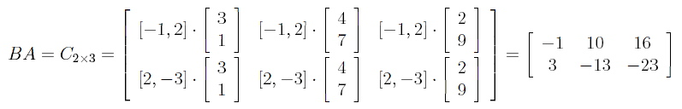
Matrix Multiply Example
Suppose
Then
And AB is undefined

Slide 67
Matrix Multiply Useful Fact
Consider AU = B where A is a matrix and U and B are column vectors
Let a₁,a₂,…,a_{n} be columns of A and u₁,u₂,…,u_{n} the elements of U
Then B = u₁a₁ + u₂a₂ + … + u_{n}a_{n}
Example:
[
3 4
1 5
]
[
2
6
]
[
]
+
[
4
5
]
[
]
=
3
1
=
30
32
2
6

Slide 68
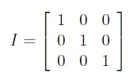
Identity Matrix
A matrix is square if it has an equal number of rows and columns
For square matrices, the identity matrix I is the multiplicative identity
AI = IA = A
The 3 x 3 identity matrix is

Slide 69

Block Matricies
Block matrices are matrices of matrices
For example
We can do arithmetic with block matrices
Block matrix multiplication works if individual matrix dimensions “match”

Slide 70

Block Matrix Mutliplication
Block matrices multiplication example
For matrices
We have
Where X = U+CT and Y = AU+BT

Slide 71

Linear Independence
Vectors u,v ∈ ℜ^{n} linearly independent if au + bv = 0 implies a=b=0
For example,
Are linearly independent

Slide 72
Linear Independence
Linear independence can be extended to more than 2 vectors
If vectors are linearly independent, then none of them can be written as a linear combination of the others
None of the independent vectors is a sum of multiples of the other vectors

