Slide 1
Part I: Crypto Chapter 3: Symmetric Key Crypto
Original Source: http://www.cs.sjsu.edu/~stamp/infosec/

Slide 2
Chapter 3: Symmetric Key Crypto
The chief forms of beauty are order and symmetry…
⎯ Aristotle
“You boil it in sawdust: you salt it in glue:
You condense it with locusts and tape:
Still keeping one principal object in view ⎯
To preserve its symmetrical shape.”
⎯ Lewis Carroll, The Hunting of the Snark

Slide 3
Symmetric Key Crypto
Stream cipher ⎯ based on one-time pad
Except that key is relatively short
Key is stretched into a long keystream
Keystream is used just like a one-time pad
Block cipher ⎯ based on codebook concept
Block cipher key determines a codebook
Each key yields a different codebook
Employs both “confusion” and “diffusion”

Slide 4
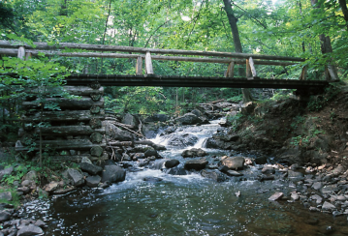
Stream Ciphers

Slide 5
Stream Ciphers
Once upon a time, not so very long ago, stream ciphers were the king of crypto
Today, not as popular as block ciphers
We’ll discuss two stream ciphers…
A5/1
Based on shift registers
Used in GSM mobile phone system
RC4
Based on a changing lookup table
Used many places

Slide 6
A5/1: Shift Registers
A5/1 uses 3 shift registers
X: 19 bits (x₀,x₁,x₂, …,x₁₈)
Y: 22 bits (y₀,y₁,y₂, …,y₂₁)
Z: 23 bits (z₀,z₁,z₂, …,z₂₂)

Slide 7
A5/1: Keystream
At each step: m = maj(x₈, y₁₀, z₁₀)
Examples: maj(0,1,0) = 0 and maj(1,1,0) = 1
If x₈ = m then X steps
t = x₁₃ ⊕ x₁₆ ⊕ x₁₇ ⊕ x₁₈
x_{i} = x_{i−1} for i = 18,17,…,1 and x₀ = t
If y₁₀ = m then Y steps
t = y₂₀ ⊕ y₂₁
y_{i} = y_{i−1} for i = 21,20,…,1 and y₀ = t
If z₁₀ = m then Z steps
t = z₇ ⊕ z₂₀ ⊕ z₂₁ ⊕ z₂₂
z_{i} = z_{i−1} for i = 22,21,…,1 and z₀ = t
Keystream bit is x₁₈ ⊕ y₂₁ ⊕ z₂₂

Slide 8
A5/1
X
x₀ | x₁ | x₂ | x₃ | x₄ | x₅ | x₆ | x₇ | x₈ | x₉ | x₁₀ | x₁₁ | x₁₂ | x₁₃ | x₁₄ | x₁₅ | x₁₆ | x₁₇ | x₁₈
⊕
Y
y₀ | y₁ | y₂ | y₃ | y₄ | y₅ | y₆ | y₇ | y₈ | y₉ | y₁₀ | y₁₁ | y₁₂ | y₁₃ | y₁₄ | y₁₅ | y₁₆ | y₁₇ | y₁₈ | y₁₉ | y₂₀ | y₂₁
⊕
⊕
Z
z₀ | z₁ | z₂ | z₃ | z₄ | z₅ | z₆ | z₇ | z₈ | z₉ | z₁₀ | z₁₁ | z₁₂ | z₁₃ | z₁₄ | z₁₅ | z₁₆ | z₁₇ | z₁₈ | z₁₉ | z₂₀ | z₂₁ | z₂₂
⊕
Each variable here is a single bit
Key is used as initial fill of registers
Each register steps (or not) based on maj(x₈, y₁₀, z₁₀)
Keystream bit is XOR of rightmost bits of registers

Slide 9
A5/1
X
1 | 0 | 1 | 0 | 1 | 0 | 1 | 0 | 1 | 0 | 1 | 0 | 1 | 0 | 1 | 0 | 1 | 0 | 1
⊕
Y
1 | 1 | 0 | 0 | 1 | 1 | 0 | 0 | 1 | 1 | 0 | 0 | 1 | 1 | 0 | 0 | 1 | 1 | 0 | 0 | 0 | 1
⊕
⊕
Z
1 | 1 | 1 | 0 | 0 | 0 | 0 | 1 | 1 | 1 | 1 | 0 | 0 | 0 | 0 | 1 | 1 | 1 | 1 | 0 | 0 | 0 | 1
⊕
In this example, m = maj(x₈, y₁₀, z₁₀) = maj(1,0,1) = 1
Register X steps, Y does not step, and Z steps
Keystream bit is XOR of right bits of registers
Here, keystream bit will be 0 ⊕ 1 ⊕ 0 = 1

Slide 10
Shift Register Crypto
Shift register crypto efficient in hardware
Often, slow if implement in software
In the past, very popular
Today, more is done in software due to fast processors
Shift register crypto still used some
Resource-constrained devices

Slide 11
RC4
A self-modifying lookup table
Table always contains a permutation of the byte values 0,1,…,255
Initialize the permutation using key
At each step, RC4 does the following
Swaps elements in current lookup table
Selects a keystream byte from table
Each step of RC4 produces a byte
Efficient in software
Each step of A5/1 produces only a bit
Efficient in hardware

Slide 12
RC4 Initialization
S[] is permutation of 0,1,...,255
key[] contains N bytes of key
for i = 0 to 255
S[i] = i
K[i] = key[i (mod N)]
next i
j = 0
for i = 0 to 255
j = (j + S[i] + K[i]) mod 256
swap(S[i], S[j])
next i
i = j = 0

Slide 13
RC4 Keystream
For each keystream byte, swap elements in table and select byte
i = (i + 1) mod 256
j = (j + S[i]) mod 256
swap(S[i], S[j])
t = (S[i] + S[j]) mod 256
keystreamByte = S[t]
Use keystream bytes like a one-time pad
Note: first 256 bytes should be discarded
Otherwise, related key attack exists

Slide 14
Stream Ciphers
Stream ciphers were popular in the past
Efficient in hardware
Speed was needed to keep up with voice, etc.
Today, processors are fast, so software-based crypto is usually more than fast enough
Future of stream ciphers?
Shamir declared “the death of stream ciphers”
May be greatly exaggerated…

Slide 15
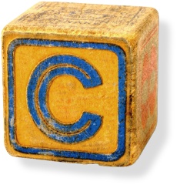
Block Ciphers

Slide 16
(Iterated) Block Cipher
Plaintext and ciphertext consist of fixed-sized blocks
Ciphertext obtained from plaintext by iterating a round function
Input to round function consists of key and output of previous round
Usually implemented in software

Slide 17
Feistel Cipher: Encryption
Feistel cipher is a type of block cipher, not a specific block cipher
Split plaintext block into left and right halves: P = (L₀,R₀)
For each round i = 1,2,...,n, compute
L_{i}= R_{i−1}
R_{i}= L_{i−1} ⊕ F(R_{i−1},K_{i})
where F is round function and K_{i} is subkey
Ciphertext: C = (L_{n},R_{n})

Slide 18
Feistel Cipher: Decryption
Start with ciphertext C = (L_{n},R_{n})
For each round i = n,n−1,…,1, compute
R_{i−1} = L_{i}
L_{i−1} = R_{i} ⊕ F(R_{i−1},K_{i})
where F is round function and K_{i} is subkey
Plaintext: P = (L₀,R₀)
Formula “works” for any function F
But only secure for certain functions F

Slide 19
Data Encryption Standard
DES developed in 1970’s
Based on IBM’s Lucifer cipher
DES was U.S. government standard
DES development was controversial
NSA secretly involved
Design process was secret
Key length reduced from 128 to 56 bits
Subtle changes to Lucifer algorithm

Slide 20
DES Numerology
DES is a Feistel cipher with…
64 bit block length
56 bit key length
16 rounds
48 bits of key used each round (subkey)
Each round is simple (for a block cipher)
Security depends heavily on “S-boxes”
Each S-boxes maps 6 bits to 4 bits

Slide 21
L
R
key
32
28
28
expand
shift
shift
One
Round
of
DES
32
48
28
28
K_{i}
⊕
48
48
compress
S-boxes
28
28
32
P box
32
32
⊕
32
L
R
key

Slide 22
DES Expansion Permutation
Input 32 bits
0 1 2 3 4 5 6 7 8 9 10 11 12 13 14 15
16 17 18 19 20 21 22 23 24 25 26 27 28 29 30 31
Output 48 bits
31 0 1 2 3 4 3 4 5 6 7 8
7 8 9 10 11 12 11 12 13 14 15 16
15 16 17 18 19 20 19 20 21 22 23 24
23 24 25 26 27 28 27 28 29 30 31 0

Slide 23
DES S-box
8 “substitution boxes” or S-boxes
Each S-box maps 6 bits to 4 bits
S-box number 1
input bits (0,5)
↓ input bits (1,2,3,4)
| 0000 0001 0010 0011 0100 0101 0110 0111 1000 1001 1010 1011 1100 1101 1110 1111
------------------------------------------------------------------------------------
00 | 1110 0100 1101 0001 0010 1111 1011 1000 0011 1010 0110 1100 0101 1001 0000 0111
01 | 0000 1111 0111 0100 1110 0010 1101 0001 1010 0110 1100 1011 1001 0101 0011 1000
10 | 0100 0001 1110 1000 1101 0110 0010 1011 1111 1100 1001 0111 0011 1010 0101 0000
11 | 1111 1100 1000 0010 0100 1001 0001 0111 0101 1011 0011 1110 1010 0000 0110 1101

Slide 24
DES P-box
Input 32 bits
0 1 2 3 4 5 6 7 8 9 10 11 12 13 14 15
16 17 18 19 20 21 22 23 24 25 26 27 28 29 30 31
Output 32 bits
15 6 19 20 28 11 27 16 0 14 22 25 4 17 30 9
1 7 23 13 31 26 2 8 18 12 29 5 21 10 3 24

Slide 25
DES Subkey
56 bit DES key, numbered 0,1,2,…,55
Left half key bits, LK
49 42 35 28 21 14 7
0 50 43 36 29 22 15
8 1 51 44 37 30 23
16 9 2 52 45 38 31
Right half key bits, RK
55 48 41 34 27 20 13
6 54 47 40 33 26 19
12 5 53 46 39 32 25
18 11 4 24 17 10 3

Slide 26
DES Subkey
For rounds i=1,2,...,16
Let LK = (LK circular shift left by r_{i})
Let RK = (RK circular shift left by r_{i})
Left half of subkey K_{i} is of LK bits
13 16 10 23 0 4 2 27 14 5 20 9
22 18 11 3 25 7 15 6 26 19 12 1
Right half of subkey K_{i} is RK bits
12 23 2 8 18 26 1 11 22 16 4 19
15 20 10 27 5 24 17 13 21 7 0 3

Slide 27
DES Subkey
For rounds 1, 2, 9 and 16 the shift r_{i} is 1, and in all other rounds r_{i} is 2
Bits 8,17,21,24 of LK omitted each round
Bits 6,9,14,25 of RK omitted each round
Compression permutation yields 48 bit subkey K_{i} from 56 bits of LK and RK
Key schedule generates subkey

Slide 28
DES Last Word (Almost)
An initial permutation before round 1
Halves are swapped after last round
A final permutation (inverse of initial perm) applied to (R₁₆,L₁₆)
None of this serves security purpose

Slide 29
Security of DES
Security depends heavily on S-boxes
Everything else in DES is linear
Thirty+ years of intense analysis has revealed no “back door”
Attacks, essentially exhaustive key search
Inescapable conclusions
Designers of DES knew what they were doing
Designers of DES were way ahead of their time

Slide 30
Block Cipher Notation
P = plaintext block
C = ciphertext block
Encrypt P with key K to get ciphertext C
C = E(P, K)
Decrypt C with key K to get plaintext P
P = D(C, K)
Note: P = D(E(P, K), K) and C = E(D(C, K), K)
But P ≠ D(E(P, K₁), K₂) and C ≠ E(D(C, K₁), K₂) when K₁ ≠ K₂

Slide 31
Triple DES
Today, 56 bit DES key is too small
Exhaustive key search is feasible
But DES is everywhere, so what to do?
Triple DES or 3DES (112 bit key)
C = E(D(E(P,K₁),K₂),K₁)
P = D(E(D(C,K₁),K₂),K₁)
Why Encrypt-Decrypt-Encrypt with 2 keys?
Backward compatible: E(D(E(P,K),K),K) = E(P,K)
And 112 bits is enough

Slide 32
3DES
Why not C = E(E(P,K),K) ?
Trick question --- it’s still just 56 bit key
Why not C = E(E(P,K₁),K₂) ?
A (semi-practical) known plaintext attack
Pre-compute table of E(P,K₁) for every possible key K₁ (resulting table has 2⁵⁶ entries)
Then for each possible K₂ compute D(C,K₂) until a match in table is found
When match is found, have E(P,K₁) = D(C,K₂)
Result gives us keys: C = E(E(P,K₁),K₂)

Slide 33
Advanced Encryption Standard
Replacement for DES
AES competition (late 90’s)
NSA openly involved
Transparent process
Many strong algorithms proposed
Rijndael Algorithm ultimately selected (pronounced like “Rain Doll” or “Rhine Doll”)
Iterated block cipher (like DES)
Not a Feistel cipher (unlike DES)

Slide 34
AES Overview
Block size: 128 bits (others in Rijndael)
Key length: 128, 192 or 256 bits (independent of block size)
10 to 14 rounds (depends on key length)
Each round uses 4 functions (3 “layers”)
ByteSub (nonlinear layer)
ShiftRow (linear mixing layer)
MixColumn (nonlinear layer)
AddRoundKey (key addition layer)

Slide 35

AES ByteSub
Treat 128 bit block as 4x6 byte array
ByteSub is AES’s “S-box”
Can be viewed as nonlinear (but invertible) composition of two math operations

Slide 36
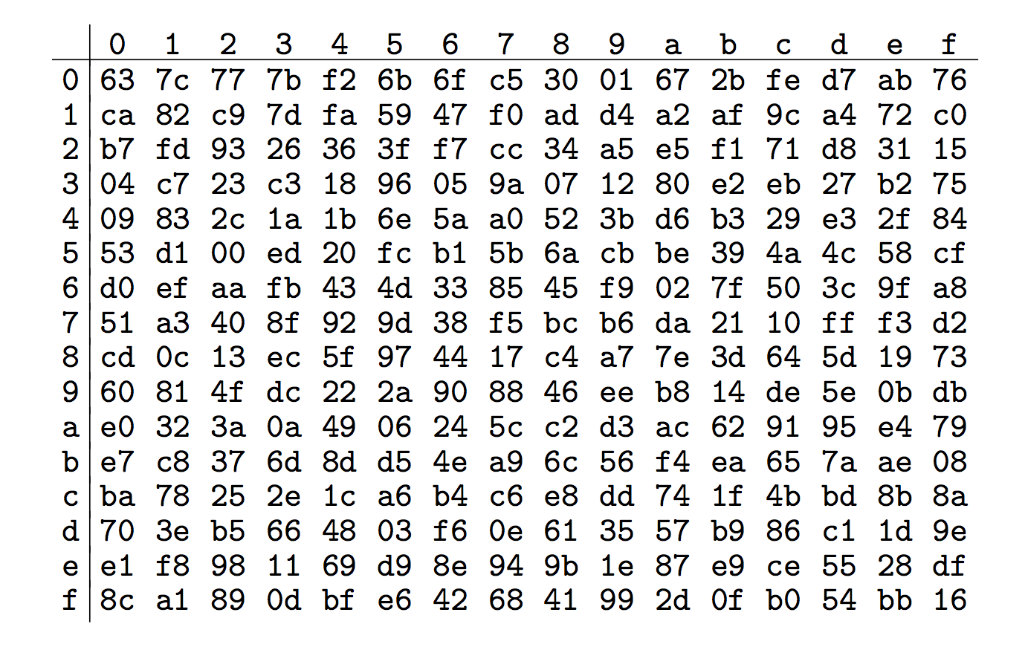
AES “S-box”
Last 4 bits of input
First 4
bits of
input

Slide 37

AES ShiftRow
Cyclic shift rows

Slide 38

AES MixColumn
Invertible, linear operation applied to each column
Implemented as a (big) lookup table

Slide 39

AES AddRoundKey
XOR subkey with block
Block
Subkey
RoundKey (subkey) determined by key schedule algorithm

Slide 40
AES Decryption
To decrypt, process must be invertible
Inverse of MixAddRoundKey is easy, since “⊕” is its own inverse
MixColumn is invertible (inverse is also implemented as a lookup table)
Inverse of ShiftRow is easy (cyclic shift the other direction)
ByteSub is invertible (inverse is also implemented as a lookup table)

Slide 41
A Few Other Block Ciphers
Briefly…
IDEA
Blowfish
RC6
More detailed…
TEA

Slide 42
IDEA
Invented by James Massey
One of the giants of modern crypto
IDEA has 64-bit block, 128-bit key
IDEA uses mixed-mode arithmetic
Combine different math operations
IDEA the first to use this approach
Frequently used today

Slide 43
Blowfish
Blowfish encrypts 64-bit blocks
Key is variable length, up to 448 bits
Invented by Bruce Schneier
Almost a Feistel cipher
R_{i} = L_{i−1} ⊕ K_{i}
L_{i} = R_{i−1} ⊕ F(L_{i−1} ⊕ K_{i})
The round function F uses 4 S-boxes
Each S-box maps 8 bits to 32 bits
Key-dependent S-boxes
S-boxes determined by the key

Slide 44
RC6
Invented by Ron Rivest
Variables
Block size
Key size
Number of rounds
An AES finalist
Uses data dependent rotations
Unusual for algorithm to depend on plaintext

Slide 45
Time for TEA
Tiny Encryption Algorithm (TEA)
64 bit block, 128 bit key
Assumes 32-bit arithmetic
Number of rounds is variable (32 is considered secure)
Uses “weak” round function, so large number of rounds required

Slide 46
TEA Encryption
Assuming 32 rounds:
(K[0],K[1],K[2],K[3]) = 128 bit key
(L,R) = plaintext (64-bit block)
delta = 0x9e3779b9
sum = 0
for i = 1 to 32
sum += delta
L += ((R<<4)+K[0])^(R+sum)^((R>>5)+K[1])
R += ((L<<4)+K[2])^(L+sum)^((L>>5)+K[3])
next i
ciphertext = (L,R)

Slide 47
TEA Decryption
Assuming 32 rounds:
(K[0],K[1],K[2],K[3]) = 128 bit key
(L,R) = ciphertext (64-bit block)
delta = 0x9e3779b9
sum = delta << 5
for i = 1 to 32
R −= ((L<<4)+K[2])^(L+sum)^((L>>5)+K[3])
L −= ((R<<4)+K[0])^(R+sum)^((R>>5)+K[1])
sum −= delta
next i
plaintext = (L,R)

Slide 48
TEA Comments
Almost a Feistel cipher
Uses + and - instead of ⊕ (XOR)
Simple, easy to implement, fast, low memory requirement, etc.
Possibly a “related key” attack
eXtended TEA (XTEA) eliminates related key attack (slightly more complex)
Simplified TEA (STEA) ⎯ insecure version used as an example for cryptanalysis

Slide 49
Block Cipher Modes

Slide 50
Multiple Blocks
How to encrypt multiple blocks?
Do we need a new key for each block?
As bad as (or worse than) a one-time pad!
Encrypt each block independently?
Make encryption depend on previous block?
That is, can we “chain” the blocks together?
How to handle partial blocks?
We won’t discuss this issue

Slide 51
Modes of Operation
Many modes ⎯ we discuss 3 most popular
Electronic Codebook (ECB) mode
Encrypt each block independently
Most obvious, but has a serious weakness
Cipher Block Chaining (CBC) mode
Chain the blocks together
More secure than ECB, virtually no extra work
Counter Mode (CTR) mode
Block ciphers acts like a stream cipher
Popular for random access

Slide 52
ECB Mode
Notation: C = E(P,K)
Given plaintext P₀,P₁,…,P_{m},…
Most obvious way to use a block cipher:
Encrypt Decrypt
C₀ = E(P₀, K) P₀ = D(C₀, K)
C₁ = E(P₁, K) P₁ = D(C₁, K)
C₂ = E(P₂, K) … P₂ = D(C₂, K) …
For fixed key K, this is “electronic” version of a codebook cipher (without additive)
With a different codebook for each key

Slide 53
ECB Cut and Paste
Suppose plaintext is
Alice digs Bob. Trudy digs Tom.
Assuming 64-bit blocks and 8-bit ASCII:
P₀ = “Alice di”, P₁ = “gs Bob. ”,
P₂ = “Trudy di”, P₃ = “gs Tom. ”
Ciphertext: C₀,C₁,C₂,C₃
Trudy cuts and pastes: C₀,C₃,C₂,C₁
Decrypts as
Alice digs Tom. Trudy digs Bob.

Slide 54
ECB Weakness
Suppose P_{i} = P_{j}
Then C_{i} = C_{j} and Trudy knows P_{i} = P_{j}
This gives Trudy some information, even if she does not know P_{i} or P_{j}
Trudy might know P_{i}
Is this a serious issue?

Slide 55
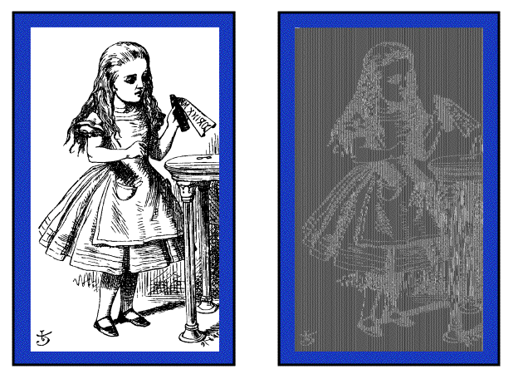
Alice Hates ECB Mode
Alice’s uncompressed image, and ECB encrypted (TEA)
Why does this happen?
Same plaintext yields same ciphertext!

Slide 56
CBC Mode
Blocks are “chained” together
A random initialization vector, or IV, is required to initialize CBC mode
IV is random, but not secret
Encryption Decryption
C₀ = E(IV ⊕ P₀, K), P₀ = IV ⊕ D(C₀, K),
C₁ = E(C₀ ⊕ P₁, K), P₁ = C₀ ⊕ D(C₁, K),
C₂ = E(C₁ ⊕ P₂, K),… P₂ = C₁ ⊕ D(C₂, K),…
Analogous to classic codebook with additive

Slide 57
CBC Mode
Identical plaintext blocks yield different ciphertext blocks ⎯ this is good!
If C₁ is garbled to, say, G then
P₁ ≠ C₀ ⊕ D(G, K), P₂ ≠ G ⊕ D(C₂, K)
But P₃ = C₂ ⊕ D(C₃, K), P₄ = C₃ ⊕ D(C₄, K),…
Automatically recovers from errors!
Cut and paste is still possible, but more complex (and will cause garbles)

Slide 58
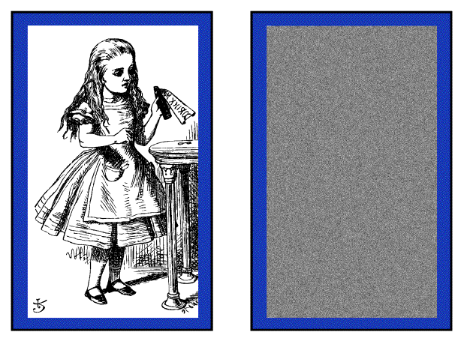
Alice Likes CBC Mode
Alice’s uncompressed image, Alice CBC encrypted (TEA)
Why does this happen?
Same plaintext yields different ciphertext!

Slide 59
Counter Mode (CTR)
CTR is popular for random access
Use block cipher like a stream cipher
Encryption Decryption
C₀ = P₀ ⊕ E(IV, K), P₀ = C₀ ⊕ E(IV, K),
C₁ = P₁ ⊕ E(IV+1, K), P₁ = C₁ ⊕ E(IV+1, K),
C₂ = P₂ ⊕ E(IV+2, K),… P₂ = C₂ ⊕ E(IV+2, K),…
CBC can also be used for random access
With a significant limitation…

Slide 60
Integrity

Slide 61
Data Integrity
Integrity ⎯ detect unauthorized writing (i.e., modification of data)
Example: Inter-bank fund transfers
Confidentiality may be nice, integrity is critical
Encryption provides confidentiality (prevents unauthorized disclosure)
Encryption alone does not provide integrity
One-time pad, ECB cut-and-paste, etc.

Slide 62
MAC
Message Authentication Code (MAC)
Used for data integrity
Integrity not the same as confidentiality
MAC is computed as CBC residue
That is, compute CBC encryption, saving only final ciphertext block, the MAC

Slide 63
MAC Computation
MAC computation (assuming N blocks)
C₀ = E(IV ⊕ P₀, K),
C₁ = E(C₀ ⊕ P₁, K),
C₂ = E(C₁ ⊕ P₂, K),…
C_{N−1} = E(C_{N−2} ⊕ P_{N−1}, K) = MAC
MAC sent with IV and plaintext
Receiver does same computation and verifies that result agrees with MAC
Note: receiver must know the key K

Slide 64
Does a MAC work?
Suppose Alice has 4 plaintext blocks
Alice computes
C₀ = E(IV⊕P₀,K), C₁ = E(C₀⊕P₁,K),
C₂ = E(C₁⊕P₂,K), C₃ = E(C₂⊕P₃,K) = MAC
Alice sends IV,P₀,P₁,P₂,P₃ and MAC to Bob
Suppose Trudy changes P₁ to X
Bob computes
C₀ = E(IV⊕P₀,K), C₁ = E(C₀⊕X,K),
C₂ = E(C₁⊕P₂,K), C₃ = E(C₂⊕P₃,K) = MAC ≠ MAC
That is, error propagates into MAC
Trudy can’t make MAC == MAC without K

Slide 65
Confidentiality and Integrity
Encrypt with one key, MAC with another key
Why not use the same key?
Send last encrypted block (MAC) twice?
This cannot add any security!
Using different keys to encrypt and compute MAC works, even if keys are related
But, twice as much work as encryption alone
Can do a little better ⎯ about 1.5 “encryptions”
Confidentiality and integrity with same work as one encryption is a research topic

Slide 66
Uses for Symmetric Crypto
Confidentiality
Transmitting data over insecure channel
Secure storage on insecure media
Integrity (MAC)
Authentication protocols (later…)
Anything you can do with a hash function (upcoming chapter…)

