Slide 1
Part III: Protocols Chapter 10: Real-World Protocols
Original Source: http://www.cs.sjsu.edu/~stamp/infosec/

Slide 2
Chapter 10: Real-World Protocols
The wire protocol guys don't worry about security because that's really
a network protocol problem. The network protocol guys don't
worry about it because, really, it's an application problem.
The application guys don't worry about it because, after all,
they can just use the IP address and trust the network.
⎯ Marcus J. Ranum
In the real world, nothing happens at the right place at the right time.
It is the job of journalists and historians to correct that.
⎯ Mark Twain

Slide 3
Real-World Protocols
Next, we look at real protocols
SSH ⎯ a simple & useful security protocol
SSL ⎯ practical security on the Web
IPSec ⎯ security at the IP layer
Kerberos ⎯ symmetric key, single sign-on
WEP ⎯ “Swiss cheese” of security protocols
GSM ⎯ mobile phone (in)security

Slide 4
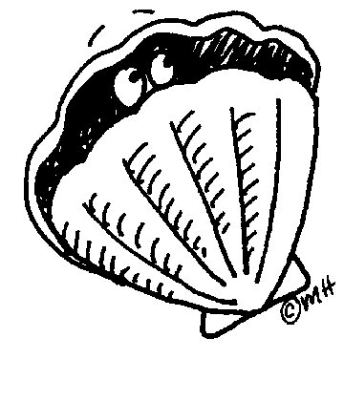
Secure Shell (SSH)

Slide 5
SSH
Creates a “secure tunnel”
Insecure command sent thru SSH tunnel are then secure
SSH used with things like rlogin
Why is rlogin insecure without SSH?
Why is rlogin secure with SSH?
SSH is a relatively simple protocol

Slide 6
SSH
SSH authentication can be based on:
Public keys, or
Digital certificates, or
Passwords
Here, we consider certificate mode
Other modes, see homework problems
We consider slightly simplified SSH…

Slide 7
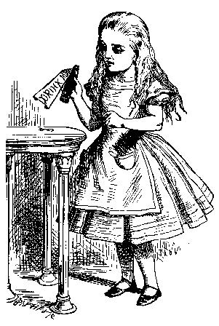
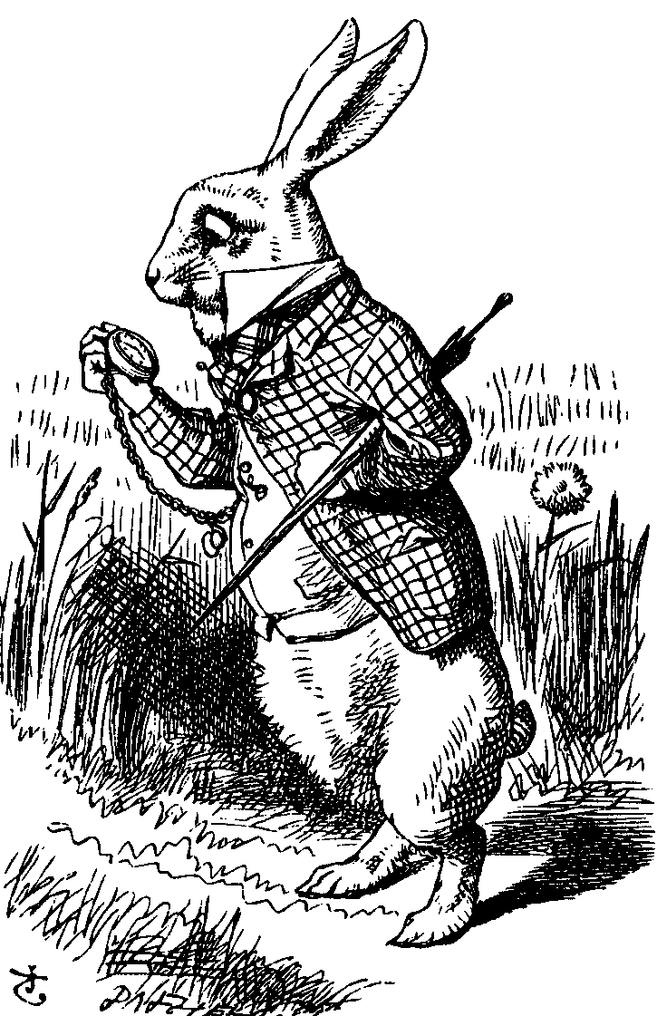
Simplified SSH
Alice, CP, R_{A}
CS, R_{B}
gª mod p
g^{b} mod p, certificate_{B}, S_{B}
Alice
E(Alice, certificate_{A}, S_{A}, K)
Bob
CP = “crypto proposed”, and CS = “crypto selected”
H = h(Alice,Bob,CP,CS,R_{A},R_{B},gª mod p,g^{b} mod p,g^{ab} mod p)
S_{B} = [H]_{Bob}
S_{A} = [H, Alice, certificate_{A}]_{Alice}
K = g^{ab} mod p

Slide 8
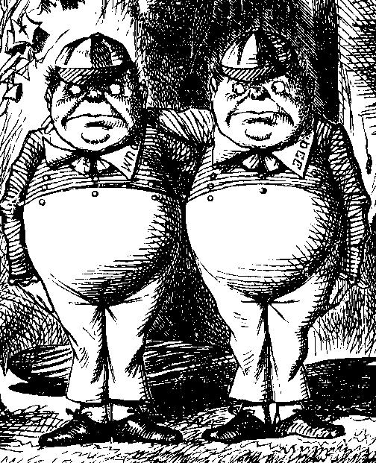
MiM Attack on SSH?
Alice, R_{A}
Alice, R_{A}
R_{B}
R_{B}
gª mod p
g^{t} mod p
g^{t} mod p, cert_{B}, S_{B}
g^{b} mod p, cert_{B}, S_{B}
Alice
E(Alice,cert_{A},S_{A},K)
Trudy
E(Alice,cert_{A},S_{A},K)
Bob
Where does this attack fail?
Alice computes:
H_{a} = h(Alice,Bob,CP,CS,R_{A},R_{B},gª mod p,g^{t} mod p,g^{at} mod p)
But Bob signs:
H_{b} = h(Alice,Bob,CP,CS,R_{A},R_{B},g^{t} mod p,g^{b} mod p,g^{bt} mod p)

Slide 9
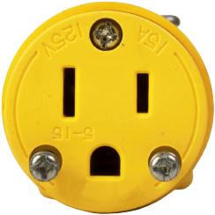
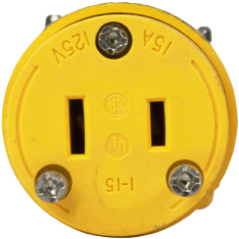
Secure Socket Layer

Slide 10
Socket layer
“Socket layer” lives between application and transport layers
SSL usually between HTTP and TCP
Socket
“layer”
application
transport
network
link
physical
User
OS
NIC

Slide 11
What is SSL?
SSL is the protocol used for majority of secure transactions on the Internet
For example, if you want to buy a book at amazon.com…
You want to be sure you are dealing with Amazon (authentication)
Your credit card information must be protected in transit (confidentiality and/or integrity)
As long as you have money, Amazon does not care who you are
So, no need for mutual authentication

Slide 12
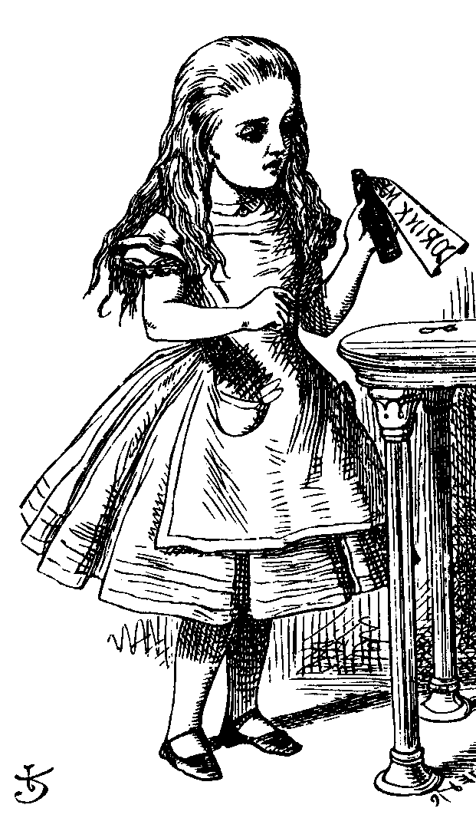
Simple SSL-like Protocol
I’d like to talk to you securely
Here’s my certificate
{K}_{Bob}
Alice
protected HTTP
Bob
Is Alice sure she’s talking to Bob?
Is Bob sure he’s talking to Alice?

Slide 13
Simplified SSL Protocol
Can we talk?, cipher list, R_{A}
certificate, cipher, R_{B}
{S}_{Bob}, E(h(msgs,CLNT,K),K)
h(msgs,SRVR,K)
Alice
Data protected with key K
Bob
S is known as pre-master secret
K = h(S,R_{A},R_{B})
“msgs” means all previous messages
CLNT and SRVR are constants

Slide 14
SSL Keys
6 “keys” derived from K = h(S,R_{A},R_{B})
2 encryption keys: send and receive
2 integrity keys: send and receive
2 IVs: send and receive
Why different keys in each direction?
Q: Why is h(msgs,CLNT,K) encrypted?
A: Apparently, it adds no security…

Slide 15
SSL Authentication
Alice authenticates Bob, not vice-versa
How does client authenticate server?
Why would server not authenticate client?
Mutual authentication is possible: Bob sends certificate request in message 2
Then client must have a valid certificate
But, if server wants to authenticate client, server could instead require password

Slide 16
SSL MiM Attack?
R_{A}
R_{A}
certificate_{T}, R_{B}
certificate_{B}, R_{B}
{S₁}_{Trudy},E(X₁,K₁)
{S₂}_{Bob},E(X₂,K₂)
h(Y₁,K₁)
h(Y₂,K₂)
Alice
E(data,K₁)
Trudy
E(data,K₂)
Bob
Q: What prevents this MiM “attack”?
A: Bob’s certificate must be signed by a certificate authority (CA)
What does browser do if signature not valid?
What does user do when browser complains?

Slide 17
SSL Sessions vs Connections
SSL session is established as shown on previous slides
SSL designed for use with HTTP 1.0
HTTP 1.0 often opens multiple simultaneous (parallel) connections
Multiple connections per session
SSL session is costly, public key operations
SSL has an efficient protocol for opening new connections given an existing session

Slide 18
SSL Connection
session-ID, cipher list, R_{A}
session-ID, cipher, R_{B,}
h(msgs,SRVR,K)
h(msgs,CLNT,K)
Alice
Protected data
Bob
Assuming SSL session exists
So, S is already known to Alice and Bob
Both sides must remember session-ID
Again, K = h(S,R_{A},R_{B})
No public key operations! (relies on known S)

Slide 19
SSL vs IPSec
IPSec ⎯ discussed in next section
Lives at the network layer (part of the OS)
Encryption, integrity, authentication, etc.
Is overly complex, has some security “issues”
SSL (and IEEE standard known as TLS)
Lives at socket layer (part of user space)
Encryption, integrity, authentication, etc.
Relatively simple and elegant specification

Slide 20
SSL vs IPSec
IPSec: OS must be aware, but not apps
SSL: Apps must be aware, but not OS
SSL built into Web early-on (Netscape)
IPSec often used in VPNs (secure tunnel)
Reluctance to retrofit applications for SSL
IPSec not widely deployed (complexity, etc.)
The bottom line…
Internet less secure than it should be!

Slide 21
IPSec

Slide 22
IPSec and SSL
IPSec lives at the network layer
IPSec is transparent to applications
application
transport
network
link
physical
User
SSL
OS
IPSec
NIC

Slide 23
IPSec and Complexity
IPSec is a complex protocol
Over-engineered
Lots of (generally useless) features
Flawed
Some significant security issues
Interoperability is serious challenge
Defeats the purpose of having a standard!
Complex
And, did I mention, it’s complex?

Slide 24
IKE and ESP/AH
Two parts to IPSec
IKE: Internet Key Exchange
Mutual authentication
Establish session key
Two “phases” ⎯ like SSL session/connection
ESP/AH
ESP: Encapsulating Security Payload ⎯ for encryption and/or integrity of IP packets
AH: Authentication Header ⎯ integrity only

Slide 25
IKE

Slide 26
IKE
IKE has 2 phases
Phase 1 ⎯ IKE security association (SA)
Phase 2 ⎯ AH/ESP security association
Phase 1 is comparable to SSL session
Phase 2 is comparable to SSL connection
Not an obvious need for two phases in IKE
If multiple Phase 2’s do not occur, then it is more costly to have two phases!

Slide 27
IKE Phase 1
Four different “key” options
Public key encryption (original version)
Public key encryption (improved version)
Public key signature
Symmetric key
For each of these, two different “modes”
Main mode and aggressive mode
There are 8 versions of IKE Phase 1!
Need more evidence it’s over-engineered?

Slide 28
IKE Phase 1
We discuss 6 of 8 Phase 1 variants
Public key signatures (main & aggressive modes)
Symmetric key (main and aggressive modes)
Public key encryption (main and aggressive)
Why public key encryption and public key signatures?
Always know your own private key
May not (initially) know other side’s public key

Slide 29
IKE Phase 1
Uses ephemeral Diffie-Hellman to establish session key
Provides perfect forward secrecy (PFS)
Let a be Alice’s Diffie-Hellman exponent
Let b be Bob’s Diffie-Hellman exponent
Let g be generator and p prime
Recall that p and g are public

Slide 30
IKE Phase 1: Digital Signature (Main Mode)
IC, CP
IC,RC, CS
IC,RC, gª mod p, R_{A}
IC,RC, g^{b} mod p, R_{B}
IC,RC, E(“Alice”, proof_{A}, K)
Alice
IC,RC, E(“Bob”, proof_{B}, K)
Bob
CP = crypto proposed, CS = crypto selected
IC = initiator “cookie”, RC = responder “cookie”
K = h(IC,RC,g^{ab} mod p,R_{A},R_{B})
SKEYID = h(R_{A}, R_{B}, g^{ab} mod p)
proof_{A} = [h(SKEYID,gª mod p,g^{b} mod p,IC,RC,CP,“Alice”)]_{Alice}

Slide 31
IKE Phase 1: Public Key Signature (Aggressive Mode)
IC, “Alice”, gª mod p, R_{A}, CP
IC,RC, “Bob”, R_{B},
g^{b} mod p, CS, proof_{B}
IC,RC, proof_{A}
Alice
Bob
Main difference from main mode
Not trying to protect identities
Cannot negotiate g or p

Slide 32
Main vs Aggressive Modes
Main mode MUST be implemented
Aggressive mode SHOULD be implemented
So, if aggressive mode is not implemented, “you should feel guilty about it”
Might create interoperability issues
For public key signature authentication
Passive attacker knows identities of Alice and Bob in aggressive mode, but not in main mode
Active attacker can determine Alice’s and Bob’s identity in main mode

Slide 33
IKE Phase 1: Symmetric Key (Main Mode)
IC, CP
IC,RC, CS
IC,RC, gª mod p, R_{A}
IC,RC, g^{b} mod p, R_{B}
IC,RC, E(“Alice”, proof_{A}, K)
Alice
K_{AB}
Bob
K_{AB}
IC,RC, E(“Bob”, proof_{B}, K)
Same as signature mode except
K_{AB} = symmetric key shared in advance
K = h(IC,RC,g^{ab} mod p,R_{A},R_{B},K_{AB})
SKEYID = h(K, g^{ab} mod p)
proof_{A} = h(SKEYID,gª mod p,g^{b} mod p,IC,RC,CP,“Alice”)

Slide 34
Problems with Symmetric Key (Main Mode)
Catch-22
Alice sends her ID in message 5
Alice’s ID encrypted with K
To find K Bob must know K_{AB}
To get K_{AB} Bob must know he’s talking to Alice!
Result: Alice’s ID must be IP address!
Useless mode for the “road warrior”
Why go to all of the trouble of trying to hide identities in 6 message protocol?

Slide 35
IKE Phase 1: Symmetric Key (Aggressive Mode)
IC, “Alice”, gª mod p, R_{A}, CP
IC,RC, “Bob”, R_{B},
g^{b} mod p, CS, proof_{B}
IC,RC, proof_{A}
Alice
Bob
Same format as digital signature aggressive mode
Not trying to hide identities…
As a result, does not have problems of main mode
But does not (pretend to) hide identities

Slide 36
IKE Phase 1: Public Key Encryption (Main Mode)
IC, CP
IC,RC, CS
IC,RC, gª mod p, {R_{A}}_{Bob}, {“Alice”}_{Bob}
IC,RC, g^{b} mod p, {R_{B}}_{Alice}, {“Bob”}_{Alice}
IC,RC, E(proof_{A}, K)
Alice
Bob
IC,RC, E(proof_{B}, K)
CP = crypto proposed, CS = crypto selected
IC = initiator “cookie”, RC = responder “cookie”
K = h(IC,RC,g^{ab} mod p,R_{A},R_{B})
SKEYID = h(R_{A}, R_{B}, g^{ab} mod p)
proof_{A} = h(SKEYID,gª mod p,g^{b} mod p,IC,RC,CP,“Alice”)

Slide 37
IKE Phase 1: Public Key Encryption (Aggressive Mode)
IC, CP, gª mod p,
{“Alice”}_{Bob}, {R_{A}}_{Bob}
IC,RC, CS, g^{b} mod p,
{“Bob”}_{Alice}, {R_{B}}_{Alice}, proof_{B}
IC,RC, proof_{A}
Alice
Bob
K, proof_{A}, proof_{B} computed as in main mode
Note that identities are hidden
The only aggressive mode to hide identities
So, why have a main mode?

Slide 38
Public Key Encryption Issue?
In public key encryption, aggressive mode…
Suppose Trudy generates
Exponents a and b
Nonces R_{A} and R_{B}
Trudy can compute “valid” keys and proofs: g^{ab} mod p, K, SKEYID, proof_{A} and proof_{B}
This also works in main mode

Slide 39
Public Key Encryption Issue?
IC, CP, gª mod p,
{“Alice”}_{Bob}, {R_{A}}_{Bob}
IC,RC, CS, g^{b} mod p,
{“Bob”}_{Alice}, {R_{B}}_{Alice}, proof_{B}
Trudy
as Alice
IC,RC, proof_{A}
Trudy
as Bob
Trudy can create exchange that appears to be between Alice and Bob
Appears valid to any observer, including Alice and Bob!

Slide 40
Plausible Deniability
Trudy can create “conversation” that appears to be between Alice and Bob
Appears valid, even to Alice and Bob!
A security failure?
In this IPSec key option, it is a feature…
Plausible deniability: Alice and Bob can deny that any conversation took place!
In some cases it might create a problem
E.g., if Alice makes a purchase from Bob, she could later repudiate it (unless she had signed)

Slide 41
IKE Phase 1 Cookies
IC and RC ⎯ cookies (or “anti-clogging tokens”) supposed to prevent DoS attacks
No relation to Web cookies
To reduce DoS threats, Bob wants to remain stateless as long as possible
But Bob must remember CP from message 1 (required for proof of identity in message 6)
Bob must keep state from 1st message on
So, these “cookies” offer little DoS protection

Slide 42
IKE Phase 1 Summary
Result of IKE phase 1 is
Mutual authentication
Shared symmetric key
IKE Security Association (SA)
But phase 1 is expensive
Especially in public key and/or main mode
Developers of IKE thought it would be used for lots of things ⎯ not just IPSec
Partly explains the over-engineering…

Slide 43
IKE Phase 2
Phase 1 establishes IKE SA
Phase 2 establishes IPSec SA
Comparison to SSL
SSL session is comparable to IKE Phase 1
SSL connections are like IKE Phase 2
IKE could be used for lots of things…
…but in practice, it’s not!

Slide 44
IKE Phase 2
IC,RC,CP,E(hash1,SA,R_{A},K)
IC,RC,CS,E(hash2,SA,R_{B},K)
IC,RC,E(hash3,K)
Alice
Bob
Key K, IC, RC and SA known from Phase 1
Proposal CP includes ESP and/or AH
Hashes 1,2,3 depend on SKEYID, SA, R_{A} and R_{B}
Keys derived from KEYMAT = h(SKEYID,R_{A},R_{B},junk)
Recall SKEYID depends on phase 1 key method
Optional PFS (ephemeral Diffie-Hellman exchange)

Slide 45
IPSec
After IKE Phase 1, we have an IKE SA
After IKE Phase 2, we have an IPSec SA
Both sides have a shared symmetric key
Now what?
We want to protect IP datagrams
But what is an IP datagram?
Considered from the perspective of IPSec…

Slide 46
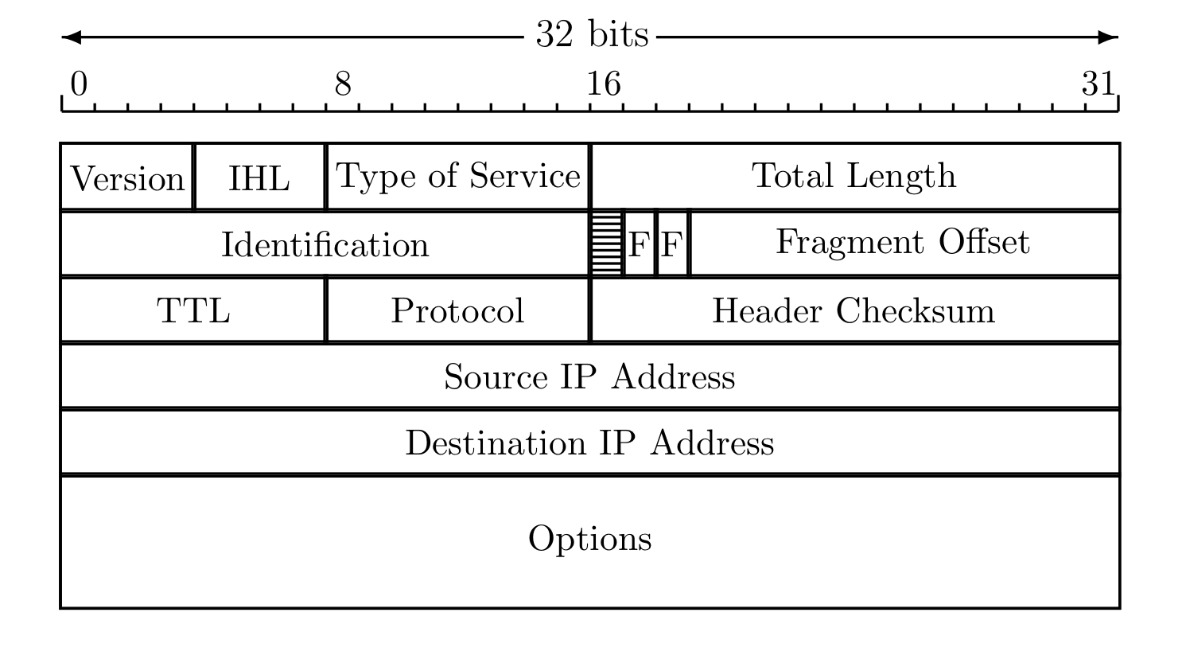
IP Review
IP datagram is of the form
IP header
data
Where IP header is

Slide 47
IP and TCP
Consider Web traffic
IP encapsulates TCP and…
…TCP encapsulates HTTP
IP header
data
IP header
TCP hdr
HTTP hdr
app data
IP data includes TCP header, etc.

Slide 48
IPSec Transport Mode
IPSec Transport Mode
IP header
data
IP header
ESP/AH
data
Transport mode designed for host-to-host
Transport mode is efficient
Adds minimal amount of extra header
The original header remains
Passive attacker can see who is talking

Slide 49
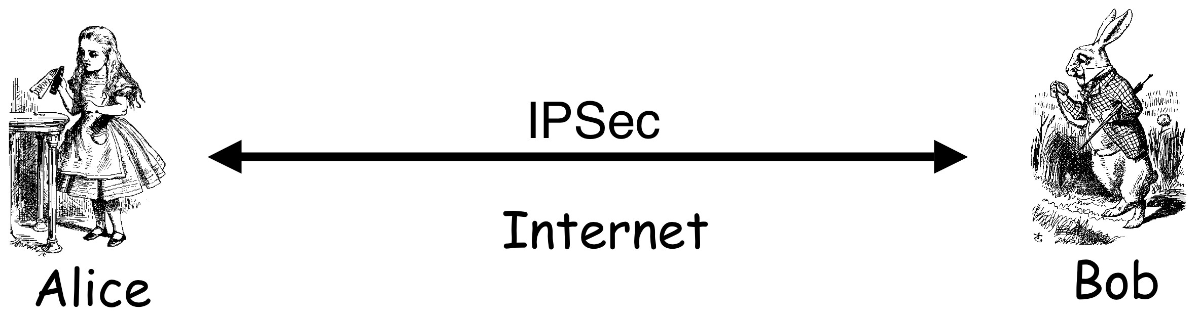
IPSec: Host-to-Host
IPSec transport mode
There may be firewalls in between
If so, is that a problem?

Slide 50
IPSec Tunnel Mode
IPSec Tunnel Mode
IP header
data
new IP hdr
ESP/AH
IP header
data
Tunnel mode for firewall-to-firewall traffic
Original IP packet encapsulated in IPSec
Original IP header not visible to attacker
New IP header from firewall to firewall
Attacker does not know which hosts are talking

Slide 51
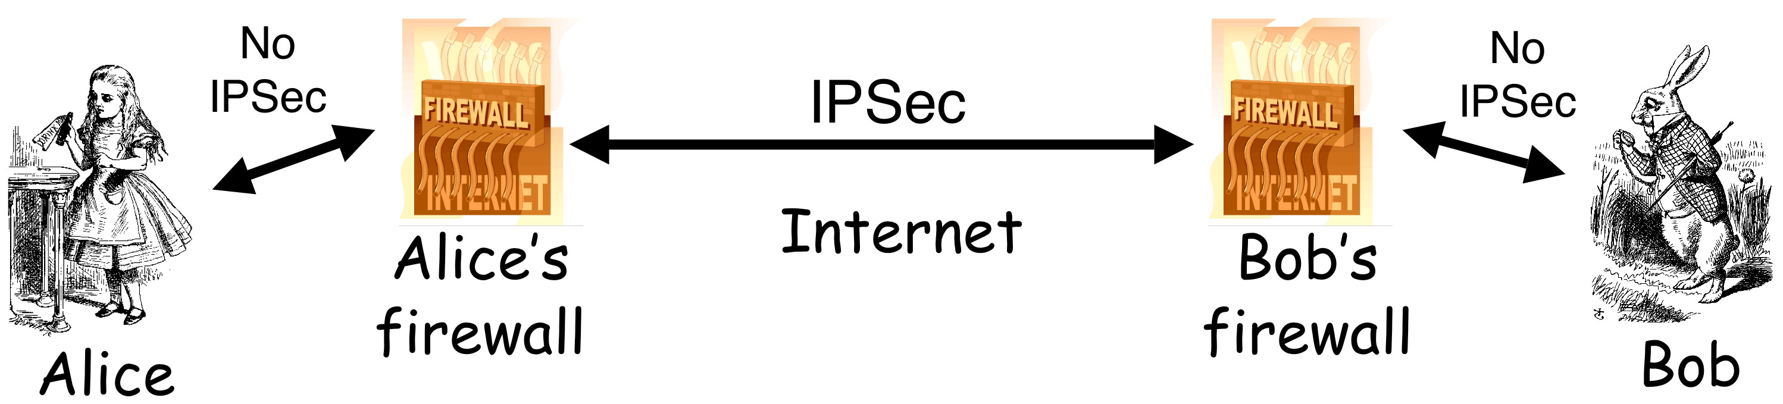
IPSec: Firewall-to-Firewall
IPSec tunnel mode
Local networks not protected
Is there any advantage here?

Slide 52
Comparison of IPSec Modes
Transport Mode
Transport Mode
Host-to-host
Tunnel Mode
Firewall-to-firewall
Transport Mode not necessary…
…but it’s more efficient
IP header
data
IP header
ESP/AH
data
Tunnel Mode
IP header
data
new IP hdr
ESP/AH
IP header
data

Slide 53
IPSec Security
What kind of protection?
Confidentiality?
Integrity?
Both?
What to protect?
Data?
Header?
Both?
ESP/AH do some combinations of these

Slide 54
AH vs ESP
AH ⎯ Authentication Header
Integrity only (no confidentiality)
Integrity-protect everything beyond IP header and some fields of header (why not all fields?)
ESP ⎯ Encapsulating Security Payload
Integrity and confidentiality both required
Protects everything beyond IP header
Integrity-only by using NULL encryption

Slide 55
ESP’s NULL Encryption
According to RFC 2410
NULL encryption “is a block cipher the origins of which appear to be lost in antiquity”
“Despite rumors”, there is no evidence that NSA “suppressed publication of this algorithm”
Evidence suggests it was developed in Roman times as exportable version of Caesar’s cipher
Can make use of keys of varying length
No IV is required
Null(P,K) = P for any P and any key K
Bottom line: Security people can be strange

Slide 56
Why Does AH Exist? (1)
Cannot encrypt IP header
Routers must look at the IP header
IP addresses, TTL, etc.
IP header exists to route packets!
AH protects immutable fields in IP header
Cannot integrity protect all header fields
TTL, for example, will change
ESP does not protect IP header at all

Slide 57
Why Does AH Exist? (2)
ESP encrypts everything beyond the IP header (if non-null encryption)
If ESP-encrypted, firewall cannot look at TCP header (e.g., port numbers)
Why not use ESP with NULL encryption?
Firewall sees ESP header, but does not know whether null encryption is used
End systems know, but not the firewalls

Slide 58
Why Does AH Exist? (3)
The real reason why AH exists:
At one IETF meeting “someone from Microsoft gave an impassioned speech about how AH was useless…”
“…everyone in the room looked around and said `Hmm. He’s right, and we hate AH also, but if it annoys Microsoft let’s leave it in since we hate Microsoft more than we hate AH.’ ”

Slide 59
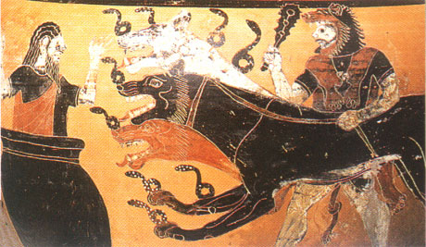
Kerberos

Slide 60
Kerberos
In Greek mythology, Kerberos is 3-headed dog that guards entrance to Hades
“Wouldn’t it make more sense to guard the exit?”
In security, Kerberos is an authentication protocol based on symmetric key crypto
Originated at MIT
Based on work by Needham and Schroeder
Relies on a Trusted Third Party (TTP)

Slide 61
Motivation for Kerberos
Authentication using public keys
N users ⇒ N key pairs
Authentication using symmetric keys
N users requires (on the order of) N² keys
Symmetric key case does not scale
Kerberos based on symmetric keys but only requires N keys for N users
Security depends on TTP
No PKI is needed

Slide 62
Kerberos KDC
Kerberos Key Distribution Center or KDC
KDC acts as the TTP
TTP is trusted, so it must not be compromised
KDC shares symmetric key K_{A} with Alice, key K_{B} with Bob, key K_{C} with Carol, etc.
And a master key K_{KDC} known only to KDC
KDC enables authentication, session keys
Session key for confidentiality and integrity
In practice, crypto algorithm is DES

Slide 63
Kerberos Tickets
KDC issue tickets containing info needed to access network resources
KDC also issues Ticket-Granting Tickets or TGTs that are used to obtain tickets
Each TGT contains
Session key
User’s ID
Expiration time
Every TGT is encrypted with K_{KDC}
So, TGT can only be read by the KDC

Slide 64
Kerberized Login
Alice enters her password
Then Alice’s computer does following:
Derives K_{A} from Alice’s password
Uses K_{A} to get TGT for Alice from KDC
Alice then uses her TGT (credentials) to securely access network resources
Plus: Security is transparent to Alice
Minus: KDC must be secure ⎯ it’s trusted!

Slide 65
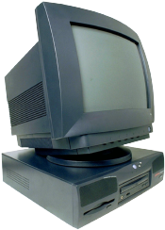

Kerberized Login
Alice wants
Alice’s
a TGT
password
E(S_{A},TGT,K_{A})
Alice
Computer
KDC
Key K_{A} = h(Alice’s password)
KDC creates session key S_{A}
Alice’s computer decrypts S_{A} and TGT
Then it forgets K_{A}
TGT = E(“Alice”, S_{A}, K_{KDC})

Slide 66
Alice Requests “Ticket to Bob”
I want to
talk to Bob
Talk to Bob
REQUEST
REPLY
Alice
Computer
KDC
REQUEST = (TGT, authenticator)
authenticator = E(timestamp, S_{A})
REPLY = E(“Bob”, K_{AB}, ticket to Bob, S_{A})
ticket to Bob = E(“Alice”, K_{AB}, K_{B})
KDC gets S_{A} from TGT to verify timestamp

Slide 67
Alice Uses Ticket to Bob
ticket to Bob, authenticator
E(timestamp + 1, K_{AB})
Alice’s
Computer
Bob
ticket to Bob = E(“Alice”, K_{AB}, K_{B})
authenticator = E(timestamp, K_{AB})
Bob decrypts “ticket to Bob” to get K_{AB} which he then uses to verify timestamp

Slide 68
Kerberos
Key S_{A} used in authentication
For confidentiality/integrity
Timestamps for authentication and replay protection
Recall, that timestamps…
Reduce the number of messages⎯like a nonce that is known in advance
But, “time” is a security-critical parameter

Slide 69
Kerberos Questions
When Alice logs in, KDC sends E(S_{A}, TGT, K_{A}) where TGT = E(“Alice”, S_{A}, K_{KDC})
Q: Why is TGT encrypted with K_{A}?
A: Extra work for no added security!
In Alice’s “Kerberized” login to Bob, why can Alice remain anonymous?
Why is “ticket to Bob” sent to Alice?
Why doesn’t KDC send it directly to Bob?

Slide 70
Kerberos Alternatives
Could have Alice’s computer remember password and use that for authentication
Then no KDC required
But hard to protect passwords
Also, does not scale
Could have KDC remember session key instead of putting it in a TGT
Then no need for TGT
But stateless KDC is major feature of Kerberos

Slide 71
Kerberos Keys
In Kerberos, K_{A} = h(Alice’s password)
Could instead generate random K_{A}
Compute K_{h} = h(Alice’s password)
And Alice’s computer stores E(K_{A}, K_{h})
Then K_{A} need not change when Alice changes her password
But E(K_{A}, K_{h}) must be stored on computer
This alternative approach is often used
But not in Kerberos

Slide 72
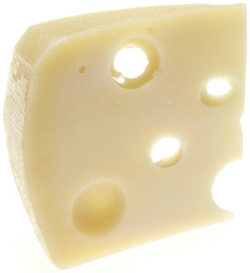
WEP

Slide 73
WEP
WEP ⎯ Wired Equivalent Privacy
The stated goal of WEP is to make wireless LAN as secure as a wired LAN
According to Tanenbaum:
“The 802.11 standard prescribes a data link-level security protocol called WEP (Wired Equivalent Privacy), which is designed to make the security of a wireless LAN as good as that of a wired LAN. Since the default for a wired LAN is no security at all, this goal is easy to achieve, and WEP achieves it as we shall see.”

Slide 74
WEP Authentication
Authentication Request
R
E(R, K)
Alice, K
Bob, K
Bob is wireless access point
Key K shared by access point and all users
Key K seldom (if ever) changes
WEP has many, many, many security flaws

Slide 75
WEP Issues
WEP uses RC4 cipher for confidentiality
RC4 is considered a strong cipher
But WEP introduces a subtle flaw…
…making cryptanalytic attacks feasible
WEP uses CRC for “integrity”
Should have used a MAC or HMAC instead
CRC is for error detection, not crypto integrity
Everyone knows NOT to use CRC for this…

Slide 76
WEP Integrity Problems
WEP “integrity” gives no crypto integrity
CRC is linear, so is stream cipher (XOR)
Trudy can change ciphertext and CRC so that checksum remains correct
Then Trudy’s introduced errors go undetected
Requires no knowledge of the plaintext!
CRC does not provide a cryptographic integrity check
CRC designed to detect random errors
Not able to detect intelligent changes

Slide 77
More WEP Integrity Issues
Suppose Trudy knows destination IP
Then Trudy also knows keystream used to encrypt IP address, since…
… C = destination IP address ⊕ keystream
Then Trudy can replace C with…
… C′ = Trudy’s IP address ⊕ keystream
And change the CRC so no error detected!
Then what happens??
Moral: Big problem when integrity fails

Slide 78
WEP Key
Recall WEP uses a long-term secret key: K
RC4 is a stream cipher, so each packet must be encrypted using a different key
Initialization Vector (IV) sent with packet
Sent in the clear, that is, IV is not secret
Note: IV similar to “MI” in WWII ciphers
Actual RC4 key for packet is (IV,K)
That is, IV is pre-pended to long-term key K

Slide 79
WEP Encryption
IV, E(packet,K_{IV})
Alice, K
Bob, K
K_{IV} = (IV,K)
That is, RC4 key is K with 3-byte IV pre-pended
Note that the IV is known to Trudy

Slide 80
WEP IV Issues
WEP uses 24-bit (3 byte) IV
Each packet gets a new IV
Key: IV pre-pended to long-term key, K
Long term key K seldom changes
If long-term key and IV are same, then same keystream is used
This is bad, bad, really really bad!
Why?

Slide 81
WEP IV Issues
Assume 1500 byte packets, 11 Mbps link
Suppose IVs generated in sequence
Since 1500 ⋅ 8/(11 ⋅ 10⁶) ⋅ 2²⁴ = 18,000 seconds…
…an IV must repeat in about 5 hours
Suppose IVs generated at random
By birthday problem, some IV repeats in seconds
Again, repeated IV (with same K) is bad!

Slide 82
Another Active Attack
Suppose Trudy can insert traffic and observe corresponding ciphertext
Then she knows the keystream for some IV
She can decrypt any packet(s) that uses that IV
If Trudy does this many times, she can then decrypt data for lots of IVs
Remember, IV is sent in the clear
Is such an attack feasible?

Slide 83
Cryptanalytic Attack
WEP data encrypted using RC4
Packet key is IV and long-term key K
3-byte IV is pre-pended to K
Packet key is (IV,K)
Recall IV is sent in the clear (not secret)
New IV sent with every packet
Long-term key K seldom changes (maybe never)
So Trudy always knows IVs and ciphertext
Trudy wants to find the key K

Slide 84
Cryptanalytic Attack
3-byte IV pre-pended to key
Denote the RC4 key bytes…
…as K₀,K₁,K₂,K₃,K₄,K₅, …
Where IV = (K₀,K₁,K₂) , which Trudy knows
Trudy wants to find K = (K₃,K₄,K₅, …)
Given enough IVs, Trudy can find key K
Regardless of the length of the key!
Provided Trudy knows first keystream byte
Known plaintext attack (1st byte of each packet)
Prevent by discarding first 256 keystream bytes

Slide 85
WEP Conclusions
Many attacks are practical
Attacks have been used to recover keys and break real WEP traffic
How to prevent WEP attacks?
Don’t use WEP
Good alternatives: WPA, WPA2, etc.
How to make WEP a little better?
Restrict MAC addresses, don’t broadcast ID, …

Slide 86

GSM (In)Security

Slide 87
Cell Phones
First generation cell phones
Brick-sized, analog, few standards
Little or no security
Susceptible to cloning
Second generation cell phones: GSM
Began in 1982 as “Groupe Speciale Mobile”
Now, Global System for Mobile Communications
Third generation?
3rd Generation Partnership Project (3GPP)

Slide 88

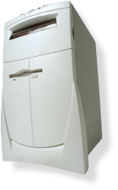

GSM System Overview
air
interface
Mobile
Base
Station
AuC
VLR
“land line”
HLR
PSTN
Internet
etc.
Base
Station
Controller
Home
Network
Visited
Network

Slide 89


GSM System Components
Mobile phone
Contains SIM (Subscriber Identity Module)
SIM is the security module
IMSI (International Mobile Subscriber ID)
User key: Ki (128 bits)
Tamper resistant (smart card)
PIN activated (usually not used)
SIM

Slide 90
GSM System Components
Visited network ⎯ network where mobile is currently located
Base station ⎯ one “cell”
Base station controller ⎯ manages many cells
VLR (Visitor Location Register) ⎯ info on all visiting mobiles currently in the network
Home network ⎯ “home” of the mobile
HLR (Home Location Register) ⎯ keeps track of most recent location of mobile
AuC (Authentication Center) ⎯ has IMSI and Ki

Slide 91
GSM Security Goals
Primary design goals
Make GSM as secure as ordinary telephone
Prevent phone cloning
Not designed to resist an active attacks
At the time this seemed infeasible
Today such an attacks are feasible…
Designers considered biggest threats to be
Insecure billing
Corruption
Other low-tech attacks

Slide 92
GSM Security Features
Anonymity
Intercepted traffic does not identify user
Not so important to phone company
Authentication
Necessary for proper billing
Very, very important to phone company!
Confidentiality
Confidentiality of calls over the air interface
Not important to phone company
May be important for marketing

Slide 93
GSM: Anonymity
IMSI used to initially identify caller
Then TMSI (Temporary Mobile Subscriber ID) used
TMSI changed frequently
TMSI’s encrypted when sent
Not a strong form of anonymity
But probably sufficient for most uses

Slide 94
GSM: Authentication
Caller is authenticated to base station
Authentication is not mutual
Authentication via challenge-response
Home network generates RAND and computes XRES = A3(RAND, Ki) where A3 is a hash
Then (RAND,XRES) sent to base station
Base station sends challenge RAND to mobile
Mobile’s response is SRES = A3(RAND, Ki)
Base station verifies SRES = XRES
Note: Ki never leaves home network!

Slide 95
GSM: Confidentiality
Data encrypted with stream cipher
Error rate estimated at about 1/1000
Error rate is high for a block cipher
Encryption key Kc
Home network computes Kc = A8(RAND, Ki) where A8 is a hash
Then Kc sent to base station with (RAND,XRES)
Mobile computes Kc = A8(RAND, Ki)
Keystream generated from A5(Kc)
Note: Ki never leaves home network!

Slide 96
GSM Security
1. IMSI
2. IMSI
4. RAND
3. (RAND,XRES,Kc)
5. SRES
Mobile
Base
Station
Home
Network
6. Encrypt with Kc
SRES and Kc must be uncorrelated
Even though both are derived from RAND and Ki
Must not be possible to deduce Ki from known RAND/SRES pairs (known plaintext attack)
Must not be possible to deduce Ki from chosen RAND/SRES pairs (chosen plaintext attack)
With possession of SIM, attacker can choose RAND’s

Slide 97
GSM Insecurity (1)
Hash used for A3/A8 is COMP128
Broken by 160,000 chosen plaintexts
With SIM, can get Ki in 2 to 10 hours
Encryption between mobile and base station but no encryption from base station to base station controller
Often transmitted over microwave link
Encryption algorithm A5/1
Broken with 2 seconds of known plaintext
Base
Station
VLR
Base
Station
Controller

Slide 98
GSM Insecurity (2)
Attacks on SIM card
Optical Fault Induction ⎯ could attack SIM with a flashbulb to recover Ki
Partitioning Attacks ⎯ using timing and power consumption, could recover Ki with only 8 adaptively chosen “plaintexts”
With possession of SIM, attacker could recover Ki in seconds

Slide 99

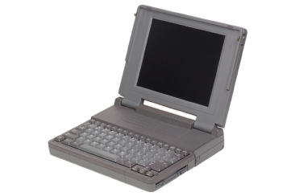

GSM Insecurity (3)
Fake base station exploits two flaws
Encryption not automatic
Base station not authenticated
RAND
SRES
Call to
destination
No
Mobile
Fake
Base Station
encryption
Base Station
Note: GSM bill goes to fake base station!

Slide 100
GSM Insecurity (4)
Denial of service is possible
Jamming (always an issue in wireless)
Can replay triple: (RAND,XRES,Kc)
One compromised triple gives attacker a key Kc that is valid forever
No replay protection here

Slide 101
GSM Conclusion
Did GSM achieve its goals?
Eliminate cloning? Yes, as a practical matter
Make air interface as secure as PSTN? Perhaps…
But design goals were clearly too limited
GSM insecurities ⎯ weak crypto, SIM issues, fake base station, replay, etc.
PSTN insecurities ⎯ tapping, active attack, passive attack (e.g., cordless phones), etc.
GSM a (modest) security success?

Slide 102
3GPP: 3rd Generation Partnership Project
3G security built on GSM (in)security
3G fixed known GSM security problems
Mutual authentication
Integrity-protect signaling (such as “start encryption” command)
Keys (encryption/integrity) cannot be reused
Triples cannot be replayed
Strong encryption algorithm (KASUMI)
Encryption extended to base station controller

Slide 103
Protocols Summary
Generic authentication protocols
Protocols are subtle!
SSH
SSL
IPSec
Kerberos
Wireless: GSM and WEP

Slide 104
Coming Attractions…
Software and security
Software flaws ⎯ buffer overflow, etc.
Malware ⎯ viruses, worms, etc.
Software reverse engineering
Digital rights management
OS and security/NGSCB

