Slide 1
Part IV: Software
Original Source: http://www.cs.sjsu.edu/~stamp/infosec/

Slide 2
Why Software?
Why is software as important to security as crypto, access control, protocols?
Virtually all of information security is implemented in software
If your software is subject to attack, your security can be broken
Regardless of strength of crypto, access control or protocols
Software is a poor foundation for security

Slide 3
Chapter 11: Software Flaws and Malware
If automobiles had followed the same development cycle as the computer,
a Rolls-Royce would today cost $100, get a million miles per gallon,
and explode once a year, killing everyone inside.
⎯ Robert X. Cringely
My software never has bugs. It just develops random features.
⎯ Anonymous

Slide 4
Bad Software is Ubiquitous
NASA Mars Lander (cost $165 million)
Crashed into Mars due to…
…error in converting English and metric units of measure
Believe it or not
Denver airport
Baggage handling system --- very buggy software
Delayed airport opening by 11 months
Cost of delay exceeded $1 million/day
What happened to person responsible for this fiasco?
MV-22 Osprey
Advanced military aircraft
Faulty software can be fatal

Slide 5
Software Issues
Alice and Bob
Find bugs and flaws by accident
Hate bad software…
…but must learn to live with it
Must make bad software work
Trudy
Actively looks for bugs and flaws
Likes bad software…
…and tries to make it misbehave
Attacks systems via bad software

Slide 6
Complexity
“Complexity is the enemy of security”, Paul Kocher, Cryptography Research, Inc.
System | Lines of Code (LOC)
Netscape | 17 million
Space Shuttle | 10 million
Linux kernel 2.6.0 | 5 million
Windows XP | 40 million
Mac OS X 10.4 | 86 million
Boeing 777 | 7 million
A new car contains more LOC than was required to land the Apollo astronauts on the moon

Slide 7
Lines of Code and Bugs
Conservative estimate: 5 bugs/10,000 LOC
Do the math
Typical computer: 3k exe’s of 100k LOC each
Conservative estimate: 50 bugs/exe
So, about 150k bugs per computer
So, 30,000-node network has 4.5 billion bugs
Maybe only 10% of bugs security-critical and only 10% of those remotely exploitable
Then “only” 45 million critical security flaws!

Slide 8
Software Security Topics
Program flaws (unintentional)
Buffer overflow
Incomplete mediation
Race conditions
Malicious software (intentional)
Viruses
Worms
Other breeds of malware

Slide 9
Program Flaws
An error is a programming mistake
To err is human
An error may lead to incorrect state: fault
A fault is internal to the program
A fault may lead to a failure, where a system departs from its expected behavior
A failure is externally observable
error
fault
failure

Slide 10
Example
char array[10];
for(i = 0; i < 10; ++i)
array[i] = `A`;
array[10] = `B`;
This program has an error
This error might cause a fault
Incorrect internal state
If a fault occurs, it might lead to a failure
Program behaves incorrectly (external)
We use the term flaw for all of the above

Slide 11
Secure Software
In software engineering, try to ensure that a program does what is intended
Secure software engineering requires that software does what is intended…
…and nothing more
Absolutely secure software is impossible
But, absolute security anywhere is impossible
How can we manage software risks?

Slide 12
Program Flaws
Program flaws are unintentional
But can still create security risks
We’ll consider 3 types of flaws
Buffer overflow (smashing the stack)
Incomplete mediation
Race conditions
These are the most common problems

Slide 13
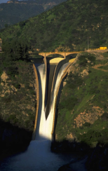
Buffer Overflow

Slide 14
Possible Attack Scenario
Users enter data into a Web form
Web form is sent to server
Server writes data to array called buffer, without checking length of input data
Data “overflows” buffer
Such overflow might enable an attack
If so, attack could be carried out by anyone with Internet access

Slide 15
Buffer Overflow
int main(){
int buffer[10];
buffer[20] = 37;}
Q: What happens when code is executed?
A: Depending on what resides in memory at location “buffer[20]”
Might overwrite user data or code
Might overwrite system data or code
Or program could work just fine

Slide 16

Simple Buffer Overflow
Consider boolean flag for authentication
Buffer overflow could overwrite flag allowing anyone to authenticate
Boolean flag
buffer
F
O
U
R
S
C
…
T
F
In some cases, Trudy need not be so lucky as in this example

Slide 17
Memory Organization
Text == code
Data == static variables
Heap == dynamic data
Stack == “scratch paper”
Dynamic local variables
Parameters to functions
Return address
low
address
text
data
heap
↓
↑
stack
pointer (SP)
stack
high
address

Slide 18
Simplified Stack Example
low →
void func(int a, int b){
char buffer[10];
}
void main(){
func(1, 2);
}
:
:
SP
buffer
SP
ret
return
address
a
SP
high →
b
SP

Slide 19
Smashing the Stack
low →
What happens if buffer overflows?
???
:
:
Program “returns” to wrong location
buffer
SP
overflow
SP
A crash is likely
ret
ret…
NOT!
overflow
a
SP
high →
b
SP

Slide 20
Smashing the Stack
low →
Trudy has a better idea…
:
:
Code injection
Trudy can run code of her choosing…
…on your machine
SP
evil code
ret
ret
SP
a
SP
high →
b
SP

Slide 21
Smashing the Stack
:
:
Trudy may not know…
Address of evil code
Location of ret on stack
Solutions
Precede evil code with NOP “landing pad”
Insert ret many times
NOP
:
NOP
evil code
ret
ret
ret
:
ret
:
:

Slide 22
Stack Smashing Summary
A buffer overflow must exist in the code
Not all buffer overflows are exploitable
Things must align properly
If exploitable, attacker can inject code
Trial and error is likely required
Fear not, lots of help is available online
Smashing the Stack for Fun and Profit, Aleph One
Stack smashing is “attack of the decade”
Regardless of the current decade
Also heap overflow, integer overflow, …

Slide 23
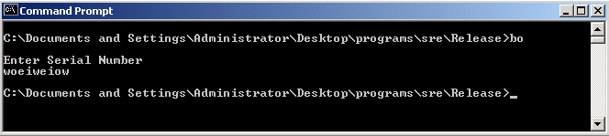
Stack Smashing Example
Program asks for a serial number that the attacker does not know
Attacker does not have source code
Attacker does have the executable (exe)
Program quits on incorrect serial number

Slide 24
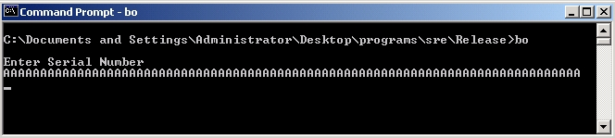
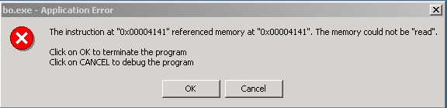
Buffer Overflow Present?
By trial and error, attacker discovers apparent buffer overflow
Note that 0x41 is ASCII for “A”
Looks like ret overwritten by 2 bytes!

Slide 25
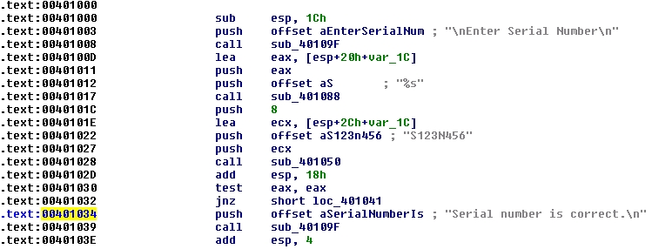
Disassemble Code
Next, disassemble bo.exe to find
The goal is to exploit buffer overflow to jump to address 0x401034

Slide 26
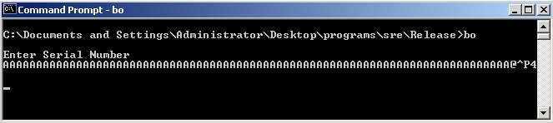
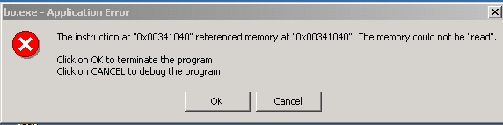
Buffer Overflow Attack
Find that, in ASCII, 0x401034 is “@^P4”
Byte order is reversed? Why?
X86 processors are “little-endian”

Slide 27
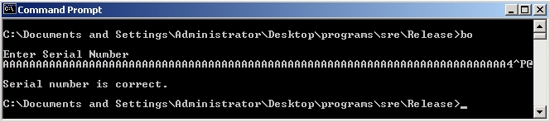
Overflow Attack, Take 2
Reverse the byte order to “4^P@” and…
Success! We’ve bypassed serial number check by exploiting a buffer overflow
What just happened?
Overwrote return address on the stack

Slide 28
Buffer Overflow
Attacker did not require access to the source code
Only tool used was a disassembler to determine address to jump to
Find desired address by trial and error?
Necessary if attacker does not have exe
For example, a remote attack

Slide 29
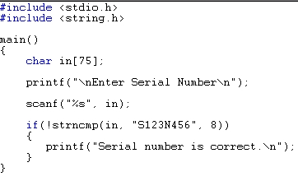
Source Code
Source code for buffer overflow example
Flaw easily found by attacker…
…without access to source code!

Slide 30
Stack Smashing Defenses
Employ non-executable stack
“No execute” NX bit (if available)
Seems like the logical thing to do, but some real code executes on the stack (Java, for example)
Use a canary
Address space layout randomization (ASLR)
Use safe languages (Java, C#)
Use safer C functions
For unsafe functions, safer versions exist
For example, strncpy instead of strcpy

Slide 31

Stack Smashing Defenses
low →
Canary
Run-time stack check
Push canary onto stack
Canary value:
Constant 0x000aff0d
Or may depends on ret
:
:
buffer
overflow
canary
overflow
ret
a
high →
b

Slide 32
Microsoft’s Canary
Microsoft added buffer security check feature to C++ with /GS compiler flag
Based on canary (or “security cookie”)
Q: What to do when canary dies?
A: Check for user-supplied “handler”
Handler shown to be subject to attack
Claim that attacker can specify handler code
If so, formerly “safe” buffer overflows become exploitable when /GS is used!

Slide 33
ASLR
Address Space Layout Randomization
Randomize place where code loaded in memory
Makes most buffer overflow attacks probabilistic
Windows Vista uses 256 random layouts
So about 1/256 chance buffer overflow works?
Similar thing in Mac OS X and other OSs
Attacks against Microsoft’s ASLR do exist
Possible to “de-randomize”

Slide 34
Buffer Overflow
A major security threat yesterday, today, and tomorrow
The good news?
It is possible to reduced overflow attacks
Safe languages, NX bit, ASLR, education, etc.
The bad news?
Buffer overflows will exist for a long time
Legacy code, bad development practices, etc.

Slide 35
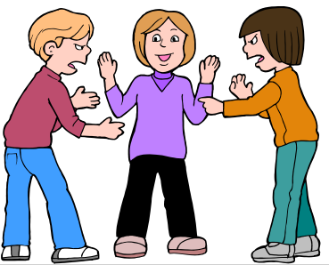
Incomplete Mediation
Notes:
Richter, Gerhard
Mediation
1986
Oil on canvas
320 x 400 cm (126 x 157 1/2 in.)
Musee des beaux-arts de Montrea

Slide 36
Input Validation
Consider: strcpy(buffer, argv[1])
A buffer overflow occurs if
len(buffer) < len(argv[1])
Software must validate the input by checking the length of argv[1]
Failure to do so is an example of a more general problem: incomplete mediation

Slide 37
Input Validation
Consider web form data
Suppose input is validated on client
For example, the following is valid
http://www.things.com/orders/final&custID=112&num=55A&qty=20&price=10&shipping=5&total=205
Suppose input is not checked on server
Why bother since input checked on client?
Then attacker could send http message
http://www.things.com/orders/final&custID=112&num=55A&qty=20&price=10&shipping=5&total=25

Slide 38
Incomplete Mediation
Linux kernel
Research has revealed many buffer overflows
Many of these are due to incomplete mediation
Linux kernel is “good” software since
Open-source
Kernel ⎯ written by coding gurus
Tools exist to help find such problems
But incomplete mediation errors can be subtle
And tools useful to attackers too!

Slide 39
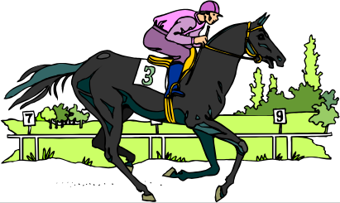
Race Conditions

Slide 40
Race Condition
Security processes should be atomic
Occur “all at once”
Race conditions can arise when security-critical process occurs in stages
Attacker makes change between stages
Often, between stage that gives authorization, but before stage that transfers ownership
Example: Unix mkdir

Slide 41
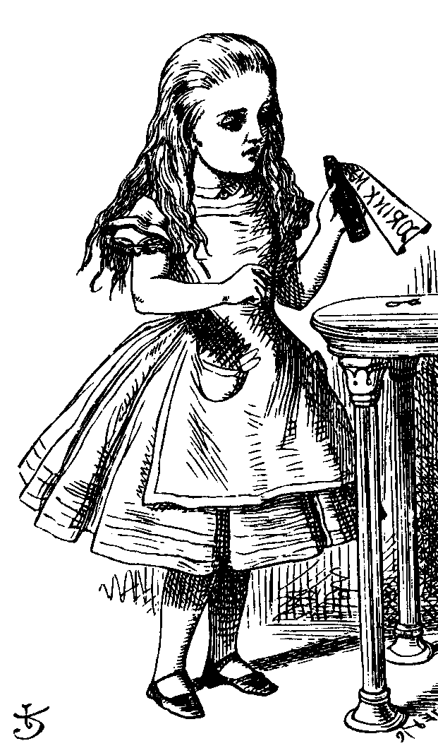
mkdir Race Condition
mkdir creates new directory
How mkdir is supposed to work
mkdir
1. Allocate
space
2. Transfer
ownership

Slide 42
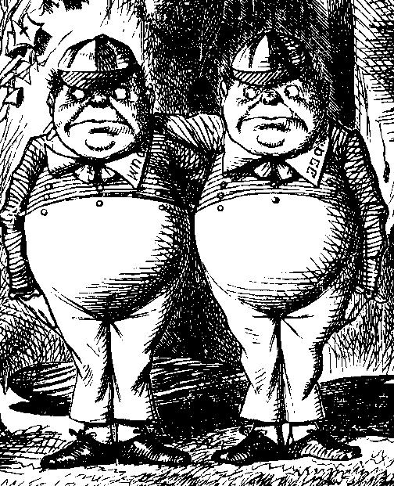
mkdir Attack
The mkdir race condition
mkdir
1. Allocate
space
3. Transfer
ownership
2. Create link to
password file
Not really a “race”
But attacker’s timing is critical

Slide 43
Race Conditions
Race conditions are common
Race conditions may be more prevalent than buffer overflows
But race conditions harder to exploit
Buffer overflow is “low hanging fruit” today
To prevent race conditions, make security-critical processes atomic
Occur all at once, not in stages
Not always easy to accomplish in practice

Slide 44
Malware

Slide 45
Malicious Software
Malware is not new…
Fred Cohen’s initial virus work in 1980’s, used viruses to break MLS systems
Types of malware (lots of overlap)
Virus ⎯ passive propagation
Worm ⎯ active propagation
Trojan horse ⎯ unexpected functionality
Trapdoor/backdoor ⎯ unauthorized access
Rabbit ⎯ exhaust system resources

Slide 46
Where do Viruses Live?
They live just about anywhere, such as…
Boot sector
Take control before anything else
Memory resident
Stays in memory
Applications, macros, data, etc.
Library routines
Compilers, debuggers, virus checker, etc.
These would be particularly nasty!

Slide 47
Malware Examples
Brain virus (1986)
Morris worm (1988)
Code Red (2001)
SQL Slammer (2004)
Botnets (currently fashionable)
Future of malware?

Slide 48
Brain
First appeared in 1986
More annoying than harmful
A prototype for later viruses
Not much reaction by users
What it did
Placed itself in boot sector (and other places)
Screened disk calls to avoid detection
Each disk read, checked boot sector to see if boot sector infected; if not, goto 1
Brain did nothing really malicious

Slide 49
Morris Worm
First appeared in 1988
What it tried to do
Determine where it could spread, then…
…spread its infection and…
…remain undiscovered
Morris claimed his worm had a bug!
It tried to re-infect infected systems
Led to resource exhaustion
Effect was like a so-called rabbit

Slide 50
How Morris Worm Spread
Obtained access to machines by…
User account password guessing
Exploit buffer overflow in fingerd
Exploit trapdoor in sendmail
Flaws in fingerd and sendmail were well-known, but not widely patched

Slide 51
Bootstrap Loader
Once Morris worm got access…
“Bootstrap loader” sent to victim
99 lines of C code
Victim compiled and executed code
Bootstrap loader fetched the worm
Victim authenticated sender!
Don’t want user to get a bad worm…

Slide 52
How to Remain Undetected?
If transmission interrupted, code deleted
Code encrypted when downloaded
Code deleted after decrypt/compile
When running, worm regularly changed name and process identifier (PID)

Slide 53
Morris Worm: Bottom Line
Shock to Internet community of 1988
Internet of 1988 much different than today
Internet designed to withstand nuclear war
Yet, brought down by one graduate student!
At the time, Morris’ father worked at NSA…
Could have been much worse
Result? CERT, more security awareness
But should have been a wakeup call

Slide 54
Code Red Worm
Appeared in July 2001
Infected more than 250,000 systems in about 15 hours
Eventually infected 750,000 out of about 6,000,000 vulnerable systems
Exploited buffer overflow in Microsoft IIS server software
Then monitor traffic on port 80, looking for other susceptible servers

Slide 55
Code Red: What it Did
Day 1 to 19 of month: spread its infection
Day 20 to 27: distributed denial of service attack (DDoS) on www.whitehouse.gov
Later version (several variants)
Included trapdoor for remote access
Rebooted to flush worm, leaving only trapdoor
Some say it was “beta test for info warfare”
But no evidence to support this

Slide 56
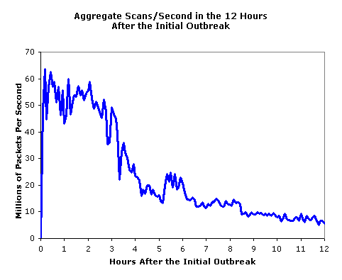
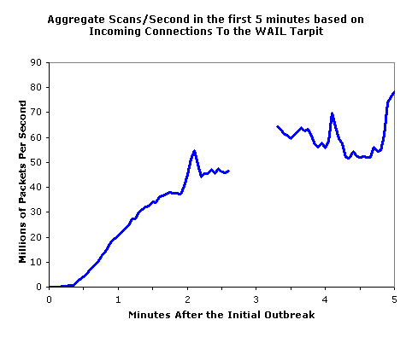
SQL Slammer
Infected 75,000 systems in 10 minutes!
At its peak, infections doubled every 8.5 seconds
Spread “too fast”…
…so it “burned out” available bandwidth

Slide 57
Why was Slammer Successful?
Worm size: one 376-byte UDP packet
Firewalls often let one packet thru
Then monitor ongoing “connections”
Expectation was that much more data required for an attack
So no need to worry about 1 small packet
Slammer defied “experts”

Slide 58

Trojan Horse Example
Trojan: unexpected functionality
Prototype trojan for the Mac
File icon for freeMusic.mp3:
For a real mp3, double click on icon
iTunes opens
Music in mp3 file plays
But for freeMusic.mp3, unexpected results…

Slide 59
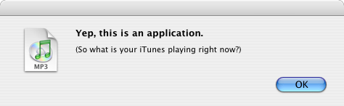
Mac Trojan
Double click on freeMusic.mp3
iTunes opens (expected)
“Wild Laugh” (not expected)
Message box (not expected)

Slide 60
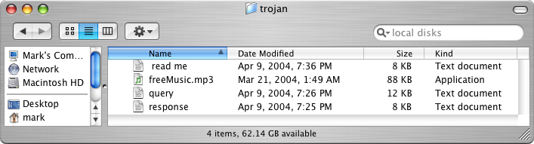
Trojan Example
How does freeMusic.mp3 trojan work?
This “mp3” is an application, not data
This trojan is harmless, but…
…could have done anything user could do
Delete files, download files, launch apps, etc.

Slide 61
Malware Detection
Three common detection methods
Signature detection
Change detection
Anomaly detection
We briefly discuss each of these
And consider advantages…
…and disadvantages

Slide 62
Signature Detection
A signature may be a string of bits in exe
Might also use wildcards, hash values, etc.
For example, W32/Beast virus has signature
83EB 0274 EB0E 740A 81EB 0301 0000
That is, this string of bits appears in virus
We can search for this signature in all files
If string found, have we found W32/Beast?
Not necessarily ⎯ string could appear elsewhere
At random, chance is only 1/2¹¹²
But software is not random

Slide 63
Signature Detection
Advantages
Effective on “ordinary” malware
Minimal burden for users/administrators
Disadvantages
Signature file can be large (10s of thousands)…
…making scanning slow
Signature files must be kept up to date
Cannot detect unknown viruses
Cannot detect some advanced types of malware
The most popular detection method

Slide 64
Change Detection
Viruses must live somewhere
If you detect a file has changed, it might have been infected
How to detect changes?
Hash files and (securely) store hash values
Periodically re-compute hashes and compare
If hash changes, file might be infected

Slide 65
Change Detection
Advantages
Virtually no false negatives
Can even detect previously unknown malware
Disadvantages
Many files change ⎯ and often
Many false alarms (false positives)
Heavy burden on users/administrators
If suspicious change detected, then what?
Might fall back on signature-based system

Slide 66
Anomaly Detection
Monitor system for anything “unusual” or “virus-like” or potentially malicious or …
Examples of “unusual”
Files change in some unexpected way
System misbehaves in some way
Unexpected network activity
Unexpected file access, etc., etc., etc., etc.
But, we must first define “normal”
Normal can (and must) change over time

Slide 67
Anomaly Detection
Advantages
Chance of detecting unknown malware
Disadvantages
No proven track record
Trudy can make abnormal look normal (go slow)
Must be combined with another method (e.g., signature detection)
Also popular in intrusion detection (IDS)
Difficult unsolved (unsolvable?) problem
Reminds me of AI…

Slide 68
Future of Malware
Recent trends
Encrypted, polymorphic, metamorphic malware
Fast replication/Warhol worms
Flash worms, slow worms
Botnets
The future is bright for malware
Good news for the bad guys…
…bad news for the good guys
Future of malware detection?

Slide 69
Encrypted Viruses
Virus writers know signature detection used
So, how to evade signature detection?
Encrypting the virus is a good approach
Ciphertext looks like random bits
Different key, then different “random” bits
So, different copies have no common signature
Encryption often used in viruses today

Slide 70
Encrypted Viruses
How to detect encrypted viruses?
Scan for the decryptor code
More-or-less standard signature detection
But may be more false alarms
Why not encrypt the decryptor code?
Then encrypt the decryptor of the decryptor (and so on…)
Encryption of limited value to virus writers

Slide 71
Polymorphic Malware
Polymorphic worm
Body of worm is encrypted
Decryptor code is “mutated” (or “morphed”)
Trying to hide decryptor signature
Like an encrypted worm on steroids…
Q: How to detect?
A: Emulation ⎯ let the code decrypt itself
Slow, and anti-emulation is possible

Slide 72
Metamorphic Malware
A metamorphic worm mutates before infecting a new system
Sometimes called “body polymorphic”
Such a worm can, in principle, evade signature-based detection
Mutated worm must function the same
And be “different enough” to avoid detection
Detection is a difficult research problem

Slide 73
Metamorphic Worm
One approach to metamorphic replication…
The worm is disassembled
Worm then stripped to a base form
Random variations inserted into code (permute the code, insert dead code, etc., etc.)
Assemble the resulting code
Result is a worm with same functionality as original, but different signature

Slide 74
Warhol Worm
“In the future everybody will be world-famous for 15 minutes” ⎯ Andy Warhol
Warhol Worm is designed to infect the entire Internet in 15 minutes
Slammer infected 250,000 in 10 minutes
“Burned out” bandwidth
Could not have infected entire Internet in 15 minutes ⎯ too bandwidth intensive
Can rapid worm do “better” than Slammer?

Slide 75
A Possible Warhol Worm
Seed worm with an initial hit list containing a set of vulnerable IP addresses
Depends on the particular exploit
Tools exist for identifying vulnerable systems
Each successful initial infection would attack selected part of IP address space
Could infect entire Internet in 15 minutes!
No worm this sophisticated has yet been seen in the wild (as of 2011)
Slammer generated random IP addresses

Slide 76
Flash Worm
Can we do “better” than Warhol worm?
Infect entire Internet in less than 15 minutes?
Searching for vulnerable IP addresses is the slow part of any worm attack
Searching might be bandwidth limited
Like Slammer
Flash worm designed to infect entire Internet almost instantly

Slide 77
Flash Worm
Predetermine all vulnerable IP addresses
Depends on details of the attack
Embed these addresses in worm(s)
Results in huge worm(s)
But, the worm replicates, it splits
No wasted time or bandwidth!
Original worm(s)
1st generation
2nd generation

Slide 78
Flash Worm
Estimated that ideal flash worm could infect the entire Internet in 15 seconds!
Some debate as to actual time it would take
Estimates range from 2 seconds to 2 minutes
In any case…
…much faster than humans could respond
So, any defense must be fully automated
How to defend against such attacks?

Slide 79
Rapid Malware Defenses
Master IDS watches over network
“Infection” proceeds on part of network
Determines whether an attack or not
If so, IDS saves most of the network
If not, only a slight delay
Beneficial worm
Disinfect faster than the worm infects
Other approaches?

Slide 80
Push vs Pull Malware
Viruses/worms examples of “push”
Recently, a lot of “pull” malware
Scenario
A compromised web server
Visit a website at compromised server
Malware loaded on you machine
Good paper: Ghost in the Browser

Slide 81
Botnet
Botnet: a “network” of infected machines
Infected machines are “bots”
Victim is unaware of infection (stealthy)
Botmaster controls botnet
Generally, using IRC
P2P botnet architectures exist
Botnets used for…
Spam, DoS attacks, keylogging, ID theft, etc.

Slide 82
Botnet Examples
XtremBot
Similar bots: Agobot, Forbot, Phatbot
Highly modular, easily modified
Source code readily available (GPL license)
UrXbot
Similar bots: SDBot, UrBot, Rbot
Less sophisticated than XtremBot type
GT-Bots and mIRC-based bots
mIRC is common IRC client for Windows

Slide 83
More Botnet Examples
Mariposa
Used to steal credit card info
Creator arrested in July 2010
Conficker
Estimated 10M infected hosts (2009)
Kraken
Largest as of 2008 (400,000 infections)
Srizbi
For spam, one of largest as of 2008

Slide 84
Computer Infections
Analogies are made between computer viruses/worms and biological diseases
There are differences
Computer infections are much quicker
Ability to intervene in computer outbreak is more limited (vaccination?)
Bio disease models often not applicable
“Distance” almost meaningless on Internet
But there are some similarities…

Slide 85
Computer Infections
Cyber “diseases” vs biological diseases
One similarity
In nature, too few susceptible individuals and disease will die out
In the Internet, too few susceptible systems and worm might fail to take hold
One difference
In nature, diseases attack more-or-less at random
Cyber attackers select most “desirable” targets
Cyber attacks are more focused and damaging

Slide 86
Future Malware Detection?
Malware today outnumbers “goodware”
Metamorphic copies of existing malware
Many virus toolkits available
Trudy: recycle old viruses, different signature
So, may be better to “detect” good code
If code not on “good” list, assume it’s bad
That is, use whitelist instead of blacklist

Slide 87
Miscellaneous Software-Based Attacks

Slide 88
Miscellaneous Attacks
Numerous attacks involve software
We’ll discuss a few issues that do not fit into previous categories
Salami attack
Linearization attack
Time bomb
Can you ever trust software?

Slide 89
Salami Attack
What is Salami attack?
Programmer “slices off” small amounts of money
Slices are hard for victim to detect
Example
Bank calculates interest on accounts
Programmer “slices off” any fraction of a cent and puts it in his own account
No customer notices missing partial cent
Bank may not notice any problem
Over time, programmer makes lots of money!

Slide 90
Salami Attack
Such attacks are possible for insiders
Do salami attacks actually occur?
Or just Office Space folklore?
Programmer added a few cents to every employee payroll tax withholding
But money credited to programmer’s tax
Programmer got a big tax refund!
Rent-a-car franchise in Florida inflated gas tank capacity to overcharge customers

Slide 91
Salami Attacks
Employee reprogrammed Taco Bell cash register: $2.99 item registered as $0.01
Employee pocketed $2.98 on each such item
A large “slice” of salami!
In LA, four men installed computer chip that overstated amount of gas pumped
Customers complained when they had to pay for more gas than tank could hold!
Hard to detect since chip programmed to give correct amount when 5 or 10 gallons purchased
Inspector usually asked for 5 or 10 gallons!

Slide 92
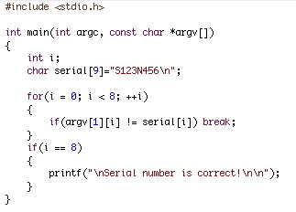
Linearization Attack
Program checks for serial number S123N456
For efficiency, check made one character at a time
Can attacker take advantage of this?

Slide 93
Linearization Attack
Correct letters takes longer than incorrect
Trudy tries all 1st characters
Find that S takes longest
Then she guesses all 2nd characters: S∗
Finds S1 takes longest
And so on…
Trudy can recover one character at a time!
Same principle as used in lock picking

Slide 94
Linearization Attack
What is the advantage to attacking serial number one character at a time?
Suppose serial number is 8 characters and each has 128 possible values
Then 128⁸ = 2⁵⁶ possible serial numbers
Attacker would guess the serial number in about 2⁵⁵ tries ⎯ a lot of work!
Using the linearization attack, the work is about 8 ∗ (128/2) = 2⁹ which is trivial!

Slide 95
Linearization Attack
A real-world linearization attack
TENEX (an ancient timeshare system)
Passwords checked one character at a time
Careful timing was not necessary, instead…
…could arrange for a “page fault” when next unknown character guessed correctly
Page fault register was user accessible
Attack was very easy in practice

Slide 96
Time Bomb
In 1986 Donald Gene Burleson told employer to stop withholding taxes from his paycheck
His company refused
He planned to sue his company
He used company time to prepare legal docs
Company found out and fired him
Burleson had been working on malware…
After being fired, his software “time bomb” deleted important company data

Slide 97
Time Bomb
Company was reluctant to pursue the case
So Burleson sued company for back pay!
Then company finally sued Burleson
In 1988 Burleson fined $11,800
Case took years to prosecute…
Cost company thousands of dollars…
Resulted in a slap on the wrist for Burleson
One of the first computer crime cases
Many cases since follow a similar pattern
I.e., companies reluctant to prosecute

Slide 98
Trusting Software
Can you ever trust software?
See Reflections on Trusting Trust
Consider the following thought experiment
Suppose C compiler has a virus
When compiling login program, virus creates backdoor (account with known password)
When recompiling the C compiler, virus incorporates itself into new C compiler
Difficult to get rid of this virus!

Slide 99
Trusting Software
Suppose you notice something is wrong
So you start over from scratch
First, you recompile the C compiler
Then you recompile the OS
Including login program…
You have not gotten rid of the problem!
In the real world
Attackers try to hide viruses in virus scanner
Imagine damage that would be done by attack on virus signature updates

