Slide 1
Part IV: Software Chapter 12: Insecurity in Software
Original Source: http://www.cs.sjsu.edu/~stamp/infosec/

Slide 2
Chapter 12: Insecurity in Software
Every time I write about the impossibility of effectively protecting digital files
on a general-purpose computer, I get responses from people decrying the
death of copyright. “How will authors and artists get paid for their work?”
they ask me. Truth be told, I don’t know. I feel rather like the physicist
who just explained relativity to a group of would-be interstellar travelers,
only to be asked: “How do you expect us to get to the stars, then?”
I’m sorry, but I don't know that, either.
⎯ Bruce Schneier
So much time and so little to do! Strike that. Reverse it. Thank you.
⎯ Willy Wonka

Slide 3

Software Reverse Engineering (SRE)

Slide 4
SRE
Software Reverse Engineering
Also known as Reverse Code Engineering (RCE)
Or simply “reversing”
Can be used for good...
Understand malware
Understand legacy code
…or not-so-good
Remove usage restrictions from software
Find and exploit flaws in software
Cheat at games, etc.

Slide 5
SRE
We assume…
Reverse engineer is an attacker
Attacker only has exe (no source code)
Not bytecode (i.e., no Java, .Net)
Attacker might want to
Understand the software
Modify (“patch”) the software
SRE usually focused on Windows
So we focus on Windows

Slide 6
SRE Tools
Disassembler
Converts exe to assembly (as best it can)
Cannot always disassemble 100% correctly
In general, it is not possible to re-assemble disassembly into working exe
Debugger
Must step thru code to completely understand it
Labor intensive ⎯ lack of useful tools
Hex Editor
To patch (modify) exe file
Process Monitor, VMware, etc.

Slide 7
SRE Tools
IDA Pro ⎯ the top-rated disassembler
Cost is a few hundred dollars
Converts binary to assembly (as best it can)
OllyDbg ⎯ high-quality shareware debugger
Includes a good disassembler
Hex editor ⎯ to view/modify bits of exe
UltraEdit is good ⎯ freeware
HIEW ⎯ useful for patching exe
Process Monitor ⎯ freeware

Slide 8
Why is Debugger Needed?
Disassembler gives static results
Good overview of program logic
User must “mentally execute” program
Difficult to jump to specific place in the code
Debugger is dynamic
Can set break points
Can treat complex code as “black box”
And code not always disassembled correctly
Disassembler and debugger both required for any serious SRE task

Slide 9
SRE Necessary Skills
Working knowledge of target assembly code
Experience with the tools
IDA Pro ⎯ sophisticated and complex
OllyDbg ⎯ best choice for this class
Knowledge of Windows Portable Executable (PE) file format
Boundless patience and optimism
SRE is a tedious, labor-intensive process!

Slide 10
SRE Example
We consider a simple example
This example only requires disassembler (IDA Pro) and hex editor
Trudy disassembles to understand code
Trudy also wants to patch the code
For most real-world code, would also need a debugger (OllyDbg)

Slide 11
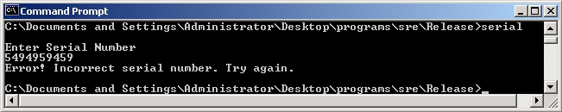
SRE Example
Program requires serial number
But Trudy doesn’t know the serial number…
Can Trudy get serial number from exe?

Slide 12
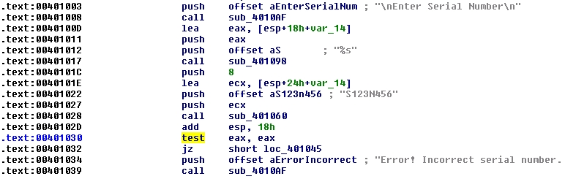
SRE Example
IDA Pro disassembly
Looks like serial number is S123N456

Slide 13
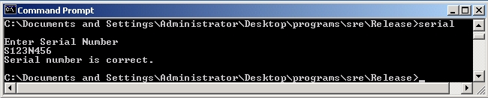
SRE Example
Try the serial number S123N456
It works!
Can Trudy do “better”?

Slide 14

SRE Example
Again, IDA Pro disassembly
And hex view…

Slide 15
SRE Example
“test eax,eax” is AND of eax with itself
Flag bit set to 0 only if eax is 0
If test yields 0, then jz is true
Trudy wants jz to always be true
Can Trudy patch exe so jz always holds?

Slide 16
SRE Example
Can Trudy patch exe so that jz always true?
xor
← jz always true!!!
Assembly Hex
test eax,eax 85 C0 …
xor eax,eax 33 C0 …

Slide 17


SRE Example
Edit serial.exe with hex editor
serial.exe
serialPatch.exe
Save as serialPatch.exe

Slide 18
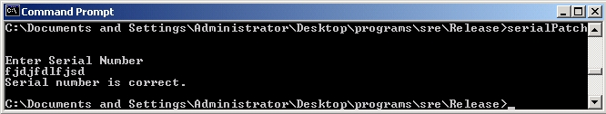
SRE Example
Any “serial number” now works!
Very convenient for Trudy!

Slide 19
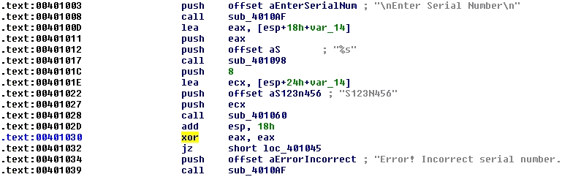
SRE Example
Back to IDA Pro disassembly…
serial.exe
serialPatch.exe

Slide 20
SRE Attack Mitigation
Impossible to prevent SRE on open system
But can make such attacks more difficult
Anti-disassembly techniques
To confuse static view of code
Anti-debugging techniques
To confuse dynamic view of code
Tamper-resistance
Code checks itself to detect tampering
Code obfuscation
Make code more difficult to understand

Slide 21
Anti-disassembly
Anti-disassembly methods include
Encrypted or “packed” object code
False disassembly
Self-modifying code
Many other techniques
Encryption prevents disassembly
But still need plaintext code to decrypt code!
Same problem as with polymorphic viruses

Slide 22
Anti-disassembly Example
Suppose actual code instructions are
inst 1
jmp
junk
inst 3
inst 4
…
What a “dumb” disassembler sees
inst 1
inst 2
inst 3
inst 4
inst 5
inst 6
…
This is example of “false disassembly”
But, clever attacker will figure it out

Slide 23
Anti-debugging
IsDebuggerPresent()
Can also monitor for
Use of debug registers
Inserted breakpoints
Debuggers don’t handle threads well
Interacting threads may confuse debugger
And therefore, confuse attacker
Many other debugger-unfriendly tricks
See next slide for one example

Slide 24
Anti-debugger Example
inst 1
inst 2
inst 3
inst 4
inst 5
inst 6
…
Suppose when program gets inst 1, it pre-fetches inst 2, inst 3 and inst 4
This is done to increase efficiency
Suppose when debugger executes inst 1, it does not pre-fetch instructions
Can we use this difference to confuse the debugger?

Slide 25
Anti-debugger Example
inst 2
inst 3
inst 4
…
inst 1
junk
inst 5
inst 6
Suppose inst 1 overwrites inst 4 in memory
Then program (without debugger) will be OK since it fetched inst 4 at same time as inst 1
Debugger will be confused when it reaches junk where inst 4 is supposed to be
Problem if this segment of code executed more than once!
Also, code is very platform-dependent
Again, clever attacker can figure this out

Slide 26
Tamper-resistance
Goal is to make patching more difficult
Code can hash parts of itself
If tampering occurs, hash check fails
Research has shown, can get good coverage of code with small performance penalty
But don’t want all checks to look similar
Or else easy for attacker to remove checks
This approach sometimes called “guards”

Slide 27
Code Obfuscation
Goal is to make code hard to understand
Opposite of good software engineering!
Simple example: spaghetti code
Much research into more robust obfuscation
Example: opaque predicate
int x,y
:
if((x−y)∗(x−y) > (x∗x−2∗x∗y+y∗y)){…}
The if() conditional is always false
Attacker wastes time analyzing dead code

Slide 28
Code Obfuscation
Code obfuscation sometimes promoted as a powerful security technique
Diffie and Hellman’s original ideas for public key crypto were based on obfuscation
But it didn’t work
Recently it has been shown that obfuscation probably cannot provide “strong” security
On the (im)possibility of obfuscating programs
Obfuscation might still have practical uses!
Even if it can never be as strong as crypto

Slide 29
Authentication Example
Software used to determine authentication
Ultimately, authentication is 1-bit decision
Regardless of method used (pwd, biometric, …)
Somewhere in authentication software, a single bit determines success/failure
If Trudy can find this bit, she can force authentication to always succeed
Obfuscation makes it more difficult for attacker to find this all-important bit

Slide 30
Obfuscation
Obfuscation forces attacker to analyze larger amounts of code
Method could be combined with
Anti-disassembly techniques
Anti-debugging techniques
Code tamper-checking
All of these increase work (and pain) for attacker
But a persistent attacker can ultimately win

Slide 31
Software Cloning
Suppose we write a piece of software
We then distribute an identical copy (or clone) to each customers
If an attack is found on one copy, the same attack works on all copies
This approach has no resistance to “break once, break everywhere” (BOBE)
This is the usual situation in software development

Slide 32
Metamorphic Software
Metamorphism is used in malware
Can metamorphism also be used for good?
Suppose we write a piece of software
Each copy we distribute is different
This is an example of metamorphic software
Two levels of metamorphism are possible
All instances are functionally distinct (only possible in certain application)
All instances are functionally identical but differ internally (always possible)
We consider the latter case

Slide 33
Metamorphic Software
If we distribute N copies of cloned software
One successful attack breaks all N
If we distribute N metamorphic copies, where each of N instances is functionally identical, but they differ internally…
An attack on one instance does not necessarily work against other instances
In the best case, N times as much work is required to break all N instances

Slide 34
Metamorphic Software
We cannot prevent SRE attacks
The best we can hope for is BOBE resistance
Metamorphism can improve BOBE resistance
Consider the analogy to genetic diversity
If all plants in a field are genetically identical, one disease can kill all of the plants
If the plants in a field are genetically diverse, one disease can only kill some of the plants

Slide 35
Cloning vs Metamorphism
Spse our software has a buffer overflow
Cloned software
Same buffer overflow attack will work against all cloned copies of the software
Metamorphic software
Unique instances ⎯ all are functionally the same, but they differ in internal structure
Buffer overflow likely exists in all instances
But a specific buffer overflow attack will only work against some instances
Buffer overflow attacks are delicate!

Slide 36
Metamorphic Software
Metamorphic software is intriguing concept
But raises concerns regarding
Software development
Software upgrades, etc.
Metamorphism does not prevent SRE, but could make it infeasible on a large scale
Metamorphism might be a practical tool for increasing BOBE resistance
Metamorphism currently used in malware
But metamorphism not just for evil!

Slide 37
Digital Rights Management

Slide 38
Digital Rights Management
DRM is a good example of limitations of doing security in software
We’ll discuss
What is DRM?
A PDF document protection system
DRM for streaming media
DRM in P2P application
DRM within an enterprise

Slide 39
What is DRM?
“Remote control” problem
Distribute digital content
Retain some control on its use, after delivery
Digital book example
Digital book sold online could have huge market
But might only sell 1 copy!
Trivial to make perfect digital copies
A fundamental change from pre-digital era
Similar comments for digital music, video, etc.

Slide 40
Persistent Protection
“Persistent protection” is the fundamental problem in DRM
How to enforce restrictions on use of content after delivery?
Examples of such restrictions
No copying
Limited number of reads/plays
Time limits
No forwarding, etc.

Slide 41
What Can be Done?
The honor system?
Example: Stephen King’s, The Plant
Give up?
Internet sales? Regulatory compliance? etc.
Lame software-based DRM?
The standard DRM system today
Better software-based DRM?
MediaSnap’s goal
Tamper-resistant hardware?
Closed systems: Game Cube, etc.
Open systems: TCG/NGSCB for PCs

Slide 42
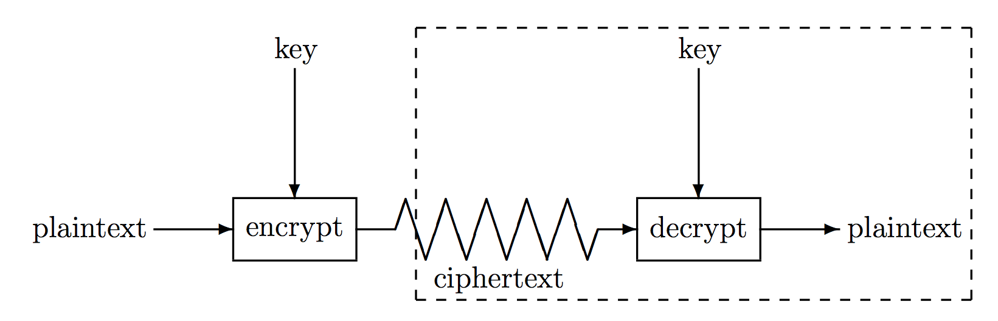
Is Crypto the Answer?
Attacker’s goal is to recover the key
In standard crypto scenario, attacker has
Ciphertext, some plaintext, side-channel info, etc.
In DRM scenario, attacker has
Everything in the box (at least)
Crypto was not designed for this problem!

Slide 43
Is Crypto the Answer?
But crypto is necessary
To securely deliver the bits
To prevent trivial attacks
Then attacker will not try to directly attack crypto
Attacker will try to find keys in software
DRM is “hide and seek” with keys in software!

Slide 44
Current State of DRM
At best, security by obscurity
A derogatory term in security
Secret designs
In violation of Kerckhoffs Principle
Over-reliance on crypto
“Whoever thinks his problem can be solved using cryptography, doesn’t understand his problem and doesn’t understand cryptography.” ⎯ Attributed by Roger Needham and Butler Lampson to each other

Slide 45
DRM Limitations
The analog hole
When content is rendered, it can be captured in analog form
DRM cannot prevent such an attack
Human nature matters
Absolute DRM security is impossible
Want something that “works” in practice
What works depends on context
DRM is not strictly a technical problem!

Slide 46
Software-based DRM
Strong software-based DRM is impossible
Why?
We can’t really hide a secret in software
We cannot prevent SRE
User with full admin privilege can eventually break any anti-SRE protection
Bottom line: The killer attack on software-based DRM is SRE

Slide 47
DRM for PDF Documents
Based on design of MediaSnap, Inc., a small Silicon Valley startup company
Developed a DRM system
Designed to protect PDF documents
Two parts to the system
Server ⎯ Secure Document Server (SDS)
Client ⎯ PDF Reader “plugin” software

Slide 48
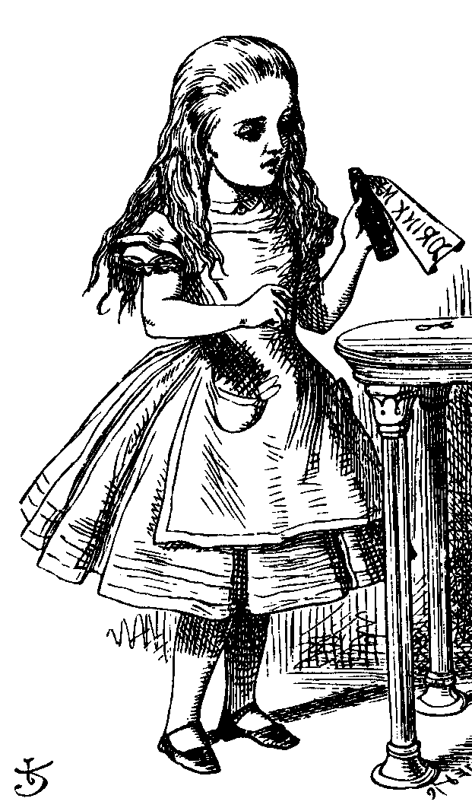
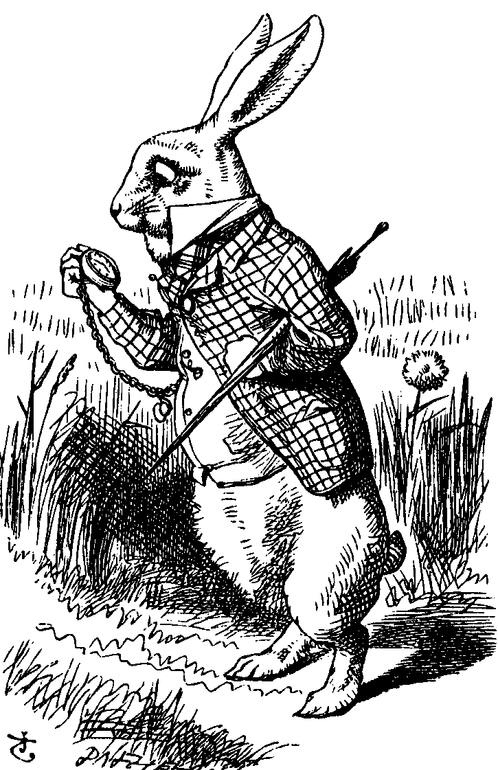

Protecting a Document
encrypt
persistent
protection
Alice
SDS
Bob
Alice creates PDF document
Document encrypted and sent to SDS
SDS applies desired “persistent protection”
Document sent to Bob

Slide 49
Accessing a Document
Request key
key
Alice
SDS
Bob
Bob authenticates to SDS
Bob requests key from SDS
Bob can then access document, but only thru special DRM software

Slide 50
Security Issues
Server side (SDS)
Protect keys, authentication data, etc.
Apply persistent protection
Client side (PDF plugin)
Protect keys, authenticate user, etc.
Enforce persistent protection
Remaining discussion concerns client

Slide 51
Security Overview
Tamper-resistance
Obfuscation
A tamper-resistant outer layer
Software obfuscation applied within

Slide 52
Tamper-Resistance
Anti-debugger
Encrypted code
Encrypted code will prevent static analysis of PDF plugin software
Anti-debugging to prevent dynamic analysis of PDF plugin software
These two designed to protect each other
But the persistent attacker will get thru!

Slide 53
Obfuscation
Obfuscation can be used for
Key management
Authentication
Caching (keys and authentication info)
Encryption and “scrambling”
Key parts (data and/or code)
Multiple keys/key parts
Obfuscation can only slow the attacker
The persistent attacker still wins!

Slide 54
Other Security Features
Code tamper checking (hashing)
To validate all code executing on system
Anti-screen capture
To prevent obvious attack on digital documents
Watermarking
In theory, can trace stolen content
In practice, of limited value
Metamorphism (or individualization)
For BOBE-resistance

Slide 55
Security Not Implemented
More general code obfuscation
Code “fragilization”
Code that hash checks itself
Tampering should cause code to break
OS cannot be trusted
How to protect against “bad” OS?
Not an easy problem!

Slide 56
DRM for Streaming Media
Stream digital content over Internet
Usually audio or video
Viewed in real time
Want to charge money for the content
Can we protect content from capture?
So content can’t be redistributed
We want to make money!

Slide 57
Attacks on Streaming Media
Spoof the stream between endpoints
Man in the middle
Replay and/or redistribute data
Capture the plaintext
This is the threat we are concerned with
Must prevent malicious software from capturing plaintext stream at client end

Slide 58
Design Features
Scrambling algorithms
Encryption-like algorithms
Many distinct algorithms available
A strong form of metamorphism!
Negotiation of scrambling algorithm
Server and client must both know the algorithm
Decryption at receiver end
To remove the strong encryption
De-scrambling in device driver
De-scramble just prior to rendering

Slide 59
Scrambling Algorithms
Server has a large set of scrambling algorithms
Suppose N of these numbered 1 thru N
Each client has a subset of algorithms
For example: LIST = {12,45,2,37,23,31}
The LIST is stored on client, encrypted with server’s key: E(LIST,K_{server})

Slide 60
Server-side Scrambling
On server side
scrambled
data
encrypted
scrambled data
data
Server must scramble data with an algorithm the client supports
Client must send server list of algorithms it supports
Server must securely communicate algorithm choice to client

Slide 61
Select Scrambling Algorithm
E(LIST, K_{server})
E(m,K)
scramble (encrypted) data
using Alice’s m-th algorithm
Alice
(client)
Bob
(server)
The key K is a session key
The LIST is unreadable by client
Reminiscent of Kerberos TGT

Slide 62
Client-side De-scrambling
On client side
encrypted
scrambled data
scrambled
data
data
Try to keep plaintext away from potential attacker
“Proprietary” device driver
Scrambling algorithms “baked in”
Able to de-scramble at last moment

Slide 63
Why Scrambling?
Metamorphism deeply embedded in system
If a scrambling algorithm is known to be broken, server will not choose it
If client has too many broken algorithms, server can force software upgrade
Proprietary algorithm harder for SRE
We cannot trust crypto strength of proprietary algorithms, so we also encrypt

Slide 64
Why Metamorphism?
The most serious threat is SRE
Attacker does not need to reverse engineer any standard crypto algorithm
Attacker only needs to find the key
Reverse engineering a scrambling algorithm may be difficult
This is just security by obscurity
But appears to help with BOBE-resistance

Slide 65
DRM for a P2P Application
Today, much digital content is delivered via peer-to-peer (P2P) networks
P2P networks contain lots of pirated music
Is it possible to get people to pay for digital content on such P2P networks?
How can this possibly work?
A peer offering service (POS) is one idea

Slide 66

P2P File Sharing: Query
Suppose Alice requests “Hey Jude”
Black arrows: query flooding
Red arrows: positive responses
Frank
Alice
Dean
Bob
Marilyn
Carol
Pat
Ted
Carol
Pat
Fred
Alice can select from: Carol, Pat

Slide 67
P2P File Sharing with POS
Suppose Alice requests “Hey Jude”
Black arrow: query
Red arrow: positive response
Bill
Ben
Joe
POS
Alice
Dean
Bob
Marilyn
Carol
Pat
Ted
Carol
Pat
Fred
Alice selects from: Bill, Ben, Carol, Joe, Pat
Bill, Ben, and Joe have legal content!

Slide 68
POS
Bill, Ben and Joe must appear normal to Alice
If “victim” (Alice) clicks POS response
DRM protected (legal) content downloaded
Then small payment required to play
Alice can choose not to pay
But then she must download again
Is it worth the hassle to avoid paying small fee?
POS content can also offer extras

Slide 69
POS Conclusions
A very clever idea!
Piggybacking on existing P2P networks
Weak DRM works very well here
Pirated content already exists
DRM only needs to be more hassle to break than the hassle of clicking and waiting
Current state of POS?
Very little interest from the music industry
Considerable interest from the “adult” industry

Slide 70
DRM in the Enterprise
Why enterpise DRM?
Health Insurance Portability and Accountability Act (HIPAA)
Medical records must be protected
Fines of up to $10,000 “per incident”
Sarbanes-Oxley Act (SOA)
Must preserve documents of interest to SEC
DRM-like protections needed by corporations for regulatory compliance

Slide 71
What’s Different in Enterprise DRM?
Technically, similar to e-commerce
But motivation for DRM is different
Regulatory compliance
To satisfy a legal requirement
Not to make money ⎯ to avoid losing money!
Human dimension is completely different
Legal threats are far more plausible
Legally, corporation is OK provided an active attack on DRM is required

Slide 72
Enterprise DRM
Moderate DRM security is sufficient
Policy management issues
Easy to set policies for groups, roles, etc.
Yet policies must be flexible
Authentication issues
Must interface with existing system
Must prevent network authentication spoofing (authenticate the authentication server)
Enterprise DRM is a solvable problem!

Slide 73
DRM Failures
Many examples of DRM failures
One system defeated by a felt-tip pen
One defeated my holding down shift key
Secure Digital Music Initiative (SDMI) completely broken before it was finished
Adobe eBooks
Microsoft MS-DRM (version 2)
Many, many others!

Slide 74
DRM Conclusions
DRM nicely illustrates limitations of doing security in software
Software in a hostile environment is extremely vulnerable to attack
Protection options are very limited
Attacker has enormous advantage
Tamper-resistant hardware and a trusted OS can make a difference
We’ll discuss this more later: TCG/NGSCB

Slide 75
Secure Software Development

Slide 76
Penetrate and Patch
Usual approach to software development
Develop product as quickly as possible
Release it without adequate testing
Patch the code as flaws are discovered
In security, this is “penetrate and patch”
A bad approach to software development
An even worse approach to secure software!

Slide 77
Why Penetrate and Patch?
First to market advantage
First to market likely to become market leader
Market leader has huge advantage in software
Users find it safer to “follow the leader”
Boss won’t complain if your system has a flaw, as long as everybody else has same flaw…
User can ask more people for support, etc.
Sometimes called “network economics”

Slide 78
Why Penetrate and Patch?
Secure software development is hard
Costly and time consuming development
Costly and time consuming testing
Cheaper to let customers do the work!
No serious economic disincentive
Even if software flaw causes major losses, the software vendor is not liable
Is any other product sold this way?
Would it matter if vendors were legally liable?

Slide 79
Penetrate and Patch Fallacy
Fallacy: If you keep patching software, eventually it will be secure
Why is this a fallacy?
Empirical evidence to the contrary
Patches often add new flaws
Software is a moving target: new versions, features, changing environment, new uses,…

Slide 80
Open vs Closed Source
Open source software
The source code is available to user
For example, Linux
Closed source
The source code is not available to user
For example, Windows
What are the security implications?

Slide 81
Open Source Security
Claimed advantages of open source is
More eyeballs: more people looking at the code should imply fewer flaws
A variant on Kerchoffs Principle
Is this valid?
How many “eyeballs” looking for security flaws?
How many “eyeballs” focused on boring parts?
How many “eyeballs” belong to security experts?
Attackers can also look for flaws!
Evil coder might be able to insert a flaw

Slide 82
Open Source Security
Open source example: wu-ftp
About 8,000 lines of code
A security-critical application
Was deployed and widely used
After 10 years, serious security flaws discovered!
More generally, open source software has done little to reduce security flaws
Why?
Open source follows penetrate and patch model!

Slide 83
Closed Source Security
Claimed advantage of closed source
Security flaws not as visible to attacker
This is a form of “security by obscurity”
Is this valid?
Many exploits do not require source code
Possible to analyze closed source code…
…though it is a lot of work!
Is “security by obscurity” real security?

Slide 84
Open vs Closed Source
Advocates of open source often cite the Microsoft fallacy which states
Microsoft makes bad software
Microsoft software is closed source
Therefore all closed source software is bad
Why is this a fallacy?
Not logically correct
More relevant is the fact that Microsoft follows the penetrate and patch model

Slide 85
Open vs Closed Source
No obvious security advantage to either open or closed source
More significant than open vs closed source is software development practices
Both open and closed source follow the “penetrate and patch” model

Slide 86
Open vs Closed Source
If there is no security difference, why is Microsoft software attacked so often?
Microsoft is a big target!
Attacker wants most “bang for the buck”
Few exploits against Mac OS X
Not because OS X is inherently more secure
An OS X attack would do less damage
Would bring less “glory” to attacker
Next, we consider the theoretical differences
See this paper

Slide 87
Security and Testing
Can be shown that probability of a security failure after t units of testing is about
E = K/t where K is a constant
This approximation holds over large range of t
Then the “mean time between failures” is
MTBF = t/K
The good news: security improves with testing
The bad news: security only improves linearly with testing!

Slide 88
Security and Testing
The “mean time between failures” is approximately
MTBF = t/K
To have 1,000,000 hours between security failures, must test 1,000,000 hours!
Suppose open source project has MTBF = t/K
If flaws in closed source are twice as hard to find, do we then have MTBF = 2t/K ?
No! Testing not as effective MTBF = 2(t/2)/K = t/K
The same result for open and closed source!

Slide 89
Security and Testing
Closed source advocates might argue
Closed source has “open source” alpha testing, where flaws found at (higher) open source rate
Followed by closed source beta testing and use, giving attackers the (lower) closed source rate
Does this give closed source an advantage?
Alpha testing is minor part of total testing
Recall, first to market advantage
Products rushed to market
Probably no real advantage for closed source

Slide 90
Security and Testing
No security difference between open and closed source?
Provided that flaws are found “linearly”
Is this valid?
Empirical results show security improves linearly with testing
Conventional wisdom is that this is the case for large and complex software systems

Slide 91
Security and Testing
The fundamental problem
Good guys must find (almost) all flaws
Bad guy only needs 1 (exploitable) flaw
Software reliability far more difficult in security than elsewhere
How much more difficult?
See the next slide…

Slide 92
Security Testing: Do the Math
Recall that MTBF = t/K
Suppose 10⁶ security flaws in some software
Say, Windows XP
Suppose each bug has MTBF of 10⁹ hours
Expect to find 1 bug for every 10³ hours testing
Good guys spend 10⁷ hours testing: find 10⁴ bugs
Good guys have found 1% of all the bugs
Trudy spends 10³ hours of testing: finds 1 bug
Chance good guys found Trudy’s bug is only 1% !!!

Slide 93

Software Development
General software development model
Specify
Design
Implement
Test
Review
Document
Manage
Maintain

Slide 94
Secure Software Development
Goal: move away from “penetrate and patch”
Penetrate and patch will always exist
But if more care taken in development, then fewer and less severe flaws to patch
Secure software development not easy
Much more time and effort required thru entire development process
Today, little economic incentive for this!

Slide 95
Secure Software Development
We briefly discuss the following
Design
Hazard analysis
Peer review
Testing
Configuration management
Postmortem for mistakes

Slide 96
Design
Careful initial design
Try to avoid high-level errors
Such errors may be impossible to correct later
Certainly costly to correct these errors later
Verify assumptions, protocols, etc.
Usually informal approach is used
Formal methods
Possible to rigorously prove design is correct
In practice, only works in simple cases

Slide 97
Hazard Analysis
Hazard analysis (or threat modeling)
Develop hazard list
List of what ifs
Schneier’s “attack tree”
Many formal approaches
Hazard and operability studies (HAZOP)
Failure modes and effective analysis (FMEA)
Fault tree analysis (FTA)

Slide 98
Peer Review
Three levels of peer review
Review (informal)
Walk-through (semi-formal)
Inspection (formal)
Each level of review is important
Much evidence that peer review is effective
Although programmers might not like it!

Slide 99
Levels of Testing
Module testing ⎯ test each small section of code
Component testing ⎯ test combinations of a few modules
Unit testing ⎯ combine several components for testing
Integration testing ⎯ put everything together and test

Slide 100
Types of Testing
Function testing ⎯ verify that system functions as it is supposed to
Performance testing ⎯ other requirements such as speed, resource use, etc.
Acceptance testing ⎯ customer involved
Installation testing ⎯ test at install time
Regression testing ⎯ test after any change

Slide 101
Other Testing Issues
Active fault detection
Don’t wait for system to fail
Actively try to make it fail ⎯ attackers will!
Fault injection
Insert faults into the process
Even if no obvious way for such a fault to occur
Bug injection
Insert bugs into code
See how many of injected bugs are found
Can use this to estimate number of bugs
Assumes injected bugs similar to unknown bugs

Slide 102
Testing Case History
In one system with 184,000 lines of code
Flaws found
17.3% inspecting system design
19.1% inspecting component design
15.1% code inspection
29.4% integration testing
16.6% system and regression testing
Conclusion: must do many kinds of testing
Overlapping testing is necessary
Provides a form of “defense in depth”

Slide 103
Security Testing: The Bottom Line
Security testing is far more demanding than non-security testing
Non-security testing ⎯ does system do what it is supposed to?
Security testing ⎯ does system do what it is supposed to and nothing more?
Usually impossible to do exhaustive testing
How much testing is enough?

Slide 104
Security Testing: The Bottom Line
How much testing is enough?
Recall MTBF = t/K
Seems to imply testing is nearly hopeless!
But there is some hope…
If we eliminate an entire class of flaws then statistical model breaks down
For example, if a single test (or a few tests) find all buffer overflows

Slide 105
Configuration Issues
Types of changes
Minor changes ⎯ maintain daily functioning
Adaptive changes ⎯ modifications
Perfective changes ⎯ improvements
Preventive changes ⎯ no loss of performance
Any change can introduce new flaws!

Slide 106
Postmortem
After fixing any security flaw…
Carefully analyze the flaw
To learn from a mistake
Mistake must be analyzed and understood
Must make effort to avoid repeating mistake
In security, always learn more when things go wrong than when they go right
Postmortem may be the most under-used tool in all of security engineering!

Slide 107
Software Security
First to market advantage
Also known as “network economics”
Security suffers as a result
Little economic incentive for secure software!
Penetrate and patch
Fix code as security flaws are found
Fix can result in worse problems
Mostly done after code delivered
Proper development can reduce flaws
But costly and time-consuming

Slide 108
Software and Security
Even with best development practices, security flaws will still exist
Absolute security is (almost) never possible
So, it is not surprising that absolute software security is impossible
The goal is to minimize and manage risks of software flaws
Do not expect dramatic improvements in consumer software security anytime soon!

