Slide 1
Part II: Access Control
Original Source: http://www.cs.sjsu.edu/~stamp/infosec/

Slide 2
Access Control
Two parts to access control
Authentication: Are you who you say you are?
Determine whether access is allowed
Authenticate human to machine
Or authenticate machine to machine
Authorization: Are you allowed to do that?
Once you have access, what can you do?
Enforces limits on actions
Note: “access control” often used as synonym for authorization

Slide 3
Chapter 7: Authentication
Guard: Halt! Who goes there?
Arthur: It is I, Arthur, son of Uther Pendragon,
from the castle of Camelot. King of the Britons,
defeater of the Saxons, sovereign of all England!
⎯ Monty Python and the Holy Grail
Then said they unto him, Say now Shibboleth:
and he said Sibboleth: for he could not frame to pronounce it right.
Then they took him, and slew him at the passages of Jordan:
and there fell at that time of the Ephraimites forty and two thousand.
⎯ Judges 12:6

Slide 4
Are You Who You Say You Are?
How to authenticate human a machine?
Can be based on…
Something you know
For example, a password
Something you have
For example, a smartcard
Something you are
For example, your fingerprint

Slide 5
Something You Know
Passwords
Lots of things act as passwords!
PIN
Social security number
Mother’s maiden name
Date of birth
Name of your pet, etc.

Slide 6
Trouble with Passwords
“Passwords are one of the biggest practical problems facing security engineers today.”
“Humans are incapable of securely storing high-quality cryptographic keys, and they have unacceptable speed and accuracy when performing cryptographic operations. (They are also large, expensive to maintain, difficult to manage, and they pollute the environment. It is astonishing that these devices continue to be manufactured and deployed.)”

Slide 7
Why Passwords?
Why is “something you know” more popular than “something you have” and “something you are”?
Cost: passwords are free
Convenience: easier for admin to reset pwd than to issue a new thumb

Slide 8
Keys vs Passwords
Crypto keys
Spse key is 64 bits
Then 2⁶⁴ keys
Choose key at random…
…then attacker must try about 2⁶³ keys
Passwords
Spse passwords are 8 characters, and 256 different characters
Then 256⁸ = 2⁶⁴ pwds
Users do not select passwords at random
Attacker has far less than 2⁶³ pwds to try (dictionary attack)

Slide 9
Good and Bad Passwords
Bad passwords
frank
Fido
password
4444
Pikachu
102560
AustinStamp
Good Passwords?
jfIej,43j-EmmL+y
09864376537263
P0kem0N
FSa7Yago
0nceuP0nAt1m8
PokeGCTall150

Slide 10
Password Experiment
Three groups of users ⎯ each group advised to select passwords as follows
Group A: At least 6 chars, 1 non-letter
Group B: Password based on passphrase
Group C: 8 random characters
Results
Group A: About 30% of pwds easy to crack
Group B: About 10% cracked
Passwords easy to remember
Group C: About 10% cracked
Passwords hard to remember
winner →

Slide 11
Password Experiment
User compliance hard to achieve
In each case, 1/3rd did not comply
And about 1/3rd of those easy to crack!
Assigned passwords sometimes best
If passwords not assigned, best advice is…
Choose passwords based on passphrase
Use pwd cracking tool to test for weak pwds
Require periodic password changes?

Slide 12
Attacks on Passwords
Attacker could…
Target one particular account
Target any account on system
Target any account on any system
Attempt denial of service (DoS) attack
Common attack path
Outsider → normal user → administrator
May only require one weak password!

Slide 13
Password Retry
Suppose system locks after 3 bad passwords. How long should it lock?
5 seconds
5 minutes
Until SA restores service
What are +’s and -’s of each?

Slide 14
Password File?
Bad idea to store passwords in a file
But we need to verify passwords
Cryptographic solution: hash the pwd
Store y = h(password)
Can verify entered password by hashing
If Trudy obtains “password file,” she does not obtain passwords
But Trudy can try a forward search
Guess x and check whether y = h(x)

Slide 15
Dictionary Attack
Trudy pre-computes h(x) for all x in a dictionary of common passwords
Suppose Trudy gets access to password file containing hashed passwords
She only needs to compare hashes to her pre-computed dictionary
After one-time work, actual attack is trivial
Can we prevent this attack? Or at least make attacker’s job more difficult?

Slide 16
Salt
Hash password with salt
Choose random salt s and compute
y = h(password, s)
and store (s,y) in the password file
Note: The salt s is not secret
Easy to verify salted password
But Trudy must re-compute dictionary hashes for each user
Lots more work for Trudy!

Slide 17
Password Cracking: Do the Math
Assumptions:
Pwds are 8 chars, 128 choices per character
Then 128⁸ = 2⁵⁶ possible passwords
There is a password file with 2¹⁰ pwds
Attacker has dictionary of 2²⁰ common pwds
Probability of 1/4 that a pwd is in dictionary
Work is measured by number of hashes

Slide 18
Password Cracking: Case I
Attack 1 password without dictionary
Must try 2⁵⁶/2 = 2⁵⁵ on average
Like exhaustive key search
Does salt help in this case?

Slide 19
Password Cracking: Case II
Attack 1 password with dictionary
With salt
Expected work: 1/4 (2¹⁹) + 3/4 (2⁵⁵) = 2^{54.6}
In practice, try all pwds in dictionary…
…then work is at most 2²⁰ and probability of success is 1/4
What if no salt is used?
One-time work to compute dictionary: 2²⁰
Expected work still same order as above
But with precomputed dictionary hashes, the “in practice” attack is free…

Slide 20
Password Cracking: Case III
Any of 1024 pwds in file, without dictionary
Assume all 2¹⁰ passwords are distinct
Need 2⁵⁵ comparisons before expect to find pwd
If no salt is used
Each computed hash yields 2¹⁰ comparisons
So expected work (hashes) is 2⁵⁵/2¹⁰ = 2⁴⁵
If salt is used
Expected work is 2⁵⁵
Each comparison requires a hash computation
Notes:
Picture would be useful here

Slide 21
Password Cracking: Case IV
Any of 1024 pwds in file, with dictionary
Prob. one or more pwd in dict.: 1 – (3/4)¹⁰²⁴ = 1
So, we ignore case where no pwd is in dictionary
If salt is used, expected work less than 2²²
See book, or slide notes for details
Approximate work: size of dict. / probability
What if no salt is used?
If dictionary hashes not precomputed, work is about 2¹⁹/2¹⁰ = 2⁹
Notes:
Calculation for salted case:
Number the passwords in file, pwd1, pwd2, …,pwd1024
Consider checking each pwd in turn. The probability pwd1 is in the dictionary is 1/4 and, if so, expected work (no. of hashes) is 2^19. If pwd1 is not in dictionary but pwd2 is, we do 2^20 hashes (for pwd1) plus an expected 2^19 hashes for pwd2 and so on. We find the expected work factor is
(1/4)*(2^19) + (3/4)*((1/4)*(2^20+2^19) + (3/4)*((1/4)*(2*2^20+2^19)+…+(3/4)((1/4)(1023*2^20+2^19)))…) < 2^22

Slide 22
Other Password Issues
Too many passwords to remember
Results in password reuse
Why is this a problem?
Who suffers from bad password?
Login password vs ATM PIN
Failure to change default passwords
Social engineering
Error logs may contain “almost” passwords
Bugs, keystroke logging, spyware, etc.

Slide 23
Passwords
The bottom line…
Password cracking is too easy
One weak password may break security
Users choose bad passwords
Social engineering attacks, etc.
Trudy has (almost) all of the advantages
All of the math favors bad guys
Passwords are a BIG security problem
And will continue to be a big problem

Slide 24
Password Cracking Tools
Popular password cracking tools
Password Crackers
Password Portal
L0phtCrack and LC4 (Windows)
John the Ripper (Unix)
Admins should use these tools to test for weak passwords since attackers will
Good articles on password cracking
Passwords - Conerstone of Computer Security
Passwords revealed by sweet deal

Slide 25
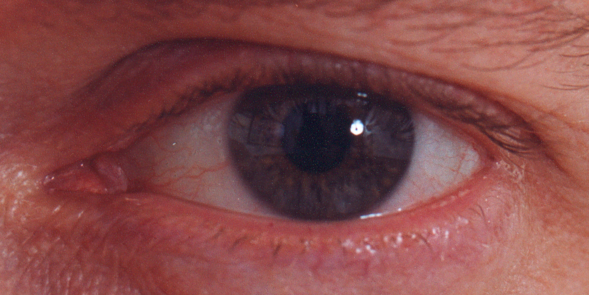
Biometrics

Slide 26
Something You Are
Biometric
“You are your key” ⎯ Schneier
Examples
Fingerprint
Handwritten signature
Facial recognition
Speech recognition
Gait (walking) recognition
“Digital doggie” (odor recognition)
Many more!
Are
Know
Have

Slide 27
Why Biometrics?
More secure replacement for passwords
Cheap and reliable biometrics needed
Today, an active area of research
Biometrics are used in security today
Thumbprint mouse
Palm print for secure entry
Fingerprint to unlock car door, etc.
But biometrics not too popular
Has not lived up to its promise (yet?)

Slide 28
Ideal Biometric
Universal ⎯ applies to (almost) everyone
In reality, no biometric applies to everyone
Distinguishing ⎯ distinguish with certainty
In reality, cannot hope for 100% certainty
Permanent ⎯ physical characteristic being measured never changes
In reality, OK if it to remains valid for long time
Collectable ⎯ easy to collect required data
Depends on whether subjects are cooperative
Also, safe, user-friendly, etc., etc.

Slide 29
Biometric Modes
Identification ⎯ Who goes there?
Compare one-to-many
Example: The FBI fingerprint database
Authentication ⎯ Are you who you say you are?
Compare one-to-one
Example: Thumbprint mouse
Identification problem is more difficult
More “random” matches since more comparisons
We are interested in authentication

Slide 30
Enrollment vs Recognition
Enrollment phase
Subject’s biometric info put into database
Must carefully measure the required info
OK if slow and repeated measurement needed
Must be very precise
May be weak point of many biometric
Recognition phase
Biometric detection, when used in practice
Must be quick and simple
But must be reasonably accurate

Slide 31
Cooperative Subjects?
Authentication — cooperative subjects
Identification — uncooperative subjects
For example, facial recognition
Used in Las Vegas casinos to detect known cheaters (terrorists in airports, etc.)
Often do not have ideal enrollment conditions
Subject will try to confuse recognition phase
Cooperative subject makes it much easier
We are focused on authentication
So, subjects are generally cooperative

Slide 32
Biometric Errors
Fraud rate versus insult rate
Fraud ⎯ Trudy mis-authenticated as Alice
Insult ⎯ Alice not authenticated as Alice
For any biometric, can decrease fraud or insult, but other one will increase
For example
99% voiceprint match ⇒ low fraud, high insult
30% voiceprint match ⇒ high fraud, low insult
Equal error rate: rate where fraud == insult
A way to compare different biometrics

Slide 33
Fingerprint History
1823 ⎯ Professor Johannes Evangelist Purkinje discussed 9 fingerprint patterns
1856 ⎯ Sir William Hershel used fingerprint (in India) on contracts
1880 ⎯ Dr. Henry Faulds article in Nature about fingerprints for ID
1883 ⎯ Mark Twain’s Life on the Mississippi (murderer ID’ed by fingerprint)

Slide 34
Fingerprint History
1888 ⎯ Sir Francis Galton developed classification system
His system of “minutia” still used today
Also verified that fingerprints do not change
Some countries require fixed number of “points” (minutia) to match in criminal cases
In Britain, at least 15 points
In US, no fixed number of points

Slide 35
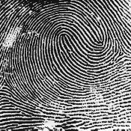
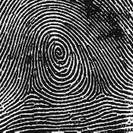
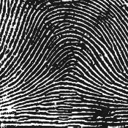
Fingerprint Comparison
Examples of loops, whorls, and arches
Minutia extracted from these features
Loop (double)
Whorl
Arch

Slide 36
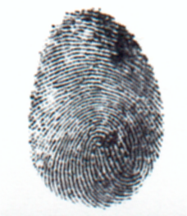
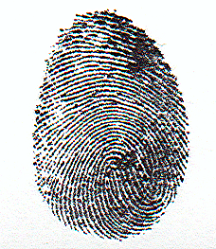
Fingerprint: Enrollment
Capture image of fingerprint
Enhance image
Identify points

Slide 37
Fingerprint: Recognition
Extracted points are compared with information stored in a database
Is it a statistical match?
Aside: Do identical twins’ fingerprints differ?

Slide 38
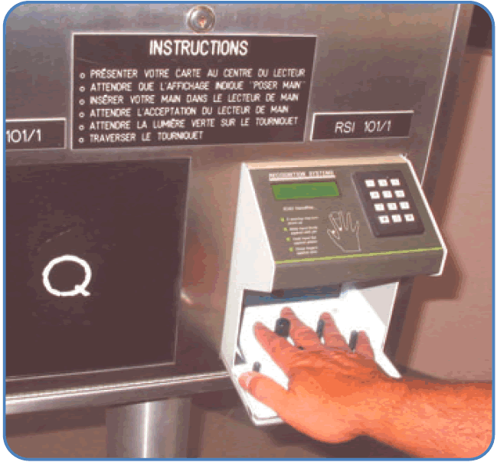
Hand Geometry
A popular biometric
Measures shape of hand
Width of hand, fingers
Length of fingers, etc.
Human hands not unique
Hand geometry sufficient for many situations
OK for authentication
Not useful for ID problem

Slide 39
Hand Geometry
Advantages
Quick ⎯ 1 minute for enrollment, 5 seconds for recognition
Hands are symmetric ⎯ so what?
Disadvantages
Cannot use on very young or very old
Relatively high equal error rate

Slide 40
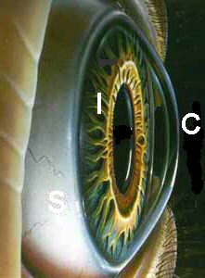

Iris Patterns
Iris pattern development is “chaotic”
Little or no genetic influence
Different even for identical twins
Pattern is stable through lifetime

Slide 41
Iris Recognition: History
1936 ⎯ suggested by Frank Burch
1980s ⎯ James Bond films
1986 ⎯ first patent appeared
1994 ⎯ John Daugman patented best current approach
Patent owned by Iridian Technologies

Slide 42

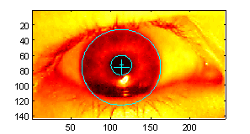
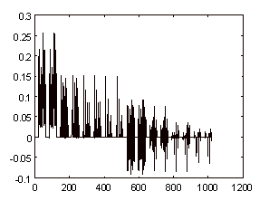
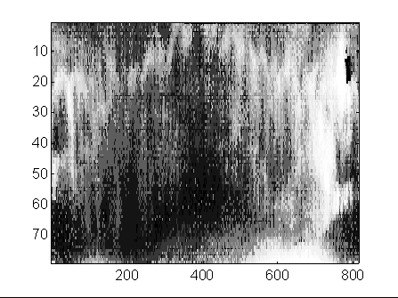
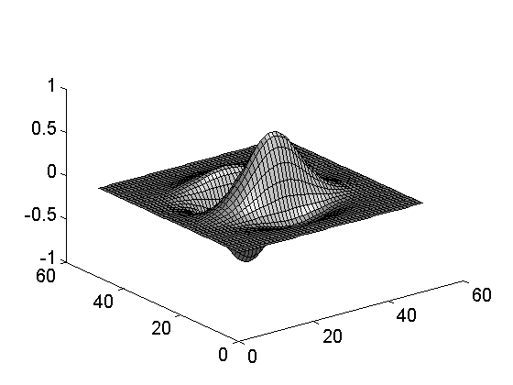
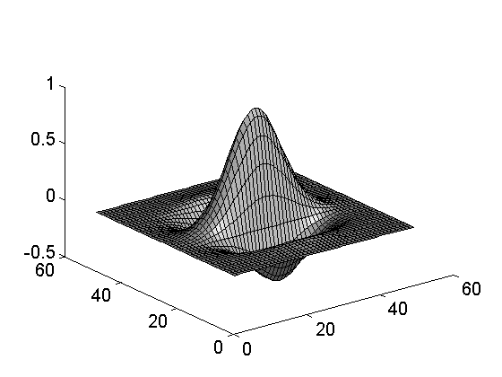
Iris Scan
Scanner locates iris
Take b/w photo
Use polar coordinates…
2-D wavelet transform
Get 256 byte iris code

Slide 43
Measuring Iris Similarity
Based on Hamming distance
Define d(x,y) to be
# of non match bits / # of bits compared
d(0010,0101) = 3/4 and d(101111,101001) = 1/3
Compute d(x,y) on 2048-bit iris code
Perfect match is d(x,y) = 0
For same iris, expected distance is 0.08
At random, expect distance of 0.50
Accept iris scan as match if distance < 0.32

Slide 44
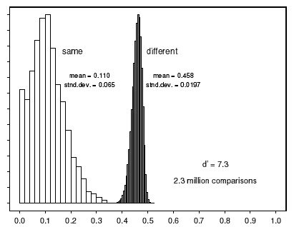

Iris Scan Error Rate
distance
Fraud rate
0.29 | 1 in 1.3∗10¹⁰
0.30 | 1 in 1.5∗10⁹
0.31 | 1 in 1.8∗10⁸
0.32 | 1 in 2.6∗10⁷
0.33 | 1 in 4.0∗10⁶
0.34 | 1 in 6.9∗10⁵
0.35 | 1 in 1.3∗10⁵
== equal error rate
distance

Slide 45
Attack on Iris Scan
Good photo of eye can be scanned
Attacker could use photo of eye
Afghan woman was authenticated by iris scan of old photo
Story is here
To prevent attack, scanner could use light to be sure it is a “live” iris

Slide 46
Equal Error Rate Comparison
Equal error rate (EER): fraud == insult rate
Fingerprint biometric has EER of about 5%
Hand geometry has EER of about 10⁻³
In theory, iris scan has EER of about 10⁻⁶
But in practice, may be hard to achieve
Enrollment phase must be extremely accurate
Most biometrics much worse than fingerprint!
Biometrics useful for authentication…
…but identification biometrics almost useless today

Slide 47
Biometrics: The Bottom Line
Biometrics are hard to forge
But attacker could
Steal Alice’s thumb
Photocopy Bob’s fingerprint, eye, etc.
Subvert software, database, “trusted path” …
And how to revoke a “broken” biometric?
Biometrics are not foolproof
Biometric use is limited today
That should change in the (near?) future

Slide 48
Something You Have
Something in your possession
Examples include following…
Car key
Laptop computer (or MAC address)
Password generator (next)
ATM card, smartcard, etc.

Slide 49
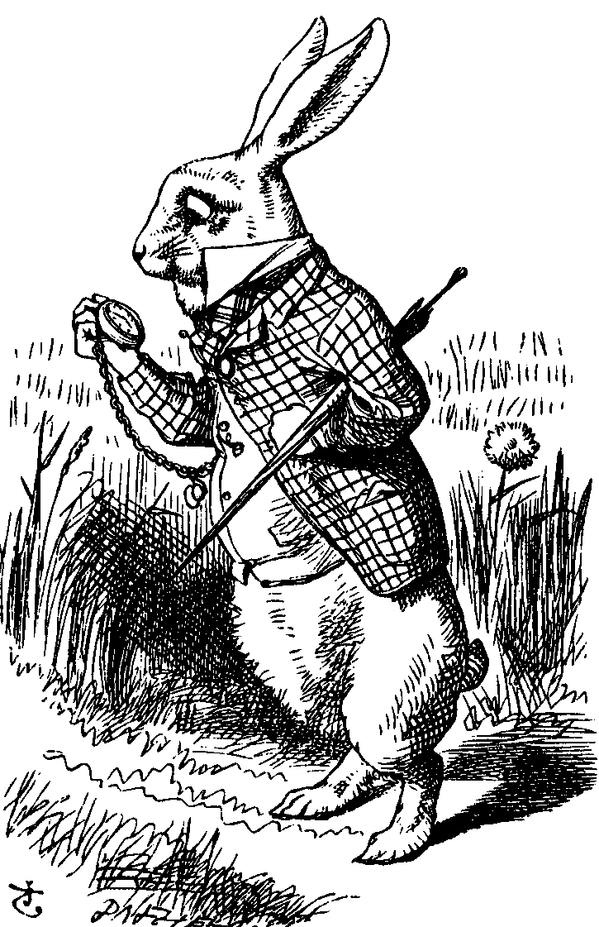
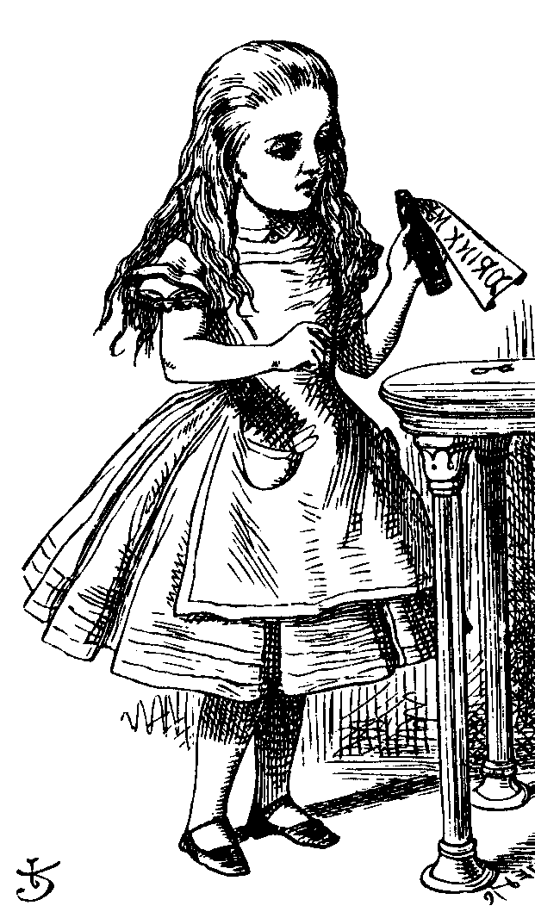
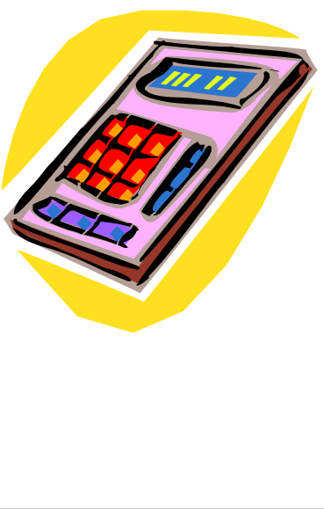
Password Generator
1. “I’m Alice”
3. PIN, R
2. R
4. h(K,R)
password
generator
K
5. h(K,R)
Alice
Bob, K
Alice receives random “challenge” R from Bob
Alice enters PIN and R in password generator
Password generator hashes symmetric key K with R
Alice sends “response” h(K,R) back to Bob
Bob verifies response
Note: Alice has pwd generator and knows PIN

Slide 50
2-factor Authentication
Requires any 2 out of 3 of
Something you know
Something you have
Something you are
Examples
ATM: Card and PIN
Credit card: Card and signature
Password generator: Device and PIN
Smartcard with password/PIN

Slide 51
Single Sign-on
A hassle to enter password(s) repeatedly
Alice wants to authenticate only once
“Credentials” stay with Alice wherever she goes
Subsequent authentications transparent to Alice
Kerberos --- example single sign-on protocol
Single sign-on for the Internet?
Microsoft: Passport
Everybody else: Liberty Alliance
Security Assertion Markup Language (SAML)

Slide 52
Web Cookies
Cookie is provided by a Website and stored on user’s machine
Cookie indexes a database at Website
Cookies maintain state across sessions
Web uses a stateless protocol: HTTP
Cookies also maintain state within a session
Sorta like a single sign-on for a website
But, a very, very weak form of authentication
Cookies also create privacy concerns

