Slide 1
Part III: Protocols
Original Source: http://www.cs.sjsu.edu/~stamp/infosec/

Slide 2
Protocol
Human protocols ⎯ the rules followed in human interactions
Example: Asking a question in class
Networking protocols ⎯ rules followed in networked communication systems
Examples: HTTP, FTP, etc.
Security protocol ⎯ the (communication) rules followed in a security application
Examples: SSL, IPSec, Kerberos, etc.

Slide 3
Protocols
Protocol flaws can be very subtle
Several well-known security protocols have significant flaws
Including WEP, GSM, and IPSec
Implementation errors can occur
Recent IE implementation of SSL
Not easy to get protocols right…

Slide 4
Ideal Security Protocol
Must satisfy security requirements
Requirements need to be precise
Efficient
Small computational requirement
Small bandwidth usage, minimal delays…
Robust
Works when attacker tries to break it
Works even if environment changes
Easy to use & implement, flexible…
Difficult to satisfy all of these!

Slide 5
Chapter 9: Simple Security Protocols
“I quite agree with you,” said the Duchess; “and the moral of that is⎯
‘Be what you would seem to be’ ⎯or
if you'd like it put more simply⎯‘Never imagine yourself not to be
otherwise than what it might appear to others that what you were
or might have been was not otherwise than what you
had been would have appeared to them to be otherwise.’ ”
⎯ Lewis Carroll, Alice in Wonderland
Seek simplicity, and distrust it.
⎯ Alfred North Whitehead

Slide 6
Secure Entry to NSA
Insert badge into reader
Enter PIN
Correct PIN?
Yes? Enter
No? Get shot by security guard

Slide 7
ATM Machine Protocol
Insert ATM card
Enter PIN
Correct PIN?
Yes? Conduct your transaction(s)
No? Machine (eventually) eats card

Slide 8
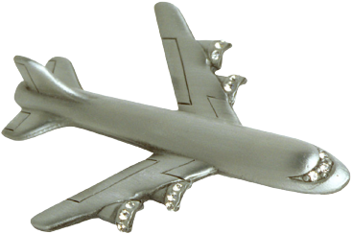


Identify Friend or Foe (IFF)
Russian
MIG
Angola
SAAF
Impala
K
2. E(N,K)
1. N
Namibia
K

Slide 9
MIG in the Middle
3. N
SAAF
Impala
K
4. E(N,K)
Angola
2. N
5. E(N,K)
6. E(N,K)
Russian
MiG
1. N
Namibia
K

Slide 10
Authentication Protocols

Slide 11
Authentication
Alice must prove her identity to Bob
Alice and Bob can be humans or computers
May also require Bob to prove he’s Bob (mutual authentication)
Probably need to establish a session key
May have other requirements, such as
Use public keys
Use symmetric keys
Use hash functions
Anonymity, plausible deniability, etc., etc.

Slide 12
Authentication
Authentication on a stand-alone computer is relatively simple
Hash password with salt
“Secure path,” attacks on authentication software, keystroke logging, etc., can be issues
Authentication over a network is challenging
Attacker can passively observe messages
Attacker can replay messages
Active attacks possible (insert, delete, change)

Slide 13
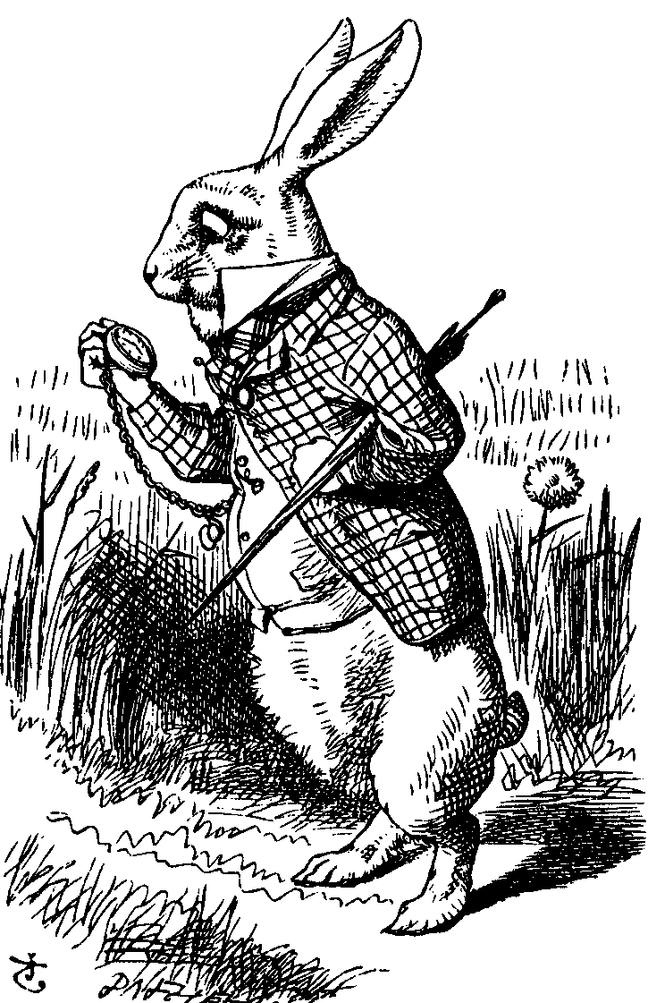
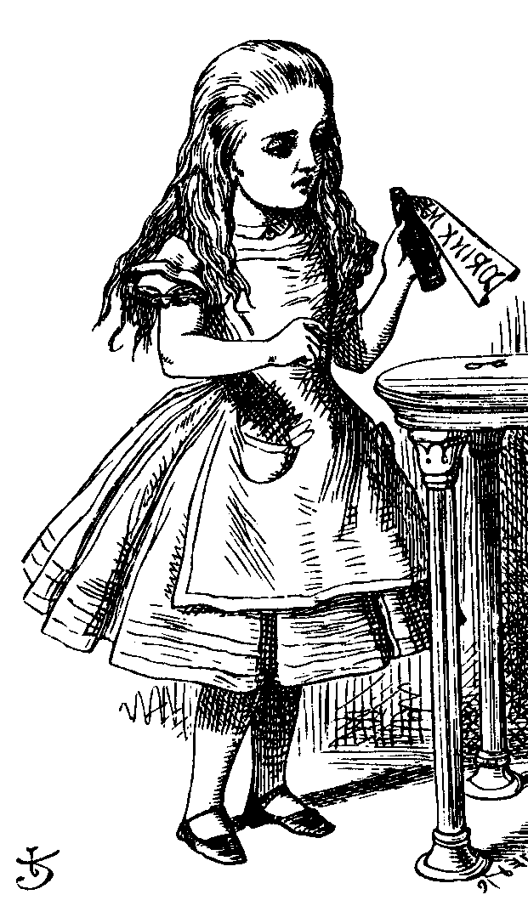
Simple Authentication
“I’m Alice”
Prove it
My password is “frank”
Alice
Bob
Simple and may be OK for standalone system
But insecure for networked system
Subject to a replay attack (next 2 slides)
Also, Bob must know Alice’s password

Slide 14
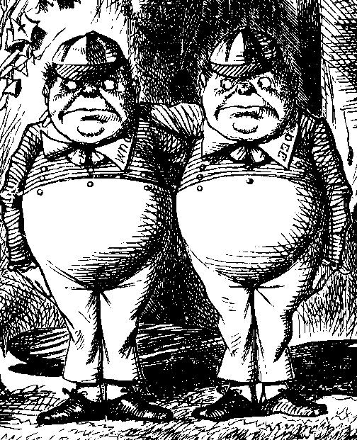
Authentication Attack
“I’m Alice”
Prove it
My password is “frank”
Alice
Bob
Trudy

Slide 15
Authentication Attack
“I’m Alice”
Prove it
My password is “frank”
Trudy
Bob
This is an example of a replay attack
How can we prevent a replay?

Slide 16
Simple Authentication
I’m Alice, my password is “frank”
Alice
Bob
More efficient, but…
… same problem as previous version

Slide 17
Better Authentication
“I’m Alice”
Prove it
h(Alice’s password)
Alice
Bob
Better since it hides Alice’s password
From both Bob and Trudy
But still subject to replay

Slide 18
Challenge-Response
To prevent replay, use challenge-response
Goal is to ensure “freshness”
Suppose Bob wants to authenticate Alice
Challenge sent from Bob to Alice
Challenge is chosen so that…
Replay is not possible
Only Alice can provide the correct response
Bob can verify the response

Slide 19
Nonce
To ensure freshness, can employ a nonce
Nonce == number used once
What to use for nonces?
That is, what is the challenge?
What should Alice do with the nonce?
That is, how to compute the response?
How can Bob verify the response?
Should we rely on passwords or keys?

Slide 20
Challenge-Response
“I’m Alice”
Nonce
h(Alice’s password, Nonce)
Alice
Bob
Nonce is the challenge
The hash is the response
Nonce prevents replay, ensures freshness
Password is something Alice knows
Note: Bob must know Alice’s pwd to verify

Slide 21
Generic Challenge-Response
“I’m Alice”
Nonce
Something that could only be
Alice
from Alice (and Bob can verify)
Bob
In practice, how to achieve this?
Hashed password works, but…
Encryption is better here (Why?)

Slide 22
Symmetric Key Notation
Encrypt plaintext P with key K
C = E(P,K)
Decrypt ciphertext C with key K
P = D(C,K)
Here, we are concerned with attacks on protocols, not attacks on crypto
So, we assume crypto algorithms are secure

Slide 23
Authentication: Symmetric Key
Alice and Bob share symmetric key K
Key K known only to Alice and Bob
Authenticate by proving knowledge of shared symmetric key
How to accomplish this?
Cannot reveal key, must not allow replay (or other) attack, must be verifiable, …

Slide 24
Authentication with Symmetric Key
“I’m Alice”
R
E(R,K)
Alice, K
Bob, K
Secure method for Bob to authenticate Alice
Alice does not authenticate Bob
So, can we achieve mutual authentication?

Slide 25
Mutual Authentication?
“I’m Alice”, R
E(R,K)
E(R,K)
Alice, K
Bob, K
What’s wrong with this picture?
“Alice” could be Trudy (or anybody else)!

Slide 26
Mutual Authentication
Since we have a secure one-way authentication protocol…
The obvious thing to do is to use the protocol twice
Once for Bob to authenticate Alice
Once for Alice to authenticate Bob
This has got to work…

Slide 27
Mutual Authentication
“I’m Alice”, R_{A}
R_{B}, E(R_{A}, K)
E(R_{B}, K)
Alice, K
Bob, K
This provides mutual authentication…
…or does it? See the next slide

Slide 28
Mutual Authentication Attack
1. “I’m Alice”, R_{A}
2. R_{B}, E(R_{A}, K)
5. E(R_{B}, K)
Trudy
Bob, K
3. “I’m Alice”, R_{B}
4. R_{C}, E(R_{B}, K)
Trudy
Bob, K

Slide 29
Mutual Authentication
Our one-way authentication protocol is not secure for mutual authentication
Protocols are subtle!
The “obvious” thing may not be secure
Also, if assumptions or environment change, protocol may not be secure
This is a common source of security failure
For example, Internet protocols

Slide 30
Symmetric Key Mutual Authentication
“I’m Alice”, R_{A}
R_{B}, E(“Bob”,R_{A},K)
E(“Alice”,R_{B},K)
Alice, K
Bob, K
Do these “insignificant” changes help?
Yes!

Slide 31
Public Key Notation
Encrypt M with Alice’s public key: {M}_{Alice}
Sign M with Alice’s private key: [M]_{Alice}
Then
[{M}_{Alice} ]_{Alice} = M
{[M]_{Alice} }_{Alice} = M
Anybody can use Alice’s public key
Only Alice can use her private key

Slide 32
Public Key Authentication
“I’m Alice”
{R}_{Alice}
R
Alice
Bob
Is this secure?
Trudy can get Alice to decrypt anything!
So, should have two key pairs

Slide 33
Public Key Authentication
“I’m Alice”
R
[R]_{Alice}
Alice
Bob
Is this secure?
Trudy can get Alice to sign anything!
Same a previous ⎯ should have two key pairs

Slide 34
Public Keys
Generally, a bad idea to use the same key pair for encryption and signing
Instead, should have…
…one key pair for encryption/decryption…
…and a different key pair for signing/verifying signatures

Slide 35
Session Key
Usually, a session key is required
I.e., a symmetric key for a particular session
Used for confidentiality and/or integrity
How to authenticate and establish a session key (i.e., shared symmetric key)?
When authentication completed, want Alice and Bob to share a session key
Trudy cannot break the authentication…
…and Trudy cannot determine the session key

Slide 36
Authentication & Session Key
“I’m Alice”, R
{R,K}_{Alice}
{R +1,K}_{Bob}
Alice
Bob
Is this secure?
Alice is authenticated and session key is secure
Alice’s “nonce”, R, useless to authenticate Bob
The key K is acting as Bob’s nonce to Alice
No mutual authentication

Slide 37
Public Key Authentication and Session Key
“I’m Alice”, R
[R,K]_{Bob}
[R +1,K]_{Alice}
Alice
Bob
Is this secure?
Mutual authentication (good), but…
… session key is not secret (very bad)

Slide 38
Public Key Authentication and Session Key
“I’m Alice”, R
{[R,K]_{Bob}}_{Alice}
{[R +1,K]_{Alice}}_{Bob}
Alice
Bob
Is this secure?
Seems to be OK
Mutual authentication and session key!

Slide 39
Public Key Authentication and Session Key
“I’m Alice”, R
[{R,K}_{Alice}]_{Bob}
[{R +1,K}_{Bob}]_{Alice}
Alice
Bob
Is this secure?
Seems to be OK
Anyone can see {R,K}_{Alice} and {R +1,K}_{Bob}

Slide 40
Perfect Forward Secrecy
Consider this “issue”…
Alice encrypts message with shared key K and sends ciphertext to Bob
Trudy records ciphertext and later attacks Alice’s (or Bob’s) computer to recover K
Then Trudy decrypts recorded messages
Perfect forward secrecy (PFS): Trudy cannot later decrypt recorded ciphertext
Even if Trudy gets key K or other secret(s)
Is PFS possible?

Slide 41
Perfect Forward Secrecy
Suppose Alice and Bob share key K
For perfect forward secrecy, Alice and Bob cannot use K to encrypt
Instead they must use a session key K_{S} and forget it after it’s used
Can Alice and Bob agree on session key K_{S} in a way that ensures PFS?

Slide 42
Naïve Session Key Protocol
E(K_{S}, K)
E(messages, K_{S})
Alice, K
Bob, K
Trudy could record E(K_{S}, K)
If Trudy later gets K then she can get K_{S}
Then Trudy can decrypt recorded messages

Slide 43
Perfect Forward Secrecy
We use Diffie-Hellman for PFS
Recall: public g and p
gª mod p
g^{b} mod p
Alice, a
Bob, b
But Diffie-Hellman is subject to MiM
How to get PFS and prevent MiM?

Slide 44
Perfect Forward Secrecy
E(gª mod p, K)
E(g^{b} mod p, K)
Alice: K, a
Bob: K, b
Session key K_{S} = g^{ab} mod p
Alice forgets a, Bob forgets b
So-called Ephemeral Diffie-Hellman
Neither Alice nor Bob can later recover K_{S}
Are there other ways to achieve PFS?

Slide 45
Mutual Authentication, Session Key and PFS
“I’m Alice”, R_{A}
R_{B}, [{R_{A}, g^{b} mod p}_{Alice}]_{Bob}
[{R_{B}, gª mod p}_{Bob}]_{Alice}
Alice
Bob
Session key is K = g^{ab} mod p
Alice forgets a and Bob forgets b
If Trudy later gets Bob’s and Alice’s secrets, she cannot recover session key K

Slide 46
Timestamps
A timestamp T is derived from current time
Timestamps used in some security protocols
Kerberos, for example
Timestamps reduce number of msgs (good)
Like a nonce that both sides know in advance
“Time” is a security-critical parameter (bad)
Clocks never exactly the same, so must allow for clock skew ⎯ creates risk of replay
How much clock skew is enough?

Slide 47
Public Key Authentication with Timestamp T
“I’m Alice”, {[T, K]_{Alice}}_{Bob}
{[T +1, K]_{Bob}}_{Alice}
Alice
Bob
Secure mutual authentication?
Session key?
Seems to be OK

Slide 48
Public Key Authentication with Timestamp T
“I’m Alice”, [{T, K}_{Bob}]_{Alice}
[{T +1, K}_{Alice}]_{Bob}
Alice
Bob
Secure authentication and session key?
Trudy can use Alice’s public key to find
{T, K}_{Bob} and then…

Slide 49
Public Key Authentication with Timestamp T
“I’m Trudy”, [{T, K}_{Bob}]_{Trudy}
[{T +1, K}_{Trudy}]_{Bob}
Trudy
Bob
Trudy obtains Alice-Bob session key K
Note: Trudy must act within clock skew

Slide 50
Public Key Authentication
Sign and encrypt with nonce…
Secure
Encrypt and sign with nonce…
Secure
Sign and encrypt with timestamp…
Secure
Encrypt and sign with timestamp…
Insecure
Protocols can be subtle!

Slide 51
Public Key Authentication with Timestamp T
“I’m Alice”, [{T, K}_{Bob}]_{Alice}
[{T +1}_{Alice}]_{Bob}
Alice
Bob
Is this “encrypt and sign” secure?
Yes, seems to be OK
Does “sign and encrypt” also work here?

Slide 52
Authentication and TCP

Slide 53
TCP-based Authentication
TCP not intended for use as an authentication protocol
But IP address in TCP connection often used for authentication
One mode of IPSec relies on IP address for authentication

Slide 54
TCP 3-way Handshake
SYN, SEQ a
SYN, ACK a+1, SEQ b
ACK b+1, data
Alice
Bob
Recall the TCP three way handshake
Initial sequence numbers: SEQ a and SEQ b
Supposed to be selected at random
If not…

Slide 55
TCP Authentication Attack
1. SYN, SEQ = t (as Trudy)
2. SYN, ACK = t+1, SEQ = b₁
…
3. SYN, SEQ = t (as Alice)
Trudy
Bob
5. ACK = b₂+1, data
5.
5.
5.
4. SYN, ACK = t+1, SEQ = b₂
Alice
5.

Slide 56


TCP Authentication Attack
Initial SEQ numbers
Mac OS X
Random SEQ numbers
If initial SEQ numbers not very random…
…possible to guess initial SEQ number…
…and previous attack will succeed

Slide 57
TCP Authentication Attack
Trudy cannot see what Bob sends, but she can send packets to Bob, while posing as Alice
Trudy must prevent Alice from receiving Bob’s packets (or else connection will terminate)
If password (or other authentication) required, this attack fails
If TCP connection is relied on for authentication, then attack can succeed
Bad idea to rely on TCP for authentication

Slide 58
Zero Knowledge Proofs

Slide 59
Zero Knowledge Proof (ZKP)
Alice wants to prove that she knows a secret without revealing any info about it
Bob must verify that Alice knows secret
But, Bob gains no info about the secret
Process is probabilistic
Bob can verify that Alice knows the secret to an arbitrarily high probability
An “interactive proof system”

Slide 60
Bob’s Cave
Alice knows secret phrase to open path between R and S (“open sarsaparilla”)
Can she convince Bob that she knows the secret without revealing phrase?
P
Q
R
S

Slide 61
Bob’s Cave
Bob: “Alice come out on S side”
P
Alice (quietly): “Open sarsaparilla”
Q
If Alice does not know the secret…
R
S
…then Alice could come out from the correct side with probability 1/2
If Bob repeats this n times, then Alice (who does not know secret) can only fool Bob with probability 1/2^{n}

Slide 62
Fiat-Shamir Protocol
Cave-based protocols are inconvenient
Can we achieve same effect without the cave?
Finding square roots modulo N is difficult
Equivalent to factoring
Suppose N = pq, where p and q prime
Alice has a secret S
N and v = S² mod N are public, S is secret
Alice must convince Bob that she knows S without revealing any information about S

Slide 63
Fiat-Shamir
x = r² mod N
e ∈ {0,1}
y = r ⋅ S^{e} mod N
Alice
secret S
random r
Bob
random e
Public: Modulus N and v = S² mod N
Alice selects random r, Bob chooses e ∈ {0,1}
Bob verifies: y² = x ⋅ v^{e} mod N
Why? Because… y² = r² ⋅ S^{2e} = r² ⋅ (S²)^{e} = x ⋅ v^{e} mod N

Slide 64
Fiat-Shamir: e = 1
x = r² mod N
e = 1
y = r ⋅ S mod N
Alice
secret S
random r
Bob
random e
Public: Modulus N and v = S² mod N
Alice selects random r, Bob chooses e =1
If y² = x ⋅ v mod N then Bob accepts it
I.e., “Alice” passes this iteration of the protocol
Note that Alice must know S in this case

Slide 65
Fiat-Shamir: e = 0
x = r² mod N
e = 0
y = r mod N
Alice
secret S
random r
Bob
random e
Public: Modulus N and v = S² mod N
Alice selects random r, Bob chooses e = 0
Bob must checks whether y² = x mod N
Alice does not need to know S in this case!

Slide 66
Fiat-Shamir
Public: modulus N and v = S² mod N
Secret: Alice knows S
Alice selects random r and commits to r by sending x = r² mod N to Bob
Bob sends challenge e ∈ {0,1} to Alice
Alice responds with y = r ⋅ S^{e} mod N
Bob checks whether y² = x ⋅ v^{e} mod N
Does this prove response is from Alice?

Slide 67
Does Fiat-Shamir Work?
If everyone follows protocol, math works:
Public: v = S² mod N
Alice to Bob: x = r² mod N and y = r ⋅ S^{e} mod N
Bob verifies: y² = x ⋅ v^{e} mod N
Can Trudy convince Bob she is Alice?
If Trudy expects e = 0, she sends x = r² in msg 1 and y = r in msg 3 (i.e., follow the protocol)
If Trudy expects e = 1, sends x = r² ⋅ v⁻¹ in msg 1 and y = r in msg 3
If Bob chooses e ∈ {0,1} at random, Trudy can only trick Bob with probability 1/2

Slide 68
Fiat-Shamir Facts
Trudy can trick Bob with probability 1/2, but…
…after n iterations, the probability that Trudy can convince Bob that she is Alice is only 1/2^{n}
Just like Bob’s cave!
Bob’s e ∈ {0,1} must be unpredictable
Alice must use new r each iteration, or else…
If e = 0, Alice sends r mod N in message 3
If e = 1, Alice sends r ⋅ S mod N in message 3
Anyone can find S given r mod N and r ⋅ S mod N

Slide 69
Fiat-Shamir Zero Knowledge?
Zero knowledge means that nobody learns anything about the secret S
Public: v = S² mod N
Trudy sees r² mod N in message 1
Trudy sees r ⋅ S mod N in message 3 (if e = 1)
If Trudy can find r from r² mod N, gets S
But that requires modular square root
If Trudy could find modular square roots, she could get S from public v
Protocol does not seem to “help” to find S

Slide 70
ZKP in the Real World
Public key certificates identify users
No anonymity if certificates sent in plaintext
ZKP offers a way to authenticate without revealing identities
ZKP supported in MS’s Next Generation Secure Computing Base (NGSCB), where…
…ZKP used to authenticate software “without revealing machine identifying data”
ZKP is not just pointless mathematics!

Slide 71
Best Authentication Protocol?
It depends on…
The sensitivity of the application/data
The delay that is tolerable
The cost (computation) that is tolerable
What crypto is supported (public key, symmetric key, …)
Whether mutual authentication is required
Whether PFS, anonymity, etc., are concern
…and possibly other factors

