Slide 1
CIS 512 Information Security Course Logistics
Lecturer: Zeyar Aung

Slide 2
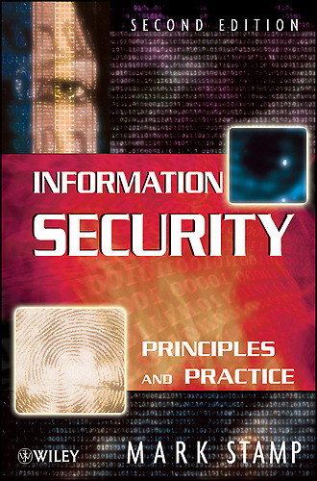
Primary Textbook
Mark Stamp, Information Security: Principles and Practice, 2nd edition, Wiley Interscience Press, 2011.
Available at the library.

Slide 3
Supplementary Materials for Primary Textbook
http://www.cs.sjsu.edu/~stamp/infosec/

Slide 4
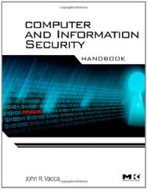
Secondary Textbook
John R. Vacca (editor), Computer and Information Security Handbook, Morgan Kaufmann Press, 2009.
The softcopies of the relevant chapters will be provided before the respective lectures.

Slide 5
Course Grading
Homework | 25% (5 x 5%)
Exams | 55% (20% for midterm + 35% for final)
Project | 20%
Total | 100%
Grading policy
If < 50 points (Grade D)
If >= 50 points and < 65 points (Grade C)
If >= 65 points
If >= 90 points (Grade A)
If >= 65 and < 90 (Depending on distribution of points, half of the students will be given Grade A and another half Grade B)

