Slide 1
Part I: Crypto Chapter 4: Public Key Cryptography
Original source: http://www.cs.sjsu.edu/~stamp/infosec/

Slide 2
Chapter 4: Public Key Cryptography
You should not live one way in private, another in public.
⎯ Publilius Syrus
Three may keep a secret, if two of them are dead.
⎯ Ben Franklin

Slide 3
Public Key Cryptography
Two keys
Sender uses recipient’s public key to encrypt
Recipient uses private key to decrypt
Based on “trap door one way function”
“One way” means easy to compute in one direction, but hard to compute in other direction
Example: Given p and q, product N = pq easy to compute, but given N, it’s hard to find p and q
“Trap door” used to create key pairs

Slide 4
Public Key Cryptography
Encryption
Suppose we encrypt M with Bob’s public key
Bob’s private key can decrypt to recover M
Digital Signature
Sign by “encrypting” with your private key
Anyone can verify signature by “decrypting” with public key
But only you could have signed
Like a handwritten signature, but way better…

Slide 5

Knapsack

Slide 6
Knapsack Problem
Given a set of n weights W₀,W₁,...,W_{n-1} and a sum S, is it possible to find a_{i} ∈ {0,1} so that
S = a₀W₀+a₁W₁ +...+ a_{n-1}W_{n-1}
(technically, this is “subset sum” problem)
Example
Weights (62,93,26,52,166,48,91,141)
Problem: Find subset that sums to S=302
Answer: 62+26+166+48=302
The (general) knapsack is NP-complete

Slide 7
Knapsack Problem
General knapsack (GK) is hard to solve
But superincreasing knapsack (SIK) is easy
SIK: each weight greater than the sum of all previous weights
Example
Weights (2,3,7,14,30,57,120,251)
Problem: Find subset that sums to S=186
Work from largest to smallest weight
Answer: 120+57+7+2=186

Slide 8
Knapsack Cryptosystem
Generate superincreasing knapsack (SIK)
Convert SIK into “general” knapsack (GK)
Public Key: GK
Private Key: SIK plus conversion factor
Ideally…
Easy to encrypt with GK
With private key, easy to decrypt (convert ciphertext to SIK problem)
Without private key, must solve GK

Slide 9
Knapsack Keys
Start with (2,3,7,14,30,57,120,251) as the SIK
Choose m = 41 and n = 491 (m, n relatively prime, n exceeds sum of elements in SIK)
Compute “general” knapsack
2 ⋅ 41 mod 491 = 82
3 ⋅ 41 mod 491 = 123
7 ⋅ 41 mod 491 = 287
14 ⋅ 41 mod 491 = 83
30 ⋅ 41 mod 491 = 248
57 ⋅ 41 mod 491 = 373
120 ⋅ 41 mod 491 = 10
251 ⋅ 41 mod 491 = 471
“General” knapsack: (82,123,287,83,248,373,10,471)

Slide 10
Knapsack Cryptosystem
Private key: (2,3,7,14,30,57,120,251)
m⁻¹ mod n = 41⁻¹ mod 491 = 12
Public key: (82,123,287,83,248,373,10,471), n=491
Example: Encrypt 10010110
82 + 83 + 373 + 10 = 548
To decrypt,
548 · 12 = 193 mod 491
Solve (easy) SIK with S = 193
Obtain plaintext 10010110

Slide 11
Knapsack Weakness
Trapdoor: Convert SIK into “general” knapsack using modular arithmetic
One-way: General knapsack easy to encrypt, hard to solve; SIK easy to solve
This knapsack cryptosystem is insecure
Broken in 1983 with Apple II computer
The attack uses lattice reduction
“General knapsack” is not general enough!
This special knapsack is easy to solve!

Slide 12
RSA

Slide 13
RSA
By Clifford Cocks (GCHQ), independently, Rivest, Shamir, and Adleman (MIT)
RSA is the gold standard in public key crypto
Let p and q be two large prime numbers
Let N = pq be the modulus
Choose e relatively prime to (p−1)(q−1)
Find d such that ed = 1 mod (p−1)(q−1)
Public key is (N,e)
Private key is d

Slide 14
RSA
Message M is treated as a number
To encrypt M we compute
C = Me mod N
To decrypt ciphertext C compute
M = C^{d} mod N
Recall that e and N are public
If Trudy can factor N=pq, she can use e to easily find d since ed = 1 mod (p−1)(q−1)
Factoring the modulus breaks RSA
Is factoring the only way to break RSA?

Slide 15
Does RSA Really Work?
Given C = Me mod N we must show
M = C^{d} mod N = M^{ed} mod N
We’ll use Euler’s Theorem:
If x is relatively prime to n then x^{ϕ(n)} = 1 mod n
Facts:
ed = 1 mod (p − 1)(q − 1)
By definition of “mod”, ed = k(p − 1)(q − 1) + 1
ϕ(N) = (p − 1)(q − 1)
Then ed − 1 = k(p − 1)(q − 1) = kϕ(N)
Finally, M^{ed} = M^{(ed − 1) + 1} = M⋅M^{ed − 1} = M⋅M^{kϕ(N)} = M⋅(M^{ϕ(N)})^{k} mod N = M⋅1^{k} mod N = M mod N

Slide 16
Simple RSA Example
Example of RSA
Select “large” primes p = 11, q = 3
Then N = pq = 33 and (p − 1)(q − 1) = 20
Choose e = 3 (relatively prime to 20)
Find d such that ed = 1 mod 20
We find that d = 7 works
Public key: (N, e) = (33, 3)
Private key: d = 7

Slide 17
Simple RSA Example
Public key: (N, e) = (33, 3)
Private key: d = 7
Suppose message M = 8
Ciphertext C is computed as
C = Me mod N = 8³ = 512 = 17 mod 33
Decrypt C to recover the message M by
M = C^{d} mod N = 17⁷ = 410,338,673 = 12,434,505 ∗ 33 + 8 = 8 mod 33

Slide 18
More Efficient RSA (1)
Modular exponentiation example
5²⁰ = 95367431640625 = 25 mod 35
A better way: repeated squaring
20 = 10100 base 2
(1, 10, 101, 1010, 10100) = (1, 2, 5, 10, 20)
Note that 2 = 1⋅ 2, 5 = 2 ⋅ 2 + 1, 10 = 2 ⋅ 5, 20 = 2 ⋅ 10
5¹= 5 mod 35
5²= (5¹)² = 5² = 25 mod 35
5⁵= (5²)² ⋅ 5¹ = 25² ⋅ 5 = 3125 = 10 mod 35
5¹⁰ = (5⁵)² = 10² = 100 = 30 mod 35
5²⁰ = (5¹⁰)² = 30² = 900 = 25 mod 35
No huge numbers and it’s efficient!

Slide 19
More Efficient RSA (2)
Use e = 3 for all users (but not same N or d)
Public key operations only require 2 multiplies
Private key operations remain expensive
If M < N^{1/3} then C = Me = M³ and cube root attack
For any M, if C₁, C₂, C₃ sent to 3 users, cube root attack works (uses Chinese Remainder Theorem)
Can prevent cube root attack by padding message with random bits
Note: e = 2¹⁶ + 1 also used (“better” than e = 3)

Slide 20
Diffie-Hellman

Slide 21
Diffie-Hellman
Invented by Williamson (GCHQ) and, independently, by D and H (Stanford)
A “key exchange” algorithm
Used to establish a shared symmetric key
Not for encrypting or signing
Based on discrete log problem:
Given: g, p, and g^{k} mod p
Find: exponent k

Slide 22
Diffie-Hellman
Let p be prime, let g be a generator
For any x ∈ {1,2,…,p-1} there is n s.t. x = g^{n} mod p
Alice selects her private value a
Bob selects his private value b
Alice sends gª mod p to Bob
Bob sends g^{b} mod p to Alice
Both compute shared secret, g^{ab} mod p
Shared secret can be used as symmetric key

Slide 23
Diffie-Hellman
Suppose Bob and Alice use Diffie-Hellman to determine symmetric key K = g^{ab} mod p
Trudy can see gª mod p and g^{b} mod p
But… gª g^{b} mod p = g^{a+b} mod p ≠ g^{ab} mod p
If Trudy can find a or b, she gets key K
If Trudy can solve discrete log problem, she can find a or b

Slide 24
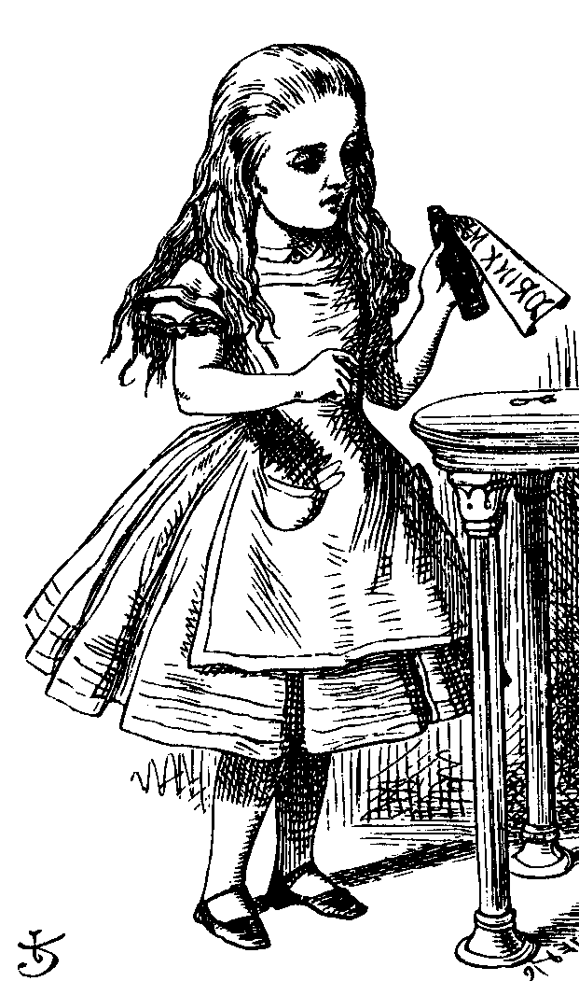
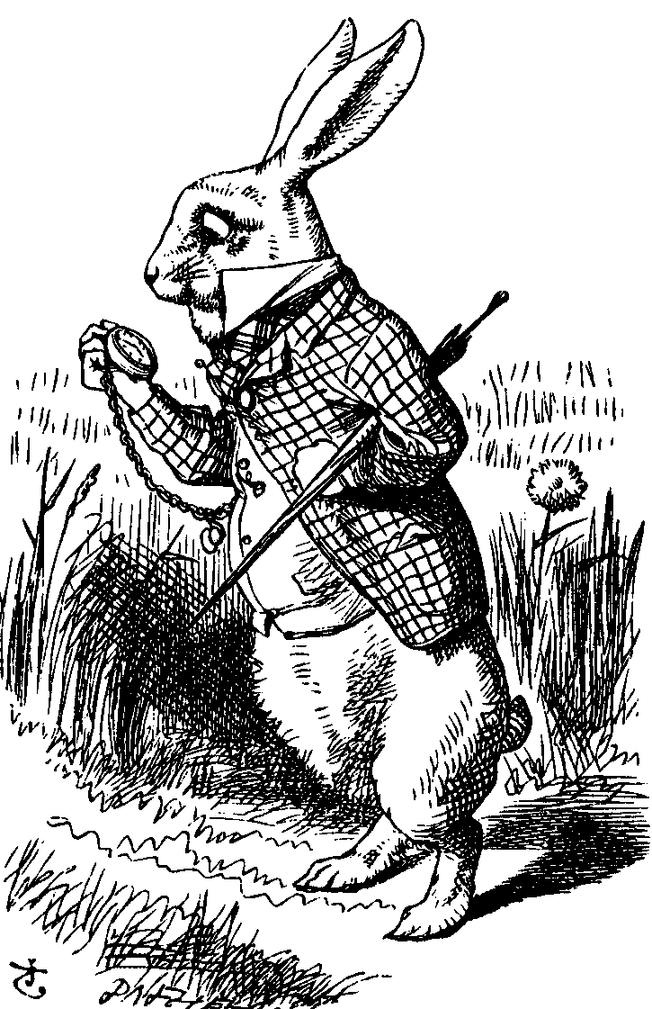
Diffie-Hellman
Public: g and p
Private: Alice’s exponent a, Bob’s exponent b
gª mod p
g^{b} mod p
Alice, a
Bob, b
Alice computes (g^{b})ª = g^{ba} = g^{ab} mod p
Bob computes (gª)^{b} = g^{ab} mod p
Use K = g^{ab} mod p as symmetric key

Slide 25
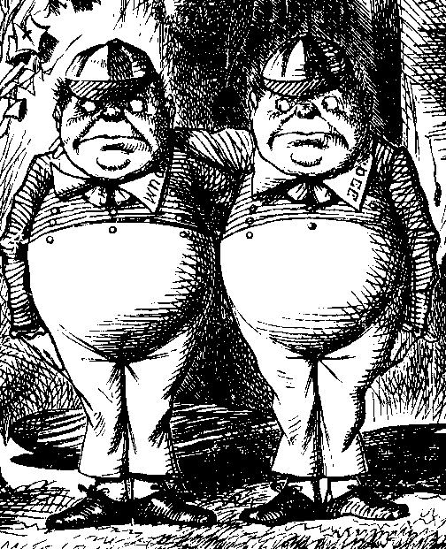
Diffie-Hellman
Subject to man-in-the-middle (MiM) attack
gª mod p
g^{t} mod p
g^{t} mod p
g^{b} mod p
Alice, a
Trudy, t
Bob, b
Trudy shares secret g^{at} mod p with Alice
Trudy shares secret g^{bt} mod p with Bob
Alice and Bob don’t know Trudy exists!

Slide 26
Diffie-Hellman
How to prevent MiM attack?
Encrypt DH exchange with symmetric key
Encrypt DH exchange with public key
Sign DH values with private key
Other?
At this point, DH may look pointless…
…but it’s not (more on this later)
In any case, you MUST be aware of MiM attack on Diffie-Hellman

Slide 27
Elliptic Curve Cryptography

Slide 28
Elliptic Curve Crypto (ECC)
“Elliptic curve” is not a cryptosystem
Elliptic curves are a different way to do the math in public key system
Elliptic curve versions DH, RSA, etc.
Elliptic curves may be more efficient
Fewer bits needed for same security
But the operations are more complex

Slide 29
What is an Elliptic Curve?
An elliptic curve E is the graph of an equation of the form
y² = x³ + ax + b
Also includes a “point at infinity”
What do elliptic curves look like?
See the next slide!

Slide 30
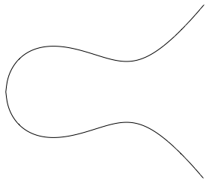
Elliptic Curve Picture
y
Consider elliptic curve
E: y² = x³ - x + 1
If P₁ and P₂ are on E, we can define
P₃ = P₁ + P₂
as shown in picture
Addition is all we need
P₂
P₁
x
P₃

Slide 31
Points on Elliptic Curve
Consider y² = x³ + 2x + 3 (mod 5)
x = 0 ⇒ y² = 3 ⇒ no solution (mod 5)
x = 1 ⇒ y² = 6 = 1 ⇒ y = 1,4 (mod 5)
x = 2 ⇒ y² = 15 = 0 ⇒ y = 0 (mod 5)
x = 3 ⇒ y² = 36 = 1 ⇒ y = 1,4 (mod 5)
x = 4 ⇒ y² = 75 = 0 ⇒ y = 0 (mod 5)
Then points on the elliptic curve are
(1,1) (1,4) (2,0) (3,1) (3,4) (4,0) and the point at infinity: ∞

Slide 32
Elliptic Curve Math
Addition on: y² = x³ + ax + b (mod p)
P₁=(x₁,y₁), P₂=(x₂,y₂)
P₁ + P₂ = P₃ = (x₃,y₃) where
x₃ = m² - x₁ - x₂ (mod p)
y₃ = m(x₁ - x₃) - y₁ (mod p)
And m = (y₂-y₁)∗(x₂-x₁)⁻¹ mod p, if P₁≠P₂
m = (3x₁²+a)∗(2y₁)⁻¹ mod p, if P₁ = P₂
Special cases: If m is infinite, P₃ = ∞, and
∞ + P = P for all P

Slide 33
Elliptic Curve Addition
Consider y² = x³ + 2x + 3 (mod 5). Points on the curve are (1,1) (1,4) (2,0) (3,1) (3,4) (4,0) and ∞
What is (1,4) + (3,1) = P₃ = (x₃,y₃)?
m = (1-4)∗(3-1)⁻¹ = -3∗2⁻¹
= 2(3) = 6 = 1 (mod 5)
x₃ = 1 - 1 - 3 = 2 (mod 5)
y₃ = 1(1-2) - 4 = 0 (mod 5)
On this curve, (1,4) + (3,1) = (2,0)

Slide 34
ECC Diffie-Hellman
Public: Elliptic curve and point (x,y) on curve
Private: Alice’s A and Bob’s B
A(x,y)
B(x,y)
Alice, A
Bob, B
Alice computes A(B(x,y))
Bob computes B(A(x,y))
These are the same since AB = BA

Slide 35
ECC Diffie-Hellman
Public: Curve y² = x³ + 7x + b (mod 37) and point (2,5) ⇒ b = 3
Alice’s private: A = 4
Bob’s private: B = 7
Alice sends Bob: 4(2,5) = (7,32)
Bob sends Alice: 7(2,5) = (18,35)
Alice computes: 4(18,35) = (22,1)
Bob computes: 7(7,32) = (22,1)

Slide 36
Uses for Public Key Crypto

Slide 37
Uses for Public Key Crypto
Confidentiality
Transmitting data over insecure channel
Secure storage on insecure media
Authentication (later)
Digital signature provides integrity and non-repudiation
No non-repudiation with symmetric keys

Slide 38
Non-non-repudiation
Alice orders 100 shares of stock from Bob
Alice computes MAC using symmetric key
Stock drops, Alice claims she did not order
Can Bob prove that Alice placed the order?
No! Since Bob also knows the symmetric key, he could have forged message
Problem: Bob knows Alice placed the order, but he can’t prove it

Slide 39
Non-repudiation
Alice orders 100 shares of stock from Bob
Alice signs order with her private key
Stock drops, Alice claims she did not order
Can Bob prove that Alice placed the order?
Yes! Only someone with Alice’s private key could have signed the order
This assumes Alice’s private key is not stolen (revocation problem)

Slide 40
Public Key Notation
Sign message M with Alice’s private key: [M]_{Alice}
Encrypt message M with Alice’s public key: {M}_{Alice}
Then
{[M]_{Alice}}_{Alice} = M
[{M}_{Alice}]_{Alice} = M

Slide 41
Sign and Encrypt vs Encrypt and Sign

Slide 42
Confidentiality and Non-repudiation?
Suppose that we want confidentiality and integrity/non-repudiation
Can public key crypto achieve both?
Alice sends message to Bob
Sign and encrypt {[M]_{Alice}}_{Bob}
Encrypt and sign [{M}_{Bob}]_{Alice}
Can the order possibly matter?

Slide 43
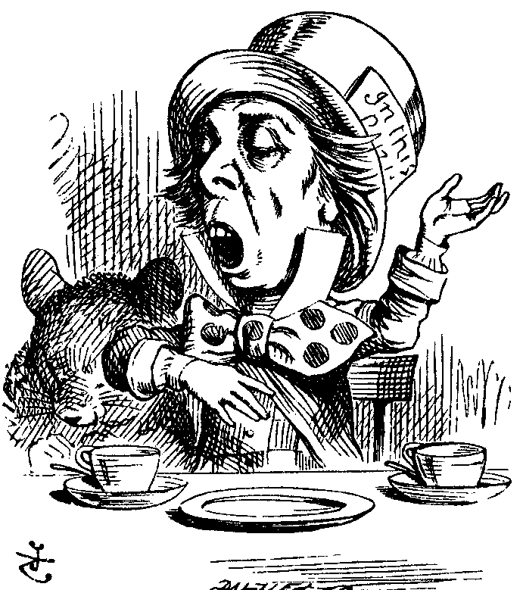
Sign and Encrypt
M = “I love you”
{[M]_{Alice}}_{Bob}
{[M]_{Alice}}_{Charlie}
Alice
Bob
Charlie
Q: What’s the problem?
A: No problem ⎯ public key is public

Slide 44
Encrypt and Sign
M = “My theory, which is mine….”
[{M}_{Bob}]_{Alice}
[{M}_{Bob}]_{Charlie}
Alice
Charlie
Bob
Note that Charlie cannot decrypt M
Q: What is the problem?
A: No problem ⎯ public key is public

Slide 45
Public Key Infrastructure

Slide 46
Public Key Certificate
Certificate contains name of user and user’s public key (and possibly other info)
It is signed by the issuer, a Certificate Authority (CA), such as VeriSign
M = (Alice, Alice’s public key), S = [M]_{CA}
Alice’s Certificate = (M, S)
Signature on certificate is verified using CA’s public key:
Verify that M = {S}_{CA}

Slide 47
Certificate Authority
Certificate authority (CA) is a trusted 3rd party (TTP) ⎯ creates and signs certificates
Verify signature to verify integrity & identity of owner of corresponding private key
Does not verify the identity of the sender of certificate ⎯ certificates are public keys!
Big problem if CA makes a mistake (a CA once issued Microsoft certificate to someone else)
A common format for certificates is X.509

Slide 48
PKI
Public Key Infrastructure (PKI): the stuff needed to securely use public key crypto
Key generation and management
Certificate authority (CA) or authorities
Certificate revocation lists (CRLs), etc.
No general standard for PKI
We mention 3 generic “trust models”

Slide 49
PKI Trust Models
Monopoly model
One universally trusted organization is the CA for the known universe
Big problems if CA is ever compromised
Who will act as CA???
System is useless if you don’t trust the CA!

Slide 50
PKI Trust Models
Oligarchy
Multiple trusted CAs
This is approach used in browsers today
Browser may have 80 or more certificates, just to verify certificates!
User can decide which CAs to trust

Slide 51
PKI Trust Models
Anarchy model
Everyone is a CA…
Users must decide who to trust
This approach used in PGP: “Web of trust”
Why is it anarchy?
Suppose a certificate is signed by Frank and you don’t know Frank, but you do trust Bob and Bob says Alice is trustworthy and Alice vouches for Frank. Should you accept the certificate?
Many other trust models and PKI issues

Slide 52
Confidentiality in the Real World

Slide 53
Symmetric Key vs Public Key
Symmetric key +’s
Speed
No public key infrastructure (PKI) needed
Public Key +’s
Signatures (non-repudiation)
No shared secret (but, private keys…)

Slide 54
Notation Reminder
Public key notation
Sign M with Alice’s private key
[M]_{Alice}
Encrypt M with Alice’s public key
{M}_{Alice}
Symmetric key notation
Encrypt P with symmetric key K
C = E(P,K)
Decrypt C with symmetric key K
P = D(C,K)

Slide 55
Real World Confidentiality
Hybrid cryptosystem
Public key crypto to establish a key
Symmetric key crypto to encrypt data…
{K}_{Bob}
E(Bob’s data, K)
E(Alice’s data, K)
Alice
Bob
Can Bob be sure he’s talking to Alice?

