Slide 1
Part I: Crypto Chapter 5: Hash Functions and Others
Original Source: http://www.cs.sjsu.edu/~stamp/infosec/

Slide 2
Chapter 5: Hash Functions++
“I'm sure [my memory] only works one way.” Alice remarked.
“I can't remember things before they happen.”
“It's a poor sort of memory that only works backwards,”
the Queen remarked.
“What sort of things do you remember best?" Alice ventured to ask.
“Oh, things that happened the week after next,"
the Queen replied in a careless tone.
⎯ Lewis Carroll, Through the Looking Glass

Slide 3
Chapter 5: Hash Functions++
A boat, beneath a sunny sky
Lingering onward dreamily
In an evening of July ⎯
Children three that nestle near,
Eager eye and willing ear,
...
⎯ Lewis Carroll, Through the Looking Glass

Slide 4
Hash Function Motivation
Suppose Alice signs M
Alice sends M and S = [M]_{Alice} to Bob
Bob verifies that M = {S}_{Alice}
Can Alice just send S?
If M is big, [M]_{Alice} costly to compute & send
Suppose instead, Alice signs h(M), where h(M) is much smaller than M
Alice sends M and S = [h(M)]_{Alice} to Bob
Bob verifies that h(M) = {S}_{Alice}

Slide 5
Hash Function Motivation
So, Alice signs h(M)
That is, Alice computes S = [h(M)]_{Alice}
Alice then sends (M, S) to Bob
Bob verifies that h(M) = {S}_{Alice}
What properties must h(M) satisfy?
Suppose Trudy finds M’ so that h(M) = h(M’)
Then Trudy can replace (M, S) with (M’, S)
Does Bob detect this tampering?
No, since h(M’) = h(M) = {S}_{Alice}

Slide 6
Crypto Hash Function
Crypto hash function h(x) must provide
Compression ⎯ output length is small
Efficiency ⎯ h(x) easy to compute for any x
One-way ⎯ given a value y it is infeasible to find an x such that h(x) = y
Weak collision resistance ⎯ given x and h(x), infeasible to find y ≠ x such that h(y) = h(x)
Strong collision resistance ⎯ infeasible to find any x and y, with x ≠ y such that h(x) = h(y)
Lots of collisions exist, but hard to find any

Slide 7
Pre-Birthday Problem
Suppose N people in a room
How large must N be before the probability someone has same birthday as me is ≥ 1/2 ?
Solve: 1/2 = 1 − (364/365)^{N} for N
We find N = 253

Slide 8
Birthday Problem
How many people must be in a room before probability is ≥ 1/2 that any two (or more) have same birthday?
1 − 365/365 ⋅ 364/365 ⋅ ⋅ ⋅(365−N+1)/365
Set equal to 1/2 and solve: N = 23
Surprising? A paradox?
Maybe not: “Should be” about sqrt(365) since we compare all pairs x and y
And there are 365 possible birthdays

Slide 9
Of Hashes and Birthdays
If h(x) is N bits, 2^{N} different hash values are possible
So, if you hash about 2^{N/2} random values then you expect to find a collision
Since sqrt(2^{N}) = 2^{N/2}
Implication: secure N bit symmetric key requires 2^{N−1} work to “break” while secure N bit hash requires 2^{N/2} work to “break”
Exhaustive search attacks, that is

Slide 10
Non-crypto Hash (1)
Data X = (X₀,X₁,X₂,…,X_{n-1}), each X_{i} is a byte
Define h(X) = X₀+X₁+X₂+…+X_{n-1}
Is this a secure cryptographic hash?
Example: X = (10101010, 00001111)
Hash is h(X) = 10111001
If Y = (00001111, 10101010) then h(X) = h(Y)
Easy to find collisions, so not secure…

Slide 11
Non-crypto Hash (2)
Data X = (X₀,X₁,X₂,…,X_{n-1})
Suppose hash is defined as
h(X) = nX₀+(n−1)X₁+(n−2)X₂+…+1⋅X_{n-1}
Is this a secure cryptographic hash?
Note that
h(10101010, 00001111) ≠ h(00001111, 10101010)
But hash of (00000001, 00001111) is same as hash of (00000000, 00010001)
Not “secure”, but this hash is used in the (non-crypto) application rsync

Slide 12
Non-crypto Hash (3)
Cyclic Redundancy Check (CRC)
Essentially, CRC is the remainder in a long division calculation
Good for detecting burst errors
Random errors unlikely to yield a collision
But easy to construct collisions
CRC has been mistakenly used where crypto integrity check is required (e.g., WEP)

Slide 13
Popular Crypto Hashes
MD5 ⎯ invented by Rivest
128 bit output
Note: MD5 collisions easy to find
SHA-1 ⎯ A U.S. government standard, inner workings similar to MD5
160 bit output
Many other hashes, but MD5 and SHA-1 are the most widely used
Hashes work by hashing message in blocks

Slide 14
Crypto Hash Design
Desired property: avalanche effect
Change to 1 bit of input should affect about half of output bits
Crypto hash functions consist of some number of rounds
Want security and speed
Avalanche effect after few rounds
But simple rounds
Analogous to design of block ciphers

Slide 15
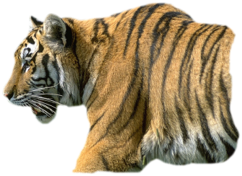
Tiger Hash
“Fast and strong”
Designed by Ross Anderson and Eli Biham ⎯ leading cryptographers
Design criteria
Secure
Optimized for 64-bit processors
Easy replacement for MD5 or SHA-1

Slide 16
Tiger Hash
Like MD5/SHA-1, input divided into 512 bit blocks (padded)
Unlike MD5/SHA-1, output is 192 bits (three 64-bit words)
Truncate output if replacing MD5 or SHA-1
Intermediate rounds are all 192 bits
4 S-boxes, each maps 8 bits to 64 bits
A “key schedule” is used

Slide 17
Tiger Outer Round
a
b
c
X_{i}
F₅
W
Input is X
X = (X₀,X₁,…,X_{n-1})
X is padded
Each X_{i} is 512 bits
There are n iterations of diagram at left
One for each input block
Initial (a,b,c) constants
Final (a,b,c) is hash
Looks like block cipher!
key schedule
F₇
W
key schedule
F₉
W
⊕
−
+
a
b
c
a
b
c

Slide 18
Tiger Inner Rounds
a
b
c
Each F_{m} consists of precisely 8 rounds
512 bit input W to F_{m}
W=(w₀,w₁,…,w₇)
W is one of the input blocks X_{i}
All lines are 64 bits
The f_{m,i} depend on the S-boxes (next slide)
f_{m,0}
w₀
f_{m.1}
w₁
f_{m,2}
w₂
f_{m,7}
w₇
a
b
c

Slide 19
Tiger Hash: One Round
Each f_{m,i} is a function of a,b,c,w_{i} and m
Input values of a,b,c from previous round
And w_{i} is 64-bit block of 512 bit W
Subscript m is multiplier
And c = (c₀,c₁,…,c₇)
Output of f_{m,i} is
c = c ⊕ w_{i}
a = a − (S₀[c₀] ⊕ S₁[c₂] ⊕ S₂[c₄] ⊕ S₃[c₆])
b = b + (S₃[c₁] ⊕ S₂[c₃] ⊕ S₁[c₅] ⊕ S₀[c₇])
b = b ∗ m
Each S_{i} is S-box: 8 bits mapped to 64 bits

Slide 20
Tiger Hash Key Schedule
x₀ = x₀ − (x₇ ⊕ 0xA5A5A5A5A5A5A5A5)
x₁ = x₁ ⊕ x₀
x₂ = x₂ + x₁
x₃ = x₃ − (x₂ ⊕ ((~x₁) << 19))
x₄ = x₄ ⊕ x₃
x₅ = x₅ +x₄
x₆ = x₆ − (x₅ ⊕ ((~x₄) >> 23))
x₇ = x₇ ⊕ x₆
x₀ = x₀ +x₇
x₁ = x₁ − (x₀ ⊕ ((~x₇) << 19))
x₂ = x₂ ⊕ x₁
x₃ = x₃ +x₂
x₄ = x₄ − (x₃ ⊕ ((~x₂) >> 23))
x₅ = x₅ ⊕ x₄
x₆ = x₆ +x₅
x₇ = x₇ −(x₆ ⊕ 0x0123456789ABCDEF)
Input is X
X=(x₀,x₁,…,x₇)
Small change in X will produce large change in key schedule output

Slide 21
Tiger Hash Summary (1)
Hash and intermediate values are 192 bits
24 (inner) rounds
S-boxes: Claimed that each input bit affects a, b and c after 3 rounds
Key schedule: Small change in message affects many bits of intermediate hash values
Multiply: Designed to ensure that input to S-box in one round mixed into many S-boxes in next
S-boxes, key schedule and multiply together designed to ensure strong avalanche effect

Slide 22
Tiger Hash Summary (2)
Uses lots of ideas from block ciphers
S-boxes
Multiple rounds
Mixed mode arithmetic
At a higher level, Tiger employs
Confusion
Diffusion

Slide 23
HMAC
Can compute a MAC of the message M with key K using a “hashed MAC” or HMAC
HMAC is a keyed hash
Why would we need a key?
How to compute HMAC?
Two obvious choices: h(K,M) and h(M,K)
Which is better?

Slide 24
HMAC
Should we compute HMAC as h(K,M) ?
Hashes computed in blocks
h(B₁,B₂) = F(F(A,B₁),B₂) for some F and constant A
Then h(B₁,B₂) = F(h(B₁),B₂)
Let M’ = (M,X)
Then h(K,M’) = F(h(K,M),X)
Attacker can compute HMAC of M’ without K
Is h(M,K) better?
Yes, but… if h(M’) = h(M) then we might have h(M,K)=F(h(M),K)=F(h(M’),K)=h(M’,K)

Slide 25
The Right Way to HMAC
Described in RFC 2104
Let B be the block length of hash, in bytes
B = 64 for MD5 and SHA-1 and Tiger
ipad = 0x36 repeated B times
opad = 0x5C repeated B times
Then
HMAC(M,K) = h(K ⊕ opad, h(K ⊕ ipad, M))

Slide 26
Hash Uses
Authentication (HMAC)
Message integrity (HMAC)
Message fingerprint
Data corruption detection
Digital signature efficiency
Anything you can do with symmetric crypto
Also, many, many clever/surprising uses…

Slide 27
Online Bids
Suppose Alice, Bob and Charlie are bidders
Alice plans to bid A, Bob B and Charlie C
They don’t trust that bids will stay secret
A possible solution?
Alice, Bob, Charlie submit hashes h(A), h(B), h(C)
All hashes received and posted online
Then bids A, B, and C submitted and revealed
Hashes don’t reveal bids (one way)
Can’t change bid after hash sent (collision)
But there is a flaw here…

Slide 28
Spam Reduction
Spam reduction
Before accept email, want proof that sender spent effort to create email
Here, effort == CPU cycles
Goal is to limit the amount of email that can be sent
This approach will not eliminate spam
Instead, make spam more costly to send

Slide 29
Spam Reduction
Let M = email message
R = value to be determined
T = current time
Sender must find R so that
h(M,R,T) = (00…0,X), where
N initial bits of hash value are all zero
Sender then sends (M,R,T)
Recipient accepts email, provided that…
h(M,R,T) begins with N zeros

Slide 30
Spam Reduction
Sender: h(M,R,T) begins with N zeros
Recipient: verify that h(M,R,T) begins with N zeros
Work for sender: about 2^{N} hashes
Work for recipient: always 1 hash
Sender’s work increases exponentially in N
Small work for recipient regardless of N
Choose N so that…
Work acceptable for normal email users
Work is too high for spammers

Slide 31
Secret Sharing

Slide 32
Shamir’s Secret Sharing
Y
Two points determine a line
Give (X₀,Y₀) to Alice
Give (X₁,Y₁) to Bob
Then Alice and Bob must cooperate to find secret S
Also works in discrete case
Easy to make “m out of n” scheme for any m ≤ n
(X₁,Y₁)
(X₀,Y₀)
(0,S)
X
2 out of 2

Slide 33
Shamir’s Secret Sharing
Y
Give (X₀,Y₀) to Alice
Give (X₁,Y₁) to Bob
Give (X₂,Y₂) to Charlie
Then any two can cooperate to find secret S
But one can’t find secret S
A “2 out of 3” scheme
(X₀,Y₀)
(X₁,Y₁)
(X₂,Y₂)
(0,S)
X
2 out of 3

Slide 34
Shamir’s Secret Sharing
Y
Give (X₀,Y₀) to Alice
Give (X₁,Y₁) to Bob
Give (X₂,Y₂) to Charlie
3 pts determine parabola
Alice, Bob, and Charlie must cooperate to find S
A “3 out of 3” scheme
What about “3 out of 4”?
(X₀,Y₀)
(X₁,Y₁)
(X₂,Y₂)
(0,S)
X
3 out of 3

Slide 35
Secret Sharing Example
Key escrow ⎯ suppose it’s required that your key be stored somewhere
Key can be “recovered” with court order
But you don’t trust FBI to store your keys
We can use secret sharing
Say, three different government agencies
Two must cooperate to recover the key

Slide 36
Secret Sharing Example
Y
Your symmetric key is K
Point (X₀,Y₀) to FBI
Point (X₁,Y₁) to DoJ
Point (X₂,Y₂) to DoC
To recover your key K, two of the three agencies must cooperate
No one agency can get K
(X₀,Y₀)
(X₁,Y₁)
(X₂,Y₂)
(0,K)
X

Slide 37
Visual Cryptography
Another form of secret sharing…
Alice and Bob “share” an image
Both must cooperate to reveal the image
Nobody can learn anything about image from Alice’s share or Bob’s share
That is, both shares are required
Is this possible?

Slide 38
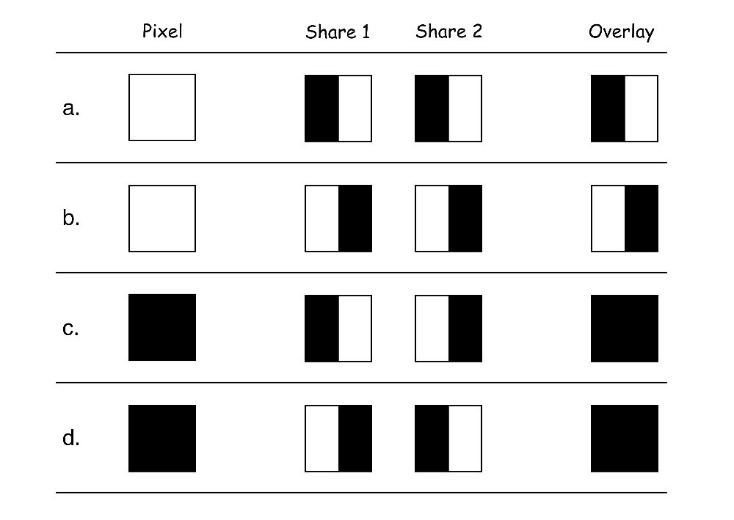
Visual Cryptography
How to share a pixel?
Suppose image is black and white
Then each pixel is either black or white
We split pixels as shown

Slide 39
Sharing a B&W Image
If pixel is white, randomly choose a or b for Alice’s/Bob’s shares
If pixel is black, randomly choose c or d
No information in one “share”

Slide 40

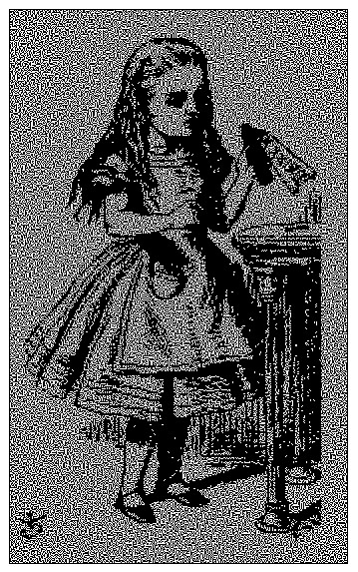
Visual Crypto Example
Alice’s share
Bob’s share
Overlaid shares

Slide 41
Visual Crypto
How does visual “crypto” compare to regular crypto?
In visual crypto, no key…
Or, maybe both images are the key?
With encryption, exhaustive search
Except for a one-time pad
Exhaustive search on visual crypto?
No exhaustive search is possible!

Slide 42
Visual Crypto
Visual crypto ⎯ no exhaustive search…
How does visual crypto compare to crypto?
Visual crypto is “information theoretically” secure ⎯ true of other secret sharing schemes
With regular encryption, goal is to make cryptanalysis computationally infeasible
Visual crypto an example of secret sharing
Not really a form of crypto, in the usual sense

Slide 43
Random Numbers in Cryptography

Slide 44
Random Numbers
Random numbers used to generate keys
Symmetric keys
RSA: Prime numbers
Diffie Hellman: secret values
Random numbers used for nonces
Sometimes a sequence is OK
But sometimes nonces must be random
Random numbers also used in simulations, statistics, etc.
Such numbers need to be “statistically” random

Slide 45
Random Numbers
Cryptographic random numbers must be statistically random and unpredictable
Suppose server generates symmetric keys…
Alice: K_{A}
Bob: K_{B}
Charlie: K_{C}
Dave: K_{D}
But, Alice, Bob, and Charlie don’t like Dave
Alice, Bob, and Charlie working together must not be able to determine K_{D}

Slide 46
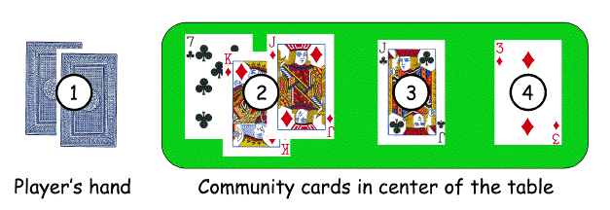
Non-random Random Numbers
Online version of Texas Hold ‘em Poker
ASF Software, Inc.
Random numbers used to shuffle the deck
Program did not produce a random shuffle
A serious problem or not?

Slide 47
Card Shuffle
There are 52! > 2²²⁵ possible shuffles
The poker program used “random” 32-bit integer to determine the shuffle
So, only 2³² distinct shuffles could occur
Code used Pascal pseudo-random number generator (PRNG): Randomize()
Seed value for PRNG was function of number of milliseconds since midnight
Less than 2²⁷ milliseconds in a day
So, less than 2²⁷ possible shuffles

Slide 48
Card Shuffle
Seed based on milliseconds since midnight
PRNG re-seeded with each shuffle
By synchronizing clock with server, number of shuffles that need to be tested < 2¹⁸
Could then test all 2¹⁸ in real time
Test each possible shuffle against “up” cards
Attacker knows every card after the first of five rounds of betting!

Slide 49
Poker Example
Poker program is an extreme example
But common PRNGs are predictable
Only a question of how many outputs must be observed before determining the sequence
Crypto random sequences not predictable
For example, keystream from RC4 cipher
But “seed” (or key) selection is still an issue!
How to generate initial random values?
Keys (and, in some cases, seed values)

Slide 50
What is Random?
True “randomness” hard to define
Entropy is a measure of randomness
Good sources of “true” randomness
Radioactive decay ⎯ radioactive computers are not too popular
Hardware devices ⎯ many good ones on the market
Lava lamp ⎯ relies on chaotic behavior

Slide 51
Randomness
Sources of randomness via software
Software is (hopefully) deterministic
So must rely on external “random” events
Mouse movements, keyboard dynamics, network activity, etc., etc.
Can get quality random bits by such methods
But quantity of bits is very limited
Bottom line: “The use of pseudo-random processes to generate secret quantities can result in pseudo-security”

Slide 52
Information Hiding

Slide 53
Information Hiding
Digital Watermarks
Example: Add “invisible” identifier to data
Defense against music or software piracy
Steganography
“Secret” communication channel
Similar to a covert channel (more on this later)
Example: Hide data in image or music file

Slide 54
Watermark
Add a “mark” to data
Visibility of watermarks
Invisible ⎯ Watermark is not obvious
Visible ⎯ Such as TOP SECRET
Robustness of watermarks
Robust ⎯ Readable even if attacked
Fragile ⎯ Damaged if attacked

Slide 55
Watermark Examples
Add robust invisible mark to digital music
If pirated music appears on Internet, can trace it back to original source of the leak
Add fragile invisible mark to audio file
If watermark is unreadable, recipient knows that audio has been tampered (integrity)
Combinations of several types are sometimes used
E.g., visible plus robust invisible watermarks

Slide 56
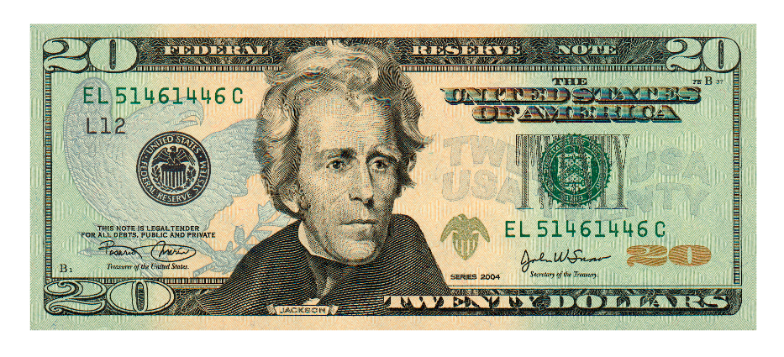
Watermark Example (1)
Non-digital watermark: U.S. currency
Image embedded in paper on rhs
Hold bill to light to see embedded info

Slide 57
Watermark Example (2)
Add invisible watermark to photo
Claimed that 1 inch² contains enough info to reconstruct entire photo
If photo is damaged, watermark can be used to reconstruct it!

Slide 58
Steganography
According to Herodotus (Greece 440 BC)
Shaved slave’s head
Wrote message on head
Let hair grow back
Send slave to deliver message
Shave slave’s head to expose message ⎯ warning of Persian invasion
Historically, steganography used more often than cryptography

Slide 59
Images and Steganography
Images use 24 bits for color: RGB
8 bits for red, 8 for green, 8 for blue
For example
0x7E 0x52 0x90 is this color
0xFE 0x52 0x90 is this color
While
0xAB 0x33 0xF0 is this color
0xAB 0x33 0xF1 is this color
Low-order bits don’t matter…

Slide 60
Images and Stego
Given an uncompressed image file…
For example, BMP format
…we can insert information into low-order RGB bits
Since low-order RGB bits don’t matter, result will be “invisible” to human eye
But, computer program can “see” the bits

Slide 61
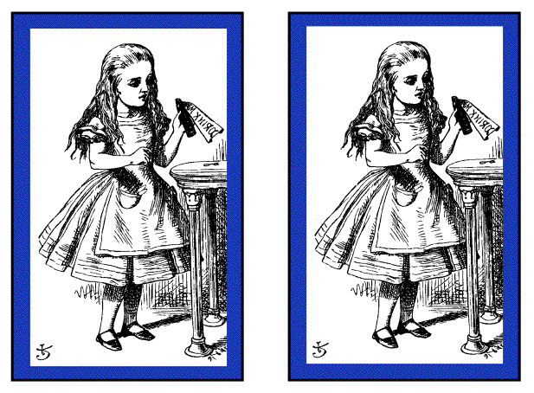
Stego Example 1
Left side: plain Alice image
Right side: Alice with entire Alice in Wonderland (pdf) “hidden” in the image

Slide 62
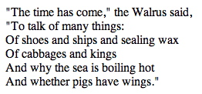
Non-Stego Example
Walrus.html in web browser
“View source” reveals:
<font color=#000000>"The time has come," the Walrus said,</font><br>
<font color=#000000>"To talk of many things: </font><br>
<font color=#000000>Of shoes and ships and sealing wax </font><br>
<font color=#000000>Of cabbages and kings </font><br>
<font color=#000000>And why the sea is boiling hot </font><br>
<font color=#000000>And whether pigs have wings." </font><br>

Slide 63
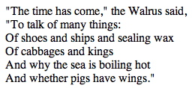
Stego Example 2
stegoWalrus.html in web browser
“View source” reveals:
<font color=#000101>"The time has come," the Walrus said,</font><br>
<font color=#000100>"To talk of many things: </font><br>
<font color=#010000>Of shoes and ships and sealing wax </font><br>
<font color=#010000>Of cabbages and kings </font><br>
<font color=#000000>And why the sea is boiling hot </font><br>
<font color=#010001>And whether pigs have wings." </font><br>
“Hidden” message: 011 010 100 100 000 101

Slide 64
Steganography
Some formats (e.g., image files) are more difficult than html for humans to read
But easy for computer programs to read…
Easy to hide info in unimportant bits
Easy to destroy info in unimportant bits
To be robust, must use important bits
But stored info must not damage data
Collusion attacks are another concern
Robust steganography is tricky!

Slide 65
Information Hiding: The Bottom Line
Not-so-easy to hide digital information
“Obvious” approach is not robust
Stirmark: tool to make most watermarks in images unreadable without damaging the image
Stego/watermarking active research topics
If information hiding is suspected
Attacker may be able to make information/watermark unreadable
Attacker may be able to read the information, given the original document (image, audio, etc.)

