Slide 1
CIS612 Information Security
Modular Arithmetic

Slide 2

Modulus
Modulus the reminder of a division.
13 mod 12 = 1 (because 13 = 12 × 1 + 1)
22 mod 4 = 2 (because 22 = 4 × 5 +2)
In a modulo m system, all the final results are in the range 0 .. m-1.
Example: a clock is a modulo 12 system.
(9 + 4) mod 12 = 13 mod 12 = 1

Slide 3
Modulus
16 mod 5 = 1 can be written as: 16 ≡ 1 (mod 5) -> read as 16 and 1 are congruent modulo 5
It is equivalent to: 1 ≡ 16 (mod 5)
16 mod 5 -> value
16 ≡ 1 (mod 5) -> statement

Slide 4
Modulus
If x ≡ y (mod m) and a ≡ b (mod m)
Then
x + a ≡ y + b (mod m)
x - a ≡ y - b (mod m)
x . a ≡ y . b (mod m)

Slide 5
Negative Numbers
-8 ≡ 2 (mod 5)
How to convert -8 mod 5 into a non-negative number?
Add -8 with a multiple of 5 until you get a non-negative number.
-8 mod 5 = (-8+10) mod 5 = 2 mod 5
In a modulo m system, for every negative integer, there exists an congruent non-negative integer.

Slide 6
Additive Inverse
-3 ≡ 2 (mod 5) -> 3 is the additive inverse of 2 modulo 5
0 ≡ 3+2 (mod 5)
0 ≡ 5 (mod 5)
-2 ≡ 3 (mod 5) -> 2 is the additive inverse of 3 modulo 5

Slide 7
Prime Numbers
A prime number is a positive integer which is not divisible by any positive integers other than itself and 1.
13 is a prime number.
21is not a prime number, because 7 | 21(read as 7 divides 21 or 21 is divisible by 7 or 7 is a factor of 21.
2 is the only even prime number.

Slide 8
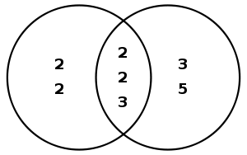
Greatest Common Divisor (gcd)
48 = 2 × 2 × 2 × 2 × 3
180 = 2 × 2 × 3 × 3 × 5
So, gcd(48, 180) = 2 × 2 × 3 = 12

Slide 9
Co-prime Numbers
Co-prime numbers are also called relatively prime numbers.
Two integers are co-prime if the gcd of them is 1. (i.e., there is no common factor > 1 for them.)
Eg. 21 and 26 are co-prime. gcd(21, 26) = 1
But, 21 and 14 are not co-prime because gcd(21, 14) = 7.

Slide 10
Multiplicative Inverse
a . b ≡ 1 (mod m)
b is the multiplicative inverse of a modulo m
a is the multiplicative inverse of b modulo m
Can be written as b⁻¹ ≡ a (mod m) and a⁻¹ ≡ b (mod m)
E.g.
7 × 4 ≡ 1 (mod 27)
7⁻¹ ≡ 4 (mod 27)
4⁻¹ ≡ 7 (mod 27)

Slide 11
Multiplicative Inverse
Multiplicative inverse of a exists in modulo m only if a and m are co-prime, i.e., gcd(a, m) = 1.
If the multiplicative inverse of a exists, it is unique (in modulo m).
To find multiplicative inverse of a modulo m (where a < m):
Brute force: try every number b ∈ {1 .. m-1} until you find the one that gives you a . b ≡ 1 (mod m)

Slide 12
Multiplicative Inverse
Brute Force Example:

Slide 13
Extended Euclidean Algorithm
Extended Euclidean Algorithm
Say we want to find: 23⁻¹ mod 120.

Slide 14
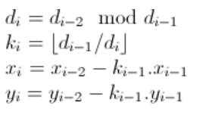
Extended Euclidean Algorithm
i | x | y | d | k
1 | 1 | 0 | 120
2 | 0 | 1 | 23 | 5
3 | 1 | -5 | 5 | 4
4 | -4 | 21 | 3 | 1
5 | 5 | -26 | 2 | 1
6 | -9 | 47 | 1 | 2
23⁻¹ ≡ 47 (mod 120)
Also,
120⁻¹ ≡ -9 (mod 23) (OR)
5⁻¹ ≡ 14 (mod 23)

Slide 15
Extended Euclidean Algorithm
Read the details in: http://en.wikipedia.org/wiki/ Extended_Euclidean_algorithm

Slide 16
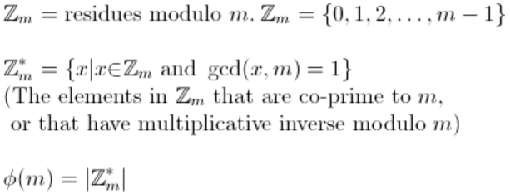
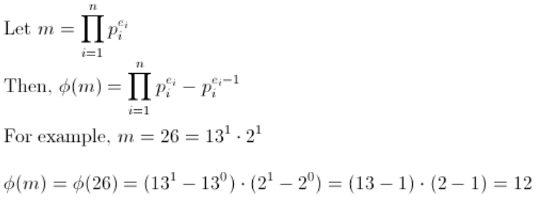
Euler’s Totient Function
0 1 2 3 4 5 6 7 8 9 10 11 12 13 14 15 16 17 18 19 20 21 22 23 24 25

Slide 17
Euler’s Theorem
m is positive integer.
ϕ is Euler’s totient function.
x ^{ϕ(m)} ≡ 1 (mod m)
for all integers x which are co-prime with m, i.e., gcd(x, m) = 1.

Slide 18
Fermat’s Theorem
p is a prime number.
x ^{p-1} ≡ 1 (mod p)
for all integers x which are co-prime with p, i.e., gcd(x, p) = 1.
It is a special case of Euler’s theorem.

