Slide 1
Optimal Power Allocation in Server Farms
Anshul Gandhi(CMU), Mor Harchol-Balter(CMU), Rajashri Das(IBM T.J. Watson),Charles Lefurgy(IBM Austin)
Presented By
Rahul Singh

Slide 2
Motivation
Cost of energy is rising
  a 300W high performance server requires more than $330 of energy cost per year
Server farms usually have a fixed peak power budget
  Are billed based on their peak power requirements
Peak power budges also determines the cooling and power delivery infrastructure costs

Slide 3
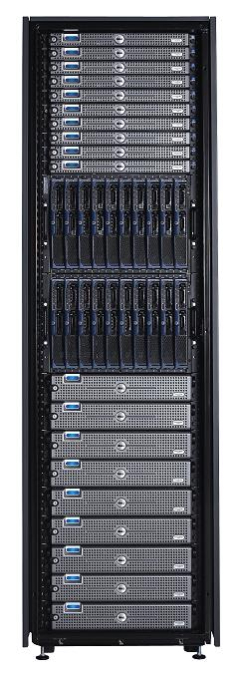
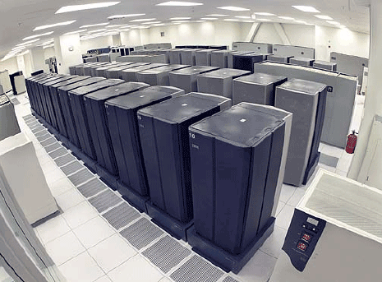
Goal
Get the best performance from the
power, P, that we have.
Data Center
P

Slide 4

Goal
How to split P to minimize mean response time?
P₁
P
P₂
P₃
Constraint:
P ≥ P₁ + P₂ + P₃

Slide 5
Why is this problem difficult ?
No single power allocation is optimal in all scenarios
Optimal power allocation depends on a lot of factors
  Arrival rate, open or closed workload, power-to-frequency curve, maximum power a server can use, minimum power a server can use

Slide 6
Contributions
Power → Speed
How power affects server speed for a single server
Speed → Response time
How response time of server farm depends on
individual server speeds
Optimal power allocation
Theorems and Experiments

Slide 7
Experimental Setup
14 IBM BladeCenter blade servers in a single chassis
  3 GHz dual-core Intel processors
  1 GB memory per blade
  Apache installed on each blade
Another blade server on same chassis is workload generator
  httperf, open configuration
  wbox, closed configuration

Slide 8
Speed scaling
Reduce power by reducing server speed
  Intel’s SpeedStep , AMD’s Cool ‘n’ Quiet

Slide 9
Speed Scaling mechanisms
DFS
  8 operating points
  12.5%,25%,37.5%,50%…..100% of maximum server frequency
DVFS
  4 operating points
  66.5%,77.7%…100%
DVFS + DFS
  11 operating points
  Apply DFS on the lowest performance state available in DVFS

Slide 10
Power consumption of a server
Baseline power: Pmin watts
  Minimum power consumed by a fully-utilized server over the entire range of frequencies
  The speed at which it consumes this power smin
Maximum power: Pmax Watts
  Maximum power consumed by a fully utilized server over the entire range of frequencies
  The speed at which it consumed this power smax
These values depend on the workload

Slide 11
Terms
Power
(Watts)
Pmax
Pmin
smin
smax_x0003_
Frequency
(GHz)

Slide 12
Power-to-Frequency curve
Apply a particular power cap on a server
Run jobs back-to-back to ensure the server is fully utilized
Shift between frequency states to ensure you don’t exceed the maximum power
System-level power, NOT just CPU

Slide 13



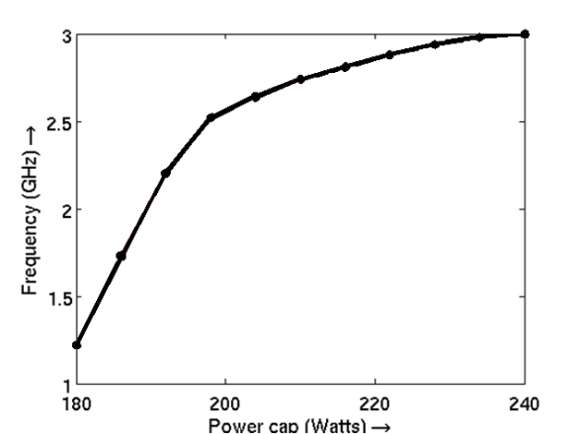
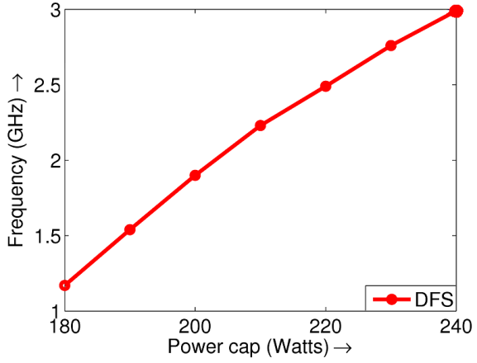
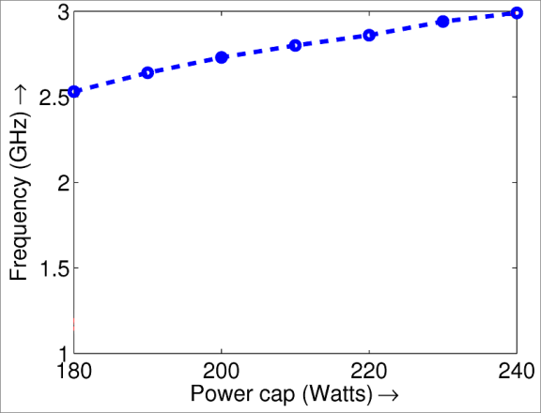


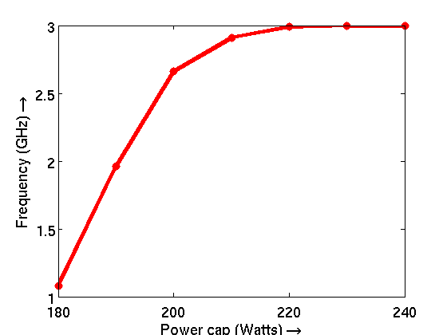
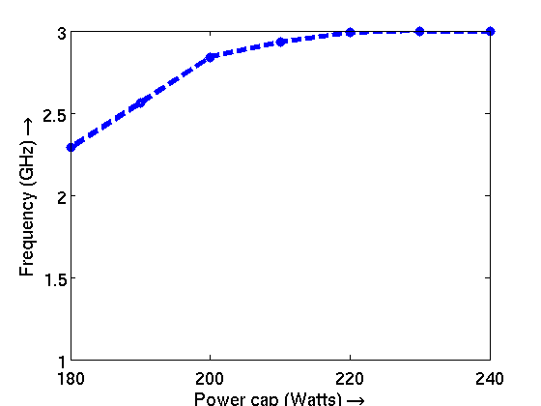
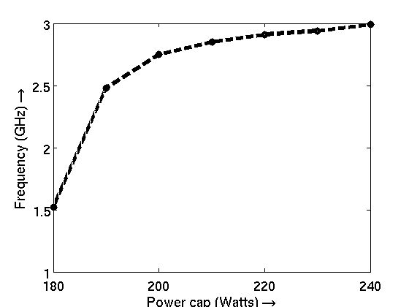
Our Experimental Results
How power affects server speed for a single server
DVFS
DVFS
+DFS
“LINPACK”
CPU BOUND
DFS
Power (Watts)
Power (Watts)
Power (Watts)
DVFS
DVFS
+DFS
DFS
“STREAM”
MEM BOUND
Power (Watts)
Power (Watts)
Power (Watts)

Slide 14
Power-to-frequency curve
We approximate the server speed s GHz as a function of the power allocated to it P Watts as :
  for DFS and DVFS
  for DVFS + DFS

Slide 15
Queuing model

Slide 16
Deriving Theorems
Corresponding to any vector of power allocation there exists an optimal workload allocation vector
Find the optimal power allocation for a k-server farm which minimizes the mean response time E[T] given the fixed peak power budget
  open loop configuration, closed loop configuration
Deriving optimal power allocation is hard, but computing E[T] given an allocation is easy
Assume that the total power P is such that
  P = Pmaxn = Pminm

Slide 17
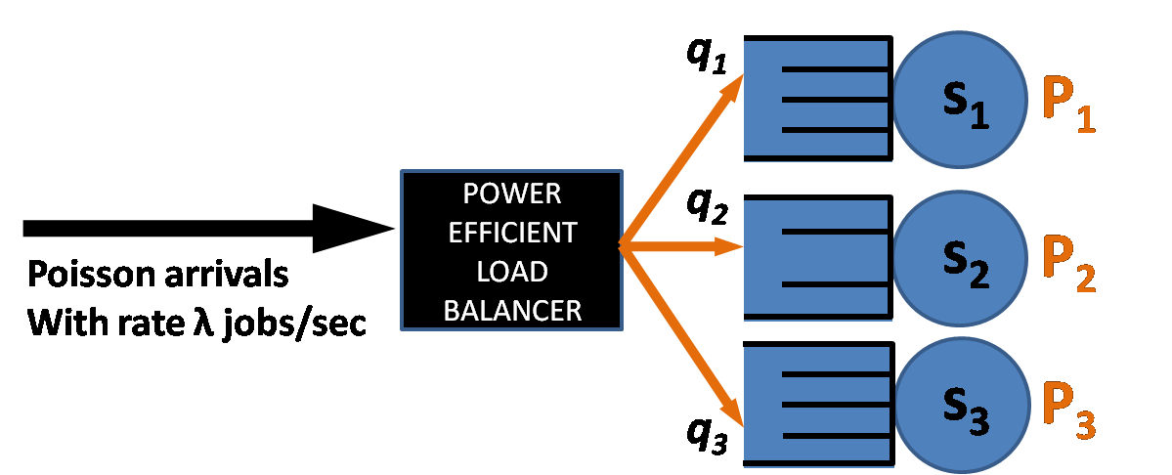
Response Time for Server Farm
Open loop configuration
(Mean Resp. Time)

Slide 18
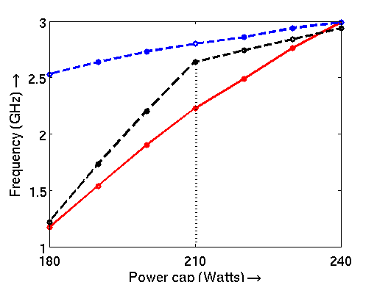

Power Allocation Choices
PowMin
DVFS
Ex: P = 720W PowMin = 4 X 180
DFS
DVFS
+DFS
PowMax
Ex: P = 720W PowMax = 3 X 240
180 210 240
PowMed
Ex: P = 720W PowMed = 3 X 210

Slide 19
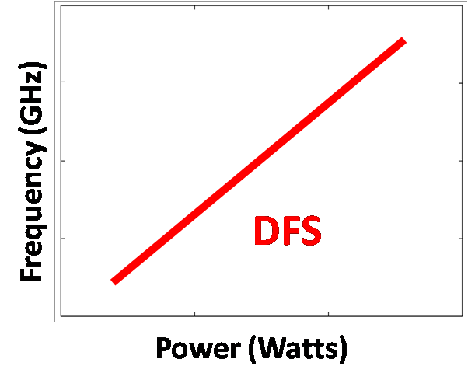
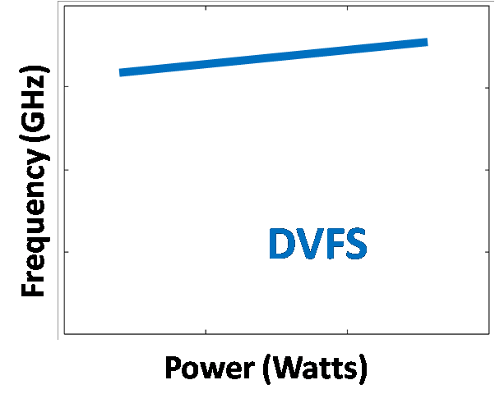
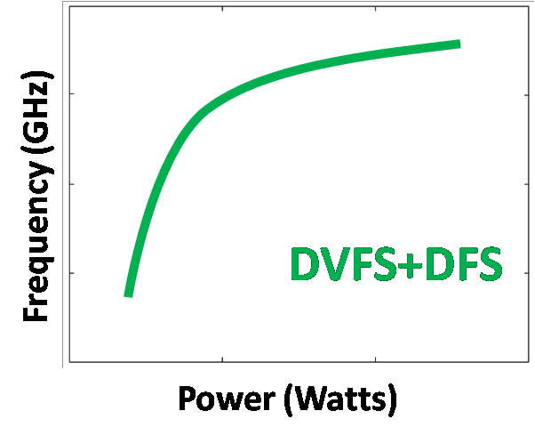
Power Allocation Theorems
INPUTS
System Parameters
OUTPUT
Optimal Power Allocation
linear
steep
linear
flat
cubic
PowMin
Speed scaling technology
Workload type
P_{min}, P_{max}
Arrival rate: (2 regimes)
Open vs. Closed workload configuration
THEOREMS
PowMax
λ < λ₀
λ ≥ λ₀
PowMed

Slide 20

Linear speed scaling
Open loop configuration
 | CPU bound “LINPACK” | Memory bound “STREAM”
DFS
DVFS
DVFS+DFS
DFS
Power (Watts)

Slide 21
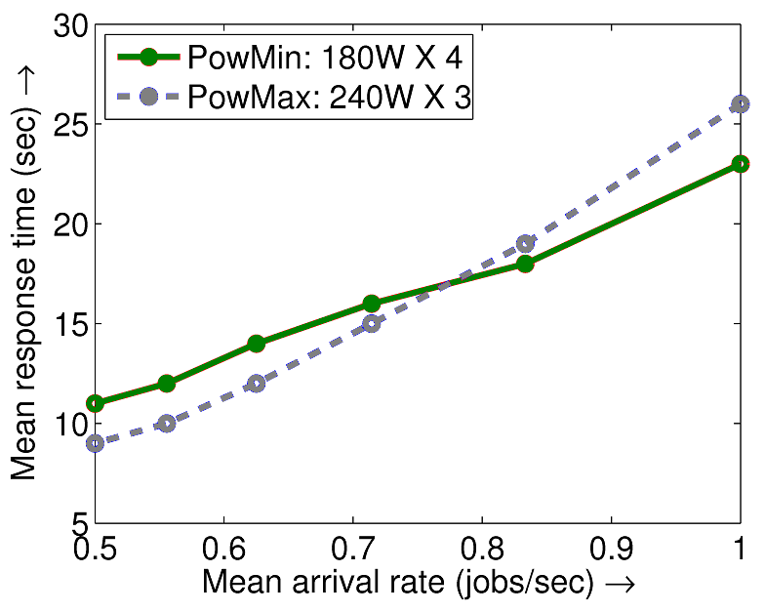
Linear, Open Loop
 | CPU bound “LINPACK” | Memory bound “STREAM”
DFS
DVFS
DVFS+DFS
DVFS
Power (Watts)

Slide 22
Intuition

Slide 23
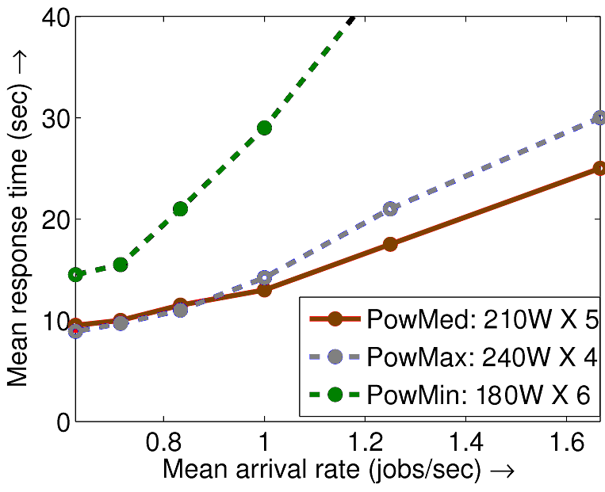

Cubic speed scaling, open loop
 | CPU bound “LINPACK” | Memory bound “STREAM”
DFS
DVFS
DVFS+DFS
DVFS
+DFS
Power (Watts)

Slide 24
Intuition
When arrival rate is low, few fast servers are optimal
For higher arrival rate, we allocate to each server the power that maximizes its frequency per watt
For cubic this value lies between Pmax and Pmin, hence Pmed is optimal

Slide 25
Closed Loop Configuration
We consider two asymptotic situations
  number of jobs N is very low, N is close to 1
  number of jobs N is very high, N > 10k, k is total number of servers

Slide 26
When N is very low
PowMax is optimal for all speed scaling
Very few jobs in the system, hence few fast servers are optimal

Slide 27
Very High N
Linear speed scaling
 | CPU bound “LINPACK” | Memory bound “STREAM”
DFS
DVFS
DVFS+DFS
DFS
Power (Watts)

Slide 28
Linear, Closed Loop
 | CPU bound “LINPACK” | Memory bound “STREAM”
DFS
DVFS
DVFS+DFS
DVFS
Power (Watts)

Slide 29
Intuition
For a closed queueing system with zero think time, E[T] is inversely proportional to the throughput
When N is high, all servers are busy, throughput is the sum of the server speeds
Under PowMin throughput is sminm
Under PowMax throughput is smaxn

Slide 30
Cubic Speed Scaling, Closed Loop
 | CPU bound “LINPACK” | Memory bound “STREAM”
DFS
DVFS
DVFS+DFS
DVFS
+DFS
Power (Watts)

Slide 31
Intuition
We want to maximize throughput
If we turn on a server at Pmin the increase in throughput is smin
For low values in sb this increase is small so PowMax is optimal
For high values of sb it pays to turn on a server
Once a server is on, there is an initial steep increase in frequency per watt in a cubic curve, so PowMed is optimal

Slide 32
What has not been handled ?
Arrival rates may vary over time
  Incorporate switching costs
Servers can be put into sleep states and be woken up quickly
Power management at the storage level and for individual components in the server

Slide 33
Thank you!

