Slide 1
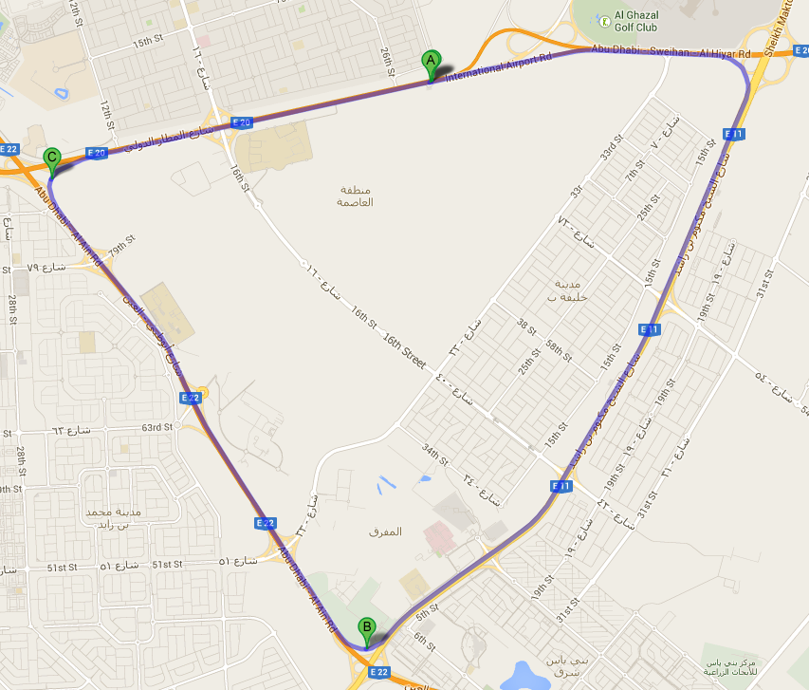
ROUTE 1
ROUTE 3
ROUTE 2

Slide 2
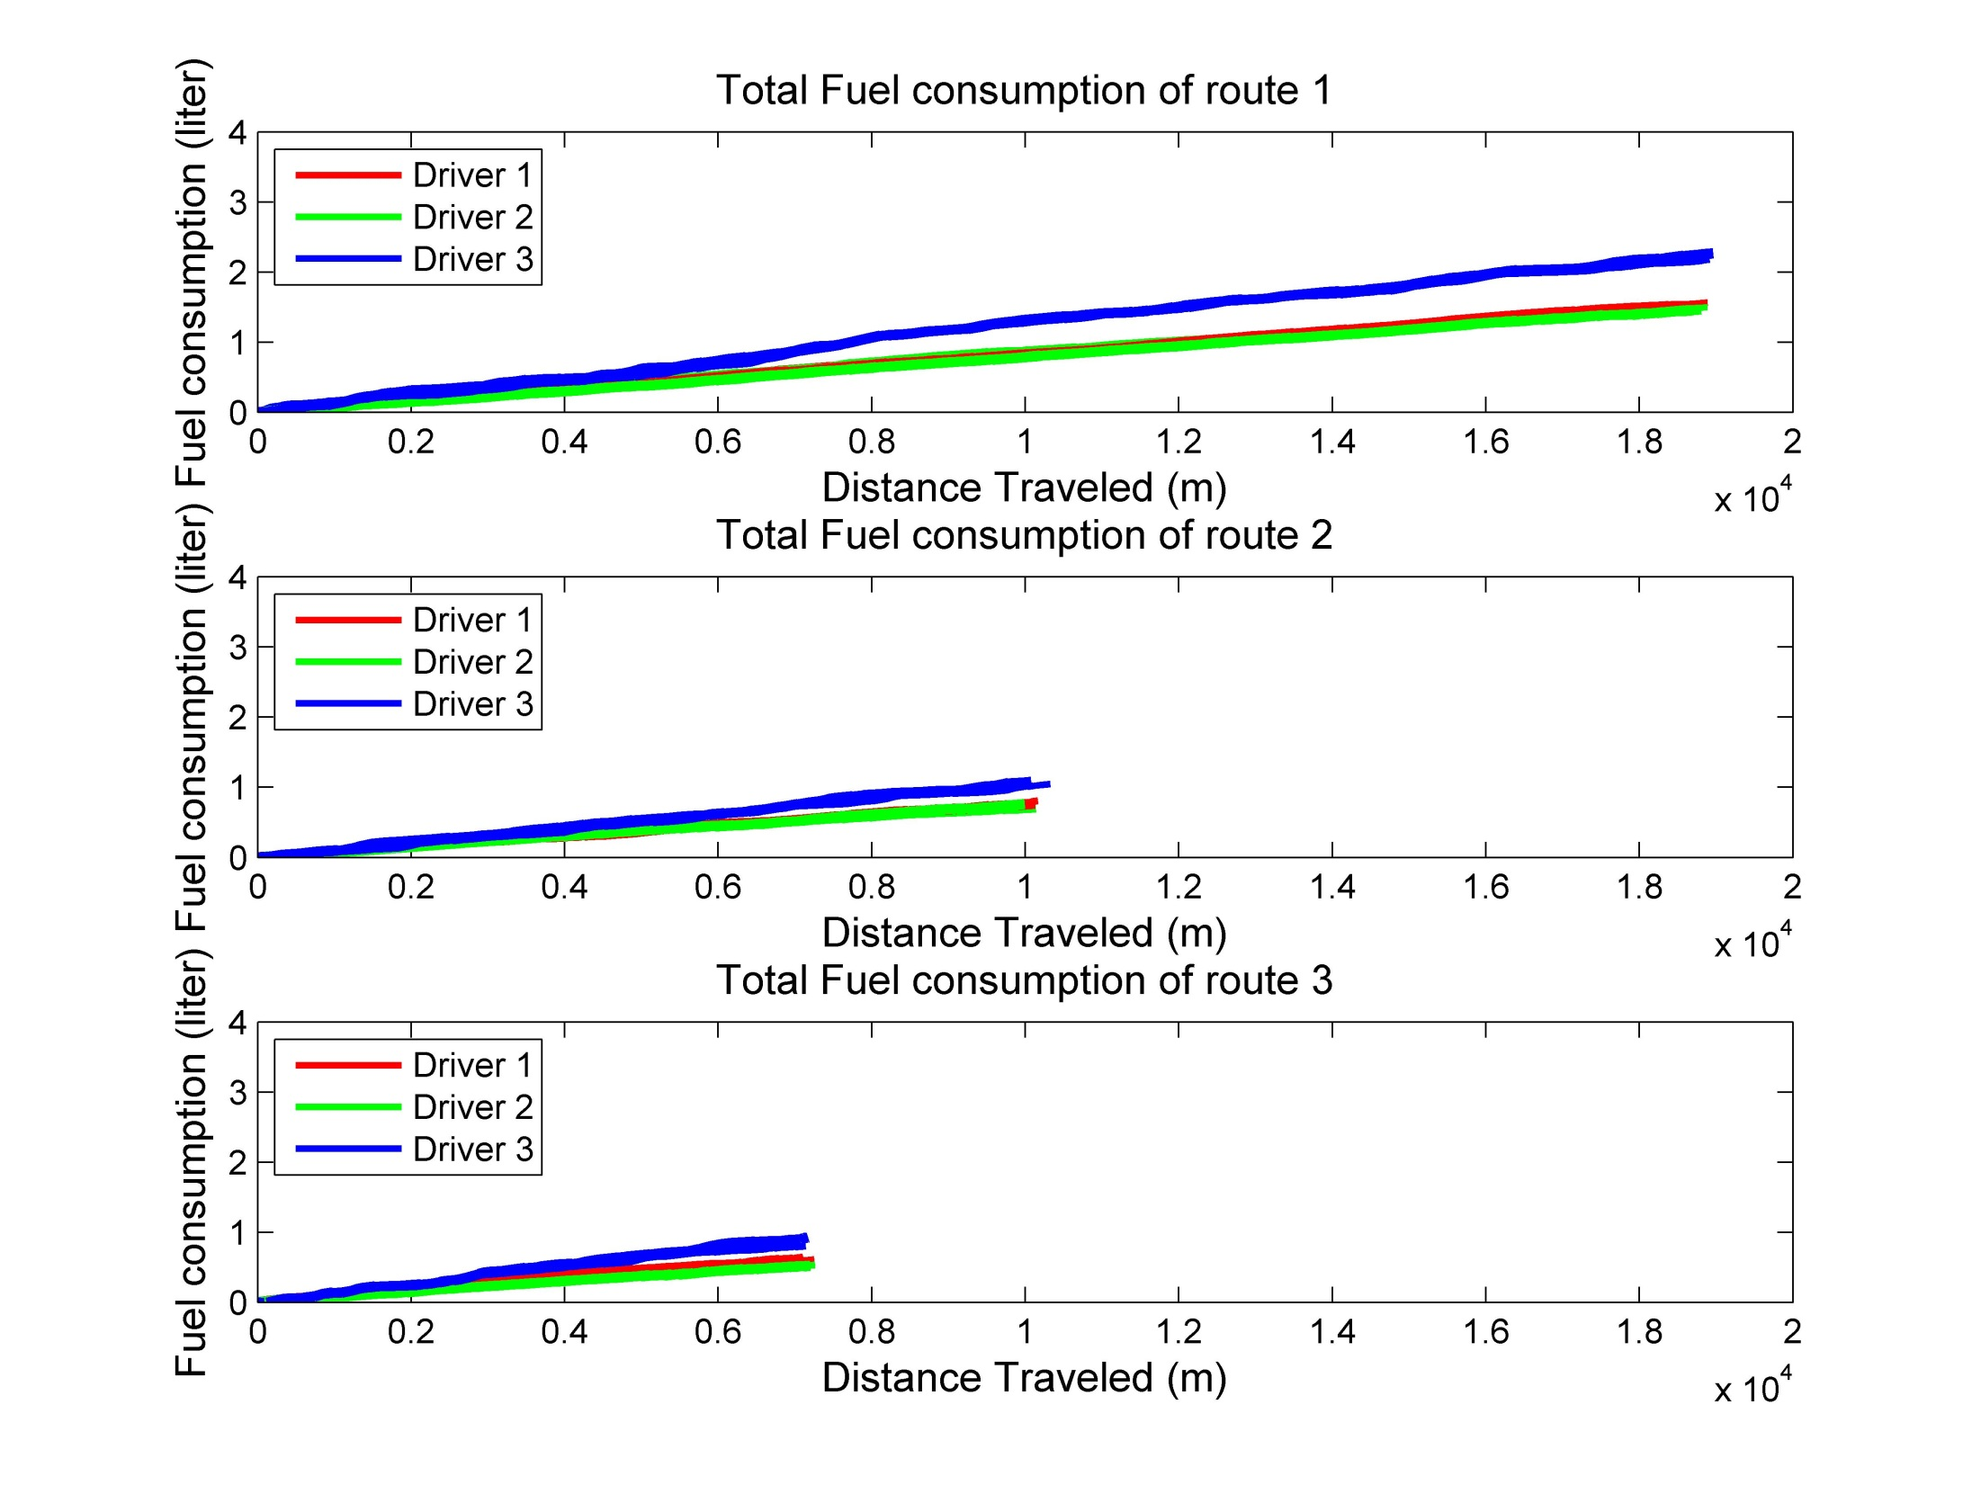

Slide 3
Using Linear Regression Model to estimate fuel consumption in different driving condition.

