Slide 1
MISSION
ZERO
5 MOZKOVÝCH BUŇEK
1/14

Slide 2
OBSAH
01
03
02
04
SVĚTLO
VLHKOST
TLAK
TEPLOTA
2/14

Slide 3
SVĚTLO
THERMAL ENERGY
ELECTRICAL ENERGY
PHYSICO-CHEMICAL
Despite being red, Mars is actually a cold place full of iron oxide dust
Venus has a beautiful name and is the second planet from the Sun
Neptune is the farthest planet from the Sun. It’s really cold there
3/14

Slide 4
TLAK
H2O
O2
Neptune is the farthest planet from the Sun
Despite being red, Mars is a cold place
CO2
N2
Venus has a beautiful name, but it’s very hot
Saturn is the ringed planet and a gas giant
4/14

Slide 5
VLHKOST
Do you know what helps you make your point clear? Lists like this one:
● They’re simple
● You can organize your ideas clearly
● You’ll never forget to buy milk!
And the most important thing: the audience won’t miss the point of your presentation
5/14

Slide 6
TEPLOTA
You can give a brief description of the topic you want to talk about here. For example, if you want to talk about Mercury, you can say that it’s the smallest planet in the entire Solar System
6/14

Slide 7
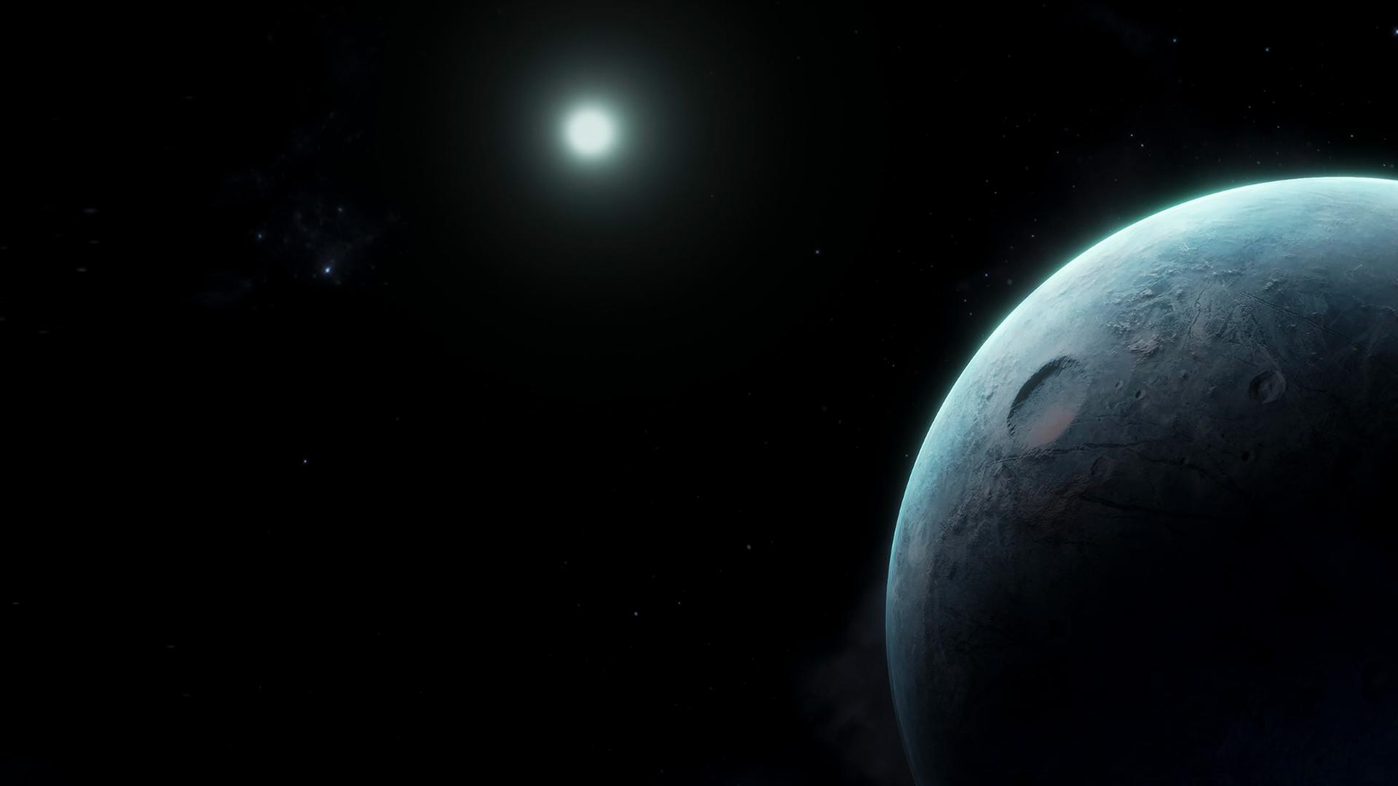
vysvětlivky
7/14

Slide 8
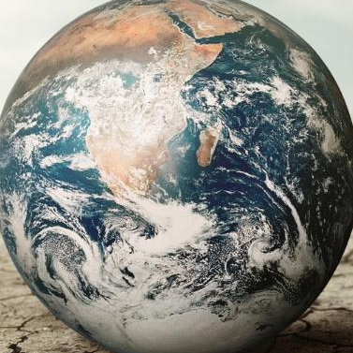
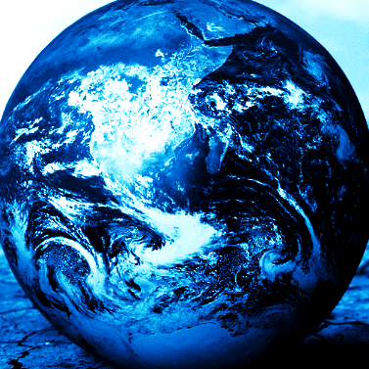
MISSION
SPACE LAB
5 MOZKOVÝCH BUNĚK
8/14

Slide 9
OBSAH
SLIDE 1
SLIDE 3
01
02
03
04
SLIDE 2
SLIDE 4
9/14

Slide 10
9h 55m 23s
333,000
386,000 km
Jupiter's rotation period
The Sun’s mass compared to Earth’s
Distance between Earth and the Moon
10/14

Slide 11
FUNCTIONS OF THE ATMOSPHERE
ATMOSPHERIC FRICTION
CONSTANT VELOCITY
BIOGEOCHEMICAL CYCLES
Despite being red, Mars is a cold place
Neptune is the farthest planet from the Sun
Mercury is the closest planet to the Sun
SOLAR RADIATION FILTER
GREENHOUSE EFFECT
Saturn is the ringed planet and a gas giant
Venus has a beautiful name, but it’s very hot
11/14

Slide 12
12/14
“This is a quote, words full of wisdom that someone important said and can make the reader get inspired.”
—SOMEONE FAMOUS

Slide 13
WHAT IS IN THE EARTH'S ATMOSPHERE?
Guiding you from the object, identify in which earth's atmospheric layer it is located
PASSENGER PLANE
RADIOSONDE
Write the answer here
Write the answer here
METEORS
SATELLITE
Write the answer here
Write the answer here
13/14

Slide 14
DĚKUJEME ZA POZORNOST
14/14

Slide 15
THANKS!

Slide 16
WHOA!
This can be the part of the presentation where you introduce yourself, write your email,your phone number…

Slide 17
01
INTRODUCTION
You can enter a subtitle here if you need it

Slide 18
INTRODUCTION
You can give a brief description of the topic you want to talk about here. For example, if you want to talk about Mercury, you can say that it’s the smallest planet in the entire Solar System

Slide 19
02
ATMOSPHERE CONCEPT
You can enter a subtitle here if you need it

Slide 20
ATMOSPHERE CONCEPT
MARS
VENUS
Despite being red, Mars is a cold place, not hot. It’s full of iron oxide dust
Venus has a beautiful name and is the second planet from the Sun. It’s terribly hot

Slide 21
787,402 in
is the distance between the troposphere and the surface of Earth and continues an approximate height of 40 to 50 km to the atmosphere

Slide 22
THIS IS A MAP
NEPTUNE
Neptune is the farthest planet from the Sun
VENUS
Venus has a beautiful name, but it’s very hot
SATURN
Saturn is the ringed planet and a gas giant

Slide 23
LAYERS OF THE ATMOSPHERE
EXOSPHERE
Neptune is the farthest planet from the Sun
THERMOSPHERE
Saturn is the ringed planet and a gas giant
MESOSPHERE
Venus has a beautiful name, but it’s very hot
STRATOSPHERE
Jupiter is the biggest planet of them all
TROPOSPHERE
Mercury is the smallest planet of them all

Slide 24
9h 55m 23s
333,000
386,000 km
Jupiter's rotation period
The Sun’s mass compared to Earth’s
Distance between Earth and the Moon

Slide 25
DYNAMICS OF THE ATMOSPHERE
THERMAL ENERGY
ELECTRICAL ENERGY
PHYSICO-CHEMICAL
Despite being red, Mars is actually a cold place full of iron oxide dust
Venus has a beautiful name and is the second planet from the Sun
Neptune is the farthest planet from the Sun. It’s really cold there

Slide 26
“This is a quote, words full of wisdom that someone important said and can make the reader get inspired.”
—SOMEONE FAMOUS

Slide 27
PERCENTAGES OF GASES IN THE ATMOSPHERE
21%
78%
0.5%
0.5%
OXIGEN
NITROGEN
CARBON DIOXIDE
ARGON
Mars is actually a cold place
Venus has a beautiful name
Saturn is the ringed planet
Jupiter is the biggest planet

Slide 28
03
LAYERS OF THE ATMOSPHERE
You can enter a subtitle here if you need it

Slide 29
LAYERS OF EARTH'S ATMOSPHERE
TROPOSPHERE
STRATOSPHERE
OZONOSPHERE
Neptune is the farthest planet from the Sun
Despite being red, Mars is a cold place
Venus has a beautiful name, but it’s very hot
MESOSPHERE
THERMOSPHERE
EXOSPHERE
Saturn is a gas giant with several rings
Jupiter is the biggest planet in the Solar System
Mercury is the closest planet to the Sun

Slide 30
EVOLUTION OF THE ATMOSPHERE
SOURCE
MICROBIOLOGICAL
Mercury is the closest planet to the Sun
Despite being red, Mars is a cold place
PREBIOTIC STAGE
BIOLOGICAL STAGE
Venus has a beautiful name, but it’s very hot
Saturn is the ringed planet and a gas giant

Slide 31
A PICTURE IS WORTH A THOUSAND WORDS

Slide 32
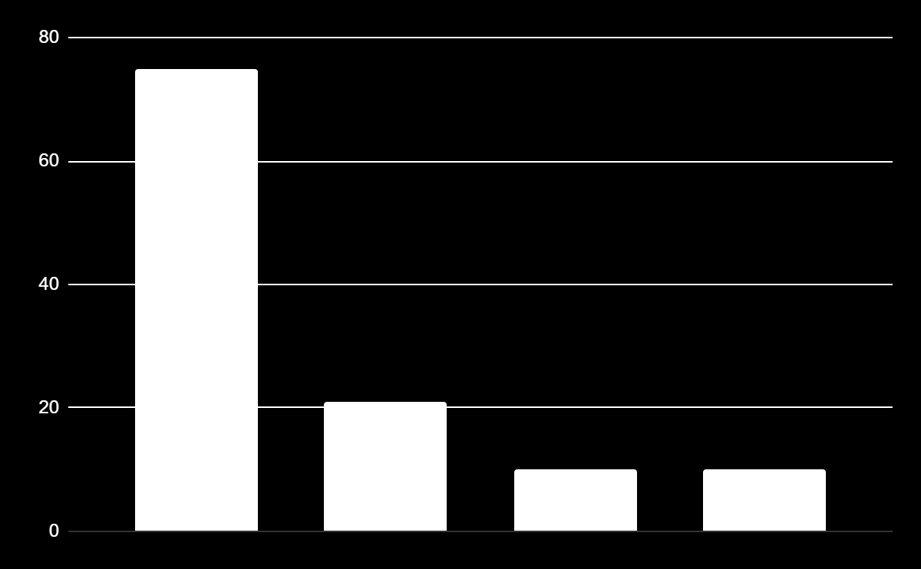
ATMOSPHERIC COMPOSITION
N2 - 78%
21% - O2
Neptune is the farthest planet from the Sun
Despite being red, Mars is a cold place
0.5% - AR
0.5% - OTHER
Venus has a beautiful name, but it’s very hot
Saturn is the ringed planet and a gas giant
N2
O2
AR
OTHER
Follow the link in the graph to modify its data and then paste the new one here. For more info, click here

Slide 33
GASES THAT ARE ON THE EARTH'S ATMOSPHERE
H2O
O2
Neptune is the farthest planet from the Sun
Despite being red, Mars is a cold place
CO2
N2
Venus has a beautiful name, but it’s very hot
Saturn is the ringed planet and a gas giant

Slide 34
DISTANCE BETWEEN LAYERS
1.
TROPOSPHERE
12 KM (7 MI)
2
2.
STRATOSPHERE
49 KM (30 MI)
3
3.
MESOSPHERE
1
85 KM (53 MI)
4.
THERMOSPHERE
700 KM (435 MI)
4
5.
EXOSPHERE
700+ KM (500+ MI)
5

Slide 35
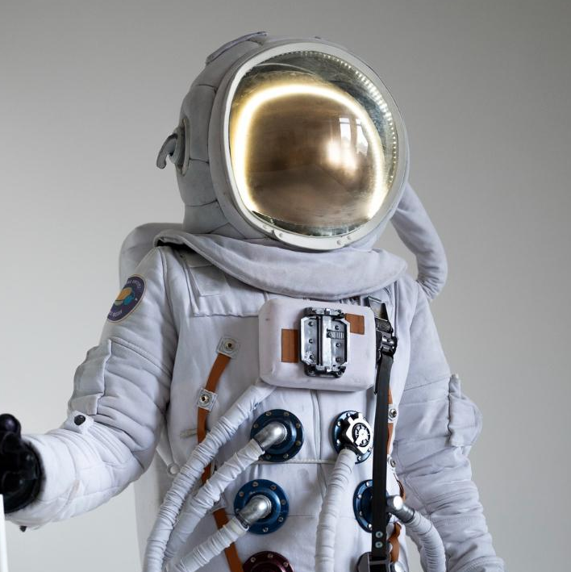
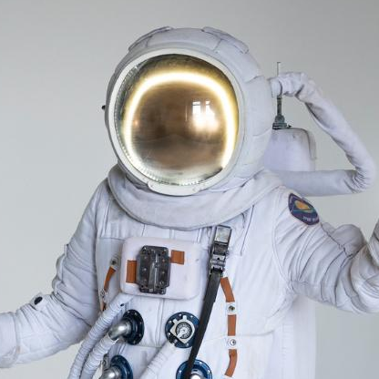
OUR TEAM
JOHN JAMES
LAURA PATTERSON
You can speak a bit about this person here
You can speak a bit about this person here

Slide 36
04
EXERCISES
You can enter a subtitle here if you need it

Slide 37
SCIENTIFIC CURIOSITIES ABOUT THE ATMOSPHERE
Do you know what helps you make your point clear? Lists like this one:
● They’re simple
● You can organize your ideas clearly
● You’ll never forget to buy milk!
And the most important thing: the audience won’t miss the point of your presentation

Slide 38
STRUCTURE OF THE ATMOSPHERE
LAYERS | HEIGHT (KM) | THICKNESS (KM) | TEMPERATURE (ºC) | OTHERS
TROPOSPHERE | 10 | 10 | 15 -55 | 90% air
STRATOSPHERE | 50 | 40 | 55 - 17 | Ozone rich zone
MESOSPHERE | 80 | 30 | 17 - 100 | Radiation is not absorbed
THERMOSPHERE | 500 | 420 | 100 or more | Shooting stars and auroras

Slide 39
WHAT IS IN THE EARTH'S ATMOSPHERE?
Guiding you from the object, identify in which earth's atmospheric layer it is located
PASSENGER PLANE
RADIOSONDE
Write the answer here
Write the answer here
METEORS
SATELLITE
Write the answer here
Write the answer here

Slide 40
FUNCTIONS OF THE ATMOSPHERE
ATMOSPHERIC FRICTION
CONSTANT VELOCITY
BIOGEOCHEMICAL CYCLES
Despite being red, Mars is a cold place
Neptune is the farthest planet from the Sun
Mercury is the closest planet to the Sun
SOLAR RADIATION FILTER
GREENHOUSE EFFECT
Saturn is the ringed planet and a gas giant
Venus has a beautiful name, but it’s very hot

Slide 41
STUDY OF EARTH'S ATMOSPHERE
Match the gas in column A with the correct percentage found in the atmosphere in column B
COLUMN A
COLUMN B
Oxigen
A.78%
Water vapor
B.0.4%
Nitrogen
C.21%
Carbon dioxide
D.50%

Slide 42
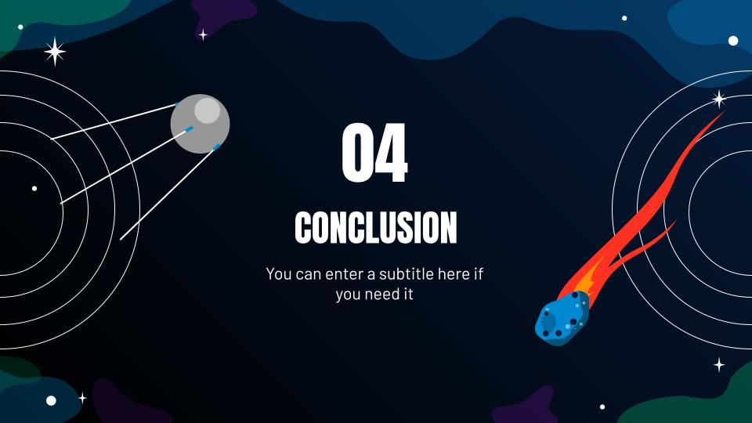
SMARTPHONE
You can replace the image on the screen with your own work. Just delete this one and add yours

Slide 43
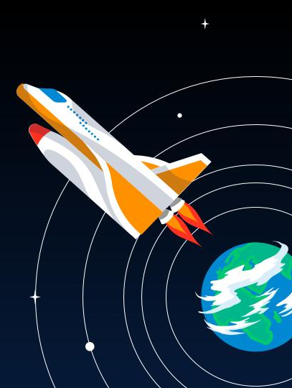
TABLET APP
You can replace the image on the screen with your own work. Just delete this one and add yours

Slide 44
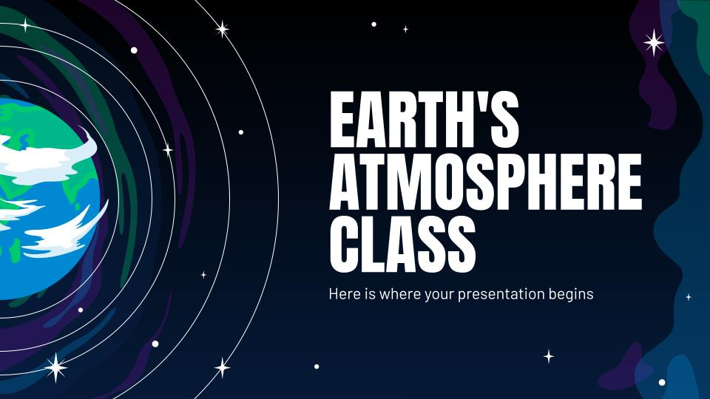
LAPTOP MOCKUP
You can replace the image on the screen with your own work. Just delete this one and add yours

Slide 45
THANKS!
Does anyone have any questions?
addyouremail@freepik.com
+91 620 421 838
yourcompany.com
Please keep this slide for attribution

Slide 46
ALTERNATIVE RESOURCES

Slide 47
SPACE FLAT ICON PACK

Slide 48
Fonts & colors used
This presentation has been made using the following fonts:
Anton
(https://fonts.google.com/specimen/Anton)
Barlow
(https://fonts.google.com/specimen/Barlow)
#ffffffff
#979797
#000000
#061a38
#052e3a
#0088d3
#00c970
#740fa3
#ff3121
#ff9000

