Slide 1


Sentry h Ship with Confidence Monitor, Fix, and Improve

Slide 2
About me
Swiss Native from the Winterthur Region
25 Years old
Bachelor’s Degree in Computer Science
6 Years of work experience at Profile GmbH
6 Years of expertise in Omnis Development

Slide 3
About Profile GmbH
Founded 1994
Developing with Omnis since version 3+
Currently working with Omnis 10
Main product is ‚Helper‘ a ERP-software for prepress-companies
Evolution to a workflow solution for large-volume-scanning, like generating PDFs, branding pages, adding bookmarks

Slide 4
About this session
Brief introduction into Sentry
Setup Sentry account
Setup test library
Explore various errors and the Sentry UI
Close look at the source code
Releases; How to automatically generate them from Omnis VCS
Open discussion

Slide 5

What is Sentry?
Sentry.io is a powerful, open-source monitoring and error-tracking platform
Comprehensive visibility into the health of your application (Releases)
Live Error-Reporting of any application in production
Helps to debug all kind of errors with ease
Helps to find “hidden” bugs
Don’t expect your customers to report bugs correctly!
https://sentry.io/welcome/
Notes:
Sentry.io is a powerful, open-source monitoring and error-tracking platform designed to help developers identify and resolve application issues in real time.
It provides comprehensive visibility into the health of your application by tracking errors, performance issues, and even user feedback.
Sentry’s goal is to bridge the gap between code and customer experience, allowing developers to catch and resolve issues before they impact users.

Slide 6
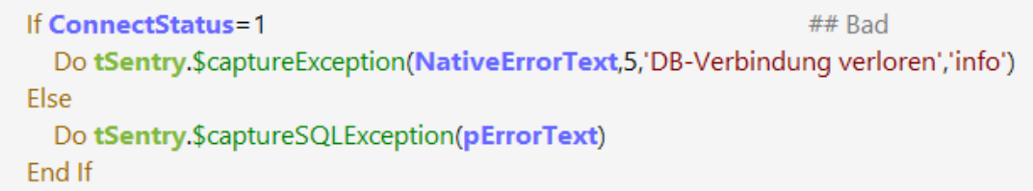
What is Sentry?
Sentry is no magic solution / tool
It's only as effective as the effort you put into implementing it
It shines when implemented in super classes and super error handlers
TSuper.$sqlerror

Slide 7
Example Usecases
Capture SQL-Exceptions
Warning when deprecated code is run
Generate log messages for virtually any event or action
Example: Get Notified when a customer uses more licenses than he pays for

Slide 8
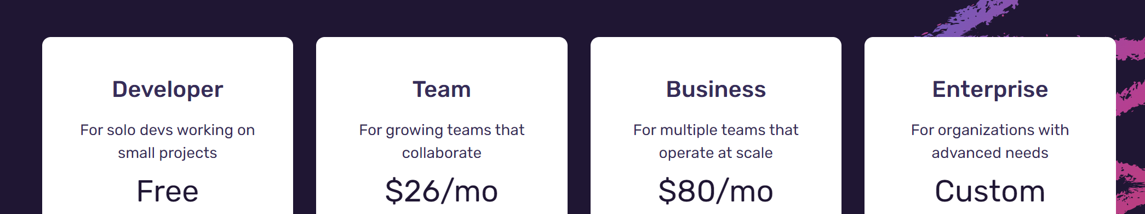
Pricing
5k errors vs. 50k errors per Month
1 User vs. multiple Users
30-day data retention vs. 90-day data retention
No API access vs. Full API access
https://sentry.io/pricing/

Slide 9
No Money? No Problem!
Sentry is Open Source so feel free to self host!
Installation via Docker Compose
Resource intensive (4 Cores, 16 GB RAM)
Multiple containers running
Unlimited retention days
https://develop.sentry.dev/self-hosted/

Slide 10
Setup Sentry Account
Now it’s your turn!
Create your own Sentry account at
https://sentry.io/signup/

Slide 11
Download the Testlibrary
https://github.com/Profile-GmbH/Sentry

Slide 12

Report an Error
We can report an error to Sentry by sending a JSON payload through an HTTP POST request
OSentryHL
OSentry
$captureSQLException()
$captureDeprecatedCodeException()
$captureLog()
An Adapter object as abstraction layer
$captureException(param1,…,param7)
Gathers stack information
Gathers variable information
Generates JSON
Sends JSON to Sentry

Slide 13
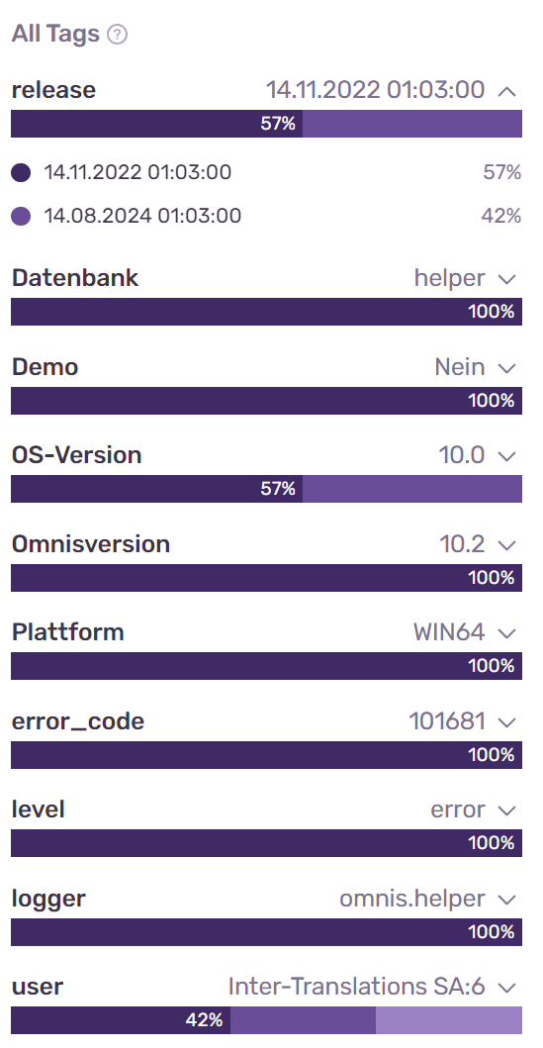
Terminology
Tags
Used for short bits of information
You can filter issues by tags

Slide 14
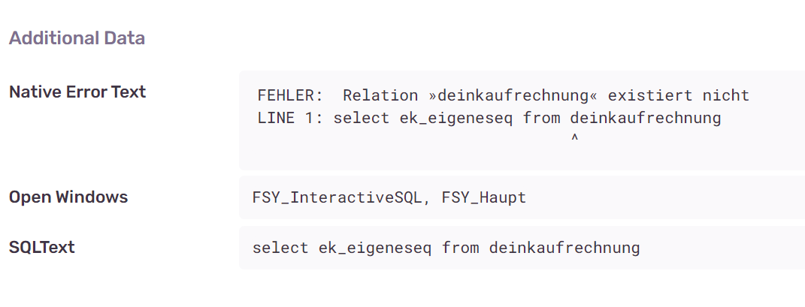
Terminology
Extras
Used for longer bits of information

Slide 15
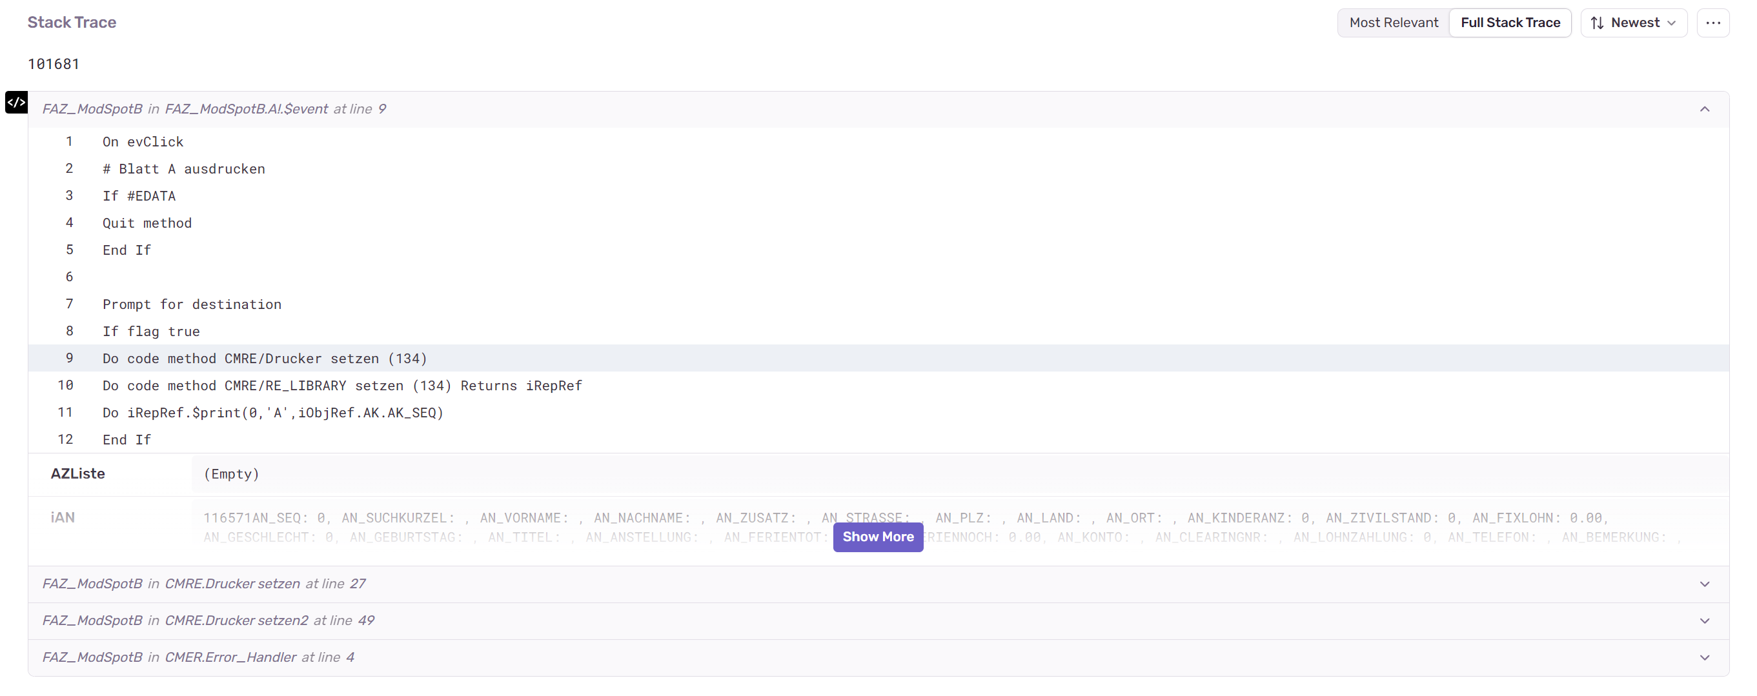
Terminology
StackTraceInterface
Sends all Stacktrace information to Sentry
Includes all instance and parameter variables

Slide 16
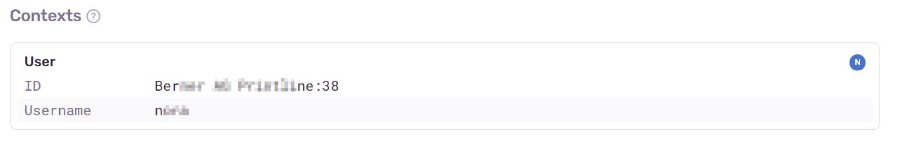
Terminology
UserInterface
Creates an extra UI element for the customer information

Slide 17
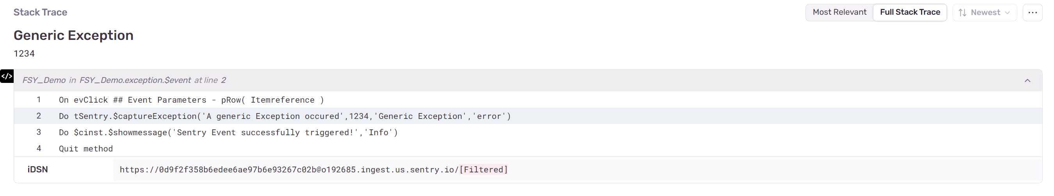
Terminology
ExceptionInterface
Container which can display Exceptionname and error code
It is the parent of the StackTraceInterface

Slide 18
Thanks for joining me!
Feel free to contact me if you have any issues or questions when using Sentry!
silvan.baach@profile.ch
T +41 52 213 63 33

