Slide 1

EQ Automation Forum Meet 16-05-2019
By:
Bakkiya
Suresh.N
Dilna
Divya

Slide 2
Agenda
1.Discussion on below topics.
Page factory
Utility
Jira
2. Showcase on Page factory.
3. Q & A
4. Feedback and Next session plan

Slide 3
1.Page Factory
Introduction: The PageFactory Class in Selenium is an extension to the Page Object design pattern. It is used to initialize the elements of the Page Object or instantiate the Page Objects itself. ... It is used to initialize elements of a Page class without having to use 'FindElement' or 'FindElements'.

Slide 4


The PageFactory relies on using sensible defaults, means the name of the field in the Java class is assumed to be the “id” or “name” of the element on the HTML page. For example:

Slide 5
2. Utility The utilities are the functions that perform generic actions across the automation execution, for example, objClick. Utility class (TestUtil.java) stores and handles the functions (The code which is repetitive in nature such as waits, actions, capturing screenshots, accessing excels, sending email etc.,) which can be commonly used across the entire framework. The reason behind creating utility class is to achieve reusability. This class extends the TestBase class to inherit the properties of TestBase in TestUtil.

Slide 6
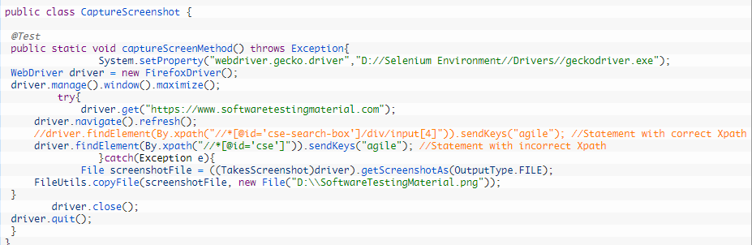
Sample code for Screenshots:

Slide 7
Sample utility functions
Copy ( )
Readlines ( )
Write ( )
CopyFile ( )
Split ( )
GetName ( )

Slide 8
3.Jira
JIRA is a tool developed by Australian Company Atlassian. It is used for bug tracking, issue tracking, and project management.
Reports can view(Pie chart)

Slide 9
Issue Attributes
Issue Attributes encompasses
Statuses
Resolutions
Priorities
Statuses: Different statuses are used to indicate the progress of a project like
To do,
InProgress,
Open,
Closed,
ReOpened, and
Resolved. Likewise, you have resolutions and priorities, in resolution it again tells about the progress of issue like Fixed, Won't fix, Duplicate, Incomplete, Cannot reproduce, Done also you can set the priorities of the issue whether an issue is critical, major, minor, blocker and Trivial.

Slide 10
System Administration
Audit Log
Issue Linking
Mail in JIRA
Events
Watch list
Issue Collectors

Slide 11
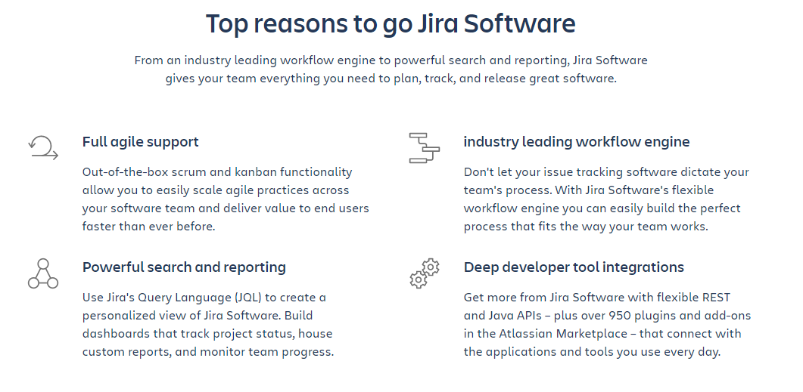

Slide 12
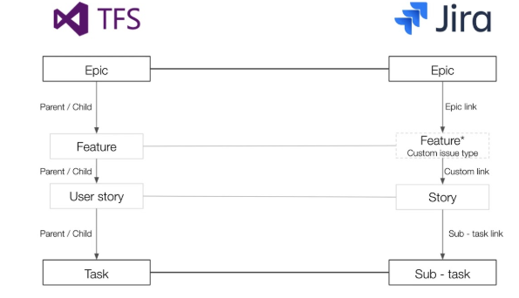
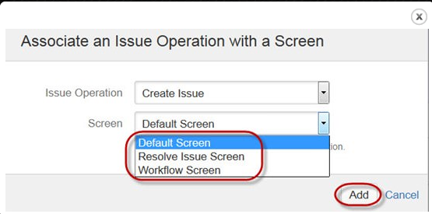

Slide 13
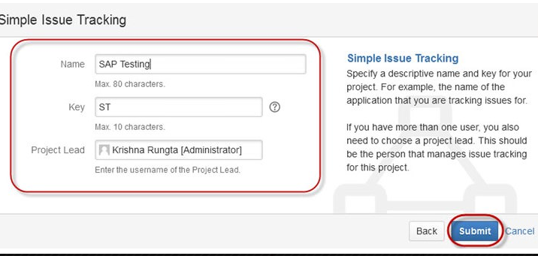
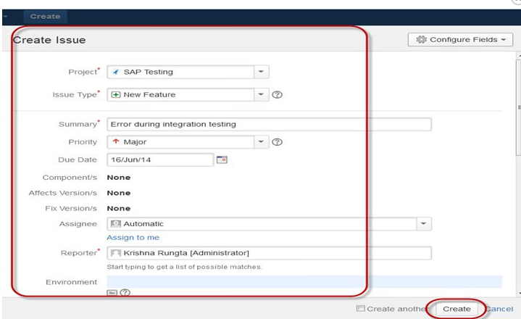


Slide 14
Showcase on Page Factory
Click here

Slide 15


Slide 16
Thank you

