Slide 1
EQ-Automation Forum Meet 27-06-2019
Presented By:
Bakkiya
Suresh.N
Dilna
Divya

Slide 2
Agenda
1.Discussion on below topics.
Jenkins
Maven
2. Showcase on Jenkins and Maven
3. Q & A

Slide 3

1.Jenkins
Introduction:
Jenkins is an open source automation server written in Java. Jenkins helps to automate the non-human part of the software development process, with continuous integration and facilitating technical aspects of continuous delivery. It is a server-based system that runs in servlet containers such as Apache Tomcat.

Slide 4
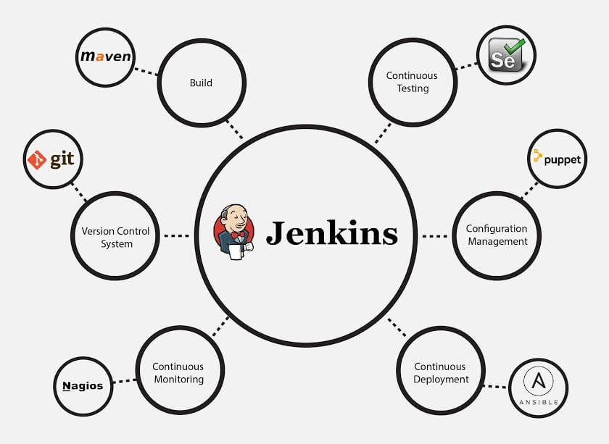

Slide 5
Requirements
Server to Host Jenkins
Basic knowledge of:
Linux Command line,
Git (version-control system).

Slide 6
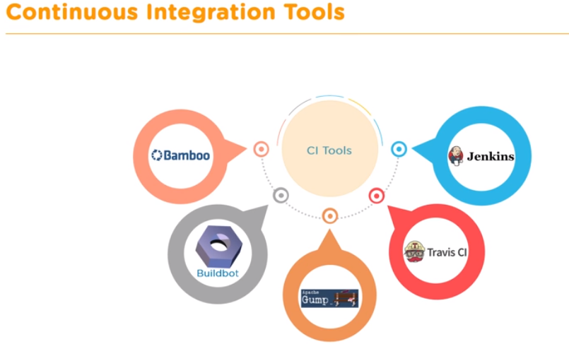

Slide 7
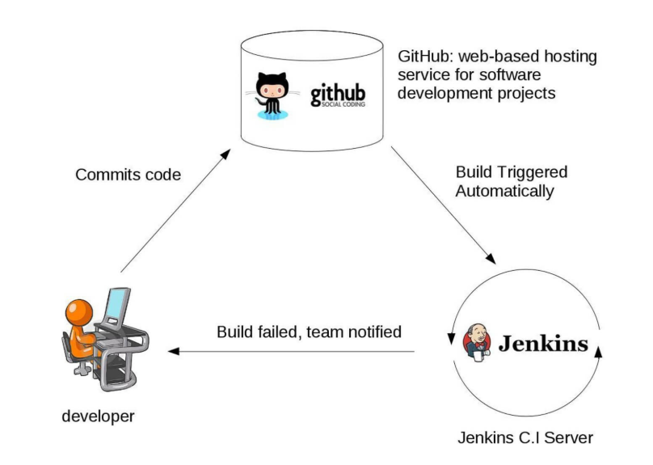
Automation Engineer/Developer

Slide 8
Advantages
1.Open source—Taking feed back from the cutomer for improment.
2.It’s support 320+ plugins
3.cloud based support.
4. Jenkins became popular is that it was created by a developer for developers.

Slide 9
Disadvantages
UI is not user friendly
Some skills as server administrator to monitor its activity.
Difficulty in installing and configuring Jenkins

Slide 10
2. Maven
What is?
Maven is an automation and management tool developed by Apache Software Foundation.
It is written in Java Language and used to build and manage projects written in C#, Ruby, Scala, and other languages. It allows the developer to create projects using Project Object Model and plugins.
It helps to build projects, dependency, and documentation.
Maven is also able to build any number of projects into desired output such as jar, war, metadata.

Slide 11
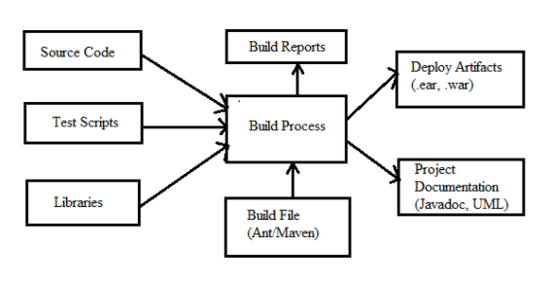
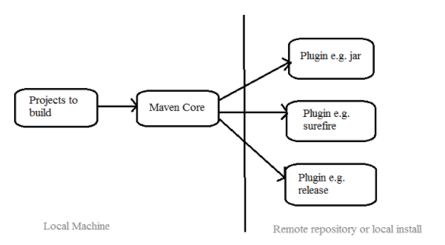
Maven Architecture

Slide 12
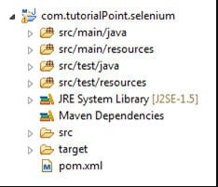

General Phrases used in Maven:
GroupId: Generally groupId refers to domain id. For best practices company name is used as groupId. It identifies the project uniquely.
ArtifactId: It is basically the name of the Jar without version.
version: This tag is used to create a version of the project.
Local repository: Maven downloads all the required dependencies and stores in the local repository called m2.

Slide 13
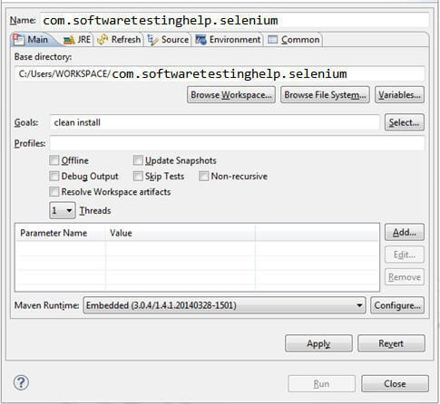
Build The Project: The project can be built by both using IDE and command prompt. Using IDE you have to right click on POM-Run As-Maven Build
Enter goals like clean install etc. and click Run. Same can be done using a command prompt. Navigate to project folder where pom.xml lies. And use below commands to clean, compile and install
For clean: mvn clean For compile: mvn compile For Install: mvn install
Most of the projects follow maven structure because Maven simplifies the code handling and process of building the project.

Slide 14
Showcase on
Jenkins
Maven

Slide 15



Slide 16
Thank you

