Slide 1
Case Study: Spelling Correction
Niranjan Kasi
Profisor Services

Slide 2
Concept
It works in Naïve’s Bayes therom,
P(A/B)= P(B/A).P(A)/P(B)
Here argument matrix is P(A/B) .
P(B) is the correction which choose the mostly correction word.

Slide 3
Different Stages in the program
Selection
Candidate Model
Probability of the word
Accuracy

Slide 4
Methods
Selecting:
In this method we find the highest combined probability.
Candidate model:
In this stage we works on deletion, transpose, replaces, splits, letters and inserts. For a word of length n, there will be n deletions, n-1 transpositions, 26n alterations, and 26(n+1) insertions, for a total of 54n+25 (of which a few are typically duplicates).

Slide 5
Methods
Probability of the model:
In this type, we can find the probability of word p(word) by counting the word appears in each time in the dataset. Here the word splits the word into two words and counts the words appear in each time in the dataset.
Here P estimates the probability of each word .

Slide 6
Accuracy
Finally we calculate the accuracy by finding the,
correct resolutions/total data points

Slide 7
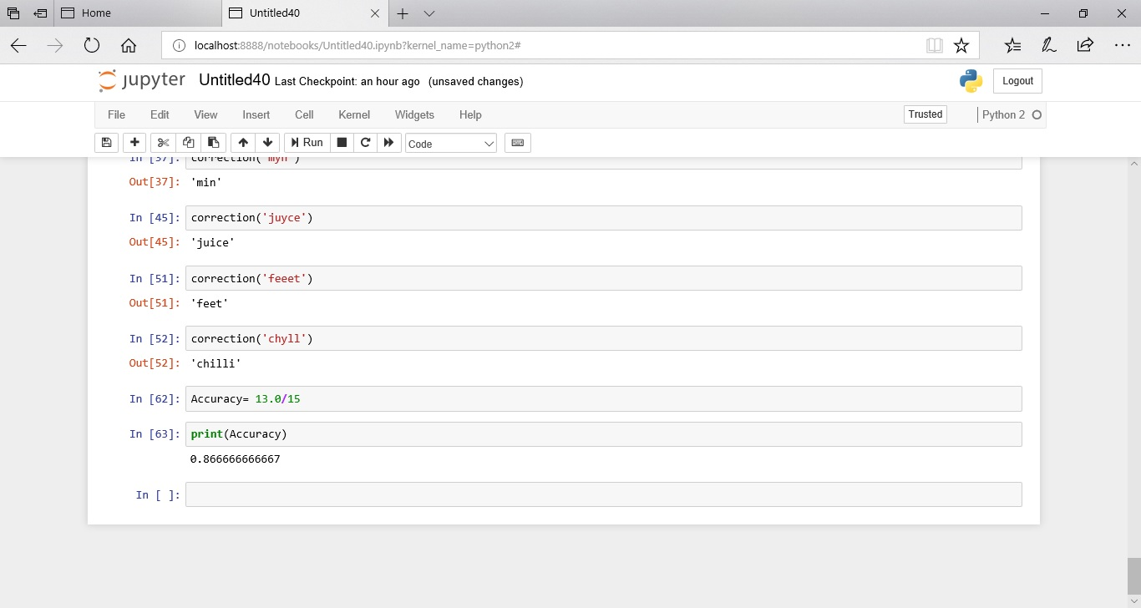
Accuracy checking:
In this model we got the accuracy of 86.66 which is quite better.

Slide 8
Conclusion:
Though Norvig’s approach is most accurate but it is still slower in the account of different probabilities. There are many ways to improve the accuracy and faster capabilities.
Faroo’s implementation is very fast but it is very less accurate. We can build the most accurate and much faster than Faroo approach:
def correction_for(word)
return(word)
end

Slide 9
Conclusion
Deep text corrector uses TenserFlow to train sequence-to-sequence models that are capable to automatically correcting small errors in the conversation.
We can also use TextBlob for better accuracy in the spell correction.

Slide 10
Thank you

