Slide 1
Exploring Personality through Data Science
Erin Wolpert

Slide 2
Introduction
Personality Trait Theory
Dataset
50K global respondents
163 questions
Scale 1-5 (strongly disagree to strongly agree)

Slide 3
NMF 8 Trait Theory
Trait 1: Social / Respects Rules
Trait 2: Worried / Reserved
Trait 3: Partier / Emotionally Volatile
Trait 4: Breaks Rules / Judgmental
Trait 5: Angry / Dislikes Complex Ideas and Art
Trait 6: Passive / Messy / Sees Oneself as Average
Trait 7: Emotionally Open / Intellectually Thoughtful
Trait 8: Reserved

Slide 4
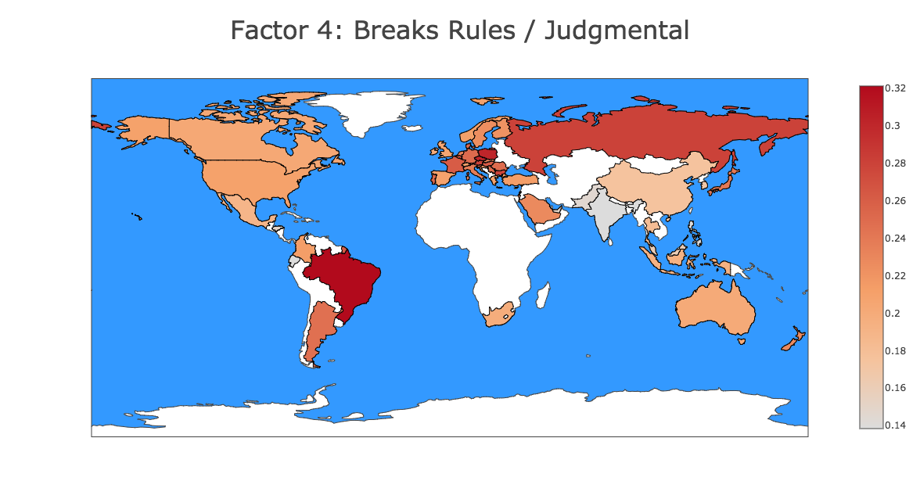
Notes:
https://plot.ly/~alacrity28/28/factor-4-breaks-rules-judgemental/

Slide 5
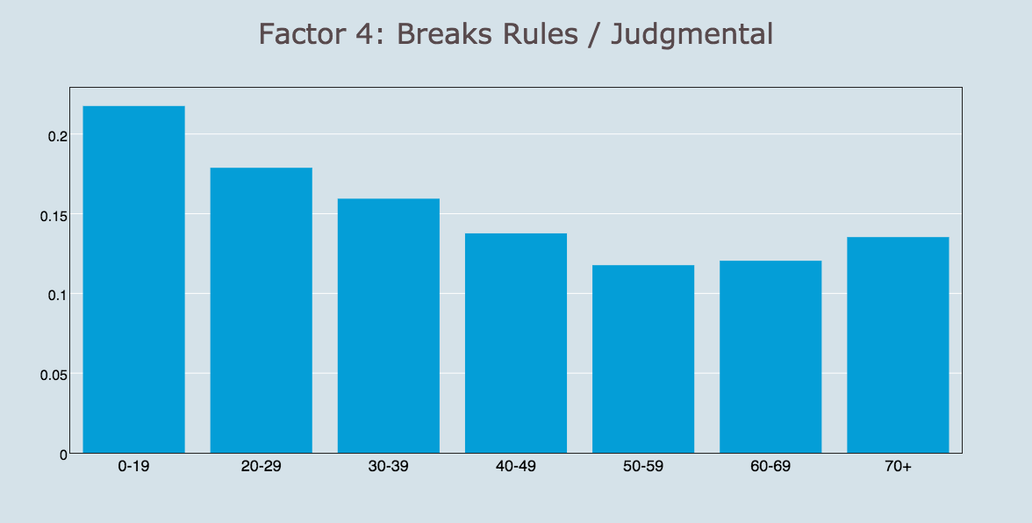

Slide 6
Big Five Trait Theory | NMF Big Five
Neuroticism Extraversion Openness to Experience Conscientiousness Agreeableness | Neuroticism / Low-Self Confidence Social / People – Oriented Not Open to New Ideas Alone Party Animal / Rule Breaker

Slide 7
Erin Wolpert
personalitydatascience.com

