Slide 1
Applying Data Science to Personality Trait Theory
Erin Wolpert

Slide 2
Big Five Trait Theory | NMF Big Five
Neuroticism Extraversion Openness to Experience Conscientiousness Agreeableness | Neuroticism / Low-Self Confidence Social / People – Oriented Not Open to New Ideas (sub-traits: private and respects authority) Alone Party Animal / Rule Breaker

Slide 3
NMF 8 Trait Theory
Topic 1: Social / Respects Rules
Topic 2: Worried / Reserved
Topic 3: Partier / Emotionally Volatile
Topic 4: Breaks Rules / Judgmental
Topic 5: Angry / Dislikes Complex Ideas and Art
Topic 6: Passive / Messy / Sees Oneself as Average
Topic 7: Emotionally Open / Intellectually Thoughtful
Topic 8: Reserved

Slide 4
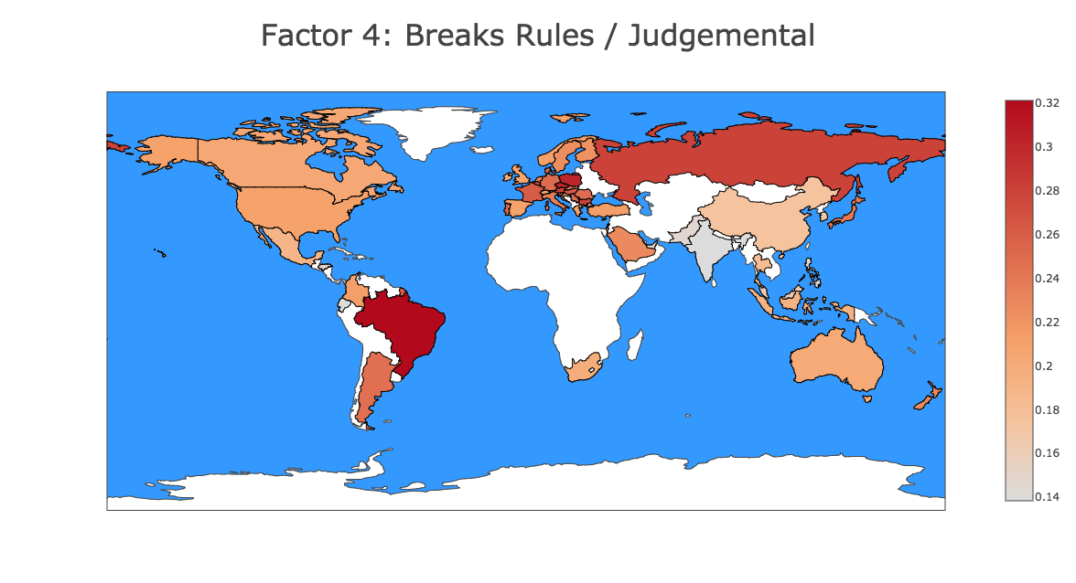
Notes:
https://plot.ly/~alacrity28/28/factor-4-breaks-rules-judgemental/

Slide 5
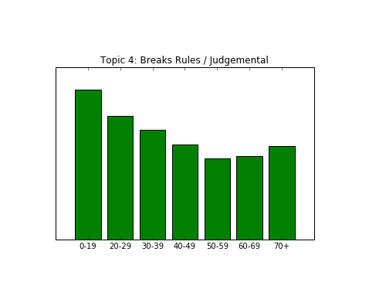

Slide 6
Erin Wolpert
Find me at: www.linkedin.com/in/erinwolpert
Current link for project website:
54-84-12-244:8000

