Slide 1
CarMind
Sprint 1: Login and Authentication
Abdullah Misar
CCSW 431 Mobile Programming
Notes:
I am presenting my Sprint 1 contribution: email/password login for CarMind. CarMind is our vehicle monitoring app concept. This course implementation uses native Android with Java and XML, following the course examples. The demo uses a local Firebase Authentication emulator because the team has not created a cloud Firebase project yet. My teammate will add the registration section. Sources: course site https://ccsw431.malahmadi.sa/ and CarMind_Senior_Project_I_Final_Report.pdf, PDF pages 2 and 7. The early report supplies the concept only.

Slide 2
Login story
Story 002
A registered user signs in to access their CarMind account.
The app validates the form and asks Firebase to check the credentials.
Successful authentication opens the home screen.
Notes:
Story 002: As a registered CarMind user, I want to sign in with my email address and password so I can access my account. The course requires Registration and Login and Authentication in Sprint 1. I own login. My teammate owns registration. Login uses Firebase Authentication to check credentials. Sources: Final_Project_CCSW431.pdf, PDF pages 3, 5 and 10-11. https://ccsw431.malahmadi.sa/

Slide 3
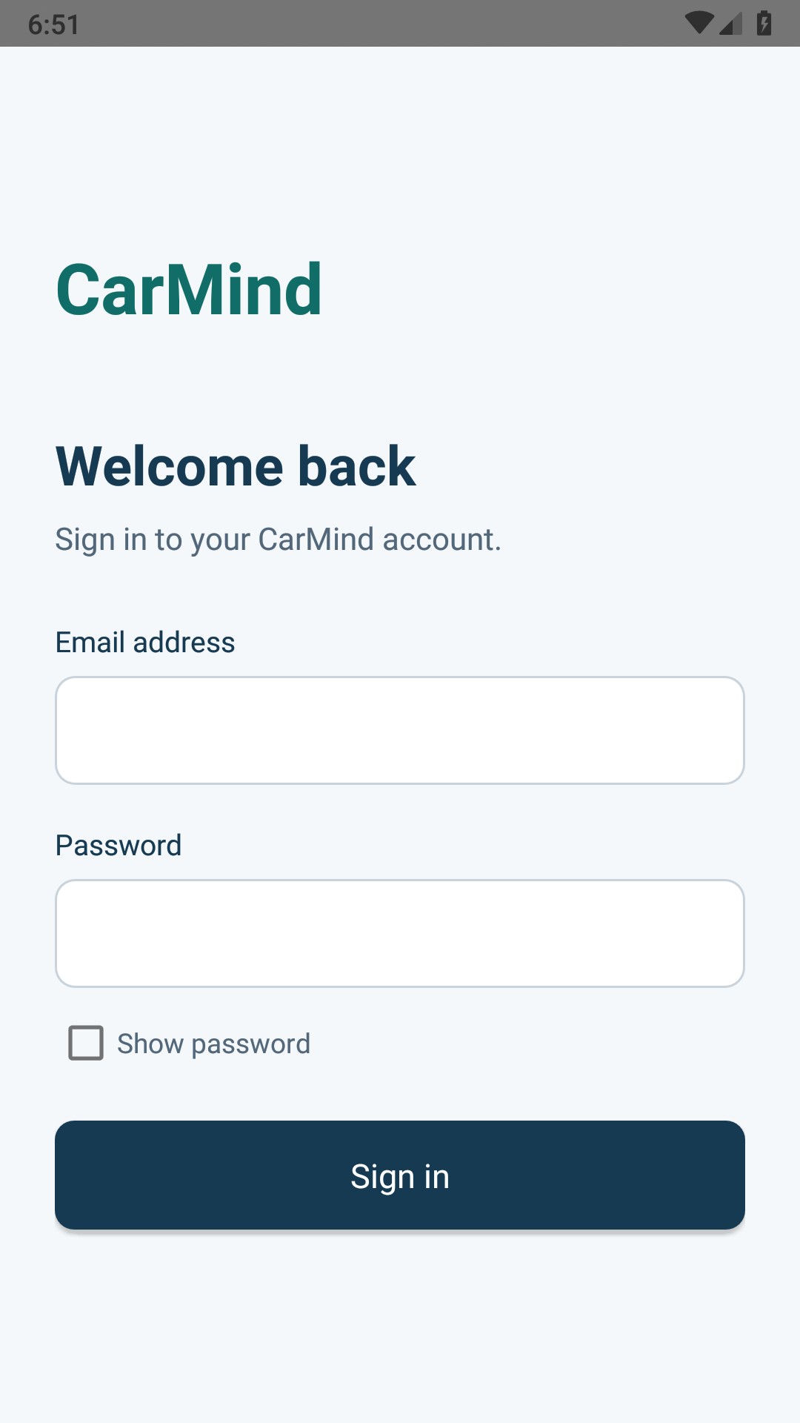
Login screen
Email and password
Required fields and email format checks
Masked password with an optional reveal control
Loading state prevents repeated submissions
Android 9 device emulator with local Firebase Auth
Notes:
Explain the email and password fields. Passwords start masked and the user may reveal them deliberately. Surrounding whitespace in email is trimmed. The password is sent exactly as entered, including spaces. The form disables during the asynchronous request and displays readable validation or provider errors. The screenshot is a genuine screenshot of the built APK from the local Android device emulator. Source code: app/src/main/java/com/carmind/app/LoginActivity.java and LoginValidation.java. Image: docs/screenshots/login.png.

Slide 4
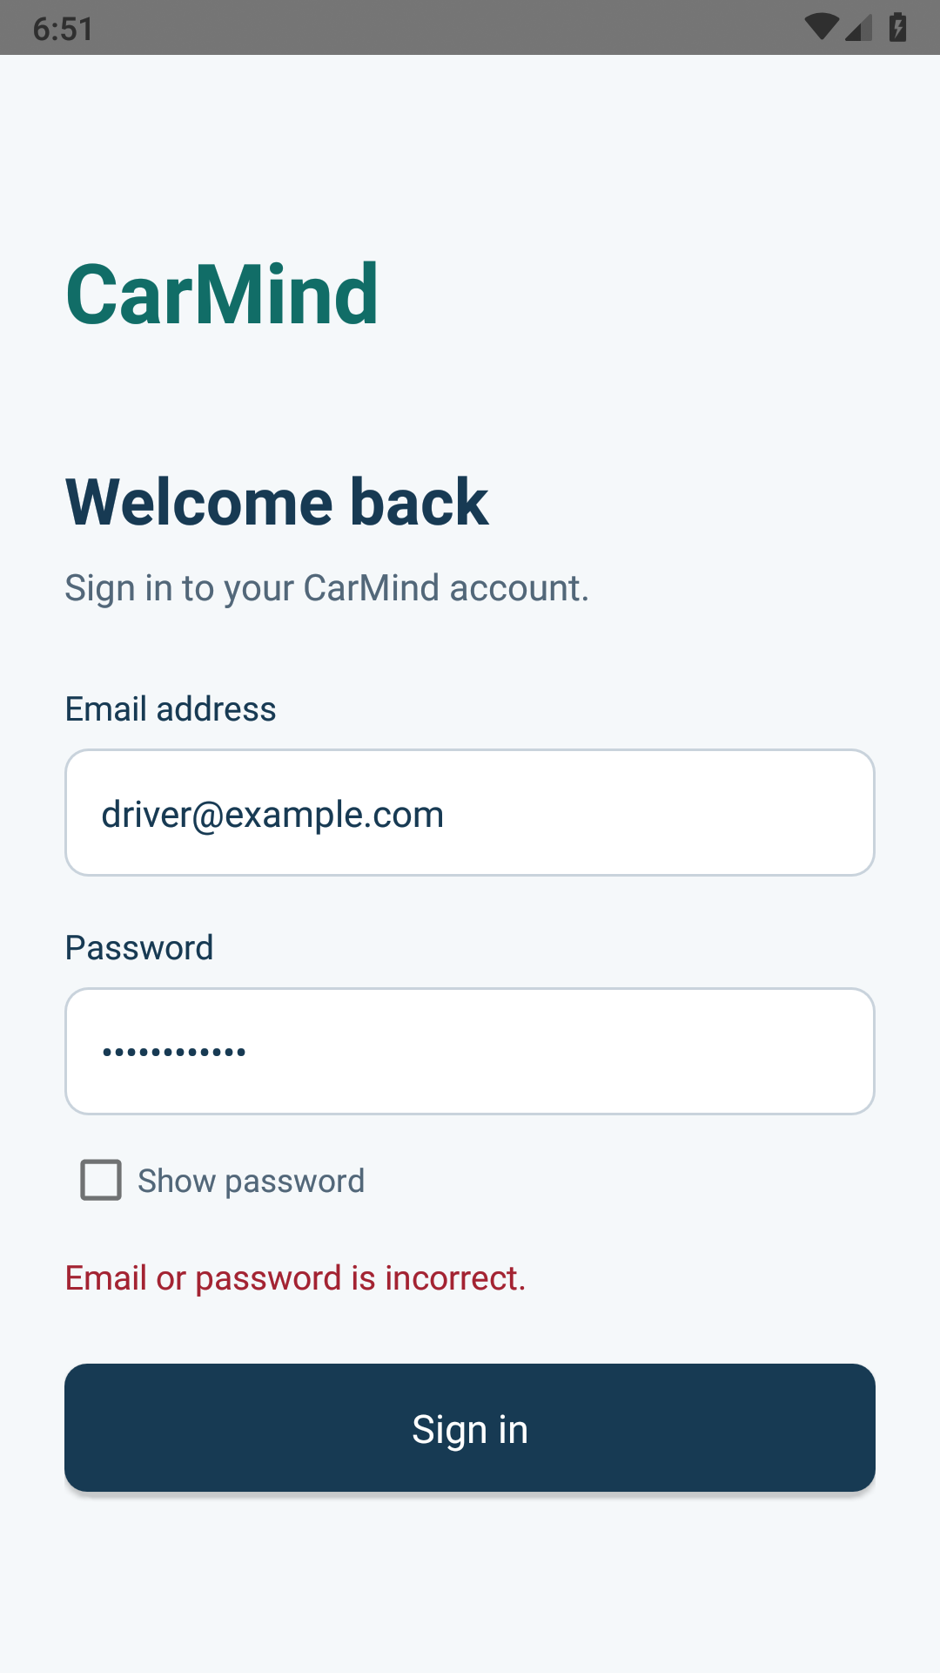
Failed authentication
Email or password is incorrect.
The user stays on the login screen and can retry.
The app displays a readable message without exposing raw exceptions.
Android 9 device emulator with local Firebase Auth
Notes:
Demonstrate an incorrect password. Firebase rejects the request, the user stays on Login, and the form re-enables. The visible generic credential message avoids distinguishing an unknown email from a wrong password. Network, disabled-account and throttling errors have readable messages, but those provider cases still need manual testing. The local emulator test verifies the wrong-password case. Source: app/src/main/java/com/carmind/app/LoginActivity.java. Firebase documentation: https://firebase.google.com/docs/auth/android/password-auth. Image: docs/screenshots/invalid-credentials.png.

Slide 5
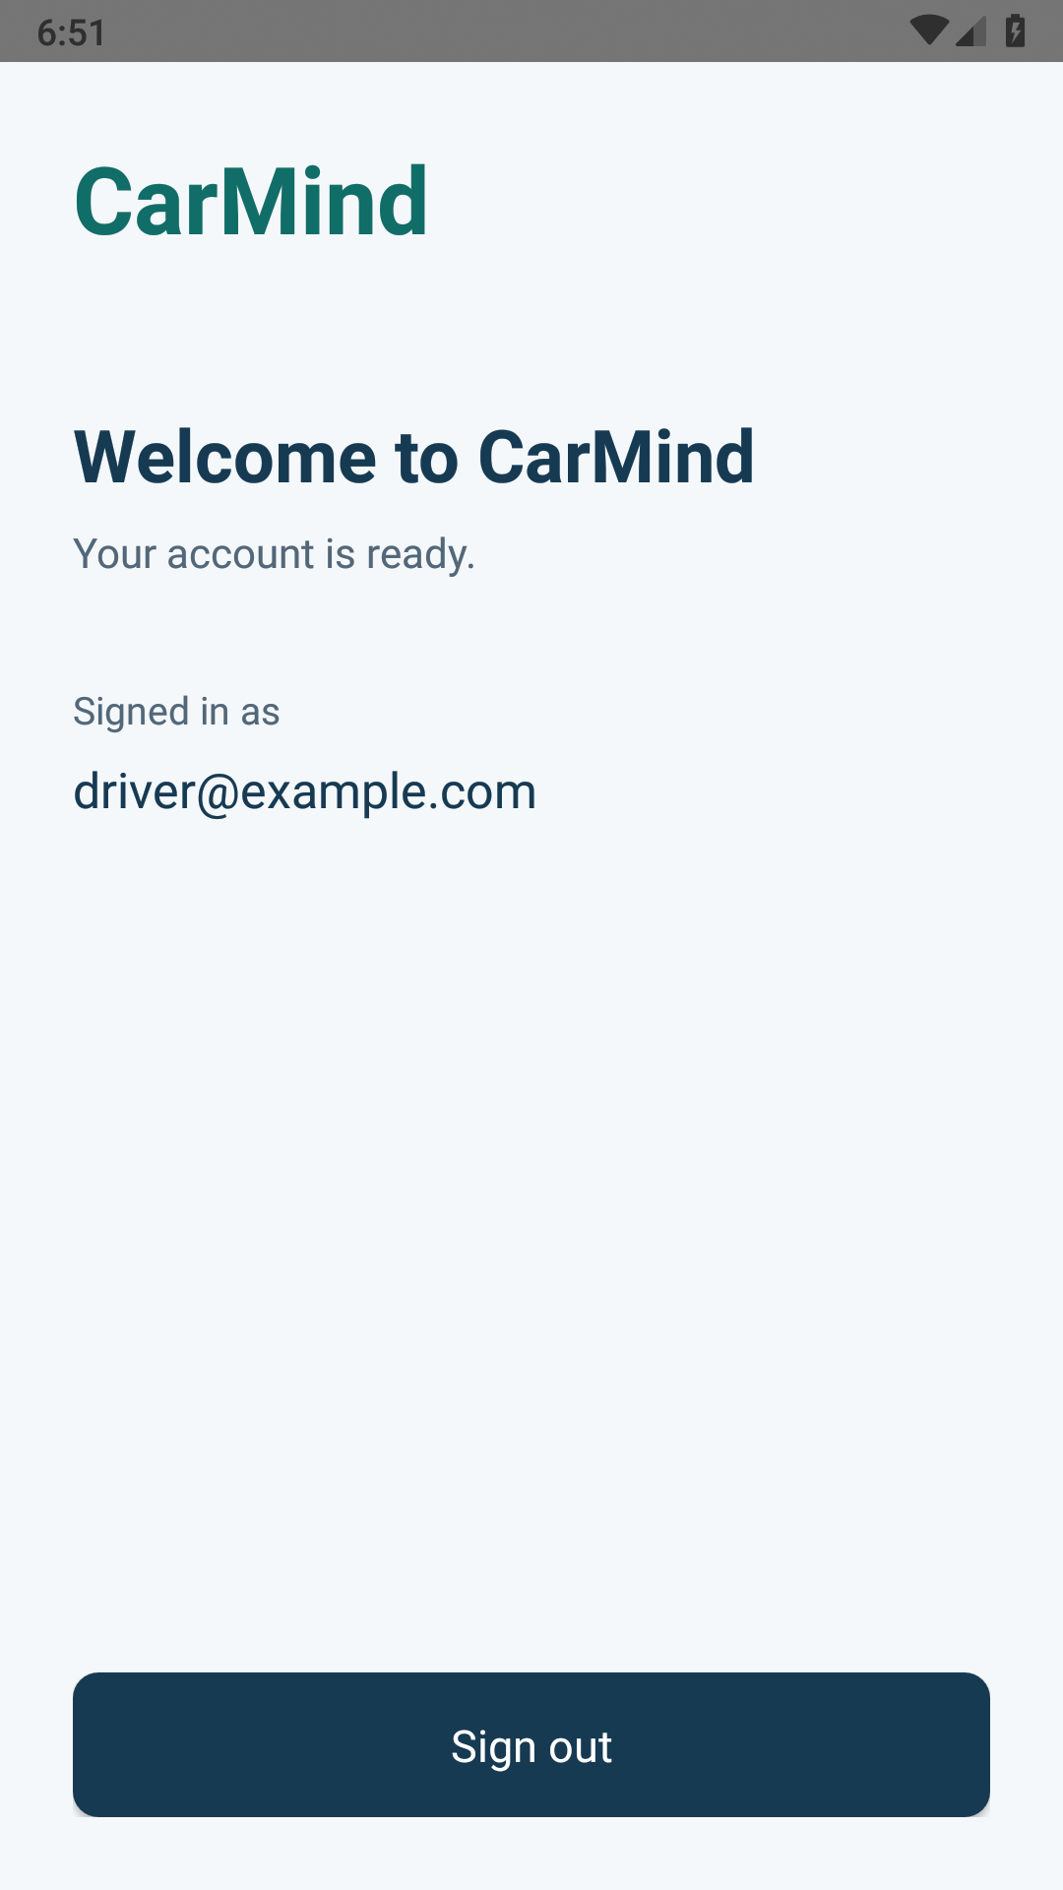
Successful authentication and session
Valid credentials open Home
Firebase restores the session when the app starts again.
Sign-out clears the session and returns the user to Login.
Android 9 device emulator with local Firebase Auth
Notes:
Show the local registered account on Home. A valid Firebase session opens Home again after an app restart. Sign-out clears the session and activity history, so Back cannot reopen Home. This is a minimal Sprint 1 landing screen, not a completed vehicle dashboard. Future backend services must verify identity independently. Source: app/src/main/java/com/carmind/app/HomeActivity.java. Firebase documentation: https://firebase.google.com/docs/auth/android/password-auth. Image: docs/screenshots/home.png.

Slide 6
Test results
6 validation checks passed
Blank fields, email format and login password rules
9 device checks passed
Login outcomes, masking, session restoration and sign-out
Android 9 device emulator and local Firebase Auth. Cloud checks remain pending.
Notes:
Six JVM input-validation tests passed. Nine device checks passed on Android API 28 using the built emulator-mode APK and the local Firebase Auth emulator. Device cases covered blank form, malformed email, blank password, masking, wrong password, valid login, session restoration, sign-out/navigation, and a password containing surrounding spaces. Android debug build and lint passed. These results do not prove cloud deployment. Network failures, disabled accounts, throttling, and lifecycle behavior remain manual checks. Source: app/build/test-results/testDebugUnitTest/TEST-com.carmind.app.LoginValidationTest.xml and docs/device-check-results.json.

Slide 7
Registration contribution
Teammate section
Add the registration screen and account creation demo.
Add registration test results and the register-then-login check.
Pending teammate implementation and integration
Notes:
Reserved for the teammate to replace with the registration implementation, genuine screenshots and actual test outcomes. The course requires registration as Story 001 in this sprint. Registration should share the FirebaseAuth instance from CarMindApplication.getAuth(). After integration, demonstrate that a user created through the registration screen can sign in. Registration is not implemented in the login branch. Source: README.md Registration integration and Final_Project_CCSW431.pdf PDF page 3.

Slide 8
Remaining Sprint 1 work
Team Firebase setup and cloud verification
Registration integration and shared-account testing
Provider failures and request lifecycle checks
Two real meeting records and the sprint submission package
Notes:
My login contribution is implemented and verified locally. The team still needs to configure its real Firebase project with Email/Password authentication, integrate the teammate registration story, run the pending provider and lifecycle checks, and record both actual stand-up meetings. The course submission includes progress with screenshots, test cases, meeting cheat sheet and source ZIP. Sources: docs/SPRINT1.md, Final_Project_CCSW431.pdf PDF pages 3-4 and 7. Cloud setup instructions: https://firebase.google.com/docs/auth/android/password-auth.

