Slide 1

CarMind
Login and Authentication
Sprint 1
Abdullah Misar
CCSW431 Mobile Programming
Notes:
I am Abdullah Misar. This is my Sprint 1 login and authentication contribution to CarMind for CCSW431. Our course version uses native Android Java and XML. The demo uses the local Firebase Auth emulator because we do not yet have a team cloud project. Registration belongs to my teammate. The cover is an AI-generated automotive illustration, not a photo of an actual vehicle or app evidence. Sources: Final_Project_CCSW431.pdf, PDF pages 3 and 5. CarMind_Senior_Project_I_Final_Report.pdf, concept sections. Course examples: https://ccsw431.malahmadi.sa/.

Slide 2
The account entry point
Story 002
Android
A registered user signs in
to their CarMind account.
Java and XML
Firebase Auth
CarMind brings vehicle information and
maintenance into one mobile app concept.
Email and password
Notes:
CarMind is based on our senior-project concept of vehicle information and maintenance support. Those vehicle features are outside this login increment. Story 002 is: As a registered CarMind user, I want to sign in using my email and password so I can access my account. The course requires registration and login/authentication in Sprint 1. I own login, and my teammate will add registration. Sources: Final_Project_CCSW431.pdf, PDF pages 3, 5 and 10-11. CarMind_Senior_Project_I_Final_Report.pdf, concept sections. Course Java/XML examples and Firebase sample: https://ccsw431.malahmadi.sa/.

Slide 3
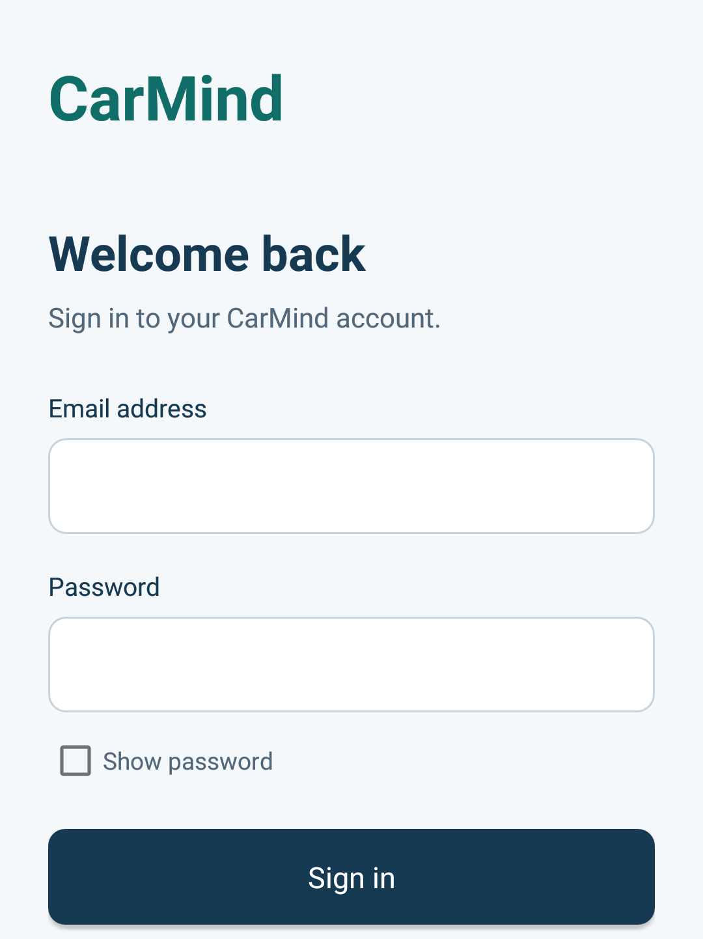
Sign in
Email and password
The password starts hidden.
The user can choose to reveal it.
The form disables input while
Firebase checks the credentials.
Notes:
Explain the actual screen before touching the demo. The email field trims surrounding whitespace. Passwords start masked and Show password reveals them only when selected. The password itself stays exactly as entered. During an asynchronous Firebase request, the app disables the form and shows progress. The implementation includes this guard, but the rapid-submission manual test still remains pending. Screenshot source: docs/screenshots/login.png, genuine capture of the emulator-mode APK. Code: LoginActivity.java and LoginValidation.java.

Slide 4
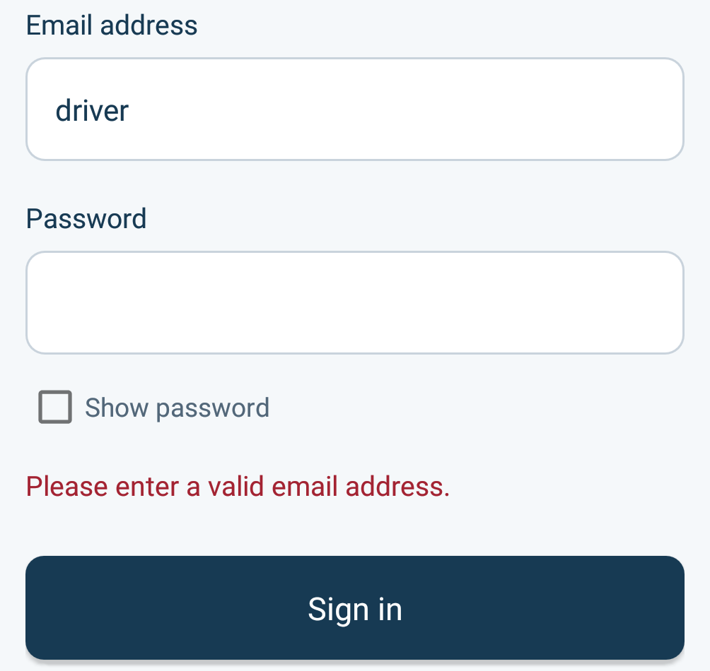
Input checks
Before Firebase
Required fields and
email format
Email whitespace is trimmed.
Password characters stay unchanged.
Actual Android validation state
Notes:
The app checks required fields and email format locally before calling Firebase. This example enters driver without a domain. The validation message appears next to the form. No authentication request is necessary to detect this input error. Email whitespace is trimmed, and password characters remain unchanged. Screenshot: docs/screenshots/invalid-email.png, native crop of a genuine Android capture retaining the entered email, password field, visible validation message and Sign in action. Sources: LoginValidation.java, LoginActivity.java and LOGIN-02 in device-check-results.json.

Slide 5
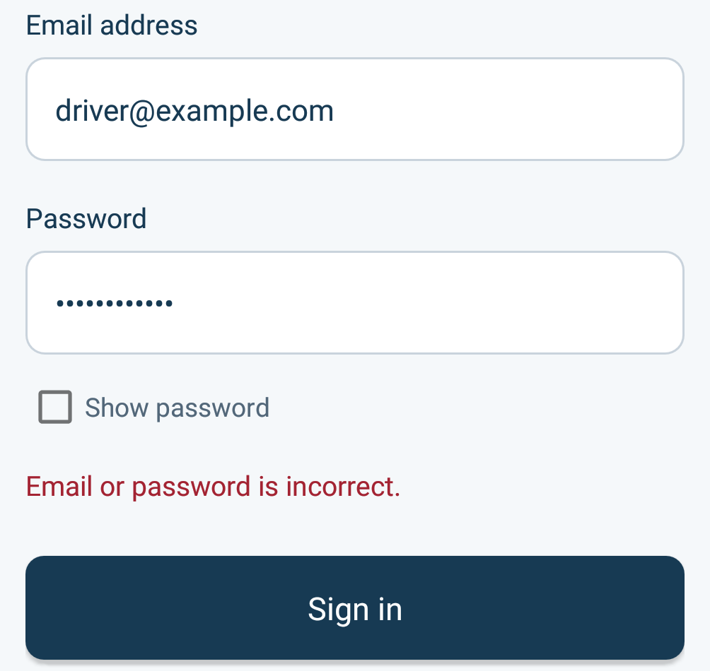
Incorrect
credentials
The user stays on Sign in
and can retry.
The message does not identify
which credential failed.
Local Firebase Auth response
Notes:
Show what happens with the wrong password. Firebase rejects the credentials and the user stays on the login screen. The form becomes available for another attempt. The generic message does not disclose whether the email or the password was wrong. This screenshot proves the local wrong-password case only. Network failures, disabled accounts and provider throttling still need cloud/manual checks. Source: LoginActivity.java, LOGIN-05 in device-check-results.json. Screenshot: docs/screenshots/invalid-credentials.png. Firebase password auth documentation: https://firebase.google.com/docs/auth/android/password-auth.

Slide 6
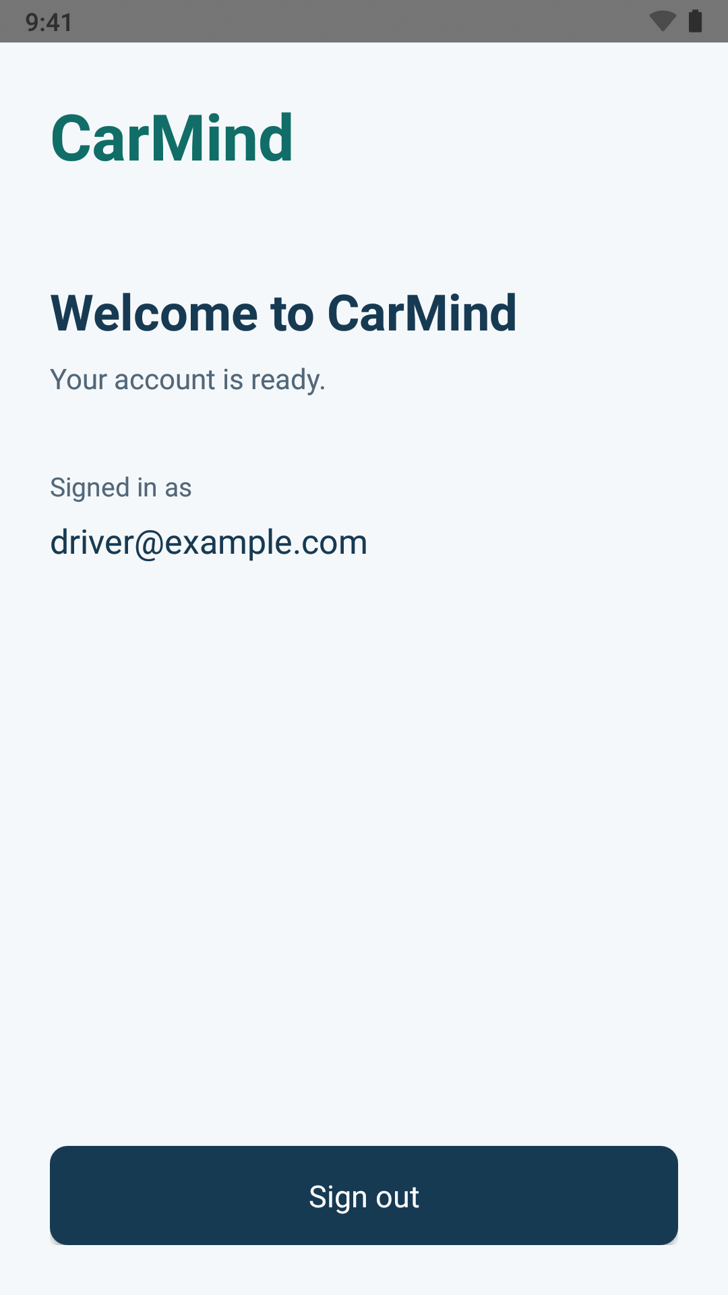
Authenticated
home
Valid credentials open Home.
The screen shows
the signed-in account.
Sprint 1 landing screen
Notes:
Valid local credentials open Home and display the account email. This is the minimal authenticated landing screen for Sprint 1, not a completed vehicle dashboard. The account shown is a disposable local emulator account using the reserved example.com domain. The deck contains no password, token or cloud credentials. Source: HomeActivity.java, LOGIN-06 in docs/device-check-results.json. Screenshot: docs/screenshots/home.png. Firebase Android password auth: https://firebase.google.com/docs/auth/android/password-auth.

Slide 7

Session behavior
App restart
The saved Firebase session
opens Home again.
Sign out
The session clears. Back and restart
keep the user on Sign in.
After sign-out
Notes:
The Firebase SDK restores the existing session after the app restarts, and LoginActivity opens Home. Sign-out clears the Firebase session and opens Login with the activity task cleared. Back and restart do not reopen Home. The screenshot records the actual signed-out state after using the home screen Sign out action. Source: LoginActivity.java, HomeActivity.java, LOGIN-07 and LOGIN-08 in device-check-results.json. Screenshot: docs/screenshots/signed-out.png.

Slide 8
Test evidence
6
9
Input validation
tests passed
Android device
checks passed
Validation and exact
password handling
Login outcomes, masking,
session restore and sign-out
Android API 28 and local Firebase Auth emulator. Cloud checks remain pending.
Notes:
Six JVM input-validation tests passed with zero failures and errors. Nine device checks passed on Android API 28 with the built debug APK and the local Firebase Auth emulator. LOGIN-01 blank form, LOGIN-02 malformed email, LOGIN-03 blank password, LOGIN-04 masking, LOGIN-05 incorrect credentials, LOGIN-06 successful login, LOGIN-07 restored session, LOGIN-08 sign-out and navigation guard, LOGIN-09 unchanged password spaces. Android debug/release builds and lint passed, with lint reporting zero errors and five warnings. Sources: docs/TEST_RESULTS.txt, docs/device-check-results.json and app/src/test/java/com/carmind/app/LoginValidationTest.java. These are local results. Rapid repeated submission, cloud network failure, disabled accounts, throttling, pending-request lifecycle and registration integration remain pending.

Slide 9
Registration
Teammate contribution
Registration
screenshot
Presenter name
Account creation result
Register-then-login check
Space for the working feature
Pending teammate contribution
Notes:
Reserved for my teammate to replace with the real registration implementation, presenter name, genuine screenshot and actual test results. Course Story 001 requires registration. The registration implementation must share CarMindApplication.getAuth(). After integration, verify that a user created through Registration can sign in. This slide contains no claim that registration is completed. Source: README.md Registration integration, docs/SPRINT1.md and Final_Project_CCSW431.pdf PDF page 3.

Slide 10
Next Sprint 1 checks
Login is ready for the local demo.
01
Team Firebase project and cloud verification
02
Registration and a new-account login check
03
Provider failures and request lifecycle
Notes:
The login contribution is ready for the local demo. The remaining team tasks are to configure the actual Firebase project and enable Email/Password auth, integrate registration and verify a new account, run the remaining provider/lifecycle checks and complete the course submission with two actual meeting records, test evidence and the source ZIP. Do not claim the two meetings occurred until the team supplies real records. Suggested live demo: open blank Login, enter an invalid email, show wrong credentials, sign in using the seeded local account, restart the app to show restoration, then sign out and check Back. The feature is a local implementation until the cloud checks are completed. Sources: docs/SPRINT1.md, docs/TEST_RESULTS.txt, Final_Project_CCSW431.pdf PDF pages 3-4 and 7. Firebase setup: https://firebase.google.com/docs/auth/android/password-auth.

