Slide 1
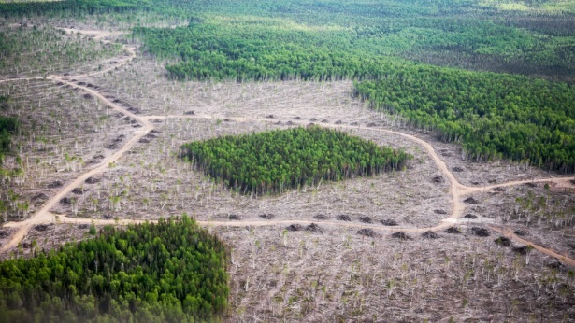

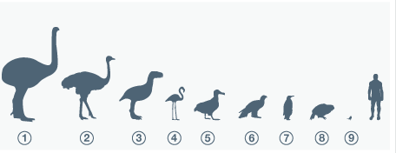
bird community body size , habitat fragmentation and biodiversity
Final presentation
Frank Hopman 10192395
Supervisor: Daniel Kissling

Slide 2
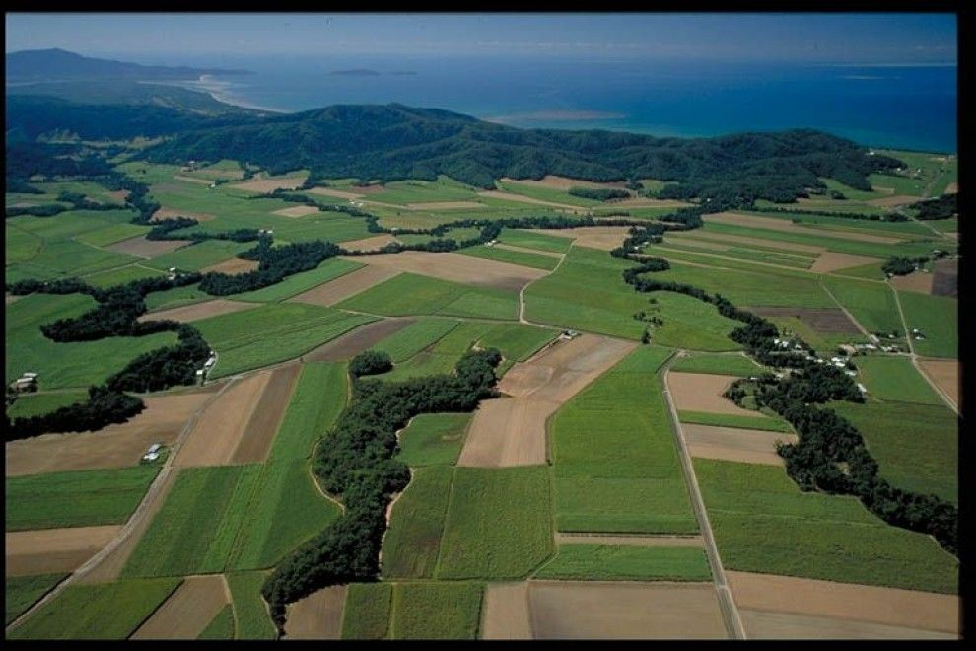

Habitat fragmentation
Habitat fragmentation caused by habitat destruction
Leads to:
Isolated patches
Smaller populations
Notes:
such as a higher bird predation rate near the
edge of forest edges and having more plants near the edge due to more sunlight exposure (Murcia, 1995
On top of that, due to the smaller mass of the populations inside fragmented habitats, do species tend go extinct faster due to lower gene exchange and a higher vulnerability for stochastic processes (Woodroffe and Ginsberg, 1998).

Slide 3
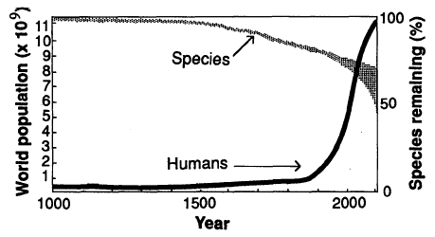
Effects habitat fragmentation
Decreases biodiversity
Changes overall species composition
Different species, different habitat fragmentation sensitivity

Slide 4
body size
Body size negative correlated with habitat fragmentation
Body size negative correlated with species richness

Slide 5
Research questions
Is there a relation between habitat fragmentation and bird community body size?
Is there a relation between biodiversity and bird community body size?

Slide 6
Hypotheses
Habitat fragmentation has a negative relation with bird community body size
Biodiversity has a negative relation with bird community body size

Slide 7


Methods
Community body size
Weighted mean community body mass
Abundance: PREDICTS database
Species mean body mass: Received from Dr. W. D. Kissling
Habitat fragmentation
Core area index
Maps of forest cover change by Dr. W. D. Kissling and Colleagues
Biodiversity
Distance to edge of high biodiversity habitat: PREDICTS database

Slide 8
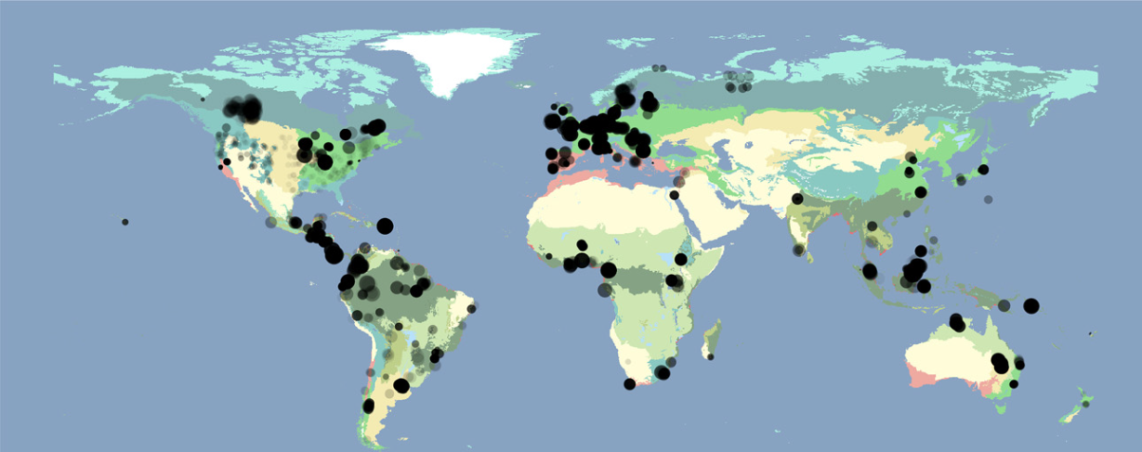

Community Body size
Weighted mean community body mass
PREDICTS database
Database of 666 studies which looked into biodiversity
Selected studies concerning bird species and abundance
Sites within study => 10
Minimal species counted per site => 3
Notes:
Taxonomic rank

Slide 9

Weighted mean community body mass
Abundance: PREDICTS database
Species average body mass received from Dr. W. D. Kissling
Example:
10 birds of species A with average body-mass 10 grams
5 birds of species B with average body-mass 20 grams
WMCBM = 10/15 * 10 + 5 /15 * 20 = 13.33 grams

Slide 10
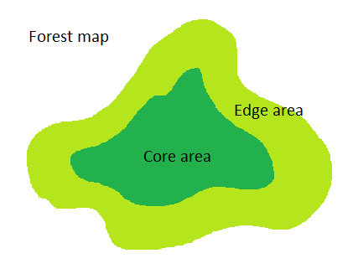
Habitat fragmentation
Map by from Kissling and colleagues
Used to measure habitat fragmentation per site
Core area index used as a unit for habitat fragmentation
Intersect with sites from PREDICTS database
Core area index = Core area / Edge area

Slide 11
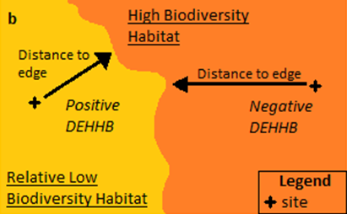
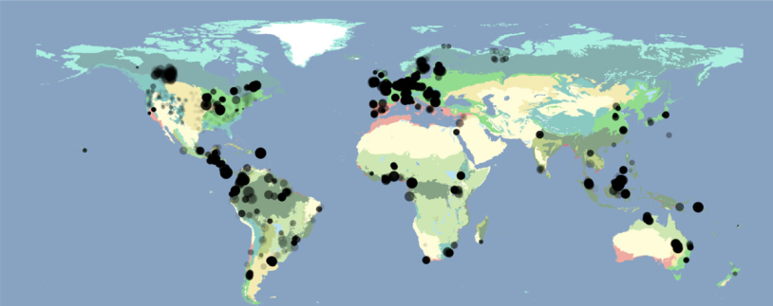
Distance to edge of high biodiversity habitat
Given by PREDICTS database
Negative value inside
Positive value outside

Slide 12
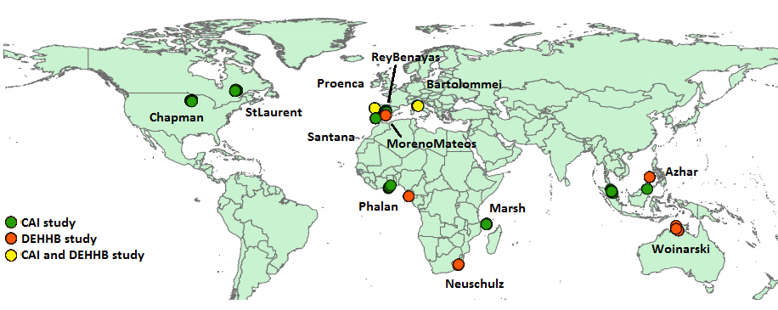
Results
Ten sites for habitat fragmentation analyzis
Seven sites for biodiveristy analyzis
Study locations and study names

Slide 13
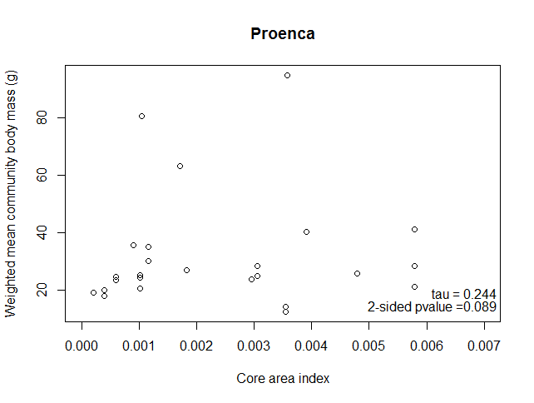
Results – Habitat fragmentation
Three of ten studies negative correlation
Three of ten studies significant correlation
These latter three do not correspond with the first
No consistent relation found between core area index and weighted mean community body mass

Slide 14
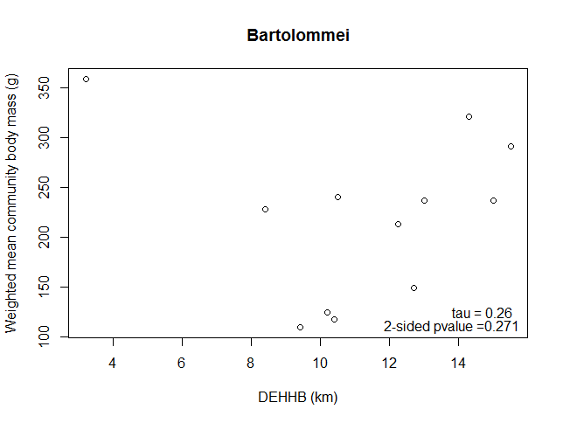
Results – edge distance
Three of seven studies negative correlation
No study gave a significant correlation
No relation found between distance to nearest edge of habitat supporting high biodiversity and weighted mean community body mass

Slide 15
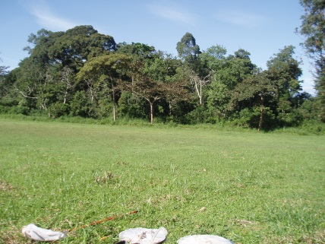
Discussion
No relation found between habitat fragmentation and community body size
No relation found between biodiverstiy and community body size
Different spiecies have different on edge effects
Limited amount of species in this study.
Different reaction on different type of edges
Vague variable: distance to nearest edge of habitat supporting high biodiversity remains vague in PREDICTS database.

Slide 16
Conclusion
Results are in contrast with hypotheses
No relation found between habitat fragmentation and community body size of birds
No relation found between biodiverstiy and community body size birds
More inclusive research needed to verify

Slide 17
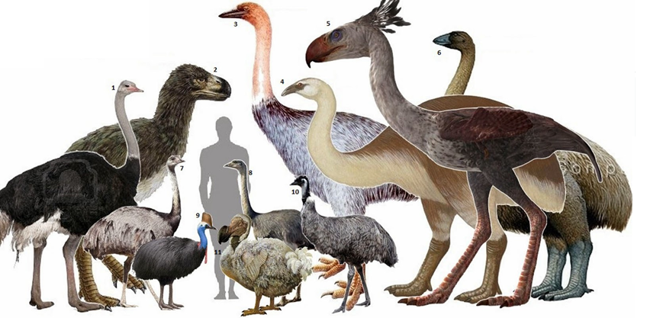
Questions?

