Slide 1

LIGHTS ON PARKING

Slide 2
The Problem
In huge city is very difficult looking for a parking space near your home, your work place o wherever you prefer to go.
Citizens search for much time a parking lot and so they are stressed and tired.

Slide 3
What are the problems?
Human’s stress
Ambiental pollution
Traffic
Useless expense

Slide 4
Rome parking situation
From the research of Parkclick.it we found the following data:
35-45 minutes a day (4 hours a week);
7/10 Romans use the car to go to work;
2/3 park on the street;
629 cars for every 1000 citizens;
107 hours a year in the traffic.

Slide 5
Existing approaches
PAYBYSKY – PARKING BY SATELLITE
(http://paybysky.com/);
PARKWISE – REAL-TIME PARKING GUIDANCE SOFTWARE
(http://parkwise.mobi/);
STANLEY ROBOTICS – AUTOMATED VALET PARKING
(https://stanley-robotics.com/).

Slide 6
Our solution
Lights on Parking is a project created to monitor the availability of parking spaces and consequently, if they are free, indicate them to the citizen through an app / web page, optimizing the traffic of those looking for a lot.

Slide 7
Goals
A smart way to find a parking space efficiently;
Less time spent in the car;
Less stress for the drivers;
Reduction of traffic due to the search for a parking space;
Reduction of fuel consumption(economic aspect);
Reduction of fuel emission (ambiental aspect);

Slide 8
Requirements
1.Space: public parking lots
2.Information: availability or occupancy
3.Individual: citiziens
4.Time: real time
5.Energy consumptions: lower possible

Slide 9

THE DEVICE

Slide 10
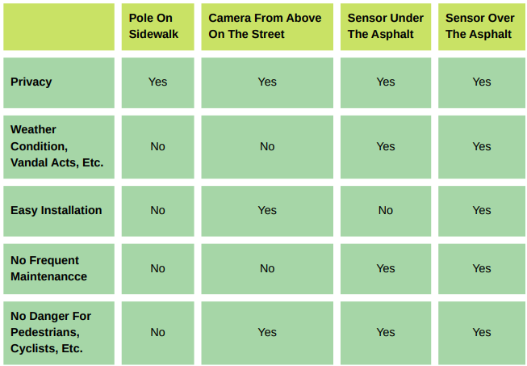
Pros and cons
We have analyzed the requirements and we have choosen for our project the sensor over the asphalt with coverage.

Slide 11
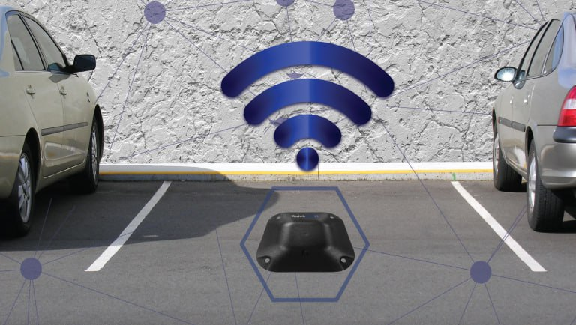
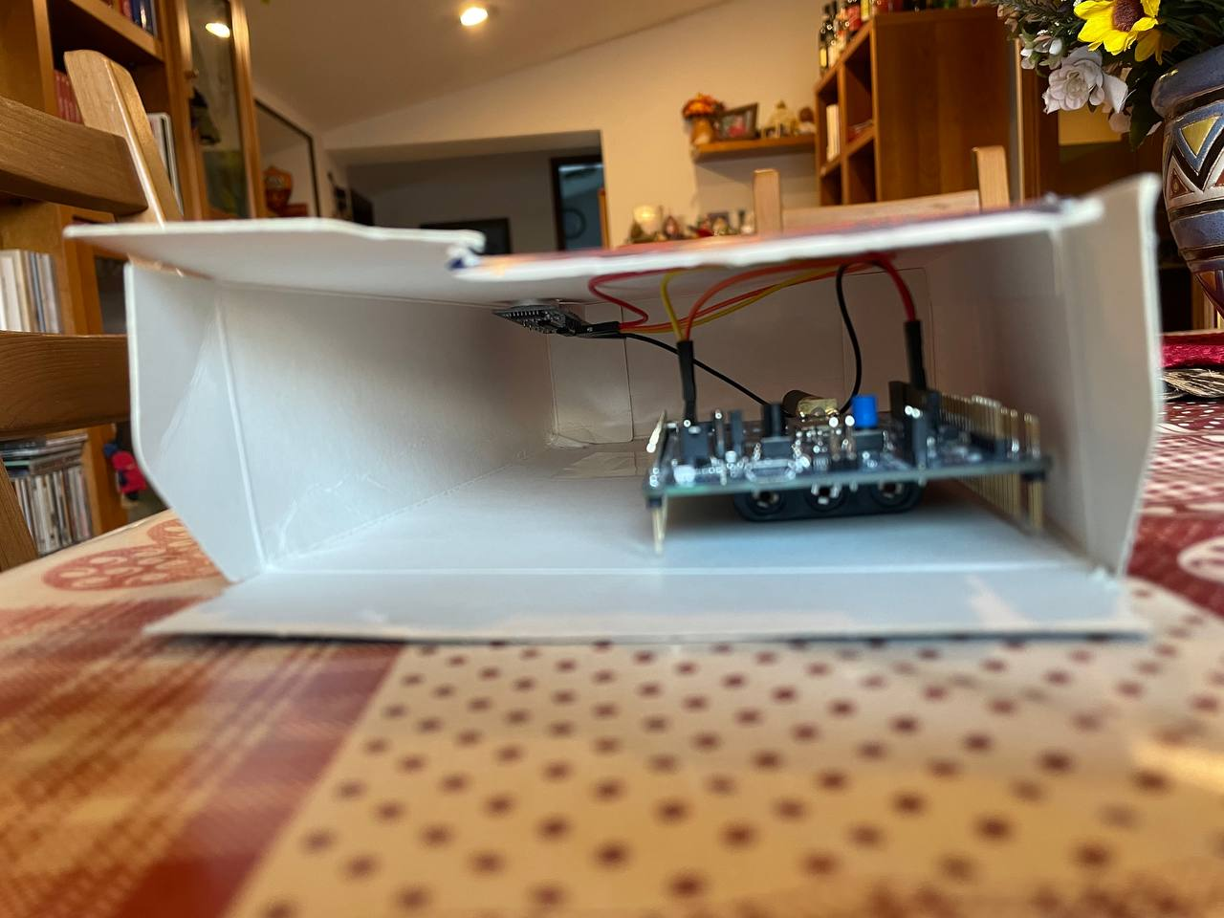
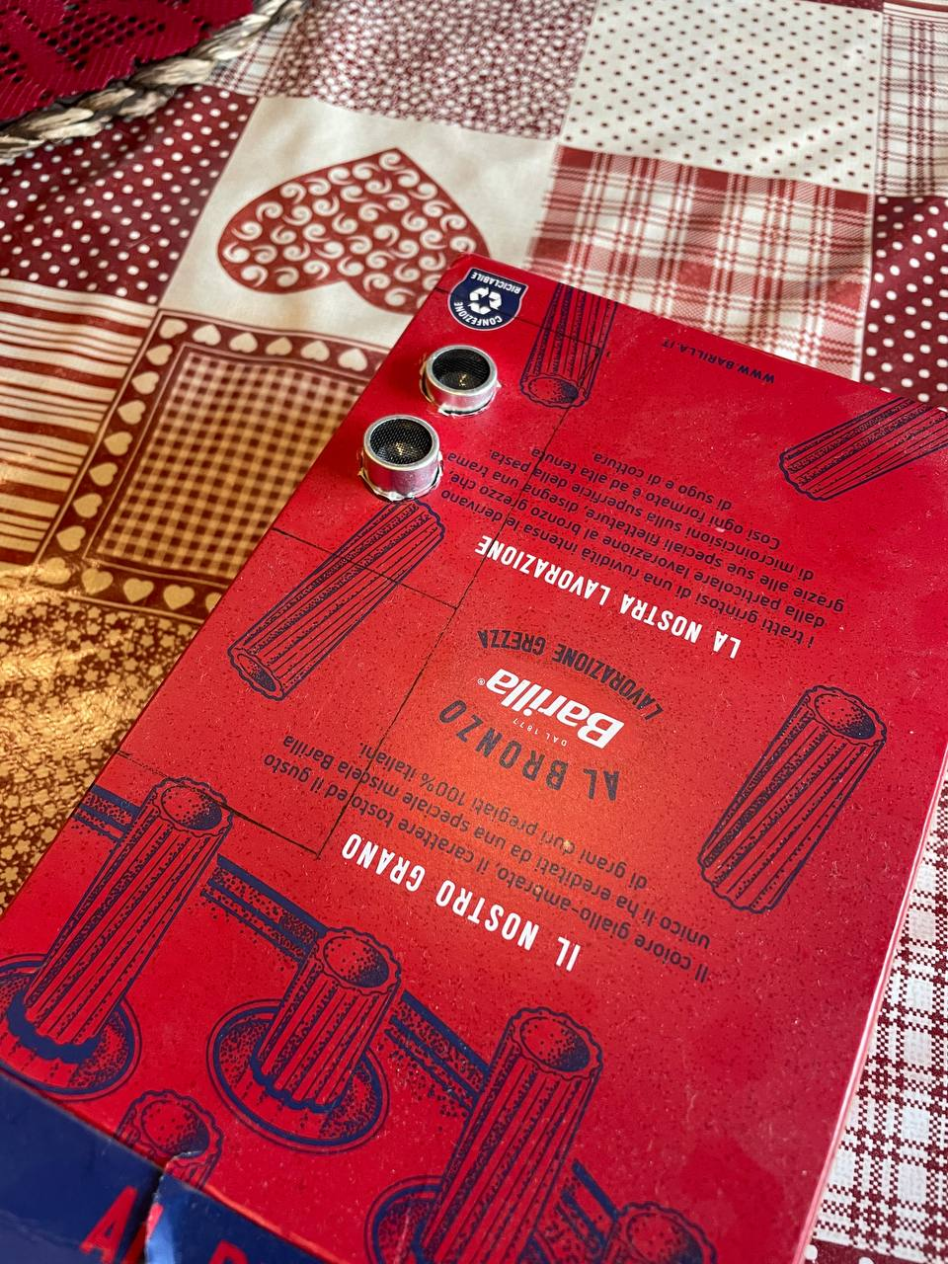
The prototype

Slide 12
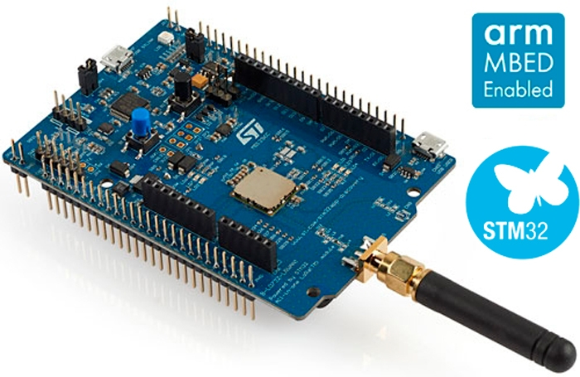
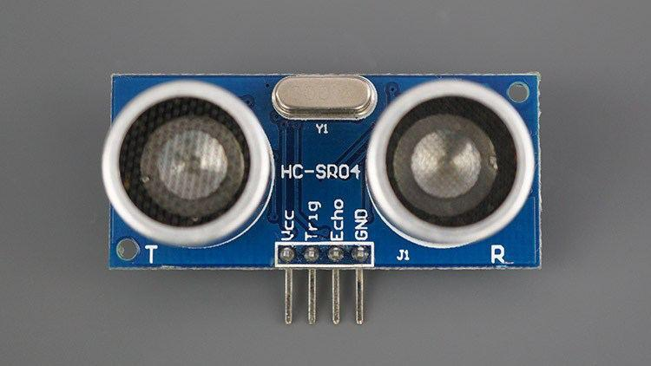
STMICROELETRONICS B-L072Z-LRWAN1 STM32 LoRaWAN DISCOVERY BOARD:
is a development tool to learn and develop solutions based on LoRa.
HC-SR04:
an ultrasonic sensor uses sonar to determine distance to an object.

Slide 13
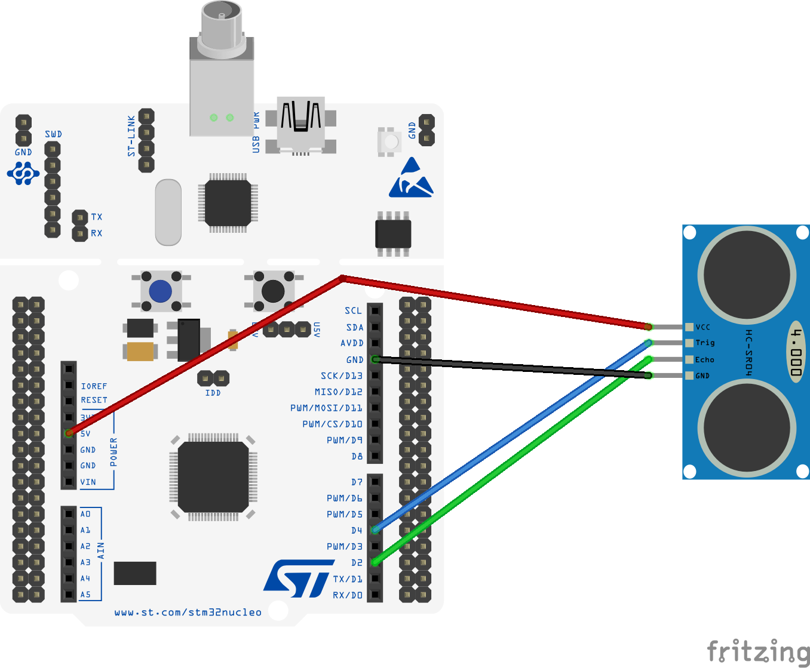
Hardware Schema
The project is built in a STM32 LoRaWAN Discovery board, in which we implemented an ultrasonic proximity sensor which is used to determine when a car is parked in a certain parking space.

Slide 14
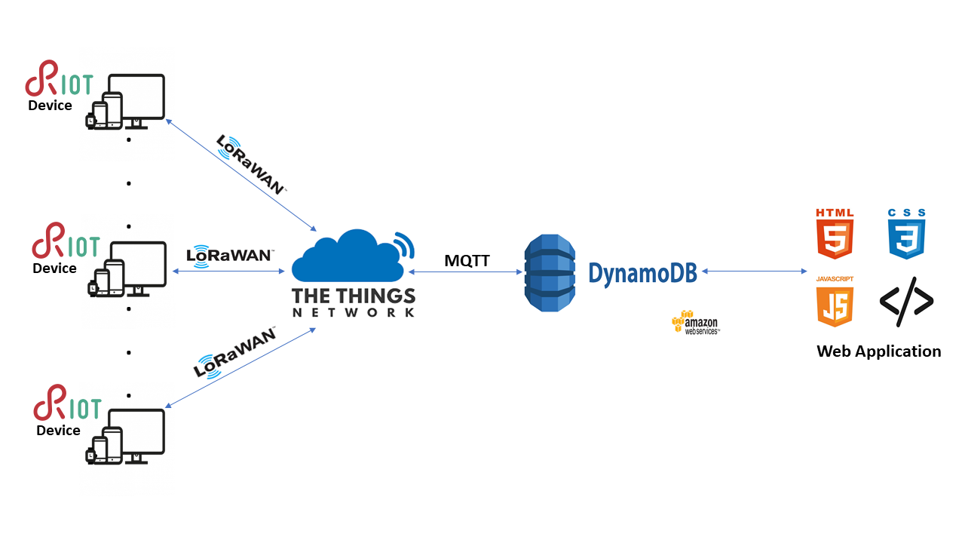

Software Schema

Slide 15
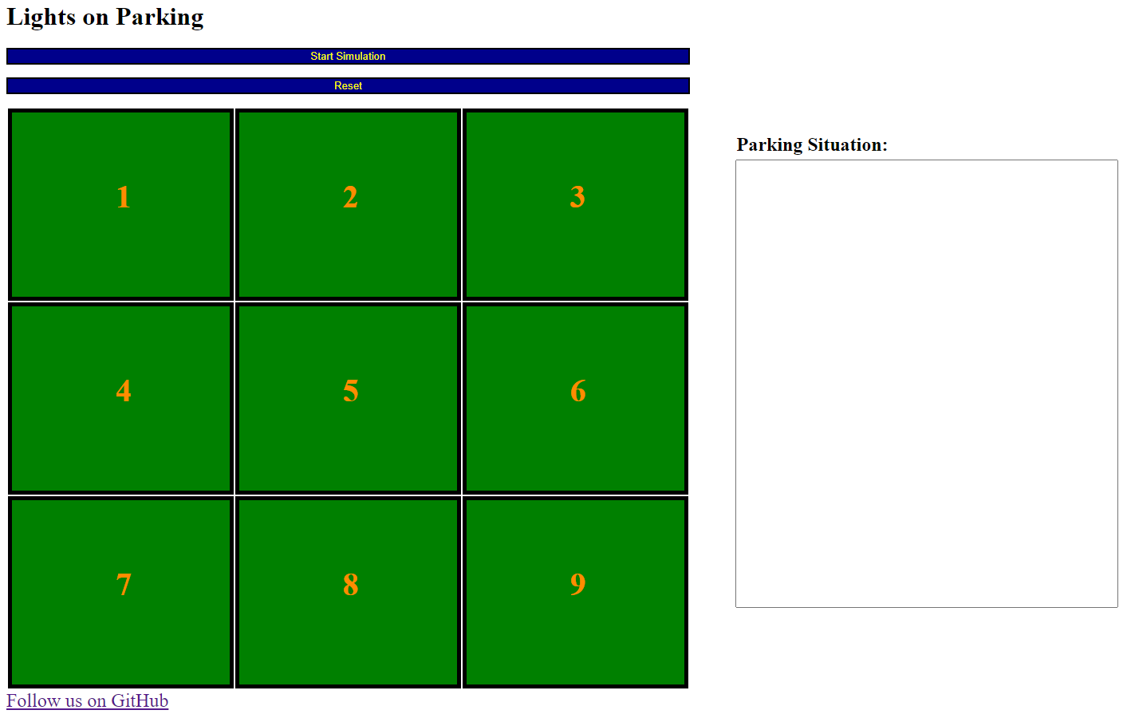
Web Page

Slide 16
The code
The device measures by means of the ultrasonic sensor the distance from the car and there are two cases:
There is a car → the parking lot is occupied.
There is nothing → the parking lot is free.
The update of the data in the cloud is done only when there is a change of the state.

Slide 17
The demo
The demo is available here:
https://www.youtube.com/watch?v=2jt28GkLYO0&t=4s

Slide 18
EVALUATION

Slide 19
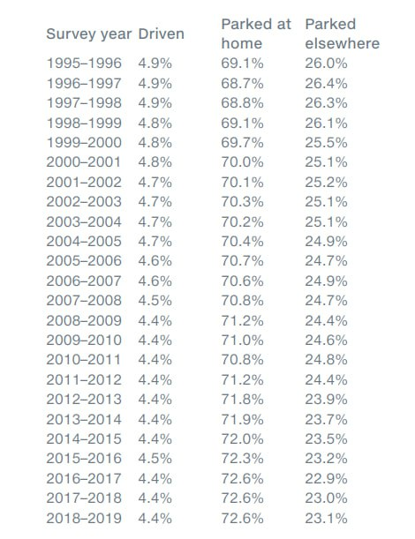
Our assumptions
Website link

Slide 20
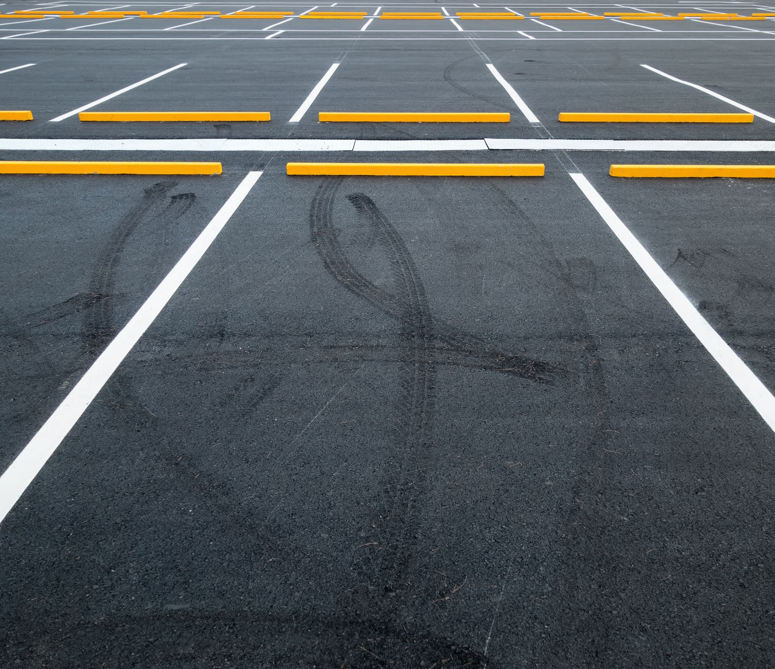
Energy consumption
We have analyzed energy consumption trying to reduce it efficently.
Our measurements change according to the states of parking spaces.
The states are:
Free: data measure every 30 seconds;
Occupied: data measure every 10 minutes.

Slide 21
Device Consumptions
Battery: 14000mAh power bank
Ultrasonic sensor consumes 15mAh
Board STM32 consumes:
12.7mAh in run mode
0.82mAh in sleep mode

Slide 22

Three specific evaluation cases

Slide 23
Constantly connected device
In 1 hour it consumes (15 + 12.7) mA = 27.7mAh
In one day it consumes 664.8mAh
The device discharges after approximately 21 days.

Slide 24
Device with always free parking (worst case)
We check parking situation every 30 seconds.
58s sleep mode. -> 3480s of sleep mode -> consumes 0.79mA in one hour.
2s run mode. -> 120s of run mode -> consumes 0.42mA in one hour
Overall in 1 hour it consumes (0.79 + 0.42) mA = 1.21mA.
In one day it consumes 29.04mA.
The device discharges after approximately 482 days.

Slide 25
Device with always occupied parking (best case)
We check parking situation every 10 minutes.
3594s of sleep mode in 1 hour -> consumes 0.818mA in one hour
6s of run mode in 1 hour -> consumes 0.046mA in one hour
Overall in 1 hour it consumes (0.818 + 0.046) mA = 0.864mA
In one day it consumes 20.736mA.
The device discharges after approximately 675 days.

Slide 26
Radio usage
Sending data only:
Empty parking space -> Occupied parking space.
Occupied parking space -> Empty parking space.

Slide 27
Latency
T_{Ultrasonic} = 1s
T_{Air} = 0.05s
T_{Air} = 0.07s - 0.08s.
T_{Cloud} = 2s
T_{Ultrasonic}+T_{Message}+T_{Air}+T_{Cloud} = 1s+0.05s+0.08s+2s≃3s

Slide 28
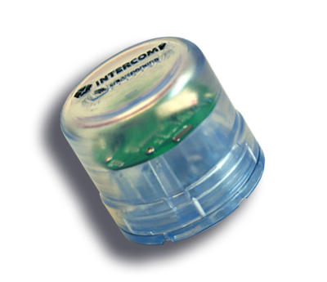
Future plans
-Electromagnetic sensor
-Edge computing

Slide 29
THANKS FOR WATCHING!

