Slide 1
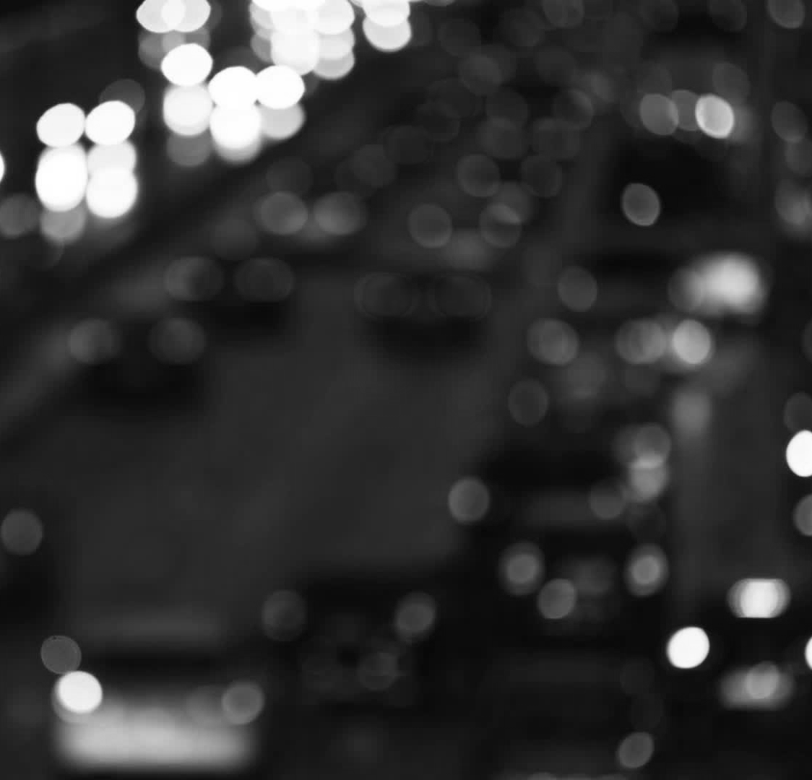
LIGHTS ON PARKING

Slide 2
Brief description
Lights on Parking is a project born from the desire to give a solution to the problem of finding a parking space, in all circumstances, when you go to work, to university or go out for a little fun.
Thanks to our device, no one will have any more problems finding a free parking space.

Slide 3
We collected the requirements, interviewing people who use their cars in different areas: a little city, a big city or a suburban area of a city.
Requirements

Slide 4
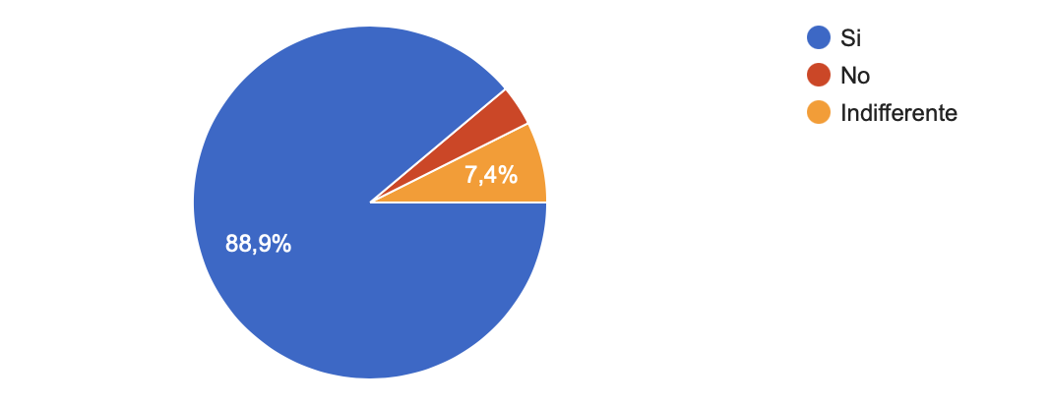
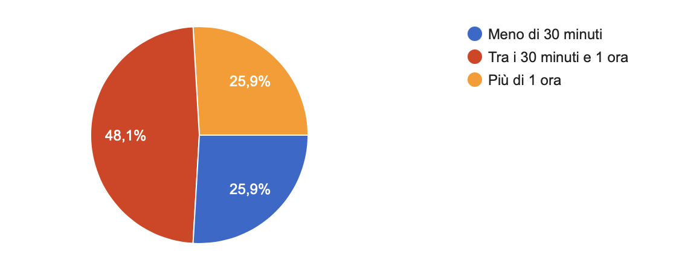
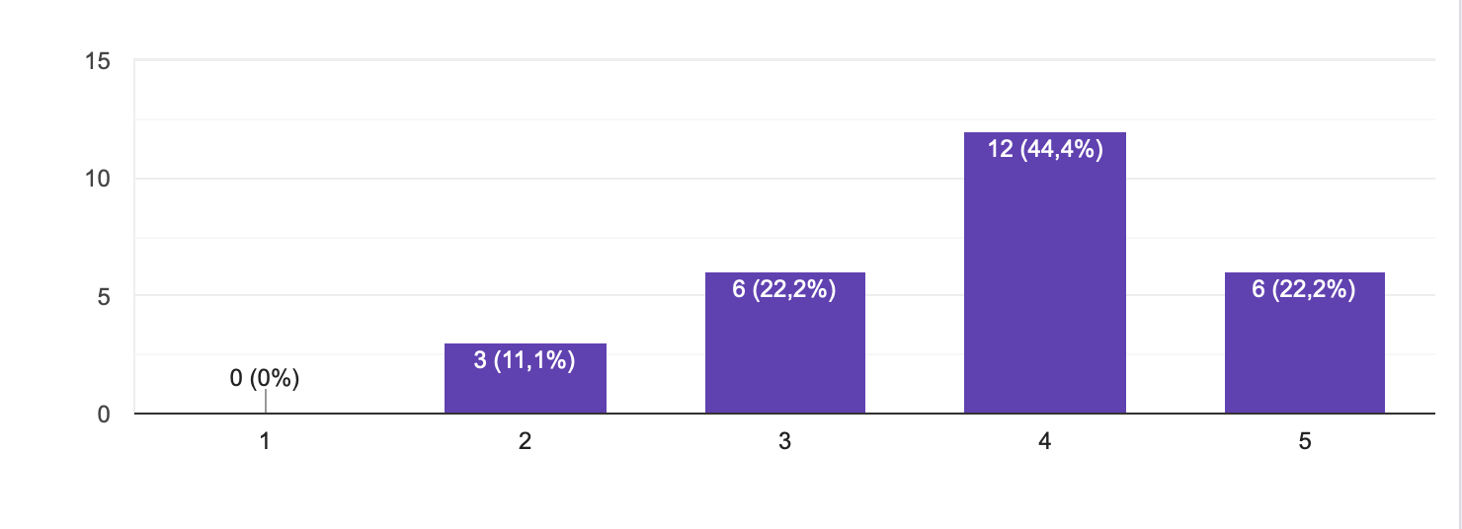
A smart way to find a parking space efficiently
Less time spent in the car;
Less stress for the drivers;

Slide 5
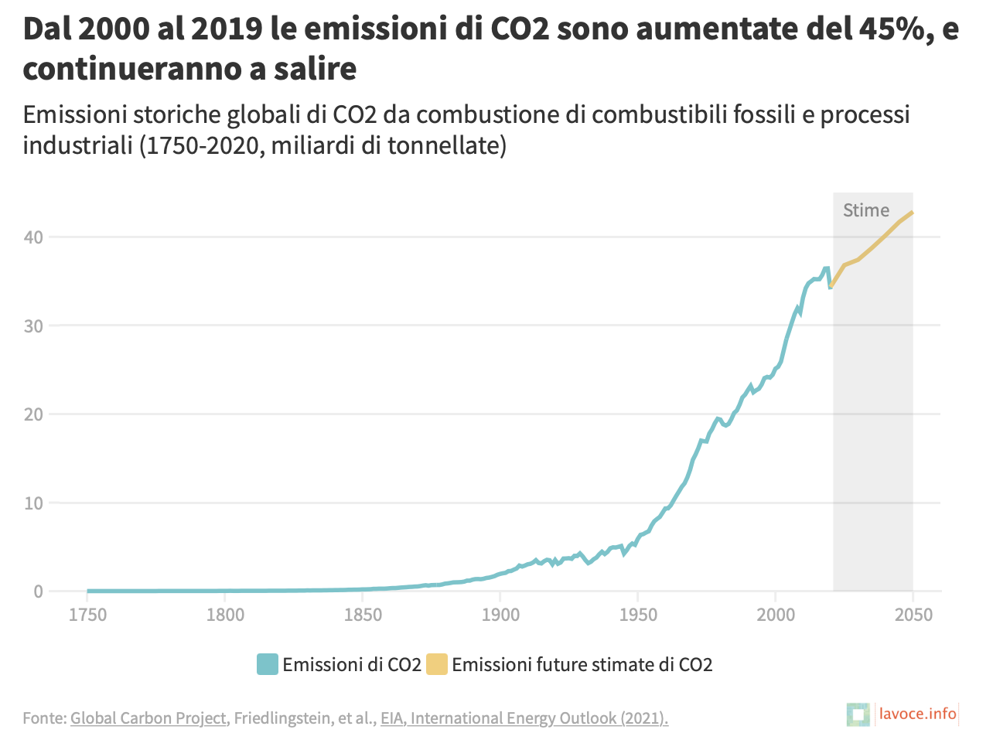
Reduction of traffic due to the search for a parking space; Reduction of fuel emission (economic aspect); Reduction of fuel consumption (ambiental aspect).

Slide 6

THE DEVICE

Slide 7
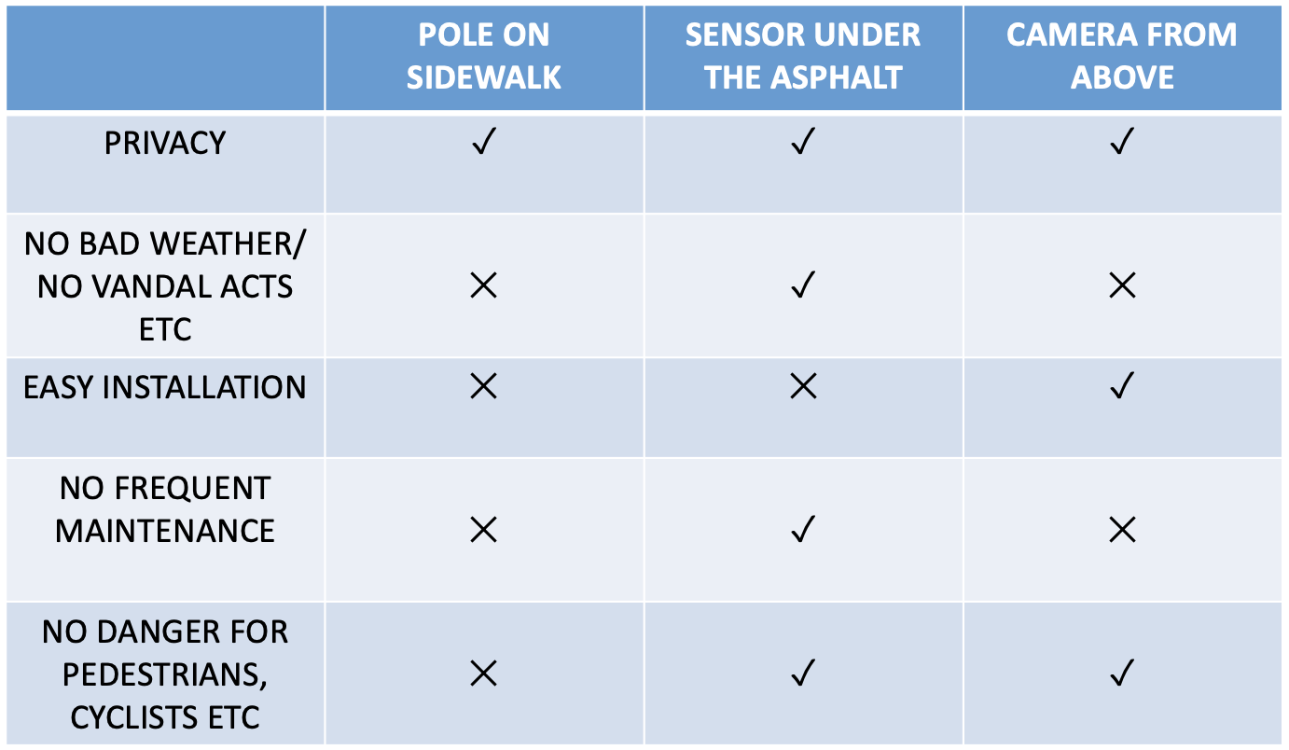
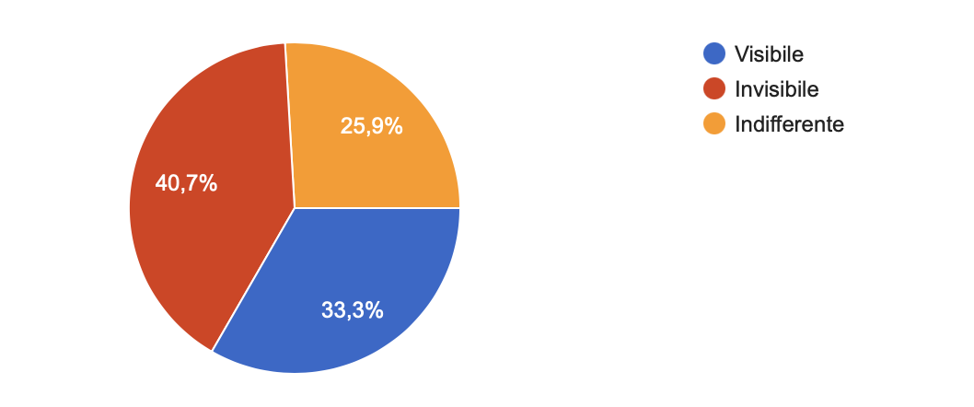
Devices Requirements
People preferred the invisible device
We have analyzed the requirements and we have choosen for our project sensor under the asphalt.

Slide 8
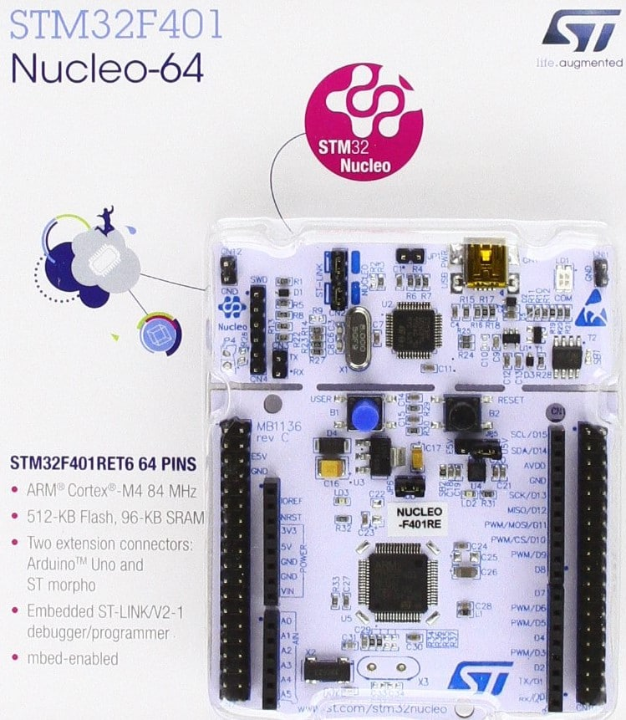
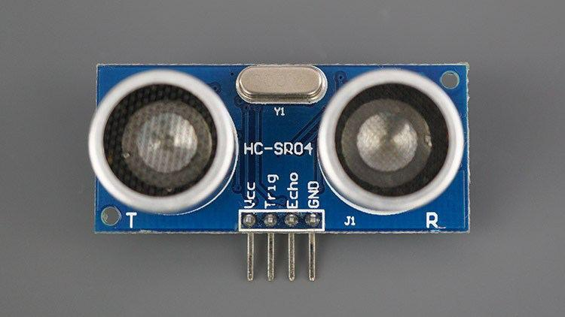
STM32 NUCLEO-64 F401RE:
a versatile board used to build prototypes, combining performaces and low power consumes.
HC-SR04:
an ultrasonic sensor uses sonar to determine distance to an object.

Slide 9
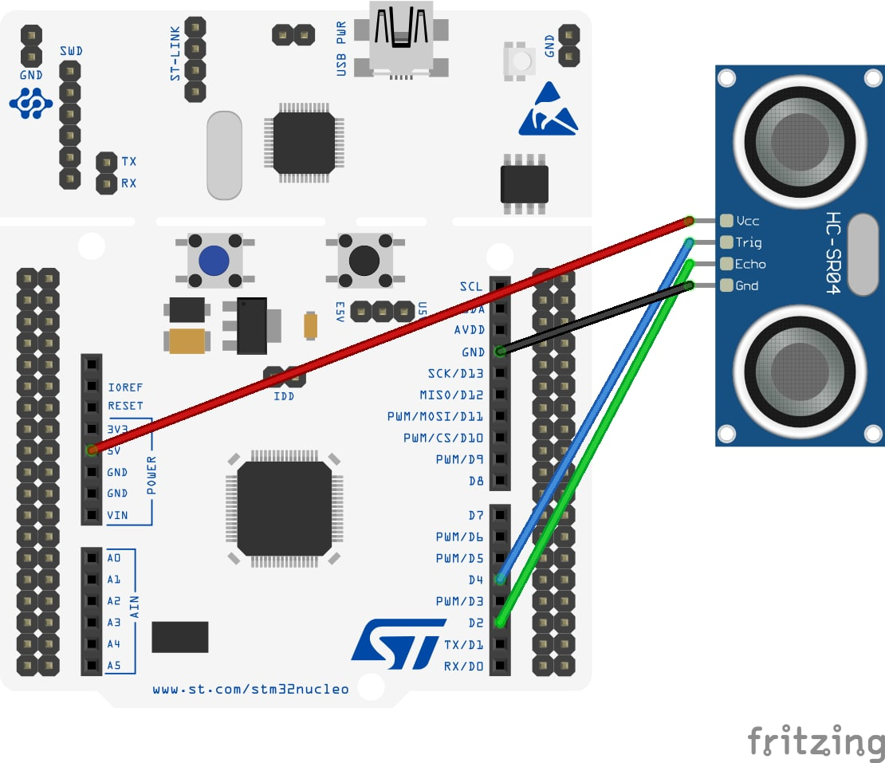
Hardware Schema
The project is built in a STM32 Nucleo-64 board, in which we implemented an ultrasonic proximity sensor which is used to determine when a car is parked in a certain parking space.

Slide 10
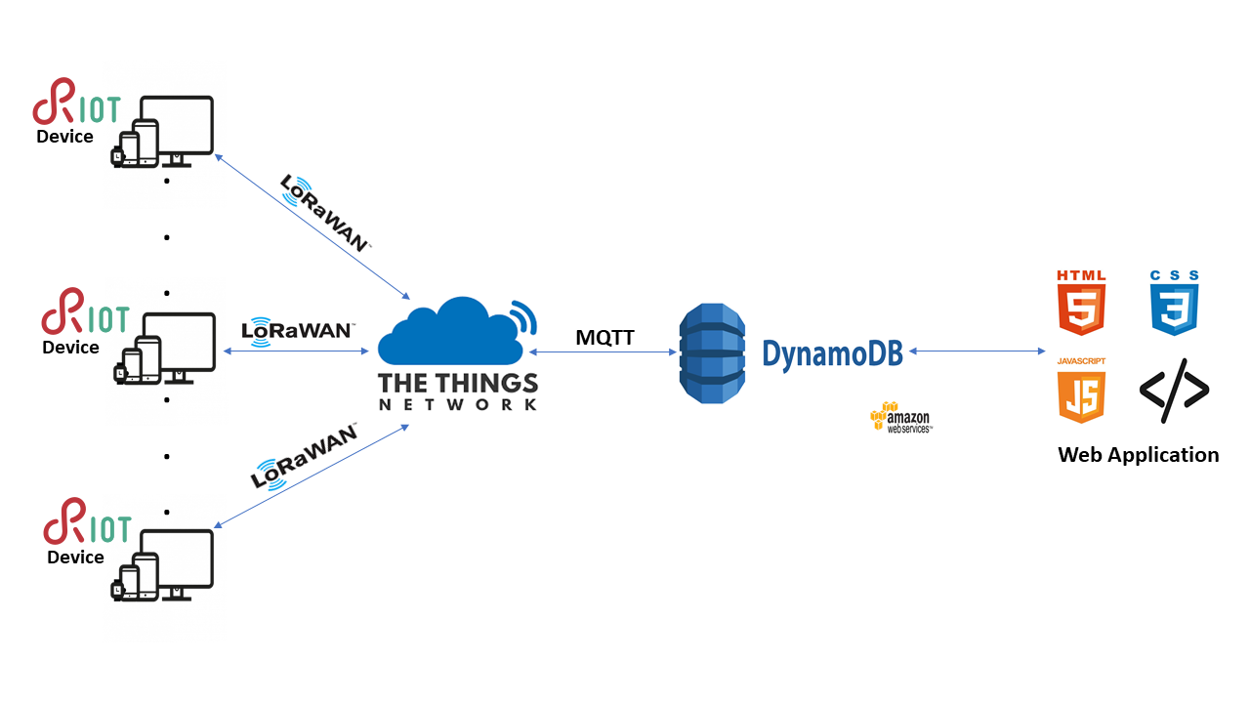
Software Schema

Slide 11
The code
The device is is positioned under the asphalt.
The code works in the following way: it measure by means of the ultrasonic sensor the distance from the car and there are two cases:
There is a car → the parking lot is occupied.
There is nothing → the parking lot is free.
The update of the date on the table in the cloud is done only when there is a change of the state (from free to occupied or from occupied to free).

Slide 12
The demo
The demo is available here:
https://www.youtube.com/watch?v=2jt28GkLYO0&t=4s

Slide 13
The code
The device is is positioned under the asphalt.
The code works in the following way: It measure by means of the ultrasonic sensor the distance from the car and there are two cases:
There is a car → the parking lot is occupied.
There is nothing → the parking lot is free.
The update of the date on the table in the cloud is done only when there is a change of the state (from free to occupied or from occupied to free).

Slide 14
EVALUATION https://youtu.be/5KO33bAF0us

Slide 15
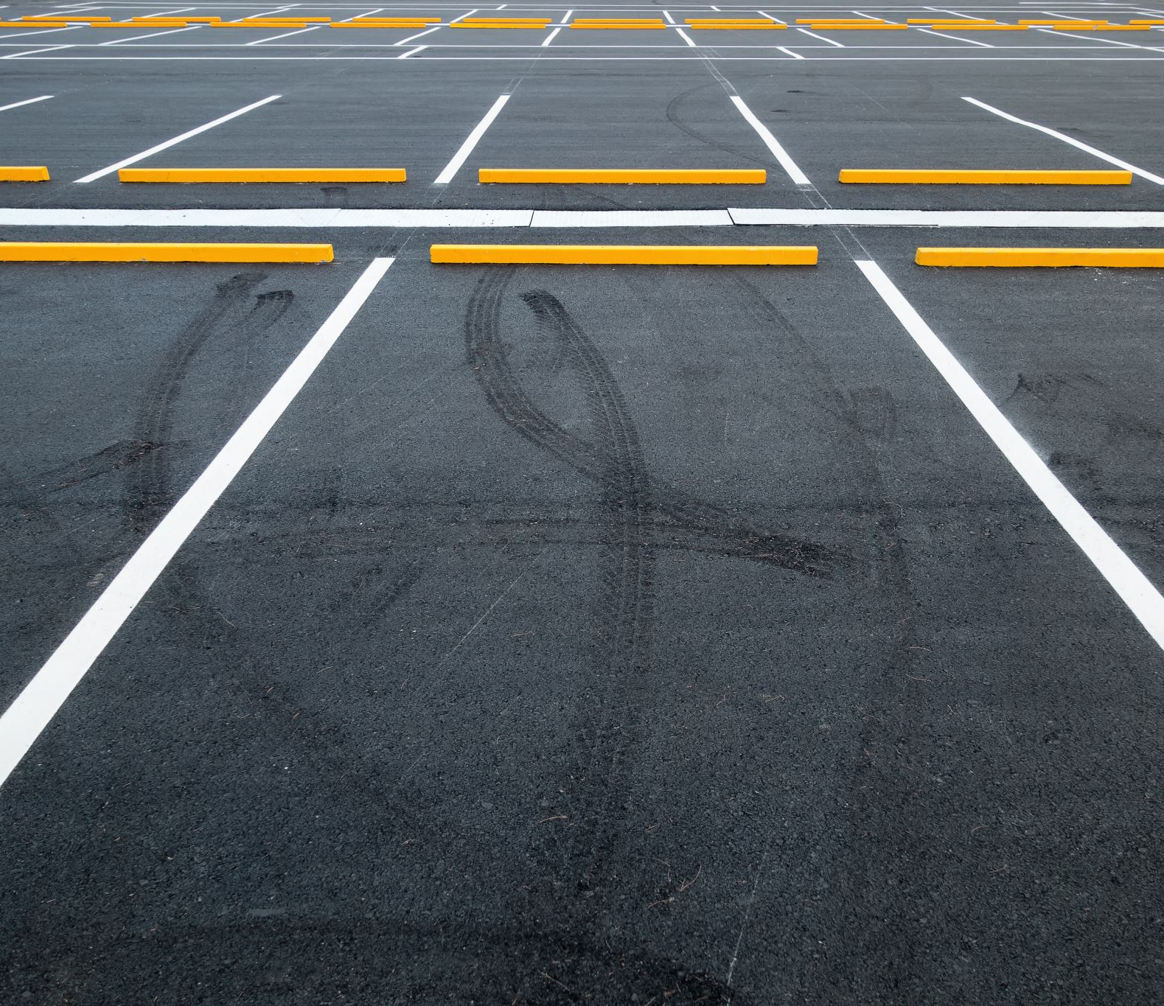
Energy consumption
We have analyzed energy consumption trying to reduce it efficently.
Our measurements change according to the states of parking spaces.
The states are:
if the parking space is free, our idea is to measure the data every minute;
if the parking space is occupied, the idea is to measure the data every 10 minutes.

Slide 16
Device Consumptions
Battery: 14000mAh power bank
Ultrasonic sensor consumes 15mAh
Board STM32 consumes:
12.7mAh in run mode
0.82mAh in sleep mode

Slide 17

Three specific evaluation cases

Slide 18
Constantly connected device
In 1 hour it consumes (15 + 12.7) mA = 27.7mAh
In one day it consumes 664.8mAh
The device discharges after approximately 21 days.

Slide 19
Device with always free parking (worst case)
We check parking situation every minute.
59s sleep mode. -> 3540s of sleep mode -> consumes 0.80mA in one hour.
1s run mode. -> 60s of run mode -> consumes 0.46mA in one hour
Overall in 1 hour it consumes (0.80 + 0.46) mA = 1.26mA.
In one day it consumes 30.42mA.
The device discharges after approximately 460 days.

Slide 20
Device with always occupied parking (best case)
We check parking situation every 10 minutes.
3594s of sleep mode in 1 hour -> consumes 0.818mA in one hour
6s of run mode in 1 hour -> consumes 0.046mA in one hour
Overall in 1 hour it consumes (0.818 + 0.046) mA = 0.864mA
In one day it consumes 20.736mA.
The device discharges after approximately 675 days.

Slide 21
Future plans
This is the list of our future plans for the project:
Evaluation of battery consumption for the sending of data;
Precise evaluation of data by analyzing with IoT-Lab / INA;
Connecting devices with Lora and edge computing;
Web Application.

Slide 22
THANKS FOR WATCHING!

