Slide 1
Lights on parking

Slide 2
Concept
1

Slide 3
Nowadays in highly populated cities finding a free parking space can be really complicated, and this problem can cause in addition to waste of time, unnecessary congestion of the roads.

Slide 4
Internet of Things
A smart city is an urban area in which, thanks to the use of digital technologies and more generally of technological innovation, it is possible to optimize and improve the infrastructures and services to citizens, making them more efficient.

Slide 5
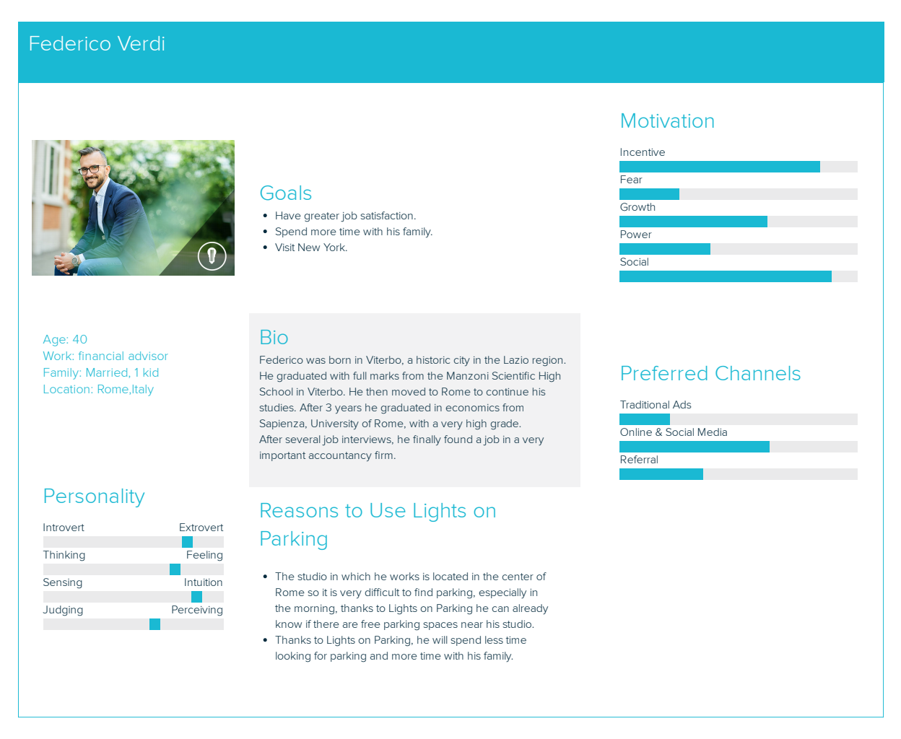
User 1

Slide 6
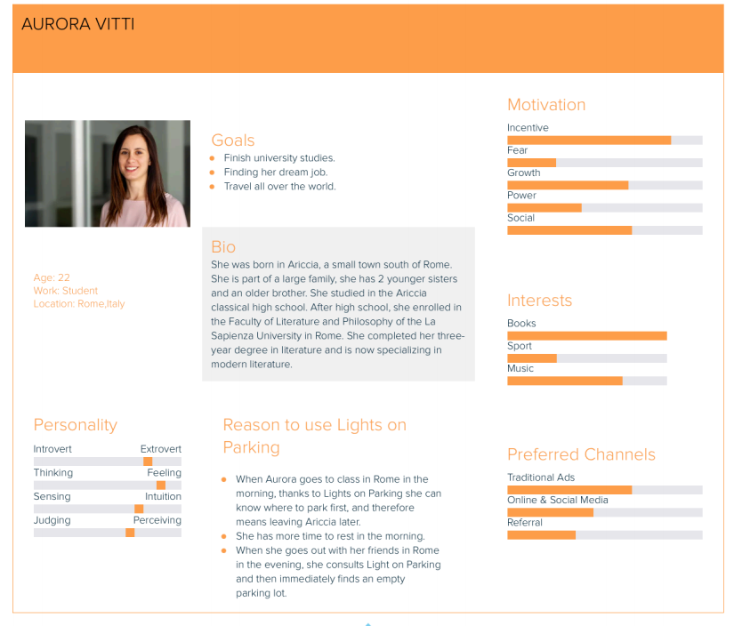
User 2

Slide 7
The idea
The project is born with the idea of to provide to the users a smart way to find parking lots.

Slide 8
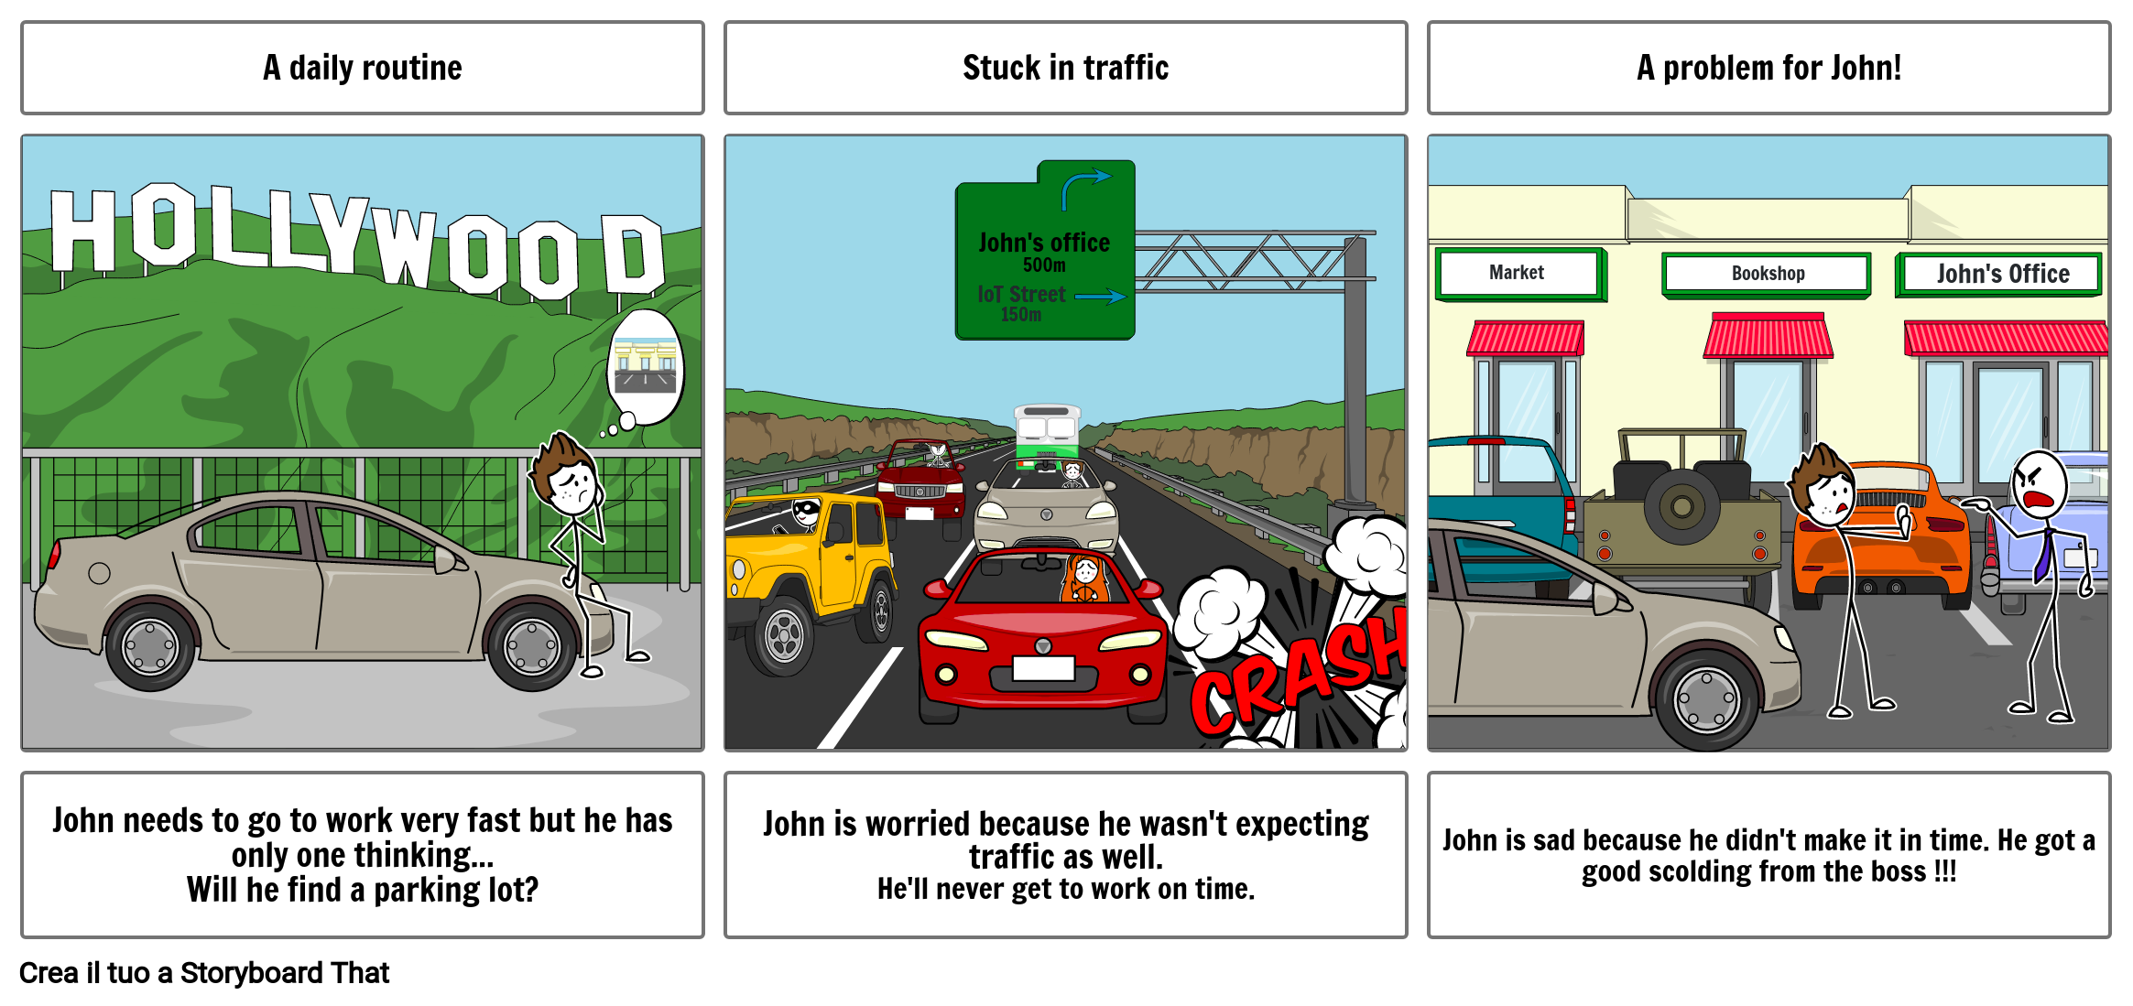
The storyboards – Problem 1

Slide 9
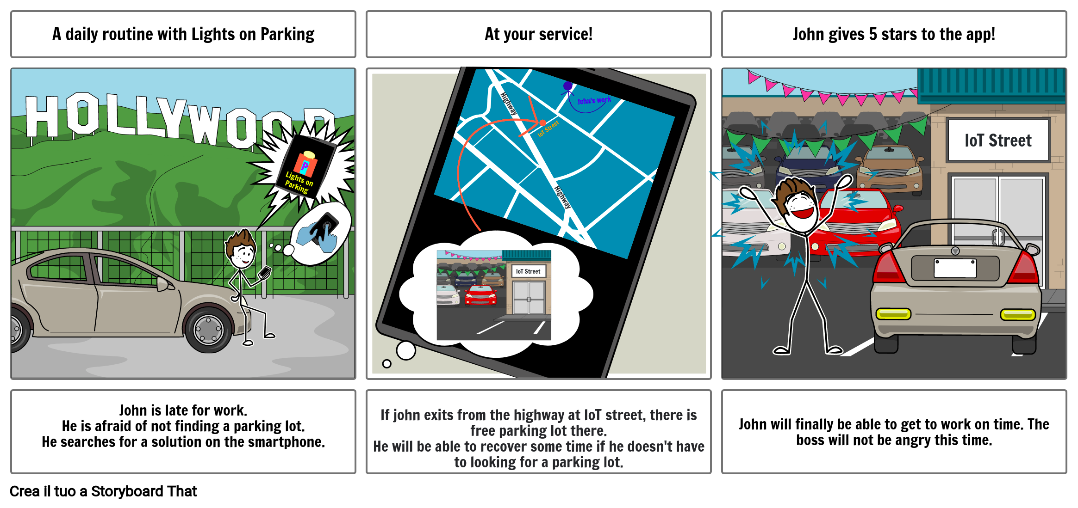
The storyboards – Solution 1

Slide 10
But not only
There is also a smart lighting system thanks to which the sidewalk is illuminated when a pedestrian passes by the pole.

Slide 11
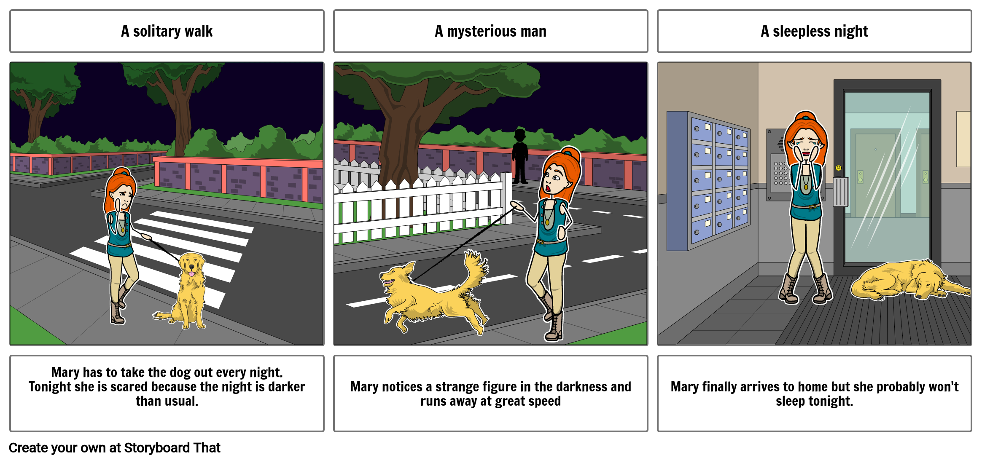
The storyboards – Problem 2

Slide 12
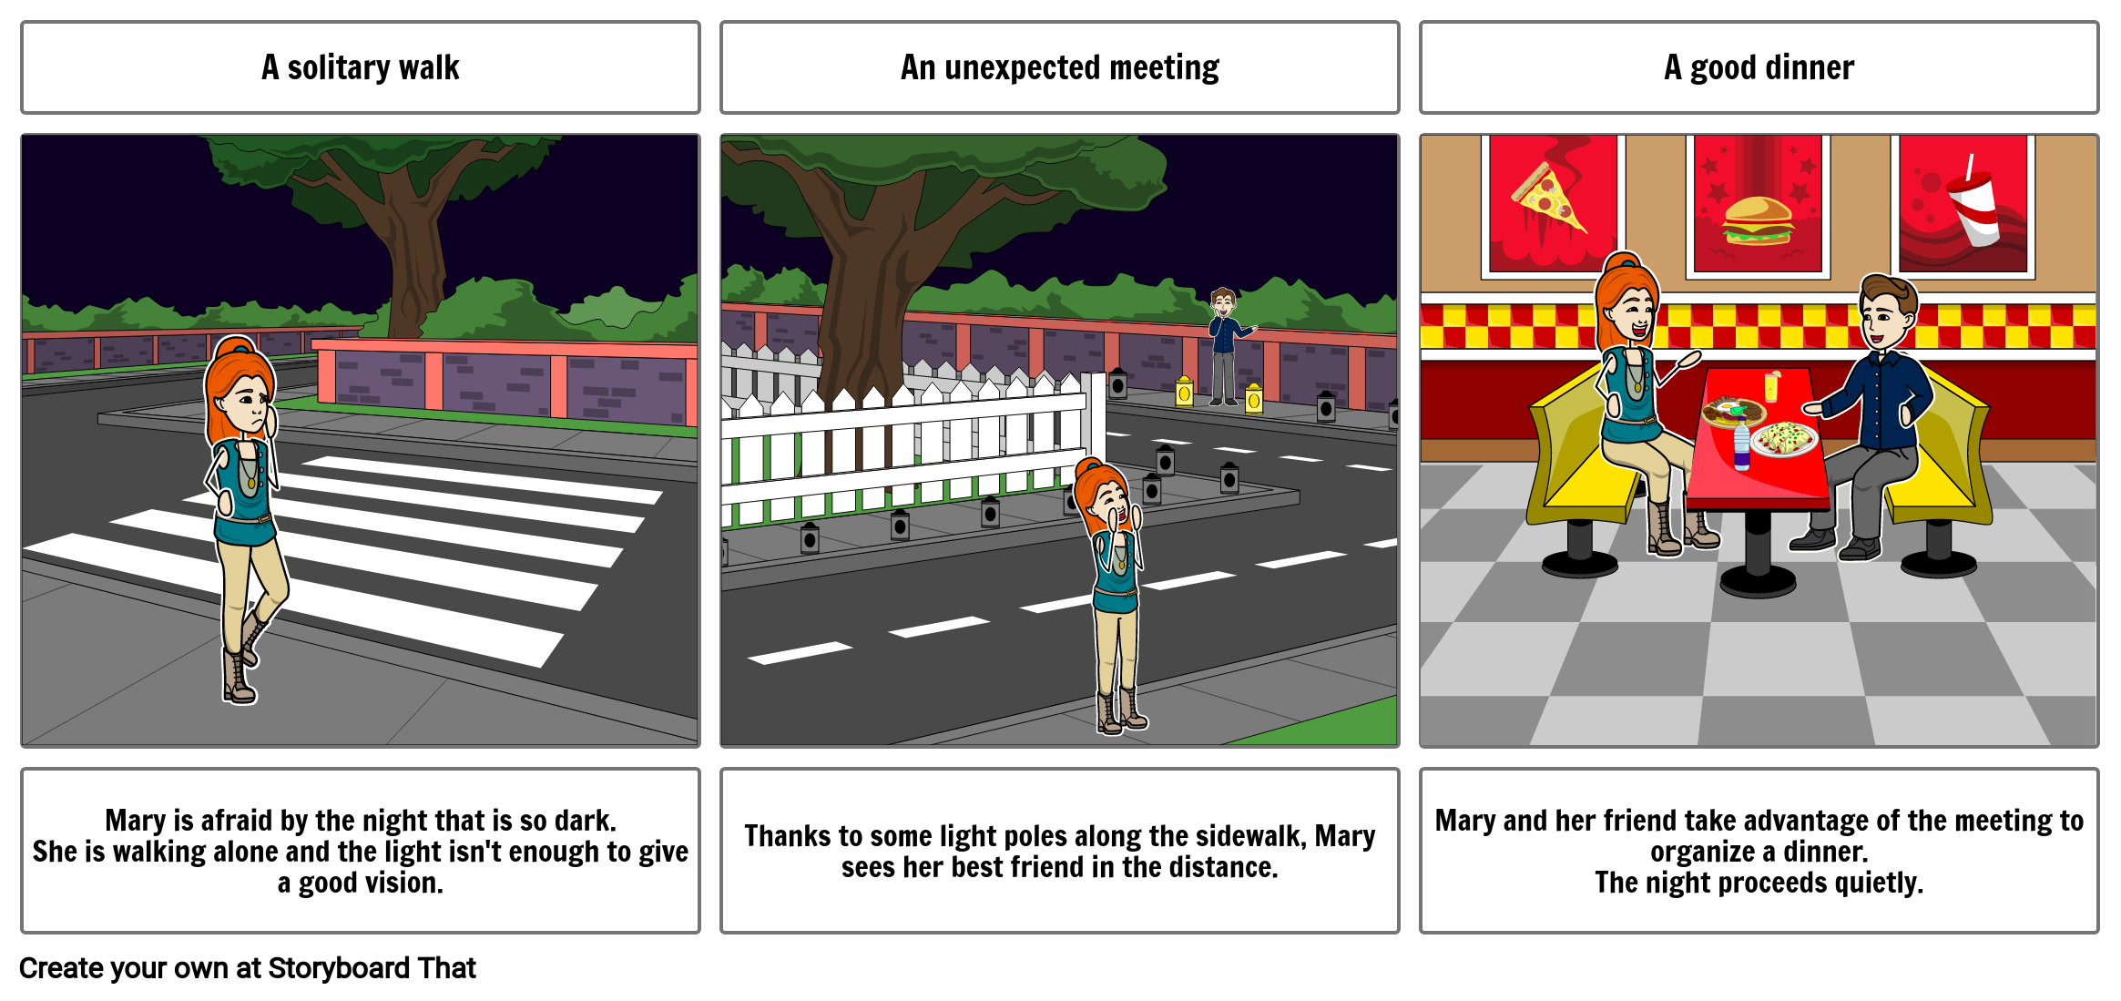
The storyboards – Solution 2

Slide 13
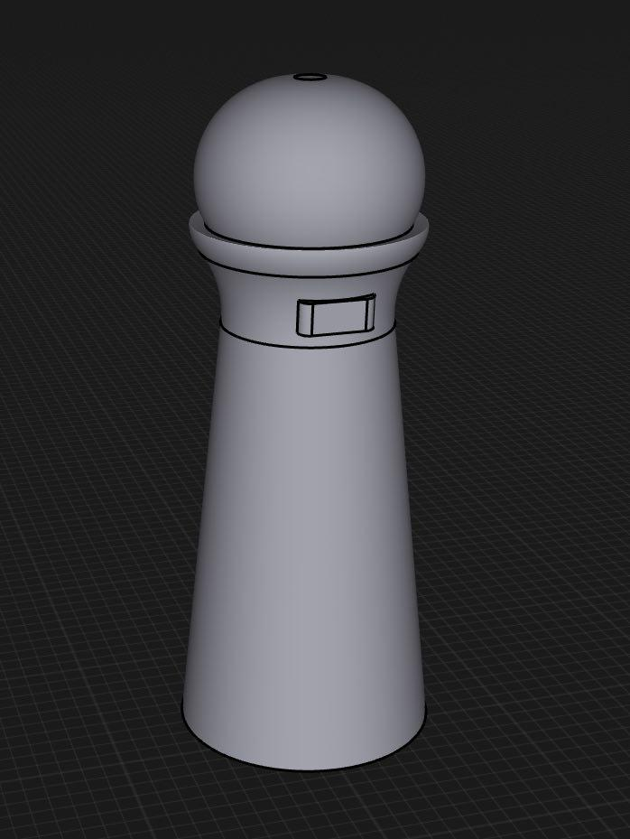
Prototype
The IoT device in question is placed on a pole, place beside the parking lot on the sidewalk.
Parking
On the one hand the device provides parking control
Pedestrian
On the other hand it provides another service: the smart lighting system.

Slide 14

Web page
The user can interact with the system by means of a web app and to deduce whether or not he could find a parking space in that area before leaving for that destination.

Slide 15
Technology
2

Slide 16
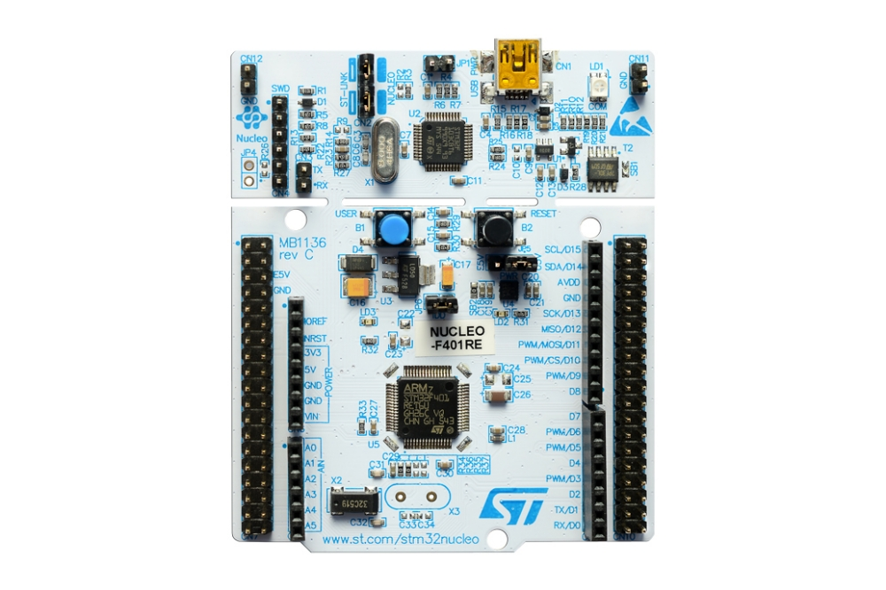
Hardware
The project is built in a STM32 Nucleo-64 board, in which we implemented an ultrasonic proximity sensor and a movement sensor.

Slide 17
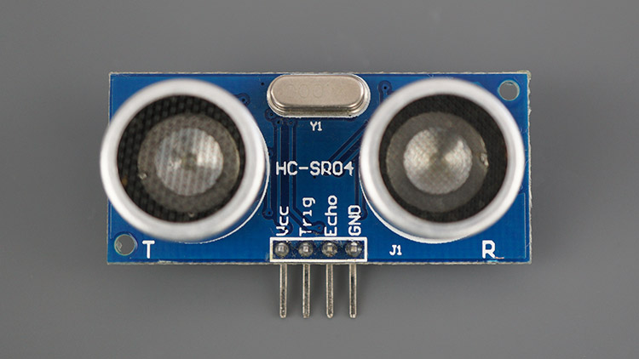
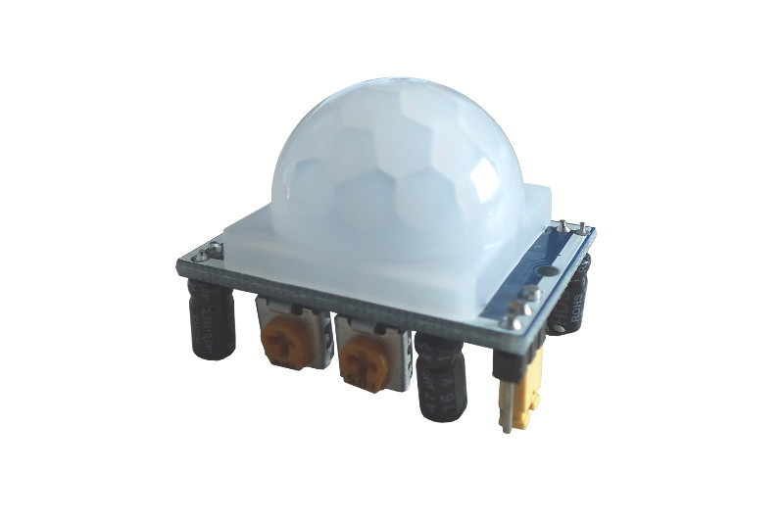
Sensors
Ultrasonic sensor
Ultrasonic sensor uses sonar to determine distance to an object like bats or dolphins do.
Movement sensor
Sensor detects motion by measuring changes in the infrared levels emitted by surrounding objects.

Slide 18
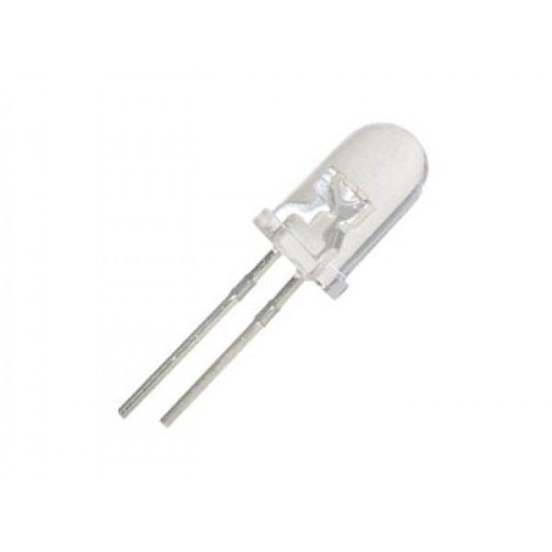
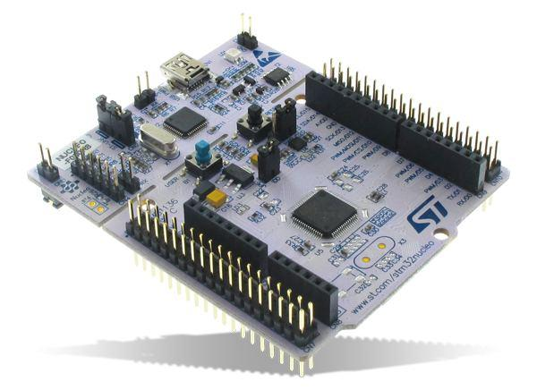


Scheme of hardware components
SOFTWARE
COMPONENTS

Slide 19
Software
RIOT is a small operating system for networked, memory-constrained systems with focus on low-power wireless Internet of Things devices. It is open-source software.
RIOT is based on a microkernel architecture and in contrast to other operating systems with similarly low memory use, it allows applications software programming with the programming language C and C++, also by an experimental API

Slide 20


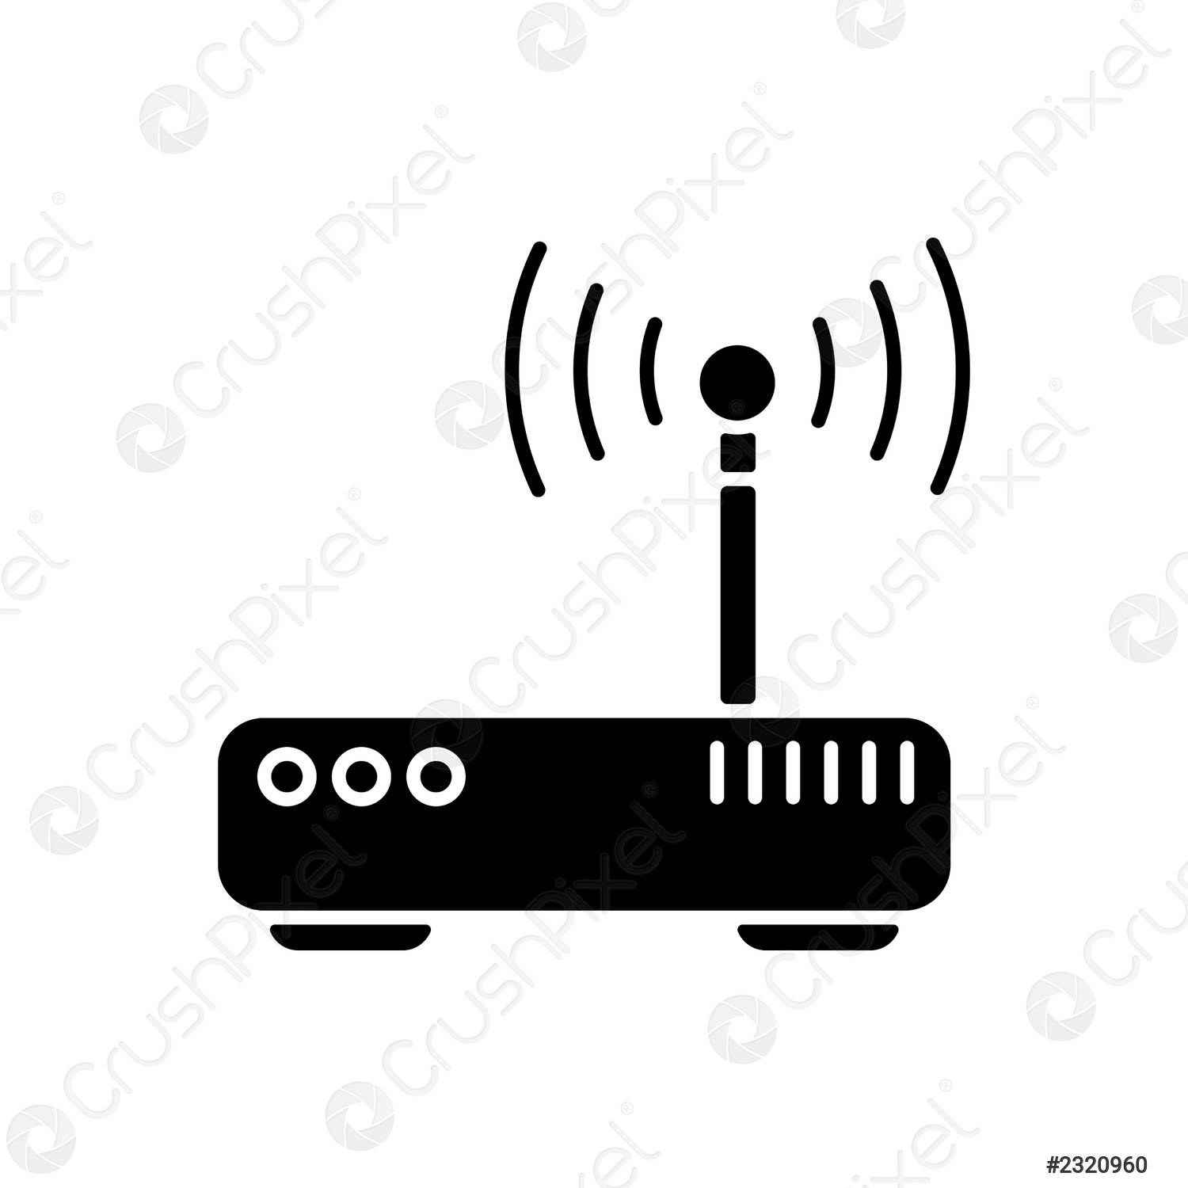

Scheme of software components
LoRa-Wan
MQTT
LoRa-Wan
LoRa-Wan

Slide 21
Evaluation
3

Slide 22
Network Technologies
We expect the connection between poles devices and the gateway is handled by the LoRa-Wan protocol.
The gateway communicates with the AWS Cloud via MQTT.

Slide 23
Embedded Device
We expect energy consumption to be limited to avoid having to carry out too frequent maintenance.
We plan to update the devices every few minutes so as not to burden the battery.
As we do not have the prototype, we cannot yet evaluate the actual consumption.

Slide 24
Costs of Hardware
STM32 Nucleo Board: € 13,56
PIR Motion Sensor: € 3,00
Ultrasonic Sensor: € 2,90
Led Light: € 1,00

Slide 25
THANKS!
Any questions?
You can find us at:
rucci.1794004@studenti.uniroma1.it
scalera.1649947@studenti.uniroma1.it
santamaria1666501.@studenti.uniroma1.it

