Slide 1

PrognosAI: AI-Driven Predictive Maintenance System Using Time-Series Sensor Data
Internship: Infosys Virtual Internship 6.0
Name: Chivukula Sai Rithivik
Data-Set: NASA C-MAPPS

Slide 2
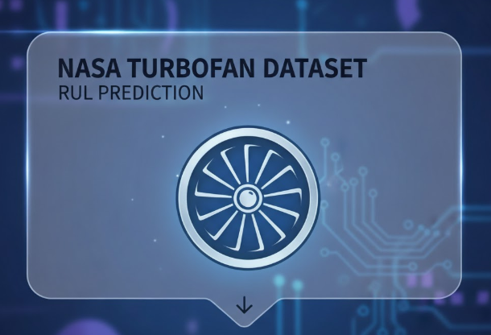
AGENDA
Objective
The internship focuses on predicting the Remaining Useful Life (RUL) of turbofan engines using an LSTM-based model. This enables proactive maintenance, reducing downtime and improving engine reliability and safety. The model analyzes historical sensor data to capture temporal patterns, and results are visualized through dashboards for easy monitoring. The project demonstrates the application of deep learning for real-world predictive maintenance.

Slide 3
Dashboard Deployment
Model Building
Model Evaluation
Preprocessing
Internship Overview
RUL Prediction
For CMAPS
Dataset

Slide 4
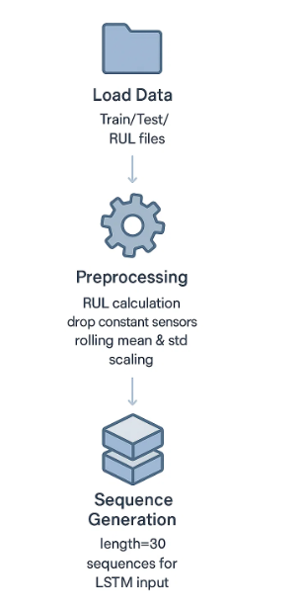
Milestone 1
1. Load Data
          Imported training (train_FD001.txt) and test (test_FD001.txt) datasets, along with true RUL labels (RUL_FD001.txt).
              Defined column names for engine settings and sensor readings.
2. Preprocessing
RUL Calculation: Added Remaining Useful Life (RUL) to training data (RUL = max_cycle - current_cycle, capped at 125).
Sensor Selection: Dropped constant sensors to reduce noise.
Feature Engineering: Added rolling mean & standard deviation (window=5) for each sensor.
Scaling: Min-Max normalization applied to all features.
3. Sequence Generation
Generated sequences of length 30 for LSTM input.
Each sequence contains sensor features + RUL label.
Training sequences from all cycles, test sequences aligned with true RUL.
4. Save Processed Data
All sequences saved as a compressed .npz file for model training (FD004_sequences.npz).

Slide 5
Milestone 2
1. Model Architecture
Input: Sequences of length 30 × number of sensor features.
LSTM Layers:
128 units → Dropout 0.3 → BatchNorm
        64 units → Dropout 0.3 → BatchNorm
        32 units → Dropout 0.3 → BatchNorm
        Batch Normalization stabilizes learning by normalizing layer inputs, improving convergence.
Dense Layers:
64 → ReLU → Dropout 0.2
  32 → ReLU → Dropout 0.2
  1 output neuron (RUL prediction)
  Dense layers map extracted sequential features to RUL; ReLU adds non-linearity, dropout prevents overfitting.
2. Compilation & Loss
Optimizer: Adam
Loss: Mean Squared Error (MSE)
Metric: Mean Absolute Error (MAE)
3. Training Strategy
Epochs: 100, Batch size: 64, Validation split: 15%
Callbacks:
    EarlyStopping: Stops training if validation loss doesn’t improve, preventing overfitting.
    ReduceLROnPlateau: Reduces learning rate when loss plateaus for stable convergence.
4. Evaluation Metrics
RMSE: Measures prediction error magnitude
R² Score: Indicates how well predicted RUL matches actual values

Slide 6
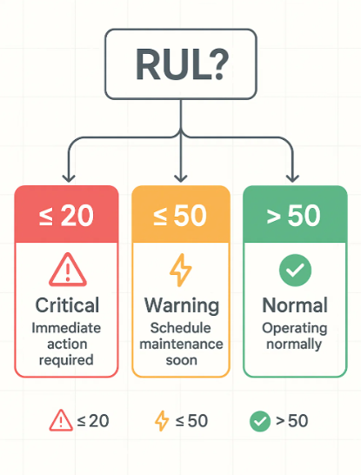
Milestone 3
Loaded Test Data & Trained Model
Imported the saved LSTM model (fd004_model.h5)
  Loaded the test sequences and their true RUL values
  Used the model to predict the RUL for all test samples
  Calculated Evaluation Metrics
  Computed RMSE, MAE, and R² score to measure prediction accuracy
Labeled the Predictions
Assigned condition labels based on predicted RUL:
  Normal, Warning, Critical
Generated Visual Analyses
Created plots showing predicted vs actual RUL, residual distribution, and bias trends
Saved All Results
Exported metrics, labeled data, and bias analysis as CSV files
Saved all plots in the results folder

Slide 7
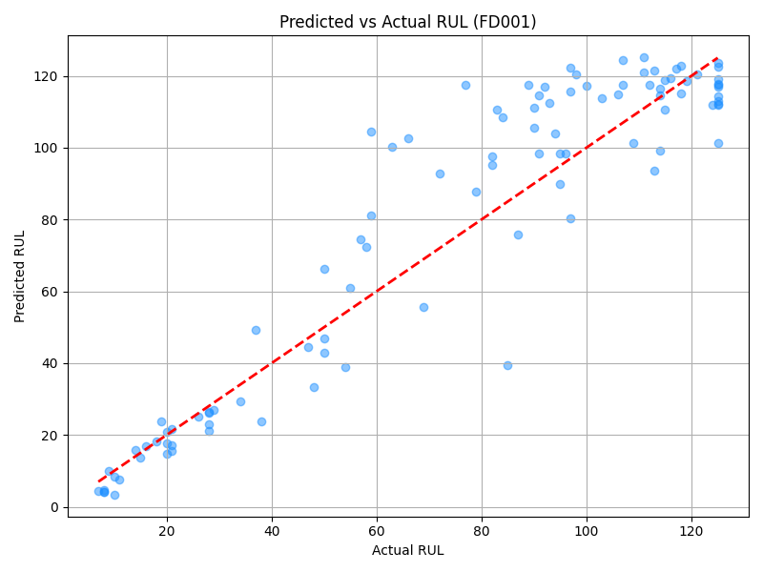
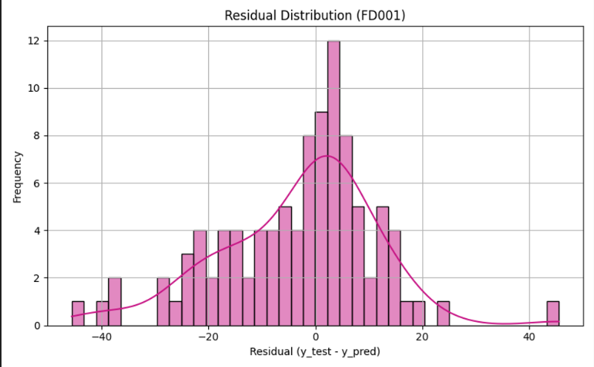
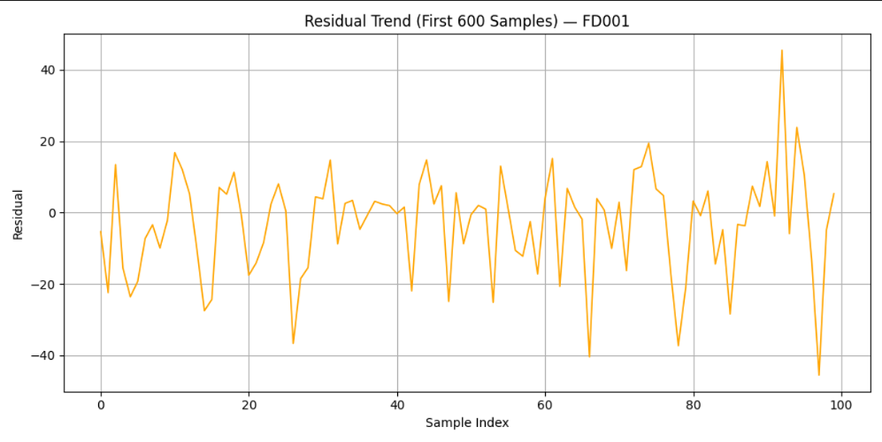
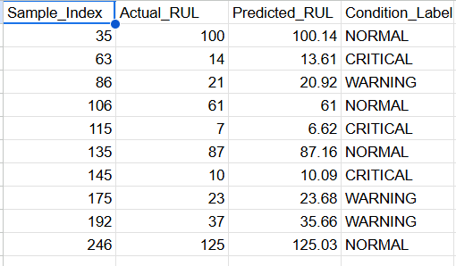
Results of the milestone 3

Slide 8
Milestone 4
Data & Model Loading:
Loads preprocessed test sequences (.npz) and trained LSTM models (.h5) for each FD dataset (FD001–FD004).Fetches label CSVs for reference.
Prediction & Evaluation:
  Uses the model to predict RUL values.
  Computes key metrics — RMSE, MAE, and R² Score for accuracy assessment.
Interactive Dashboard (Dash + Plotly):
Dropdown to select FD dataset.
Metric Cards display evaluation scores.
Graphs:
  Predicted vs Actual RUL – model performance
  Residual Histogram – error distribution
  RUL Trend Plot – temporal comparison of predictions
Table showing label data (first 10 rows).
Deployment:
Hosted locally with Dash Bootstrap styling for a professional UI.
Accessible via browser: http://127.0.0.1:8050/

Slide 9
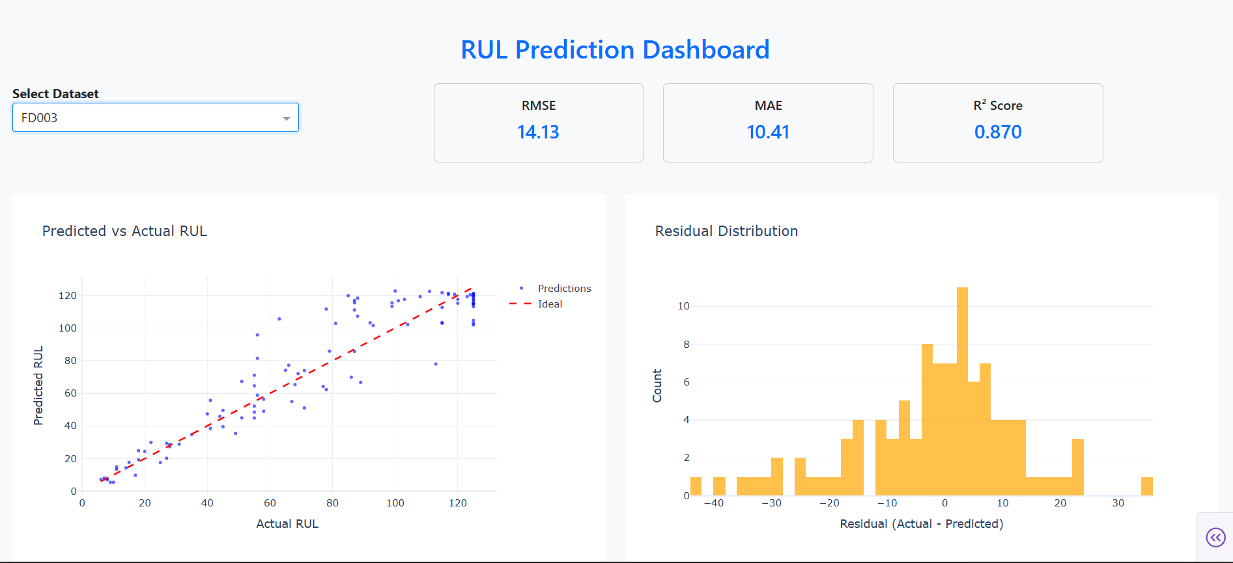
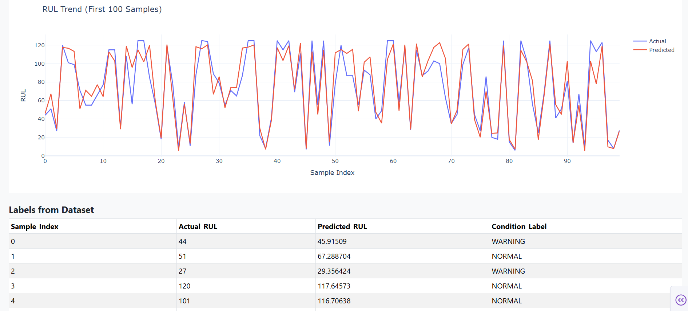
Results of the milestone 4

Slide 10
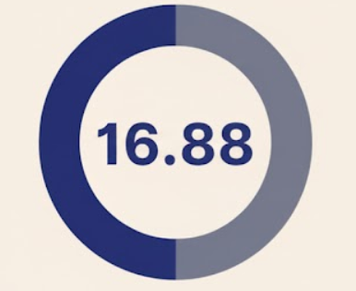
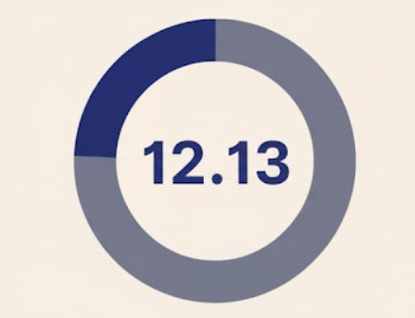
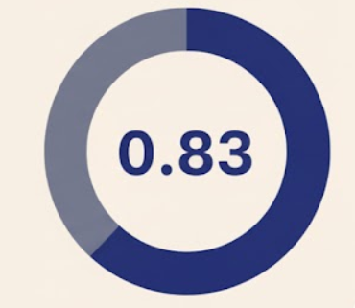
Overall Performance
RMSE
MAE
R² Score
Indicates overall prediction error level.
Shows average deviation in RUL prediction.
Represents model’s prediction accuracy..

Slide 11
Final Architecture Diagram
C-MAPS Dataset
Preprocessing
Model building
Dash board deployment
Model Evaluation

Slide 12
References
Kaggle. C-MAPS Turbofan Dataset
GeeksforGeeks. LSTM Neural Networks in Python. Available at: https://www.geeksforgeeks.org/deep-learning/long-short-term-memory-networks-using-pytorch/
TensorFlow Documentation. Keras API Guide. Available at: https://www.tensorflow.org/guide/keras
Scikit-learn Documentation. Preprocessing and Metrics Modules. Available at: https://scikit-learn.org/stable/modules/preprocessing.html
Matplotlib and Seaborn Documentation. Data Visualization Libraries in Python. Available at: https://matplotlib.org/stable/contents.html and https://seaborn.pydata.org/
NumPy Documentation. Array and Numerical Computation Library. Available at: https://numpy.org/doc/
Acknowledgements
I would like to express my sincere gratitude to my mentor for their continuous guidance, encouragement, and insightful feedback throughout the course of this internship. I am also thankful to my peers and colleagues for their support, collaborative spirit, and valuable discussions.
I acknowledge the use of open-source libraries such as NumPy, Pandas, Scikit-learn, TensorFlow/Keras, Matplotlib, and Seaborn that were instrumental in implementing preprocessing, model building, and evaluation pipelines. I also appreciate platforms like Kaggle for providing the C-MAPSS dataset and GeeksforGeeks for helpful tutorials and resources on LSTM model implementation.

Slide 13

Thank You!

