Slide 1
PrognosAI: AI-Driven Predictive Maintenance System Using Time-Series Sensor Data
Prepared by: Durga Veera Prasad V
Dataset: NASA Turbofan Jet Engine (CMAPSS)

Slide 2
Abstract
PrognosAI is an AI-driven predictive maintenance framework that estimates the Remaining Useful Life (RUL) of turbofan jet engines using time-series sensor data. The system integrates deep learning, dynamic alerting, and visualization dashboards to provide interpretable insights and optimize maintenance planning.

Slide 3
Introduction and Objectives
Predictive maintenance aims to forecast equipment failures before they occur.
Objectives:
- Develop an LSTM model for accurate RUL prediction
- Implement dynamic alerts for maintenance scheduling
- Provide a real-time visualization dashboard

Slide 4
Dataset Description
Source: NASA CMAPSS Dataset
Features: 21 sensors + 3 operational settings
Units: Multiple engine units (FD001–FD004)
Target: Remaining Useful Life (RUL)

Slide 5
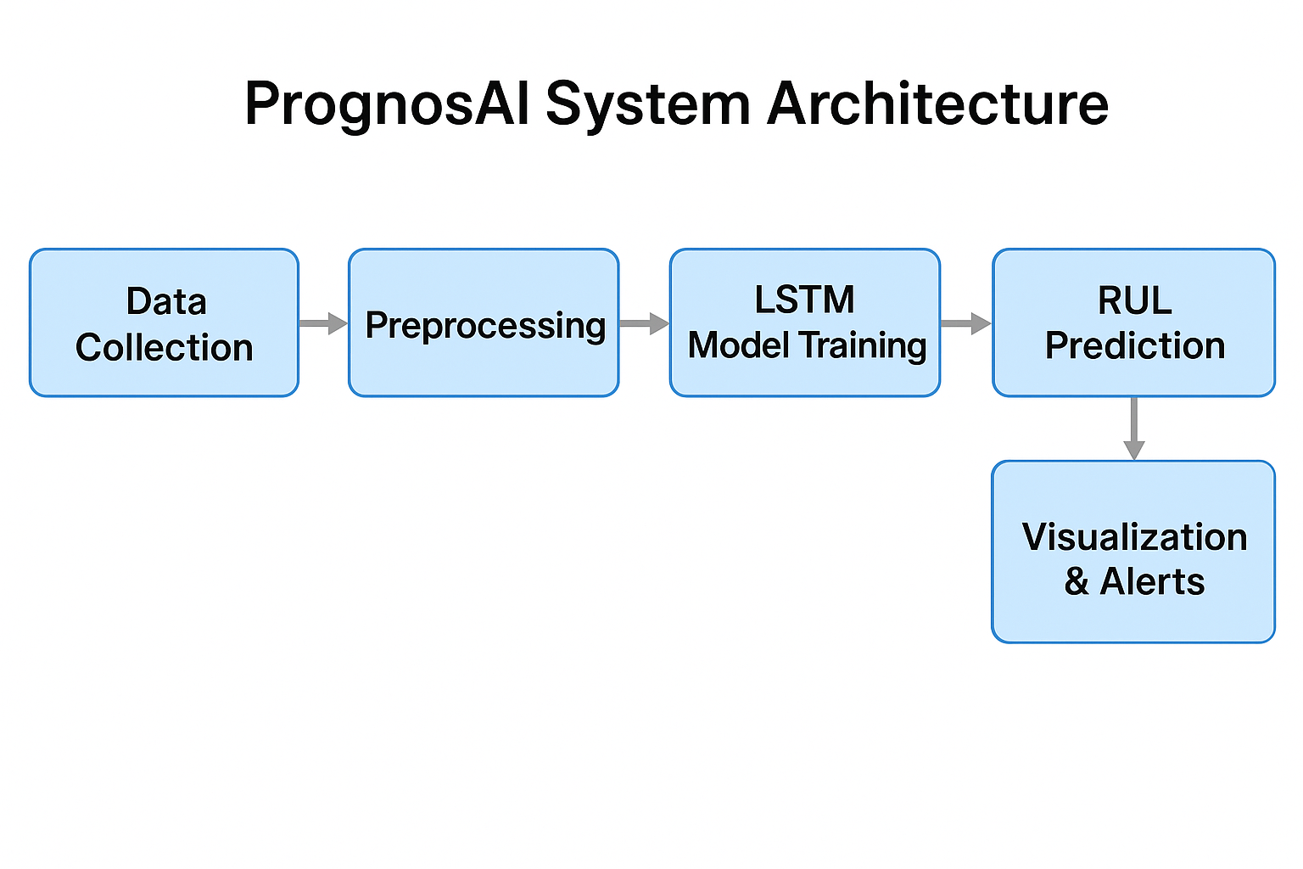
System Architecture
Workflow: Data Collection → Preprocessing → Feature Scaling → LSTM Model Training → RUL Prediction → Visualization & Alerts
Figure 1: PrognosAI System Architecture
Figure1: PrognosAI System Architecture

Slide 6
Milestone 1 – Data Preparation
• Loaded CMAPSS datasets
• Calculated RUL per engine cycle
• Applied MinMaxScaler for normalization
• Generated time-window sequences for LSTM input
Libraries: pandas, numpy, sklearn.preprocessing

Slide 7
Milestone 2 – Model Development
• Built LSTM model using Keras Sequential API
• Layers: LSTM(128) → Dropout → Dense(64, 32, 1)
• Optimizer: Adam | Loss: MSE
• Used 5-Fold Cross-Validation
• Saved model and scalers for deployment
Libraries: tensorflow, keras, sklearn

Slide 8
Milestone 3 – Evaluation and Alert System
• Achieved R² > 0.95 with low RMSE and MAE
• Dynamic alert thresholds:
- Critical: RUL ≤ 20%
- Warning: 20% < RUL ≤ 50%
- Normal: RUL > 50%
• Generated alert summaries and visual reports
Libraries: numpy, pandas, sklearn.metrics, matplotlib, plotly

Slide 9
Milestone 4 – Visualization Dashboard
• Developed interactive Streamlit dashboard
• Allowed upload of test CSV/TXT files
• Displayed engine-wise RUL predictions and alerts
• Supported result download and threshold control
Libraries: streamlit, pandas, numpy, plotly, joblib, tensorflow.keras
Figures 2,3 and 4: Dashboard Screens, RUL Trends, Alert Distribution

Slide 10
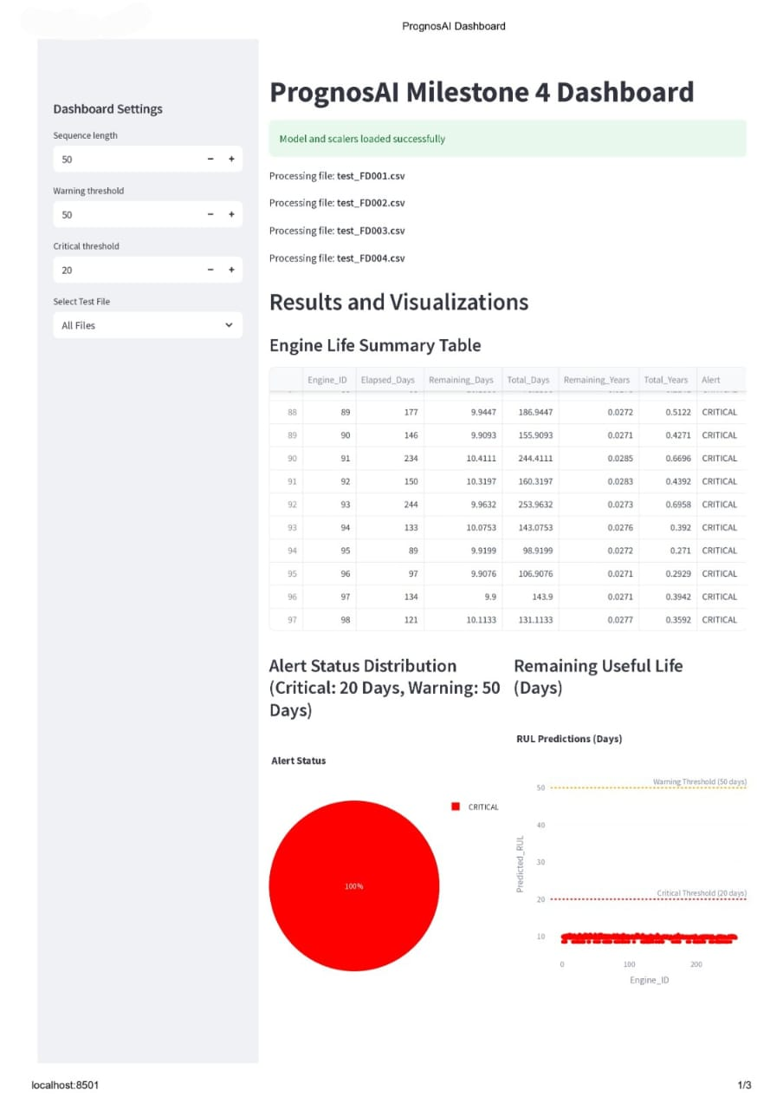
Figure2: PrognosAI Dashboard Visualization

Slide 11
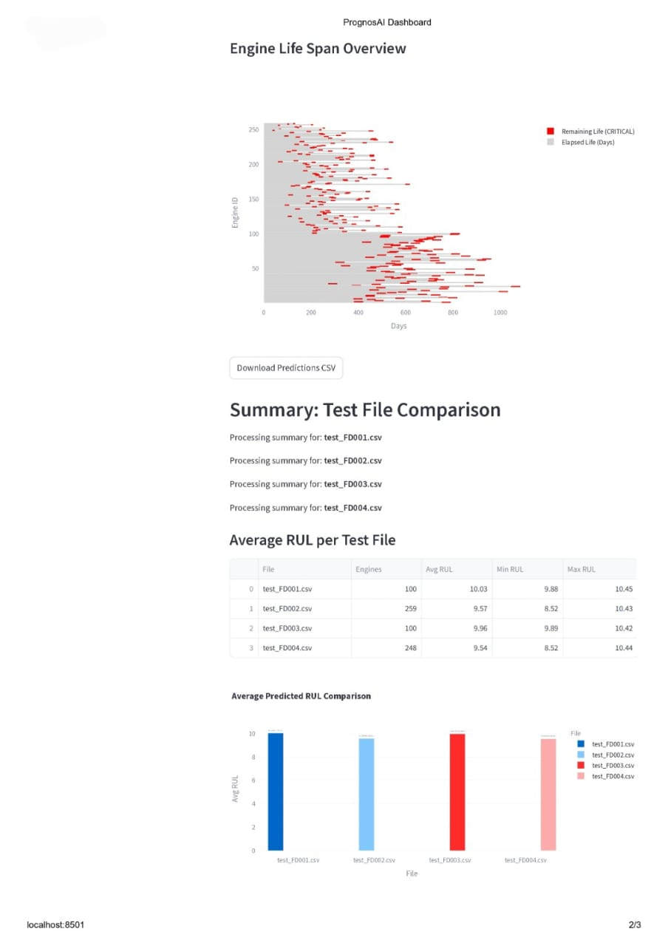
Figure3: PrognosAI Engine Life Span

Slide 12
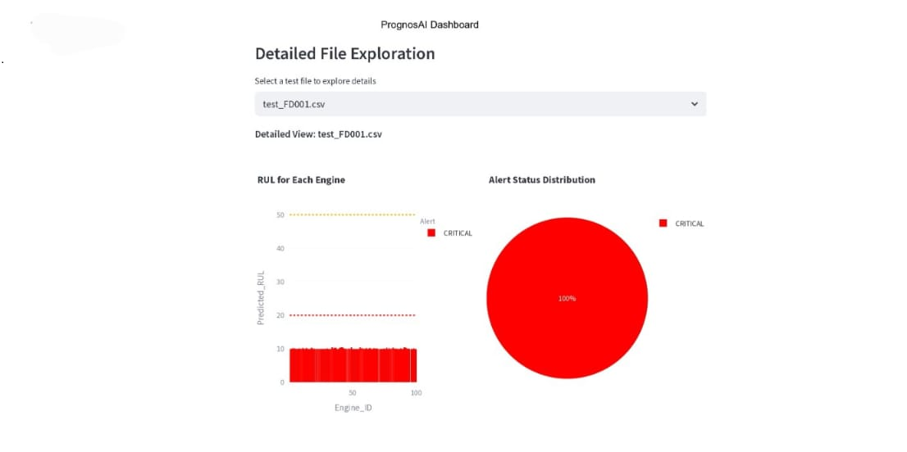
Figure4: PrognosAI Alert Distribution

Slide 13
Results and Performance
Metrics:
- R²: >0.95
- RMSE: Low
- MAE: Low
Highlights:
- Stable LSTM performance
- Accurate RUL predictions with low error
- Effective alert-based decision support

Slide 14
Conclusion and Future Scope
Conclusion:
PrognosAI effectively predicts Remaining Useful Life (RUL) using AI-based modeling and visualization.
Future Enhancements:
- Real-time IoT data integration
- Adaptive online learning
- Cloud deployment and API services

Slide 15
Acknowledgment
Grateful acknowledgment to mentor and NASA for CMAPSS dataset.
Thanks to peers and collaborators for support.

Slide 16
References and Tools Used
Languages: Python 3.10
Libraries: tensorflow, keras, pandas, numpy, sklearn, matplotlib, plotly, streamlit, joblib, reportlab
Dataset: NASA CMAPSS
Environment: Jupyter Notebook / VS Code / Streamlit

Slide 17
Thank You

