Slide 1


PrognosAI: AI-Driven Predictive Maintenance System
Using Time-Series Sensor Data from NASA CMAPSS
Presented by: Praveen Kumar S – IIIT Kottayam
Python
TensorFlow
Keras
Pandas
Matplotlib
Seaborn

Slide 2



Contents
01
Introduction & Motivation
02
Literature & Problem Scope
03
Methodology & Dataset
04
Model Architecture
05
Results & Evaluation
06
Insights & Applications
07
Conclusion & Future Work

Slide 3

01
Introduction & Motivation

Slide 4
Motivation: From Reactive to Predictive
Failure
Prediction
Prevention
Unplanned downtime & costly repairs.
AI forecasts Remaining Useful Life (RUL).
Proactive maintenance before breakdown.
Our core objective is to leverage AI to predict the Remaining Useful Life (RUL) of engines, enabling a shift from costly reactive fixes to efficient proactive maintenance.

Slide 5
02
Literature & Problem Scope

Slide 6
Literature Review: The Evolution to Deep Learning
Traditional ML
Deep Learning
Linear Regression, SVM
LSTM, GRU
Limited temporal understanding.
Effectively capture time dependencies.
Identified Gap & Our Solution:
Most research focuses on single datasets, leading to poor generalization. We address this by combining all four CMAPSS subsets (FD001–FD004) to build a universally robust model.

Slide 7
Problem Statement & System Goal
Sensor Input
AI Model
RUL Prediction
Maintenance Alert
Multivariate Time-Series Data
Hybrid BiLSTM+GRU Network
Remaining Useful Life
Proactive Decision Making
Build an AI system to predict RUL from complex sensor data, handling multiple fault types and conditions, to generate timely maintenance alerts and prevent critical failures.

Slide 8
Gaps in Existing Work & Our Solutions
Identified Gaps
Our Solutions
Lack of multi-condition generalization.
Training on combined datasets for universal performance.
Limited sensor interpretability.
In-depth sensor correlation analysis for insights.
No automatic alerting system.
Integrated risk-based alerting system.

Slide 9
03
Methodology & Dataset

Slide 10
Proposed AI Pipeline Methodology
Data Ingestion
Feature Engineering
Sequence Creation
Hybrid Model
Evaluation
Alerting & Viz

Slide 11
NASA CMAPSS Dataset Breakdown
The dataset comprises four subsets with varying complexity, totaling 21 sensor readings and 3 operational settings per engine.
FD001
FD002
Operating Conditions: 1 | Fault Modes: 1 | Engines: 100
Operating Conditions: 6 | Fault Modes: 1 | Engines: 260
~20k Samples
~49k Samples
FD003
FD004
Operating Conditions: 1 | Fault Modes: 2 | Engines: 100
Operating Conditions: 6 | Fault Modes: 2 | Engines: 249
~24k Samples
~61k Samples

Slide 12

Data Preprocessing & Feature Engineering
Normalization: Min-Max scaling applied per dataset.
Domain Encoding: One-hot vectors for dataset IDs (ds_FD00X).
Sequence Creation: Sliding window of 30 cycles.
Final Input Shape:
220,000 sequences × 25 features
Output: Single RUL value per sequence.

Slide 13
04
Model Architecture

Slide 14
Model Architecture
A hybrid design to capture both long-term and short-term temporal patterns.
Bidirectional LSTM (128 units)
Captures long-term dependencies by processing data in both forward and reverse directions.
GRU (64 units)
Learns short-term variations and refines the features extracted by the LSTM layer.
Loss: MSE | Optimizer: Adam | Metric: MAE

Slide 15
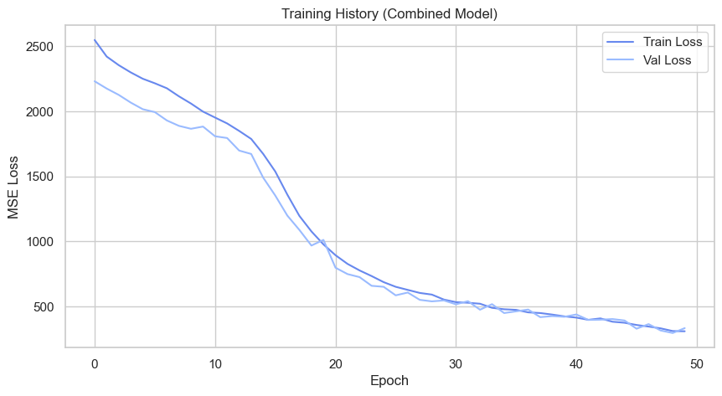
Training Configuration & Setup
Training Parameters
Epochs: 80, Batch Size: 64
Train/Validation Split: 80/20
Callbacks
Early Stopping (Patience=10)
ReduceLROnPlateau, ModelCheckpoint
Training Outcome
Stopped at Epoch 50 (Best Val Loss)
Hardware: 16GB RAM, CPU/GPU

Slide 16
05
Results & Evaluation

Slide 17
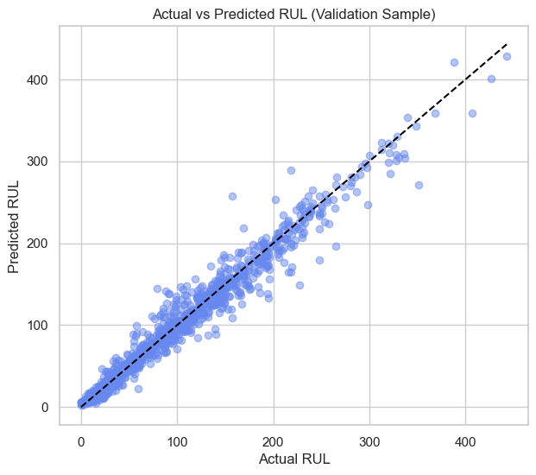
Training Performance Results
Epoch 1
Train MSE: 2573.08
Val MSE: 2231.30
Epoch 50 (Best)
Train MSE: 296.75
Val MSE: 334.21
✅ Loss steadily decreased
✅ Validation follows training
✅ RMSE ≈ 18.27 cycles

Slide 18
Cross-Dataset Model Evaluation
FD001
RMSE: 17.28 | MAE: 10.5
FD002
RMSE: 17.30 | MAE: 10.7
FD003
RMSE: 17.75 | MAE: 10.6
FD004
RMSE: 16.91 | MAE: 10.5
✅ The model demonstrates strong generalization across all four datasets, proving its robustness and adaptability.

Slide 19
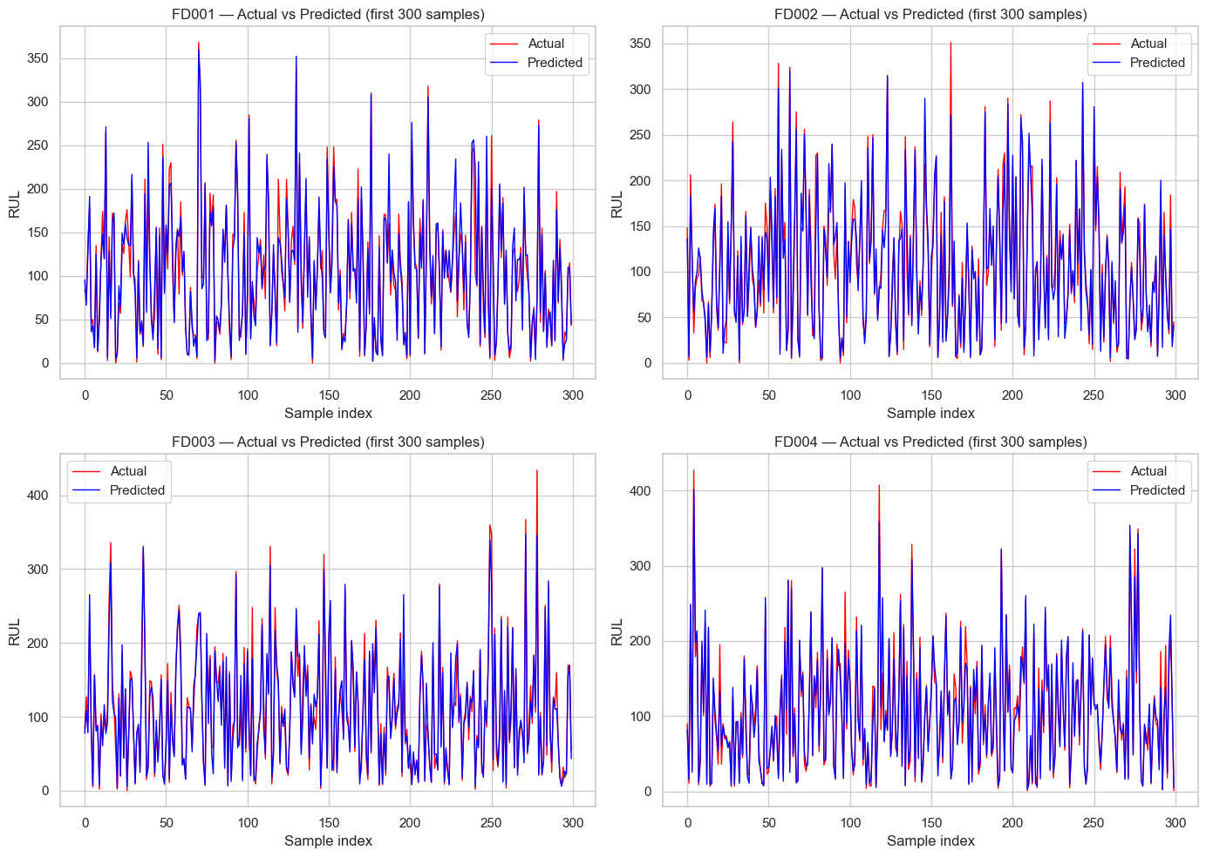
Predicted vs Actual RUL Trends
FD001
FD002
FD003
FD004
Predicted RUL closely aligns with actual values.
Error distribution is centered near zero, indicating unbiased predictions.

Slide 20
06
Insights & Applications

Slide 21
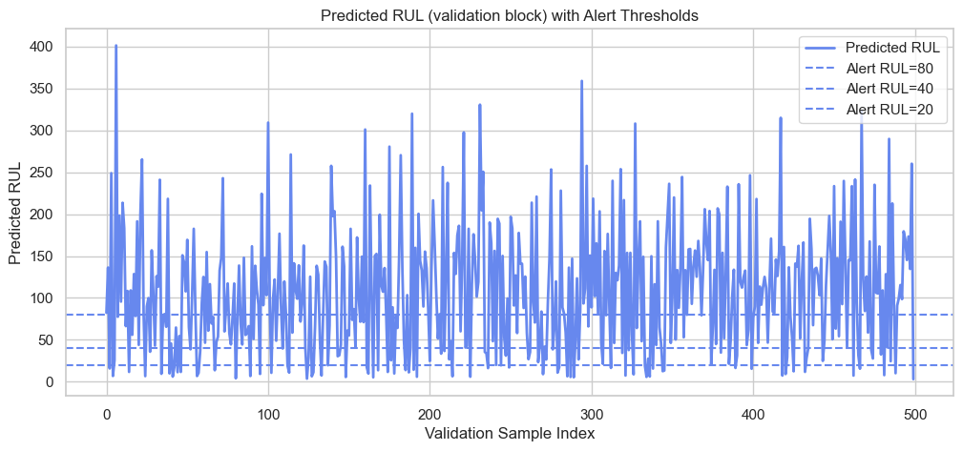
Risk Thresholding & Alert System
Automated alerts are triggered based on the predicted RUL to enable proactive maintenance.
Normal: RUL > 80 cycles
Caution: RUL 40-80 cycles
Warning: RUL 20-40 cycles
Critical: RUL < 20 cycles

Slide 22
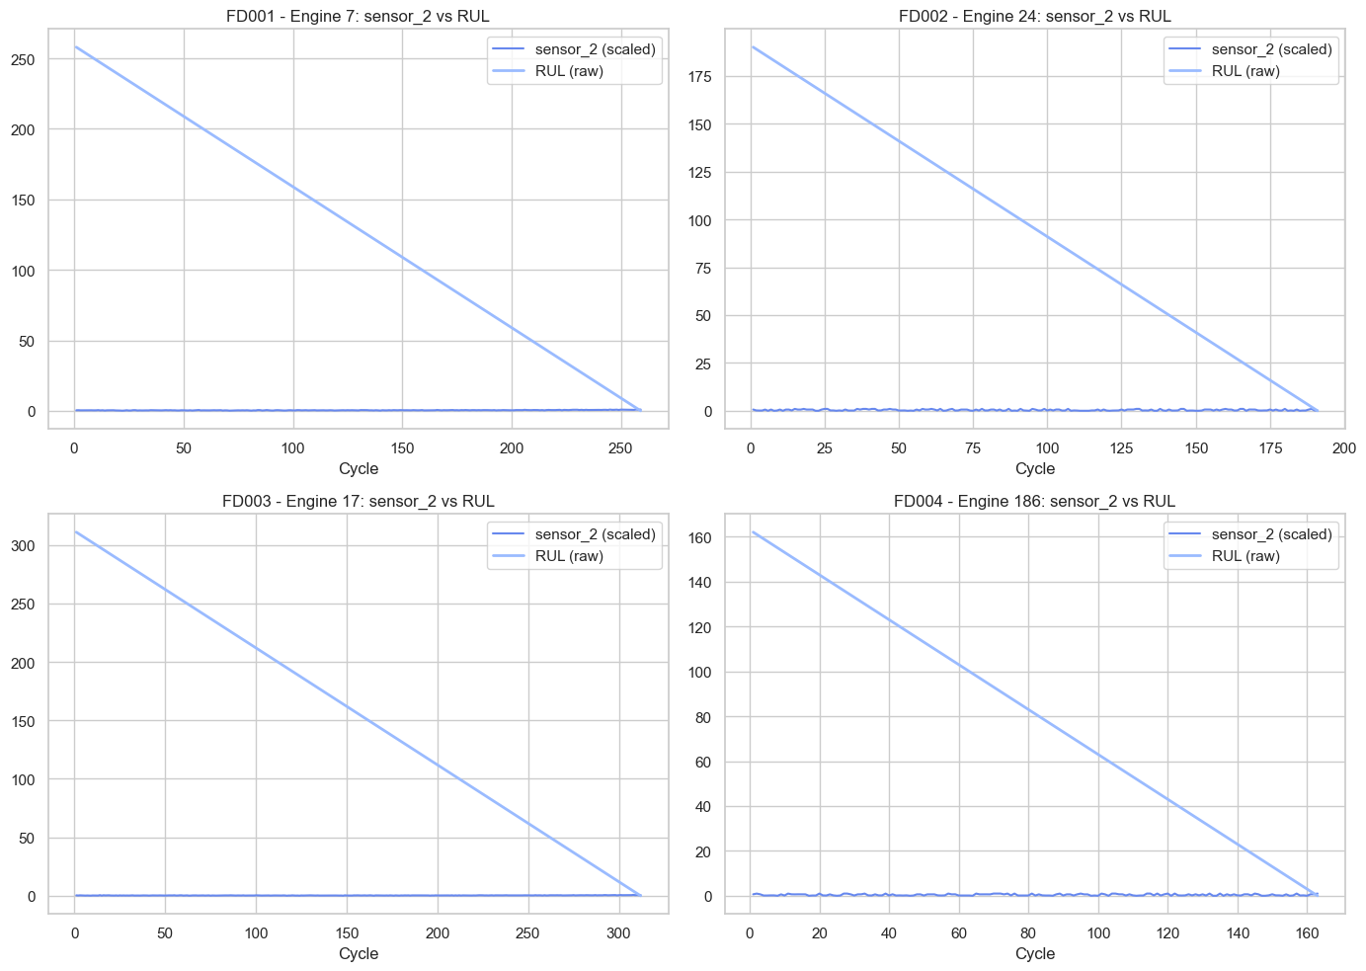
Sensor Behavior & Feature Insights
Key Predictive Sensors
11, 14, 15, 17, 20
Highly correlated with RUL degradation.
Weak / Non-informative
2, 5, 8
Show little to no correlation with RUL.
Example: Sensor_2
Remained flat across all cycles, confirming its irrelevance for prediction.

Slide 23
07
Conclusion & Future Work

Slide 24
Key Findings & Future Work
Key Findings
Strong generalization with an RMSE of ~18 cycles.
Early alert logic successfully improves maintenance efficiency.
Sensor analysis provides valuable insights for feature selection.
Hybrid model effectively captures complex temporal patterns.

Slide 25
THANK YOU

