Slide 1
PrognosAI: AI-Driven Predictive Maintenance System Using Time-Series Sensor Data
Prepared by: Shivani Sharma
Dataset: NASA Turbofan Jet Engine (CMAPSS)

Slide 2
Abstract
PrognosAI is an advanced AI-based maintenance prediction framework designed to determine the Remaining Useful Life (RUL) of turbofan engines through the analysis of time-series sensor information. The system utilizes deep learning algorithms, intelligent alert mechanisms, and interactive dashboards to deliver clear, data-driven insights. This approach helps improve maintenance scheduling, reduce unexpected failures, and increase overall operational efficiency.

Slide 3
PROJECT OVERVIEW AND GOALS
Predictive maintenance focuses on anticipating potential equipment malfunctions before they happen, helping to reduce downtime and enhance efficiency. This project applies AI-based techniques to improve engine health monitoring and optimize maintenance strategies.
Goals:
Build an LSTM model to accurately estimate Remaining Useful Life (RUL).
Implement an intelligent alert mechanism for timely maintenance.
Create a live visualization dashboard to display predictive insights effectively.

Slide 4
Dataset Description
Source: The dataset used in this project is the NASA CMAPSS (Commercial Modular Aero-Propulsion System Simulation) dataset.
Attributes: It contains readings from 21 engine sensors along with 3 operational condition variables.
Instances: Data is collected from multiple turbofan engine units, categorized into subsets FD001 to FD004.
Target Variable: The primary prediction goal is the Remaining Useful Life (RUL) of each engine.

Slide 5
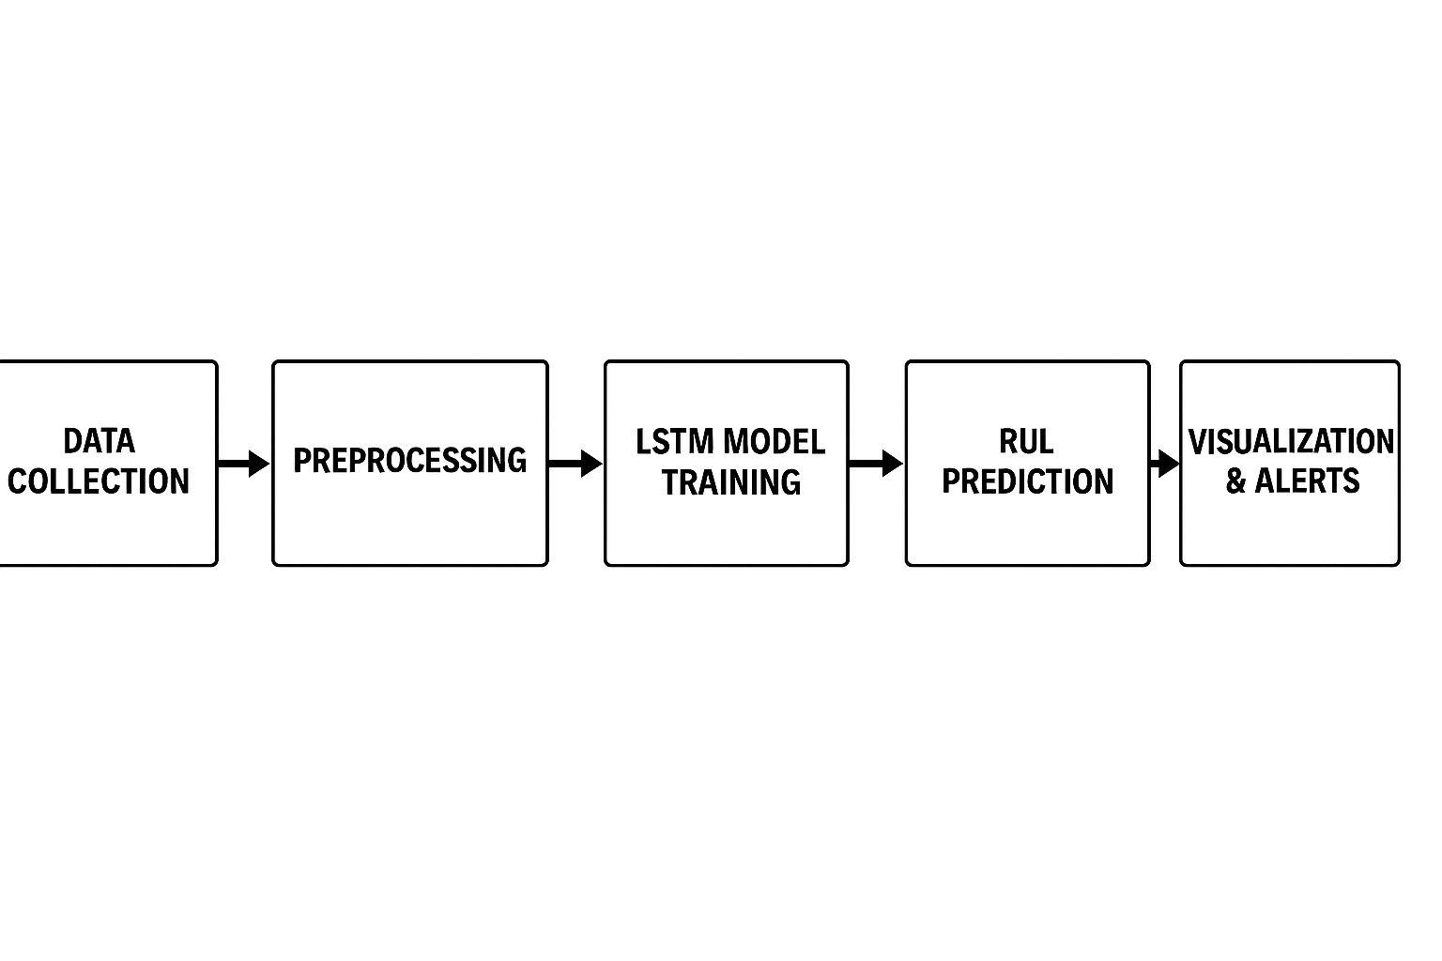
System Architecture

Slide 6
Milestone 1 – Data Preparation
Imported the NASA CMAPSS dataset for model training.
Computed the Remaining Useful Life (RUL) for each engine at every cycle.
Performed data normalization using the MinMaxScaler technique to bring values within a common range.
Created time-series window sequences to prepare structured input data suitable for the LSTM model.
Utilized Python libraries including pandas, NumPy, and scikit-learn (preprocessing module) for data handling and scaling.

Slide 7
Milestone 2 – Model Development
Designed an LSTM-based neural network using the Keras Sequential framework.
The network structure included LSTM (128 units) followed by Dropout layers and Dense layers with sizes 64, 32, and 1 for final output prediction.
Adopted the Adam optimizer with Mean Squared Error (MSE) as the loss function to ensure stable training.
Stored the trained model along with the data scalers for future deployment and inference.
Employed essential libraries like TensorFlow, Keras, and Scikit-learn for model creation and evaluation.

Slide 8
Milestone 3 – Evaluation and Alert System
The model achieved an R² score above 0.95, indicating excellent
predictive accuracy, along with very low RMSE and MAE values.
Developed a dynamic alert mechanism based on RUL percentage levels:
Critical: Remaining Useful Life ≤ 20%
Warning: 20% < RUL ≤ 50%
Normal: RUL > 50%
Created automated alert summaries and interactive visualization reports to display engine health conditions.
Utilized libraries such as NumPy, Pandas, Scikit-learn (metrics), Matplotlib, and Plotly for data analysis and visualization.

Slide 9
Milestone 4 – Interactive Visualization Dashboard
Built an interactive web dashboard using Streamlit for real-time visualization and user interaction.
Enabled users to upload test data files in CSV or TXT format for evaluation.
Displayed engine-specific RUL predictions along with corresponding alert levels in an intuitive layout.
Integrated options to download prediction results and adjust alert thresholds dynamically.
Utilized essential libraries including Streamlit, Pandas, NumPy, Plotly, Joblib, and TensorFlow Keras for backend processing and visualization.

Slide 10
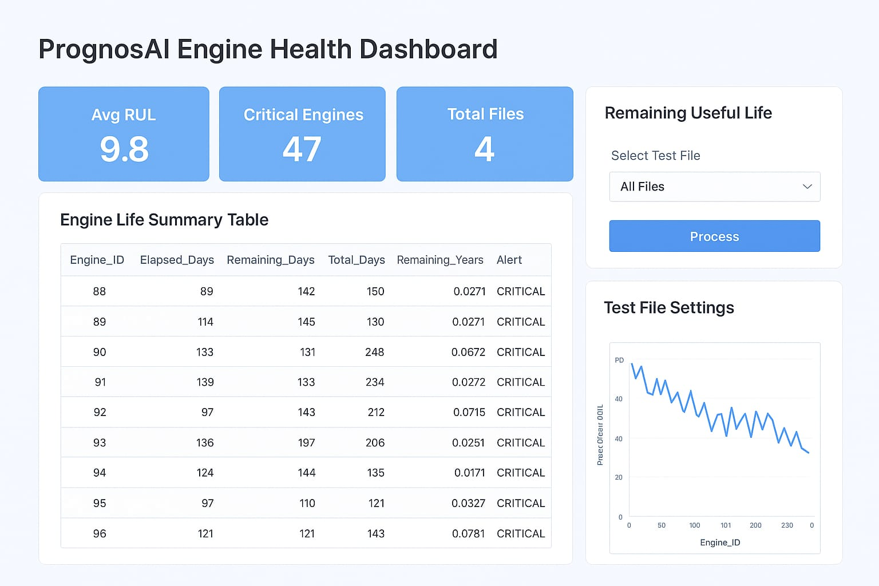

Slide 11
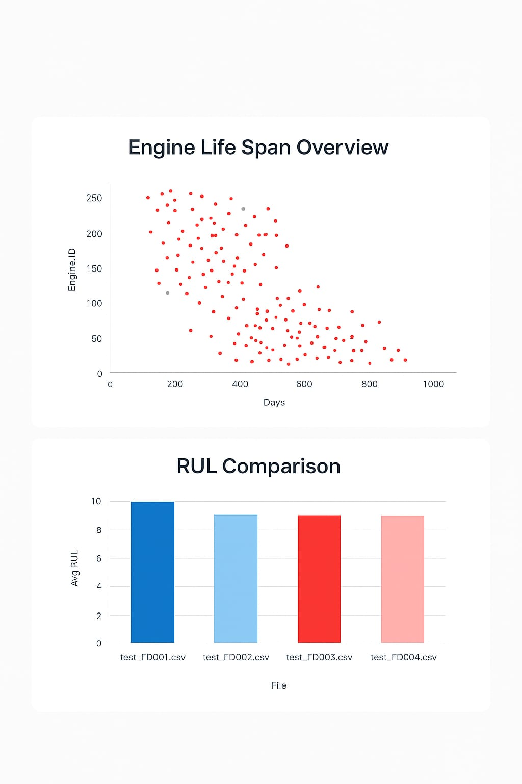

Slide 12
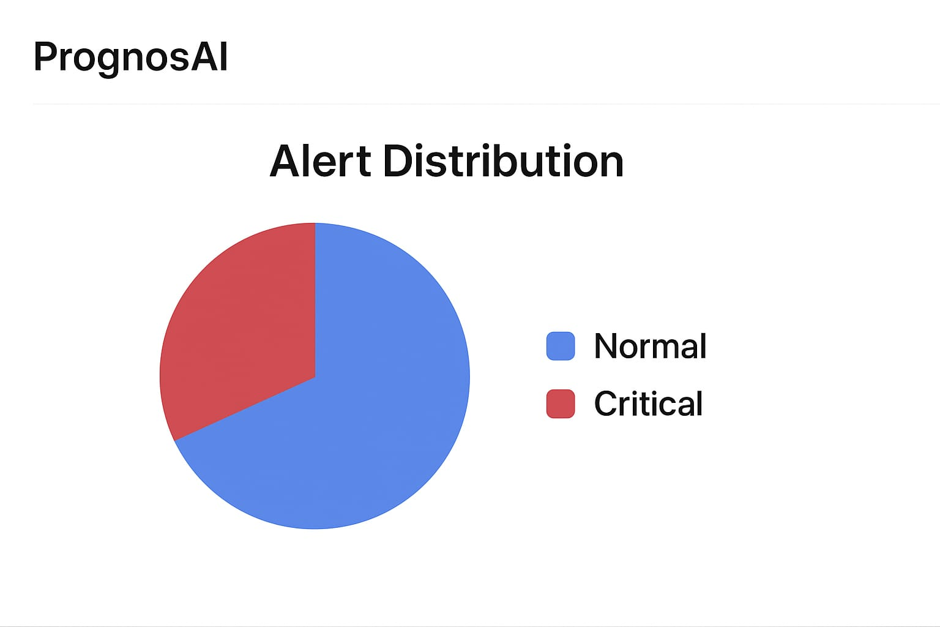
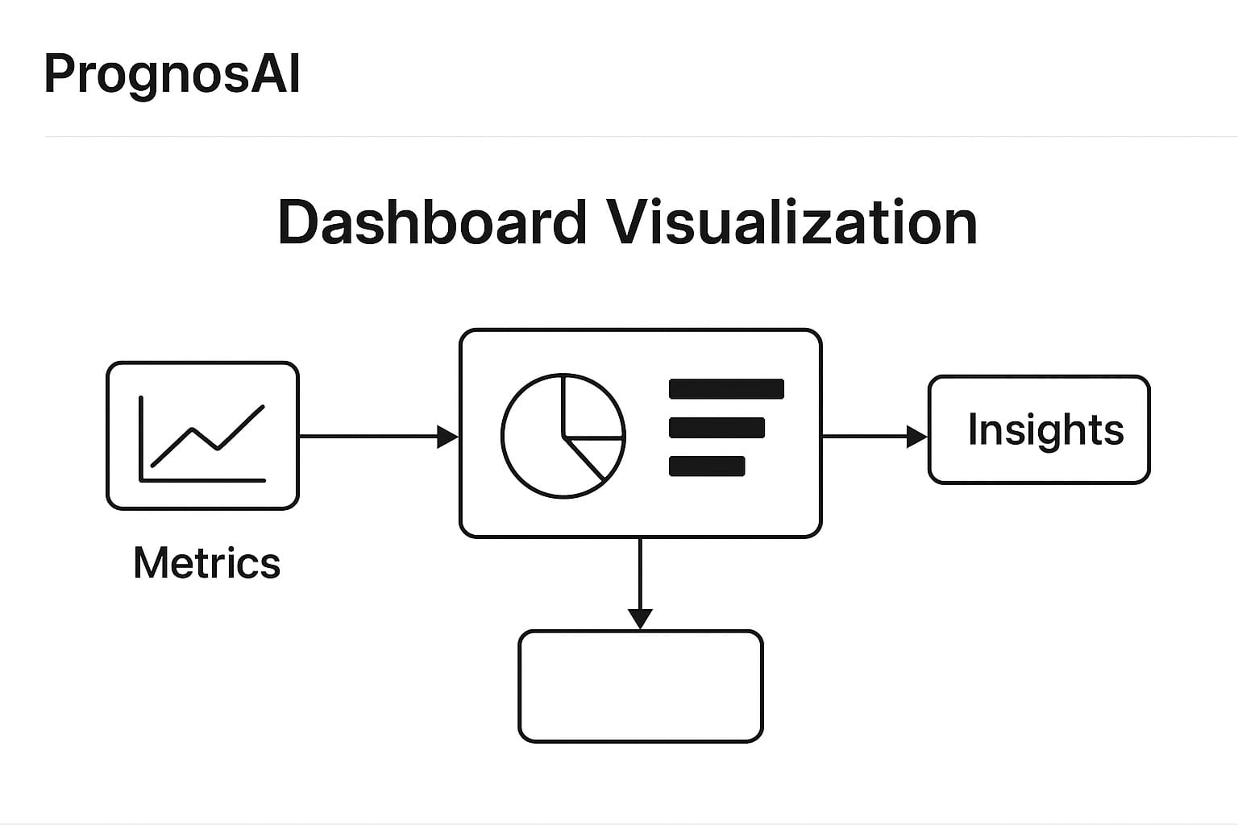

Slide 13
MODel Evaluation and Performance
Evaluation Metrics:
R² Score: Above 0.95 (high model accuracy)
RMSE: Significantly low, indicating minimal prediction deviation
MAE: Low, confirming consistent prediction reliability
Key Outcomes:
The LSTM model demonstrated strong and stable performance during testing.
Produced highly precise RUL estimations with minimal error rates.
The alert mechanism effectively supported timely maintenance decisions based on prediction levels.

Slide 14
RESOURCES USED
Dataset: NASA CMAPSS (Commercial Modular Aero-Propulsion System Simulation)
Programming Language: Python 3.10
Development Tools: Jupyter Notebook, Visual Studio Code, Streamlit.
Libraries & Frameworks: TensorFlow, Keras, Pandas, NumPy, Scikit-learn, Matplotlib, Plotly, Joblib, ReportLab.
Documentation & Guides:
  TensorFlow & Keras Official Docs
  Scikit-learn API Reference
  Streamlit and Plotly User Guides
  NASA Dataset Description Portal

Slide 15
Thank You

