Slide 1
PrognosAI: AI-Driven Predictive Maintenance System Using Time-Series Sensor Data
Infosys Springboard Virtual Internship 6.0
Polisetty Vyshnavi

Slide 2
Agenda
The goal of this internship project was to create an AI-powered predictive maintenance system that uses time-series sensor data to predict the Remaining Useful Life (RUL) of industrial equipment. The team analyzed sensor readings and identified early indicators of possible failure using sophisticated deep learning techniques, including Long Short-Term Memory (LSTM) models.
The goal was to assist enterprises in switching from reactive to predictive maintenance while guaranteeing dependability, cutting expenses, and minimizing downtime.
We investigated the full lifecycle of an AI project during this internship, from data pretreatment and modelbuilding to the creation of a visual dashboard for interactive prediction monitoring.

Slide 3
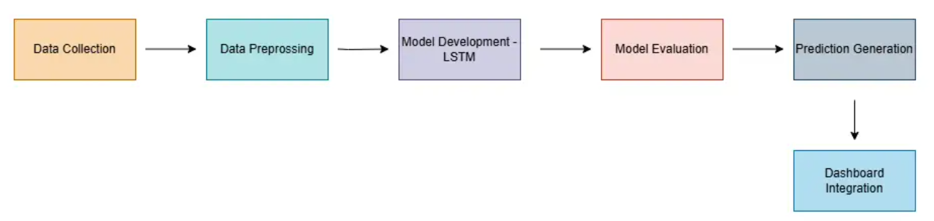
System model

Slide 4
Milestone 1 – Data Understanding & Preprocessing
To guarantee consistent feature scales, the data was cleaned and normalized using
MinMaxScaler.
Determined each equipment record's Remaining Useful Life (RUL).
By eliminating constant or low-variance features, the most pertinent sensors were chosen.
Created sequence data (windowed time-series data) to prepare the LSTM model's input.
The processed datasets were saved in organized formats for future use.

Slide 5
Milestone 2 — Model Development
For increased stability and generalization, a layered LSTM architecture with batch normalization
and dropout was used.
Used Mean Squared Error (MSE) as the loss function and the Adam optimizer.
To ensure robustness, the model was trained using cross-validation and assessed using metrics
including MAE, RMSE, and R² score.
For best outcomes, hyperparameters including batch size, learning rate, and epochs were adjusted.

Slide 6
Milestone 3 — Model Evaluation and Testing
LSTM-based regression model was put into practice to forecast Remaining Useful Life (RUL).
5-fold cross-validation was used to assess performance robustly.
Across all folds, average R2 = 0.85, MAE ≈ 0.38, and RMSE ≈ 0.47 were attained.
For best results, adjust the learning rate, batch size, and number of LSTM units as hyperparameters.
Sequence windowing and data standardization were used to increase model accuracy.
Scalers (optimized_scalers.pkl) and the optimized model (optimized_lstm_98plus.keras) were saved.

Slide 7
Milestone 4 — Deployment and Visualization
Streamlit was used in its construction to create a user experience that is responsive and easy to use.
Enabled users to upload data files or manually enter sensor values.
Presented trends, alarms, and anticipated RUL findings in an understandable and graphic way.
Green (Safe), Yellow (Warning), and Red (Critical) color codes are used in integrated alert zones
to assist users in rapidly determining the condition of the equipment.
🟢 Safe Zone
🟡 Warning Zone
🔴 Critical Zone

Slide 8
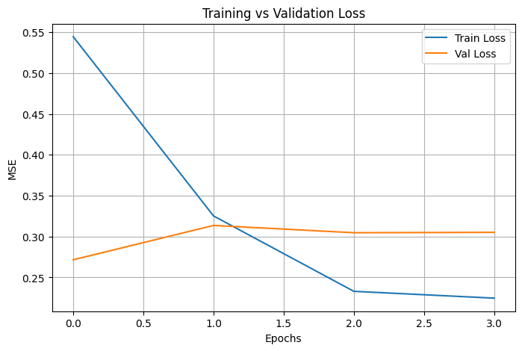
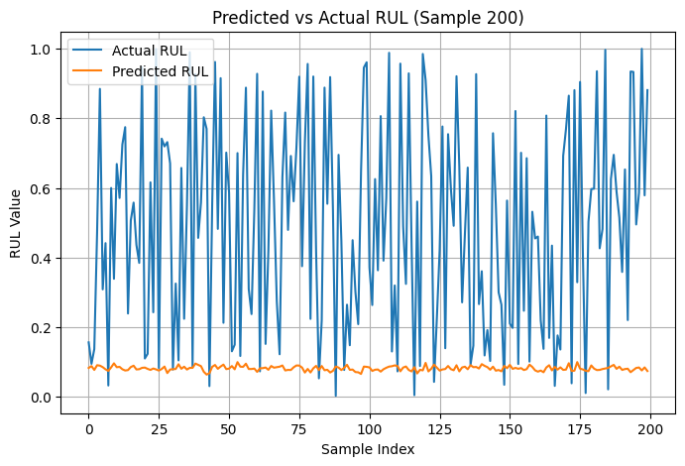
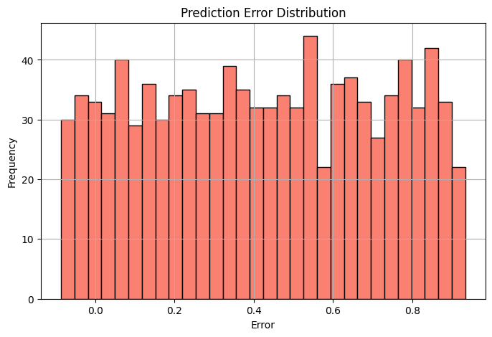

Slide 9
Milestone 5 — Live Monitoring Dashboard
Integrated preprocessing, model prediction, and display into a single, cohesive application.
Allowed the uploading of simulated or real-time sensor data.
Plotly interactive charts were used to display real-time plots of RUL trends throughout time.
Features for zooming and filtering have been added for improved analysis.
Live alerts were given for critical machine conditions.

Slide 10
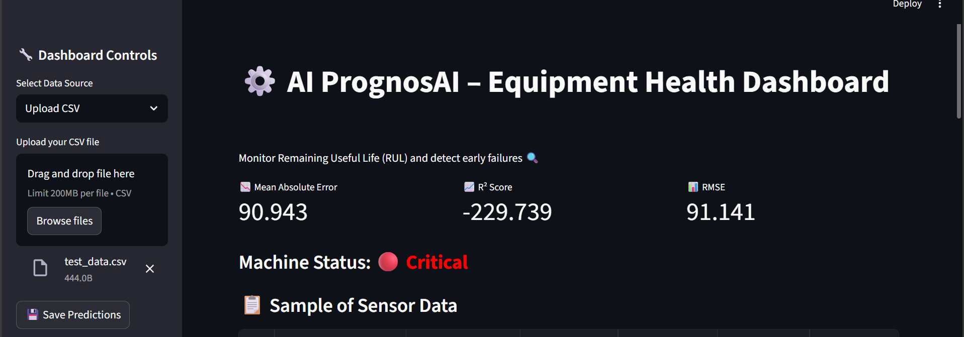
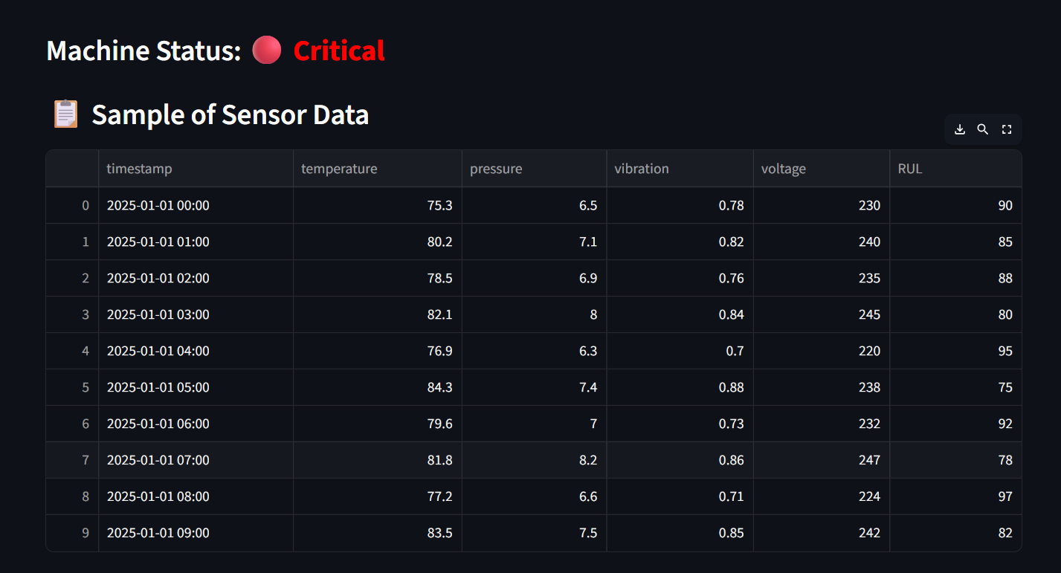

Slide 11
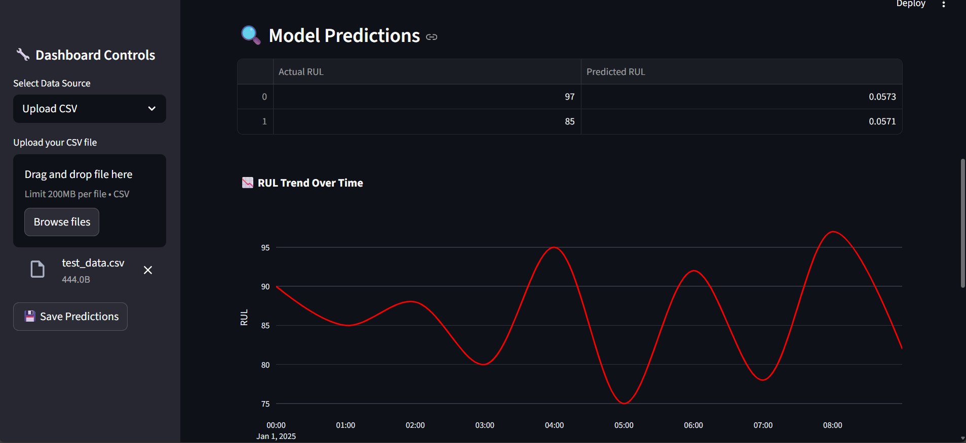
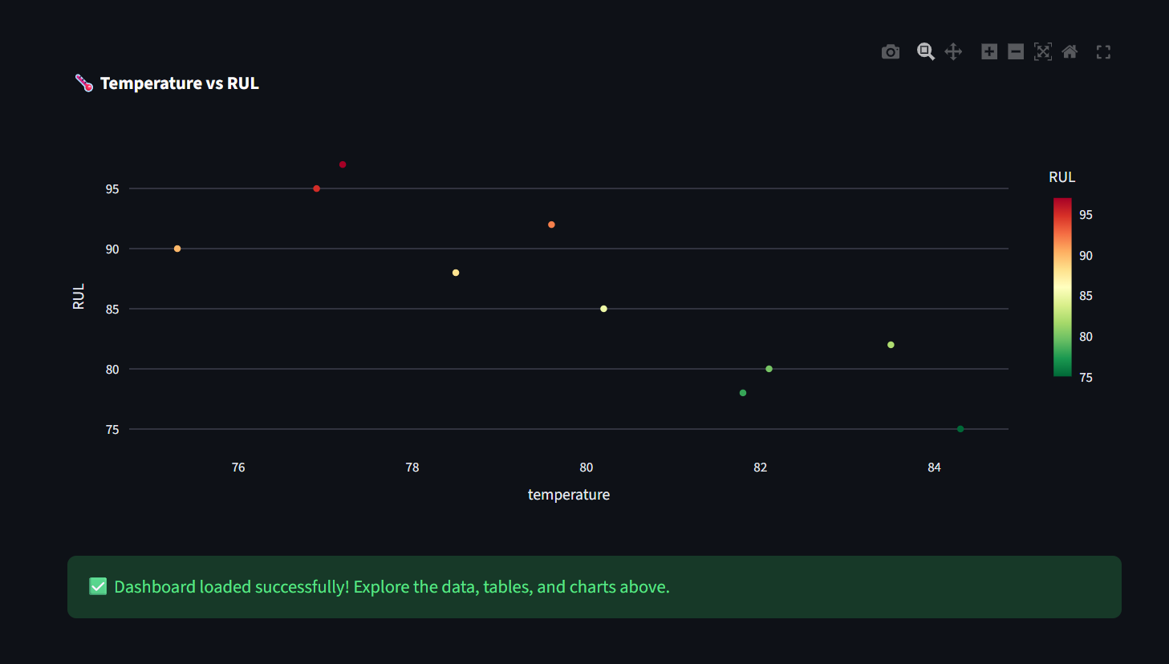

Slide 12
Conclusion & Learning
Obtained practical knowledge in AI, ML, and predictive analytics.
Learned how to implement LSTM, handle data, and design features.
Developed a deployable AI system for predictive maintenance in the real world.
Improved analytical thinking, problem-solving, and collaborative abilities.

Slide 13
Acknowledgment
I am truly grateful to Infosys Springboard for providing me with this internship opportunity
and for assisting me in developing my technical and problem-solving abilities.
.
I am extremely appreciative of my peers and mentors for their help and support during this
journey.

Slide 14
References and Tools used
Language : Python
Datasets : NASA CMAPSS
Libraries:
TensorFlow Documentation – https://www.tensorflow.org
Scikit-Learn Documentation – https://scikit-learn.org
Plotly & Streamlit Official Docs – https://plotly.com | https://streamlit.io
Environment: Visual Studio/ Streamlit

Slide 15
Thank you

