Slide 1
Team 3 Capstone 2019
Fayetteville technical community college

Slide 2
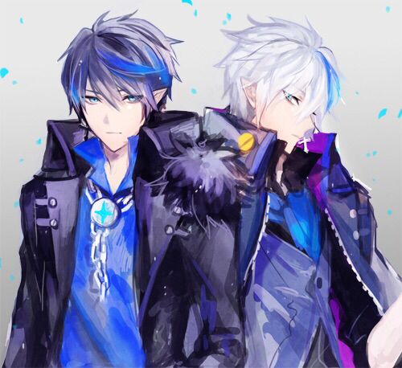
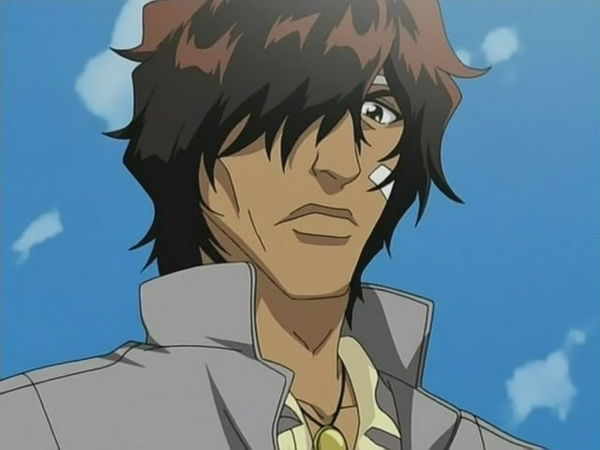
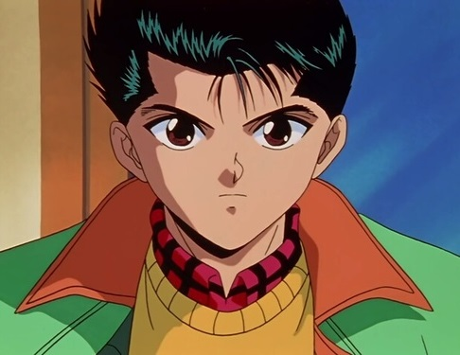
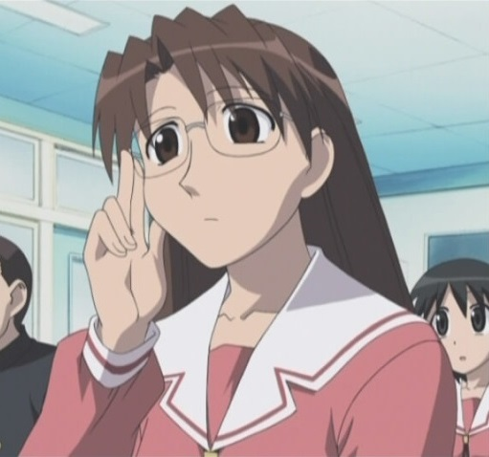
Who is Team 3?
- Samuel and Michael Blythe
(We still can’t tell them apart)
- Juan Santiago
(Sonic the Hedgehog’s best bro)
- Alex Lopez
(Blame him for the project name)
- Bethany Reagan
(She just wanted to make
a text adventure)

Slide 3
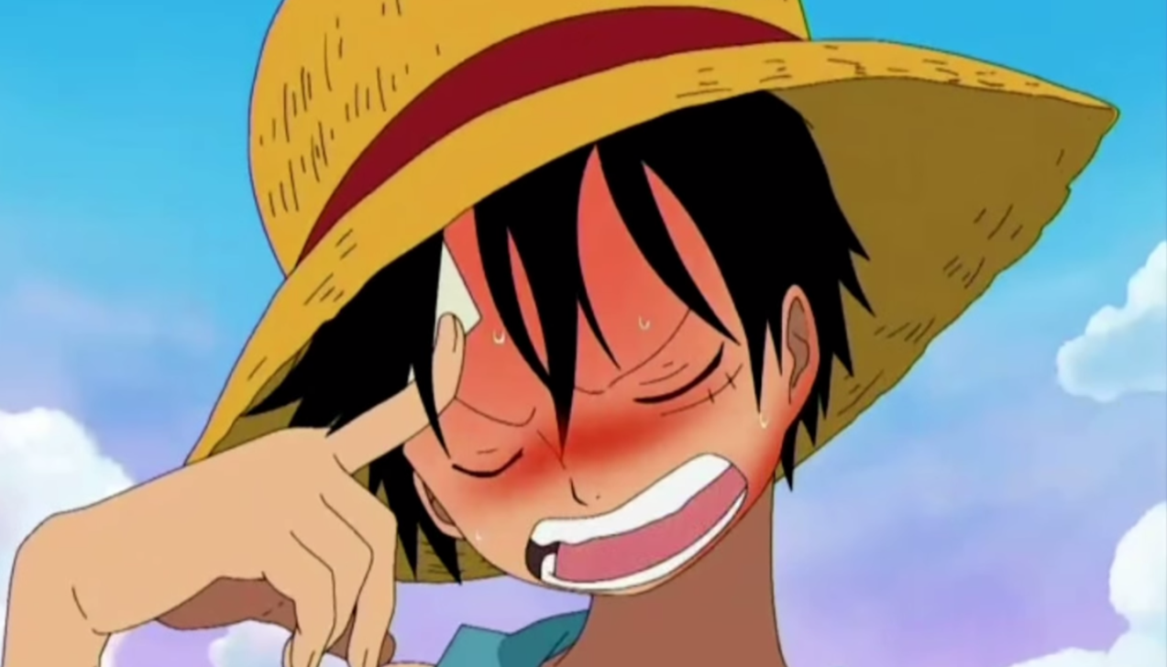
How can I find more anime???

Slide 4
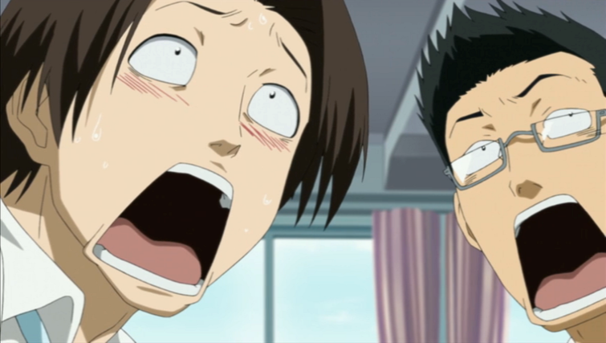
AniRater
It is a rater of anime. On da webs, for da weebs.

Slide 5
AniRater
A web-based program intended to:
Present various anime movies and TV shows to the otaku
Allow users to review, rate, and view listings of the shows/films they’ve liked
Creates recommendations of new shows to watch in the future.

Slide 6
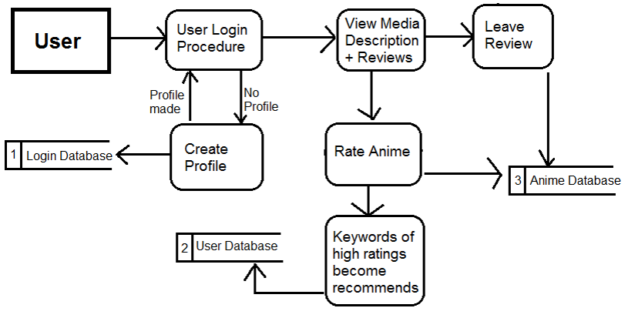
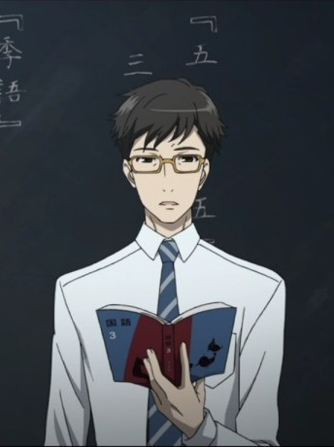
The General Idea – Data Flow

Slide 7





What is being used?

Slide 8
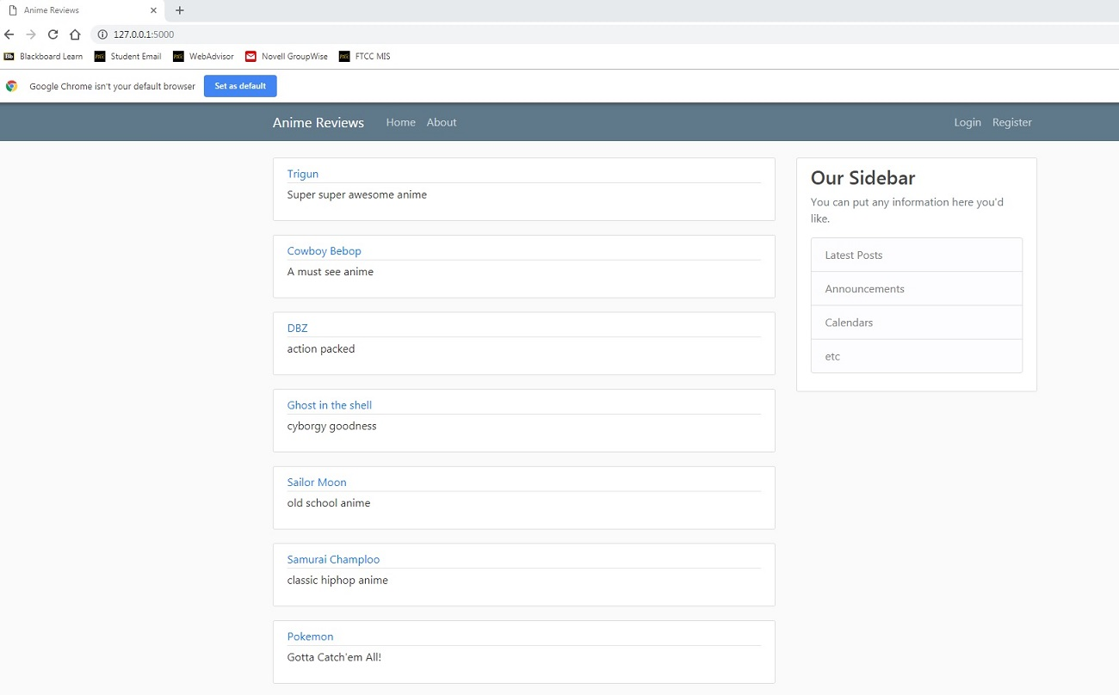
Preliminary Screenshot

Slide 9
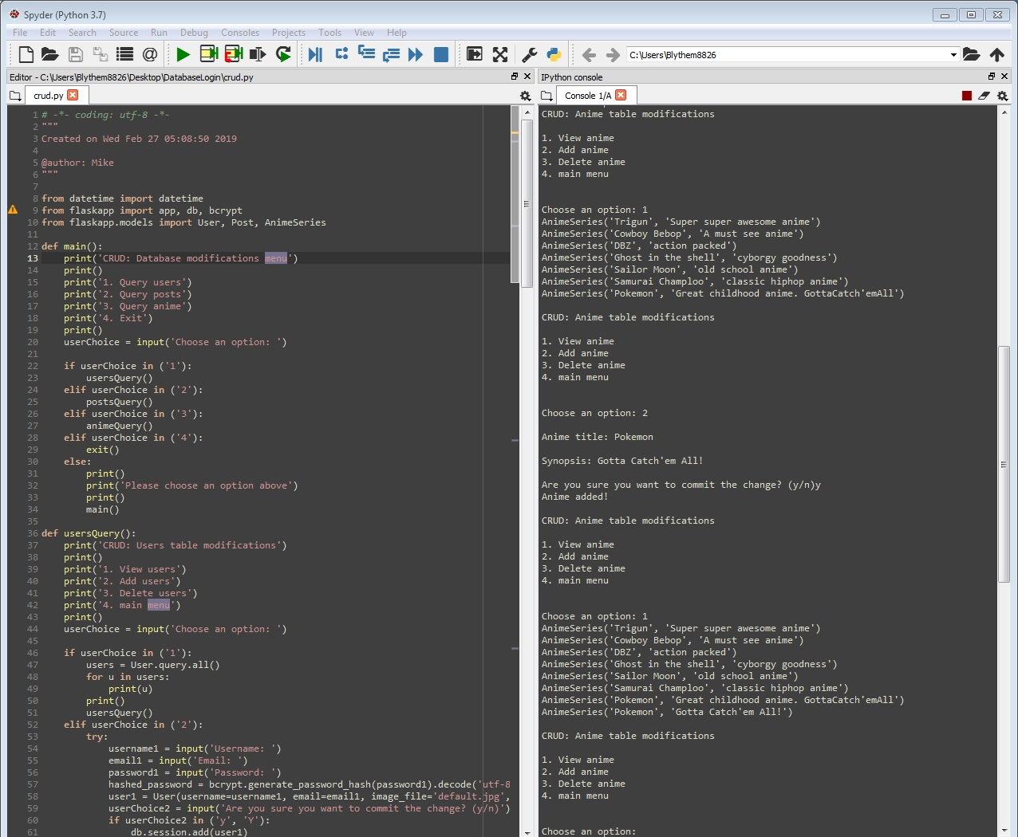
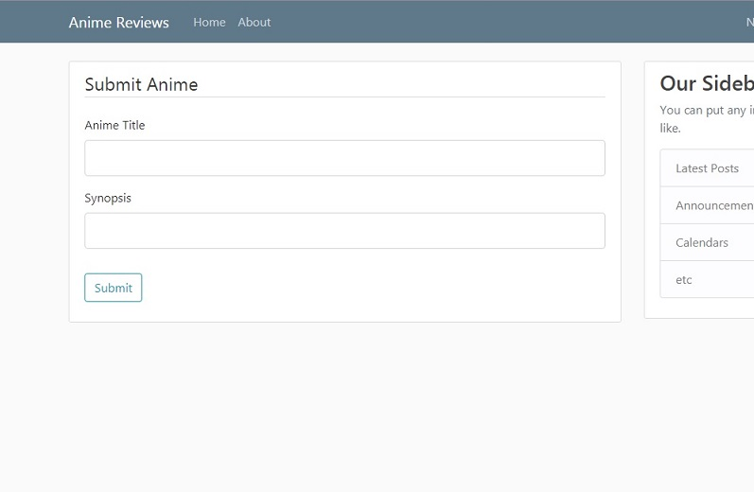
Adding in More Anime…

Slide 10
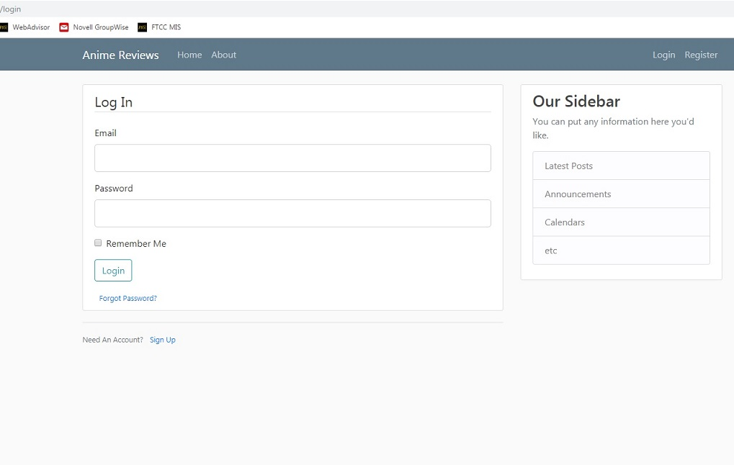
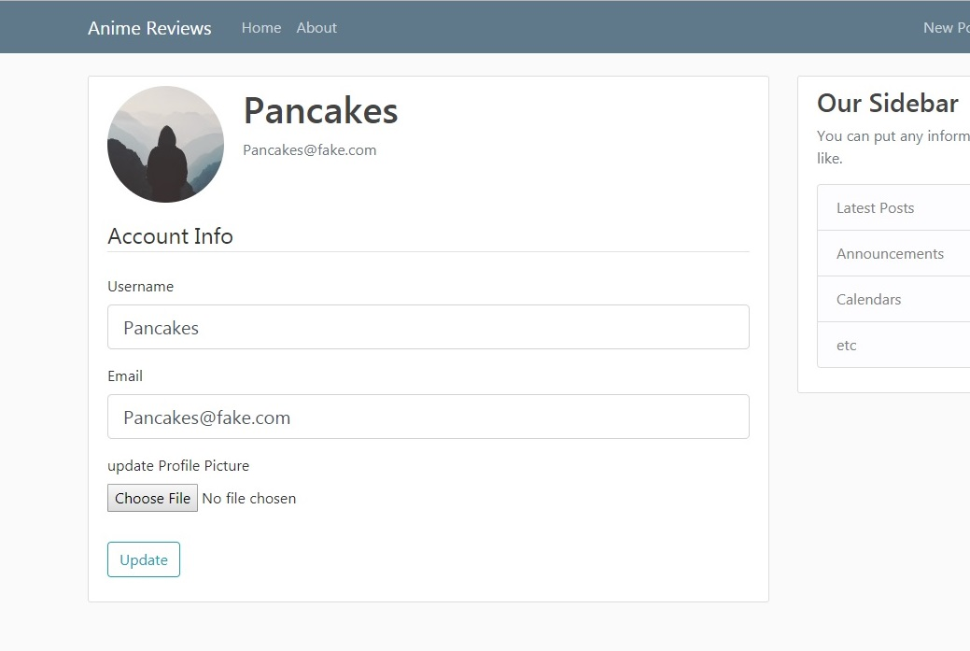
Logging In And Account…

Slide 11
A Taste of Things to Come…
Anime Images
Search Bar/Tags
Brand new layout
Favorites lists
Recommendations
Plot descriptions
User reviews

Slide 12


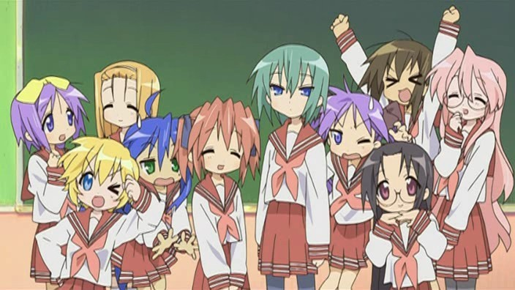
Wish us luck!

