Slide 1
NEAT IA Jetpack Project
By Joel Aumedes & Joel Farré

Slide 2
Index
- Game Design and Programming
- AI
- What are neural netwoks?
- The neural networks in our project
- Genetic Algorithms
- The project running
- Conclusions

Slide 3
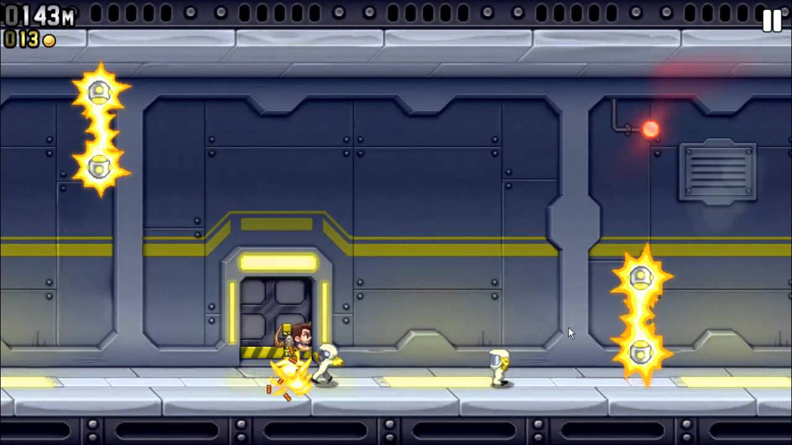
Game Design and Programming
- Main idea

Slide 4
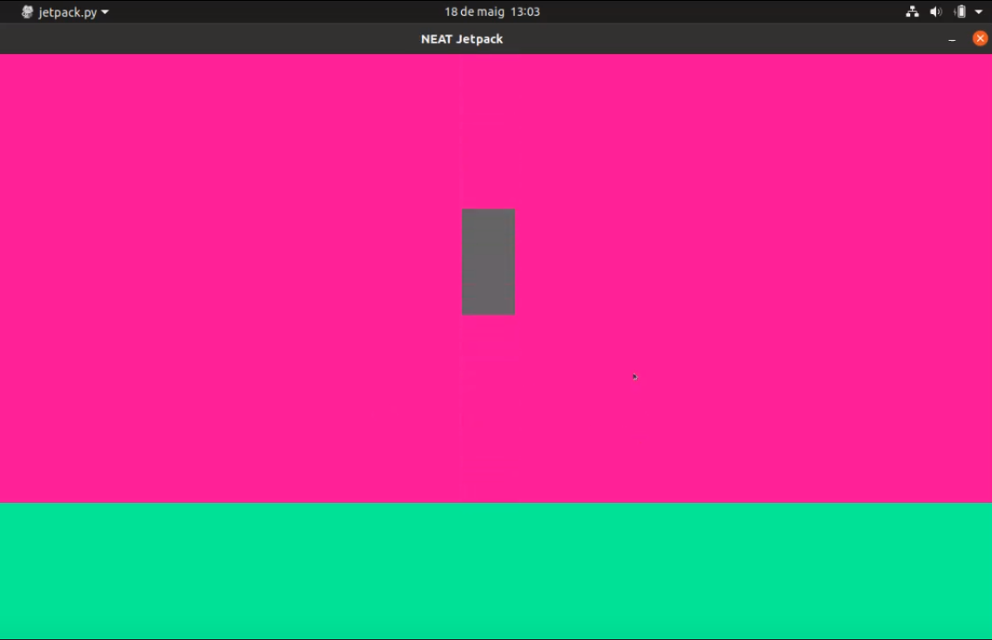
Game Design and Programming
- Physics and logic
GRAVITY FORCE

Slide 5
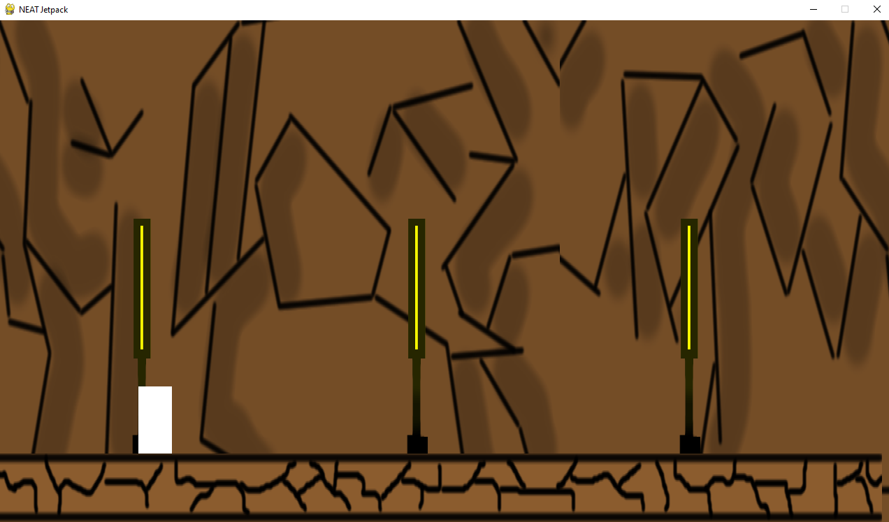
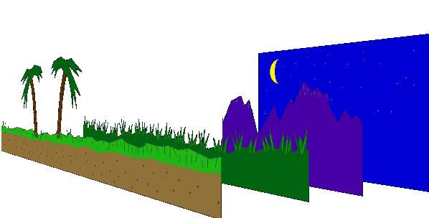
Game Design and Programming
- Illusion of movement

Slide 6
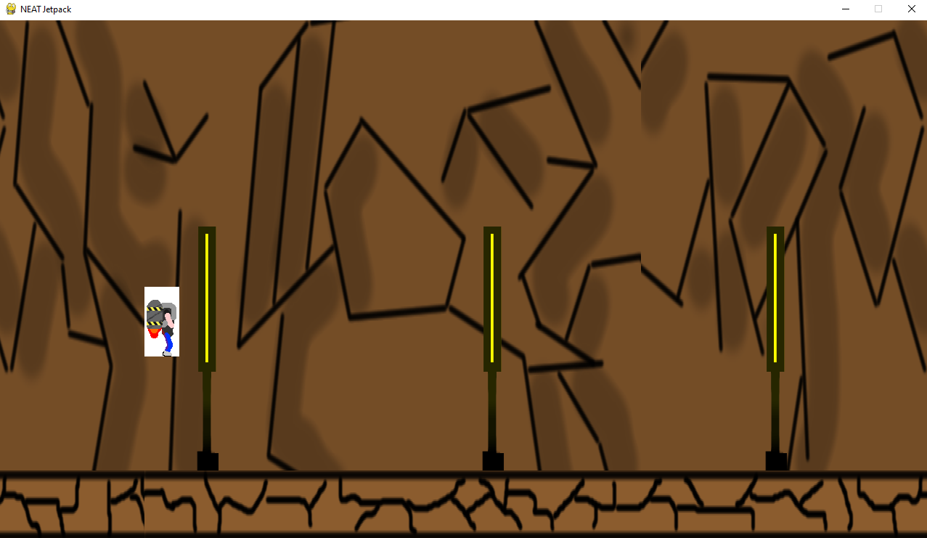


Game Design and Programming
- Sprite Design
+ =

Slide 7


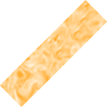
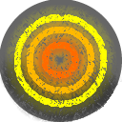

Game Design and Programming
- Obstacles

Slide 8
Game Design and Programming
- Collisions
AABB Collision

Slide 9
Game Design and Programming
- Collisions
Mask Collision

Slide 10
AI
The NEAT Algorithm – Neuro Evolution of Augmented Topologies
N
E
A
T
Neural
Networks
Genetic
Algorithms

Slide 11
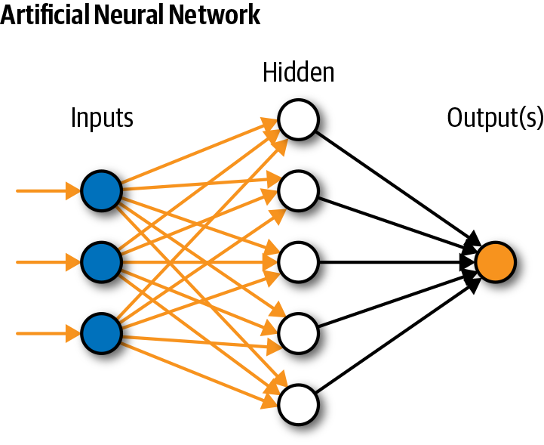
What are neural netwoks?
- What are they?
- How do they work?

Slide 12
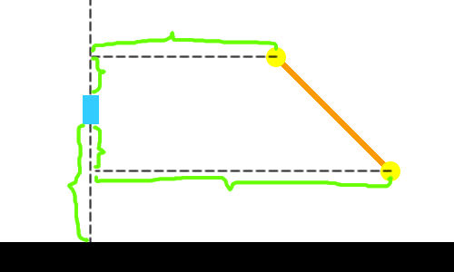
The neural networks in our project
- Inputs
- Outputs
- Activation function

Slide 13
Genetic Algorithms
- Selection
  - Fitness function
- Genetic operations
- Elitism

Slide 14
NEAT
- Adapting the game
- Implementing NEAT
- Training

Slide 15
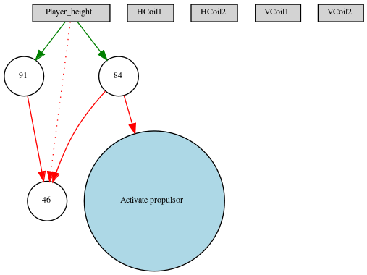
Neural Networks Evaluation
- Using 5 inputs and a population size of 20

Slide 16
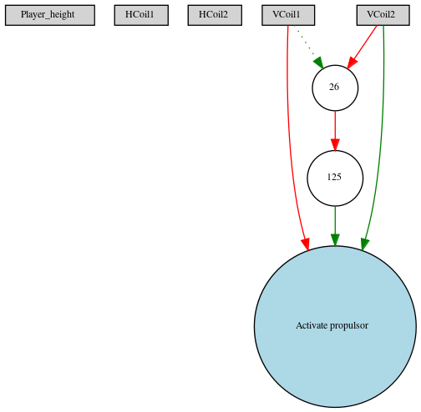
Neural Networks Evaluation
- Using 5 inputs and a population size of 100

Slide 17
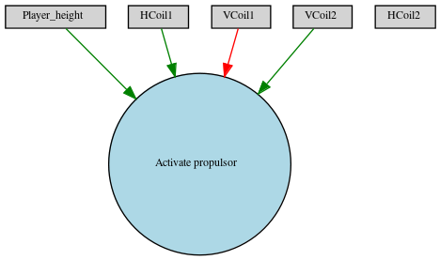
Neural Networks Evaluation
- Using 5 inputs and a population size of 200

Slide 18
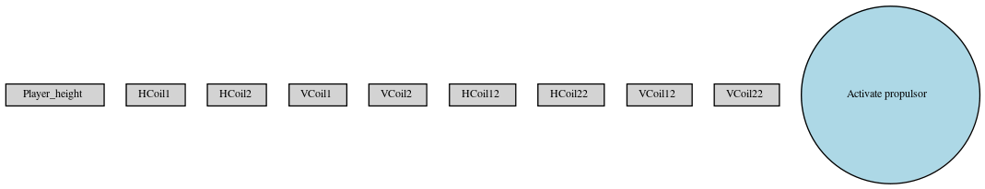
Neural Networks Evaluation
- Using 9 inputs and a population size of 20

Slide 19
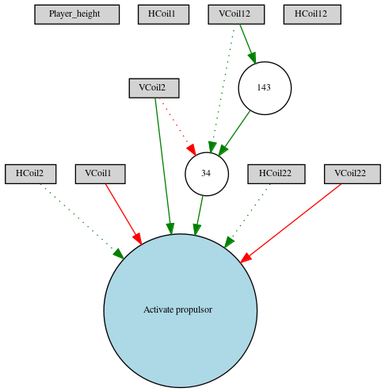
Neural Networks Evaluation
- Using 9 inputs and a population size of 100

Slide 20
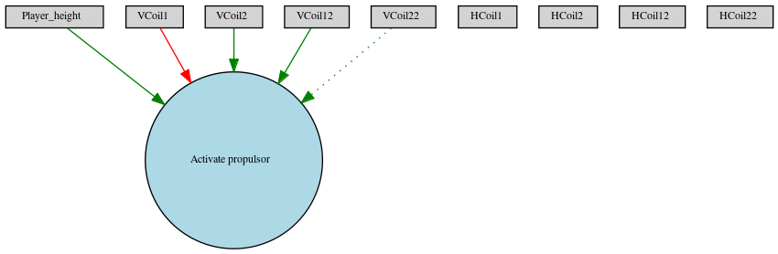
Neural Networks Evaluation
- Using 9 inputs and a population size of 200

Slide 21
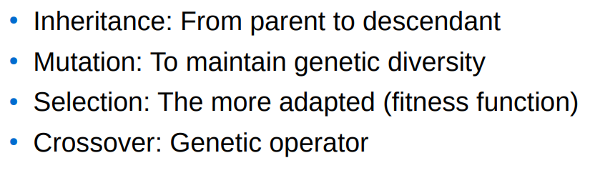
Used genetic algorithms
- Types of algorithms
- Used algorythms

Slide 22
The project running

Slide 23
Conclusions
- What we have learned?
- Difficulties
- Positive feedback

