Slide 1

Relational Database Design and implementation

Slide 2


What’s so good about data?
Data has become a popular topic of discussion following the start of the 21st century
You may hear companies talking about the benefits of “big data” as it relates to their business or scientists striving to make “data-driven decisions” to develop breakthrough technologies
Why is data suddenly so important???

Slide 3

Why we need data
We use data to create breakthroughs in:
artificial intelligence
Science
Business
Criminal justice
If data is so important to our success, do we have enough?

Slide 4
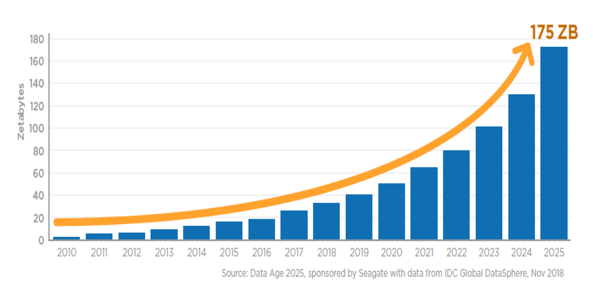
Yes, yes we do…
The chart to the left shows the projected amount of data growth on the planet from 2010-2025 in zetabytes (1 zettabyte = 1000 terabytes!!)
This growth in data is mainly due to the growth of computer technology over the years
With so much data to gain insights from, how do we store it?
Growth of data in zetabytes from 2010-2025

Slide 5

The answer is databases
To organize, manage and interact with the astronomical quantities of data that we have available today, we use databases and database management systems
By using databases, we are able to optimize our use of data
Let’s talk about the two main types of databases out there: relational and non-relational

Slide 6
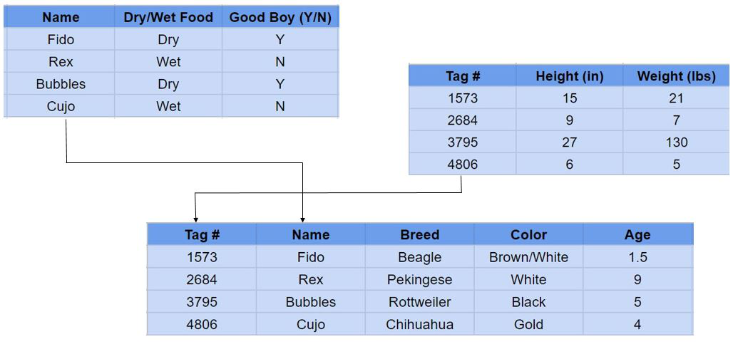
Relational databases
A relational database, also called Relational Database Management System (RDBMS) or SQL database, stores data in tables and rows also referred to as records.
Relational databases work by linking information from multiple tables through “keys”, or unique identifiers which can be assigned to a row of data contained within a table.
The use of keys enables us to create relationships between data records across multiple tables, therefore making our database “relational”
Some of the most popular RDBMS are MySQL, MS SQL Server, PostreSQL and SQLite

Slide 7

Non-relational databases
The non-relational database, or NoSQL database, stores data. However, unlike the relational database, there are no tables, rows or keys. Instead, the non-relational database uses a storage model optimized for specific requirements of the type of data being stored.
There are four popular non-relational types: document data store, column-oriented database, key-value store and graph database. Often combinations of these types are used for a single application.
Some of the more popular NoSQL databases are MongoDB, Apache Cassandra, Redis, Couchbase and Apache HBase.

Slide 8
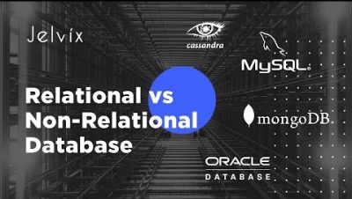
Relational vs. non-relational databases

Slide 9

Relational database definitions
Before going forward, let’s lay out some definitions integral to relational databases…
Table – a set of data related to each other; subset of database
Schema – The design of your entire database
Row / Record / Tuple – a single entry in a table; instances of the table (like a class instance)
Column / Field/ Attribute– a single category in a table (like a member / attribute of an object)

Slide 10

the structured query language (SQL)
We know that relational databases organize data using tables, and that these tables have rows representing records and columns representing attributes
How do we add, remove, alter and create entities in our database?
We do this using the Structured Query Language, better known as SQL
SQL is a programming language used to manage all contents in a relational database
With SQL, we can manage our relational database with ease!

Slide 11
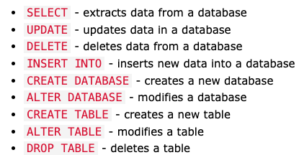
Basic sql syntax

Slide 12
SQL STATEMENTS
CREATE DATABASE [NAME] – Creates database called NAME
CREATE TABLE [NAME] – Creates table called NAME
DROP DATABASE [NAME] – Deletes database called NAME
DROP TABLE [NAME] – Deletes table called NAME
SELECT * FROM [TABLE] – Returns all records from the specified table, * indicates all
SELECT * FROM [TABLE] WHERE [CONDITION] – Executes above statement, though only when the record meets specified CONDITION
INSERT INTO [TABLE] ([attribute names]) VALUES ([attributed data]) – Inserts new data record into specified table
ALTER TABLE [NAME] ADD [attribute] – Adds new attribute / field to table called NAME
DELETE FROM [TABLE] – Deletes all records in given table

Slide 13
Basic SQL data types
CHAR(size) - A FIXED length string (can contain letters, numbers, and special characters). Size between (0, 255)
VARCHAR(size) - A VARIABLE length string (can contain letters, numbers, and special characters). Size between (0, 65535)
INT(size) - A medium integer. Signed range is from -2147483648 to 2147483647. Unsigned range is from 0 to 4294967295. The size parameter specifies the maximum display width (which is 255)
DECIMAL(size, d) - An exact fixed-point number. The total number of digits is specified in size. The number of digits after the decimal point is specified in the d parameter. The maximum number for size is 65. The maximum number for d is 30.
DATETIME(fsp) - A date and time combination. Format: YYYY-MM-DD hh:mm:ss. The supported range is from '1000-01-01 00:00:00' to '9999-12-31 23:59:59'.

Slide 14
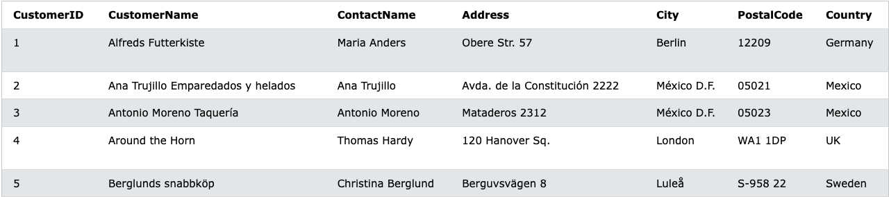
Here, we have a sample table called Customers
SELECT CustomerName, City FROM Customers – This returns all CustomerName and City data currently in the table
SELECT * FROM Customers WHERE Country = ‘Germany’ – This returns all records that indicate Germany as the country
SELECT * FROM Customers WHERE Country = ‘Germany’ OR Country = ‘Mexico’ – Returns all records that indicate Germany OR Mexico as the country
SELECT * FROM Customers WHERE Country = ‘Germany’ AND City = ‘Berlin’ – Returns all records that indicate Germany as the country AND Berlin as the city

Slide 15
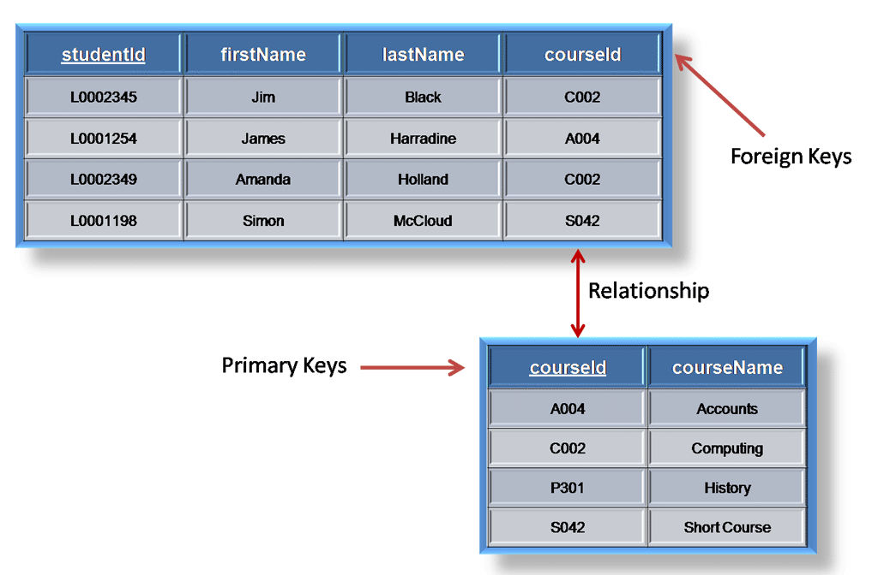
Primary and foreign keys
A primary key is a column or a set of columns in a table whose values uniquely identify a row in the table.
A relational database is designed to enforce the uniqueness of primary keys by allowing only one row with a given primary key value in a table.
A foreign key is a column or a set of columns in a table whose values correspond to the values of the primary key in another table.
In order to add a row with a given foreign key value, there must exist a row in the related table with the same primary key value.
It’s important to realize that foreign keys are the primary keys of other tables; this is how we are able to relate tables to one another

Slide 16
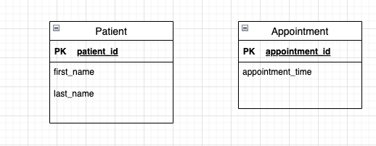
Relating tables with keys: example
To the right, we have two tables: a patient table and an appointment table
We have a primary key for each table, which uniquely identify each data record
These tables seem to be related… a patient usually HAS an appointment
How can we relate these two tables?
We can use keys!

Slide 17
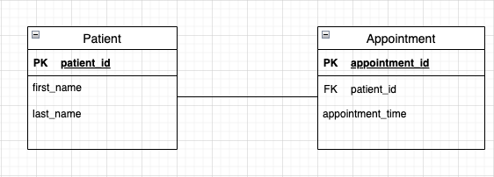
Relating tables with keys: example (continued)
You can see that another key has been added to the appointment table, a foreign key called patient_id.
This foreign key is simply the primary key from the patient table.
By adding this foreign key to the appointment table, we have constrained our database so that each entry in the appointment table MUST be related to an entry in the patient table
Now that these two tables have been related using a foreign key, a data record in the patient table cannot be deleted if a record in the appointment table is related to it. This is known as referential integrity.
Notes:
Example: Patient John Smith, patient_id = 1, has an appointment on 4/1/22 at 3 pm. Therefore, the appointment record has John Smith’s patient_id as a foreign key. If I try to delete John Smith’s data record, I will be prohibited from doing so as the appointment depends on the record!

Slide 18


Exercise
To the right, I have one data record in the patient table and one record in the appointment table.
Question: If I wanted to delete John Smith from the patient table, how would I go about doing that? Can I simply delete his record from the database?
Answer: To delete John Smith’s record from the patient table, I must first delete his appointment record, as it is related to his record in the patient table using the foreign key patient_id
If I try to delete his record in the patient table before deleting the appointment, SQL will prohibit me from doing so.

Slide 19
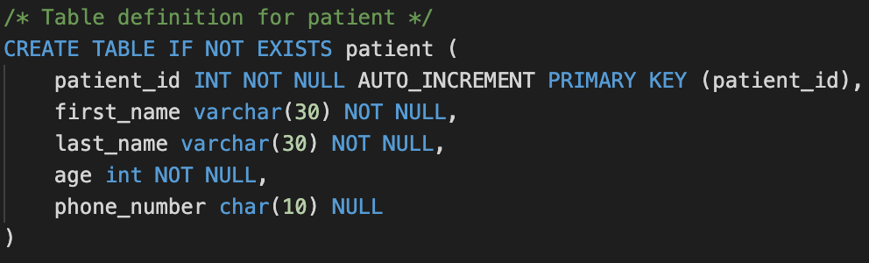
Table design
As we learned before, relational databases use tables to store information.
Tables are very similar to class definitions in OOP : we define the table, which has attributes and can create instances of the table in the form of rows.
To the right you can see how we would create our simple patient table from the prior example
We have defined a primary key patient_id, frst_name, last_name, age and phone_number

Slide 20
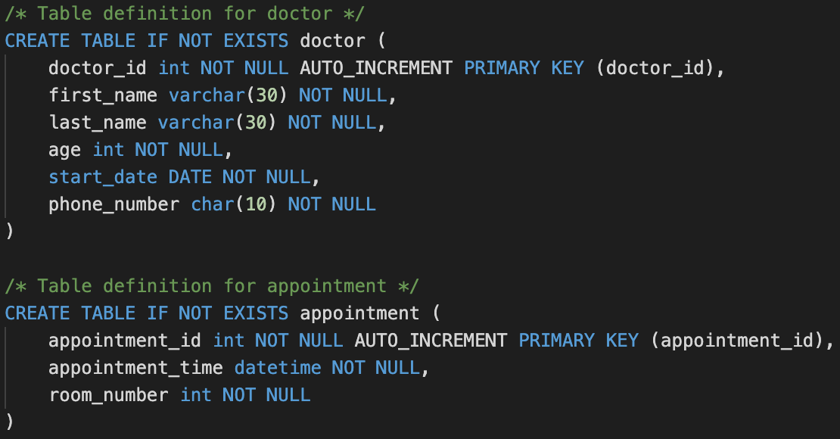
Table design (cont.)
Let’s put two more table definitions into our database now, one called doctor and one called appointment
We have all the information a doctor would need in our doctor table: first name, last name, age, start date, phone number, etc. and same with the appointment table
We could add more attributes, though for a simple database this is fine

Slide 21
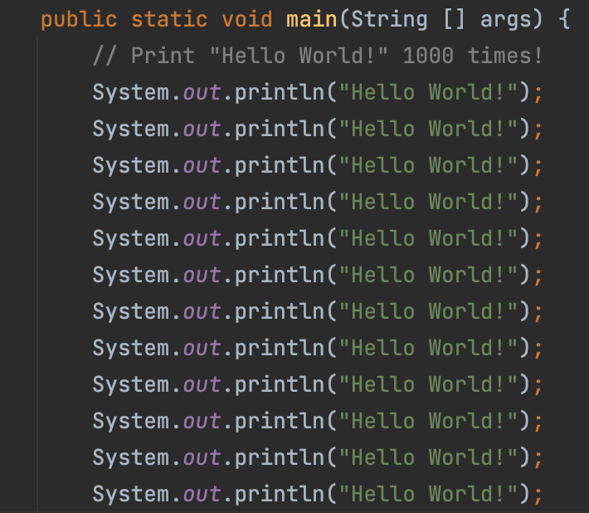
Is our design perfect?
Unfortunately, our database schema right now is a little redundant
For example, in the patient and doctor tables we have a field for phone number
Why don’t we just create a phone number table and use foreign keys to relate a doctor or patient to a phone number?
This concept of minimizing data redundancy is called database normalization
Something tells me this could be done better…

Slide 22

database normalization
Database normalization is the process of structuring a database in accordance with a series of so-called normal forms in order to reduce data redundancy and improve data integrity.
It was first proposed by Edgar F. Codd (left) as part of his relational model.
Normalization entails organizing the columns (attributes) and tables of a database to ensure that their dependencies are properly enforced by database integrity constraints.

Slide 23

Database normalization video

Slide 24
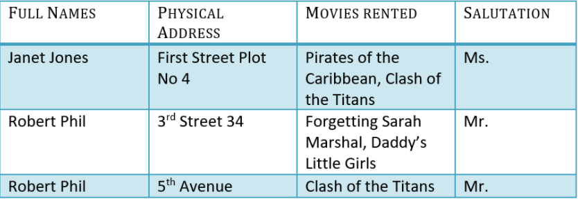
Normalization examples
Let’s look at this movie rental database with a single table called Customers for our example. You can see in the table we have a full name attribute, physical address, movies rented and salutation.

Slide 25
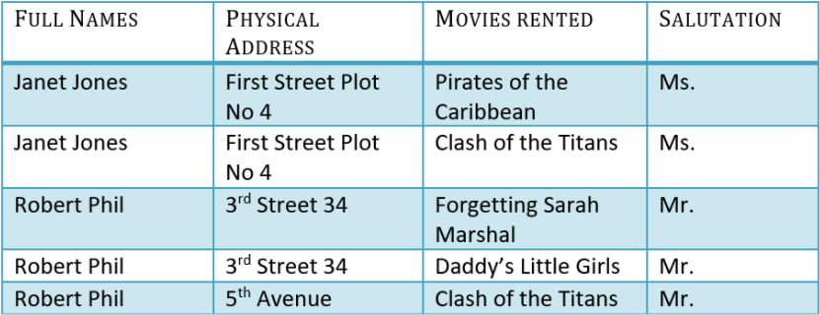
First normal form
According to first normal form, each data record should contain a single value and be unique
By splitting up the movies rented attribute, we can transform our table into first normal form

Slide 26
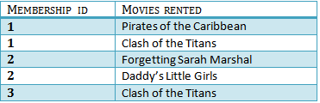

Second normal form
To transform our database into second normal form, we must:
Ensure that our database is in first normal form
We have a single column primary key that does not functionally depend on any other key
By splitting our table into two tables, Customers and Movies Rented, we have transformed our schema into second normal form

Slide 27
Third normal form
To transform our database into third normal form, we must do the following:
Transform into second normal form
Has no transitive dependencies (transitive dependencies are those non-key columns which may cause other non-key columns to change indirectly)
An example of a transitive dependency is the full name field, as changing the name from Robert Phil to Jane Phil will change the salutation field

Slide 28
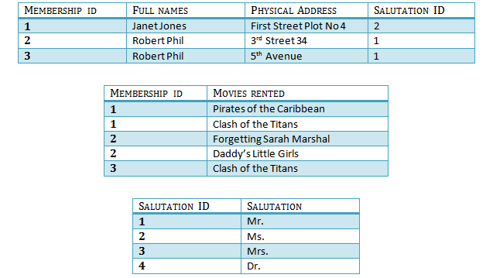
Third normal form (cont.)
By breaking up the Customer table again, we have rid our database of transitive dependencies by creating a Salutation table

Slide 29
Connecting a mysql database to java application
MySQL Download: https://dev.mysql.com/downloads/mysql/
JDBC MySQL Download: https://dev.mysql.com/downloads/connector/j/

Slide 30
Closing remarks
If you take anything away from this presentation, it’s that data and databases are extremely useful. Without these tools, any software we create would be, practically speaking, useless!
If you want to learn more about databases, I recommend you look at the resources on the next slide, take a course on databases (ICSI 410 here is database systems) and see what you can do with them on your own!
Thanks for listening!!!

Slide 31
Resources
https://www.pluralsight.com/blog/software-development/relational-vs-non-relational-databases
https://aws.amazon.com/relational-database/#:~:text=A%20relational%20database%20is%20a,be%20represented%20in%20the%20database
https://www.youtube.com/watch?v=iUtQN8LMEp0
https://www.w3schools.com/sql/default.asp
https://www.guru99.com/database-normalization.html#8
https://www.youtube.com/watch?v=ABwD8IYByfk
https://www.digitalocean.com/community/tutorials/how-to-create-a-new-user-and-grant-permissions-in-mysql
https://www.mysqltutorial.org/mysql-create-table/

