Slide 1

Project Solderingstation
Felix Kremer

Slide 2



Table of contents
Material and methods
Schematic
PCB
Mechanical design
Finalized product
Discussion

Slide 3
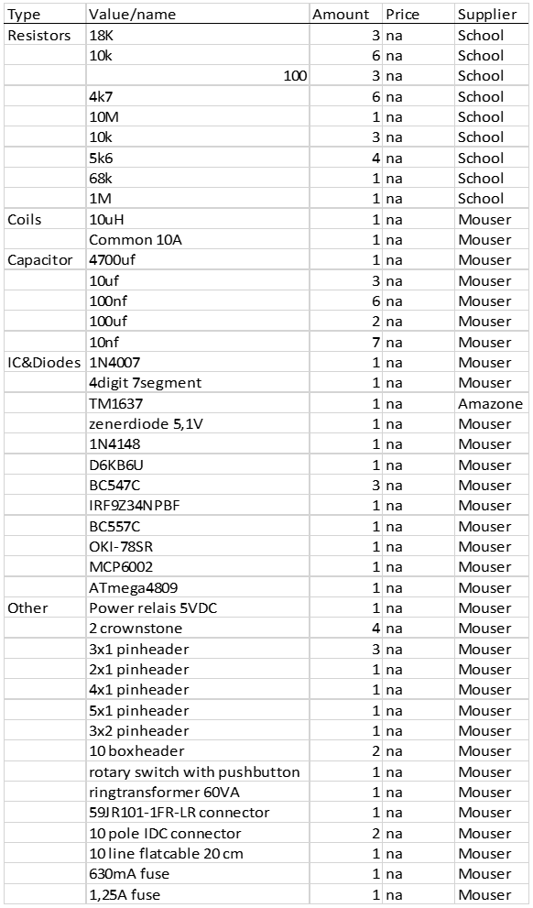
Material and methods
Parts
Methods

Slide 4
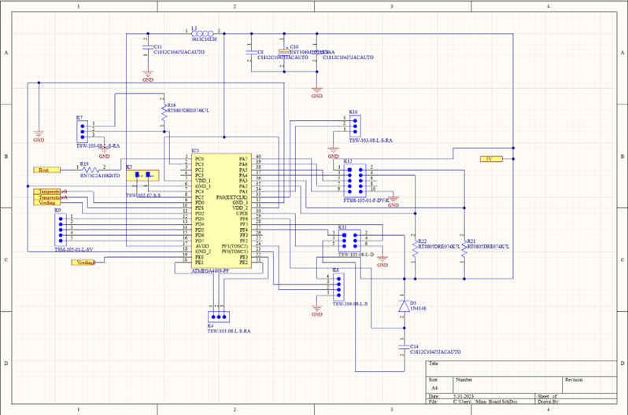
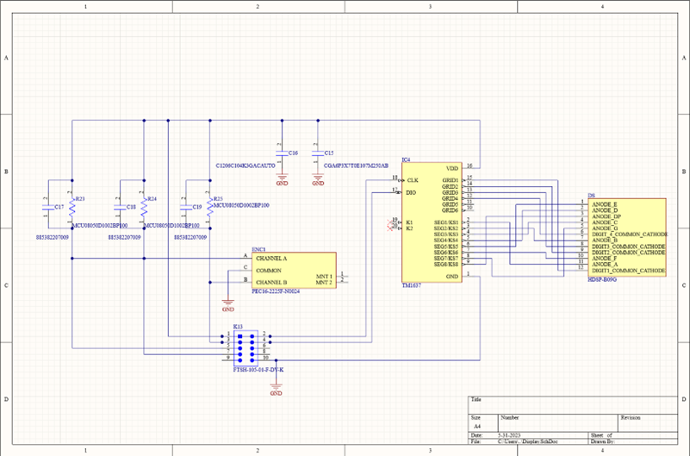
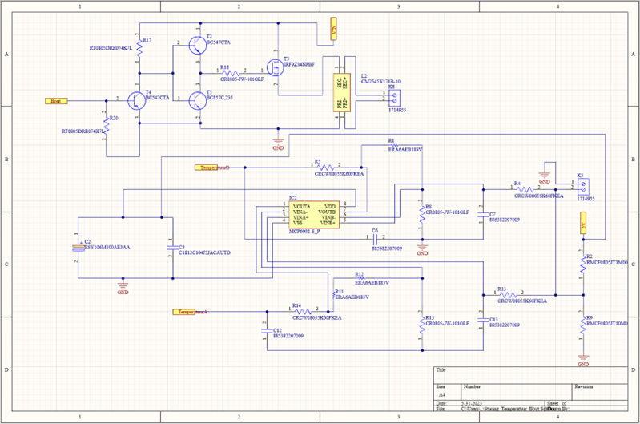
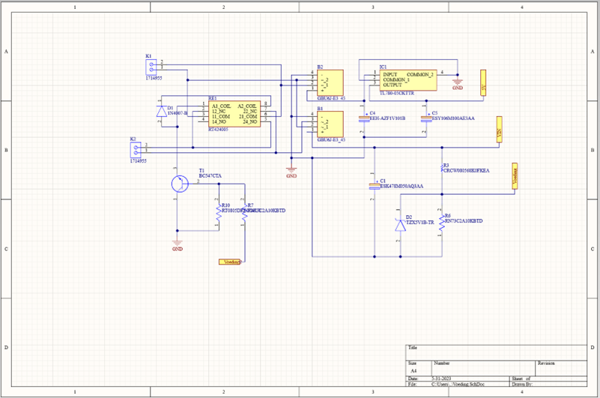
Schematic
How it works?

Slide 5
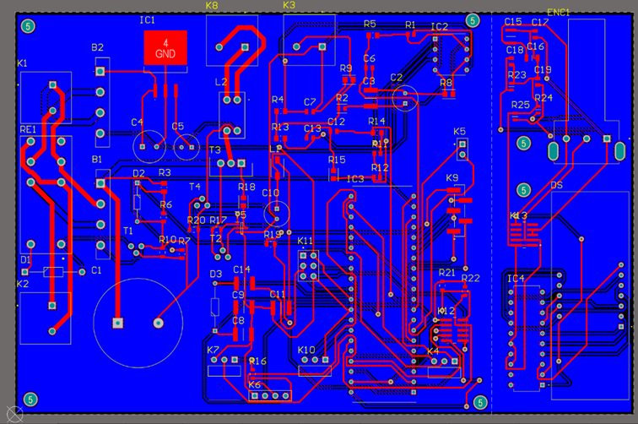
PCB
Lay out
Display layout

Slide 6
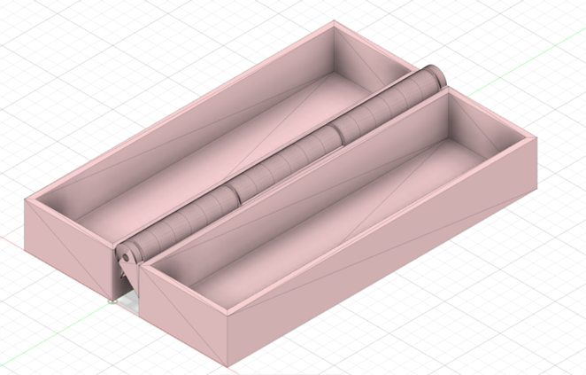
Mechanical design
Environmental impact
Time saving

Slide 7
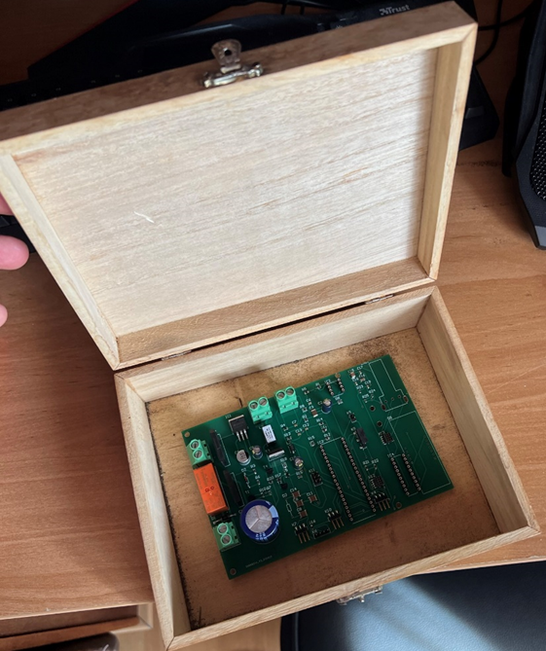
Finalized product
Does it work?

Slide 8
Discussion
What went well?
What didn’t go well?
Possible future improvements

Slide 9

Questions

